Slide 1
Darija Translator
Architecture and Pipeline

Slide 2
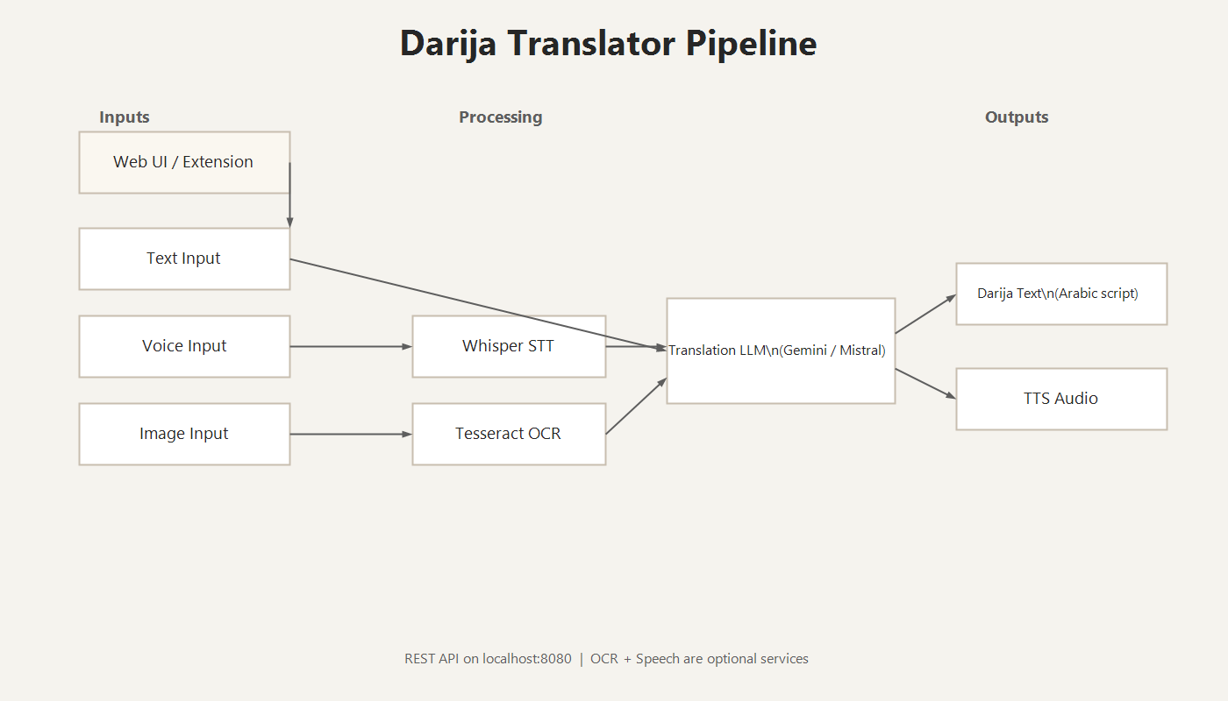
Architecture Overview
Notes:
Got it — here’s a longer English script matched to the French length, still ~5 minutes total.
Slide 1 — Darija Translator (Title)
“Hello and thanks for joining. Today I’m presenting a Darija translator delivered as both a web app and a Chrome extension. The objective is simple: translate English into Moroccan Darija accurately, with support for text, voice, and images. The system is designed to be modular and easy to evolve. A single REST backend handles all core logic, while the UI remains lightweight. This makes it easy to swap models or services without rebuilding the interface.”
Slide 2 — Architecture Overview
“This slide shows the full architecture. Users interact through the web UI or the Chrome side panel. Both send requests to the same backend API, which is the single source of truth. The backend orchestrates multiple services based on the input type. For text, it directly calls the LLM. For voice, it runs Whisper for transcription, then passes the transcript to the LLM. For images, it uses OCR to extract text before translation. Finally, if audio output is requested, a TTS module generates speech. The key design is separation of concerns: each service is isolated, which makes debugging, scaling, and replacement straightforward.”
Slide 3 — Text Translation Pipeline
“For text input, the pipeline is direct and fast. The client sends the text to /api/translator/translate. The backend validates the request and forwards it to the translation layer. The LLM produces Darija output in Arabic script and returns it to the UI. This flow is the baseline for quality and speed, and it’s where most users start. Because translation is centralized in the backend, we can switch between Gemini and a local model without changing the UI. That also allows offline usage if a local LLM is available.”
Slide 4 — Voice Translation Pipeline
“For voice, the system adds two extra steps. The client records audio and sends it as base64. The backend first calls Whisper to convert speech into text. That transcript is then translated by the same LLM used for text. If the user wants audio output, the translated Darija text is passed to a TTS engine to produce speech. This provides a full voice-to-voice experience. Importantly, Whisper is an optional service — if it’s not running, voice features fail gracefully while text and images continue to work.”
Slide 5 — Image Translation Pipeline
“For images, the backend performs OCR first. We use local Tesseract to detect and extract the visible text. That extracted text is then passed to the translation layer. If Tesseract returns no result and a Gemini key is available, the system can fall back to Gemini Vision for OCR. The OCR and translation steps are intentionally separated so we can evaluate OCR accuracy independently from translation quality, and tune each one without affecting the other.”
Slide 6 — Modular Architecture
“The final point is modularity and maintainability. The UI is decoupled from the backend, which makes it easy to deploy multiple clients. Whisper, OCR, TTS, and the LLM are all swappable components. We can disable optional services, change models, or adjust prompts without rewriting the front end. This structure supports fast iteration and deployment to different environments. In summary, the project delivers a clear, multi‑modal English‑to‑Darija pipeline that is stable, extensible, and ready for real usage.”

Slide 3
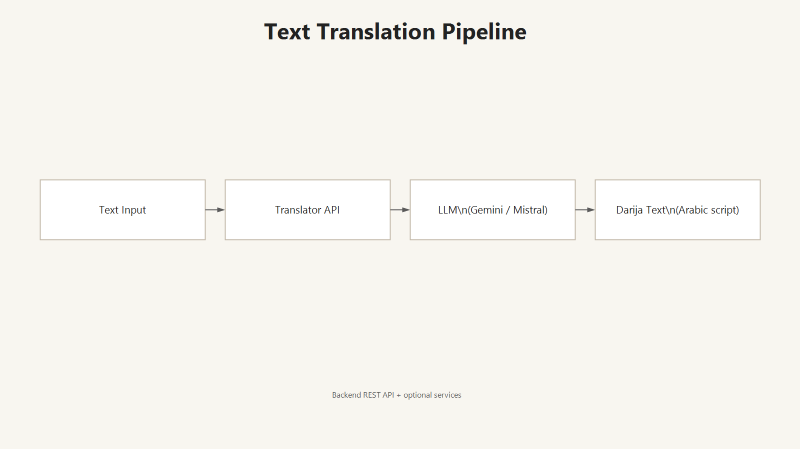
Text Translation Pipeline

Slide 4
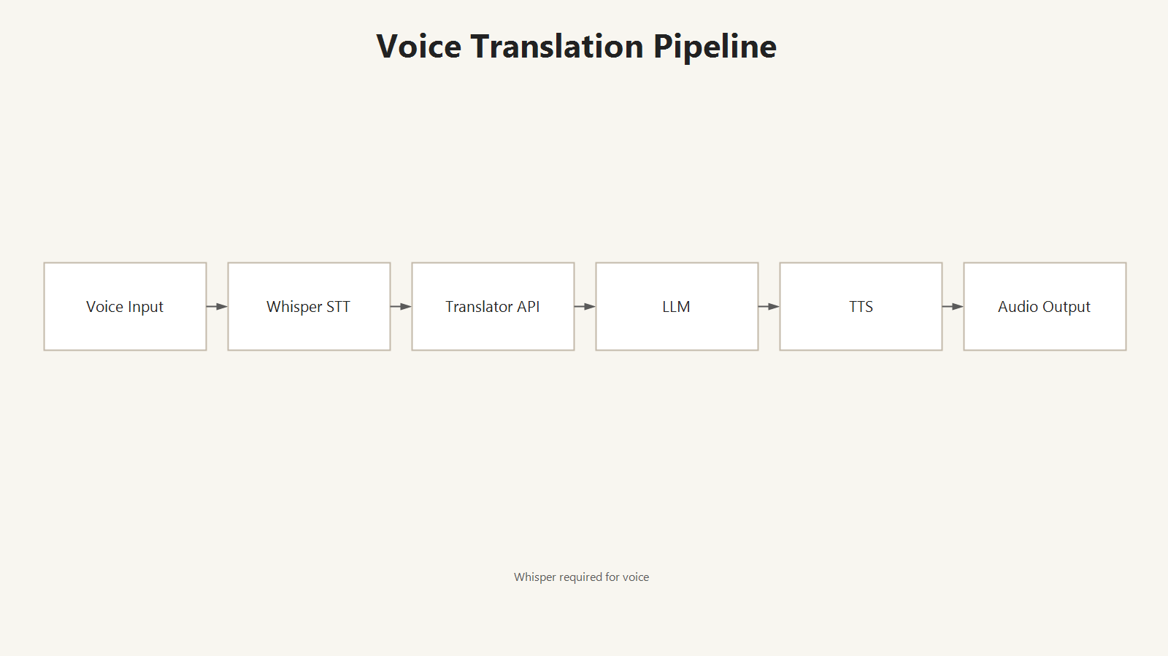
Voice Translation Pipeline

Slide 5
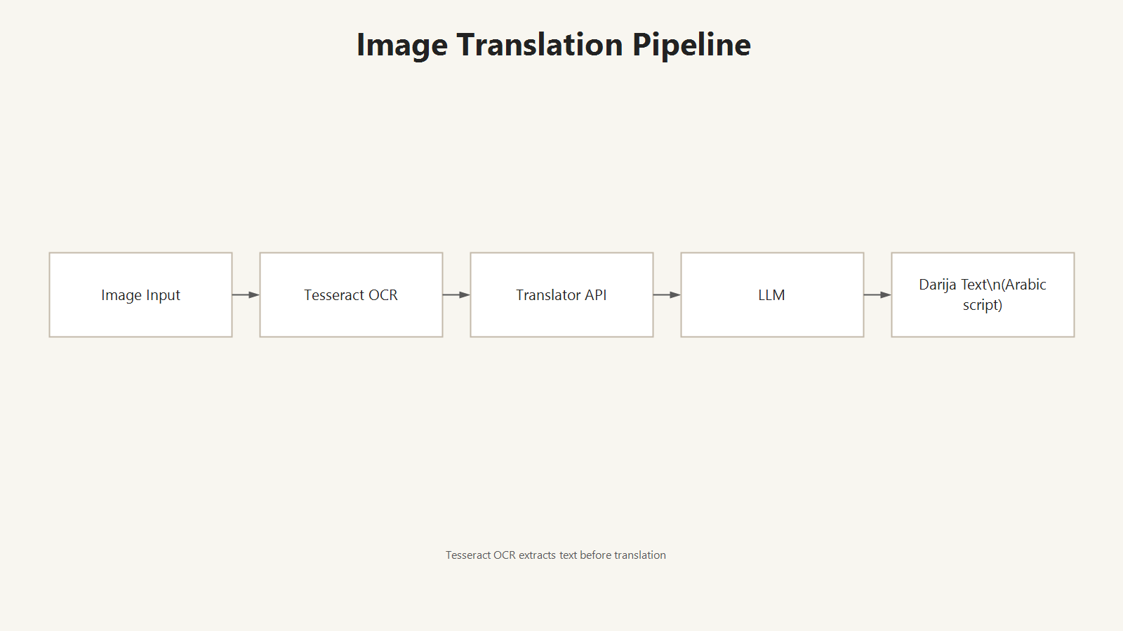
Image Translation Pipeline

Slide 6
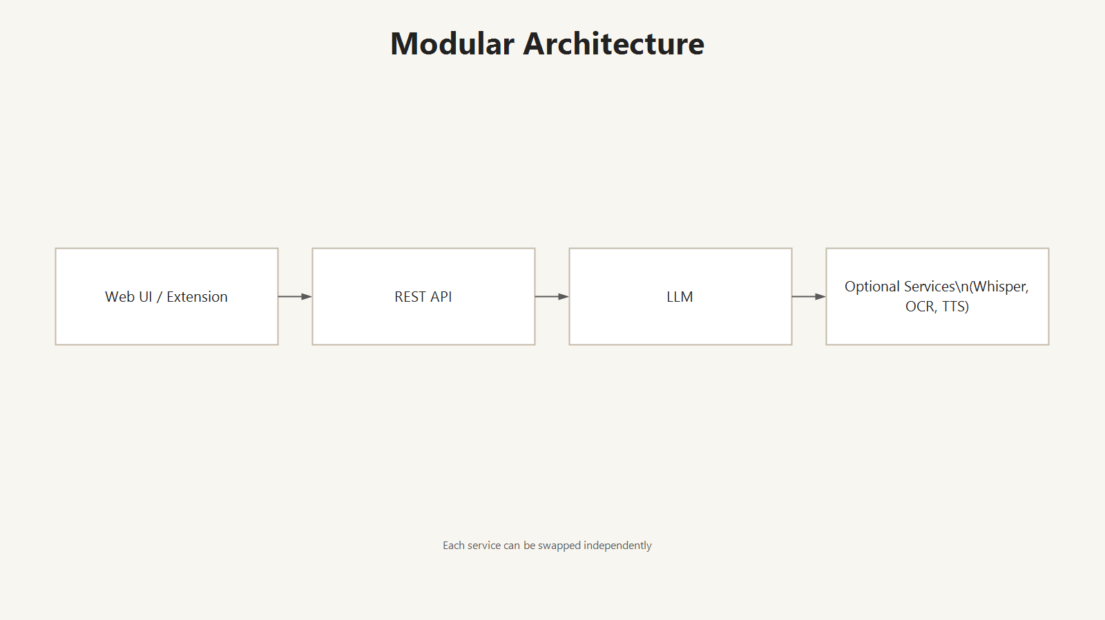
Modular Architecture
Notes:
lide 1 — Darija Translator (Title) ~45s
“Hello and thanks for joining. Today I’m presenting a Darija translator delivered as a web app and a Chrome extension. The goal is to provide fast English‑to‑Darija translation while keeping the architecture modular. A single REST backend handles all logic, which keeps the UI thin and makes it easy to swap services or models without changing the interface.”
Slide 2 — Architecture Overview ~55s
“This slide shows the full architecture. Users interact through the web UI or the extension. Both call the same backend API. The backend orchestrates services depending on the input type: for text it goes straight to the LLM; for voice it uses Whisper to transcribe first, then translates; for images it uses Tesseract OCR to extract text, then translates. If audio output is needed, a TTS service synthesizes speech. This pipeline keeps components independent and replaceable.”
Slide 3 — Text Translation Pipeline ~55s
“For text input, the flow is direct. The UI sends the text to /api/translator/translate, the backend validates the request, and the LLM produces a Darija translation in Arabic script. The result is returned to the client. This path is the fastest and serves as the baseline for quality. We can switch between Gemini and a local model without touching the UI.”
Slide 4 — Voice Translation Pipeline ~60s
“For voice, the client records audio and sends it as base64. The backend runs Whisper for speech‑to‑text, then passes the transcript to the LLM for Darija translation. If the user wants audio output, TTS generates it. This pipeline is longer but enables hands‑free use. It is optional: if Whisper is offline, text and image features still work.”
Slide 5 — Image Translation Pipeline ~55s
“For images, the backend performs OCR first. We use local Tesseract to extract text from the image, then send that text to the same LLM for translation. If Tesseract fails and a Gemini key is available, we can fall back to Gemini Vision. Separating OCR from translation helps debugging and lets us tune each step independently.”
Slide 6 — Modular Architecture ~50s
“The key design choice is modularity. The UI is decoupled from the backend. Whisper, OCR, TTS, and the LLM are all swappable components. This makes the system easier to maintain and deploy. In summary, this project delivers a practical, multi‑modal English‑to‑Darija pipeline with a clean and extensible architecture.”
If you want a shorter 3‑minute version or a more detailed 7‑minute version, tell me.

