Slide 1

Online Gas Booking System

Slide 2
Team Members
E/17/040 : Chandrasena M.M.D
E/17/356 : Upekha H.P.S
E/17/407 : Wijesooriya H.D

Slide 3
Aims of the project
Computerize the online booking management system.
Identify the advantages of the online booking systems.
Make online delivery system more efficient.

Slide 4
Proposed System
Mainly focus on basic operations in an online booking system
* getting customer details and orders through html forms
* keeping records in transactions
* keep records about agency members
* updating information ( eg. Price of gas cylinders , agency member details)
Faster deliveries
*delivery boys deliver orders ,so customers don’t have to wait in a queue
Less paper works
*details are stored in a database

Slide 5
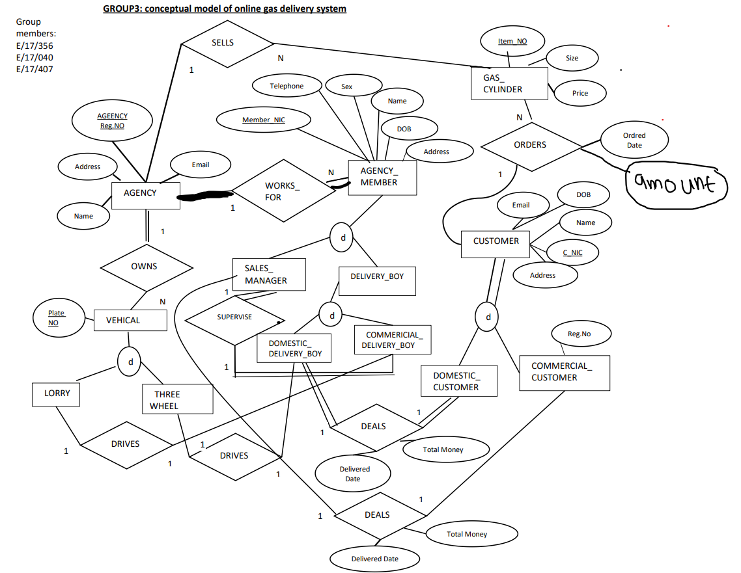
Entity
Relationship
(ER)
Diagram

Slide 6
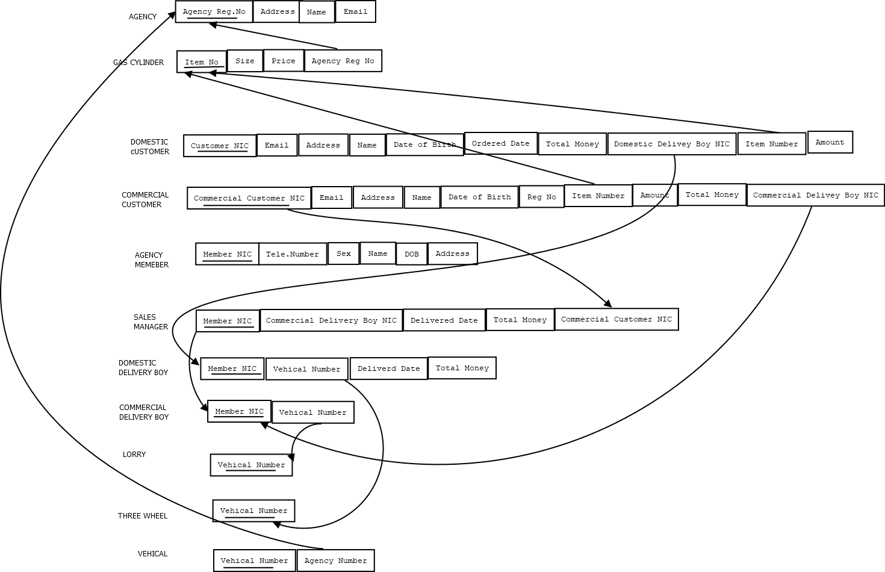
RELATIONAL DATA MODEL

Slide 7
Used Technologies
Web page
DATABASE
HTML
CSS
PHP
MY SQL
PHP

Slide 8

Interface to get customer orders

Slide 9

Interface to get agency member details

Slide 10
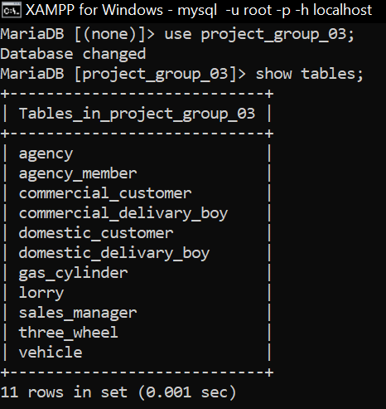
Tables in our database

Slide 11
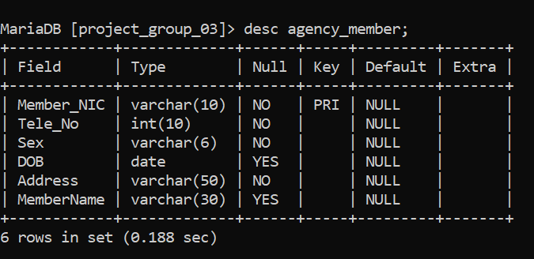
Creating tables
Eg:

Slide 12
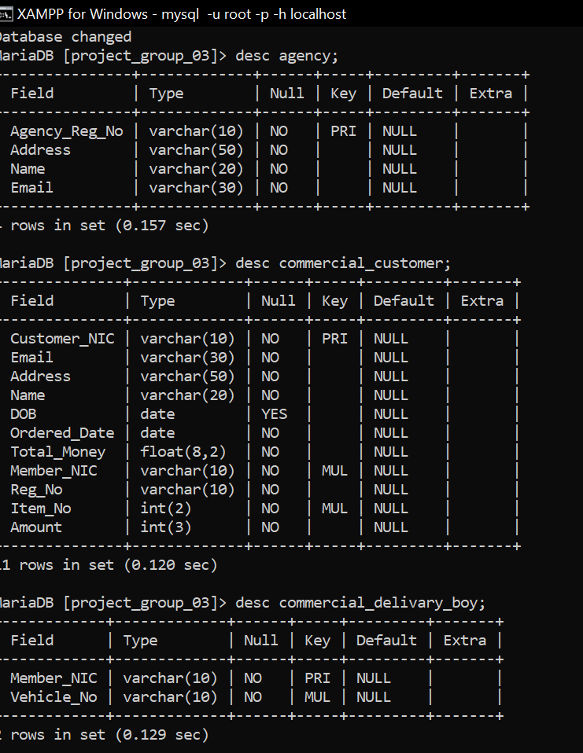

Slide 13
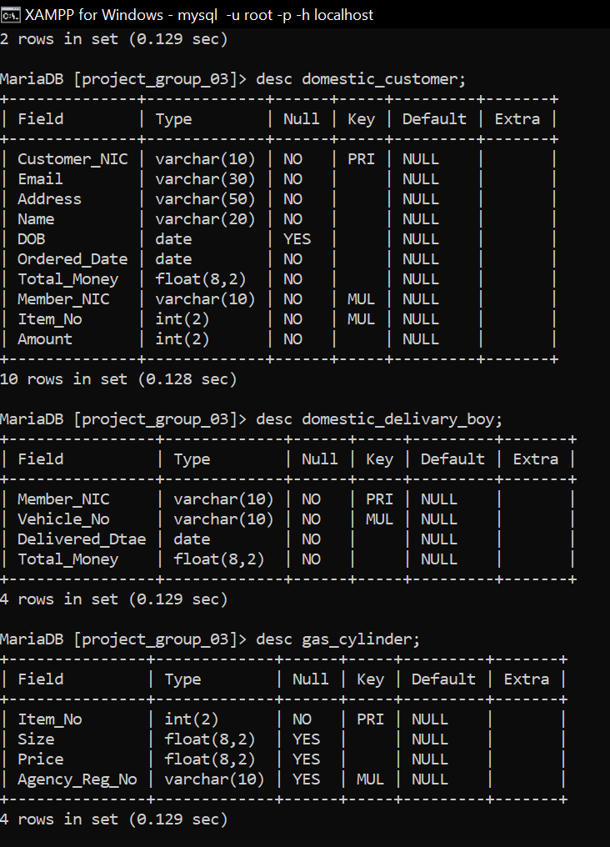

Slide 14
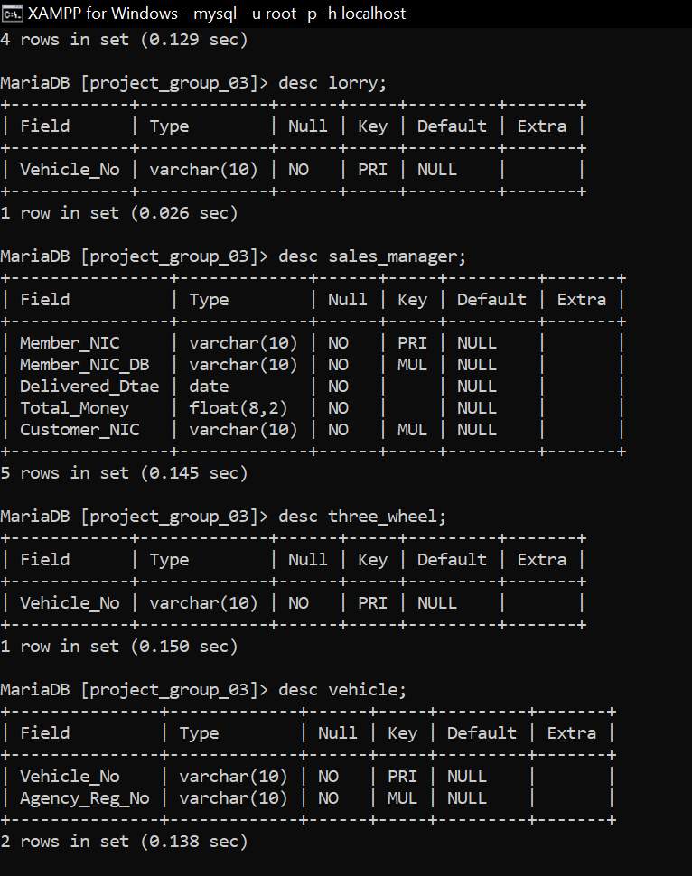

Slide 15
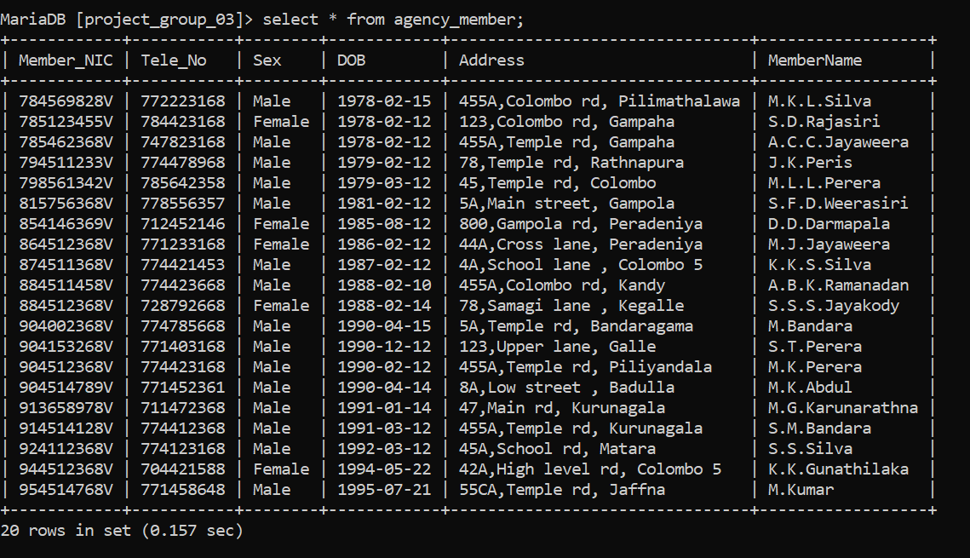
Populated database

Slide 16

Q & A

