Slide 1
NAT and PAT
Use one clean address story every time.
Keep 10.0.0.1 inside, 150.150.0.1 translated, and 200.100.10.1 outside
1
Notes:
[Sources] - User-provided source deck: NAT met PAT.pptx

Slide 2
Why NAT and PAT still matter
As you follow a packet, keep three addresses straight: inside, translated, and outside.
When 10.0.0.1 leaves the private network, NAT can present it as 150.150.0.1.
The outside server still sees the conversation as happening with 150.150.0.1.
The core story did not change. Only the ruleset language did.
Teaching goal
Separate translation, filtering, and state so you can explain the packet before you explain the rule.
Keep the mental model. Update the commands.
That gives you cleaner labs without changing the network story.
2
Notes:
[Sources] - User-provided source deck: NAT met PAT.pptx

Slide 3
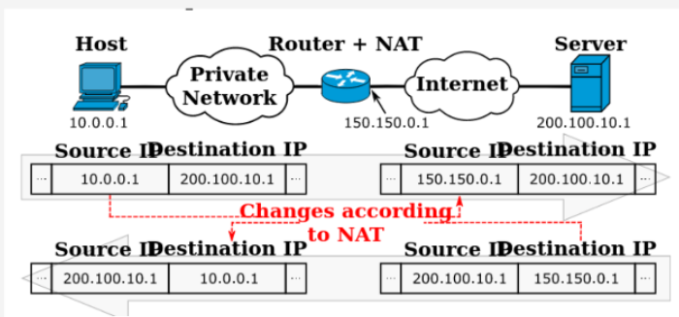
Same packet path, new ruleset
When you look at a packet headed for 200.100.10.1, ask what the source address looks like before and after NAT.
Destination translation still matters before the routing decision.
Source translation still matters after the routing decision.
Filtering and NAT are separate concerns, even when one device does both.
Reference example with fixed inside, translated, and outside addresses
3
Notes:
[Sources] - User-provided source deck image adapted from NAT met PAT.pptx - nftables wiki, Netfilter hooks, https://wiki.nftables.org/wiki-nftables/index.php/Netfilter_hooks

Slide 4
Source NAT, SNAT, and masquerade
Use this example when you explain source NAT: 10.0.0.1 becomes 150.150.0.1 on the way to 200.100.10.1.
Use SNAT when the translated address is fixed and known.
Keep translation in a nat table and policy in a filter or inet table.
table ip nat {
chain postrouting {
type nat hook postrouting priority srcnat;
ip saddr 10.0.0.0/24 oifname "outside" snat to 150.150.0.1
}
}
What to notice
Watch the source address change. The host is still 10.0.0.1 inside, but the outside world sees 150.150.0.1.
4
Notes:
[Sources] - User-provided source deck: NAT met PAT.pptx - Debian Handbook, Packet Filtering with nftables, https://www.debian.org/doc/manuals/debian-handbook/sect.firewall-packet-filtering.el.html

Slide 5
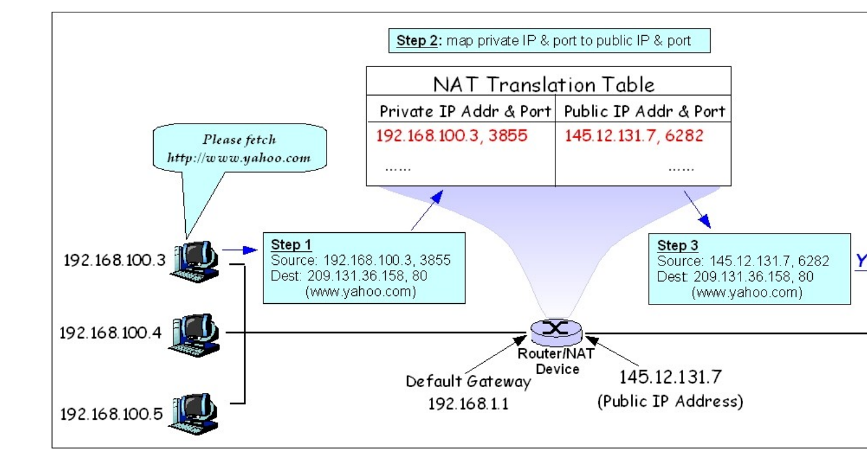
PAT, what actually changes
PAT is still address translation plus port translation.
Read it as a tuple: 10.0.0.1:high-port becomes 150.150.0.1:translated-port on the way to 200.100.10.1:80.
Conntrack keeps flows unique by tracking tuples, not just a single IP.
One public IP can represent many inside sessions at once.
5
Notes:
[Sources] - User-provided source deck image adapted from NAT met PAT.pptx

Slide 6
DNAT and port publishing
Use this example when you publish an inside service: traffic aimed at 150.150.0.1:80 is redirected to 10.0.0.1:80.
Destination translation happens before the packet is routed onward.
Publishing a service needs both the DNAT rule and the matching forward policy.
table ip nat {
chain prerouting {
type nat hook prerouting priority dstnat;
iifname "outside" ip daddr 150.150.0.1 tcp dport 80 dnat to 10.0.0.1:80
}
}
table inet fw {
chain forward {
type filter hook forward priority 0;
policy drop;
ct state established,related accept
iifname "outside" oifname "inside" ip daddr 10.0.0.1 tcp dport 80 accept
}
}
Keep the public address and the inside address visible together, or the example gets muddy fast.
6
Notes:
[Sources] - User-provided source deck: NAT met PAT.pptx - nftables wiki, Netfilter hooks, https://wiki.nftables.org/wiki-nftables/index.php/Netfilter_hooks

Slide 7
Stateful filtering with conntrack
New flows are where your explicit policy matters.
Return traffic is usually admitted with established,related state.
When 10.0.0.1 talks to 200.100.10.1 through 150.150.0.1, conntrack is what keeps the return traffic sane.
table inet fw {
chain forward {
type filter hook forward priority 0;
policy drop;
ct state established,related accept
ip saddr 10.0.0.0/24 ip daddr 200.100.10.1 tcp dport { 80, 443 } accept
ip saddr 10.0.0.0/24 ip daddr 200.100.10.1 udp dport 53 accept
}
}
When you test
Use counters or a before-and-after test to prove the stateful rule. Do not trust the config just because it loaded.
7
Notes:
[Sources] - User-provided source deck: NAT met PAT.pptx

Slide 8
Read the old, teach the new
iptables
nftables
iptables -t nat -A POSTROUTING \
-o eth1 -s 10.81.100.0/24 \
-j MASQUERADE
table ip nat {
chain postrouting {
type nat hook postrouting priority srcnat;
ip saddr 10.0.0.0/24 snat to 150.150.0.1
}
}
Same job, cleaner grammar.
Use the same inside, translated, and outside addresses in every example so the syntax does not hide the packet story.
Keep iptables in the course as a legacy reading skill, not the main language.
8
Notes:
[Sources] - Debian Handbook, Packet Filtering with nftables, https://www.debian.org/doc/manuals/debian-handbook/sect.firewall-packet-filtering.el.html - nftables wiki, Main differences with iptables, https://wiki.nftables.org/wiki-nftables/index.php/Main_differences_with_iptables

Slide 9
Containerlab-friendly lab pattern
Topology skeleton
[inside1] [inside2]
\ /
\ /
[ fw1 ]
/ | \
[dmzweb] | [outside]
|
capture / tests
Use one simple example path first: 10.0.0.1 to 200.100.10.1 through translated address 150.150.0.1.
Split the labs into host firewall, transit firewall, and NAT or publishing.
Put the screenshot prompt beside the command that produces the evidence.
Better lab order
Host firewall rules on a single endpoint.
Transit policy on fw1 using forward.
NAT and port publishing after you can explain inside, translated, and outside addresses cleanly.
9
Notes:
[Sources] - Recommendation based on the user-provided deck and repo style; no external claims.

Slide 10
Common mistakes to kill in the rewrite
Mixing host output rules with router forward rules in the same exercise.
Losing track of which address is inside, which is translated, and which belongs to the outside server.
Teaching NAT and filtering as if they are one table or one idea.
Publishing a service without the matching forward rule.
Leaving required screenshots until the end of the lab.
The new deck should remove ambiguity, not just update syntax.
10
Notes:
[Sources] - Recommendation based on the user-provided deck and lab rewrite goals.

Slide 11
Key takeaways
Keep the packet path and the address story.
Teach nftables as the main language.
Use iptables only as a legacy reading skill.
Write the labs around evidence, not platform trivia.
Best next move: rebuild the NAT lab first, using 10.0.0.1, 150.150.0.1, and 200.100.10.1 all the way through.
11
Notes:
[Sources] - User-provided source deck: NAT met PAT.pptx - Debian Handbook, Packet Filtering with nftables, https://www.debian.org/doc/manuals/debian-handbook/sect.firewall-packet-filtering.el.html

