Slide 1

Presentation Title (Verdana 20pt) - maximum 2 lines

Slide 2
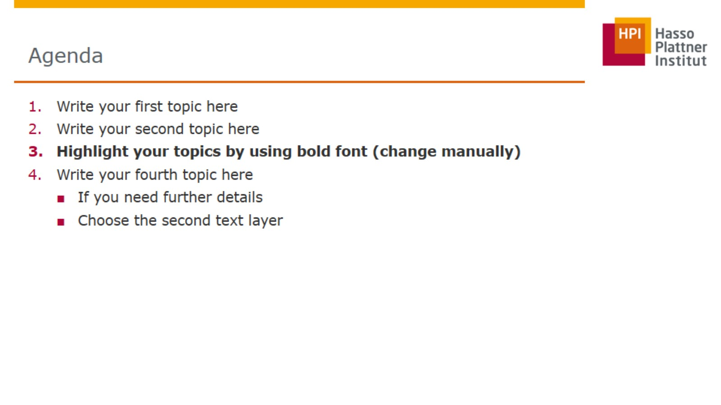
Agenda

Slide 3


Slide 4


Slide 5

Thank you for your attention!

Slide 6


Slide 7


Slide 8


Slide 9
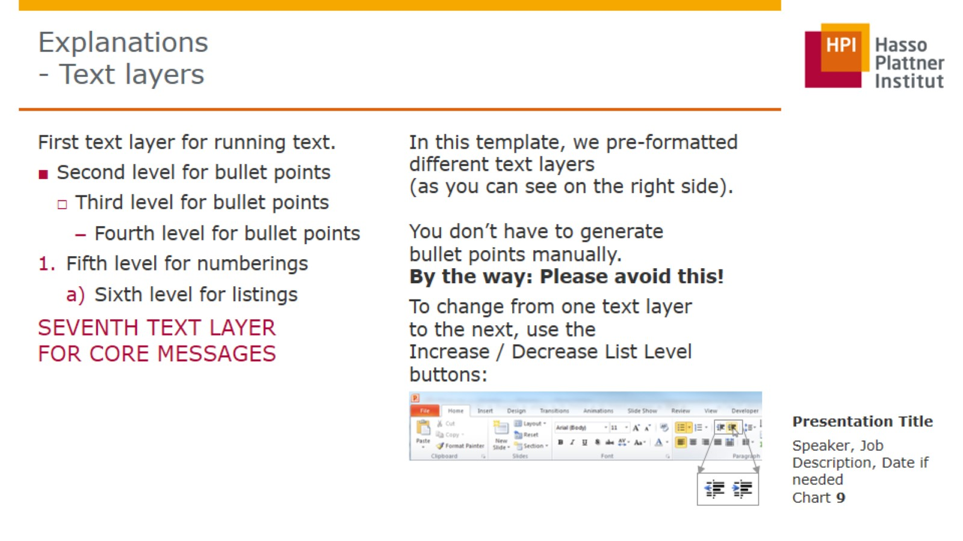
Explanations - Text layers

Slide 10
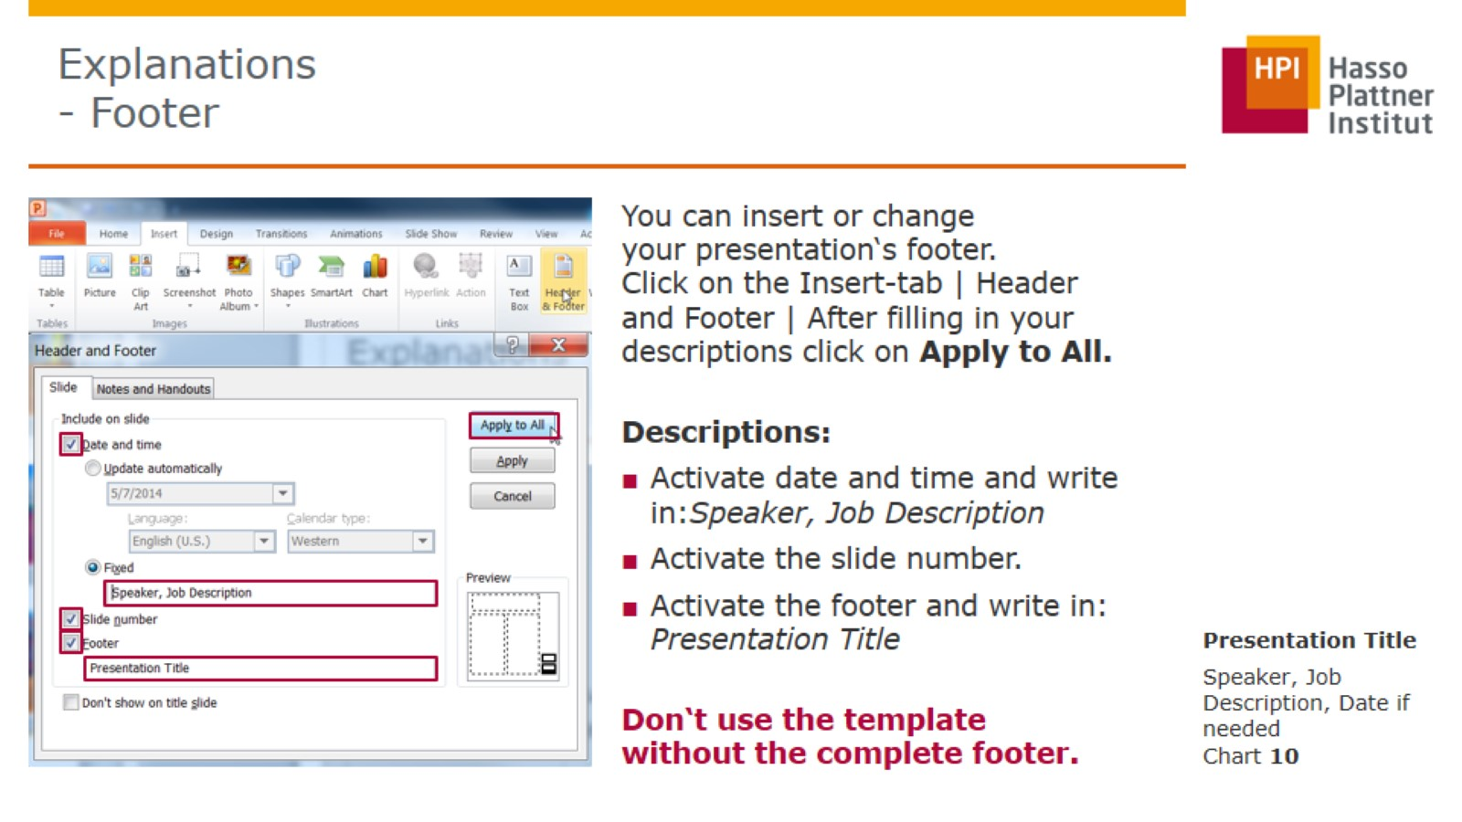
Explanations - Footer

Slide 11
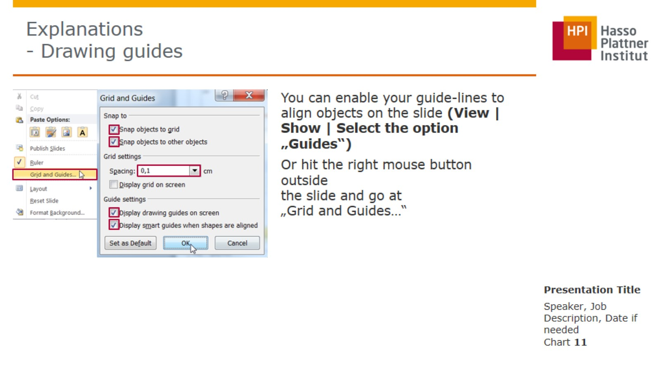
Explanations - Drawing guides

Slide 12
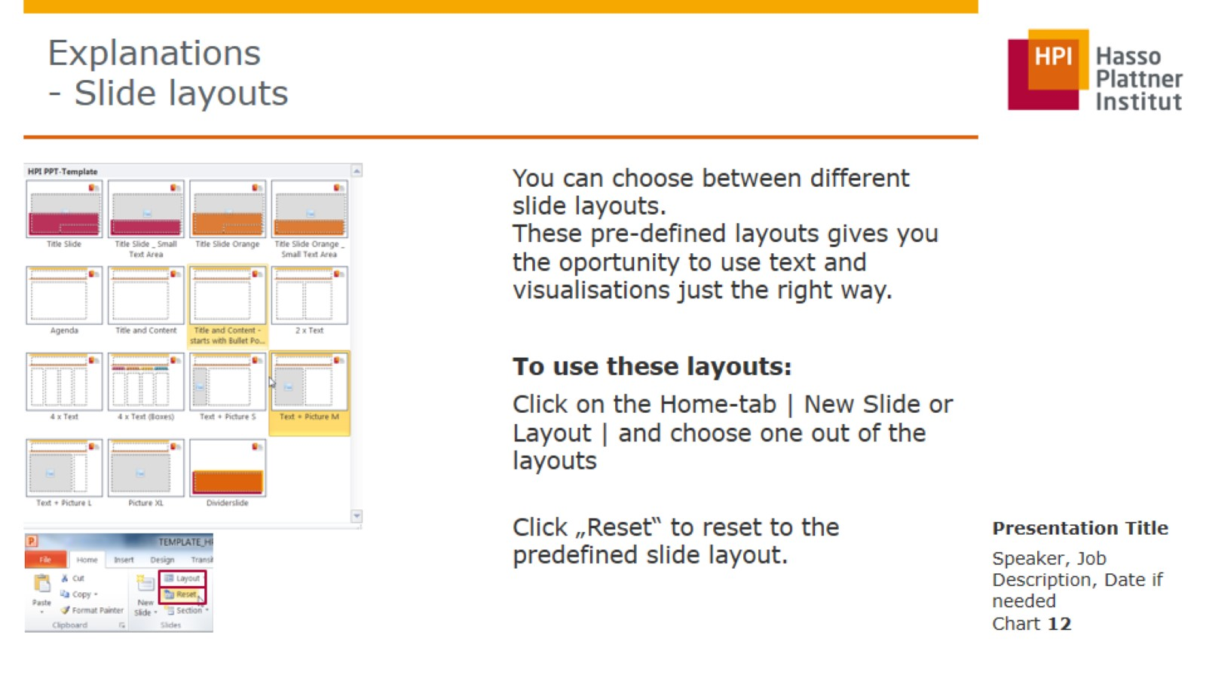
Explanations - Slide layouts

