Slide 1
A brief introduction of LP
Liu Tao | 2022-06-15

Slide 2
Agenda
- What is Liner Programming
- History of Liner Programming
- How to solve an LP problem
- How to test an LP solver

Slide 3
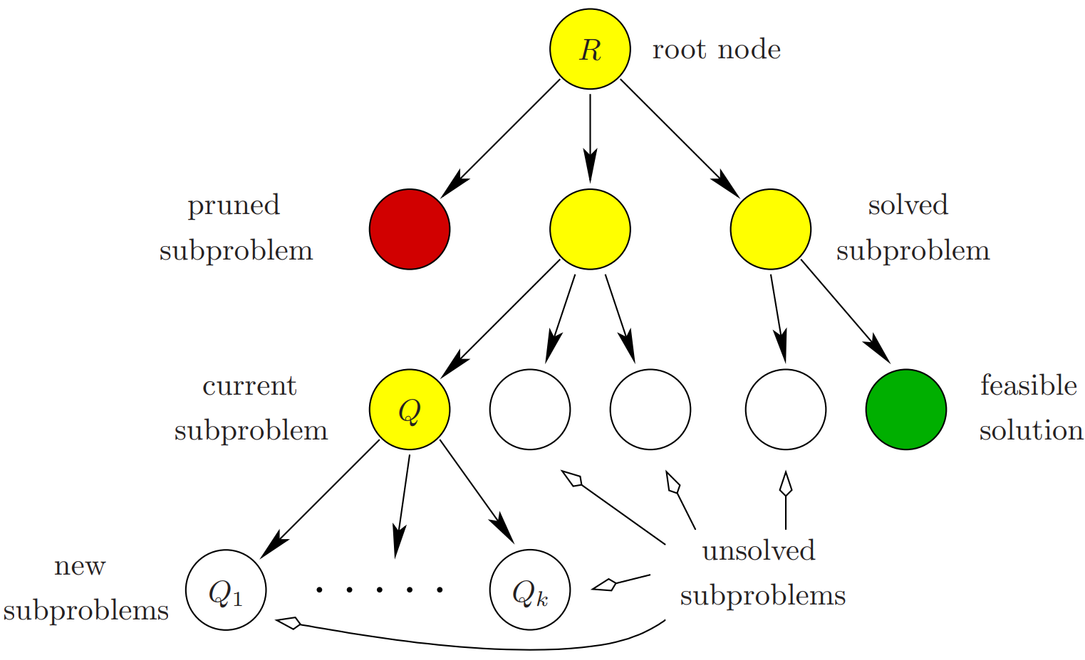
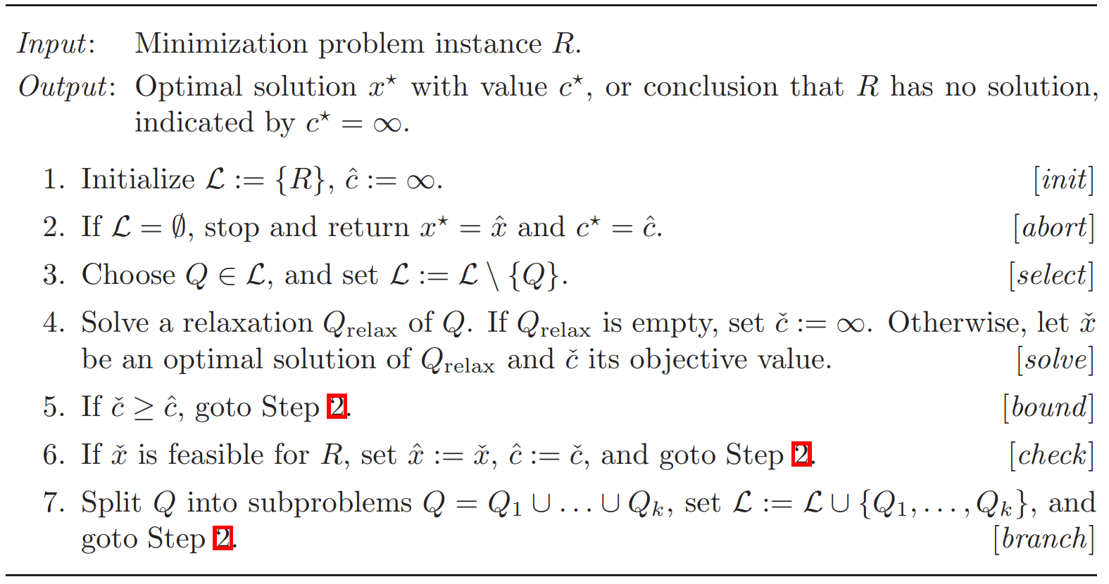
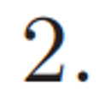


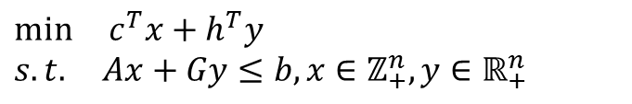








MIP: Definition
Mixed-integer Programs are problems that can be expressed in canonical form as:
$$\min{c^{T}x+h^{T}y}$$
$$s.t. Ax+Gy≤b, x∈ℤ_{+}^{n}, y∈ℝ_{+}^{n}$$
MIP: Branch-and-Bound
$$x_{1}=3.5$$
$$R$$
$$x_{1}=3$$
$$x_{1}=4$$
$$x_{2}=1.7$$
$$100$$
$$x_{1}=4$$
$$x_{2}=1$$
$$x_{1}=4$$
$$x_{2}=2$$
$$Q$$
$$105$$

Slide 4

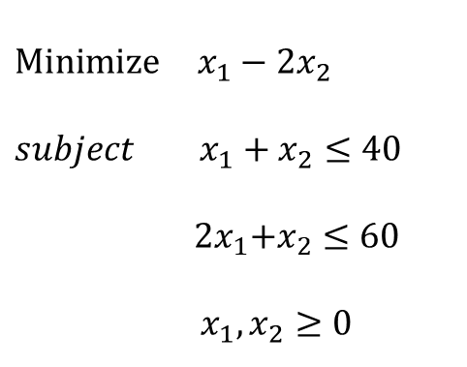





What is Liner Programming
Optimize a liner objective function of decision variables subject to a set of liner constraints
Example
Graphic representation
$$x_{2}$$
$$\operatorname{Minimize}{x_{1}−{2x}_{2}}$$
$$subject{ x}_{1}+x_{2}≤40$$
${ 2x}_{1}+x_{2}≤60$
$${ x}_{1}, x_{2}≥0$$
$x_{1}−{2x}_{2}$= -80
$x_{1}−{2x}_{2}$=30
$$x_{1}$$
$${ 2x}_{1}+x_{2}=60$$
$${ x}_{1}+x_{2}=40$$

Slide 5
History of Liner Programming
Conceived by G.B.Dantzig(1947):
- mechanized planning tool for a development. training, and logistical supply program in USAF
Named by T.C.Koopmans & G.B.Dantzig(1948):
- programming in lines structure(optimization with liner structure)->Liner Programming
Simplex Method proposed by G.B.Dantzig(1948):
- L.V.Kantorovich worked on a rsetricted classe in 1939
Kantorovich & Koopmans received the Noble Prize in Economic Science(1975):
- Theory of optimum allocation of resources
Ellipsoid Method proposed by L.G.Khachian(1979):
- First polynomial-time algorithm for LP
Interior-Point Method proposed by N.Karmarkar(1984):
- First "good" polynomial-time algorithm for LP

Slide 6






How to solve an LP problem
Liner constraints shape the feasible domain as a convex polyhedral set with a finite number of vertices
$$x_{2}$$
$x_{1}−{2x}_{2}$= -80
Liner objective function provides a liner contour of each fixed value
$x_{1}−{2x}_{2}$=30
For a liner programming problem, if its feasible domain is not empty, the it optimum is either unbounded or is attained at least at one vertex of the feasible domain
$$x_{1}$$
$${ 2x}_{1}+x_{2}=60$$
$${ x}_{1}+x_{2}=40$$

Slide 7








How to solve an LP problem
Enumeration Method
Simplex Method
Interior-Point Method
Find all vertices and choose the optimal one by comparison
$$C\left(n,m\right)=\frac{n!}{m!\left(n−m\right)!}$$
$$x^{∗}$$
$$x^{0}$$
$$x^{∗}$$
$$x^{1}$$
$$x^{0}$$
$$C\left(1000,500\right)>{10}^{15}$$
$$x^{1}$$
In general, the simplex method works well:
It is a polynomial-time algorithm with complexity:
$${it visits about 0.7159m}^{0.9522}n^{0.3109} vertiees$$
$$O(n^{3}L)$$
In the worst case, Kell & Minty(1971):
It outperformed the simplex method for large size LP problems
$${it requires to traverse 2}^{n}−1 vertiees$$
Problem of exponential-time algorithm.

Slide 8
How to test an LP solver
Benchmark test set
Name | Rows | Cols | Nonzeros | Bytes | BR | Optimal Value
25FV47 | 822 | 1571 | 11127 | 70477 |  | 5501.845888
80BAU3B | 2263 | 9799 | 29063 | 298952 | B | 987232.1607
ADLITTLE | 57 | 97 | 465 | 3690 |  | 225494.9632
AFIRO | 28 | 32 | 88 | 794 |  | -464.7531429
AGG | 489 | 163 | 2541 | 21865 |  | -35991767.29
AGG2 | 517 | 302 | 4515 | 32552 |  | -20239252.36
AGG3 | 517 | 302 | 4531 | 32570 |  | 10312115.94
BANDM | 306 | 472 | 2659 | 19460 |  | -158.6280185
BEACONFD | 174 | 262 | 3476 | 17475 |  | 33592.48581
BLEND | 75 | 83 | 521 | 3227 |  | -30.81214985
BNL1 | 644 | 1175 | 6129 | 42473 |  | 1977.629286
BNL2 | 2325 | 3489 | 16124 | 127145 |  | 1811.23654
BOEING1 | 351 | 384 | 3865 | 25315 | BR | -335.2135675
BOEING2 | 167 | 143 | 1339 | 8761 | BR | -315.018728
BORE3D | 234 | 315 | 1525 | 13160 | B | 1373.080394
BRANDY | 221 | 249 | 2150 | 14028 |  | 1518.509897
CAPRI | 272 | 353 | 1786 | 15267 | B | 2690.012914
CYCLE | 1904 | 2857 | 21322 | 166648 | B | -5.226393025
CZPROB | 930 | 3523 | 14173 | 92202 | B | 2185196.699
D2Q06C | 2172 | 5167 | 35674 | 258038 |  | 122784.2362
D6CUBE | 416 | 6184 | 43888 | 167633 | B | 315.4916667
DEGEN2 | 445 | 534 | 4449 | 24657 |  | -1435.178
DEGEN3 | 1504 | 1818 | 26230 | 130252 |  | -987.294
DFL001 | 6072 | 12230 | 41873 | 353192 | B | 11266400**
E226 | 224 | 282 | 2767 | 17749 |  | -18.75192907
ETAMACRO | 401 | 688 | 2489 | 21915 | B | -755.7152177
FFFFF800 | 525 | 854 | 6235 | 39637 |  | 555679.6117
FINNIS | 498 | 614 | 2714 | 23847 | B | 172790.9655
FIT1D | 25 | 1026 | 14430 | 51734 | B | -9146.378092
FIT1P | 628 | 1677 | 10894 | 65116 | B | 9146.378092
FIT2D | 26 | 10500 | 138018 | 482330 | B | -68464.29329
… | … | … | … | … | … | …

Slide 9
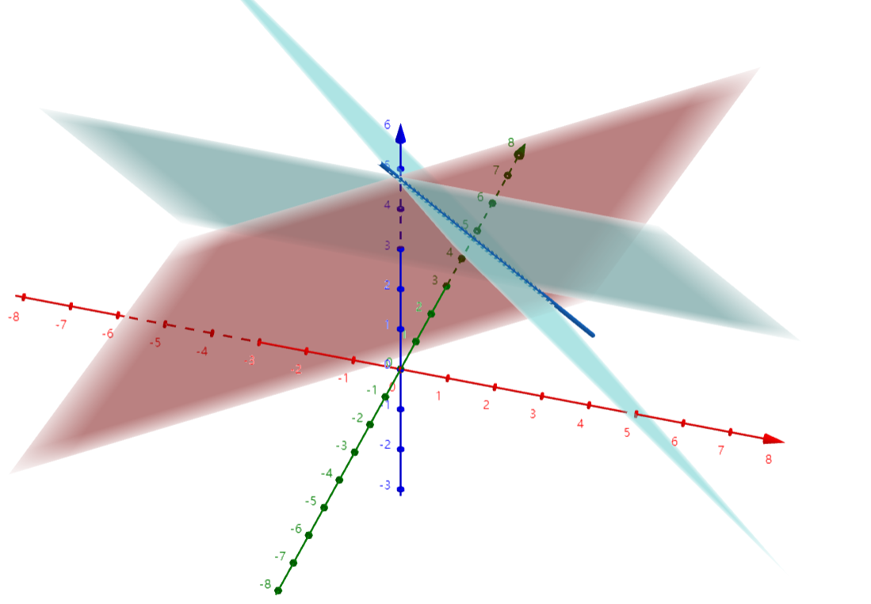
How to test an LP solver
Self-built test set
Feasible(Unique) Problem
Constraint & Objective :
General
Negative Coefficients, Large Coefficients, Decimal Coefficients, Scale Coefficients
Only Bound/Only Constraint
B=0 when performing row transform
Degenerate
Bounds: Bounded Variable, No upper/Lower bound, Free Variable
Feasible(infinite) Problem
Equations of a Plane Group(Line Group)
Infeasible Problem
Contradictory constraints.
Unbounded Problem
Non-closed constraints & bounds
x + y + z = 5
α(x + y + z) + β(y + z) = 5α+4β
y + z = 4

