Slide 1
3D FPS on FPGA
Wiktor Lidwin, Ysatis Tagle
Notes:
Pptx
Video due 12/12
Github Readme must have a link to a video as a Google Drive File

Slide 2
Overview
Implement simplified 3D FPGS on FPGA
Inspired by games like Doom, Wolfenstein 3D
Components include: Game Logic FSM, VGA and Button Drivers, Text Display, 3D environment, enemies spawning
Goals:
Implement ray casting to simulate 3D environment
Interact with environment via user input of on-board buttons
Display on VGA
Have a game sequence
Have enemies appear
Motivations
Explore FPGA capabilities and limitations in a hands on manner for optimization, constraints
Fun and creative.

Slide 3
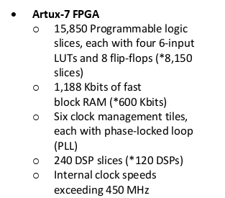
Specification and Requirements
Specifications
Xilinx NEXYS A7 FPGA platform
VGA output for display (RGB, horizontal and vertical sync)
Interface with on board buttons for user interaction
Requirements
Performance :
Want as smooth as possible
No VGA glitching
Functionality:
User interaction works as expected
Has a form of game progression
Utilize FPGA resources
Compatible with Xilinx
Stable gameplay

Slide 4
Overview Functionality
FPGA
Raycaster: Generates the current view of the 3D environment
User
Input
Buttons
Driver
i/o
Game FSM: Controls display and behavior of game
Movement: Translates inputs from position and orientation to x & Y
Display: Maps RGB values for each pixel of the screen
Breakdown:
Wiktor
Ysatis
Text Display: Arranges text onto the screen, updates text
VGA Driver: Drive signal for x and y
Timers
VGA Display
i/o

Slide 5
Detailed Functionality : Game FSM
FPGA
Raycaster: Generates the current view of the 3D environment
User
Input
Buttons
Driver
i/o
Game FSM: Controls display and behavior of game
Movement: Translates inputs from position and orientation to x & Y
Display: Maps RGB values for each pixel of the screen
Text Display: Arranges text onto the screen, updates text
VGA Driver: Drive signal for x and y
Timers
VGA Display
i/o

Slide 6
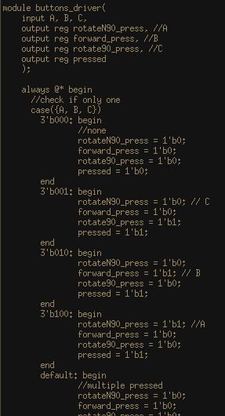
Game FSM: Button Driver
Takes in user input and forces the output such that the program only outputs when only one button
Done for movement simplicity
Also outputs “pressed”, which is activated when one or multiple buttons are pressed
Used for start menu “press any game to begin”

Slide 7
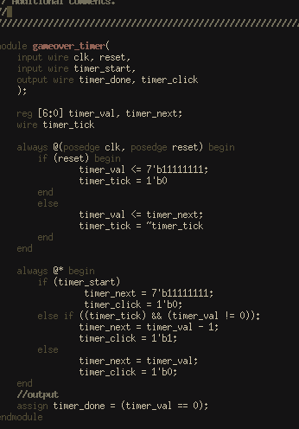
Game FSM: Timers
Two count-down timers:
Game over timer (shown): two seconds long
Game timer: three minutes long
Takes in timer_start signal and outputs timer_done as well as each click of the timer
Tradeoff of simplicity and functionality:
Wanted timer to output numbers for the text display, but that resorted in this design format (registers and timer behavior)
Registers
Timer behavior

Slide 8
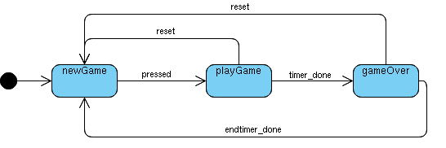
Game FSM: States
newGame
Initializes raycaster
Stops any occurring timers
Reads multiple buttons at a time
playGame
Starts game timer
Starts enemy spawning
Enables movement
Reads one button at a time
gameOver
Starts game over timer
Stops enemy spawning
Disables movement
State transitions are as shown

Slide 9
Detailed Functionality: Text
FPGA
Raycaster: Generates the current view of the 3D environment
User
Input
Buttons
Driver
i/o
Game FSM: Controls display and behavior of game
Movement: Translates inputs from position and orientation to x & Y
Display: Maps RGB values for each pixel of the screen
Text Display: Arranges text onto the screen, updates text
VGA Driver: Drive signal for x and y
Timers
VGA Display
i/o

Slide 10
Text Display
Game Text:
Constructs and places words based on screen pixels available.
Updates text based on timer value
Click
Game FSM: Controls display and behavior of game
Movement: Translates inputs from position and orientation to x & Y
RGB
Timer
Display
Font Rom: Stores each pixel of 8x16 font, row by row
Data
Text Display: Arranges text onto the screen, updates text
Notes:
Forgot to put input from display of pixel x and pixel y.
Pixel coordinates are treated as tiles based on predictable font character size.
8 x 16 bits
Acces character then row by row

Slide 11
Detailed Functionality: Display
FPGA
Raycaster: Generates the current view of the 3D environment
User
Input
Buttons
Driver
i/o
Game FSM: Controls display and behavior of game
Movement: Translates inputs from position and orientation to x & Y
Display: Maps RGB values for each pixel of the screen
Text Display: Arranges text onto the screen, updates text
VGA Driver: Drive signal for x and y
Timers
VGA Display
i/o

Slide 12
Detailed Functionality: Display
Display: Maps RGB values for each pixel of the screen
Display -> State-based MUX
Example: If state is gameover, then the RGB values from the text-display module will be passed to the VGA display, otherwise, the RGB values from the raycaster’s framebuffer will be passed out.
Pixel by pixel for current frame

Slide 13
Overview Functionality
FPGA
Raycaster: Generates the current view of the 3D environment
User
Input
Buttons
Driver
i/o
Game FSM: Controls display and behavior of game
Movement: Translates inputs from position and orientation to x & Y
Display: Maps RGB values for each pixel of the screen
Text Display: Arranges text onto the screen, updates text
VGA Driver: Drive signal for x and y
Timers
VGA Display
i/o

Slide 14
Detailed Functionality - Raycaster
Raycaster: Generates the current view of the 3D environment
FPGA
Buttons
Driver
X,y, angle
Individual Slice Render:
Compute Slice
Graphics Render: Continuous rendering of current frame
Color and
Line Height
Game Memory: Frame Buffer
Color
Game FSM: Controls display and behavior of game
Slice
Movement: Translates inputs from position and orientation to x & Y
Graphics Render: Continuous rendering of current frame
Movement
VGA Driver
Lookup Tables: Angles, Map, Height Calculation, Slice
Data
VGA Driver: Drive Signal for x and y based on a frame buffer
Text Display: Arranges text onto the screen, updates text

Slide 15
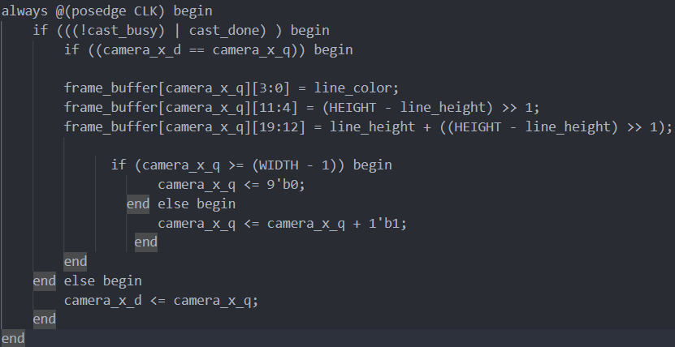
Raycaster - Graphics Render
Check for Splice Completion
Store Results
in frame_buffer
Updating next splice x value
Helpful Timing Logic

Slide 16
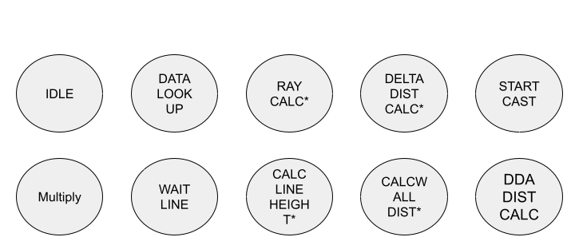
Raycaster - Splice Render
Used a FSM to share resources and pipeline process(Each time a multiply operation is found a new DSP module is burnt for that specific line) → share multiplier
Slice Render FSM

Slide 17
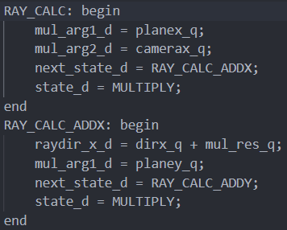
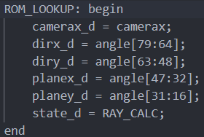
Raycaster - Splice Render
FSM Optimizations
Original C++ Code
dirX = dirX * cos(rotSpeed) - dirY * sin(rotSpeed);
dirY = oldDirX * sin(rotSpeed) + dirY * cos(rotSpeed);
planeX = planeX * cos(rotSpeed) - planeY * sin(rotSpeed);
planeY = oldPlaneX * sin(rotSpeed) + planeY * cos(rotSpeed);
Original C++ Code
double rayDirX = dirX + planeX * cameraX;

Slide 18
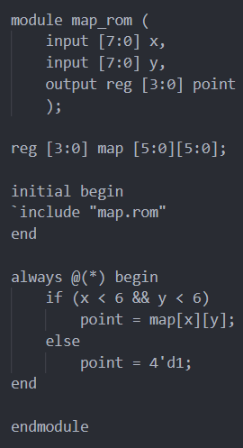
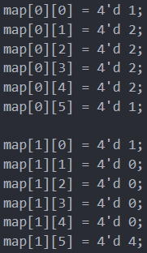
Raycaster - Splice Render
ROM LOOKUPS

Slide 19
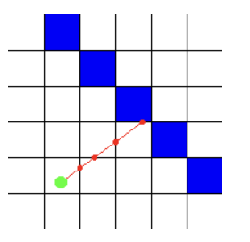
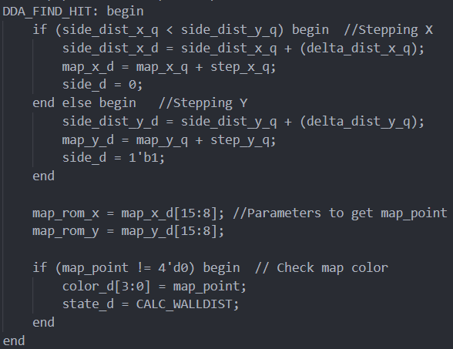
Raycaster - Splice Render
DDA

Slide 20
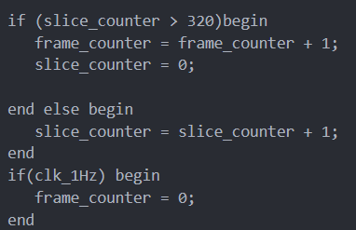
Most proud Verilog
Over 4000 FPS
Notes:
Animate Bottom text?
Design Tradeoff Discussion - Too optimized

Slide 21
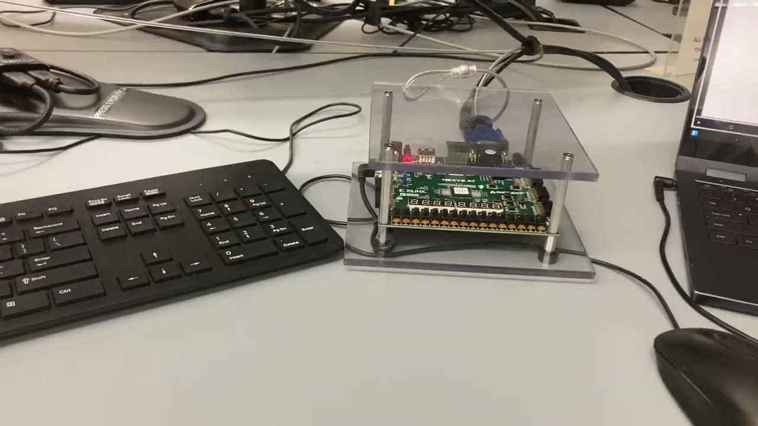
Video of 3D Environment
Note: Currently implemented with switches

Slide 22
November Presentation to Due Date Timeline
From November to Now:
Single Frame Testing Display → Dynamic rendering
+ Movement in x/y plane
+ Rotation angle
No In-Game logic → Controls and Collisions with walls, start menu and game over
External module
Next steps:
Finish movement -> X/Y to forward/turn
Game integration:
combine 3D environment and movement with game menus, text display, and button driver
? Graphics:
Player Sprites, textures
? In game logic:
Spawning enemies, shooting enemies, points

Slide 23
Original Timeline and Goals
Render a room
Make sure display works
Design all graphics
Make sure FPGA can reset
Rotate POV in room
Make sure input works
Move around room
Make sure input works
Make sure both inputs can happen at same time
Collisions with room ← Currently Here
Enemies spawning
Collisions and bullets (Goal) ← On track for this
Make sure input works, and can work w others at same time
HUD & Sound Effects
Levels (Extra)

Slide 24
Success, Failure
Successes:
Able to generate a 3D environment
Able to control VGA display with user input
Movement in the X/Y plane and angle
Timers effectively control FSM
Able to achieve high (4000) frames per second for 3D display
Minimal utilization of FPGA -> enough room for integration
Collisions with room
Failures:
Time: May be unable to incorporate game textures and enemy movement
Enemies will be stationary(more like targets)
Fix-Point accuracy causes distortions

Slide 25
References
https://iamard.blogspot.com/2014/03/verilog-coding-for-vga-signal-controller.html VGA Photo

Slide 26
Thank You!

Slide 27
Master Functionality ::: All the blocks
Individual Slice Render:
Compute Slice
Lookup Tables: Angles, Map, Height Calculation, Slice
Color and
Line Height
Game Memory: Frame Buffer
Data
FPGA
Slice
Color
Game Engine:
Input mapping to position and orientation
Collisions
Graphics Render: Continuous rendering of current frame
VGA Driver: Drive Signal for x and y based on a frame buffer
x.y
angle
Buttons Driver:
Button input to valid behavior
Game FSM: Controls display and behavior of game
Input
i/o
i/o
VGA Display
Movement: Translates inputs from position and orientation to x & Y
Text Display: Arranges text onto the screen, updates text
Font ROM: Stores fonts pixel by pixel
In-GameTimer (3m)
Game Over Timer (2s)

Slide 28
Overview Functionality
FPGA
Individual Slice Render:
Compute Slice
Lookup Tables: Angles, Map, Height Calculation, Slice
Color and
Line Height
Game Memory: Frame Buffer
Data
Slice
Color
Input
Game Engine:
Input mapping to position and orientation
Collisions
Graphics Render: Continuous rendering of current frame
VGA Driver: Drive Signal for x and y based on a frame buffer
VGA Display
i/o
x.y
angle
i/o

Slide 29
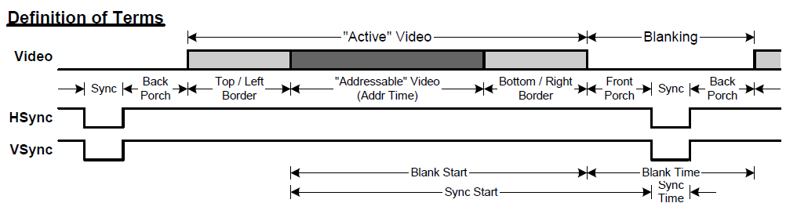
VGA Display Driver

