Slide 1


Physics-Informed Neural Networks for the phonon Boltzmann Transport Equation and Electrical Property Tomography
Wiktor Lidwin
Advisor: Professor Luca Dal Negro

Slide 2
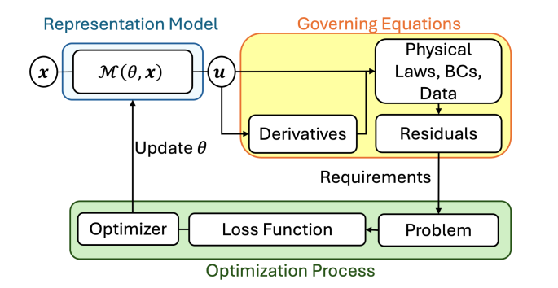
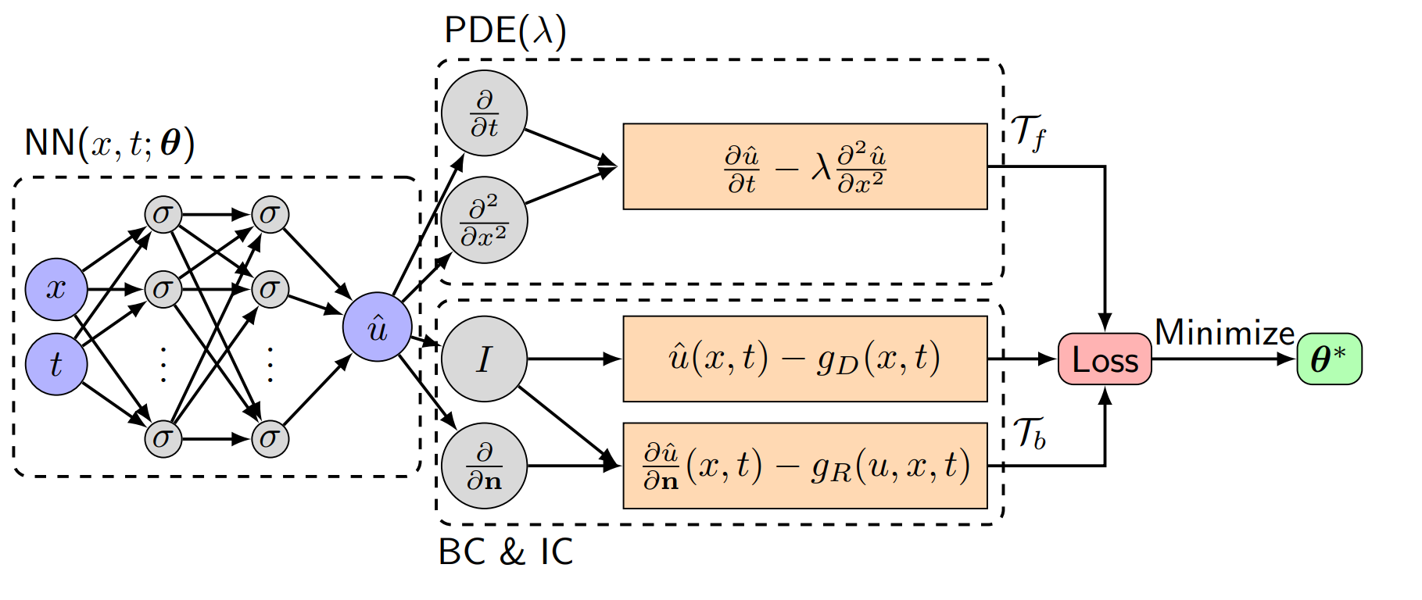
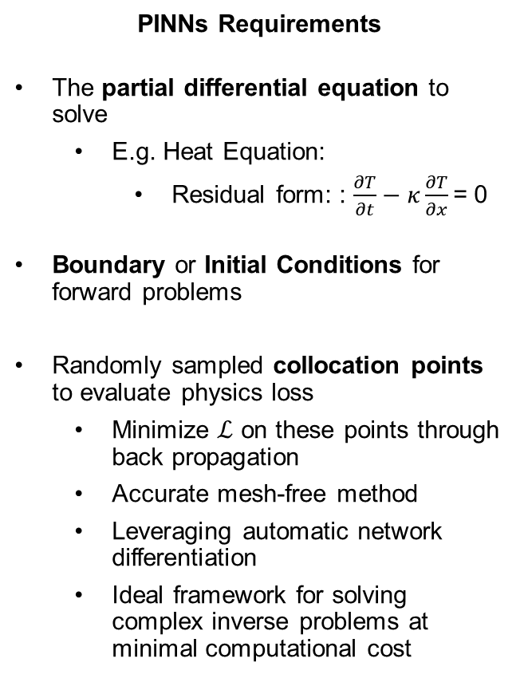

Introduction to Physics-Informed Neural Networks (PINNs)
$$ℒ=ℒ_{PDE}+ℒ_{BC}+ℒ_{IC}$$
PINN High-level Training
PINNs Requirements
The partial differential equation to solve
E.g. Heat Equation:
Residual form: : $\frac{∂T}{∂t}−κ\frac{∂T}{∂x}$= 0
Boundary or Initial Conditions for forward problems
Randomly sampled collocation points to evaluate physics loss
Minimize $ℒ$ on these points through back propagation
Accurate mesh-free method
Leveraging automatic network differentiation
Ideal framework for solving complex inverse problems at minimal computational cost
J.D. Toscano et al., arXiv:2410.13228, (2024)
PINN Explicit Training
Lu Lu et al., arXiv:1907.04502, (2020)

Slide 3
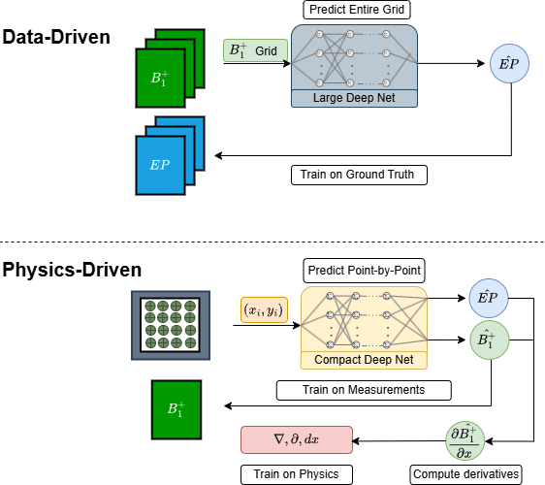
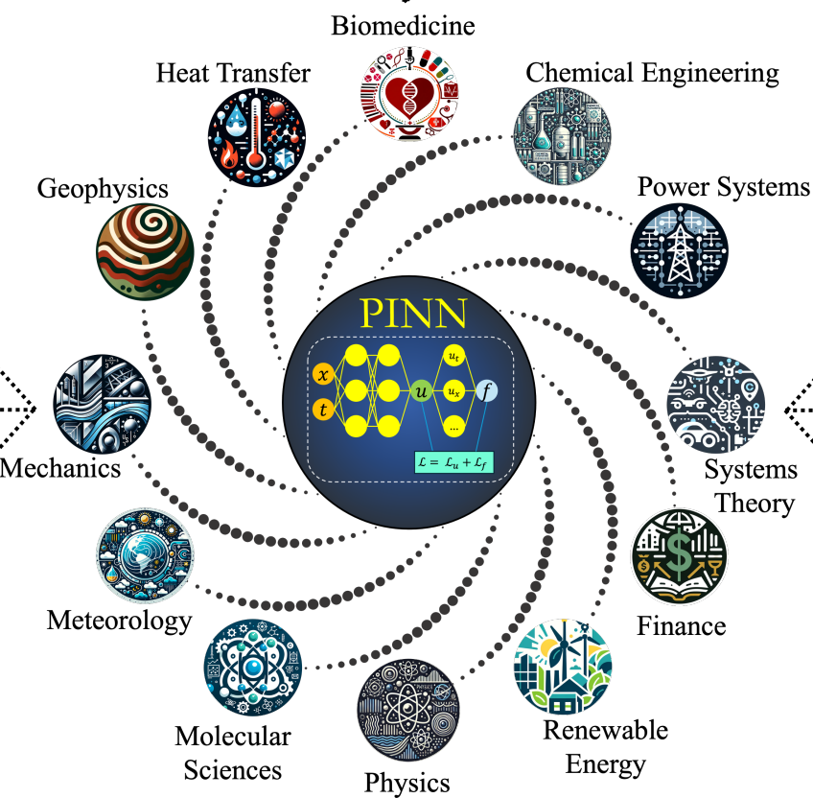
PINN vs Traditional Data-Driven ML Methods
This is NOT a data-driven ML technique!
Physics-Informed Neural Networks
J.D. Toscano et al., arXiv:2410.13228, (2024)

Slide 4
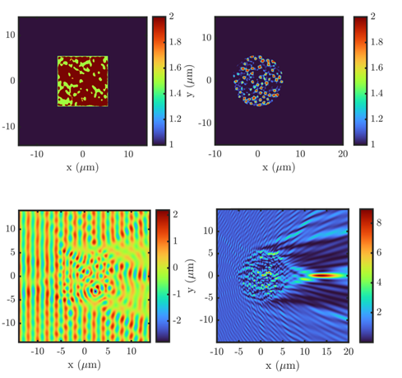
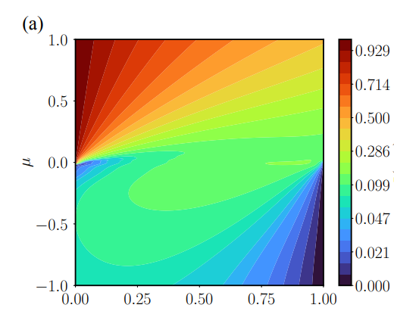
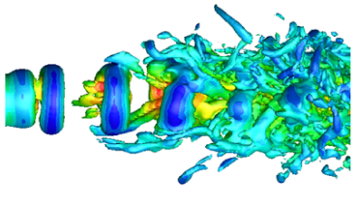
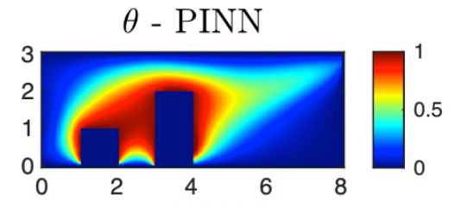
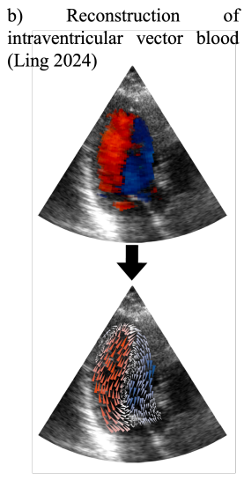
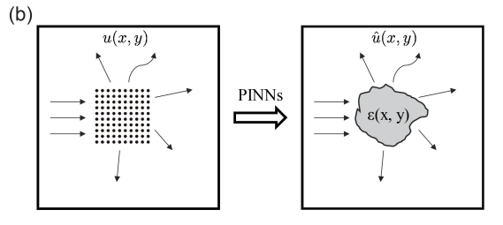
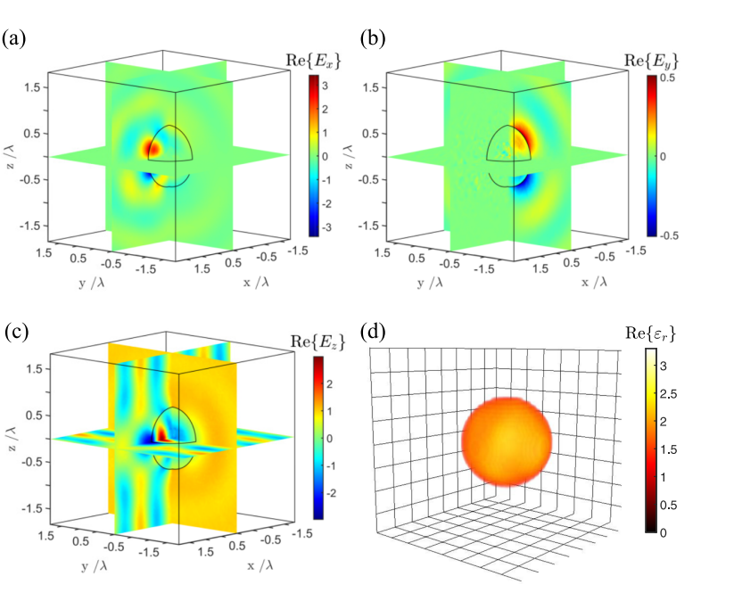
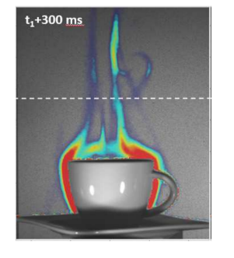
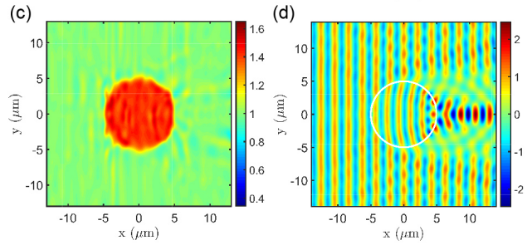
PINNs state-of-the-art
PINNs research in Prof. Dal Negro’s
Nano Research Group
Complex transport problems
Thermal
Jet Flow
Cai, Shengze, et al., Journal of Heat Transfer, 143, 6 (2021)
Cai, et al., IEEE Trans.Instrum. Meas., (2024)
R. Roberto, et al., arXiv ,(2025)
R. Roberto, et al., APINN for Radiative Transfer , 2023
Pressure Flow
Intraventricular Vector
Flow Mapping
Y. Chen, et al., Inverse
nano-optics problems ,(2020)
Y. Chen, et al., Parameter Retrieval ,(2022)
H.J. Ling et al., IEEE Trans. Ultrason. Ferroelectr. Freq. Control, 2024.
M.A. Calicchia et al., J. Exp. Biol., 226(8), 2023.

Slide 5
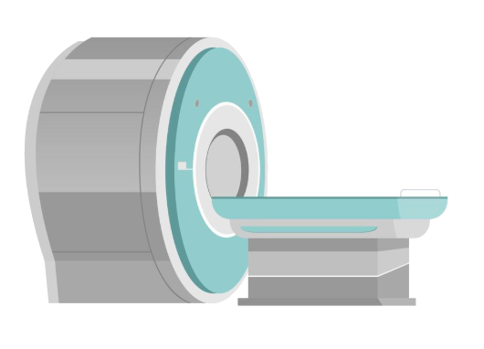
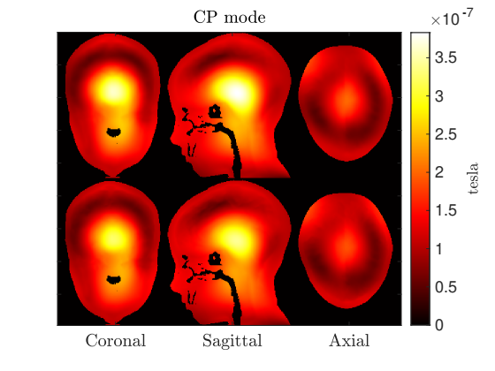
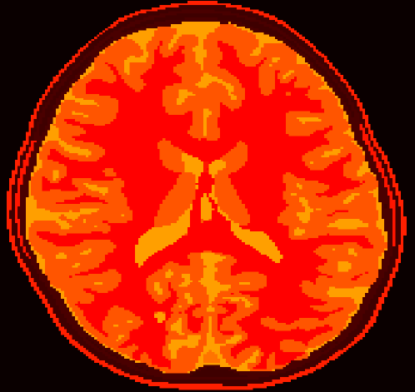
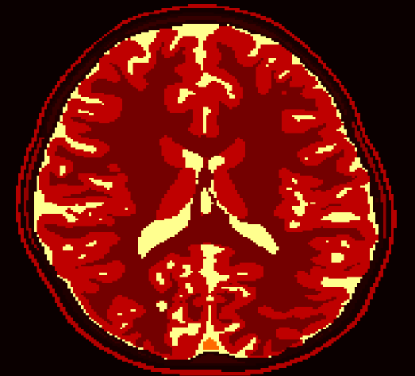
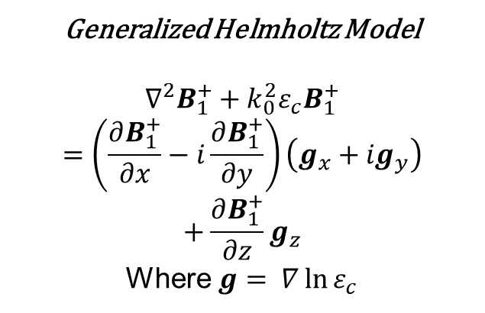

Introduction to Magnetic Resonance-Electrical Property Tomography (MR-EPT)
MRI machines create a magnetic field (B) to retrieve electrical properties (EP) ($ε_{c}$)
Tomography Problem is solved with :
Motivation
High-precision reconstructions improves the effectiveness of
Early tumor detection
Improved effectiveness of radiofrequency hyperthermia
Generalized Helmholtz Model
$$∇^{2}B_{1}^{+}+k_{0}^{2}ε_{c}B_{1}^{+}=\left(\frac{∂B_{1}^{+}}{∂x}−i\frac{∂B_{1}^{+}}{∂y}\right)\left(g_{x}+{ig}_{y}\right)+\frac{∂B_{1}^{+}}{∂z}g_{z}$$
Where $g= ∇\ln{ε_{c}}$
parameter to be retrieved based on training data
Permittivity
MRI Scan
EPT
Permittivity
Conductivity
Notes:
Based on the universal approximation theorem, PINNs implement a neural network with its output $\hat{u}$to approximate the surrogate solution to PDE. We then build the loss function that constrains this solution to satisfy the PDE and also potential BCs and ICs. We train the PINN to minimize loss below a certain threshold and then the surrogate solution becomes the solution to the PDE in the end. Different from the finite element method FEM that require building a mesh over the studied domain. The derivative of this surrogate solution is evaluated using the automatic differentiation technique which is mesh-free technique and is available in tensorflow package.
One advantage of using PINN is solving conveniently the inverse problem for PDE. Let’s say we want to retrieve the unknown parameters \lambda in a PDE problem given the solution u generated by this unknown parameter. In PINNs we can easily retrieve \lambda by adding an extra loss term Li that restrict PINN’s output to be our observed solution. PINN then optimize all wights and biases and also the parameter lambda to minimize the loss. By the end of the training, PINN will predict the unknown parameter lambda. Moreover, PINN requires only single dataset for training rather than tons of datasets in other methods, so it saves a lot computation resources.

Slide 6
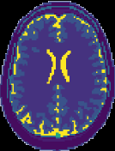
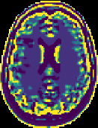
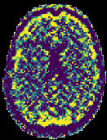
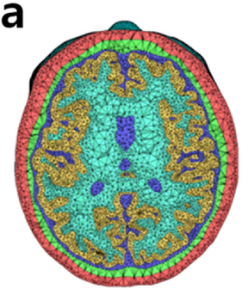
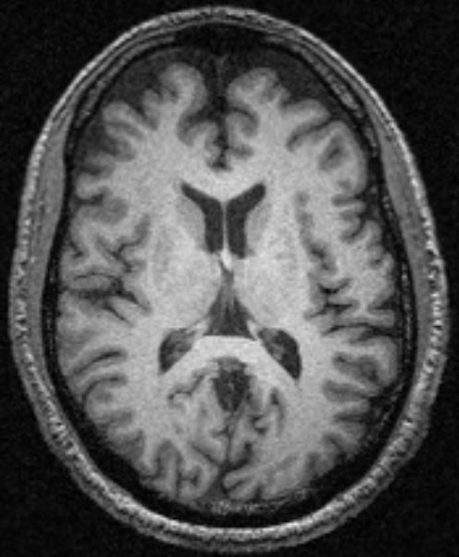
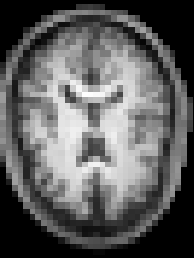
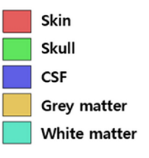
MR-EPT – Limitations of Traditional Methods
Conductivity Reconstruction Reconstruction
Ground-Truth SNR = inf. SNR = 100
Traditional approach for MR-EPT:
Finite Element Method(FEM)
Sensitive to noisy data
Artifacts caused by numerical differentiation
Desired PINN Improvements:
Analytical derivatives reduce artifacts
Strong denoising capabilities
Increased spatial resolution
80
MPRAGE
1 mm
MPRAGE
5 mm
30
2.5
0
Notes:
Based on the universal approximation theorem, PINNs implement a neural network with its output $\hat{u}$to approximate the surrogate solution to PDE. We then build the loss function that constrains this solution to satisfy the PDE and also potential BCs and ICs. We train the PINN to minimize loss below a certain threshold and then the surrogate solution becomes the solution to the PDE in the end. Different from the finite element method FEM that require building a mesh over the studied domain. The derivative of this surrogate solution is evaluated using the automatic differentiation technique which is mesh-free technique and is available in tensorflow package.
One advantage of using PINN is solving conveniently the inverse problem for PDE. Let’s say we want to retrieve the unknown parameters \lambda in a PDE problem given the solution u generated by this unknown parameter. In PINNs we can easily retrieve \lambda by adding an extra loss term Li that restrict PINN’s output to be our observed solution. PINN then optimize all wights and biases and also the parameter lambda to minimize the loss. By the end of the training, PINN will predict the unknown parameter lambda. Moreover, PINN requires only single dataset for training rather than tons of datasets in other methods, so it saves a lot computation resources.

Slide 7
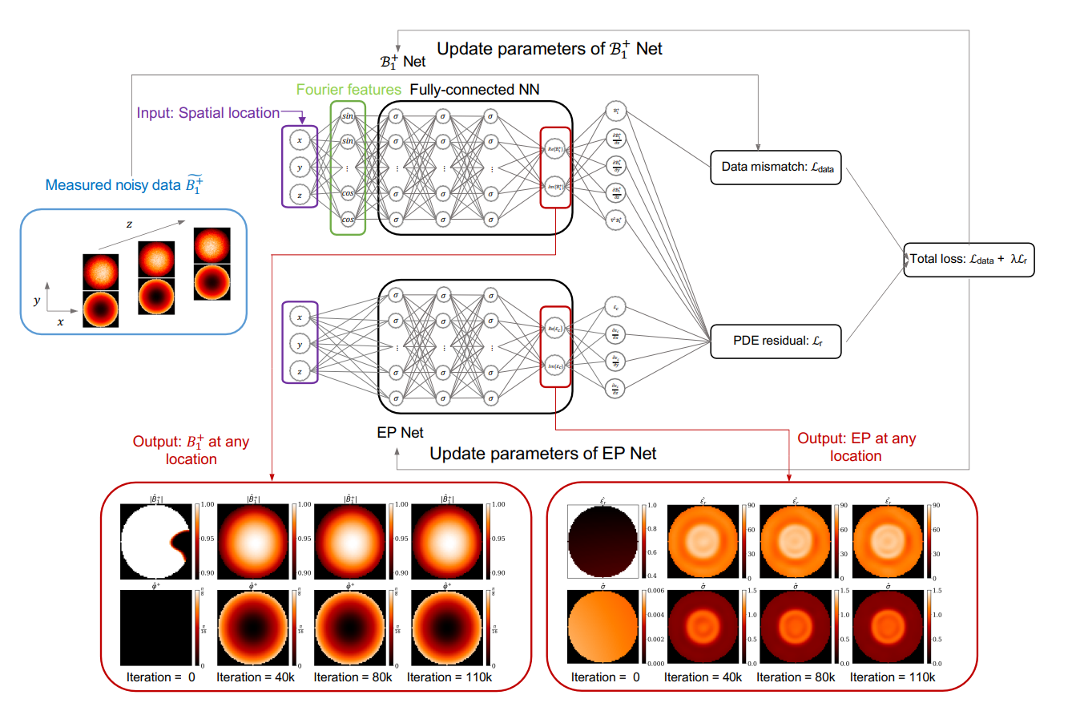
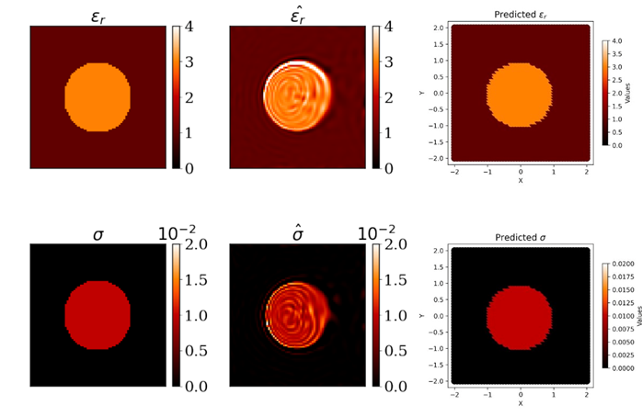




MR-EPT – Starting PIFON point
PIFON – 2023
EPT Using Physics-Informed Fourier Networks
Developed PINN framework for EPT
Reconstruction results of <10% with Noisy Data
Struggles with contrast
Working with our collaborators from New York University, Department of Radiology – 2024 - Now
Developing High-Precision Reconstruction
PIFON Framework
$$ε_{r}$$
$$\hat{ε_{r}}$$
$$σ$$
$$\hat{σ}$$
PIFON Results

Slide 8
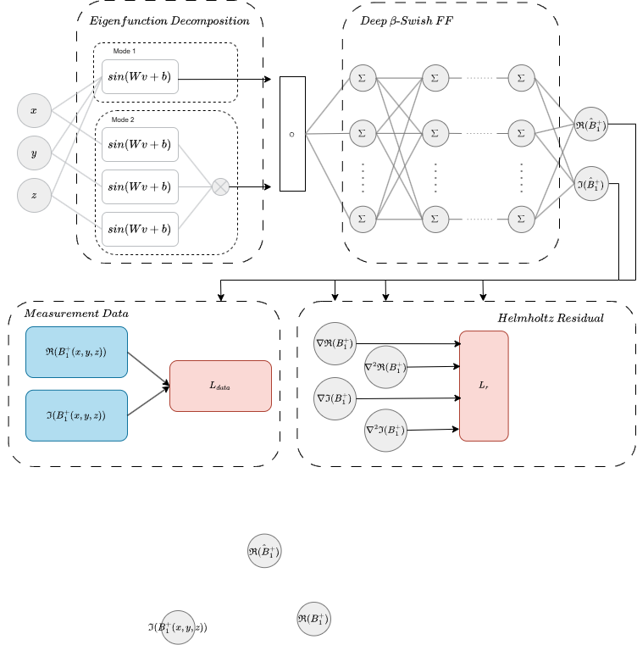
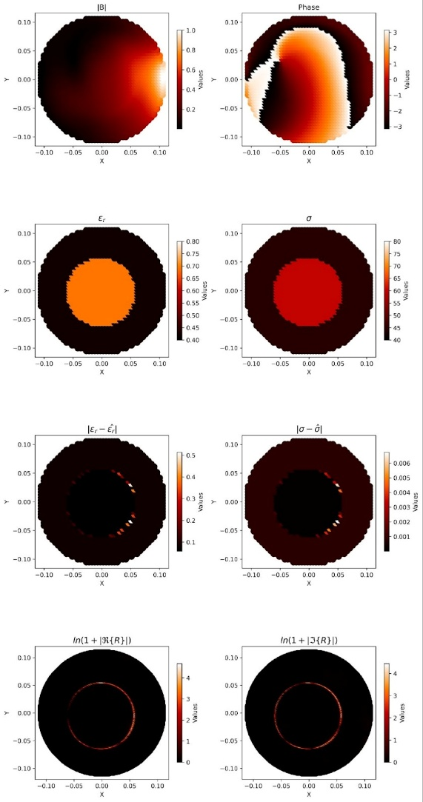

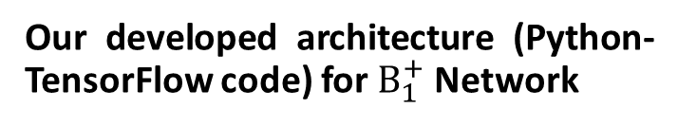
MR-EPT – Developed B Network During this Project
Developed Sections
Eigenfunction Decomposition
Specific Frequency Tuning
Expansion of Random Fourier Features
Additional Utilized techniques
β-Swish
Our developed architecture (Python-TensorFlow code) for $B_{1}^{+}$Network
$${|B}_{1}^{+}|$$
Noisy
Data
Phase

Slide 9
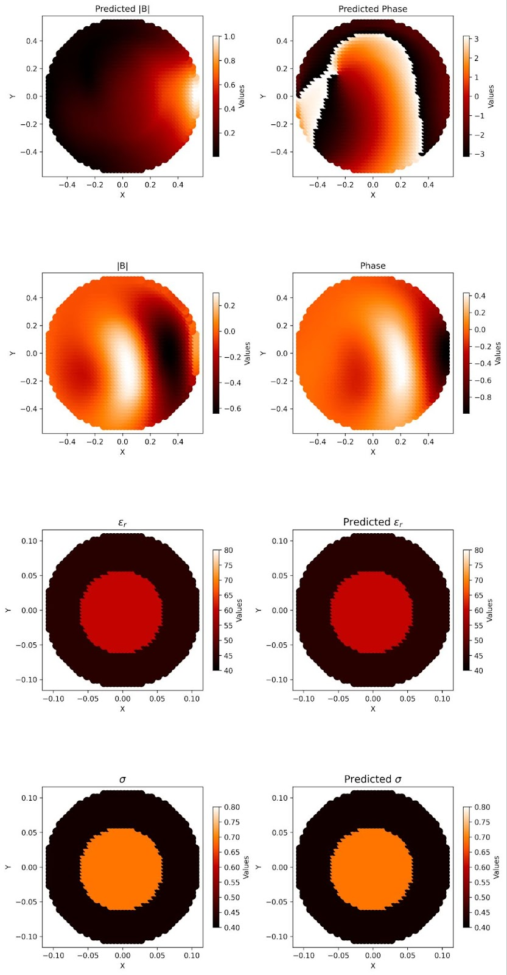
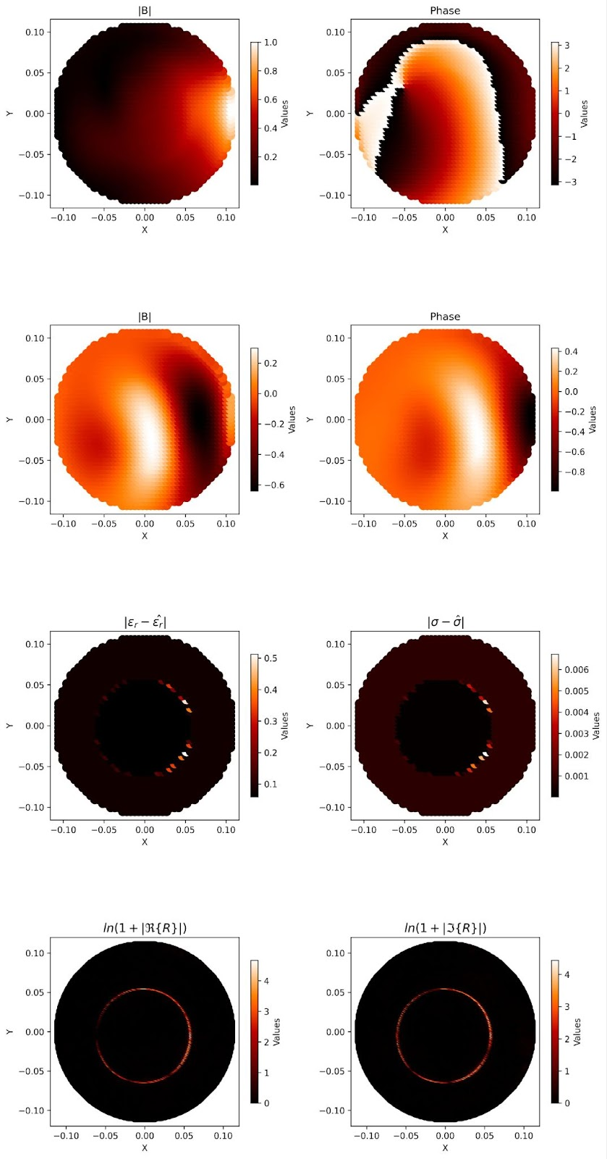
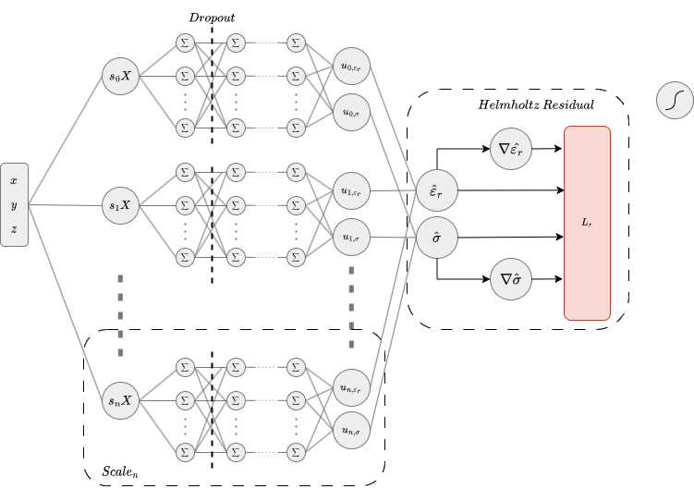



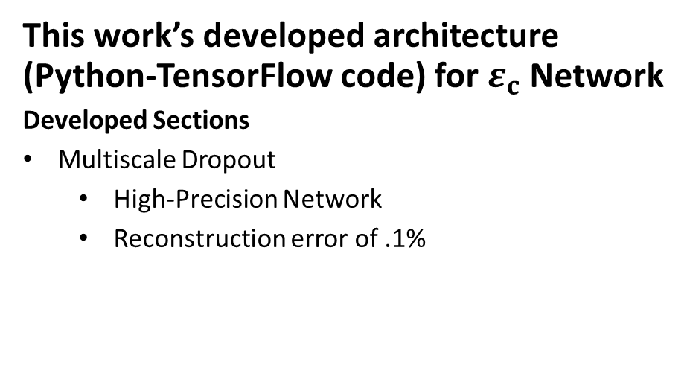

MR-EPT – Developed EP Network During this Project
This work’s developed architecture (Python-TensorFlow code) for $ε_{c}$Network
Developed Sections
Multiscale Dropout
High-Precision Network
Reconstruction error of .1%
Predicted
Absolute Error
$$\hat{ε_{r}}$$
$$.12\%$$
$$\hat{σ}$$
$$.08\%$$

Slide 10
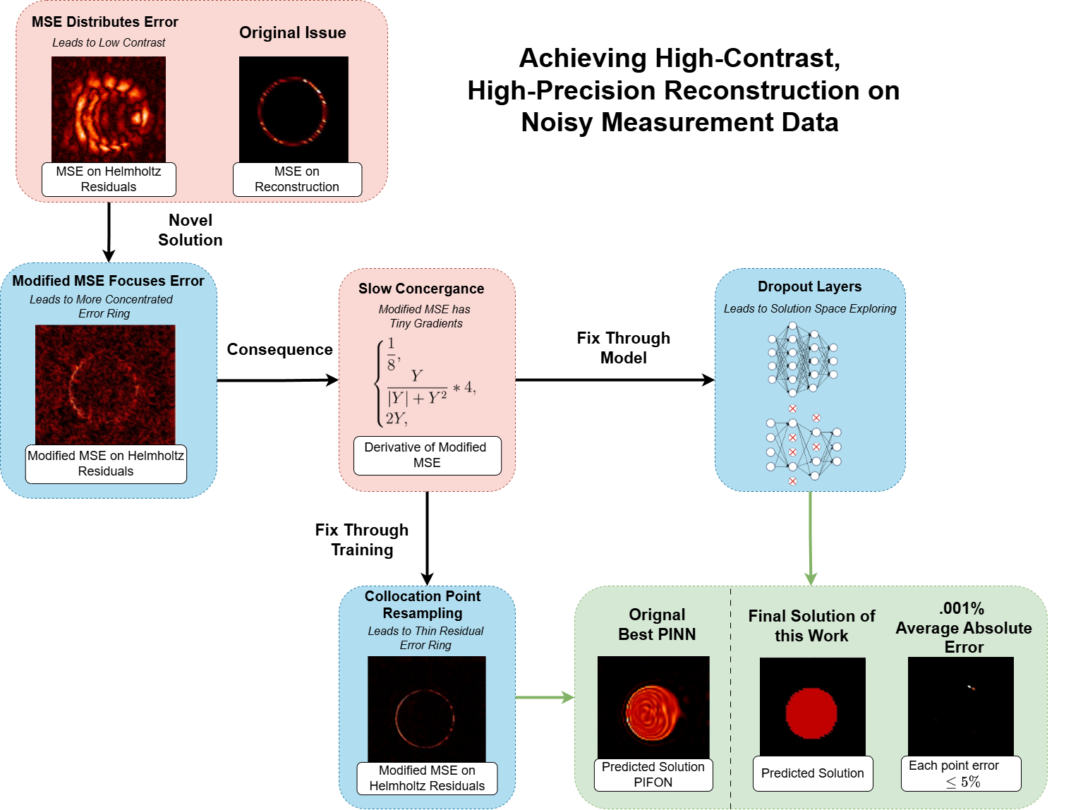
Our Proposed Modified Mean Squared Error (MSE) Metric
PIFON
Starting Point
PIFON Results

Slide 11

Our Proposed Modified Mean Squared Error (MSE) Metric

Slide 12

Our Proposed Modified Mean Squared Error (MSE) Metric
Dropout Layers
Randomly Drops neurons during training
Decrease overfitting

Slide 13
Our Proposed Modified Mean Squared Error (MSE) Metric

Slide 14
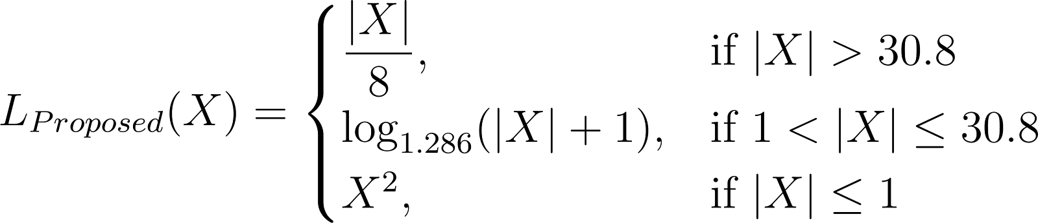
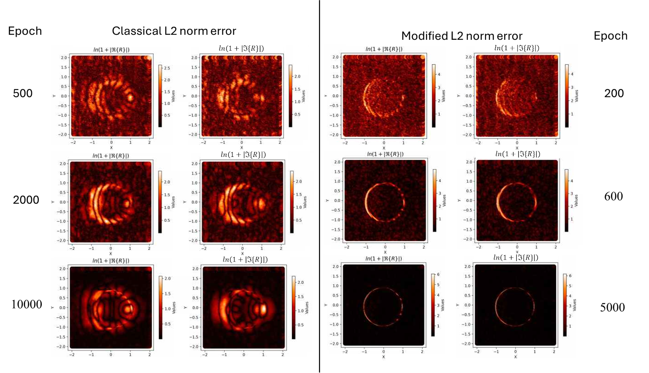
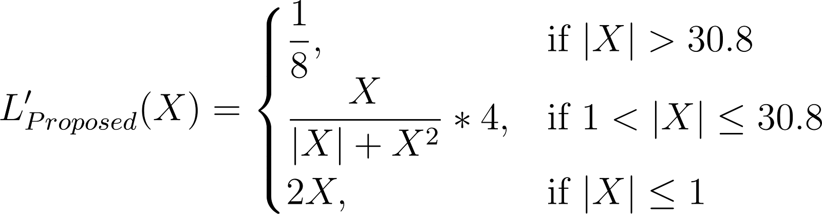
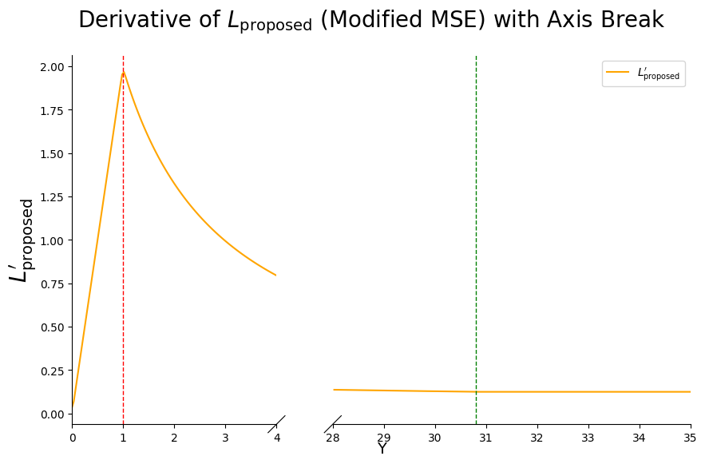
MR-EPT – Proposed Modified MSE Results
This work’s novel Mean Squared Error Modification*
Classic MSE
Modified MSE*

Slide 15
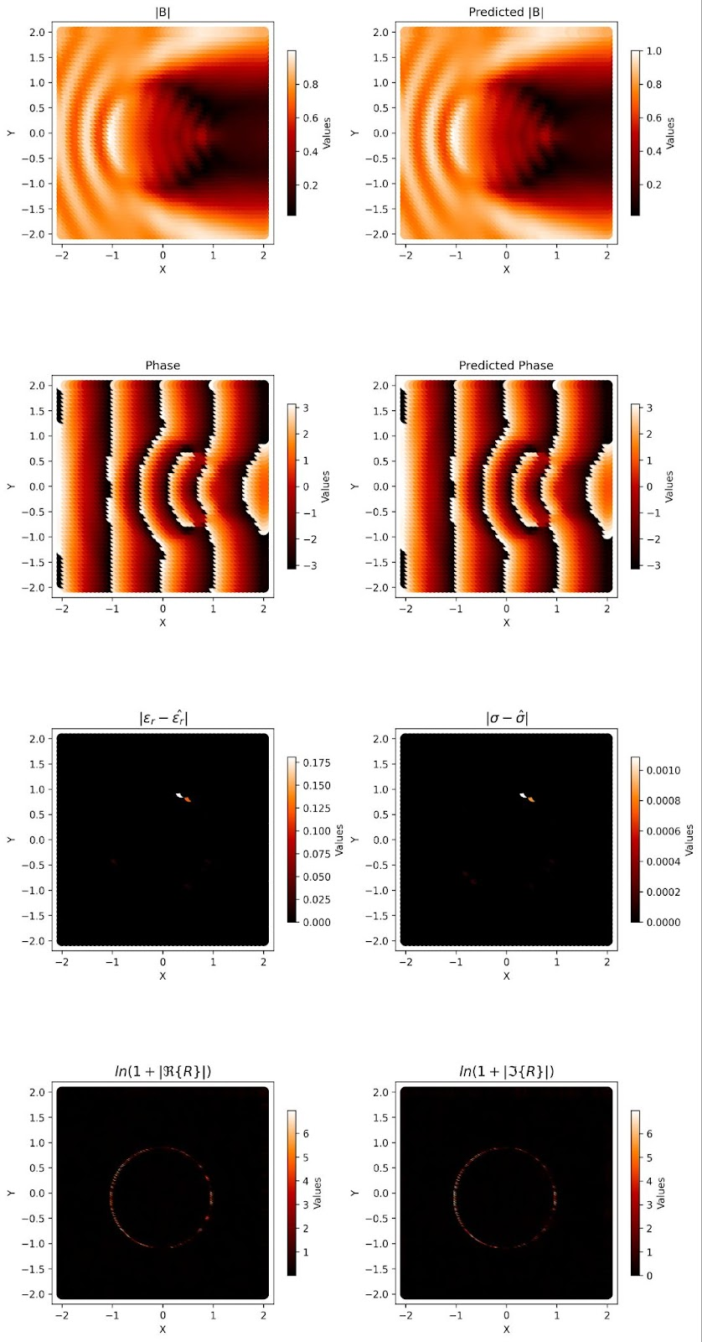
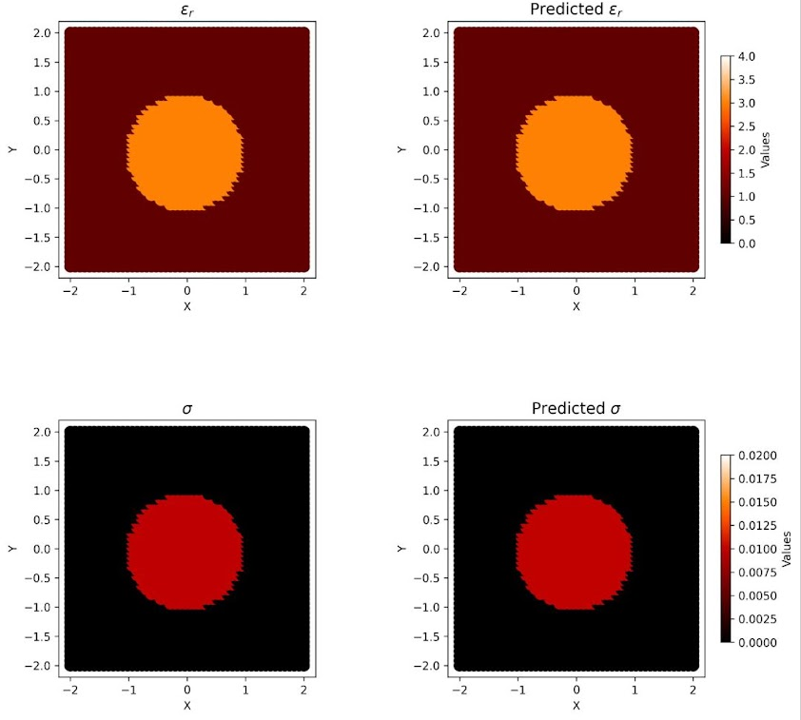
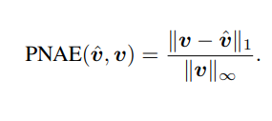









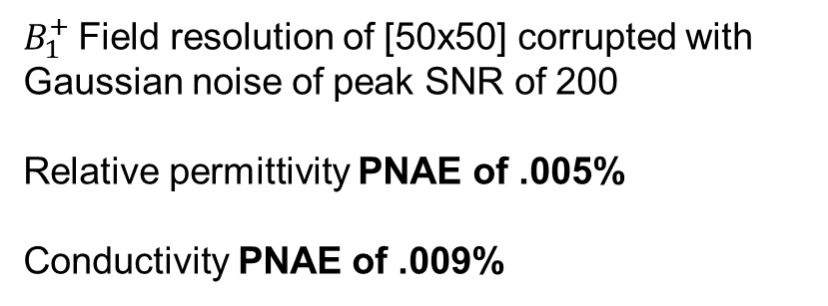


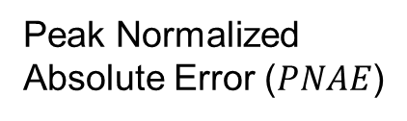


MR-EPT – 2D Plane Wave Excitation Results
$${|B}_{1}^{+}|$$
$$\hat{{|B}_{1}^{+}|}$$
$$ε_{r}$$
$$\hat{ε_{r}}$$
Peak Normalized Absolute Error ($PNAE$)
$$φ$$
$$\hat{φ}$$
$$σ$$
$$\hat{σ}$$
$$|ε_{r}−\hat{ε_{r} }|$$
$$|σ−\hat{σ}|$$
$B_{1}^{+}$Field resolution of [50x50] corrupted with Gaussian noise of peak SNR of 200
Relative permittivity PNAE of .005%
Conductivity PNAE of .009%
$$log⁡(1+|ℜ\left\{R\right\}|)$$
$$log⁡(1+|ℑ\left\{R\right\}|)$$

Slide 16


MR-EPT - PIFON Comparison
Ground Truth
PIFON
Our Work
$$\hat{ε_{r}}$$
$$\hat{σ}$$
Comparison to Original PIFON using the Simplified Helmholtz Equation work from our collaborators at New York University, Department of Radiology

Slide 17
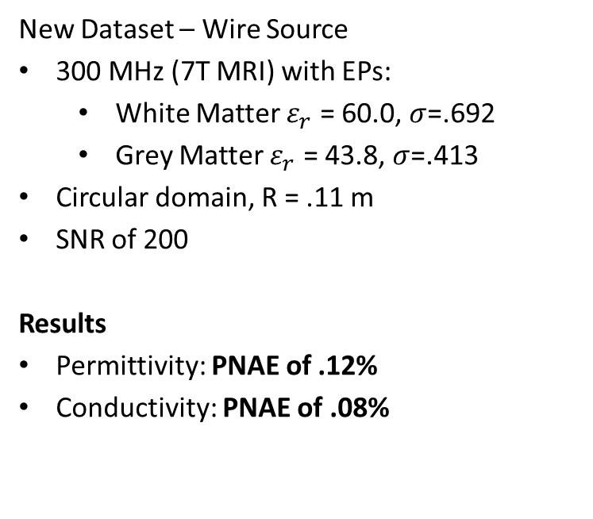
MR-EPT – 2D Wire Source Excitation
New Dataset – Wire Source
300 MHz (7T MRI) with EPs:
White Matter $ε_{r}$ = 60.0, $σ$=.692
Grey Matter $ε_{r}$ = 43.8, $σ$=.413
Circular domain, R = .11 m
SNR of 200
Results
Permittivity: PNAE of .12%
Conductivity: PNAE of .08%

Slide 18
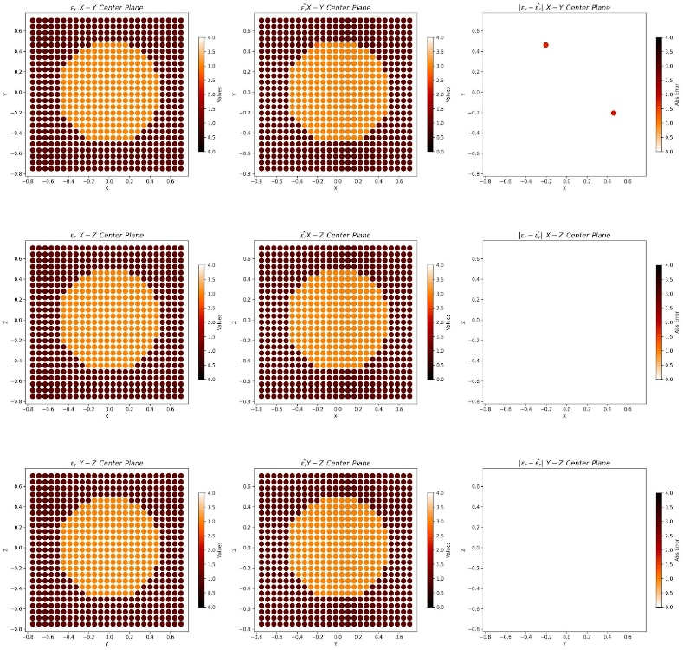
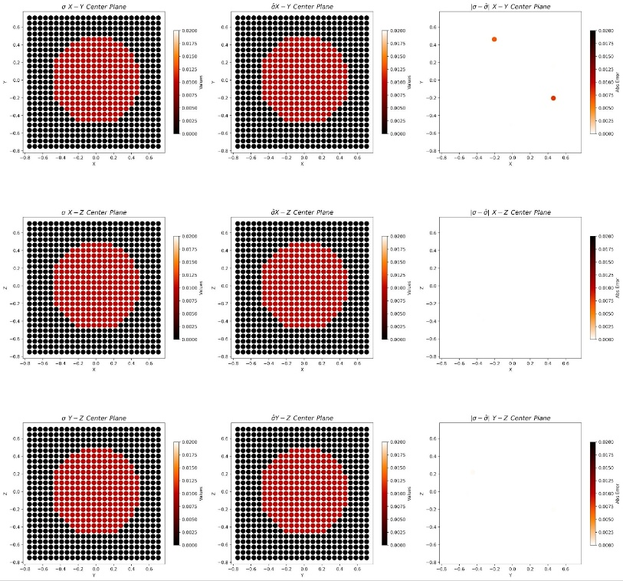
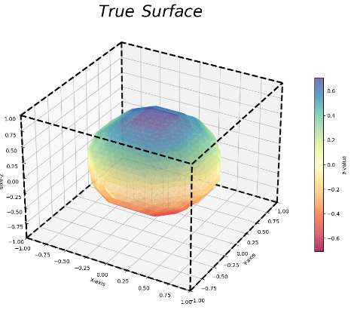



MR-EPT – 3D Plane Wave Excitation
3D Sphere under Plane Wave
EPs identical to 2D example
{$ε_{r}$ = 3, $σ$=.01}
${\left[25\right]}^{3}=15625$ points
Results
Permittivity: PNAE of .12%
~30 points misidentify
Conductivity: PNAE of .17%

Slide 19

phonon Boltzmann Transport Equation
phonon Boltzmann Transport Equation
(BTE) PINN Section
Notes:
Based on the universal approximation theorem, PINNs implement a neural network with its output $\hat{u}$to approximate the surrogate solution to PDE. We then build the loss function that constrains this solution to satisfy the PDE and also potential BCs and ICs. We train the PINN to minimize loss below a certain threshold and then the surrogate solution becomes the solution to the PDE in the end. Different from the finite element method FEM that require building a mesh over the studied domain. The derivative of this surrogate solution is evaluated using the automatic differentiation technique which is mesh-free technique and is available in tensorflow package.
One advantage of using PINN is solving conveniently the inverse problem for PDE. Let’s say we want to retrieve the unknown parameters \lambda in a PDE problem given the solution u generated by this unknown parameter. In PINNs we can easily retrieve \lambda by adding an extra loss term Li that restrict PINN’s output to be our observed solution. PINN then optimize all wights and biases and also the parameter lambda to minimize the loss. By the end of the training, PINN will predict the unknown parameter lambda. Moreover, PINN requires only single dataset for training rather than tons of datasets in other methods, so it saves a lot computation resources.

Slide 20


phonon BTE– Motivation
Motivation – phonon BTE
Current compact electronics have their performance limited by thermal throttling
BTE solvers can model thermal profiles on small length scales
Advance next-gen transistor thermal design with better heat dissipation
Captures both ballistic and diffusive thermal regimes
Phonon scattering from diffusive to ballistic depending on mean-free path
$$\vec{v}⋅∇\left(f^{eq}+f^{neq}\right)=−\frac{f^{neq}}{τ}$$
$$f(\vec{x},\vec{s}, k, p)$$
Notes:
Based on the universal approximation theorem, PINNs implement a neural network with its output $\hat{u}$to approximate the surrogate solution to PDE. We then build the loss function that constrains this solution to satisfy the PDE and also potential BCs and ICs. We train the PINN to minimize loss below a certain threshold and then the surrogate solution becomes the solution to the PDE in the end. Different from the finite element method FEM that require building a mesh over the studied domain. The derivative of this surrogate solution is evaluated using the automatic differentiation technique which is mesh-free technique and is available in tensorflow package.
One advantage of using PINN is solving conveniently the inverse problem for PDE. Let’s say we want to retrieve the unknown parameters \lambda in a PDE problem given the solution u generated by this unknown parameter. In PINNs we can easily retrieve \lambda by adding an extra loss term Li that restrict PINN’s output to be our observed solution. PINN then optimize all wights and biases and also the parameter lambda to minimize the loss. By the end of the training, PINN will predict the unknown parameter lambda. Moreover, PINN requires only single dataset for training rather than tons of datasets in other methods, so it saves a lot computation resources.

Slide 21


PINN -- BTE
PINNs for solving phonon BTE with large temperature non-equilibrium 2022
Li et al.’s PINN BTE solver models the 2D rectangular phonon transport problem using isothermal boundaries
Their model suffers from inefficiency due to the high-dimensionality of the BTE: takes 4 hours to train PINN for all simulations
Goals
Translate Li et al.’s open-source code into Python TensorFlow
Reduce computational resources
Notes:
Based on the universal approximation theorem, PINNs implement a neural network with its output $\hat{u}$to approximate the surrogate solution to PDE. We then build the loss function that constrains this solution to satisfy the PDE and also potential BCs and ICs. We train the PINN to minimize loss below a certain threshold and then the surrogate solution becomes the solution to the PDE in the end. Different from the finite element method FEM that require building a mesh over the studied domain. The derivative of this surrogate solution is evaluated using the automatic differentiation technique which is mesh-free technique and is available in tensorflow package.
One advantage of using PINN is solving conveniently the inverse problem for PDE. Let’s say we want to retrieve the unknown parameters \lambda in a PDE problem given the solution u generated by this unknown parameter. In PINNs we can easily retrieve \lambda by adding an extra loss term Li that restrict PINN’s output to be our observed solution. PINN then optimize all wights and biases and also the parameter lambda to minimize the loss. By the end of the training, PINN will predict the unknown parameter lambda. Moreover, PINN requires only single dataset for training rather than tons of datasets in other methods, so it saves a lot computation resources.

Slide 22


BTE – Our Developed Approach
This work’s developed architecture (Python-TensorFlow code) for Feq and Fneq Networks
Our Approach
Use hard constraints
Post processing step, done with multiplying the Network output with nullifying function
Satisfy boundary conditions by construction
Adaptive Network Initialization
Benefits
Deletes requirement for large boundary training grid
Allows for smaller models
Speeds up convergence
Feq Net
Fneq Net

Slide 23




BTE Results
Domain geometry and heating function
Results
Training time reduced from 4 hours for all simulations to 10 minutes per length scale
Li et al.’s Work
This Work

Slide 24

BTE Results
Center axis cut of Temperature Profile
Results
As we decrease the length scale, we display more linear temperature profiles

Slide 25

Conclusions and final thoughts
MR-EPT Key Achievements
High-precision reconstruction with errors $≤ .1\%$ on data with an SNR of 200
Original PIFON had $≤10\%$ PNAE
This work improves to $≤ .01\%$
Developed novel loss function for discontinuous interface modeling
Detailed methodology for resolving large errors
MR-EPT– Next Steps
Test proposed PINN architecture on realistic head phantoms for clinical relevance
Expand the Modified MSE to other interface-dependent PDEs to test generalization
BTE Key Achievements
Developed HC-PINN for efficient phonon BTE solutions across thermal regimes
Reduced Li et al.’s PINN training time from 4 hours to 10 min
Future Work – Next Steps
Validate phonon BTE PINN with experimental results
Apply our architectures to model complex devices with multiple-materials

Slide 26


Acknowledgments
Nanomaterials & Nanostructure Optics Lab @ BU
Wiktor Lidwin (wlidwin@bu.edu)
Roberto Riganti
Dr. Riccardo Franchi
Tornike Shubitidze
Smridhi Chawla
Peyton Brown
Yilin Zhu (now at Huawei)
Yuyao Chen (now at OMNIVISION)
Advisor: Prof. Luca Dal Negro
Special Thanks to Roberto Riganti for the great help with PINN through this exciting project!
Collaborators
Prof. Enrico Bellotti (BU ECE)
Dr. Ilias I. Giannakopoulos
Prof. Riccardo Lattanzi
Department of Radiology,
New York University
Grossman School of Medicine

