Slide 1
Spin-wave-mediated Skyrmionics for Spiking Neurons
Wilbert Tan
Supervisor: Prof. Kelvin Xuanyao Fong
Examiner: A/P Albert Gengchiau Liang
CA4 Presentation

Slide 2
Executive Summary
Current artificial synaptic devices that use displacement are limited by device size
Current artificial synaptic devices that store weights are limited by the number of the skyrmions
The resolution of firing is often not analogue, but dependent on the number of skyrmions
Considerations
How can spin-wave mediated skyrmionics overcome the limitations faced by current skyrmionics synaptic devices?
Objective
Using the arrangement of skyrmions to mediate the interfering waves offers promise in developing a spin-wave mediated spiking neuron which can overcome limitations of size and dependencies on the number of skyrmions
Introducing Spin-wave mediated Skyrmionics for Spiking Neurons
Proposal
Investigating skyrmion arrangement and spin-wave phenomenon
Develop spin-wave mediated spiking neuron using ring configuration
Develop spin-wave mediated spiking neural network using individual spiking neurons
Results
Background
Methodology
Results
Conclusion
Notes:
My thesis is born from an evaluation of

Slide 3
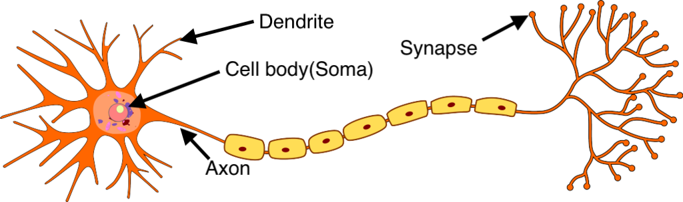
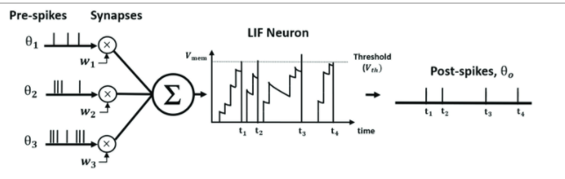
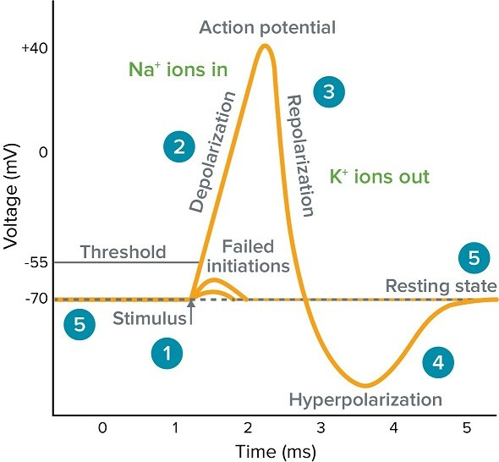
Biological Neurons are being modelled mathematically
LIF Model
1) Leaky – constant leakiness if no input
2) Integrate – integration of inputs
3) Firing Threshold – At the action potential neuron fires and resets
Energy efficient
Better at processing spatio-temporal data¹
¹ M. Pfeiffer, T. Pfeil , Deep Learning With Spiking Neurons: Opportunities and Challenges., Frontiers in Neuroscience, 2018
J. Stone, Principles of neural information theory: Computational neuroscience, Sebtel Press, 2018.
C. Lee, S.S. Sarwar, P. Panda, G. Srinivasan, K. Roy. Enabling Spike-Based Backpropagation for Training Deep Neural Network Architectures. Frontiers in Neuroscience, 2020
Background
Methodology
Results
Conclusion
Notes:
The spiking behaviour in biological neurons being mathematically represented. Spiking neuron behaviour is more energy efficient because neurons communicate with each other through electrical spikes as opposed to continuous signals, and work in continuous time rather than discrete time. Produce dynamics in real-time.

Slide 4
Spintronic hardware are strong candidates for modelling neuron behaviour
Current Devices
Traditional hardware suffers from high energy consumption and area requirements
More devices are required to store weights and the connections between weights
Spintronic Hardware
Allows for non-linear magnetisation dynamics and stochastic processes that can be manipulated to emulate neuron behaviour
Skyrmions (magnetic solitons) can be used to as vectors of information with better compactness and energy efficiency than existing electronic devices
Skyrmion hardware gradually becoming more realisable – Room Temperature Stable Skyrmions
Background
Methodology
Results
Conclusion
Notes:
However, when it comes to modelling these mathematical models in hardware there are some complications.
Current devices struggle to accommodate for larger, and more complicated neural networks and behaviour
Spintronic hardware offers a promising alternative
1. Allow for non-linear magnetisation dynamics and stochastic processes that are can be manipulated to resemble neuron behaviour. E.g. wave interference can be mapped to the biological processes of integration of ions in the neuron
2. A particular micromagnetic spin structure on called skyrmions can be used as vectors of information because they offer better compactness and significantly less energy than existing electronic devices (reported up to two magnitudes lower)
3. More realizable – stable at room temperature
Lifetime dependent on temperature

Slide 5
Comparison of Skyrmion Implementations
Author/Date | Integrate | Fire | Reset | Leaky | Learning | Improvements
Liang et al., 2020 | Yes, distance d to detector from centre | Yes, when skyrmion reaches detector | (?) Can do both annihilation and moving skyrmion back to origin | Yes, boundary induced force sends skyrmion back | No | Hasn’t been demonstrated in network
He et al., 2017 | Yes, accumulation of skyrmions | Yes, when enough skyrmions are in the output region (number of skyrmions needed to depin domain wall) | Nucleate new domain wall pair by spin polariser and fire new input skyrmion (fan – out) | No | Yes, uses weight domain wall pair Network from excitatory, inhibitory neurons Offline learning Binary synapse | Offline learning Weight dependent on number of skyrmions
Chen et al., 2018 | Yes, distance d to the detector and mapping motion of skyrmion | Yes, once skyrmion reaches the end of the ‘free layer’ | Reverse current and move skyrmion back to origin | No | Validated on MNIST Offline Learning Different conductance branches Weight – device conductance (read current) | Offline Learning Weight dependent on number of ‘setups’
Huang et al., 2018 | Yes, number of skyrmions at detector | Yes, when enough skyrmions reach detector | Reverse current and move skyrmion back to origin | No | Skyrmions left in the post-synaptic area (detector) affect the weight as a matter of driving force | Weight dependent on number of skyrmions
Background
Methodology
Results
Conclusion
Notes:
Comparing different skyrmion implementations of synaptic devices. To do so I evaluated each model in scholarship based on the components of the LIF model as well learning.

Slide 6
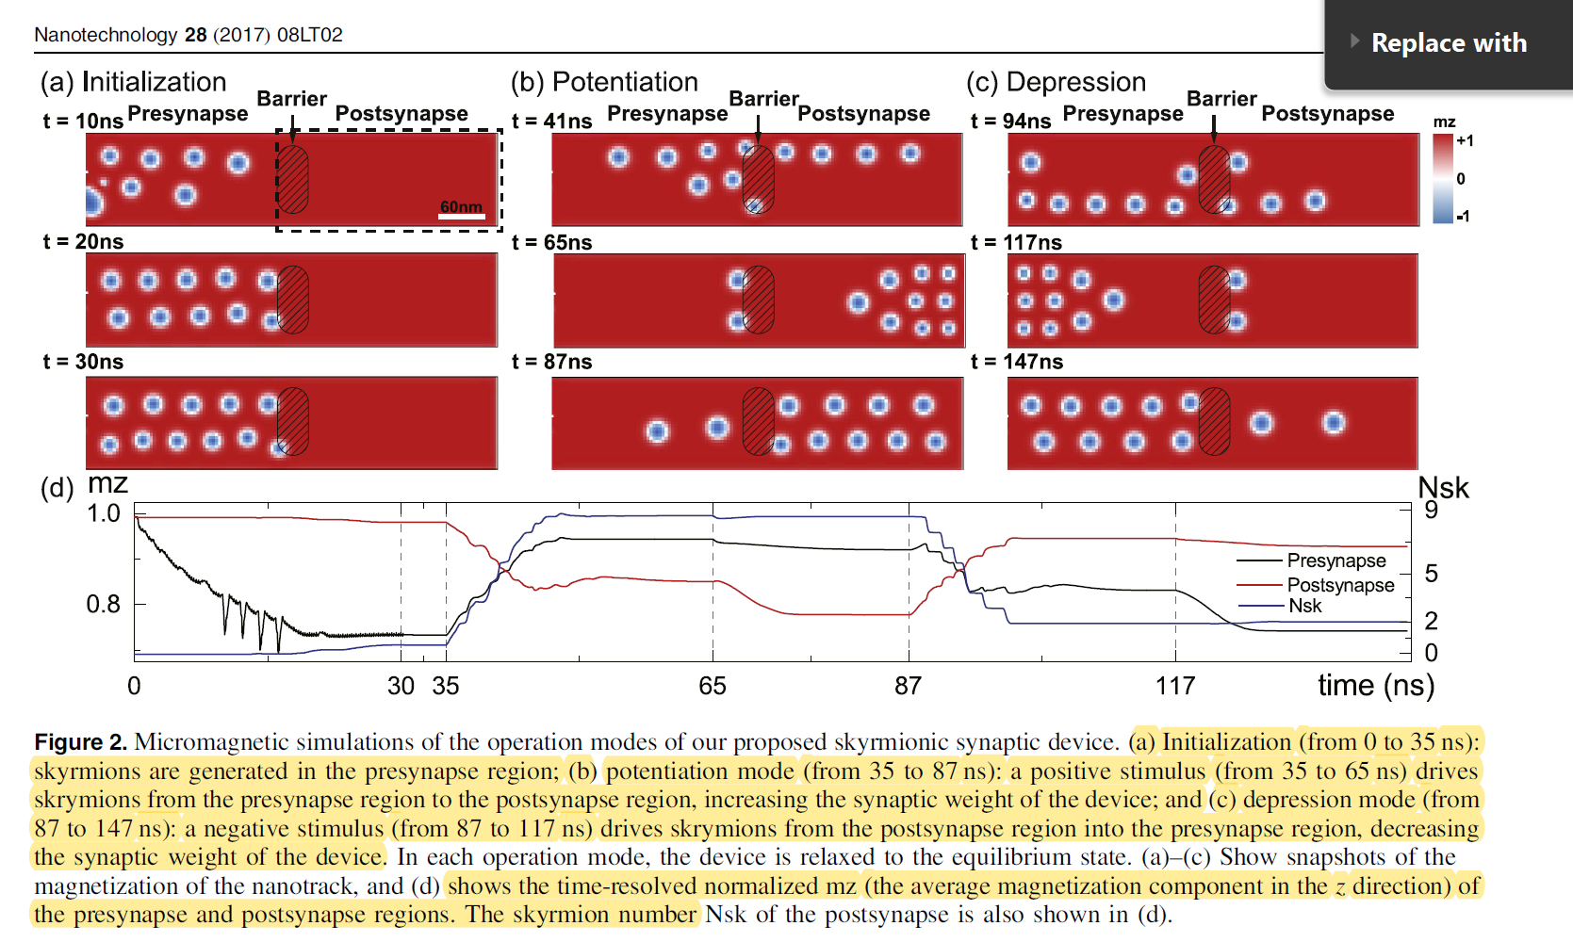
Adaptive weight but size and resolution limited: Huang et al. (2017)
Y. Huang, W. Kang, X. Zhang, Y. Zhou and W. Zhao, "Magnetic skyrmion-based synaptic devices," Nanotechnology, vol. 28, 2017.
Example
Integrate: Displacement
Fire: Number of Skyrmions
Weight: Number of Skyrmions
Weight resolution based on number of skyrmions
Potentiation easier than Depression
Skyrmions remaining in post synapse region
Background
Methodology
Results
Conclusion
Notes:
One such device I evaluated was quintessential of the findings that I found.
This model of an integrate and fire neuron has skyrmions move along a barrier. And when enough skyrmions are detected in this region called the postsynaptic region, then the skyrmion fires
Harder to go from post back to pre because of repelling forces and less driving force – skyrmions left behind which biases this system
Modelling to an IF model
Integrate – displacement
Fire
Weight – number of skyrmions in the post synaptic region
This device is representative in design commonalties between different devise in the field. There are three dependencies 1. on displacement 2. the number of skyrmions storing weight 3. Threshold for firing

Slide 7
Evaluation of Spiking Neuron Devices
1) Displacement based devices are limited by size
Current artificial synaptic devices that use displacement are limited by device size during integration, and storage of weights as displacement
2) Dependency on the number of skyrmions for weight
Current artificial synaptic devices that store weights are limited by the number of the skyrmions
3) Dependent on the number of skyrmions to determine the firing threshold
The resolution of firing is often not analogue, but dependent on the number of skyrmions because more fidelity requires more skyrmion.
An alternative approach to displacement and number of skyrmion dependent devices could be spin waves!
Background
Methodology
Results
Conclusion
Notes:
However, these depdencies have significant drawbacks for the future of skyrmion devices
Displacement based devise, which integrate as the skyrmions moves along a track limit the size of the device.
Dependency

Slide 8
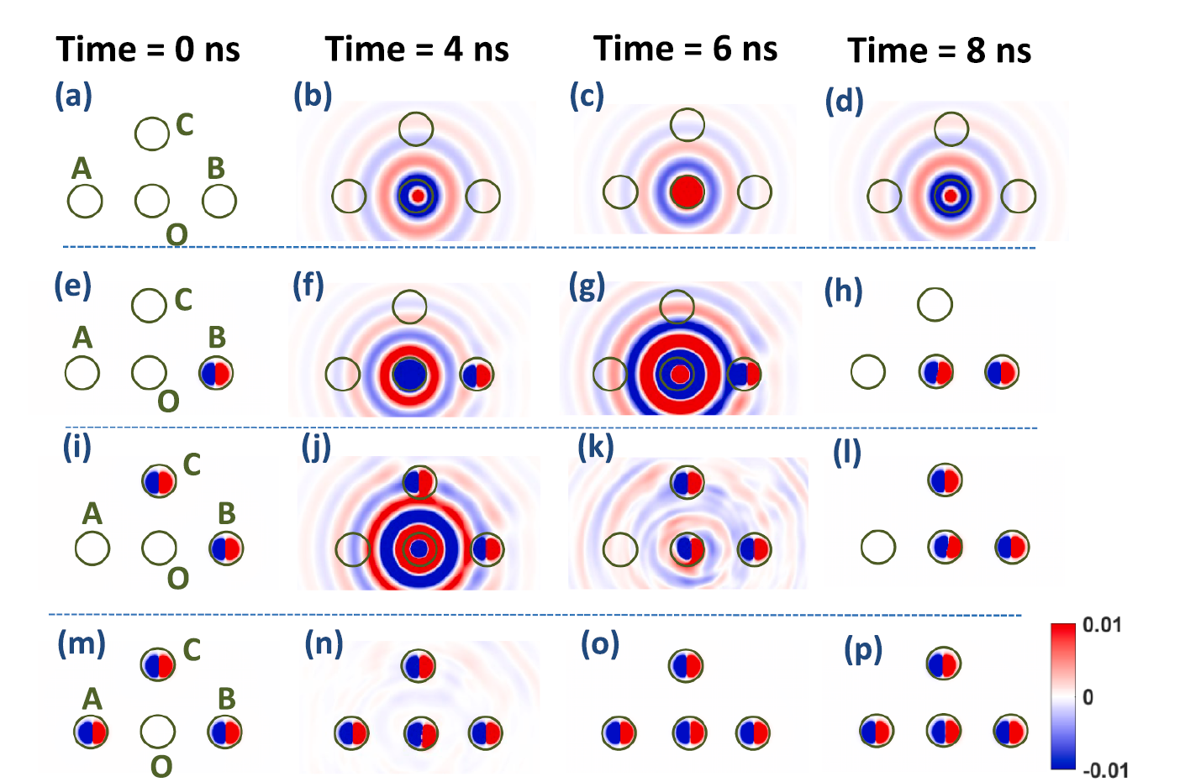
Features of Skyrmions and Spin Waves (SWs) using Skyrmion Arrangement
Skyrmions at certain distances can amplify or attenuate the SWs from STNO
Skyrmions can be created by SWs
Skyrmions are treated as rigid particles
Skyrmions are measured by measuring magnetoresistance
V. P. K. Miriyala, Z. Zhu, G. Liang and X. Fong, "Spin-wave mediated interactions for majority computation using Skyrmions," Journal of Magnetism and Magnetic Materials, vol. 486, 2019.
Background
Methodology
Results
Conclusion
Notes:
Previous a paper about using spin-wave interactions might help here
A little introduction about the context of skyrmion and spin-wave mediated interaction.

Slide 9
Possible Approaches using Skyrmion and SWs
Advantages of SW approach
Not ‘displacement’ dependent
Reduces limitation on size constraints
Higher Resolution Weights
Wave interference is the medium for integration rather than displacement or number of skyrmions
Dependent on skyrmion arrangements rather than completely dependent on the number of skyrmions
Mapping to IF Model to Skyrmion Arrangement
1. Integration: Interference between spin-waves at the STNO region
2. Thresholding for Firing: Does a skyrmion nucleate or not in the STNO region after 7ns
3. Synaptic Weights:
1) What are the different forms of skyrmion arrangement?
2) How can one develop a spin wave-mediated spiking neuron?
3) How can one develop a spin-wave mediated spiking neural network?
Background
Methodology
Results
Conclusion
Notes:
Create amplification skyrmions to mimic excitatory reinforcement and attenuation skyrmions to mimic inhibitory reinforcement
Similar to Huang et al. Create Skyrmions in the STNO upon firing but annihilate % of skyrmions depending – adaptive learning
Temporal based – Weights can be attributed to timescale– ask Thao
Make decision tree explaining for next week
Temporal Based approach interesting

Slide 10
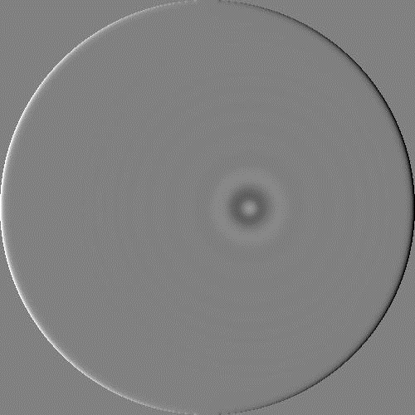

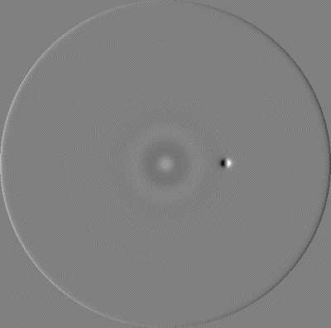
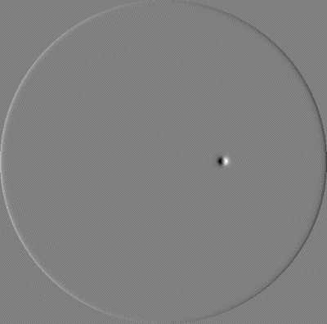
Motivation for Experiments
What are the different forms of skyrmion arrangement?
How can one develop a spin wave-mediated spiking neuron?
How can one develop a spin-wave mediated spiking neural network?
Investigating skyrmion arrangement and spin-wave phenomenon
Develop spin-wave mediated spiking neuron using ring configuration
Develop spin-wave mediated spiking neural network using individual spiking neurons
Experiments
Region 1
Region 2
Results
Region 3
Region 4
Objective
How can spin-wave mediated skyrmionics overcome the limitations faced by current skyrmionics synaptic devices?
Background
Methodology
Results
Conclusion
Notes:
From mapping each of these questions, I developed the line of investigation for my experiments.
First experiment explores skyrmion-spin wave phenomenon,
the second experiment builds on experiment 1 to develop a spiking neuron using skyrmion mediated spin-wave phenomenon found in experiment 1.
And the final experiment builds on experiment 2 in constructing an example of a possible network of spiking neurons

Slide 11
CA2 Proposed Experiments (Old)
Skyrmion arrangement requirements
i) Create amplification and attenuation SWs using skyrmions
ii) Can the interfering SWs be controlled? If so to what degree and how can it be done?
b) Multiple Skyrmion in STNO Region
Creates skyrmions in the STNO region via SW, and after firing annihilate a % of skyrmions
Is this a viable alternative for adaptive learning?
c) Temporal based using STDP
Use skyrmion arrangement/current pulse width to change/store weight based on timing of input spikes
Could be used as an a proof of concept to integrate multiple inputs?
Develop spin-wave mediated spiking neuron using ring configuration
Develop spin-wave mediated spiking neural network using individual spiking neurons
Background
Methodology
Results
Conclusion
Notes:
Highlight that there was a shift of focus from my previous experiments in CA2.
I will not going over these results but I want to provide a rationale for the changes for experiment 2 and experiment 3.
While testing experiment 2, the results me realise that having multiple skyrmions nucleate in such a small area meant that they would interfere with each other.
Of course I could increase the size of STNO region to accommodate for this but then I would be constrained by size. I then found a finding that I had in experiment 1 more interesting and more promising and that was using the phenomon of the ring configuration I will discuss later.
For experiment 3 which was integrating STDP, I managed to integrate STDP into the design of a single neuron. That is to say incorporate STDP into the design of the new experiment 2, because it turned it made sense to use STDP as I will show later on.

Slide 12
Methodology
Tools
Mumax3 – Lack in documentation
OOMMF – More documentation
Ubermag – Python based
Mumax3 – Return since can run on cluster and more adept
MATLAB (Analysis)
Brian 2 – neural simulator (Analysis)
Steps
Developed testbed device in Mumax3
Currently conducted experiments in Mumax3
Background
Methodology
Results
Conclusion
Notes:
So with the three experiments in mind,
Study of skyrmio-spin wave phenomon, building neuron device, then building neural network, I will go into discussing the methodology
Used various micromagnetic tools, and ended up settling on Mumax3 which I became adept at using towards
I used MATLAB to analyse the data.
I also employed Brian 2 neural simulator as a means to simulate my hardware device in software. The reason being I wanted to demonstrate training, or the neuron behaviour of my device
However because of limitations of the software as well as the field still being in its infancy when it comes to training SNNs I wouldn’t be permitted to do so unless I took a serious undertaking of contributing to the library

Slide 13
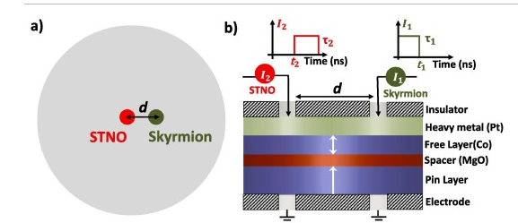
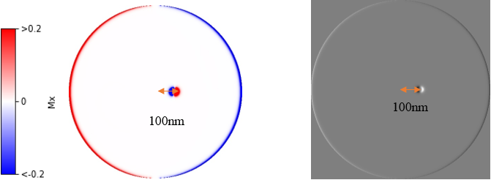
Testbed Device Setup
V. P. K. Miriyala, Z. Zhu, G. Liang and X. Fong, "Spin-wave mediated interactions for majority computation using Skyrmions," Journal of Magnetism and Magnetic Materials, vol. 486, 2019.
1um diameter disk
40nm diameter STNO region
Skyrmions nucleated at different distances from STNO region
Background
Methodology
Results
Conclusion
Notes:
I want to introduce the experimental testbed which is the testbed used in experiment 1 and 2. Experiment 3 is an extension of this testbed as I will discuss later.
So the testbed is the same as outlined in previous experiments. It comprises of …

Slide 14
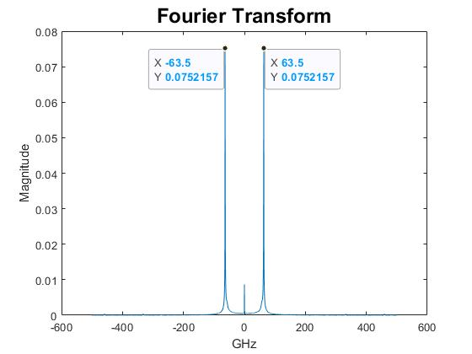
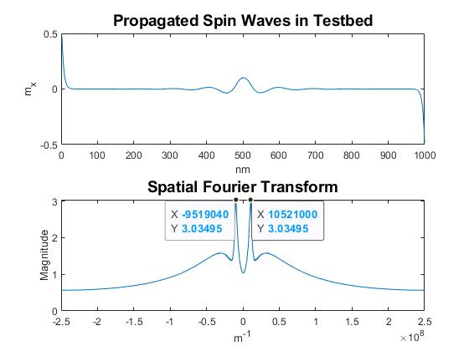
Testbed Verification: FFT and Spatial FFT
63.5 GHz spin wave, and 100.5nm spin wave wavelength which is approximate to the 63GHz and 100nm results recorded in previous experiments.
Therefore my experimental testbed should replicate the same spin-wave interference phenomenon according to previous experiments
Background
Methodology
Results
Conclusion
Notes:
The importance of establishing the testbed is to ensure we obtain the same results as in previous experiments.
To calibrate the testbed I performed FFT and spatial FFT and yielded approximate results to that in previous literature
Therefore, my experiment should replicate the same spin-wave interference phenomenon in previous experiments

Slide 15
Experiments Overview
Experiment #1
Experiment #2
Experiment #3
What are the different forms of skyrmion arrangement?
How can one develop a spin wave-mediated spiking neuron?
How can one develop a spin-wave mediated spiking neural network?
Investigating skyrmion arrangement and spin-wave phenomenon
Develop spin-wave mediated spiking neuron using ring configuration
Develop spin-wave mediated spiking neural network using individual spiking neurons
Region 1
Region 2
Region 3
Region 4
Objective
How can spin-wave mediated skyrmionics overcome the limitations faced by current skyrmionics synaptic devices?
Background
Methodology
Results
Conclusion
Notes:
With the testbed correct, I will now present my results. Before I do, I would like to recap on the three experiments.

Slide 16
Experiment 1: Skyrmion arrangement requirements
Investigate how skyrmion arrangements affect reflected spin waves
How to create amplification and attenuation skyrmions using spin waves?
Single Skyrmion
Rectified Single Skyrmion for 175nm
How can spin waves be controlled? And to what degree it can be done so?
Double Skyrmion
Ring Configuration
Current Density
Background
Methodology
Results
Conclusion
Notes:
Experiment 1 answers two questions
The first question sought to develop my understanding of the previous experiment, by create amplification and attenuation skyrmions and examining their trends
1. Here I focus on single skyrmions
2. As well as rectifying differences that I encountered with previous experiment
The second question extends existing work, where I examine the effect of different variables such as different skyrmion arrangements and changing the current density to examine the effect on spin waves.

Slide 17
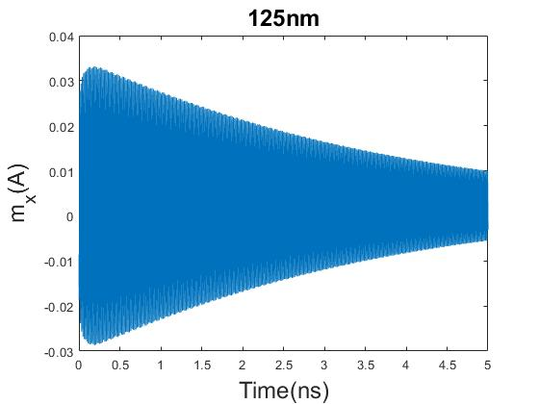
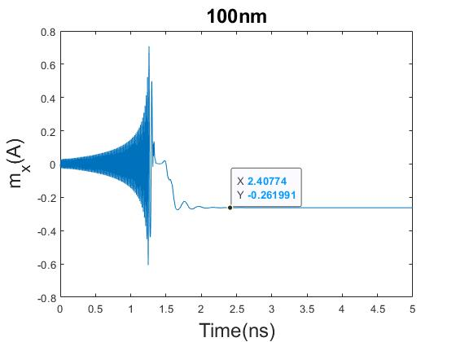
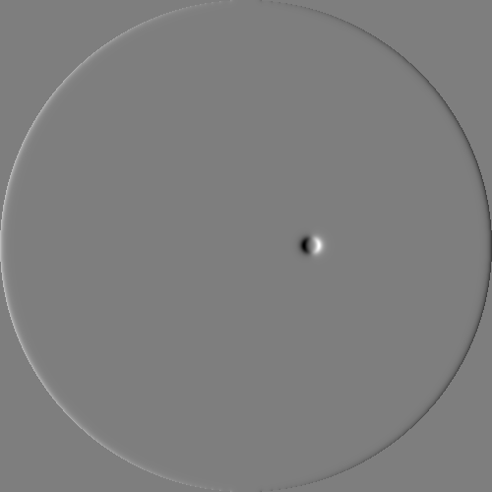
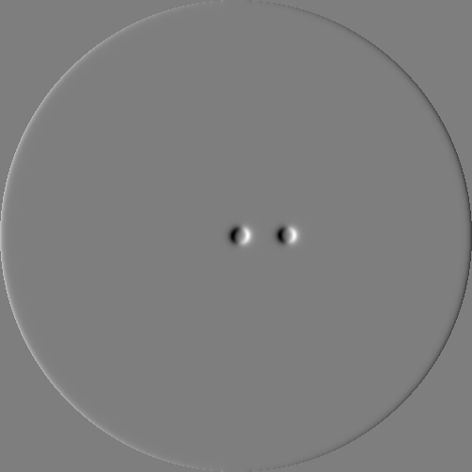
Experiment 1: Single Skyrmion Results Attenuation and Amplification
How to create amplification and attenuation skyrmions using spin waves?
Background
Methodology
Results
Conclusion
Notes:
I replicated attenuation and amplification skyrmions by placing a single skyrmion a distance from the STNO region.
When the attenuation is strong enough, skyrmions do not form in STNO region because the magnetization of the spin waves is not high enough to flip the precession
On the other hand, amplification enables the skyrmions to form in the STNO region
I measured the time taken for skyrmion nucleation to occur ~0.262

Slide 18
Experiment 1: Single Skyrmion Analysis
How to create amplification and attenuation skyrmions using spin waves?
Distance (nm) | Time(s)
100 | 2.4E-09
150 | 3.6E-08
200 | 4.0E-08
Distance (nm) | Time(s)
Control | 4.8E-08
125 | N/A
175 | 4.9E-08
Amplification and attenuation occur at standing wave intervals of 50nm
Further away single skyrmions are, the more reduced their effect
175nm created a skyrmion in the STNO region despite being attenuation?
Background
Methodology
Results
Conclusion
Notes:
Summarising the results for single skyrmions in a tabular format. I would like to draw your attention to three findings
The first is that amplification and attenuation occur at 50nm intervals. We can identify this tend by comparing the control spin wave with the other results. This finding is supported by standing wave theory and previous experiment
The second is that the further away single skyrmions are from the STNO region, the more reduced their effect is.
This can be seen by the tables on the right. In the table of amplification skyrmions time taken to nucleate an STNO skyrmion increases the further away the single skyrmion is placed.
The table below shows the attenuation skyrmions and we can seen an increase in timing and attenuation effect from 125nm to 175nm
The last finding I would like to highlight is the 175nm result which produced a skyrmion. Wherein previous experiments, no skyrmion was formed.

Slide 19
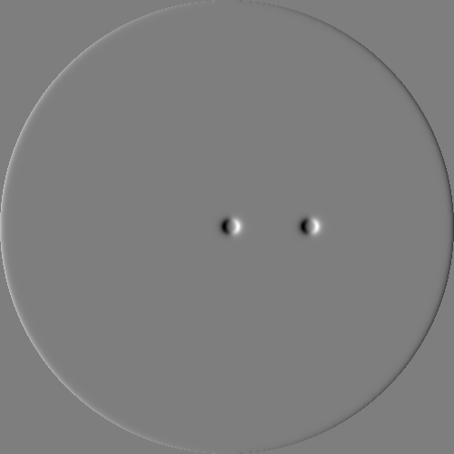
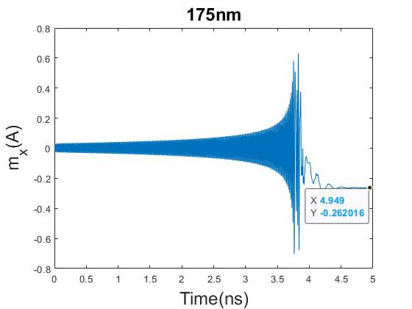
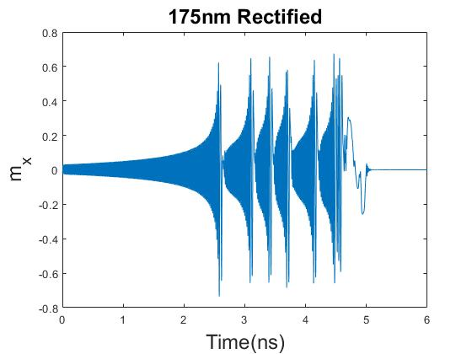
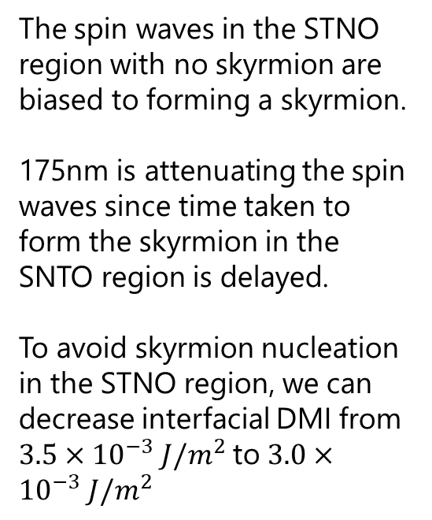
Experiment 1: Rectifying 175nm Results
The spin waves in the STNO region with no skyrmion are biased to forming a skyrmion.
175nm is attenuating the spin waves since time taken to form the skyrmion in the SNTO region is delayed.
To avoid skyrmion nucleation in the STNO region, we can decrease interfacial DMI from $3.5×{10}^{−3} J/m^{2}$to $3.0×{10}^{−3} J/m^{2}$
Background
Methodology
Results
Conclusion
Notes:
During my investigation of why my result contradicts previous experiments.
I realized that my device to nucleating a STNO skyrmion without 0 skyrmions placed. This finding indicates that my device is biased towards forming a skyrmion in the STNO region
I also realized that at 175nm the skyrmion was attenuating; except that the attenuation was not so strong as to stop skyrmion nucleation, rather it delayed nucleation
To obtain the same results as reported in previous literature so as to not produce an STNO skyrmion, I can rectify the 175nm result by changing the interfacial DMI or the antisymmetric exchange interaction with the material so as to reduce the sensitivity towards skyrmion nucleation. We can the results on the right here.

Slide 20
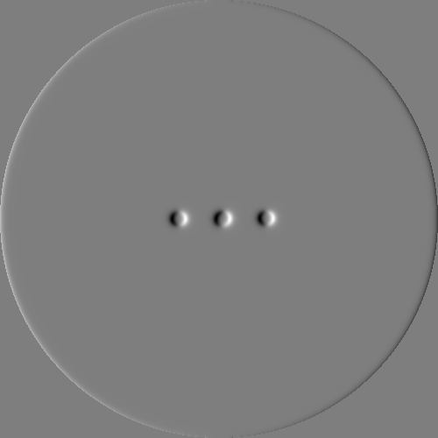
Experiment 1: Double Skyrmion Results
How can spin waves be controlled? And to what degree it can be done so?
When two directly opposing skyrmions are placed along the same plane (x-axis) at different distances to the STNO region
How do Double Skyrmions affect spin waves?
[100nm 100nm] Double Skyrmion Configuration
Background
Methodology
Results
Conclusion
Notes:
The next part of experiment 1 involved look at other factors including skyrmion arrangement and current density to see how they affect spin-wave mediate interaction
One of the arraignments I look is called Double Skyrmions. When I refer to double Skyrmions, I refer to a specific configuration not just two skyrmions.
Double Skyrion
So I to test double skyrmions I kept one skyrmion at the same distance for both amplification and attenuation cases and varied the distance of the opposing skyrmion

Slide 21
Experiment 1: Double Skyrmion Results
Skyrmion #1 (nm) | Skyrmion #2 (nm) | Wave | Skyrmion Creation | Localized Reduced Magnetization (unit length) | Time (s)
No Skyrmion | No Skyrmion | Control | Yes | -0.262 | 4.8e-08
100 | -100 | Amplification | Yes | -0.262 | 2.59E-9
100 | -125 | Amplification | Yes | -0.262 | 2.99E-9
100 | -150 | Amplification | Yes | -0.262 | 2.38E-9
100 | -175 | Amplification | Yes | -0.262 | 2.51E-9
100 | -200 | Amplification | Yes | -0.262 | 2.34E-9
125 | -125 | Attenuation | No | N/A | N/A
125 | -150 | Attenuation | No | N/A | N/A
125 | -175 | Attenuation | No | N/A | N/A
125 | -200 | Attenuation | No | N/A | N/A
When two directly opposing skyrmions are close in proximity, their overall amplification or attenuation effect is reduced.
Background
Methodology
Results
Conclusion
Notes:
Lets take a look at the results. I first want to draw your attention in the results with grey rows, which are the amplification double skyrmions We an observe that the time taken to nucleate a skyrmion is faster the further away the opposing skyrmion is from the other skyrmion.

Slide 22
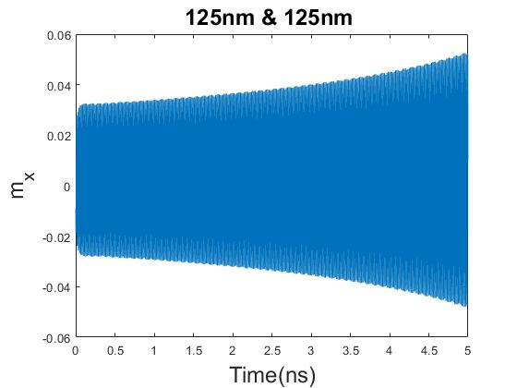
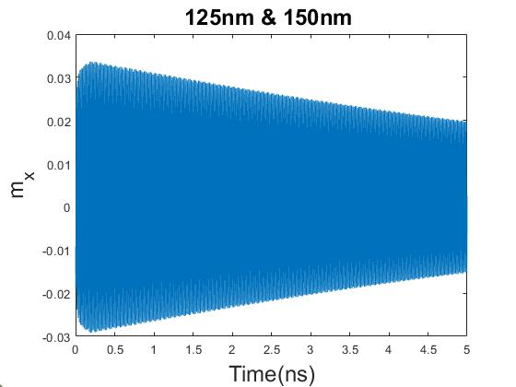
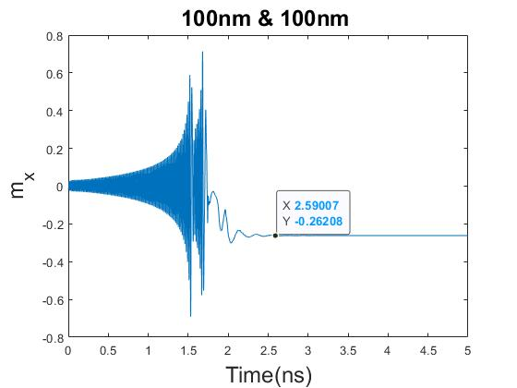
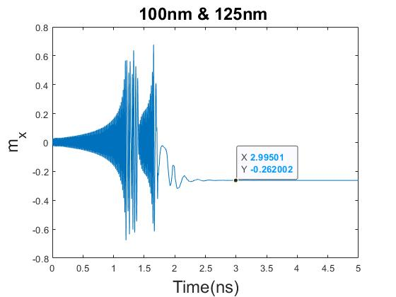
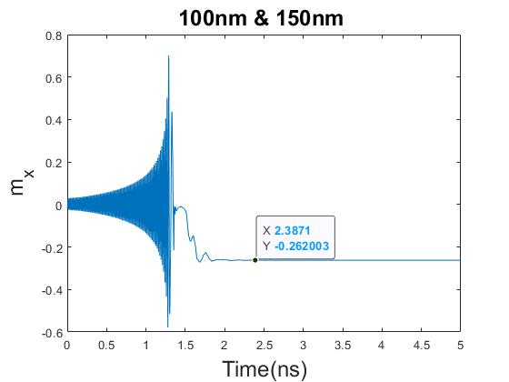
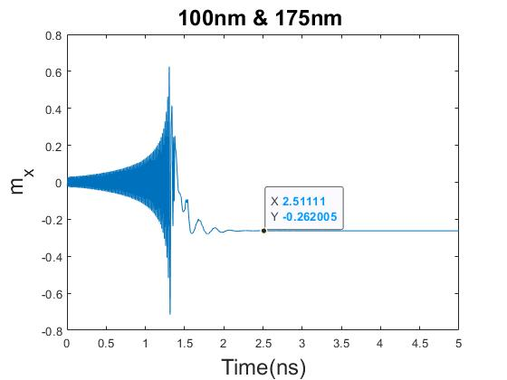
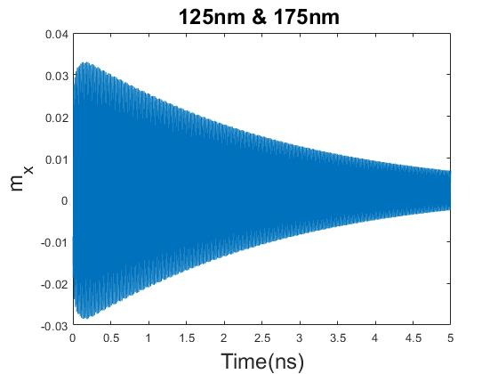
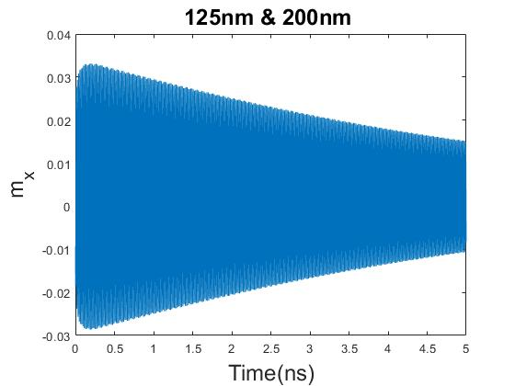

Experiment 1: Double Skyrmion Graphical Results
1. When two directly opposing skyrmions are close in proximity, their overall amplification or attenuation effect is reduced
2.Closest skyrmion determines the general interference pattern.
Background
Methodology
Results
Conclusion
Notes:
Graphically we observe the same trend. We can see in the attenuation graph that the attenuation gradient is greater at 125nm and 175nm than at 125 and 125nm. Therefore when two directly opposing skyrmions…
The second trend I would like to highlight is that the closest skyrmion determines the general interference pattern. We can see that for the attenuation results, all plots had low spin wave magnetization and therefore no skyrmion formed.
Likewise, in the 100nm results, application was observed
I found it surprising that when skyrmions are closest the effect is reduced since we had previously shown that in the single skyrmion case, that proximity corresponded to magnified effects.

Slide 23
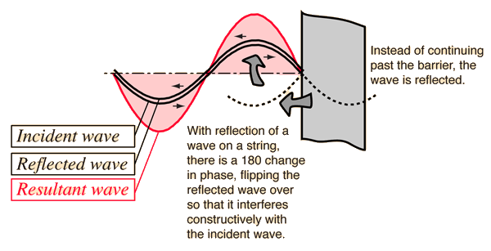
Experiment 1: Double Skyrmion Analysis
When two directly opposing skyrmions are close in proximity, their overall amplification or attenuation effect is reduced
One possible reason could be that it takes longer for the STNO region to stabilize because of more complex spin-wave interference patterns occurring in the STNO region. For example, distortions to the standing wave are likely to magnified such as phase difference when the skyrmions are close in proximity. However, these perturbations do not change the overall amplification or attenuation pattern.
Image Source: R,Nave. Hyperphysics
Background
Methodology
Results
Conclusion
Notes:
To explain this finding, I postulate that one possible reason is that the proximity of skyrmions amplifies spin waves, not just amplification and attenuation. What I mean by this is that the skyrmions although act as rigid barriers are not placed at precise locations so as to lead to complete attenuation or amplification. Therefore distortions such as phase difference may be amplified too. In the case of the single skyrmion, the phase difference was negligible, however, because of the multiple skyrmions are close to each other and reflecting each other’s spin waves, distortions such as the phase difference are amplified. When we extend the displacement of the second skyrmion, the effect of this distortion is reduced as well as the amplification and attenuation effect. However, the perturbations are not as large, so the overall amplification and attenuation is enhanced versus a single skyrmion case.This close proximity produces complex spin wave patterns that results show lead to interesting results.

Slide 24

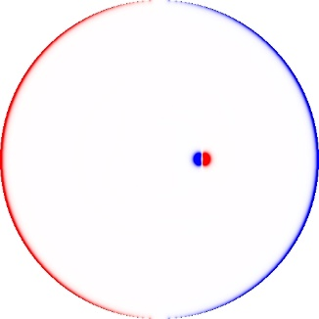
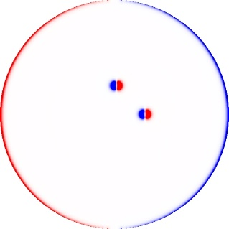
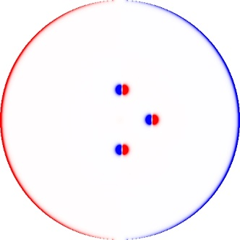
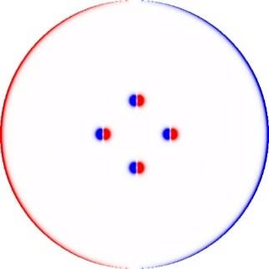
Experiment 1: Ring Configuration
How can spin waves be controlled? And to what degree it can be done so?
Ring cfon
Placing multiple skyrmions orthogonally in a ring around the STNO region.
How does Ring Configuration affect spin waves?
Background
Methodology
Results
Conclusion
Notes:
The next skyrmion arrangement I examined is the ring configuration.

Slide 25
Experiment 2: Ring Configuration Results
Configuration (nm) | Skyrmion Formation | Reduced magnetisation (unit length) | Time (s)
125 | No | - | -
125-125 | No | - | -
125-125-125 | No | - | -
125-125-125-125 | No | - | -
100 | Yes | -0.261991 | 2.40E-9
100-100 | Yes | -0.261995 | 2.02E-9
100-100-100 | Yes | -0.262263 | 1.99E-9
100-100-100-100 | Yes | -0.261847 | 2.28E-9
Up until three skyrmions, the time taken to nucleate skyrmion decreases.
Background
Methodology
Results
Conclusion
Notes:
We can observe the time taken for amplification skyrmions to nucleate is faster until three skyrmions. This suggests that the amplification effect is stronger until three skyrmions

Slide 26
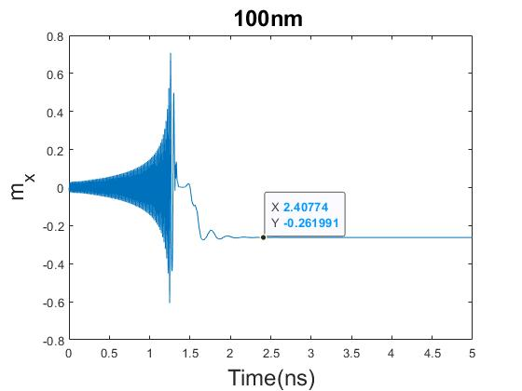
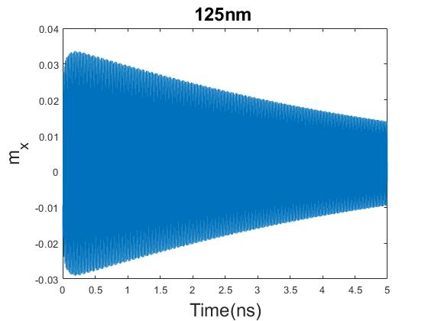
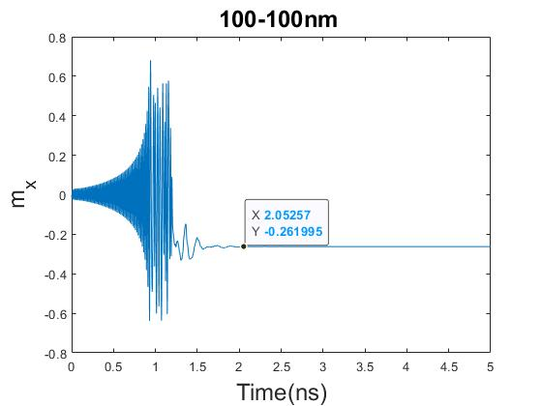
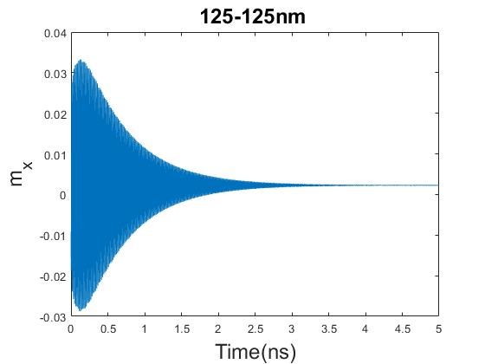
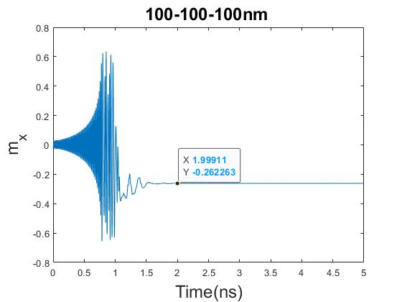
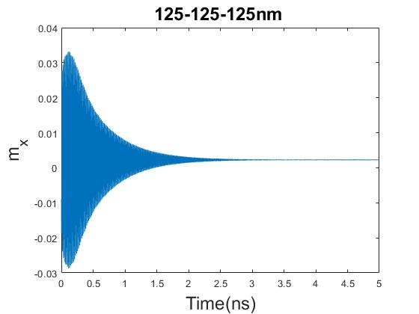
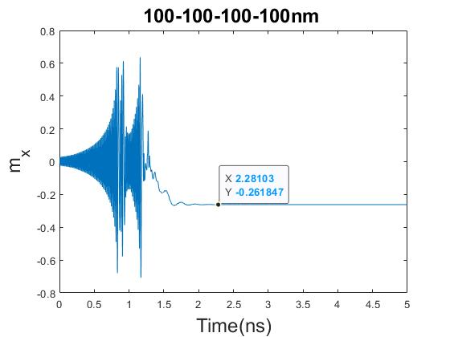
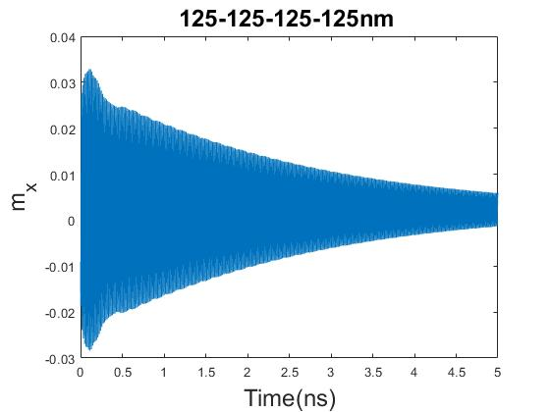
Experiment 2: Ring Configuration Graphical Results
Visually in the attenuation graphs the decreased attenuation effect of the four skyrmion ring configuration can be observed through the steepness of attenuation
The attenuation effect, just like the amplification effect, is magnified until the presence of three skyrmions
Possible reason why the four skyrmion ring has decreased effect could be addition of the directly opposing skyrmion which reduces the effectiveness of attenuation and amplification
Background
Methodology
Results
Conclusion
Notes:
We can see the same trend for attenuation as well

Slide 27
Experiment 1: Current Density
How can spin waves be controlled? And to what degree it can be done so?
STNO Region Current Density (Am⁻²) | Skyrmion Nucleation in the STNO region
-5.4985e10 | No
-5.4985e11 (Original) | Yes
-5.4985e12 | Yes
The injected spin current density must be above a certain threshold for skyrmions to form
Background
Methodology
Results
Conclusion

Slide 28
Experiment 1: Summary
Investigate how skyrmion arrangements affect reflected spin waves
Amplification and attenuation occur at standing wave intervals of 50nm
Further away single skyrmions are, the more reduced their effect
How to create amplification and attenuation skyrmions using spin waves?
Single Skyrmion
Rectified Single Skyrmion for 175nm
How can spin waves be controlled? And to what degree it can be done so?
Double Skyrmion
Ring Configuration
Current Density
1. Closest skyrmion determines the general interference pattern.
2. When two directly opposing skyrmions are close in proximity, their overall amplification or attenuation effect is reduced
3. The attenuation effect and amplification effect, is magnified until the presence of three skyrmions
4. Decreased effect when skyrmions are directly opposed
5. The injected spin current density must be above a certain threshold for skyrmions to form
Background
Methodology
Results
Conclusion

Slide 29
Experiment 2: Temporal based Spin Mediated Neuron Device
Choosing the ring configuration because of it not relying on displacement and movement of skyrmions as a method of skyrmion arrangement, we generate can generate a spiking neuron
Background
Methodology
Results
Conclusion

Slide 30
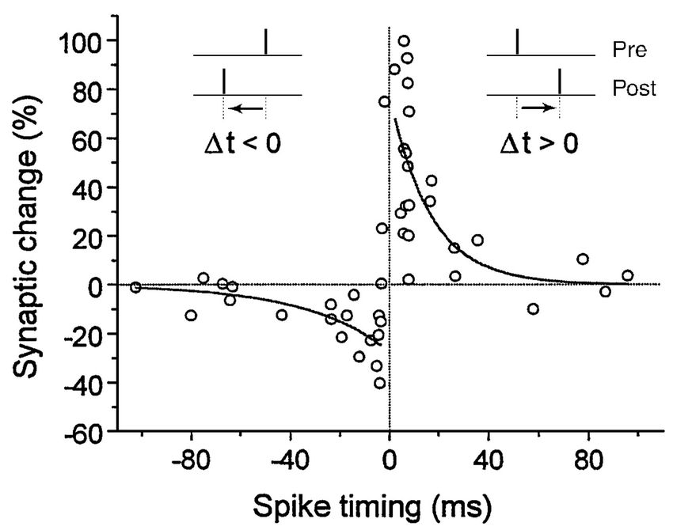
Experiment 2: Motivation for Spike-timing-dependent plasticity self-learning model (STDP)
From experiment #1 Ring Configuration :
3. The attenuation effect and amplification effect, is magnified until the presence of three skyrmions
Magnified effect is evidenced by faster timings for amplification and faster attenutation
Spike-timing-dependent plasticity self-learning model (STDP)
Biological process that adjusts synaptic strength between neurons in the brain relative to the timing of spikes
Spike timings can be mapped to synaptic weights, as well as discrete synaptic weights
M.M. Asl, A. Valizadeh, P.A. Tass. Propagation Delays Determine the Effects of Synaptic Plasticity on the Structure and Dynamics of Neuronal Networks. 2018
Background
Methodology
Results
Conclusion

Slide 31
Experiment 2: STDP State Allocation
Discretized Weight | Configuration (nm) | Time (s) | Reduced magnetisation (unit length)
A1 | 125 | - | -
A2 | 125-125 | - | -
A3 | 125-125-125 | - | -
P1 | 100 | 2.40E-9 | -0.261991
P2 | 100-100 | 2.02E-9 | -0.261995
P3 | 100-100-100 | 1.99E-9 | -0.262263
Assign discretized weight states to each of the ring configurations since each ring timing has a different amplification and attenuation effect on the timing of skyrmion nucleation
Mealy State machine : A3 ↔ A2 ↔ A1 ↔ P1 ↔ P2 ↔ P3
Background
Methodology
Results
Conclusion

Slide 33
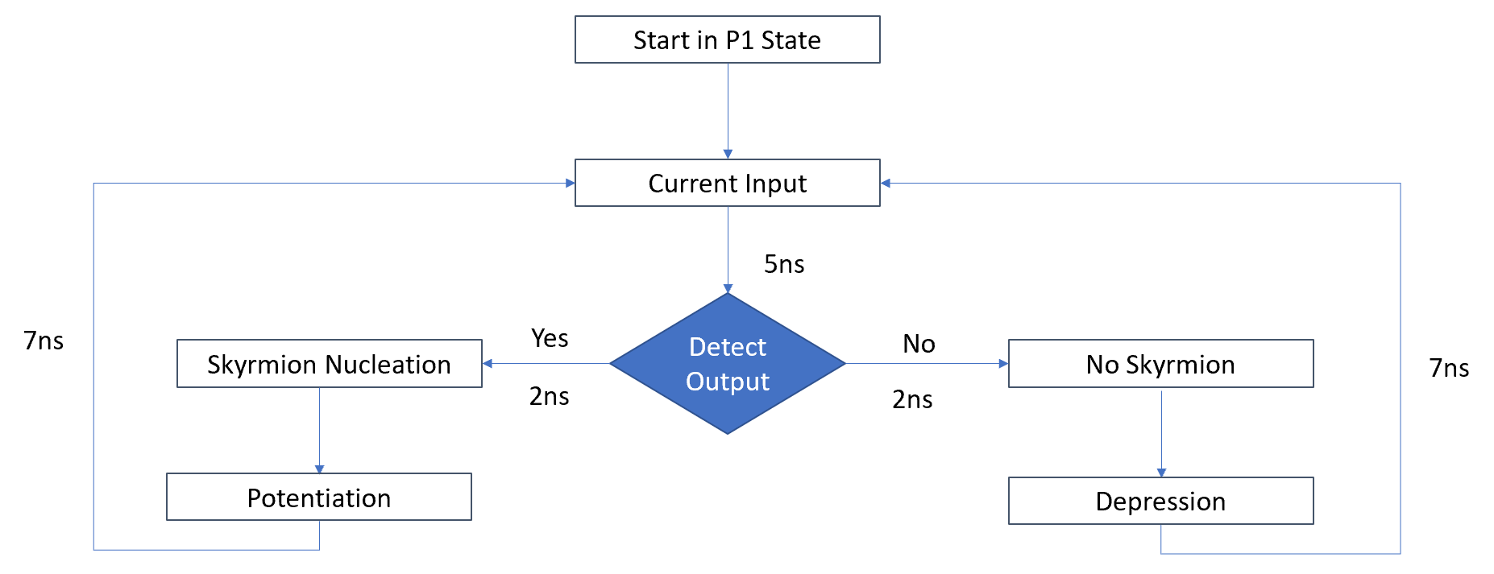
Experiment 2: Parameters for STDP Spiking Neuron
Total 14ns = Input (5ns)+ Detection (2ns) + Adjustment (7ns)
Refractory period (9ns) = Detection(2ns) + Adjustment (7ns)
Background
Methodology
Results
Conclusion

Slide 34
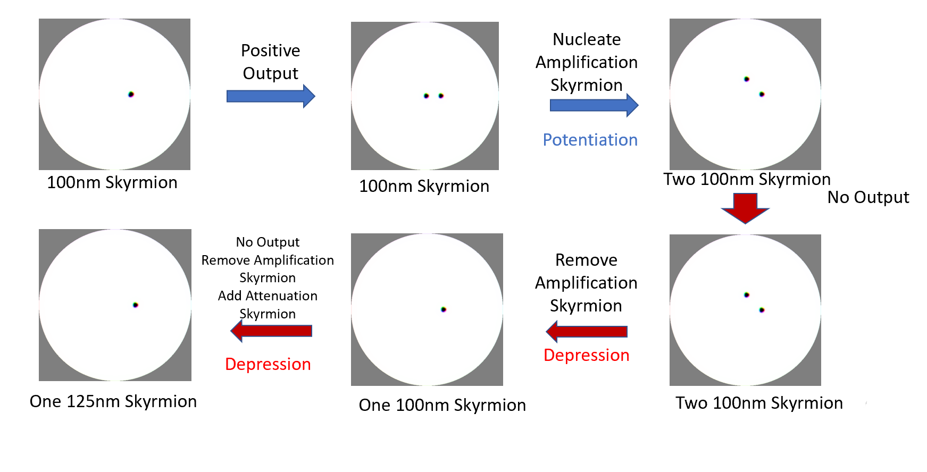
Experiment 2: Simulation
Background
Methodology
Results
Conclusion

Slide 35
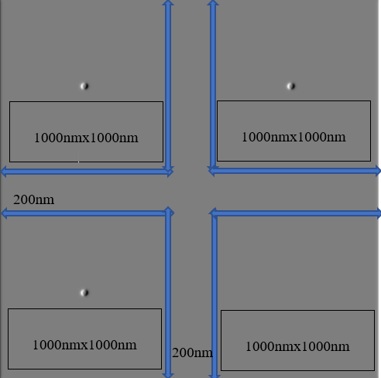
Experiment 3: SNN
Combining multiple spiking skyrmion neuron devices together into an array, we can obtain the following network device
Each single neuron device corresponds to one node in a spiking neural network. In this example, we represent at 4-4-1 network
Output calculated as sum of outputs (skyrmions in STNO region) after the 7ns detection cycle
Current Density
Spiking Neurons
Output
J1
W1
J2
W2
Logical Activation
Output
J3
W3
J4
W4
Device dimensions
Background
Methodology
Results
Conclusion

Slide 36
Experiment 3: Simulation
Excitatory
Region 1: Start Zero State → Potentiation P1 → Potentiation P2
Region 2: Start Zero State → Potentiation P1 → Potentiation P2
Excitatory/Inhibitory
Region 3: Start Zero State → Potentiation P1 → Depression A1
Inhibitory
Region 4: Start Zero State → Depression A1 → Depression A2
Output
[P2,P2, A1,A2] → input([P2,P2, A1,A2]) = 0000 to 1111
Region 1
Region 2
Region 3
Region 4
Background
Methodology
Results
Conclusion

Slide 37
Summary of Experiments
What are the different forms of skyrmion arrangement?
How can one develop a spin wave-mediated spiking neuron?
How can one develop a spin-wave mediated spiking neural network?
Investigating skyrmion arrangement and spin-wave phenomenon
Develop spin-wave mediated spiking neuron using ring configuration
Develop spin-wave mediated spiking neural network using individual spiking neurons
Experiments
Region 1
Region 2
Results
Region 3
Region 4
Objective
How can spin-wave mediated skyrmionics overcome the limitations faced by current skyrmionics synaptic devices?
Background
Methodology
Results
Conclusion

Slide 38
Conclusion
Current artificial synaptic devices that use displacement are limited by device size
Current artificial synaptic devices that store weights are limited by the number of the skyrmions
The resolution of firing is often not analogue, but dependent on the number of skyrmions
Considerations
How can spin-wave mediated skyrmionics overcome the limitations faced by current skyrmionics synaptic devices?
Objective
Using the arrangement of skyrmions to mediate the interfering waves offers promise in developing a spin-wave mediated spiking neuron which can overcome limitations of size and dependencies on the number of skyrmions
Introducing Spin-wave mediated Skyrmionics for Spiking Neurons
Proposal
Investigating skyrmion arrangement and spin-wave phenomenon
Develop spin-wave mediated spiking neuron using ring configuration
Develop spin-wave mediated spiking neural network using individual spiking neurons
Results
Background
Methodology
Results
Conclusion

Slide 39
Future Works
Verify results using BRIAN2 neural simulator
BRIAN2 unable to simulate below ms threshold
BRIAN2 unable to be used for learning (working on updating the library)
Further explore the complex interference phenomenon of Double Skyrmion
Explore different neural network architectures in hardware
Optimize the proposed implementation as well as investigate different fundamentally different methods of using spin waves as synaptic neurons
Background
Methodology
Results
Conclusion
Notes:
No definitive, efficient way to use SNN for learning – our understanding of how the brain learns is still developing

Slide 40
Thank you for your time. Q&A

Slide 41
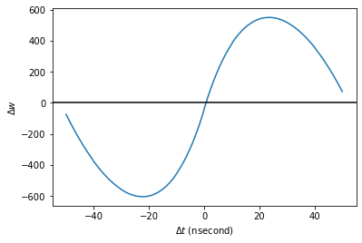
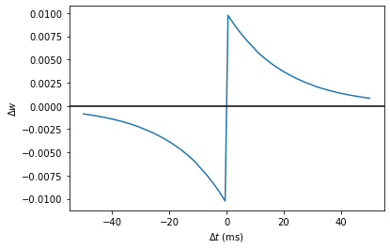
Appendix A. BRIAN 2
BRIAN 2 unable to simulate at nanosecond level
Timing function TBD in Brian2, but the proof of concept holds
Training/Learning integration code for BRIAN2 with pytorch not existent

