Slide 1
Governance
Governance is "the process of decision-making and the process by which decisions are implemented (or not implemented)". The term governance can apply to corporate, international, national, local governance or to the interactions between other sectors of society.

Slide 2
E-governance
Electronic governance or e-governance is the application of ICT for delivering government services, exchange of information communication transactions, integration of various stand-alone systems and services between
government-to-customer (G2C),
government-to-business (G2B),
government-to-government (G2G) as well as
back office processes and interactions within the entire government framework.

Slide 3
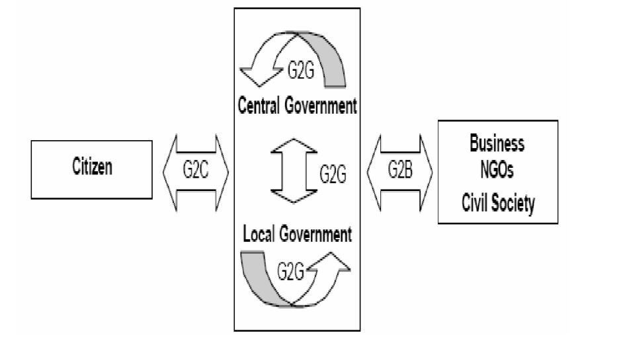
E-governance contd..
E –Governance is form of e-business in governance comprising of processes and structures involved in deliverance of electronic services to the citizens.
It also involves collaborating with business partners of the government by conducting electronic transactions with them.

Slide 4
E-governance contd..
E-Governance implies e-democracy, where in all forms of interaction between the electorate and the elected are performed electronically using IT tools as:
E-mail
Internet websites publishing
SMS connectivity
Internet development and uses
Promotion of citizen access.

Slide 5
Why e-governance?
To bridge the gap between government and citizens.
To provide productivity and to extend other benefits to its citizens.
To enhance participation of people on choice and provision of governance products and services.
To bring new sections of society under the governance sphere.

Slide 6
Citizen needs for e-Governance
Greater government accountability
Easy to access information
Convenient services
Quick response to requests
Fast delivery of services
Data security and confidentiality
Citizen centric government

Slide 7
Government’s goals through e-Governance
Becoming more proactive
Increase internal efficiency and service levels to constituents
Greater transparency
More service oriented
Reduced operating expenses
Change citizens view of their governments as bloated, wasteful, and unresponsive to their most pressing needs
Developing new sources of growth and a way to reduce vulnerability
Better public services and quality of life
Electronic communication between government agencies
Citizens can conduct important/frequent/complex -administrative procedures with government agencies electronically

Slide 8
Advantage of e-governance
It greatly simplifies the process of information accumulation for citizens and businesses.
It empowers people to gather information regarding any department of government and get involved in the process of decision making.
Introduction of e-governance brings governments closer to citizens.
Successful implementation of e-governance practices offer better delivery of services to citizens, improves interactions with business and industry, citizens empowerment through access to information , better management , greater convenience, Revenue growth and cost reduction etc.
E governance leads to automation of services.

Slide 9
E-government
e-Government is a narrower discipline dealing with the development of online government services to the citizen and businesses such as e-tax, e transportation, e-procurement, e-participation amongst others
E-government will not be successful just only buying more computers and putting up websites and automate administrative practices from the paper system to digital system
Rather, e-government is a process of transforming government; it requires planning, political will and a sustained dedication of resources.
Success of e-government will not be guaranteed with the mere purchase of advanced technology or the direct automation of complex procedures until it can increase the rate of citizen participation there by bringing about the greater effectiveness in government.
Technology introduction can not change the mentality of bureaucrats who do not view the citizen as valued customer of government or an important participant in decision making.

Slide 10
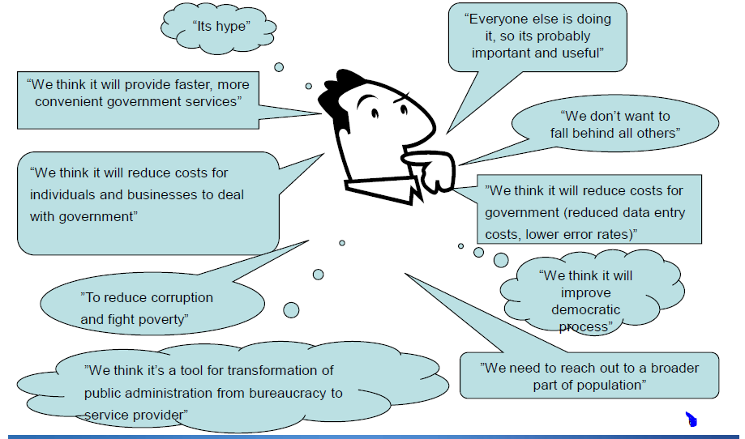
Why E-government

Slide 11
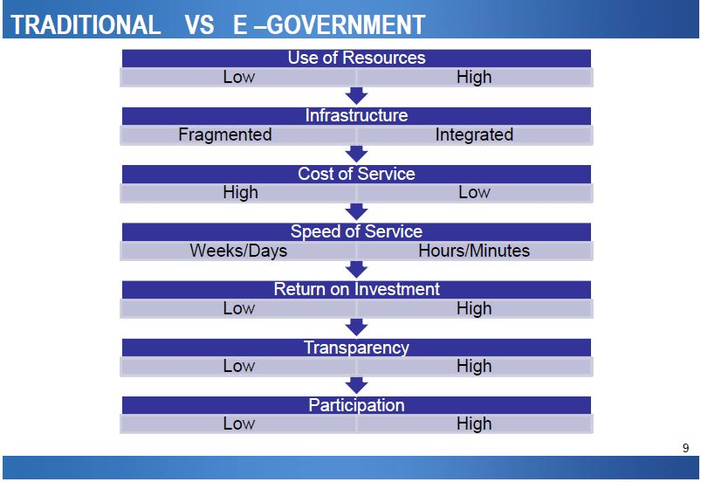

Slide 12
Strategic Objectives of e-Governance
The strategic objective of e-governance is to support and simplify governance for all parties - government, citizens, businesses and its employees.
The use of ICTs can connect all three parties and support processes and activities.

Slide 13
Major objectives of e-governance
1. Service to the Public:
This objective of e-governance is to satisfactorily fulfill the public’s needs and expectations on the front-office side, by simplifying their interaction with various online services. The use of ICTs in government operations facilitates speedy, transparent, accountable, efficient and effective interaction with the public, citizens, business and other agencies.

Slide 14
Major objectives of e-governance contd..
2. Efficient Government:
In the back-office, the objective of e-government in government operations is to facilitate a speedy, transparent, accountable, efficient and effective process for performing government administration activities. Significant cost savings (per transaction) in government operations can be the result.

Slide 15
Major objectives of e-governance contd..
3. Good Governance:
As e-governance is transparent, there is less chance of corruption at all level. It provides the service to the people in very easy manner and with less cost which makes the governance good governance.

Slide 16
Issues in the implementation of e-governance
Ready for transformation
Awareness and education
Issue of security
Privacy
Expose of public ICTs infrastructure to crime
Digital divide

Slide 17
Digital divide
The term Digital divide describes a gap between those who have ready access to information and communication technology and the skills to make use of those technology and those who do not have the access or skills to use those same technologies within a geographic area, society or community. It is an economic and social inequality between groups of persons.

Slide 18
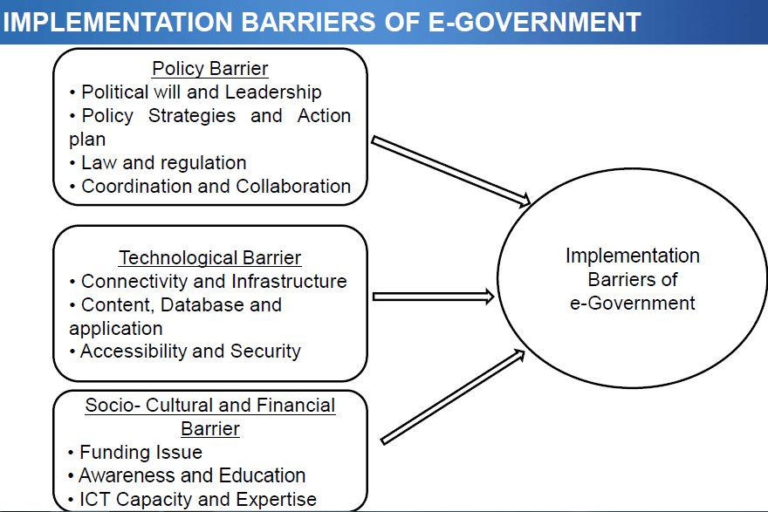

Slide 19
Conceptualization of the digital divide
Subjects who have connectivity, or who connects: individuals, organizations, enterprises, schools, hospitals, countries, etc.
Characteristics of connectivity, or which attributes: demographic and socio-economic variables, such as income, education, age, geographic location, etc.
Means of connectivity, or connectivity to what: fixed or mobile, Internet or telephony, digital TV, etc.
Intensity of connectivity, or how sophisticated the usage: mere access, retrieval, interactivity, innovative contributions.
Purpose of connectivity, or why individuals and their cohorts are (not) connecting: reasons individuals are and are not online and uses of the Internet and information and communications technologies ("ICTs").

Slide 20
Assignment 1 :
Prepare a report on the basis of following terms: E-governance, its evolution, need and scope, challenge, issue in the implementation of E governance and present trend of e-governance in Nepal.
Reference: see the paper by Tek Nath Dhakal, a professor of public administration in Nepal.

