Slide 1
Website Mockup

Slide 2



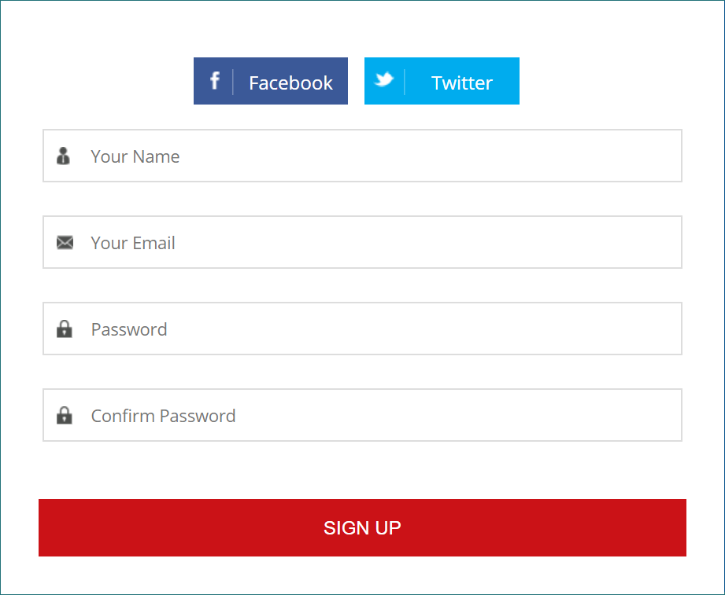
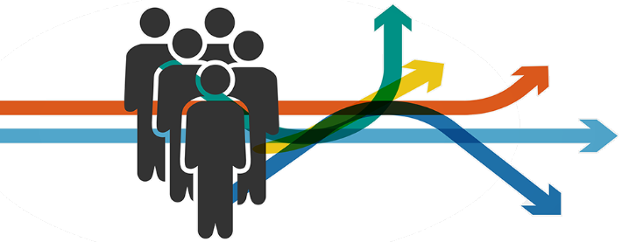


Start Page
Company login
LOGIN
FHNW
LinkedIn
“Our mission is to support you in your future, your individual path and your growth within this world”

Slide 3


User Page
Find a Job
Semantic
Opportunities
Skill
Feedback
Connections
Find a job
Opportunities
Skill Profile
Lets get to work!
Try to gain this skills to be more attractive on the market
Take a look at your skill profile and your strengths.
University:
FHNW
Study Program:
Business Information System
XP:
400P
Status:
In a internship
Feedback
Take a semantic test
Further connection
Take a look at the feedback you got form the companies
In order to better match your soft skills you can take this test
Connect to LinkedIn, Facebook, Stackoverflow, Coursera, edx, Udemy…

Slide 4

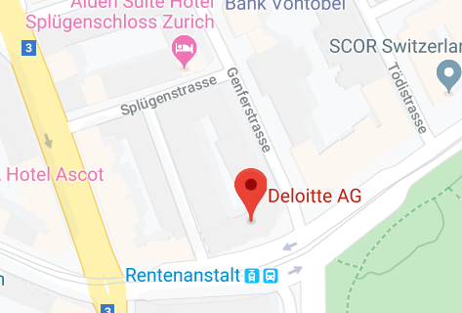
Matching Page
Find a Job
Semantic
Opportunities
Skill
Feedback
Connections
Business Analyst
APPLY NOW
NEXT!
Overview
Skilled Business Analyst assist with the implementation and support of business information systems across multiple departments. They ...
Matching Rate
83%
You match because of:
Communication
Ability to Work Under Pressure
Decision Making
Time Management
Self-motivation
Conflict Resolution
Leadership
Adaptability
Skills
Communication.
Ability to Work Under Pressure.
Decision Making
…

Slide 5
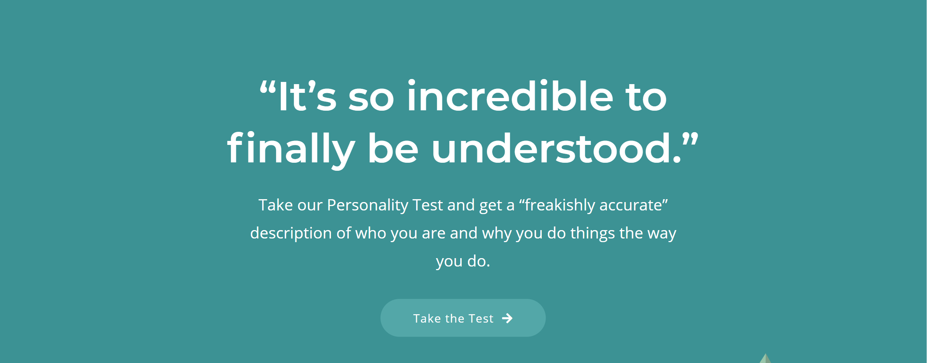
Semantic Page
Find a Job
Semantic
Opportunities
Skill
Feedback
Connections
Notes:
Via a sentiment analysis your CV, Social Media Profiles, Job Ratings and Modul Descriptions will be analyzed and present you a transparent dashboard of your strengths, weaknesses, skills, recommended branches and companies. These recommendations are based on a comparison between your personal traits, your strengths and skills with the companies values and culture as well as the requirements for the open position.

Slide 6





Semantic Test
Find a Job
Semantic
Opportunities
Skill
Feedback
Connections
Drag & drop documents
Edit Profile
Basic Test (15’)
Go Pro (45’)
Edit your personal traits, skills and self-assessment manually, add personal preferences and your self-assessment
Online questionnaire with 16 questions for a basic personality profile
Take yourself the time and answer a detailed questionnaire for a precise profile of your personality
Top Matches based on your soft skills
94%
88%
84%
Upload your CV, references and ToR here and we will optimize your recommendations
Notes:
Via a sentiment analysis your CV, Social Media Profiles, Job Ratings and Modul Descriptions will be analyzed and present you a transparent dashboard of your strengths, weaknesses, skills, recommended branches and companies. These recommendations are based on a comparison between your personal traits, your strengths and skills with the companies values and culture as well as the requirements for the open position.

Slide 7
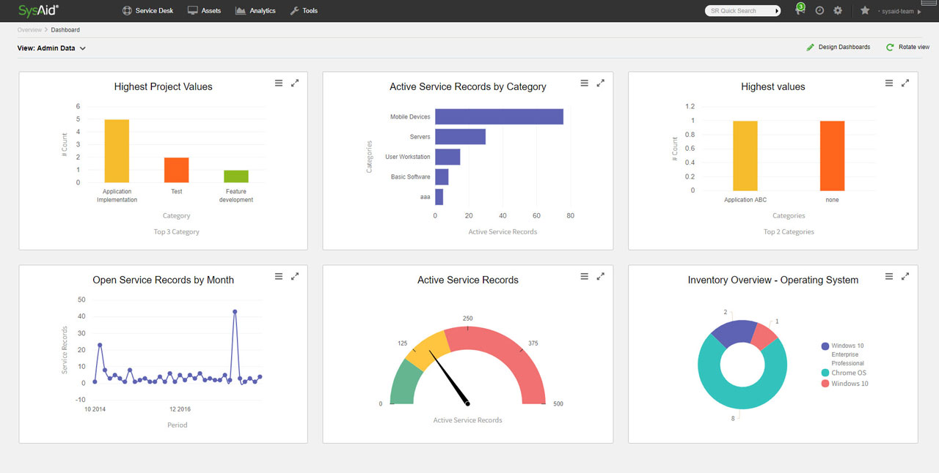

Your Profile
Find a Job
Semantic
Opportunities
Skill
Feedback
Connections
Strength
Top Skills
Top Branches
Edit your preferences
Add a not listed skill
Analytical Thinking
Time Management
Adaptability
Consulting
Controlling
Creativity
Analytical Thinking
Percent compared to others
Profile Visits
Market Value
Recommended Skills
IPMA
SCRUM
BPMN
Notes:
Via a sentiment analysis your CV, Social Media Profiles, Job Ratings and Modul Descriptions will be analyzed and present you a transparent dashboard of your strengths, weaknesses, skills, recommended branches and companies. These recommendations are based on a comparison between your personal traits, your strengths and skills with the companies values and culture as well as the requirements for the open position.

Slide 8
Your Profile
Find a Job
Semantic
Opportunities
Skill
Feedback
Connections
IPMA
SCRUM
BPMN
Implicit Search Data
Company size
Location
Salary
Large
Small
Far
Near
Large
Small
10k – 50k
30km
100k – 90k
Preferred Cities:
Zürich
Basel
Add more cities

Slide 9
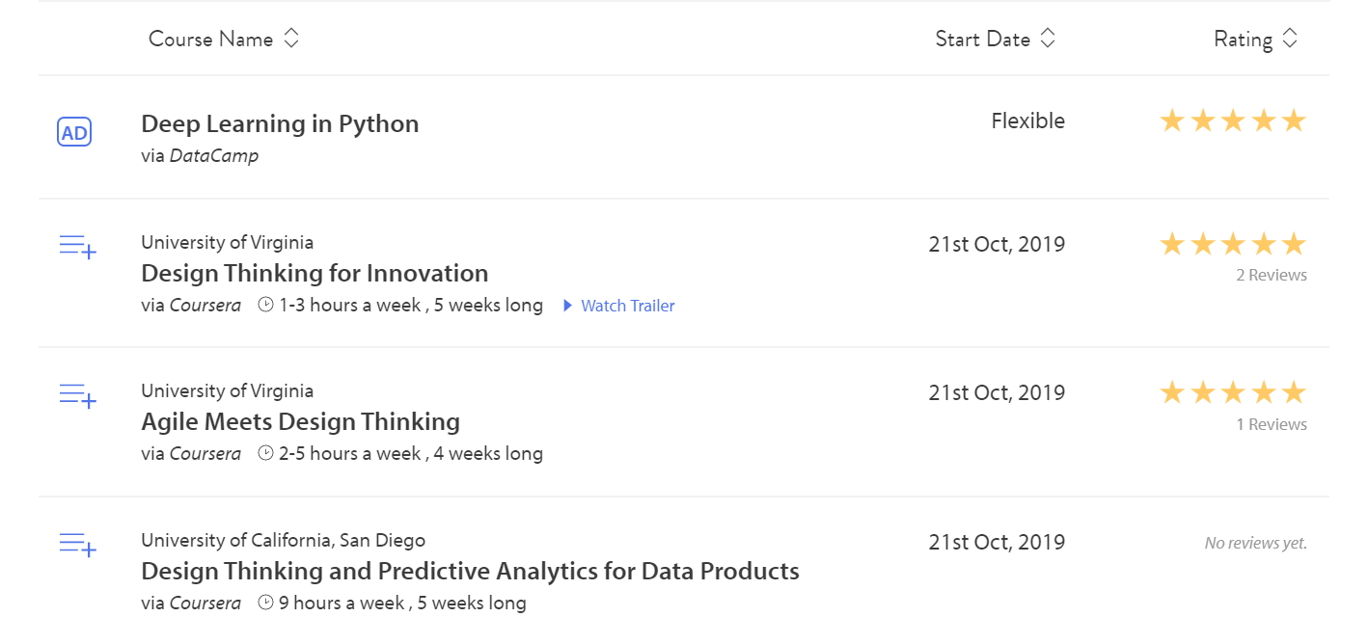
Skill Development Page
Find a Job
Semantic
Opportunities
Skill
Feedback
Connections
Just swipe and book

Slide 10
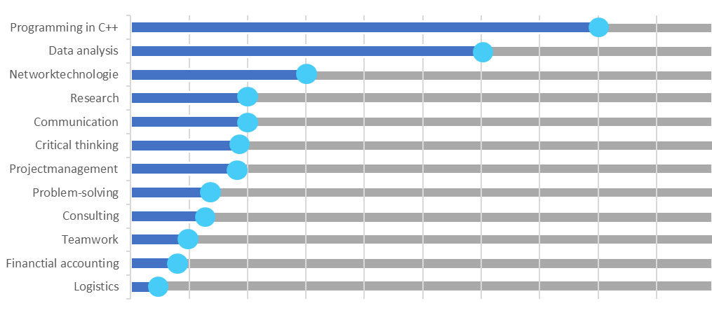

Skill Profile
Find a Job
Semantic
Opportunities
Skill
Feedback
Connections
Slide to adjust your skill
Add skill

Slide 11
Feedback Profile
Find a Job
Semantic
Opportunities
Skill
Feedback
Connections
BPMN 2.0 process analysis
☆☆☆☆
Dino is intelligent, hard-working, and dedicated to success. He will be a strong asset to any employer.
Simple ML model to predict gender & age using website traffic data
☆☆☆☆☆
I thoroughly enjoyed working with Dino, very honest hardworking and diligent. He picked up the task very fast and knew exactly how to execute it. He gave his own ideas to help improve the accuracy and worked more hours than i expected. I have already asked Dino to help me on my next project, looking forward!

Slide 12






Connections Page
Find a Job
Semantic
Opportunities
Skill
Feedback
Connections
Connected ✔
Connected ✔
Connected ✔
Connect now
Connect to other websites to confirm and import your skills

Slide 13
Company Login Page
Company login
LOGIN
Xing
LinkedIn
Company Name
Contact Persons Name
Website
Phone Number
“Our mission is to support you in your future, your individual path and your growth within this world”
Get in Contact

Slide 14


User Page
Job postings
Projects
Internships
Applicants
Upload
Post a Job
Post a Project
Post an internship
Post a full Job
Post a position in a project team for a limited time <3 months
Post an internship 6 to 12 months
Name:
PricewaterhouseCoopers International
Size:
50’000 – 100’000
Candidate profile
Model your preferred candidates profile

Slide 15
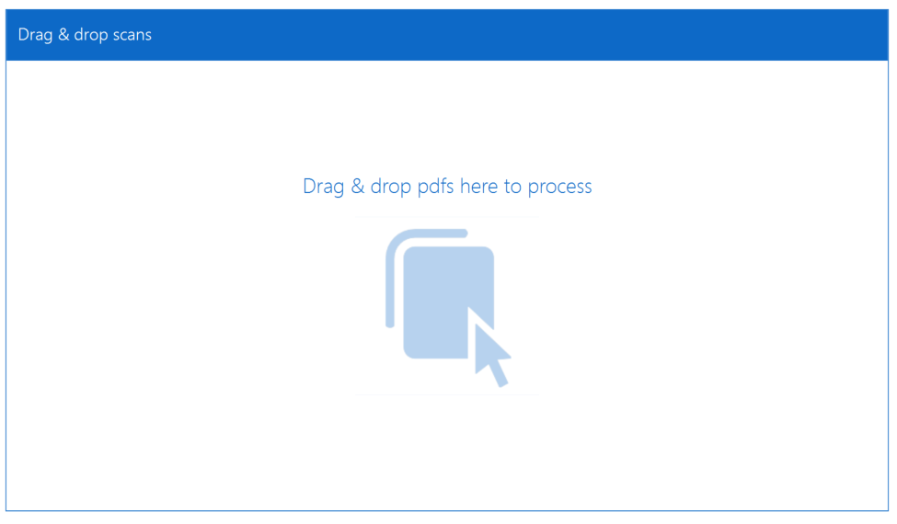
Job posting page
Upload a new job
Full Job
Projects
Internships
Upload your job description here and Sprout-Scout takes care of the rest

Slide 16
Matching Page
Job postings
Projects
Internships
Applicants
Upload
Strength
Add a strength
Top Skills
Field of study
Add a skill
Analytical Thinking
Time Management
Adaptability
Engineering
Management
Creativity
Analytical Thinking
Percent compared to others
Education
Salary-meter
Recommended Skills
PhD
Master
IPMA
Bachelor
SCRUM
BPMN
Higher education

Slide 17




Matching Page
Job postings
Projects
Internships
Applicants
Upload
☆☆☆☆☆
Oskar
Matching Rate 93%
He matches because of:
Communication
Ability to Work Under Pressure
Decision Making
Time Management
Self-motivation
….
☆☆☆☆☆
Laura
Matching Rate 86%
She matches because of:
Communication
Ability to Work Under Pressure
Decision Making
Time Management
Self-motivation
….
☆☆☆☆☆
Dino
Matching Rate 83%
He matches because of:
Communication
Ability to Work Under Pressure
Decision Making
Time Management
Self-motivation
….
☆☆☆☆☆
Ching-Chang
Matching Rate 86%
She matches because of:
Communication
Ability to Work Under Pressure
Decision Making
Time Management
Self-motivation
….
☆☆☆☆☆
Carla
Matching Rate 82%
She matches because of:
Communication
Ability to Work Under Pressure
Decision Making
Time Management
Self-motivation
….
Just swipe up to read more. Swipe left or right to see more

Slide 18
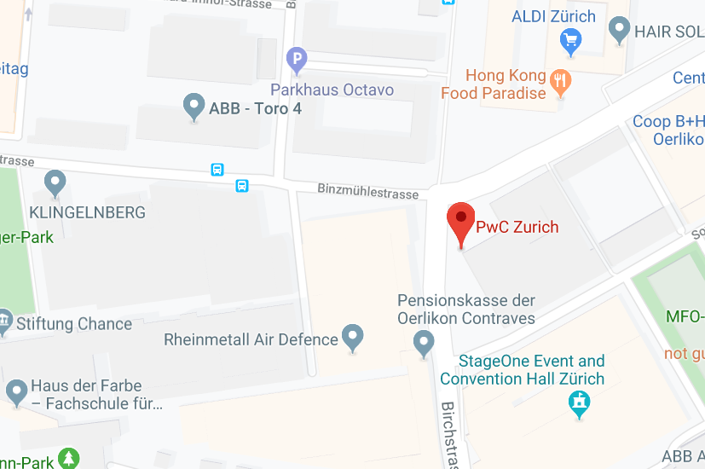
Matching Page
Job postings
Projects
Internships
Applicants
Upload
Business Analyst
CONTACT NOW!
Overview
Skilled Business Analyst assist with the implementation and support of business information systems across multiple departments. They ...
Matching Rate
93%
☆☆☆☆☆
He matches because of:
Communication
Ability to Work Under Pressure
Decision Making
Time Management
Self-motivation
Conflict Resolution
Leadership
Adaptability
Skills
Communication.
Ability to Work Under Pressure.
Decision Making
…

Slide 19
Thank you very much!

Slide 21
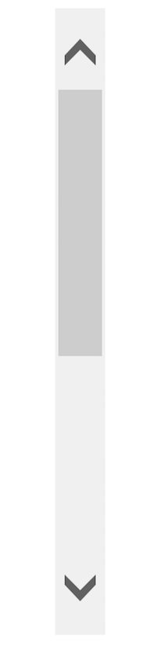
B
A

