Slide 1
Project Falcon: FY2026 Annual Programme Review
Secure field communications network · Programme Office · October 2026
Notes:
Welcome everyone. This review covers the full year: schedule, budget, technical progress, risks, and two decisions we need today.

Slide 2
Agenda
Executive summary
Programme overview
Schedule
Budget
Technical progress
Risks and issues
People and operations
Decisions and next steps
Appendix

Slide 3
Executive summary
78%
$44.8M
3 weeks
2
Overall completion against the baseline plan
Forecast at completion against a $45.0M budget
Schedule slip, driven by radio hardware delivery
Decisions needed from the Steering Committee today
Programme remains viable for Initial Operating Capability in Q2 FY2027 if the schedule recovery option is approved.
Notes:
Headline: we are mostly on track. The slip is three weeks and is concentrated in radio hardware. Budget forecast is just inside the envelope.

Slide 4
Programme overview
What Falcon delivers, who owns it, and how it is governed

Slide 5
Programme objectives
Secure voice and data
Resilient network
Encrypted voice and data between field units and command posts, rated for RESTRICTED traffic.
Mesh networking that keeps working when any single node or relay is lost.
Central management
Interoperability
One console to provision, monitor and update every radio and relay in the fleet.
Standards-based gateways to the two legacy radio systems still in service until FY2029.
Notes:
These four objectives come from the approved business case and have not changed since the last review.

Slide 6
Scope and deliverables
Deliverable | Owner | Due | Status
D1 Field radio (handheld and vehicle) | Engineering | Mar 2027 | Behind
D2 Mesh relay nodes | Engineering | Jan 2027 | On track
D3 Network core and gateways | Engineering | Dec 2026 | On track
D4 Encryption module (certified) | Security | Feb 2027 | In progress
D5 Management console | Software | Jan 2027 | On track
D6 Training package | Operations | Apr 2027 | On track
D7 Integrated logistics support | Procurement | May 2027 | Watch

Slide 7
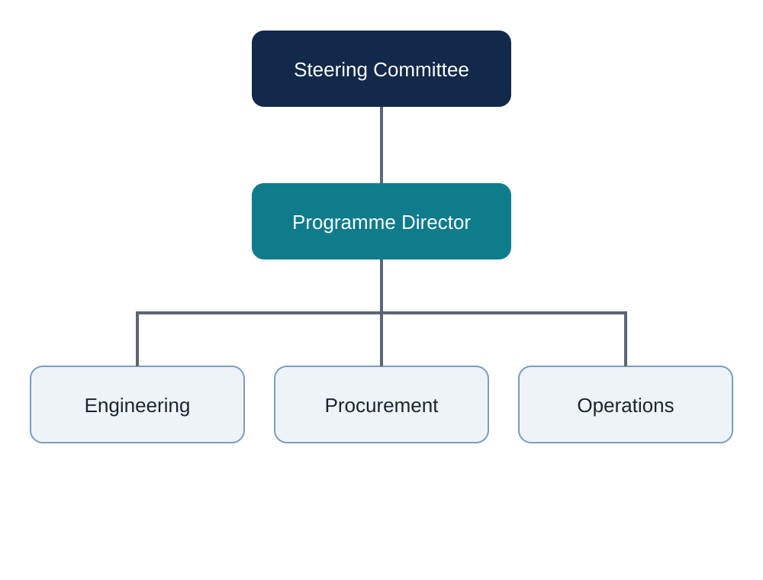
Governance structure
Steering Committee meets monthly; approves scope, budget and schedule changes above $250K.
Programme Director owns day-to-day delivery and the risk register.
Three workstreams report weekly: Engineering, Procurement, Operations.

Slide 8
Key stakeholders
Stakeholder | Interest | Engagement
Operational units (users) | Usability, reliability in the field | Monthly user panel
Security accreditation office | Certification of the encryption module | Fortnightly reviews
Finance | Budget control and forecast accuracy | Monthly report
Prime vendor | Delivery milestones, payment schedule | Weekly progress call
Logistics command | Spares, maintenance, support contracts | Quarterly workshop

Slide 9
Schedule
Milestones, variance and the critical path

Slide 10
Key milestones
Milestone | Baseline | Forecast | Status
Preliminary design review | Nov 2025 | Nov 2025 | Done
Critical design review | Feb 2026 | Feb 2026 | Done
First radio prototypes delivered | May 2026 | Jun 2026 | Done
Network core factory acceptance | Aug 2026 | Aug 2026 | Done
Integration test phase 1 | Sep 2026 | Oct 2026 | In progress
Radio production units delivered | Nov 2026 | Dec 2026 | At risk
Integration test phase 2 | Jan 2027 | Feb 2027 | Behind
Initial Operating Capability | Apr 2027 | May 2027 | Watch
Notes:
The milestones through factory acceptance are complete. The slip starts with production radio delivery and flows through to integration test phase 2.

Slide 11
Schedule variance by phase

Slide 12
Critical path
Radio production units drive the critical path: every week of delay moves integration phase 2 by one week
Integration phase 2 needs at least 40 production radios; the test bed cannot use prototypes
Encryption certification runs in parallel with 4 weeks of float
Console software has 6 weeks of float and is not on the critical path
Recovery options are on slide 39

Slide 13
Vendor delivery slip
The prime vendor's radio delivery has slipped four weeks because of a shortage of RF power amplifiers
The supplier has qualified a second amplifier source; first parts expected in mid-November
Contract allows liquidated damages after a six-week delay; we are not there yet
Weekly escalation calls are in place with the vendor's programme manager
Notes:
Note the vendor reports a four-week slip on radios, while our overall programme slip is three weeks because we re-sequenced some integration tests.

Slide 14
Budget
Spend to date, forecast and cost drivers

Slide 15
Budget overview
$45.0M
$31.2M
$13.6M
$1.1M
Approved budget (including 8% contingency)
Spent to date (69%)
Remaining commitments
Contingency used to date
Contingency use is within plan; the largest draw was the second amplifier source qualification ($0.4M).

Slide 16
Spend by quarter
Notes:
Actual spend tracks below plan mainly because radio production invoices are delayed along with the hardware.

Slide 17
Budget by workstream
Workstream | Budget ($M) | Spent ($M) | Forecast ($M) | Variance
Radios and relays | 18.5 | 12.9 | 19.2 | Over 0.7
Network core and gateways | 9.0 | 7.8 | 8.7 | Under 0.3
Encryption module | 5.5 | 3.6 | 5.6 | Over 0.1
Management console | 4.0 | 3.1 | 3.8 | Under 0.2
Training and support | 3.5 | 1.4 | 3.4 | Under 0.1
Programme management | 4.5 | 2.4 | 4.1 | Under 0.4
Total | 45.0 | 31.2 | 44.8 | Under 0.2

Slide 18
Cost drivers
RF amplifier shortage added $0.4M for second-source qualification
Extended test bed rental: about $60K per month of integration delay
Foreign exchange: 40% of hardware is priced in USD; a 5% move is worth about $0.5M
Savings in programme management from consolidating two vendor offices
Training costs fall if the e-learning modules replace one classroom phase

Slide 19
Forecast at completion
Notes:
Finance's latest forecast includes the full exchange-rate exposure and the extended test bed rental.

Slide 20
Technical progress
Subsystem status, testing and performance

Slide 21
Radio subsystem
Handheld design frozen; vehicle variant in final thermal testing
Battery life 14 hours against a 12-hour requirement
Production line qualified; awaiting RF amplifiers from the second source
Drop and immersion tests passed on prototype units

Slide 22
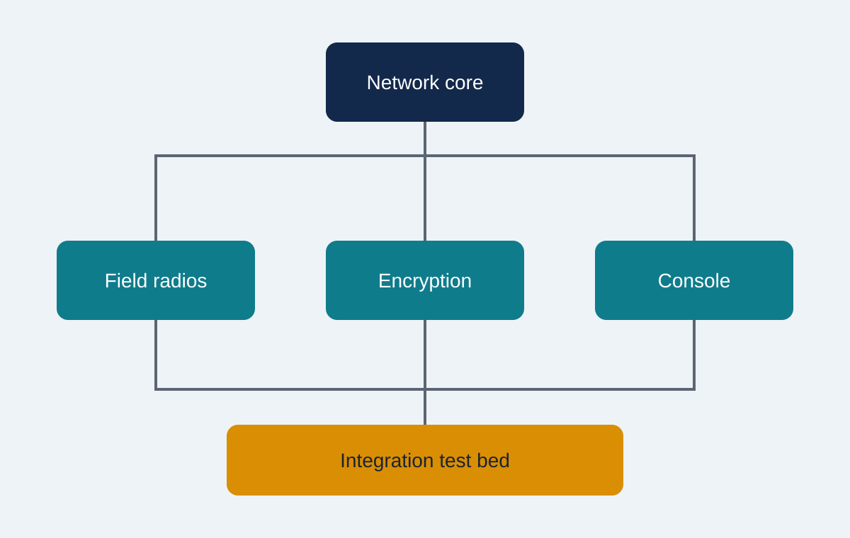
Network core
Factory acceptance passed in August with 312 of 318 test cases
Six deferred cases relate to gateway failover timing
Mesh routing recovers from node loss in 2.8 s (target 5 s)
Notes:
The diagram shows how the four subsystems come together on the integration test bed.

Slide 23
Encryption module
Algorithm implementation complete and independently reviewed
Certification evaluation started in September; target completion February 2027
Two minor findings from the first evaluation round, both fixed
Key management integration with the console still in progress

Slide 24
Management console
Fleet view, provisioning and over-the-air updates complete
Role-based access control implemented and tested
Pilot users rated usability 4.1 out of 5
Remaining work: reporting module and audit log export

Slide 25
Integration test results (phase 1)
Test area | Cases | Passed | Failed | Result
Voice call setup | 48 | 47 | 1 | Pass
Data throughput | 36 | 33 | 3 | Partial
Mesh failover | 24 | 24 | 0 | Pass
Encryption handshake | 30 | 30 | 0 | Pass
Legacy gateway interop | 28 | 21 | 7 | Fail
Console provisioning | 40 | 39 | 1 | Pass
Total | 206 | 194 | 12 | Partial
Notes:
Legacy gateway interoperability is the weak spot: seven failures, all on the older of the two legacy radio systems.

Slide 26
Defect trend

Slide 27
Performance against requirements
Requirement | Target | Measured | Result
Voice latency (end to end) | < 250 ms | 180 ms | Pass
Data throughput per link | >= 2 Mbit/s | 2.4 Mbit/s | Pass
Mesh recovery after node loss | < 5 s | 2.8 s | Pass
Radio battery life | >= 12 h | 14 h | Pass
Legacy gateway call success | >= 98% | 91% | Fail
Console fleet refresh | < 10 s for 500 units | 7 s | Pass

Slide 28
Risks and issues
What could still go wrong, and what we are doing about it

Slide 29
Top risks
Risk | Likelihood | Impact | Owner | Mitigation
Further RF amplifier delays | Medium | High | Procurement | Second source qualified; weekly tracking
Encryption certification findings | Low | High | Security | Early informal reviews with evaluators
Legacy gateway interoperability | High | Medium | Engineering | Vendor fix due November; retest
Exchange-rate movement | Medium | Medium | Finance | Partial hedging under review
Key staff turnover | Low | Medium | Director | Succession plans for four key roles
Notes:
Likelihood and impact use the corporate five-point scale, shown here as low, medium and high.

Slide 30
Risk profile over the year

Slide 31
Open issues
# | Issue | Raised | Owner | Status
I-14 | Gateway call drops with legacy system A | Sep 2026 | Engineering | Open
I-17 | Test bed rental extension not yet approved | Oct 2026 | Procurement | Open
I-09 | Console audit log format rejected by security | Jul 2026 | Software | In progress
I-11 | Spares list incomplete for vehicle variant | Aug 2026 | Logistics | In progress
I-05 | Training venue clash in March | May 2026 | Operations | Closed

Slide 32
Lessons learned
Qualify second sources for long-lead RF components at design review, not after a shortage
Book test bed capacity with a contingency month built into the rental
Bring security evaluators in early: informal reviews cut formal findings by half
Pilot users found usability issues that design reviews missed

Slide 33
People and operations
Staffing, training and early user feedback

Slide 34
Staffing levels
Notes:
Two engineering vacancies and two operations trainer roles are being recruited; offers are out for three of the four.

Slide 35
Training rollout plan
Audience | Format | People | When | Status
Instructors (train the trainer) | Classroom, 5 days | 24 | Jan 2027 | On track
Signal operators | Blended, 3 days | 420 | Feb to Apr 2027 | On track
Unit commanders | Briefing, half day | 60 | Mar 2027 | On track
Maintainers | Classroom, 10 days | 45 | Apr 2027 | Watch
Console administrators | E-learning and lab | 30 | Feb 2027 | In progress

Slide 36
Pilot user feedback
Easier to use
Battery confidence
Console wish list
Most pilot users said the handheld was easier to use than the current radio, especially group calls.
Users trusted the battery indicator and finished every exercise without a swap.
Administrators asked for bulk configuration and better search across the fleet.
Pilot: 3 units, 64 users, 6 weeks, July to August 2026

Slide 37
Decisions and next steps
What we need from the Steering Committee

Slide 38
Decisions required today
Approve schedule recovery option B (parallel integration on a second test bed), at $0.6M from contingency
Approve the test bed rental extension to March 2027 (issue I-17)
Note the revised Initial Operating Capability date of May 2027
Notes:
The first two need approval today to keep integration phase 2 in February. The third is for noting only.

Slide 39
Schedule recovery options
A. Accept the slip
B. Second test bed
C. Air freight and overtime
No extra cost. Initial Operating Capability moves to June 2027. Training plan must be re-phased.
Recommended. $0.6M. Runs integration streams in parallel and recovers about 3 weeks. IOC stays in May 2027.
$0.9M. Recovers about 2 weeks. Depends on vendor overtime the vendor has not yet confirmed.

Slide 40
Plan for next quarter
Action | Owner | Due
Receive first amplifiers from the second source | Procurement | 15 Nov 2026
Retest legacy gateway after vendor fix | Engineering | 30 Nov 2026
Complete encryption evaluation round 2 | Security | 15 Dec 2026
Stand up second test bed (if option B approved) | Engineering | 10 Jan 2027
Start instructor training | Operations | 18 Jan 2027
Next Steering Committee review | Programme Director | 26 Jan 2027

Slide 41
Contacts
Role | Name | Email | Phone
Programme Director | Alex Tan | alex.tan@example.gov.sg | +65 6123 4501
Engineering Lead | Priya Nair | priya.nair@example.gov.sg | 9123 4502
Procurement Lead | Marcus Lim | marcus.lim@example.gov.sg | 9123 4503
Security Lead | Siti Rahman | siti.rahman@example.gov.sg | 9123 4504
Operations Lead | Daniel Ong | daniel.ong@example.gov.sg | 9123 4505
All names and contact details are fictional, for testing PII masking.

Slide 42
Appendix
Detailed budget, glossary and test cases

Slide 43
Appendix A: Detailed budget lines
Line | Item | Budget ($K) | Spent ($K) | Forecast ($K)
A1 | Handheld radios (600 units) | 9,600 | 6,700 | 10,050
A2 | Vehicle radios (150 units) | 4,500 | 3,100 | 4,650
A3 | Mesh relay nodes (80 units) | 4,400 | 3,100 | 4,500
B1 | Network core hardware | 5,200 | 4,700 | 5,000
B2 | Gateways to legacy systems | 3,800 | 3,100 | 3,700
C1 | Encryption development | 3,300 | 2,600 | 3,350
C2 | Certification fees | 2,200 | 1,000 | 2,250
D1 | Console software | 4,000 | 3,100 | 3,800
E1 | Training development and delivery | 2,300 | 900 | 2,250
E2 | Integrated logistics support | 1,200 | 500 | 1,150
F1 | Programme management | 4,500 | 2,400 | 4,100
Notes:
Line totals exclude contingency, which is held centrally.

Slide 44
Appendix B: Glossary
Term | Meaning
IOC | Initial Operating Capability: first units can use the system operationally
FAT | Factory acceptance test, run at the vendor's site
Mesh relay | A node that forwards traffic so the network survives losing any single link
RF amplifier | Radio-frequency power amplifier inside each radio; the current long-lead part
Test bed | The rented integration lab where all subsystems are tested together
Liquidated damages | Contract penalty the vendor pays for delay beyond an agreed threshold

Slide 45
Appendix C: Failed integration test cases
Case | Area | Description | Severity | Status
IT-021 | Voice | Call setup over 3 s with 40 active users | Low | Open
IT-057 | Data | Throughput drops 20% above 30 nodes | Medium | In progress
IT-058 | Data | Packet loss during relay handover | Medium | In progress
IT-063 | Data | File transfer resumes from start after a drop | Low | Open
IT-131 | Gateway | Call drops after 90 s with legacy system A | High | Open
IT-132 | Gateway | No caller ID passed to legacy system A | Medium | Open
IT-133 | Gateway | Group call fails across both legacy systems | High | Open
IT-134 | Gateway | Audio echo on legacy system A | Medium | Open
IT-201 | Console | Bulk update stalls above 300 units | Medium | In progress

