Slide 1
Building a SNARK
CS251 Fall 2021
(cs251.stanford.edu)
Dan Boneh

Slide 2
Recap: zk-SNARK applications
Private Tx on a public blockchain:
Confidential transactions
Tornado cash, Zcash, IronFish
Private Dapps: Aleo
Compliance:
Proving solvency in zero-knowledge
Zero-knowledge taxes
Scalability: privacy in zk-SNARK Rollup (next week)

Slide 3
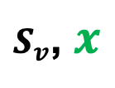
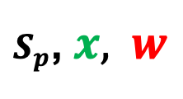



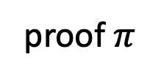
(non-interactive) Preprocessing argument systems
Public arithmetic circuit: $C( x, w ) ⇾ 𝔽$
public statement in $𝔽_{}^{n}$
secret witness in $𝔽_{}^{m}$
Preprocessing (setup): S($C$) ⇾ public parameters ( $S_{p}$, $S_{v}$ )
$S_{p}$, $x,$ $w$
$S_{v}$, $x$
proof $π$
Prover
Verifier
accept or reject

Slide 4
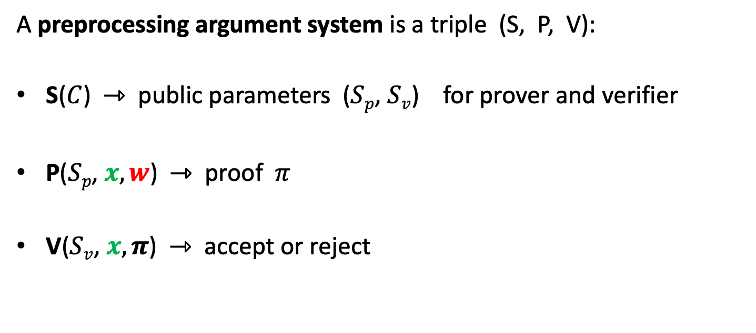
Preprocessing argument System
A preprocessing argument system is a triple (S, P, V):
S($C$) ⇾ public parameters ($Sp$, $Sv$) for prover and verifier
P($Sp$, $x, w$) ⇾ proof $π$
V($Sv$, $x, π$) ⇾ accept or reject

Slide 5


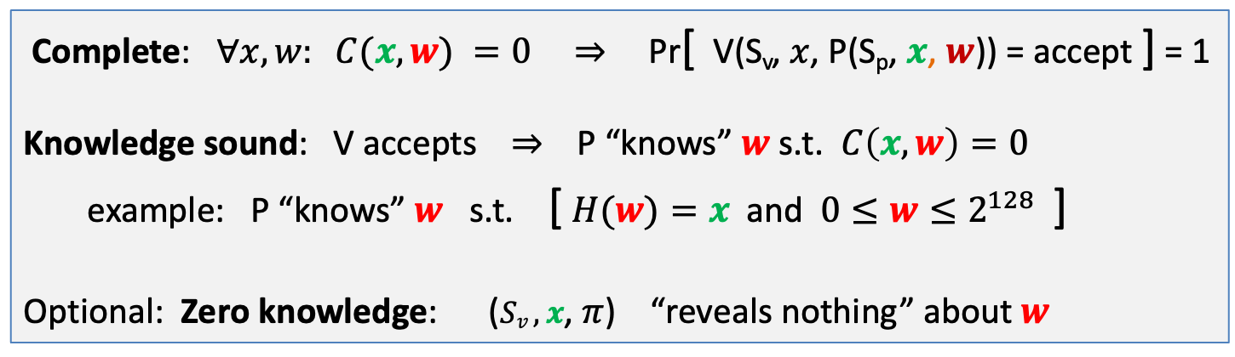

Requirements (informal)
Prover P($Sp$, $x, w$)
Verifier V ($Sv$, $x$, $π$)
proof $π$
accept or reject
Complete: $∀x, w: C(x, w) =0$ ⇒ Pr[ V(S_{v}, $x$, P(S_{p}, $x$, $w$)) = accept ] = 1
Knowledge sound: V accepts ⇒ P “knows” $w$ s.t. $C\left(x, w\right)=0$
example: P “knows” $w$ s.t. [ $H(w)=x$and $0≤w≤2^{128}$ ]
Optional: Zero knowledge: ($Sv ,x$, $π$) “reveals nothing” about $w$

Slide 6

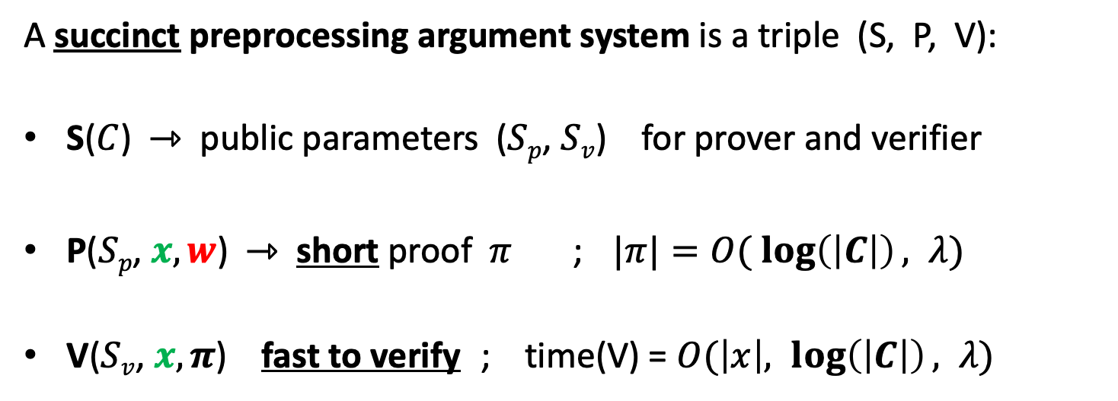
SNARK: a Succinct ARgument of Knowledge
A succinct preprocessing argument system is a triple (S, P, V):
S($C$) ⇾ public parameters ($Sp$, $Sv$) for prover and verifier
P($Sp$, $x, w$) ⇾ short proof $π$ ; $|π|=O( \log\left(\left|C\right|\right), λ)$
V($Sv$, $x, π$) fast to verify ; time(V) = $O(\left|x\right|, \log\left(\left|C\right|\right), λ)$
short “summary” of circuit
$λ$= security parameter = 128

Slide 7
A simple PCP-based SNARK
[Kilian’92, Micali’94]

Slide 8
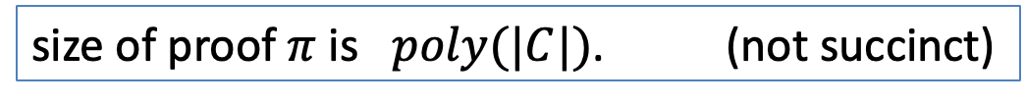
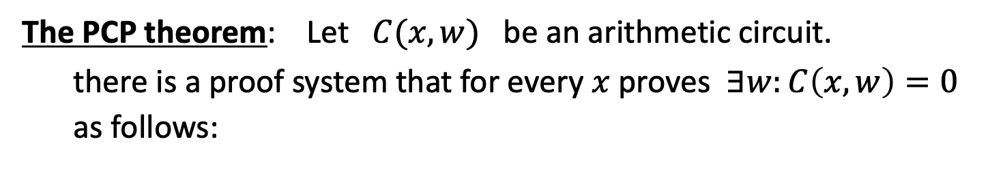
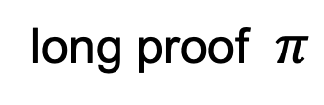
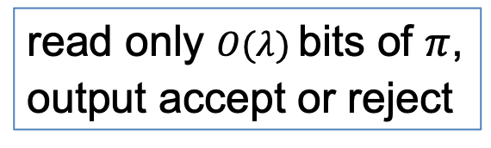
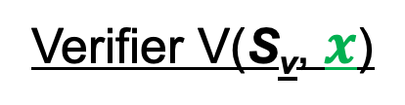
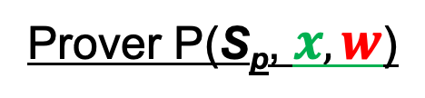
A simple construction: PCP-based SNARK
The PCP theorem: Let $C(x,w)$ be an arithmetic circuit.
there is a proof system that for every $x$ proves $∃w:C\left(x,w\right)=0$ as follows:
Prover P(S_{p}, $x, w$)
Verifier V(S_{v}, $x$)
long proof $π$
read only $O(λ)$bits of $π$,
output accept or reject
V always accepts valid proof. If no $w$, then V rejects with high prob.
size of proof $π$is $poly(|C|)$. (not succinct)
Notes:
V reads RANDOM locations in proof π, and checks look like a*b=c.

Slide 9
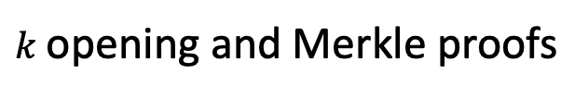
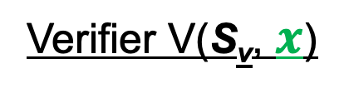
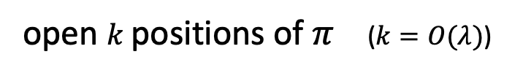
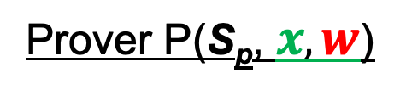


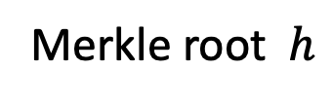


Converting a PCP proof to a SNARK
Prover P(S_{p}, $x, w$)
Verifier V(S_{v}, $x$)
$$h$$
Merkle
$$π$$
Merkle root $h$
1 hash
open $k$positions of $π$ ($k=O(λ)$)
$O(k log |C|)$ hashes
$k$opening and Merkle proofs
output accept or reject
Verifier sees $O(λ log⁡|C|)$data ⇒ succinct proof.
Problem: interactive

Slide 10
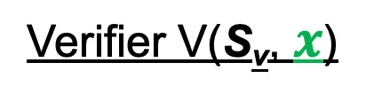

Making the proof non-interactive
The Fiat-Shamir transform:
public-coin interactive protocol ⇒ non-interactive protocol
public coin: all verifier randomness is public (no secrets)
Prover P(S_{p}, $x, w$)
Verifier V(S_{v}, $x$)
msg1
r
choose random bits r
msg2
accept or reject

Slide 11
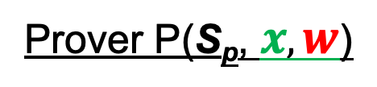
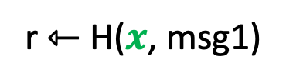
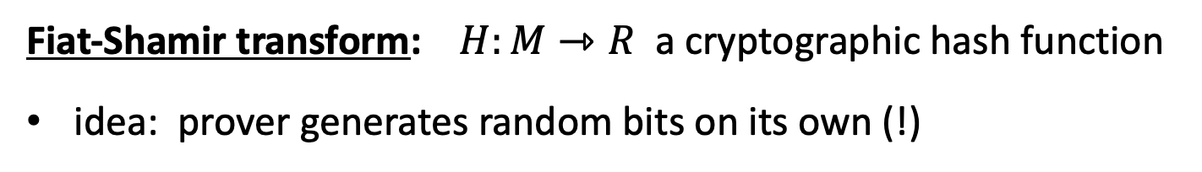
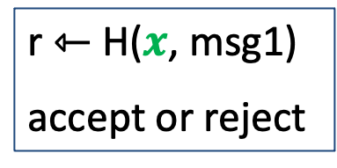

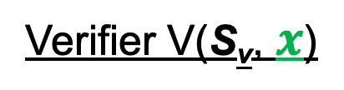
Making the proof non-interactive
Fiat-Shamir transform: $H:M⇾R$ a cryptographic hash function
idea: prover generates random bits on its own (!)
Prover P(S_{p}, $x, w$)
Verifier V(S_{v}, $x$)
generate msg1
r ⇽ H($x$, msg1)
$π$ = (msg1, msg2)
$|π|$ = O($λ log |C|)$
r ⇽ H($x$, msg1)
accept or reject
generate msg2
Fiat-Shamir: certain secure interactive protocols ⟹ non-interactive

Slide 12
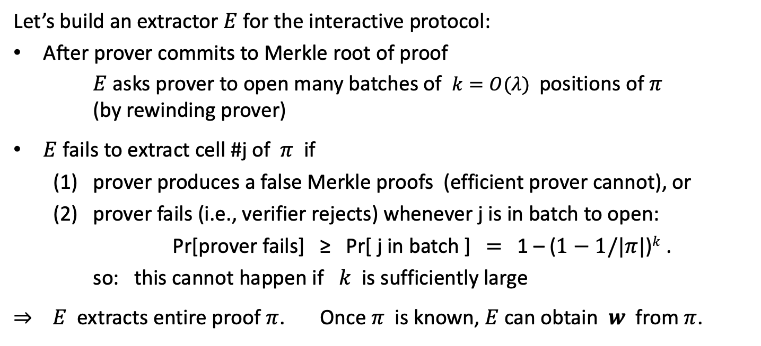
Why is this an argument of knowledge? (can skip)
Let’s build an extractor $E$ for the interactive protocol:
After prover commits to Merkle root of proof
$E$ asks prover to open many batches of $k=O(λ)$positions of $π$ (by rewinding prover)
$E$ fails to extract cell #j of $π$ if
(1) prover produces a false Merkle proofs (efficient prover cannot), or
(2) prover fails (i.e., verifier rejects) whenever j is in batch to open:
Pr[prover fails] ≥ Pr[ j in batch ] $=$ 1 – ($1−1/|π|$)$k$ .
so: this cannot happen if $k$ is sufficiently large
⇒ $E$ extracts entire proof $π$. Once $π$ is known, $E$can obtain $w$ from $π$.

Slide 13

Are we done?
Simple transparent SNARK from the PCP theorem
Use Fiat-Shamir transform to make non-interactive
We will apply Fiat-Shamir in many other settings
The bad news: an impractical SNARK --- Prover time too high
Better SNARKs: Goal: Time(Prover) = $\tilde{O}$(|C|)

Slide 14
Building an efficient SNARK

Slide 15

General paradigm
Many SNARKs are built in two steps:
polynomial
interactive oracle proofs
(poly-IOP)
polynomial
commitment
scheme
(zk)SNARK for general circuits

Slide 16
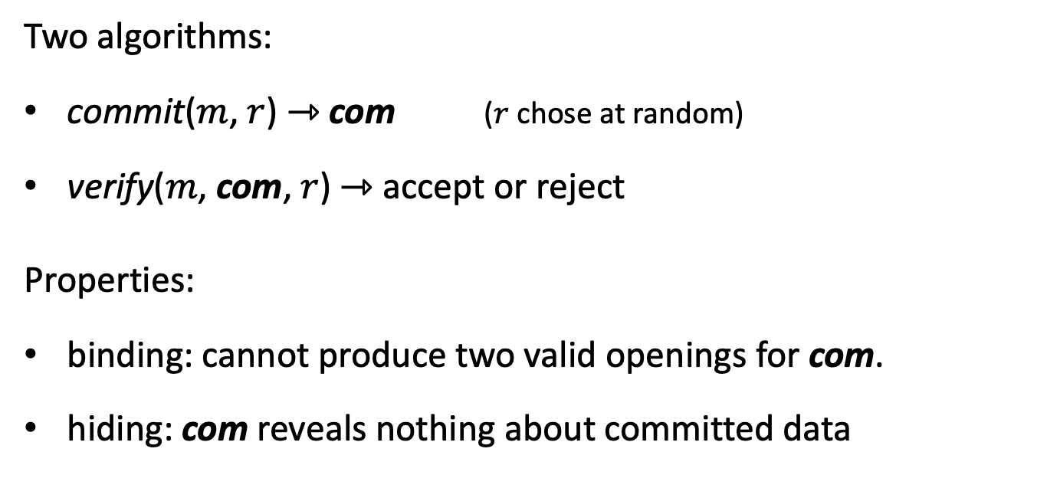
Recall: commitments
Two algorithms:
commit($m$, $r$) ⇾ com ($r$ chose at random)
verify($m$, com, $r$) ⇾ accept or reject
Properties:
binding: cannot produce two valid openings for com.
hiding: com reveals nothing about committed data

Slide 17

(1) Polynomial commitment schemes
Notation:
Fix a finite field: $𝔽_{p}=\left\{0,1,…,p−1\right\}$
$𝔽_{p}^{(≤d)}\left[X\right]:$ all polynomials in $𝔽_{p}[X]$ of degree ≤ d.

Slide 18
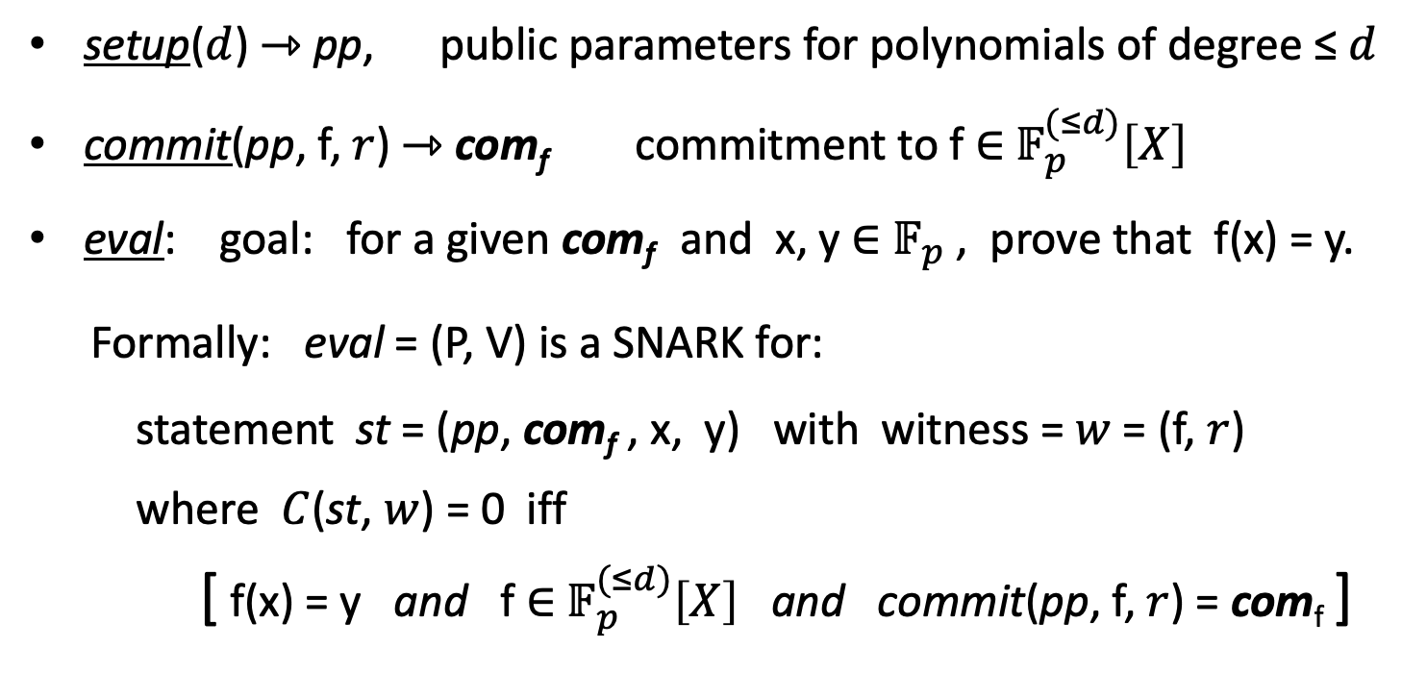
(1) Polynomial commitment schemes
setup($d$) ⇾ pp, public parameters for polynomials of degree ≤ $d$
commit(pp, f, $r$) ⇾ com_{f} commitment to f ∈ $𝔽_{p}^{(≤d)}\left[X\right]$
eval: goal: for a given com_{f} and x, y ∈ $𝔽_{p}$, prove that f(x) = y.
Formally: eval = (P, V) is a SNARK for: statement st = (pp, com_{f} , x, y) with witness = $w$ = (f, $r$)
where $C$(st, $w$) = 0 iff
[ f(x) = y and f ∈ $𝔽_{p}^{(≤d)}\left[X\right]$ and commit(pp, f, $r$) = com_{f} ]

Slide 19
(1) Polynomial commitment schemes
Properties:
Binding: cannot produce two valid openings (f_{1,} r₁), (f_{2,} r₂) for com_{f}.
eval is knowledge sounds (can extract (f, r) from a successful prover)
optional:
commitment is hiding
eval is zero knowledge

Slide 20
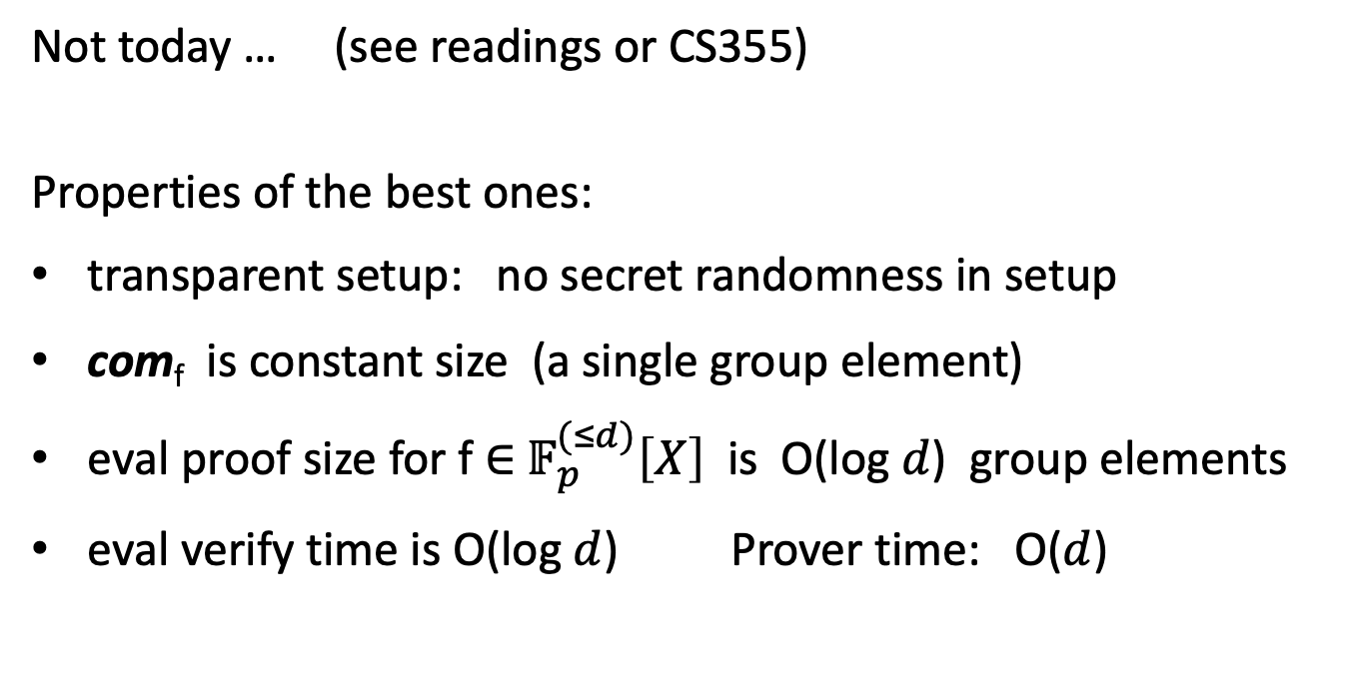
Constructing polynomial commitments
simple construction without this requirement
Not today … (see readings or CS355)
Properties of the best ones:
transparent setup: no secret randomness in setup
com_{f} is constant size (a single group element)
eval proof size for f ∈ $𝔽_{p}^{(≤d)}\left[X\right]$ is O(log $d$) group elements
eval verify time is O(log $d$) Prover time: O($d$)

Slide 21
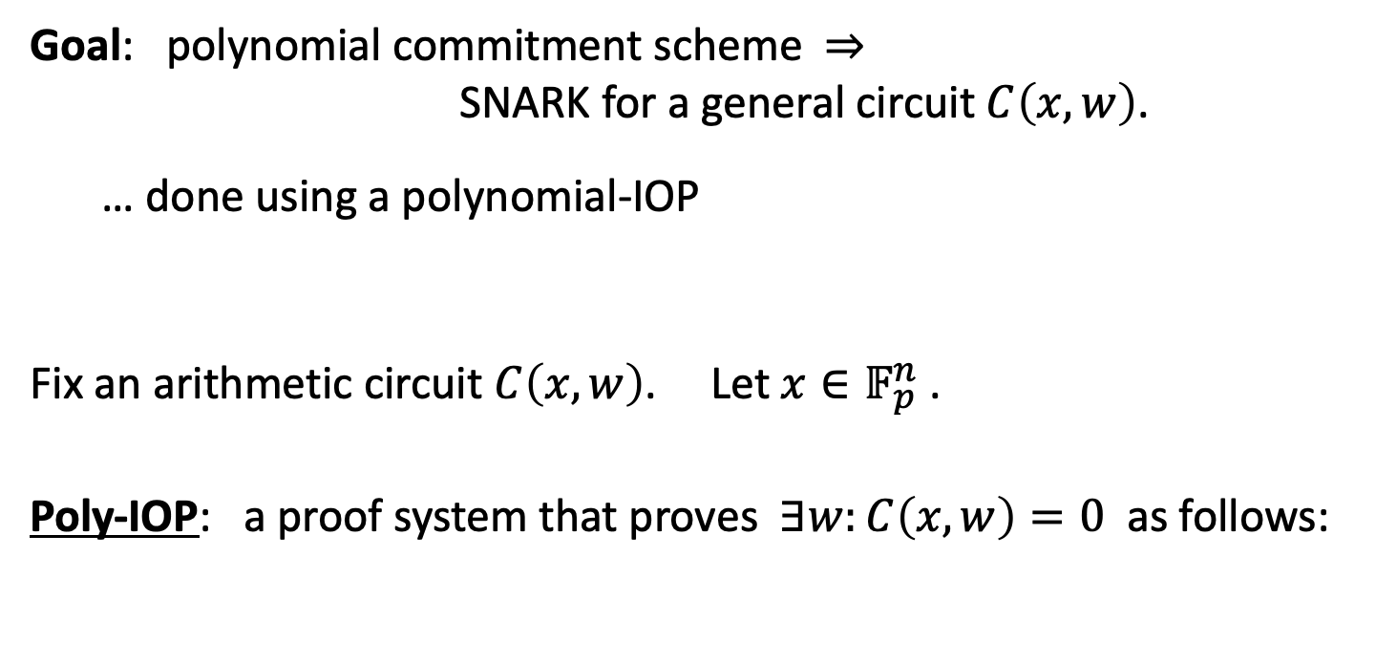
Component 2: Polynomial IOP
Goal: polynomial commitment scheme ⇒ SNARK for a general circuit $C\left(x,w\right)$.
… done using a polynomial-IOP
Fix an arithmetic circuit $C\left(x,w\right)$. Let $x∈𝔽_{p}^{n}$ .
Poly-IOP: a proof system that proves $∃w:C\left(x,w\right)=0$ as follows:

Slide 22
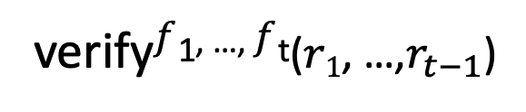
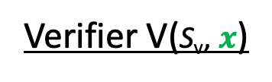


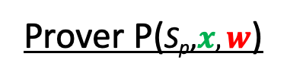






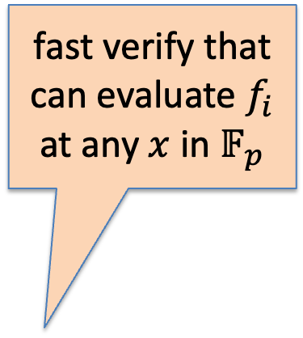

(2) Polynomial IOP
Prover P($\text{S}\text{p}\text{,}x, w$)
Verifier V($\text{S}\text{v}\text{,} x$)
$f1$ ${∈ 𝔽}_{p}^{(≤d)}\left[X\right]$
commit
$$r1⇽𝔽_{p}$$
$r$₁
fast verify that can evaluate $f_{i}$ at any $x$ in $𝔽_{p}$
$f2$ ${∈ 𝔽}_{p}^{(≤d)}\left[X\right]$
commit
$$r2⇽𝔽_{p}$$
$r$₂
⋮
$$r_{t−1}$$
$$r_{t−1}⇽𝔽_{p}$$
$ft$ ${∈ 𝔽}_{p}^{(≤d)}\left[X\right]$
commit
verify$f$^{1, …,} $f$^{t}($r1$, …,$r_{t−1}$)

Slide 23
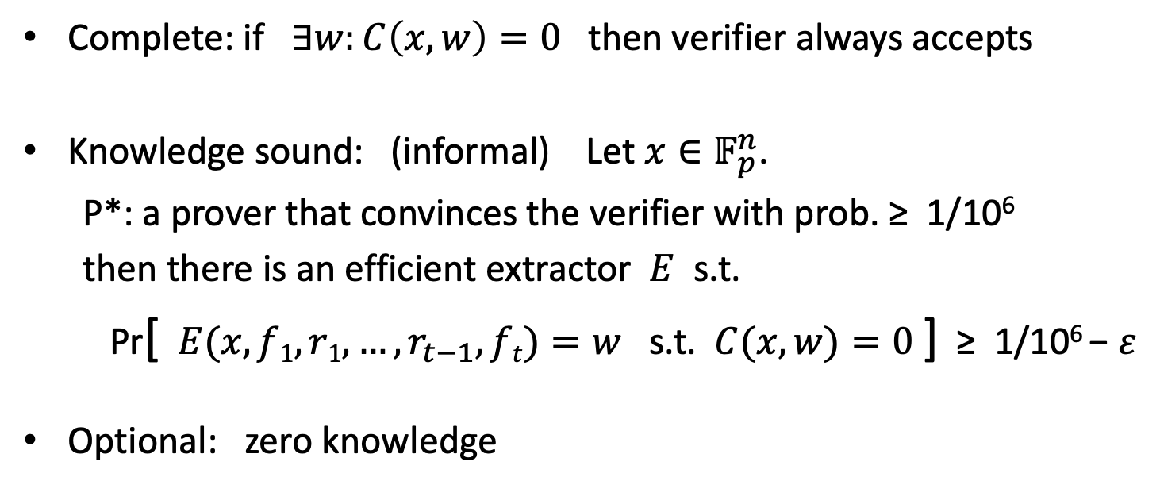
Properties
Complete: if $∃w:C\left(x,w\right)=0$ then verifier always accepts
Knowledge sound: (informal) Let $x∈𝔽_{p}^{n}$.
P*: a prover that convinces the verifier with prob. ≥ 1/10⁶
then there is an efficient extractor $E$ s.t.
Pr[ $E(x, f1, r1, …,r_{t−1}, ft)=w$ s.t. $C(x,w)=0$] ≥ 1/10⁶ − $ε$
Optional: zero knowledge

Slide 24
The resulting SNARK
Poly-IOP params: t = #polynomials, q = # eval queries in verify
The SNARK:
During interactive phase of poly-IOP: send t poly commitments
During poly-IOP verify: run poly-commit eval protocol q times
Use Fiat-Shamir to make the proof system non-interactive
Length of SNARK proof: t poly-commits + q eval proofs
SNARK verify time: q poly eval proof verifications + time(IOP-verify)
SNARK prover time: t poly commits + time(IOP-prover)

Slide 25
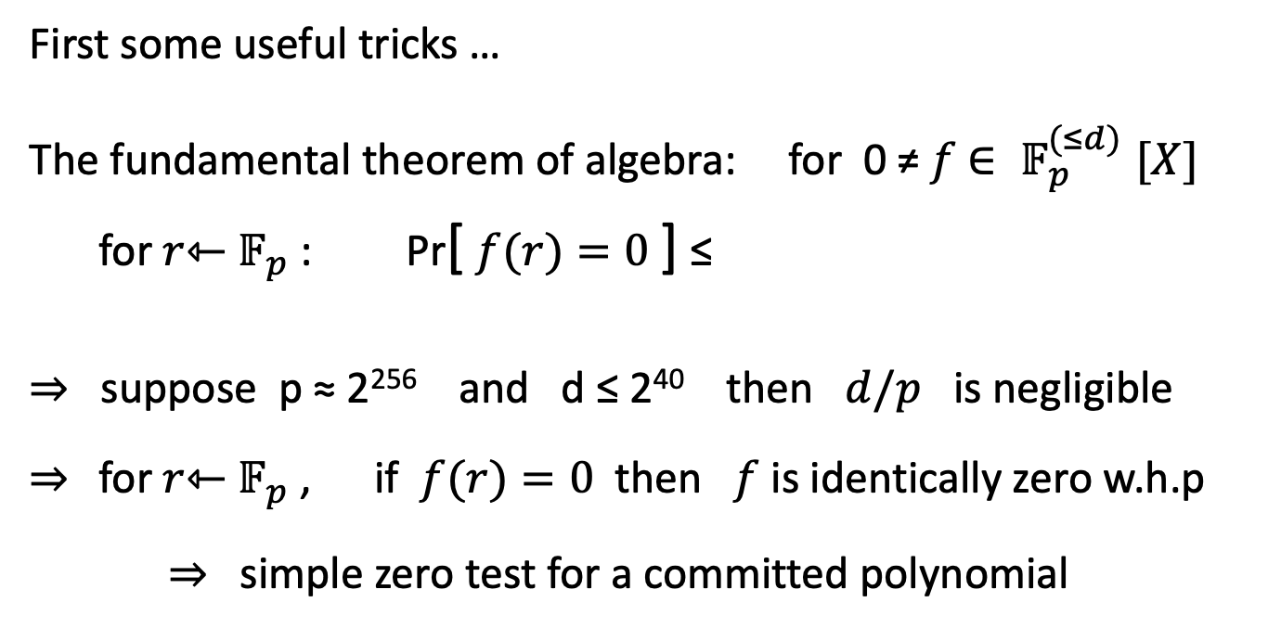

Constructing a Poly-IOP: t + q = 4
First some useful tricks …
The fundamental theorem of algebra: for 0 ≠ $f$ ${∈ 𝔽}_{p}^{(≤d)}[X]$
for $r$⇽ $𝔽_{p}$: Pr[ $f(r)=0$] ≤
⇒ suppose p ≈ 2²⁵⁶ and d ≤ 2⁴⁰ then $d/p$ is negligible
⇒ for $r$⇽ $𝔽_{p}$ , if $f(r)=0$then $f$ is identically zero w.h.p
⇒ simple zero test for a committed polynomial
$$d/p$$
Notes:
This generalizes to multivariates: Schwartz-Zipple lemma

Slide 26
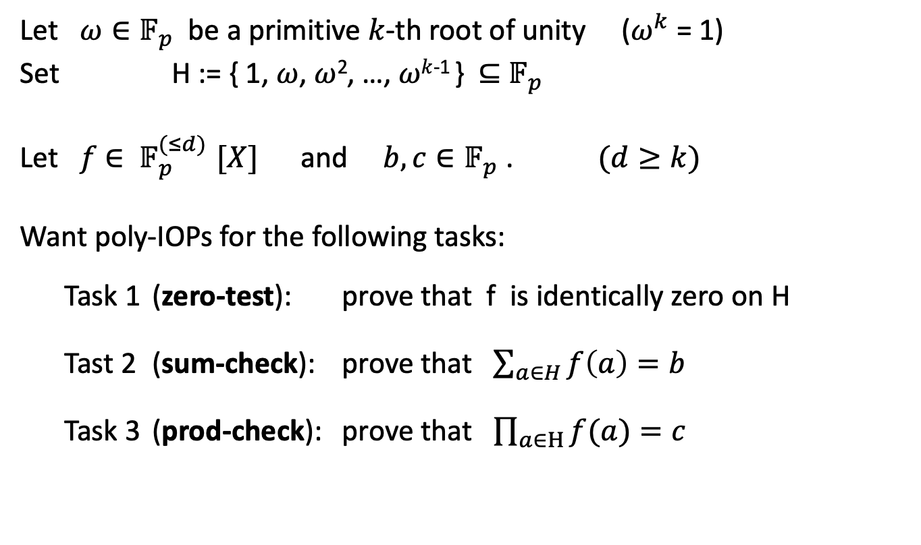
Some useful gadgets
Let $ω∈𝔽_{p}$ be a primitive $k$-th root of unity ($ω^{k}$ = 1)
Set H := { 1, $ω$, $ω$², …, $ωk$⁻¹ } ⊆ $𝔽_{p}$
Let $f$ ${∈ 𝔽}_{p}^{(≤d)}[X]$ and ${b, c∈𝔽}_{p}$ . $(d≥k)$
Want poly-IOPs for the following tasks:
Task 1 (zero-test): prove that f is identically zero on H
Tast 2 (sum-check): prove that $\sum_{a∈H}{f\left(a\right)=b }$
Task 3 (prod-check): prove that $\prod_{a∈H}{f(a)}=c$

Slide 27

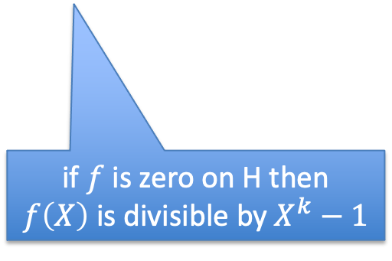


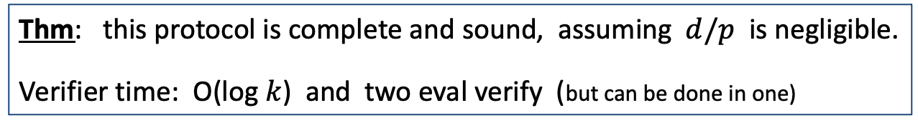

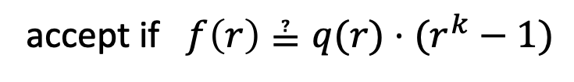
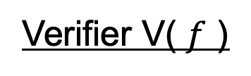
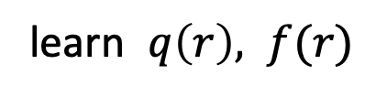
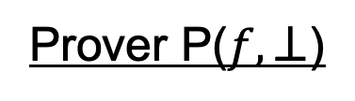
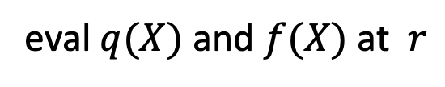

Zero test on H ( H = { 1, $ω$, $ω$², …, $ωk$⁻¹ } )
Prover P($f,⊥$)
Verifier V( $f$ )
$$q(X)⇽f(X)/(Xk –1)$$
$q$ ${∈ 𝔽}_{p}^{(≤d)}\left[X\right]$
$$r⇽𝔽_{p}$$
eval $q(X)$ and $f(X)$ at $r$
learn $q\left(r\right), f(r)$
if $f$ is zero on H then $f\left(X\right)$ is divisible by $X^{k}−1$
accept if $f\left(r\right)≟q(r)⋅(r^{k}−1)$
(implies that $f(X)=q(X)(X^{k}−1)$ )
Thm: this protocol is complete and sound, assuming $d/p$ is negligible.
Verifier time: O(log $k$) and two eval verify (but can be done in one)
Notes:
Soundness: if $f(X)=q(X)(X^{k}−1)$ then f is indeed zero on H.

Slide 28
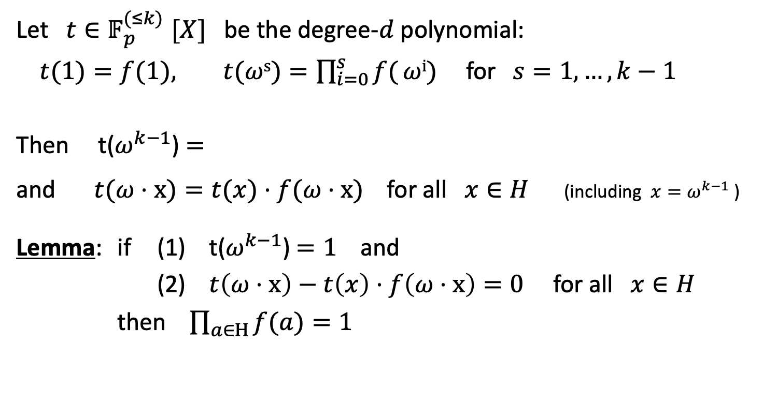

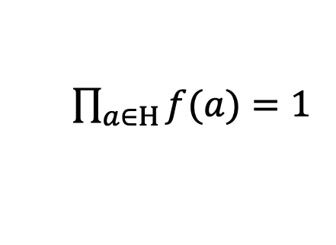
Product check on H: $\prod_{a∈H}{f(a)}=1$
Let $t{∈𝔽}_{p}^{(≤k)}[X]$ be the degree-$d$ polynomial:
$t(1)=f(1), t(ωs)=\prod_{i=0}^{s}{f(}ωi)$for$s=1, …, k−1$
Then t($ω^{k−1}$) $=$
and $t(ω⋅x)=t(x)⋅f(ω⋅x)$for all $x∈H$ (including $x=ω^{k−1}$ )
Lemma: if (1) t($ω^{k−1}$) $=1$ and
(2) $t\left(ω⋅x\right)−t\left(x\right)⋅f\left(ω⋅x\right)=0$ for all $x∈H$
then $\prod_{a∈H}{f(a)}=1$
$\prod_{a∈H}{f(a)}=1$

Slide 29

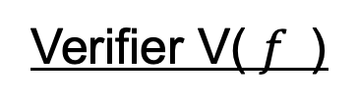

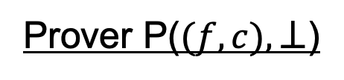




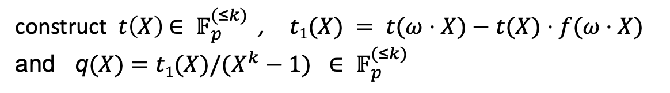

Product check on H (unoptimized)
Prover P($(f,c),⊥$)
Verifier V( $f$)
construct $t\left(X\right)$ ${∈ 𝔽}_{p}^{(≤k)}$ , $t1(X) = t(ω⋅X)−t(X)⋅f(ω⋅X)$
and q$(X)=t1(X){/(X^{k}−1) ∈ 𝔽}_{p}^{(≤k)}$
q$, t$ ${∈ 𝔽}_{p}^{(≤k)}\left[X\right]$
$$r⇽𝔽_{p}$$
eval $t(X)$ at $ω^{k−1} , r, ωr$
learn $t(ω^{k−1}$), t(r), $t(ωr)$, $q(r)$, $f(ωr)$
eval $q\left(X\right)$ at $r$ , and $f(X)$ at $ωr$
accept if $t(ω^{k−1}$) ≟ 1 and $$t\left(ωr\right)−t(r)f(ωr) ≟q(r)⋅(r^{k}−1)$$
$t1(H) = 0$ :

Slide 30
PLONK: a poly-IOP for a general circuit

Slide 31








PLONK: a poly-IOP for a general circuit $C(x,w)$
Step 1: compile circuit to a computation trace (gate fan-in = 2)
The computation trace:
$$(x1+x2)(x2+w1)$$
inputs: 5, 6, 1
Gate 0: 5 , 6 , 11
Gate 1: 6 , 1 , 7
Gate 2: 11, 7, 77
77
$$\text{×}$$
(Gate 2)
11
7
(Gate 0)
$$+$$
$$+$$
(Gate 1)
5
6
1
6
$$x1$$
$$x2$$
$$w1$$
left inputs
right inputs
outputs
5
6
1
example input
Notes:
Mention R1CS

Slide 32


Encoding the trace as a polynomial
$|C|$ $=$ total # of gates in $C$ , |$I$| $=$ |$Ix$| + |$Iw$| $=$ # inputs to $C$
let $d=3 \left|C\right|+|I|$ (in example, $d=12$) and H = { 1, $ω$, $ω$², …, $ω^{d−1}$ }
The plan: prover interpolates a polynomial
$P{∈ 𝔽}_{p}^{(≤d)}$[X]
that encodes the entire trace.
inputs: 5, 6, 1
Gate 0: 5 , 6 , 11
Gate 1: 6 , 1 , 7
Gate 2: 11, 7, 77
Let’s see how …

Slide 33

Encoding the trace as a polynomial
(prover uses FFT to compute coefficients of P in time $d \text{log}2d$ )
The plan:
Prover interpolates $P{∈ 𝔽}_{p}^{(≤d)}$[X] such that
(1) P($ω^{−j})=$ input #$j$ for $j$ = 1, …, $|I|$ (all inputs), and
(2) ∀ $l=0,…,\left|C\right|−1$:
P($ω3l$): left input to gate #$l$
P($ω3l$⁺¹): right input to gate #$l$
P($ω3l$⁺²): output of gate #$l$
inputs: 5, 6, 1
Gate 0: 5 , 6 , 11
Gate 1: 6 , 1 , 7
Gate 2: 11, 7, 77

Slide 34

Encoding the trace as a polynomial
In our example:
inputs: P($ω^{−1})=5$, P($ω^{−2})=6$, P($ω^{−3})=1$,
gate 0: P($ω^{0})=5$, P($ω^{1})=6$, P($ω^{2})=11$,
gate 1: P($ω^{3})=6$, P($ω^{4})=1$, P($ω^{5})=7$,
gate 2: P($ω^{6})=11$, P($ω^{7})=7$, P($ω^{8})=77$
inputs: 5, 6, 1
Gate 0: 5 , 6 , 11
Gate 1: 6 , 1 , 7
Gate 2: 11, 7, 77
degree(P) = 11

Slide 35





Step 2: proving validity of P
Prover P($Sp,x,w$)
Verifier V($Sv, x$)
$$P$$
build P$(X){∈𝔽}_{p}^{(≤d)}$[X]
(commitment)
Prover needs to prove that P is a correct computation trace:
P encodes the correct inputs,
every gate is evaluated correctly,
the wiring is implemented correctly,
the final output is 0
inputs: 5, 6, 1
Gate 0: 5 , 6 , 11
Gate 1: 6 , 1 , 7
Gate 2: 11, 7, 77
Proving (4) is easy: prove P($ω^{3\left|C\right|−1})=0$

Slide 36


Proving (1): P encodes the correct inputs
Both prover and verifier interpolate a polynomial $v(X)$ ${∈ 𝔽}_{p}^{(≤|I_{x}|)}$[X] that encodes the $x$-inputs to the circuit:
for $j=1,...,|I_{x}|: v(ω^{−j})=$input #j
In our example: $v\left(ω^{−1}\right)=5, v\left(ω^{−2}\right)=6$ . ($v$ is linear)
constructing $v(X)$ takes time proportional to the size of input $x$

Slide 37

Proving (1): P encodes the correct inputs
Both prover and verifier interpolate a polynomial $v(X)$ ${∈ 𝔽}_{p}^{(≤|I_{x}|)}$[X] that encodes the $x$-inputs to the circuit:
for $j=1,...,|I_{x}|: v(ω^{−j})=$input #j
Let H_{inp} = {${ ω}^{−1},ω^{−2}, …,ω^{−\left|I_{x}\right|} \}$ ⊆ H (points encoding the input)
Prover proves (1) by using a zero-test on H_{inp} to prove that
P(y) $−$ $v$(y) $=$ $0$ ∀ y ∈ H_{inp}

Slide 38


Proving (2): every gate is evaluated correctly
Idea: encode gate types using a selector polynomial S(X)
define S(X) ${∈ 𝔽}_{p}^{(≤d)}$[X] such that ∀ $l=0,…,\left|C\right|−1$:
S($ω3l$) = 1 if gate #$l$ is an addition gate
S($ω3l$) = 0 if gate #$l$ is a multiplication gate
In our example S$(ω0)=1$, S$(ω3)=1$, S$(ω6)=0$
(so that S is a quadratic polynomial)

Slide 39


Proving (2): every gate is evaluated correctly
Idea: encode gate types using a selector polynomial S(X)
define S(X) ${∈ 𝔽}_{p}^{(≤d)}$[X] such that ∀ $l=0,…,\left|C\right|−1$:
S($ω3l$) = 1 if gate #$l$ is an addition gate
S($ω3l$) = 0 if gate #$l$ is a multiplication gate
Observe that, ∀ y ∈ H_{gates} = { 1, $ω3$, $ω6$, $ω9$, …, $ω^{3(\left|C\right|−1)}$ } :
S(y)⋅[P(y) + P($ωy$)] + (1 – S(y))⋅P(y)⋅P($ωy$) =
P($ω$²y)

Slide 40





Proving (2): every gate is evaluated correctly
Setup($C$): S_{v} = ( poly commitment to S(X) )
Prover P($Sp,x,w$)
Verifier V($Sv, x$)
$$P$$
build P$(X){∈𝔽}_{p}^{(≤d)}$[X]
(commitment)
Prover uses zero-test on H_{gates} to prove that ∀ y ∈ H_{gates}
S(y)⋅[P(y) + P($ωy$)] + (1 – S(y))⋅P(y)⋅P($ωy$) − P($ω$²y) $=0$

Slide 41


Proving (3): the wiring is correct
example: x₁=5, x₂=6 , $w1$=1
$ω$⁻¹, $ω$⁻², $ω$⁻³ : 5, 6, 1
$ω$⁰, $ω$¹, $ω$² : 5, 6, 11
$ω3$, $ω$⁴, $ω$⁵ : 6, 1, 7
$ω6$, $ω$⁷, $ω$⁸ : 11, 7, 77
Step 4: encode the wires of $C$:
P($ω$⁻²) = P($ω$¹) = P($ω$³)
P($ω$⁻¹) = P($ω$⁰)
P$(ω$²) = P($ω$⁶)
P($ω$⁻³) = P($ω$⁴)
Define a polynomial W: H ⇾ H that implements a rotation:
W($ω$⁻², $ω$¹ , $ω$³) = ($ω1, ω$³, $ω$⁻² ) , W($ω$⁻¹, $ω$⁰) = ($ω$⁰ , $ω$⁻¹) , …
Lemma: ∀ $y$∈H: P($y$) = P(W($y$)) ⇒ wire constraints are satisfied

Slide 42

Proving (3): encoding the circuit wiring
Problem: the constraint P($y$) = P(W($y$)) has degree d²
⇒ prover would need to manipulate polynomials of degree d²
⇒ quadratic time prover !! (goal: linear time prover)
Cute trick: use prod-check proof to reduce this to a constraint of linear degree

Slide 43

Reducing wiring check to a linear degree
Lemma: P($y$) = P(W($y$)) for all $y$∈H if and only if $L(Y,Z)≡1$,
where $L\left(Y,Z\right)=\prod_{x∈H}{\frac{P\left(x\right)+Y∙W\left(x\right)+Z}{P\left(x\right)+Y∙x+Z}}$
To prove that $L\left(Y,Z\right)≡1$ do:
(1) verifier chooses random $y, z ∈ 𝔽_{p}$
(2) prover builds $L1$(X) s.t. $L1$($x$) $=$ $\frac{P\left(x\right)+y∙W\left(x\right)+z}{P\left(x\right)+y∙x+z}$ for all $x$∈H
(3) run prod-check to prove $\prod_{x∈H}{L1(x)}=1$
(4) validate $L1$: run zero-test on H to prove $L2$($x$) = 0 for all $x$∈H, where
$L2$(x)$=$ ($P\left(x\right)+y∙x+z$) $L1$($x$) – ($P\left(x\right)+y∙W\left(x\right)+z$)

Slide 44



The final (S, P, V) SNARK
Setup($C$): S_{v} = ( poly commitment to S(X) and W(X) )
Prover P($Sp,x,w$)
Verifier V($Sv, x$)
$$P$$
build P$(X){∈𝔽}_{p}^{(≤d)}$[X]
build $v(X){∈𝔽}_{p}^{(≤|I_{x}|)}\text{[}\text{X}\text{]}$
(commitment)
Prover proves:
(1) S(y)⋅[P(y) + P($ωy$)] + (1 – S(y))⋅P(y)⋅P($ωy$) $−$ P($ω$²y) $=$ $0$ ∀ y ∈ H_{gates}
(2) P(y) $−$ $v$(y) $=$ $0$ ∀ y ∈ H_{inp}
(3) P(y) $−$ P(W(y)) $=$ $0$ ∀ y ∈ H
(4) P($ω^{3\left|C\right|−1})=0$ (output of last gate = 0)
gates:
inputs:
wires:
output:

Slide 45
Many extensions …
Plonk proof: a short proof (O(1) commitments), fast verifier
Can handle circuits with more general gates than + and ×
PLOOKUP: efficient SNARK for circuits with lookup tables
The SNARK can easily be made into a zk-SNARK
Main challenge: reduce prover time

Slide 46
END OF LECTURE
Next lecture: scaling the blockchain

