Slide 1
Recursive SNARKs
CS251 Fall 2021
(cs251.stanford.edu)
Benedikt Bünz

Slide 2
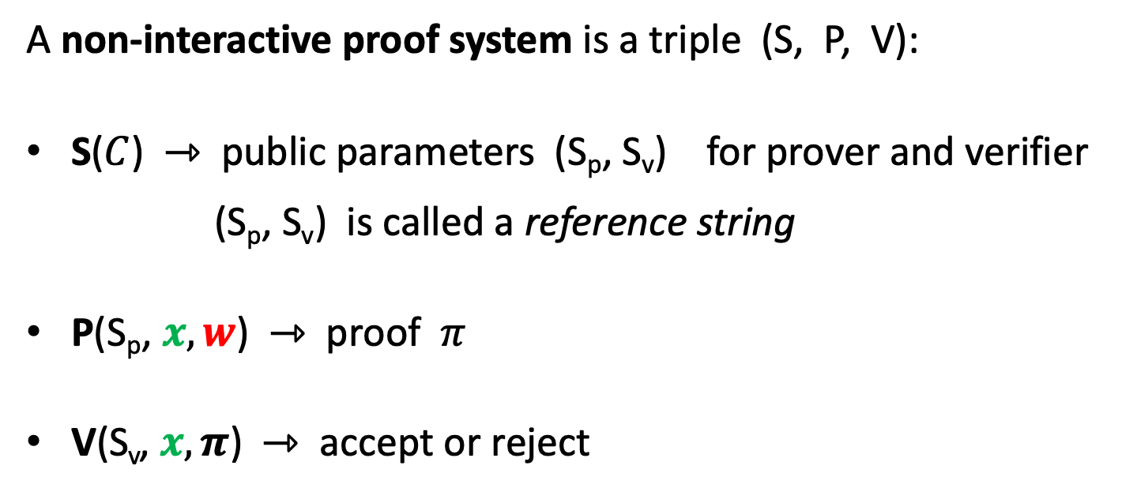
Recap: Non-interactive Proof Systems
A non-interactive proof system is a triple (S, P, V):
S($C$) ⇾ public parameters (S_{p}, S_{v}) for prover and verifier
(S_{p}, S_{v}) is called a reference string
P(S_{p}, $x, w$) ⇾ proof $π$
V(S_{v}, $x, π$) ⇾ accept or reject

Slide 3
Recap: zkRollup
Today: every miner must verify every posted Tx
verify π
verify all Tx
verify all Tx ⇒ short proof π
verify all Tx
verify π
verify all Tx
summary, π
Rollup Server
verifying proof is much easier than verifying 10K Tx

Slide 4
Recap: zkRollup
Today: every miner must verify every posted Tx
verify π
verify all Tx
verify all Tx ⇒ short proof π
verify all Tx
verify π
verify all Tx
summary, π
Rollup Server
verifying proof is much easier than verifying 10K Tx

Slide 5
Rollup with many coordinators
verify π
summary1, π₁
verify π
verify π
Server 1
summary, π
summary2, π₂
Server 2

Slide 6
Zk-zk-Rollup
Multiple servers
Each responsible for subset of users (no overlaps)
Rollup aggregator (can be one of the servers)
Rollup aggregator combines summaries (balance table) and creates one proof that
How can we combine proofs?
Trivial solution:
All servers forward all Tx
Rollup aggregator creates one SNARK
Does not save work

Slide 7
Recap: Non-interactive Proof Systems
A non-interactive proof system is a triple (S, P, V):
S($C$) ⇾ public parameters (S_{p}, S_{v}) for prover and verifier
(S_{p}, S_{v}) is called a reference string
P(S_{p}, $x, w$) ⇾ proof $π$
V(S_{v}, $x, π$) ⇾ accept or reject

Slide 8
SNARK of a SNARK Proof
A non-interactive proof system is a triple (S, P, V):
S($C$) ⇾ public parameters (S_{p}, S_{v}) for prover and verifier
(S_{p}, S_{v}) is called a reference string
P(S_{p}, $x, w$) ⇾ proof $π$
V(S_{v}, $x, π$) ⇾ accept or reject

Slide 9
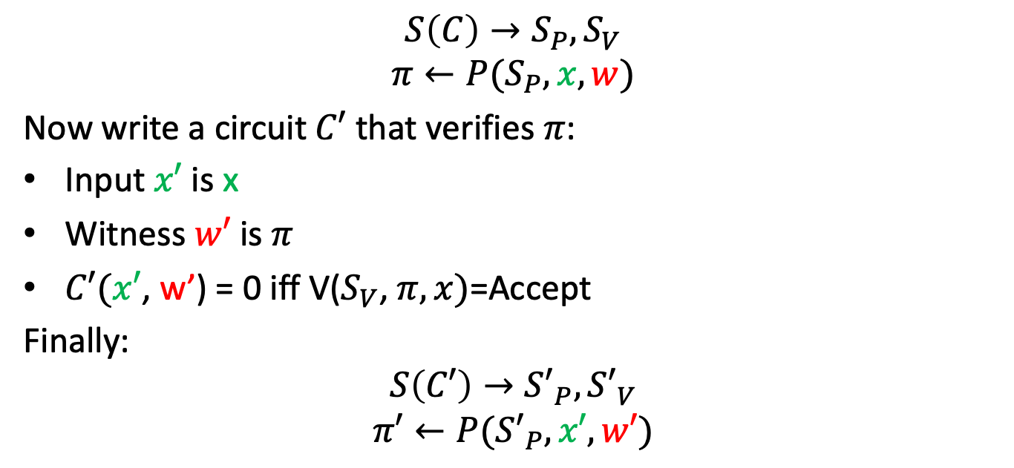
SNARK of SNARK
How can we aggregate proofs?
$$S\left(C\right)→S_{P}, S_{V}$$
$$π←P(S_{P},x, w)$$
Now write a circuit $C′$ that verifies $π$:
Input $x′$ is x
Witness $w′$ is $π$
$C′(x′$, w’) = 0 iff V($S_{V}$, $π, x)$=Accept
Finally:
$$S\left(C′\right)→{S′}_{P}, {S′}_{V}$$
$$π′←P({S′}_{P},x′, w′)$$

Slide 10
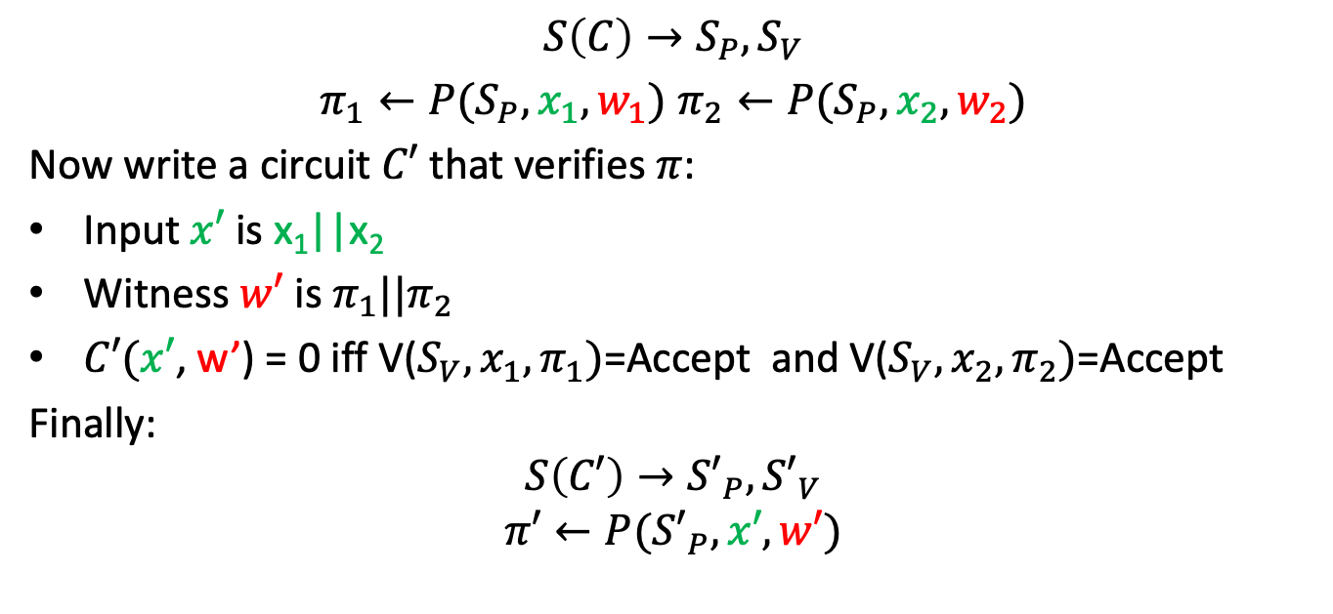
SNARK of SNARKs
How can we aggregate proofs?
$$S\left(C\right)→S_{P}, S_{V}$$
$π_{1}←P(S_{P},x_{1}, w_{1})$ $π_{2}←P(S_{P},x_{2}, w_{2})$
Now write a circuit $C′$ that verifies $π$:
Input $x′$ is x₁||x₂
Witness $w′$ is $π_{1}||π_{2}$
$C′(x′$, w’) = 0 iff V($S_{V}, x_{1},π_{1})$=Accept and V($S_{V}, x_{2},π_{2})$=Accept
Finally:
$$S\left(C′\right)→{S′}_{P}, {S′}_{V}$$
$$π′←P({S′}_{P},x′, w′)$$

Slide 11





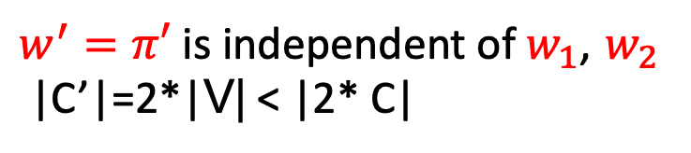


SNARK of SNARKs
Note that C’ depends only on V and S_{v} (not on C₁,C₂)
We can express V as a circuit:
$$0=“Accept”$$
$w^{′}=π′$ is independent of $w_{1}$, $w_{2}$
|C’|=2*|V| < |2* C|
$$\text{×}$$
$$+$$
$$−$$
$$S_{v}$$
$$x′$$
$$π′$$

Slide 12
Building SNARK of SNARKs
How big is C’?
Comparison |SHA256 circuit| = 20k gates
First SNARK of SNARK ~1 million gates with trusted setup (BCTV14)
Today less than 50k gates (Halo, BCLMS20, Nova)
no trusted setup
Independent of inner SNARK circuits!

Slide 13
Rollup with many coordinators
verify π
summary1, π₂
verify π
verify π
Server 1
summary, π
summary2, π₁
Server 2

Slide 14

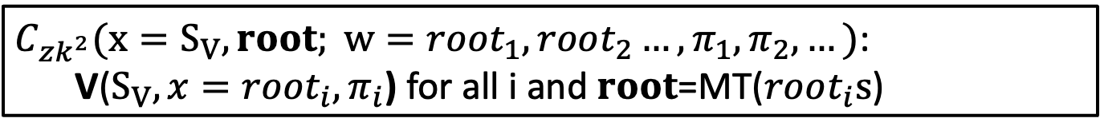




Zk-zk-Rollup
Let root_{i} be the Merkle Tree Root of summary i
$S_{V},S_{P}←S(C_{R})$ // $C_{R}$ rollup circuit
root
Merkle tree
Build one root from summaries
$$root1$$
$$root2$$
$$root3$$
$${root}_{4}$$
$C_{zk^{2}}(x=S_{V},root; w=root_{1},root_{2}…, π_{1},π_{2},…)$:
V($S_{V},x=root_{i},π_{i}$) for all i and $root$=MT($root_{i}s$)

Slide 15
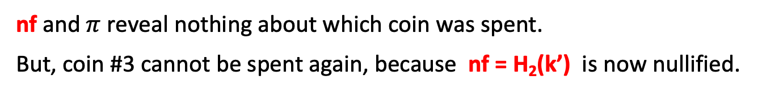
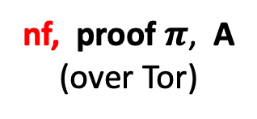
Tornado cash
H₁, H₂: R ⇾ {0,1}²⁵⁶
100 DAI pool:
each coin = 100 DAI
Treasury: 300 DAI
Merkle root
coins
Merkle
root
nf₁
Withdraw coin #3 to addr A:
nf₂
tree of
height 20
(2²⁰ leaves)
(32 bytes)
nf
nf, proof $π$, A
(over Tor)
next = 5
C₁ C₂ C₃ C₄ 0 … 0
100 DAI
nullifiers
to address A
contract state
public list of coins
… but observer does not know which are spent
nf and $π$ reveal nothing about which coin was spent.
But, coin #3 cannot be spent again, because nf = H₂(k’) is now nullified.
Notes:
Stress that H1 is collision resistant.

Slide 16




zk³-Rollup (tornado cash rollup)
verify π
$$π_{tx}$$
summary1, π₁
verify π
verify π
$$π_{tx}$$
Rollup Server 1
summary, π
$$π_{tx}$$
summary2, π₂
$$π_{tx}$$
Rollup Server 2

Slide 17
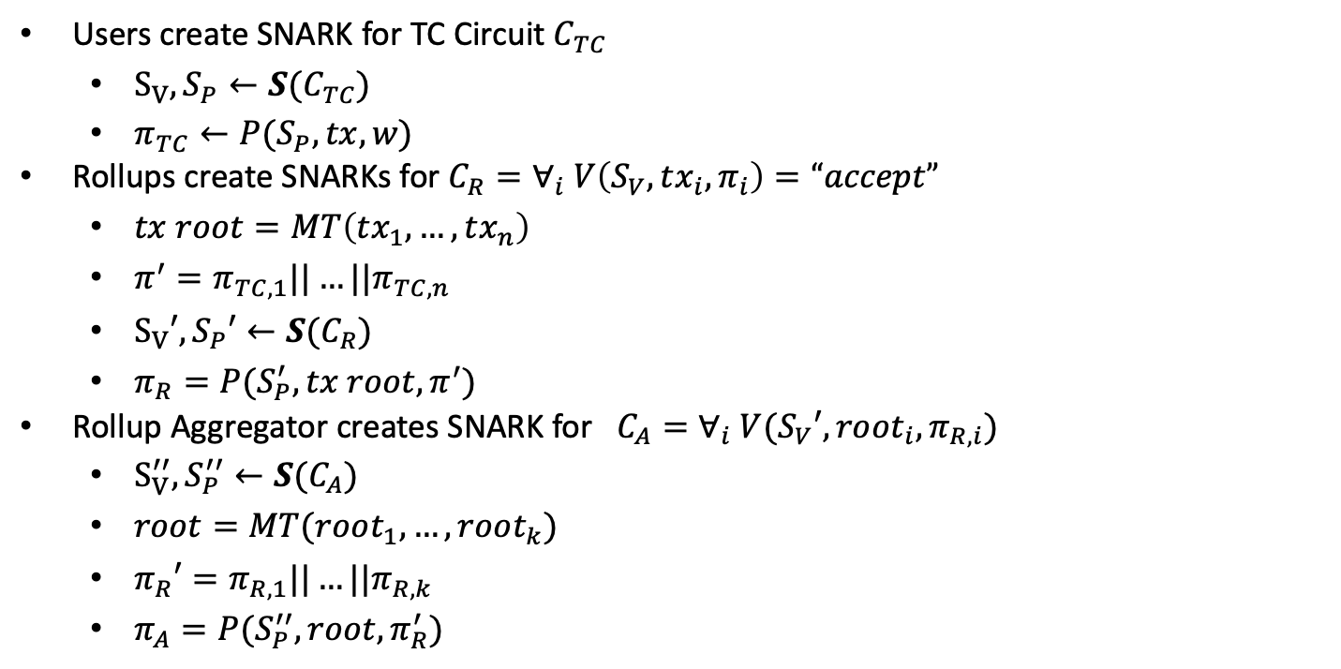
zk³-Rollup
Users create SNARK for TC Circuit $C_{TC}$
$S_{V},S_{P}←S(C_{TC})$
$π_{TC}←P(S_{P},tx,w)$
Rollups create SNARKs for $C_{R}=∀_{i} V\left(S_{V},tx_{i},π_{i}\right)=“accept”$
$tx root=MT\left(tx_{1},…,tx_{n}\right)$
$π^{′}=π_{TC,1}||…||π_{TC,n}$
$S_{V}′,S_{P}′←S(C_{R})$
$π_{R}=P(S_{P}^{′},tx root,π^{′})$
Rollup Aggregator creates SNARK for $C_{A}=∀_{i} V(S_{V}′,root_{i},π_{R,i})$
$S_{V}^{′′},S_{P}^{′′}←S(C_{A})$
$root=MT(root_{1},…,root_{k})$
$π_{R}′=π_{R,1}||…||π_{R,k}$
$π_{A}=P(S_{P}^{′′},root,π_{R}^{′})$

Slide 18
Enhancing transactions with SNARKs
We’ve seen that private transactions require zero-knowledge proofs
Add ZK-SNARKs to every transaction
Level 1 coordinators verify transaction by verifying transaction ZK-SNARKs
Additionally, we can have more complicated transactions (Smart Contracts)
Transaction verification is constant time regardless of proof complexity
Can we also hide the smart contract?

Slide 19
ZEXE private execution
ZEXE is a model of computation (like UTXOs/Scripts or Accounts/EVM)
The basic unit is a record (similar to a UTXO)
Every transaction consumes records and creates records
Universal predicate: Prevents double spends
Birth predicate: Says how a record can be created
Death predicate: Says how a record can be consumed

Slide 20
ZEXE private execution
Record 1:
Birth predicate 1
Death predicate 1
Payload 1
Record 3:
Birth predicate 3
Death predicate 3
Payload 3
Record 2:
Birth predicate 1
Death predicate 1
Payload 1
TX checks that Record 1 and Record 2 have not been spent
Birth3(R1, R2,R3) and Death1(R1, R2,R3) and Death2(R1,R2,R3)

Slide 21
ZEXE private execution
Universal predicate (similar to tornado cash)
Uses nullifiers
Checks that nullifier=H(sk,records) is properly created
Checks that nullifier only appears once
Prevents double spends
Merkle root
tree of
height 20
(2²⁰ leaves)
R₁ R₂ R₃ … 0 0 0

Slide 22
Implementing assets with ZEXE
Record payload has a value v and an asset id
Birth predicate
Defines the token
New record id needs to match consumed predicate ids
New record value is sum of inputs
Death predicate
Defines the SCRIPT
E.g. spendable by signature
E.g. Spendable by multisigature + preimage of hash

Slide 23
Implementing smart contracts with ZEXE
Record payload is state of smart contract, smart contract instance id
Birth predicate
Either creates smart contract or
One of the inputs needs to be the old smart contract record
Death predicate
Defines the smart contract logic

Slide 24
ZEXE game of Chess
Record payload is state of smart contract, smart contract instance id
Birth predicate
Starts new game (and assigns pks to black/white) or
One of the inputs needs to be the old chess game
Death predicate
If game finished then pay money to the winner
Otherwise input records must be game record + one move record
Move record must be signed by the right player
Move record must contain a valid move

Slide 25
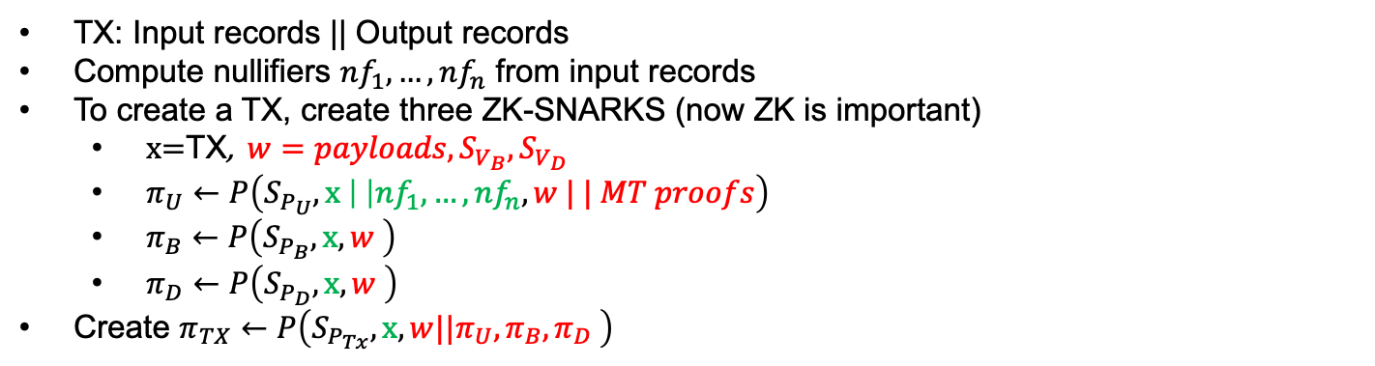
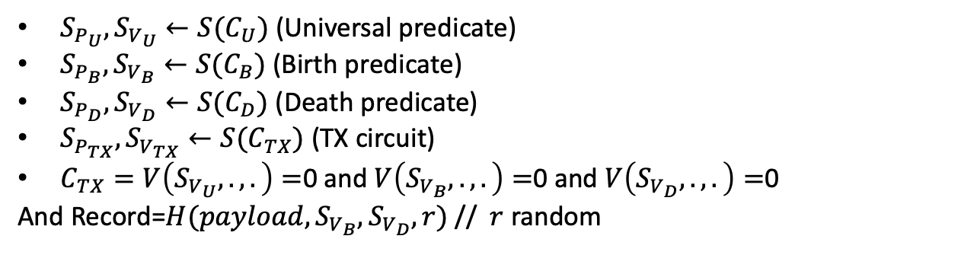
Making ZEXE private
$S_{P_{U}},S_{V_{U}}←S(C_{U})$ (Universal predicate)
$S_{P_{B}},S_{V_{B}}←S(C_{B})$ (Birth predicate)
$S_{P_{D}},S_{V_{D}}←S(C_{D})$ (Death predicate)
$S_{P_{TX}},S_{V_{TX}}←S(C_{TX})$ (TX circuit)
$C_{TX}=V\left(S_{V_{U}},.,.\right)=$0 and $V\left(S_{V_{B}},.,.\right)=$0 and $V\left(S_{V_{D}},.,.\right)=$0
And Record=$H(payload,S_{V_{B}},S_{V_{D}},r)$ // $r$ random
Merkle root
tree of
height 20
(2²⁰ leaves)
R₁ R₂ R₃ … 0 0 0
TX: Input records || Output records
Compute nullifiers $nf_{1},…,nf_{n}$ from input records
To create a TX, create three ZK-SNARKS (now ZK is important)
$\text{x}\text{=}\text{TX}$, $w=payloads,S_{V_{B}},S_{V_{D}}$
$π_{U}←P\left(S_{P_{U}},\text{x} \left| \right|nf_{1}, …,nf_{n}, w | | MT proofs\right)$
$π_{B}←P\left(S_{P_{B}},\text{x}, w \right)$
$π_{D}←P\left(S_{P_{D}},\text{x}, w \right)$
Create $π_{TX}←P\left(S_{P_{Tx}},\text{x}, w||π_{U},π_{B},π_{D} \right)$
MT of all records
Birth and death predicate as well as records are private!

Slide 26

Hitchhikers guide to the galaxy
What if we want to verify that computation?
Input
Output (42)
Long Computation

Slide 27
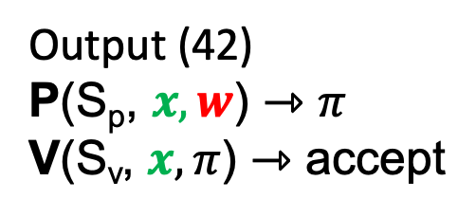
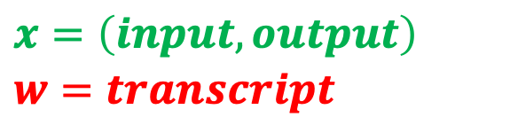
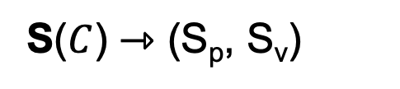
SNARKs for long computations
Issues:
-P takes very long
-Starts after proving after computation finished
-Can’t hand off computation
-S also runs at least linear in |C|
(ok if many proofs)
C – Circuit for long computation
S($C$) ⇾ (S_{p}, S_{v})
$$x=\left(input,output\right)$$
$$w=transcript$$
Input
Output (42)
P(S_{p}, $x,w$) ⇾ $π$
V(S_{v}, $x,π$) ⇾ accept
Long Computation, Transcript

Slide 28

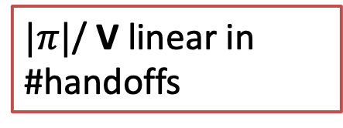
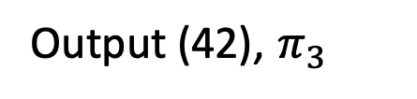

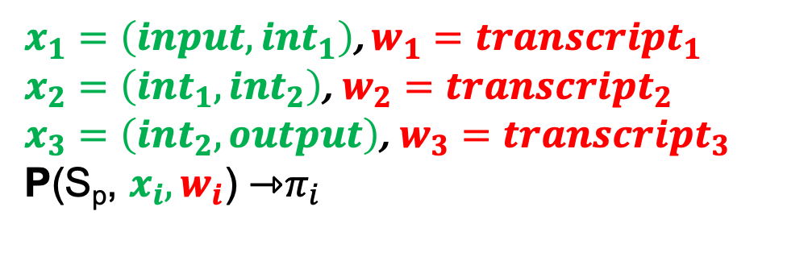
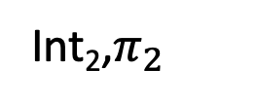
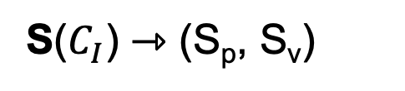
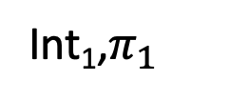
Handing off computation
$C_{I}$– Circuit for long intermediate computation
$x_{1}=\left(input,int_{1}\right)$, $w_{1}=transcript_{1}$
$x_{2}=\left(int_{1},int_{2}\right)$, $w_{2}=transcript_{2}$
$x_{3}=\left(int_{2},output\right)$, $w_{3}=transcript_{3}$
P(S_{p}, $x_{i},w_{i}$) ⇾$π_{i}$
S($C_{I}$) ⇾ (S_{p}, S_{v})
V(S_{v}, $x_{1}, π_{1}$)
V(S_{v}, $x_{2}, π_{2}$)
V(S_{v}, $x_{3}, π_{3}$)
$|π|$/ V linear in #handoffs
Input
Int₁,$π_{1}$
Int₂,$π_{2}$
Output (42), $π_{3}$
transcript₁
transcript₂
transcript₃

Slide 29
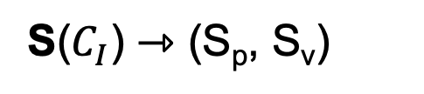
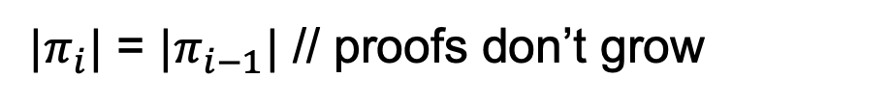
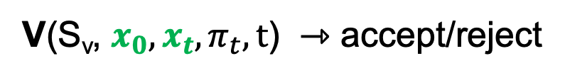
Incremental Proofs
We need updatable/incremental proofs
$C_{I}$– Circuit per computation step, $t$ number of steps/handoffs
S($C_{I}$) ⇾ (S_{p}, S_{v})
P(S_{p}, $x_{i}, w_{i},π_{i−1}$) ⇾ updated proof $π_{i}$ // $π_{0}=⊥$
V(S_{v}, $x_{0},x_{t},π_{t},t$) ⇾ accept/reject
$|π_{i}|$ = $|π_{i−1}|$ // proofs don’t grow

Slide 30
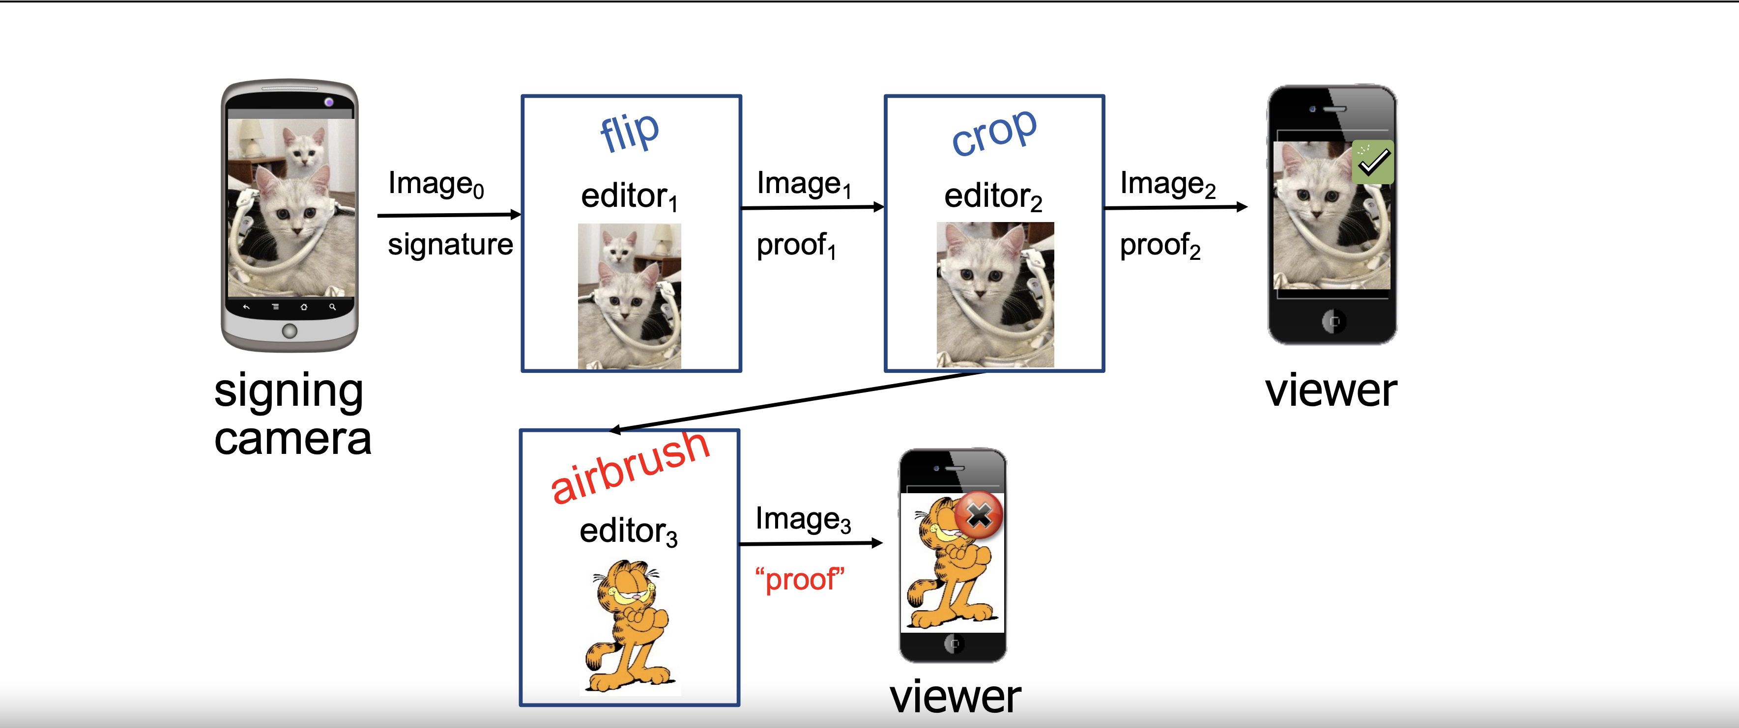
PhotoProof
Viewer can still verify authenticity
Allow valid updates of photo and provide proof

Slide 31
PhotoProof
Proof allows valid edits only, Incrementally updated

Slide 32
Constant size blockchains
Rollup reduces the verification cost
Still linear in the number of state updates
When a node joins the network they need to verify one rollup proof per block!
In general starting a full node requires verification of all blocks
Can take days!

Slide 33
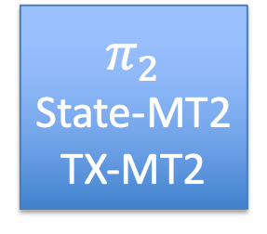
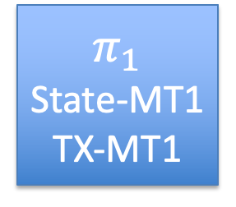
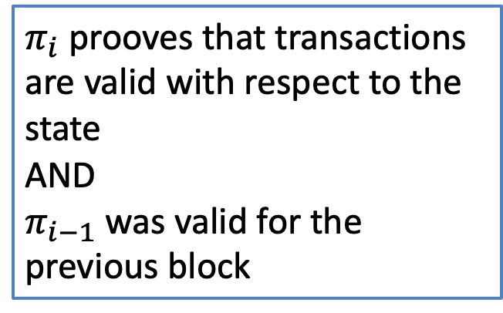
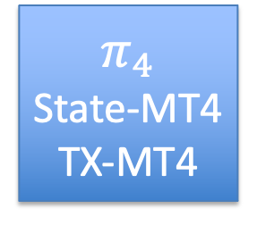
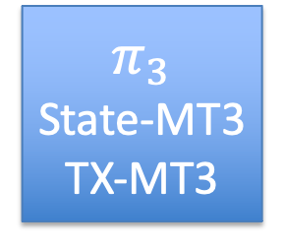
Constant size Blockchain
$$π_{1}$$
State-MT1
TX-MT1
$$π_{2}$$
State-MT2
TX-MT2
$$π_{3}$$
State-MT3
TX-MT3
$$π_{4}$$
State-MT4
TX-MT4
Merkle tree
$π_{i}$ prooves that transactions are valid with respect to the state
AND
$π_{i−1}$ was valid for the previous block
Transactions

Slide 34
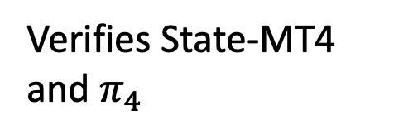
Constant size Blockchain
$$π_{1}$$
State-MT1
TX-MT1
$$π_{2}$$
State-MT2
TX-MT2
$$π_{3}$$
State-MT3
TX-MT3
$$π_{4}$$
State-MT4
TX-MT4
Merkle tree
Old miner
Head and State 4
Transactions
New miner
Verifies State-MT4 and $π_{4}$

Slide 35
Constant size Blockchain
Light clients can verify every block!
Low memory, low computation
Independent of length of chain or #transactions
Relies on data serving nodes for synching
Practical today!

Slide 36
END OF LECTURE
Next lecture: Crypto tricks and open discussion
Please attend last two lectures if you can

