Slide 1
Nakamoto Consensus
CS251 Fall 2020
(cs251.stanford.edu)
Benedikt Bünz

Slide 2
Consensus
Security Properties:
Consistency: Honest nodes do not contradict
Liveness: Progress is made
Network Models
Synchronous: Messages get delivered immediately
Partially Synchronous: Messages are out of order

Slide 3

Consensus
Accepts/Rejects TXs
Leader
Committee

Slide 4
Problems with approach
Known committee
(must communicate)
Large committee
Large communication
Honest majority (incentives)
Predictable Leader
Bribing 💸

Slide 5

Recap
genesis block
BH₃
BH₁
BH₂
version (4 bytes)
prev (32 bytes)
time (4 bytes)
bits (4 bytes)
nonce (4 bytes)
Tx root (32 bytes)
prev
Tx root
prev
Tx root
H
H
H
…
80 bytes
coinbase Tx
coinbase Tx

Slide 6
Nakamoto Consensus
BH₁
BH₂
PoW:
Find nonce s.t.
H(Block)<Target
Target s.t. blocks found every 10 min
Genesis
H(Gen)
Time
Nonce
Root
H(BH₁)
Time
Nonce
Root
H
H
H
H(BH₂)
Time
Root
H(BH₂)
Time
Root
coinbase Tx
Notes:
4 bytes

Slide 7
Nakamoto Consensus
BH₁
BH₂
BH₃
Genesis
Prev
Time
Nonce
Root
Prev
Time
Nonce
Root
H
H
H
H
H(BH₂)
Time
Root
H(BH₂)
Time
83512
Root
coinbase Tx
Notes:
4 bytes

Slide 8
Nakamoto Consensus
BH₁
BH₂
BH₃
Genesis
Prev
Time
Nonce
Root
Prev
Time
Nonce
Root
H(BH₂)
Time
83512
Root
H
H
H
H
H(BH₂₃)
Time
Root
H(BH₃)
Time
Root
coinbase Tx
Notes:
4 bytes

Slide 9
Nakamoto Consensus
PoW:
Find nonce s.t.
H(Block)<Target
Miners “race” to add blocks
Prepare Block Template
Find nonce (PoW solution)
One winner every ~10 min
Target adjusted every 2 weeks
Probability winning ~ Computation power
Prev
Time
Root
Prev
Time
Root
Notes:
4 bytes

Slide 10
Nakamoto Consensus
Miners “race” to add blocks
Need to find PoW solution
Probability winning ~ Computation power
One winner every ~10 min
Target adjusted every 2016 Blocks
On average 2016 blocks = 2 weeks
(Honest) miners extend longest chain
Timestamps must be roughly accurate
All transactions must be valid
Blocks/Transactions become final after k blocks
Leader election/race combined with tx adding
PoW:
Find nonce s.t.
H(Block)<Target
Prev
Time
Root
Prev
Time
Root
Notes:
4 bytes

Slide 11
Forks and Orphans
Working on B
B
A
C
Working on A

Slide 12
Forks and Orphans
Working on B C
Orphaned block
B
A
C
Working on A C

Slide 13


Preventing double spends
I’ll wait k blocks
I’ll just produce a different chain
Here are the keys
We’ll be working on the longest chain
No Car TX
3 BTC
For Car

Slide 14
51% Attack
I’ll just produce a different chain
Cloud
New longest chain
No Car TX
3 BTC
For Car

Slide 15
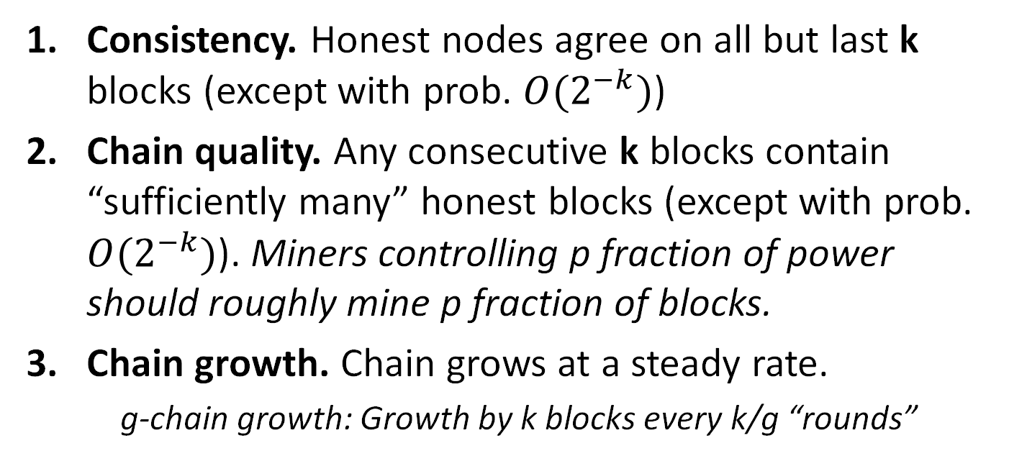
Nakamoto properties
Consistency. Honest nodes agree on all but last k blocks (except with prob. $O(2^{−k})$)
Chain quality. Any consecutive k blocks contain “sufficiently many” honest blocks (except with prob. $O(2^{−k})$). Miners controlling p fraction of power should roughly mine p fraction of blocks.
Chain growth. Chain grows at a steady rate.
g-chain growth: Growth by k blocks every k/g “rounds”

Slide 16
Nakamoto properties => Blockchain
Consistency implies Blockchain consistency
Chain growth + chain quality implies Blockchain liveness
The chain grows by k blocks every k/g periods
By chain quality, a high fraction of blocks are contributed by honest miners, and therefore include all transactions they heard so far

Slide 17
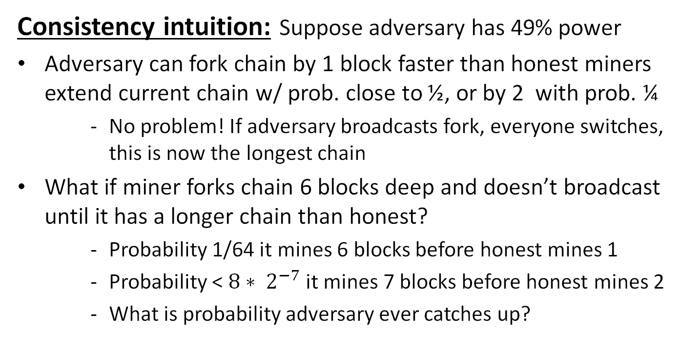
Nakamoto consensus
Consistency intuition: Suppose adversary has 49% power
Adversary can fork chain by 1 block faster than honest miners extend current chain w/ prob. close to ½, or by 2 with prob. ¼
No problem! If adversary broadcasts fork, everyone switches, this is now the longest chain
What if miner forks chain 6 blocks deep and doesn’t broadcast until it has a longer chain than honest?
Probability 1/64 it mines 6 blocks before honest mines 1
Probability < $8∗ 2^{−7}$it mines 7 blocks before honest mines 2
What is probability adversary ever catches up?
Notes:
Probability of privately mining longest chain faster than honest portion of network degrades exponentially

Slide 18
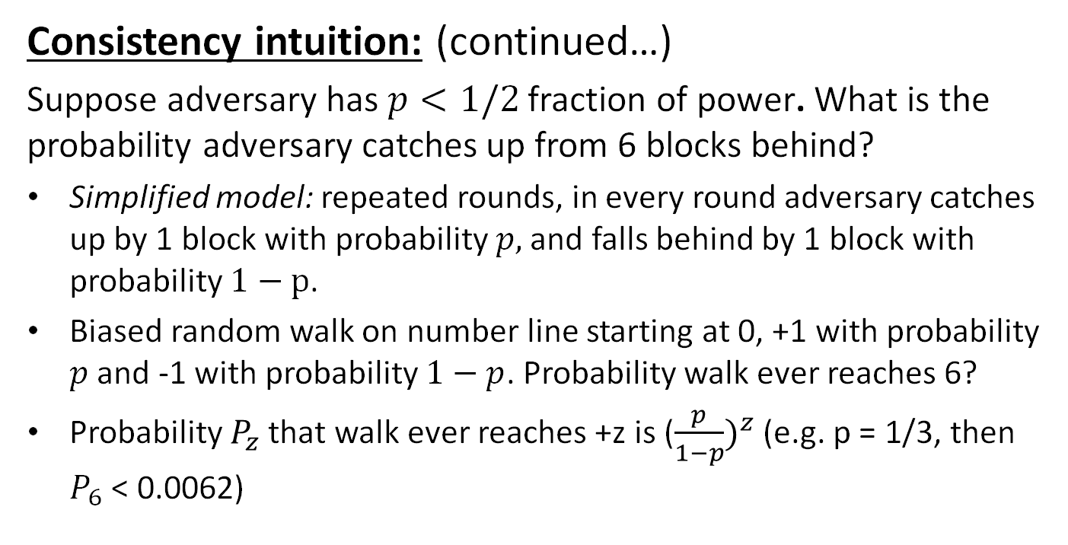
Nakamoto consensus
Consistency intuition: (continued…)
Suppose adversary has $p<1/2$fraction of power. What is the probability adversary catches up from 6 blocks behind?
Simplified model: repeated rounds, in every round adversary catches up by 1 block with probability $p,$ and falls behind by 1 block with probability $1−p$.
Biased random walk on number line starting at 0, +1 with probability $p$ and -1 with probability $1−p$. Probability walk ever reaches 6?
Probability $P_{z}$ that walk ever reaches +z is (${\frac{p}{1−p})}^{z}$ (e.g. p = 1/3, then $P_{6}$ < 0.0062)
Notes:
Probability of privately mining longest chain faster than honest portion of network degrades exponentially

Slide 19
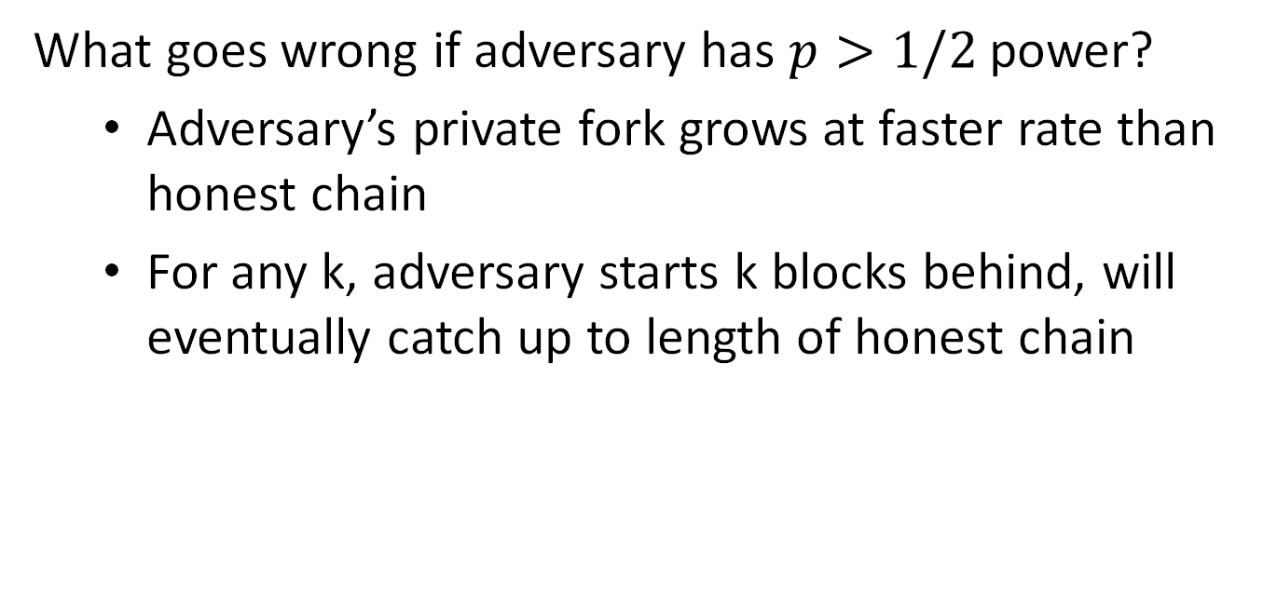
Nakamoto consensus
What goes wrong if adversary has $p>1/2$power?
Adversary’s private fork grows at faster rate than honest chain
For any k, adversary starts k blocks behind, will eventually catch up to length of honest chain

Slide 20
45% Attack
I’ll just produce a different chain
Cloud
No Car TX
3 BTC
For Car
Incur network delays and orphans

Slide 21
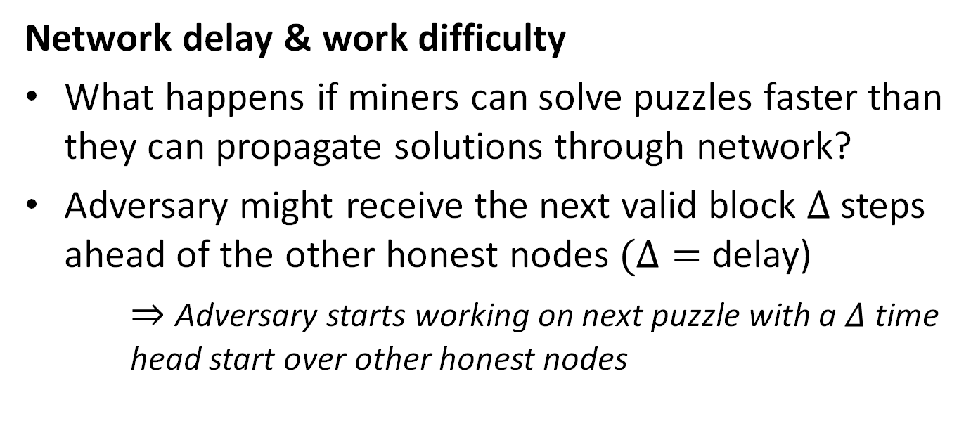
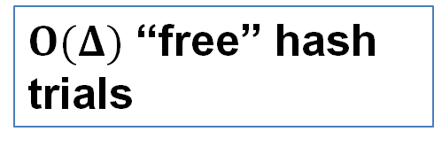
Nakamoto consensus
Network delay & work difficulty
What happens if miners can solve puzzles faster than they can propagate solutions through network?
Adversary might receive the next valid block $Δ$ steps ahead of the other honest nodes$(Δ=$ delay)
$⇒$ Adversary starts working on next puzzle with a $Δ$ time head start over other honest nodes
$O(Δ)$ “free” hash trials
Notes:
Say $Δ$ is greater than the time it takes the adversary to solve puzzles. In worst case, honest nodes only start working on next puzzle every $Δ$ time steps, after they have heard a block from other honest nodes, whereas the adversary hears blocks immediately, solves the next block in time less than $Δ,$and starts working on the next one, etc. This adversary is now mining blocks at a faster rate than the honest nodes in the network.

Slide 22
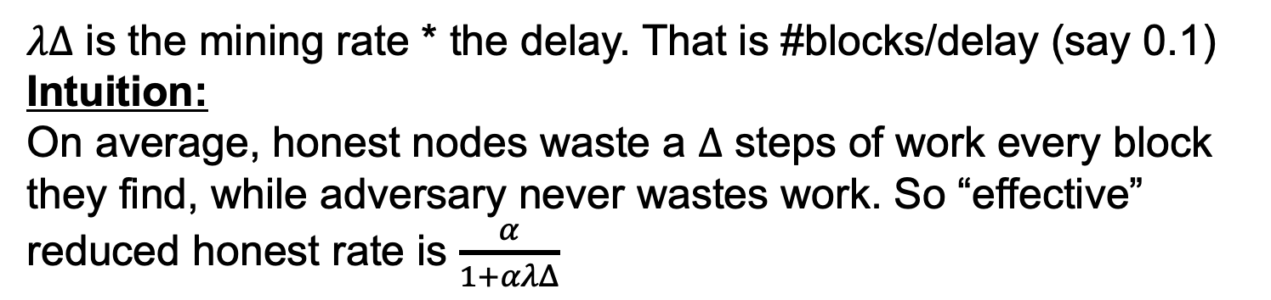

Nakamoto consensus
Adjusting difficulty for $Δ$
Formula from [SZ15]
Network mining rate (1 Block/10min)
Honest mining fraction (say 60%)
$$\frac{α}{1+αλΔ}>β$$
Adversary power (40%)
$λΔ$ is the mining rate * the delay. That is #blocks/delay (say 0.1)
Intuition:
On average, honest nodes waste a $Δ$ steps of work every block they find, while adversary never wastes work. So “effective” reduced honest rate is $\frac{α}{1+αλΔ}$
Notes:
$α\left(\frac{c}{c+1}\right)≈α\left(\frac{c−1}{c}\right)=α\left(1 −\frac{1}{c}\right)=α(1−αΔ)$

Slide 23

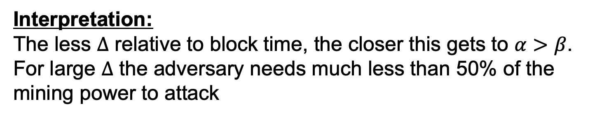
DKT+ Theorem
Theorem: There exists a k such that Nakamoto Consensus has consistency and liveness if and only if:
$$\frac{α}{1+αλΔ}>β$$
Private chain attack = Actual security (was an open question)
Interpretation:
The less $Δ$ relative to block time, the closer this gets to $α>β$.
For large $Δ$ the adversary needs much less than 50% of the mining power to attack
Notes:
$α\left(\frac{c}{c+1}\right)≈α\left(\frac{c−1}{c}\right)=α\left(1 −\frac{1}{c}\right)=α(1−αΔ)$

Slide 24

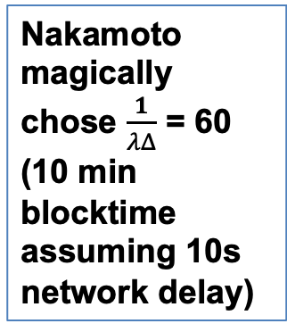
DKT+ Theorem Graph
Nakamoto magically chose $\frac{1}{λΔ}$ = 60 (10 min blocktime assuming 10s network delay)
Blue line = max value of $β$ s.t.$\frac{α}{1+αλΔ}>β$

Slide 25
Short Forks and Liveness
Long forks are impossible but short forks may not be
This is a liveness issue
Need to ensure that some “honest” blocks are in the longest chain
Could be used to censor transactions

Slide 26
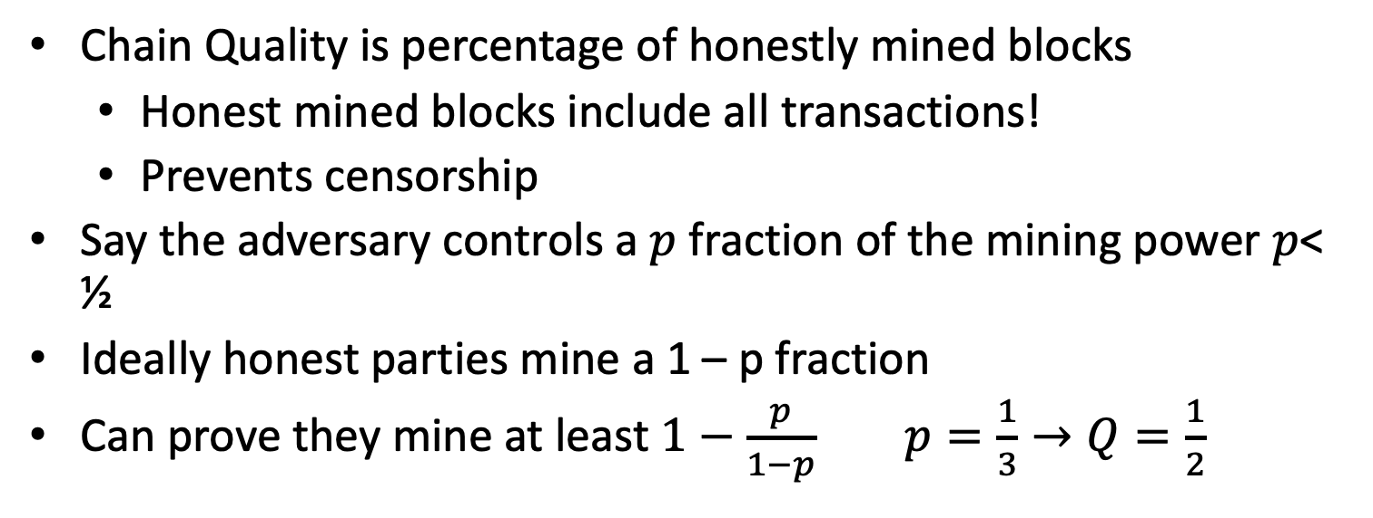
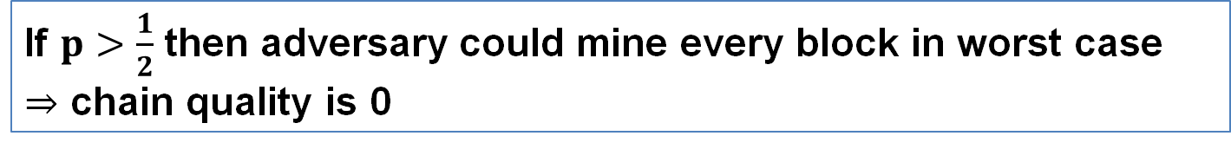
Nakamoto chain quality
Chain Quality is percentage of honestly mined blocks
Honest mined blocks include all transactions!
Prevents censorship
Say the adversary controls a $p$ fraction of the mining power $p$< ½
Ideally honest parties mine a 1 – p fraction
Can prove they mine at least $1−\frac{p}{1−p}$ $p=\frac{1}{3}→Q=\frac{1}{2}$
If $p>\frac{1}{2}$ then adversary could mine every block in worst case
$⇒$ chain quality is 0

Slide 27
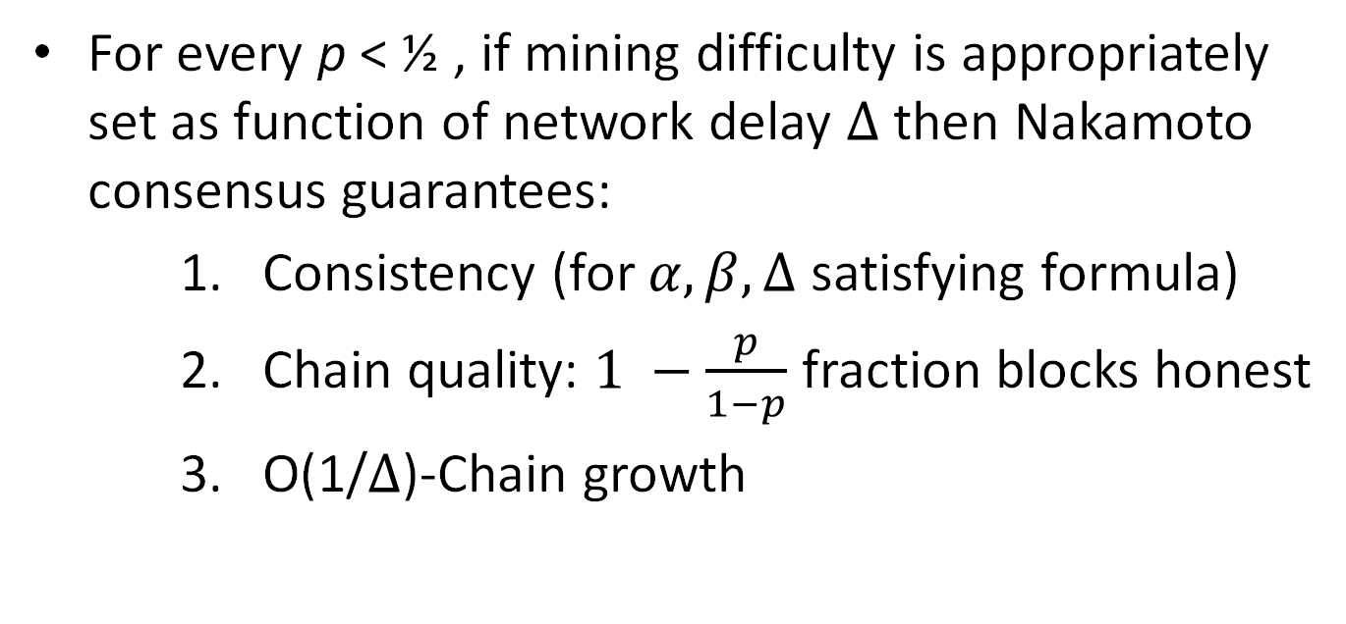
Chain Quallity Theorem
For every p < ½ , if mining difficulty is appropriately set as function of network delay $Δ$ then Nakamoto consensus guarantees:
Consistency (for $α, β, Δ$ satisfying formula)
Chain quality: $1 −\frac{p}{1−p}$ fraction blocks honest
O(1/$Δ$)-Chain growth

Slide 28
Nakamoto Conensus and Partial Synchrony
Nakamoto Consensus can be secure up to ½ corruptions
Can tolerate network delays
Contradicts partial synchrony lower bound?
No
Protocol needs a bound on delays ( c)
Consistency broken even with honest nodes

Slide 29
Nakamoto Properties
Anonymous participation
Nodes can join/leave
Very scalable
Sleeping Beauty property
Leader not known beforehand
Makes bribing harder
Up to ½ corruptions
Slow
Even when everyone is honest
Resource intensive
PoS based possible
No finality
No guarantees under long delays

Slide 30
Incentives
Mining (solving PoW puzzles) is very expensive
Honest majority does not seem realistic
Satoshi’s genius idea: Combine issuance and rewards
Block reward only paid if block part of longest chain
High Variance -> Mining Pools
💧
Block Reward 💸

Slide 31
Incentives
Large opportunity cost for unsuccessful attacks
Block Reward
Block reward
Block reward
Block Reward

Slide 32
Selfish mining attack
Attacker has 1/3 of mining power. Miner is rational (maximize rewards)
Keeps block private
Block Reward
Block Reward
Block Reward
Once attacker has a two block lead he can mine until honest chains catch up
Block Reward
Block Reward

Slide 33
Selfish mining attack
Attacker has 1/3 of mining power. Miner is rational (maximize rewards)
Keeps block private
Block Reward
Block Reward
Block Reward
Once attacker has a two block lead he can mine until honest chains catch up
Block Reward
Block Reward
Attacker publishes chain and invalidates honest blocks

Slide 34
Selfish mining attack
Attacker has 1/3 of mining power. Miner is rational (maximize rewards)
Keeps block private
Block Reward
If honest miners finds block:
Publish and it’s a block race
(Attacker has at least 1/3 p of winning)
Block Reward

Slide 35
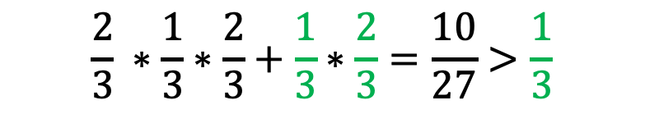
Selfish mining analysis
Honest reward=1/3
$$\frac{2}{3} ∗\frac{1}{3}∗\frac{2}{3}+\frac{1}{3}∗\frac{2}{3}=\frac{10}{27}>\frac{1}{3}$$
P Block Race:
2/3
P Run away: 1/3
Block Reward
Block Reward
Block Reward
Win: 1/3 chance
2 of 3 blocks Reward 2/3
Loose: 2/3 chance
Reward 0
Block Reward
Block Reward
Reward > 2/3

Slide 36
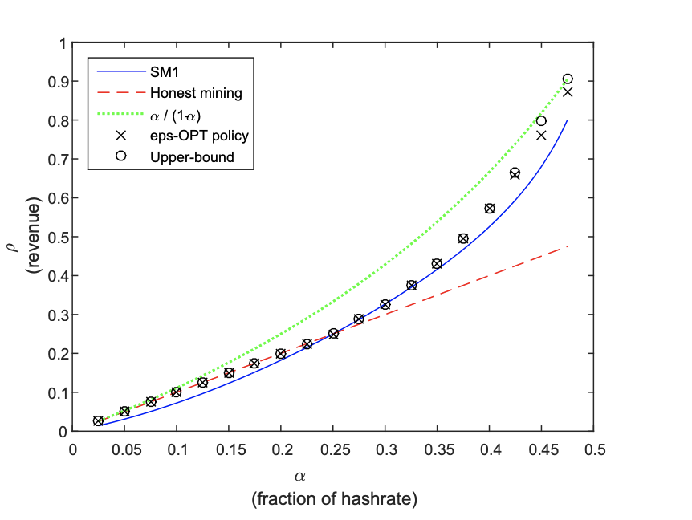
Selfish Mining
Optimal Selfish mining
Explains why chain quality <1-p

Slide 37
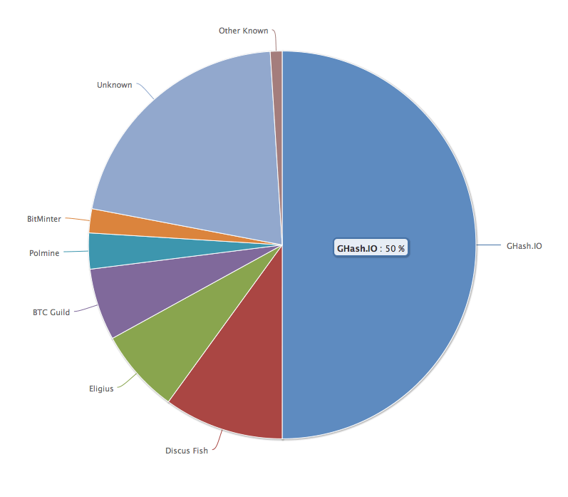
No Attacks in Practice?
Attacks possible but not seen
Ghash.IO had >50%
Gave up mining power
No Selfish mining attacks
Why?
Miners care about Bitcoin price
Not rational in $ terms to attack
Not guaranteed in the future

Slide 38
END OF LECTURE
Next lecture:
Randomness beacons, VDFs, large scale PoS

