Slide 1
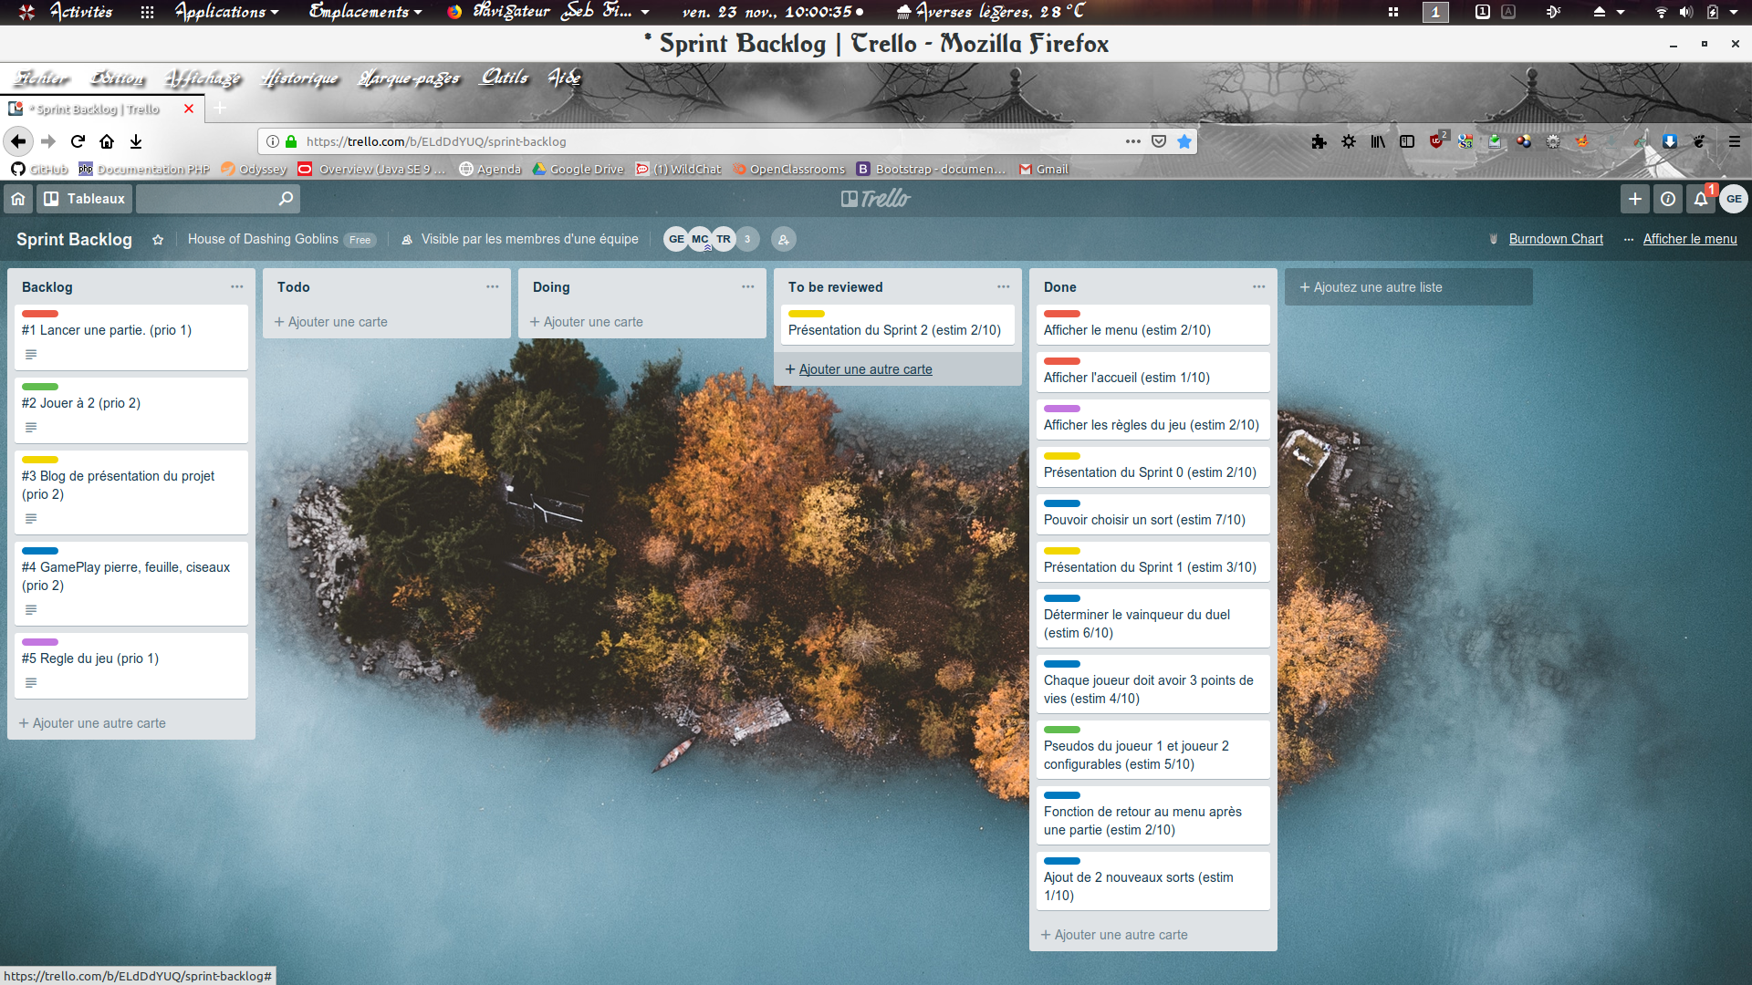
DUEL DE SORTS

Slide 2

SPRINT 2

Slide 4

LE BLOG
https://wildcodeschool.github.io/reims-1018-java-le-duel/index.html

Slide 5
DEMO

Slide 6

CONCLUSION

