Slide 1

An Astronomical Pattern-Matching Algorithm for Automated Identification of Whale Sharks (Rhincodon typus)
Jason Holmberg, Brad Norman
ECOCEAN
www.whaleshark.org

Slide 2
Limitations in Marker Tagging
Fouling
Tag loss rates are high
Signs of external interference (bites, etc.)
Invasive with possibility of “trap response”
Notes:
Marketing has become more targeted for seafood (e.g. health and quality) – need to move to sustainability
A significant emotional bridge between people’s concerns over sustainability and their buying habits is yet to be built. “Sustainability as a branding concept”

Slide 3
Challenges in Automated
Photo-identification
Multiple surface areas with spots
Variable shark orientation to camera lens (pitch\roll\yaw)
Environmental interference (light\fish)
Need for safe, non-invasive methodology
Demand for a fast, low cost identification mechanism

Slide 4
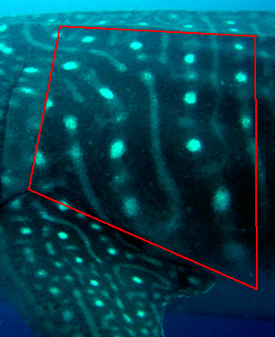
Selecting an Optimum Fiducial Region and Orientation
Defined by visible natural boundaries
Contains non-uniform patterning
Common, non-invasive angle and orientation
Low yield of spots (15-60) for low-intensity processing
Small area minimizes distortion effects, allows a “flat” surface assumption
Chosen by G. Taylor

Slide 5
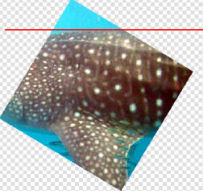
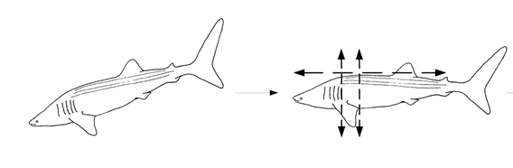
Standardized Image Processing:
Orientation Correction
Images are selected with a preference for minimum yaw and minimum roll to standardize inter-spot relationships
Images are corrected for pitch (image-plane rotation)

Slide 6
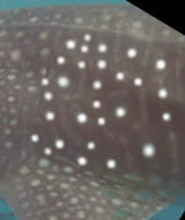
Standardized Image Processing:
Contrast Enhancement
Contrast enhancement:
assists computer recognition of spots from “real world” data using colour discrimination
reduces “noisy” pixels that may cause false spots
standardizes center points through added “best fit” spots

Slide 7
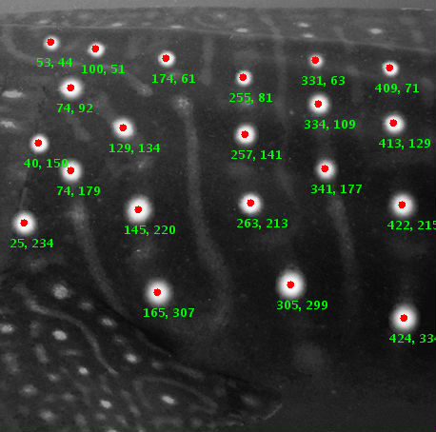
Standardized Image Processing:
Spot Metric Extraction
“Blob extraction” is a machine vision technique for object measurement
Central x,y coordinate pair for each spot is collected and stored in a list in the Library database
Total processing time from new photo to submitted pattern is approximately 15 minutes.

Slide 8
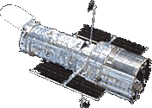
Pattern Matching:
Groth¹ Algorithm
Analysis of available pattern recognition techniques suggested a promising astronomical algorithm that:
Matches coordinate lists with as few as 25% of coordinate pairs (spots) in common
Has a proven history of usage and success in the STSDAS software for the Hubble Space Telescope program
Includes multiple tolerance parameters that can be tuned for a new problem space
1. Groth, E.J. (1986) A Pattern-Matching Algorithm for Two-Dimensional Coordinate Lists. The Astronomical Journal, 91, 1244-1248.
Notes:
Modern catching techniques and fish finding technology means fishermen are able to respond to market demands - you want monkfish - you’ll get monkfish, etc. If it’s there - they can find it.
Parents relate to Birds Eye - savvy branded marketeers increasing the desirability of fish to children.
And
Producing it in ways that mean it isn’t scary. - Ready meals, Value Added products, fish shapes…
Health message - Dr. Perricone says “Eat fish to look great”, salmon is the best food for endurance, brain food, etc.
DEVELOPED WORLD: Increase by 4%
DEVELOPING WORLD: Increase by 57%
This represents half of the world’s fish consumption

Slide 9
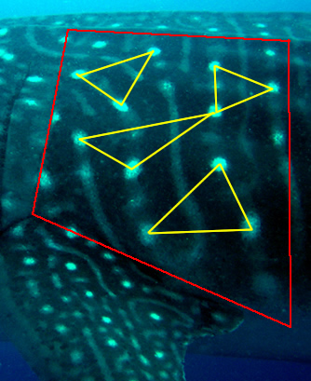
Pattern Matching:
Groth Algorithm Fundamentals
Trigonometric relationships between spots in an image create a unique identifier
Spot interrelationships can be measured and compared by forming all possible triangles of three spots
A “voting” system allows potential matches to be ranked with a numeric score value.

Slide 10
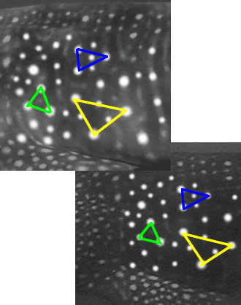
Pattern Matching:
Groth Triangle Comparison
Triangles can be matched by:
Comparing internal angles
Comparing ratios of the lengths of sides
Examining translational differences
1999
Potential “matched” triangle pairs
2001

Slide 11
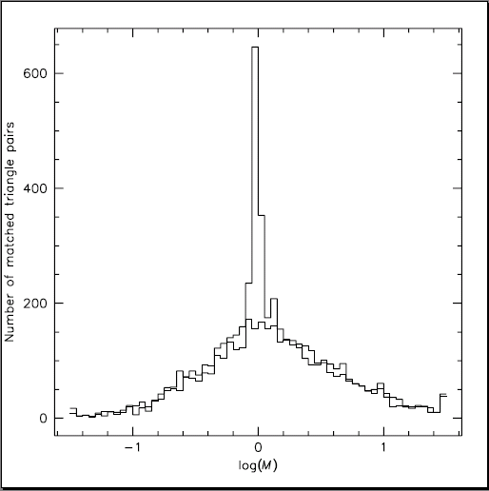
Pattern Matching:
Magnification Filtering
Matched triangle pairs from two images – if from the same shark – should share a relative magnification (M).
Filtering by standard dev. in magnification isolates the most common magnification
Triangle pairs surviving M-filtering are scored (vote).

Slide 12

Pattern Matching:
Algorithm Adaptations
Whale shark identification requires modifications to Groth’s original algorithm for star matching:
Challenge
Solution
Spot size and imperfect lighting require greater error allowance in spot location.
Increased allowable error in each spot’s position when comparing triangles.

Slide 13
Pattern Matching:
Algorithm Adaptations
Whale shark identification requires modifications to Groth’s original algorithm for star matching:
Challenge
Solution
Rotational independence is not required. Whale sharks have tops and bottoms.
Added rotational filtering when matching triangles to increase match accuracy.

Slide 14
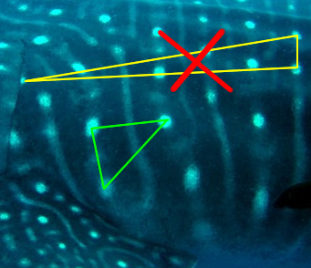
Pattern Matching:
Algorithm Adaptations
Whale shark identification requires modifications to Groth’s original algorithm for star matching:
Challenge
Solution
Natural body curvature distorts spot positioning and therefore triangle formation.
Filtered out large triangles, which are subject to the greatest amount of distortion.

Slide 15
Pattern Matching:
Algorithm Adaptations
Whale shark identification requires modifications to Groth’s original algorithm for star matching:
Challenge
Solution
Original voting scores did not provide a measure of confidence.
Developed a composite “product score” to normalize scores based on the fraction of triangles matched.
S = F_{t}V

Slide 16
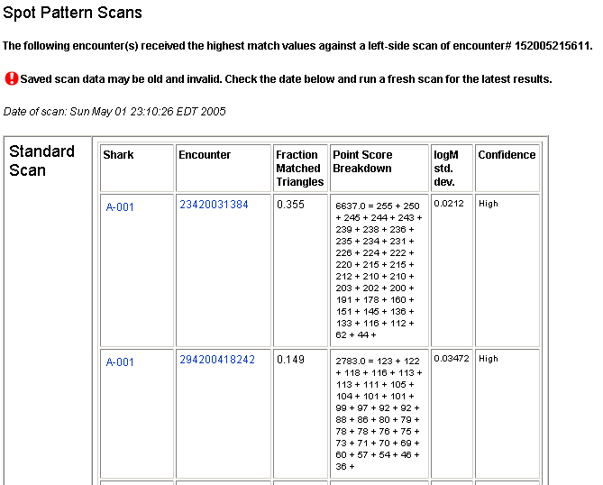
Pattern Matching:
Display of Results

Slide 17
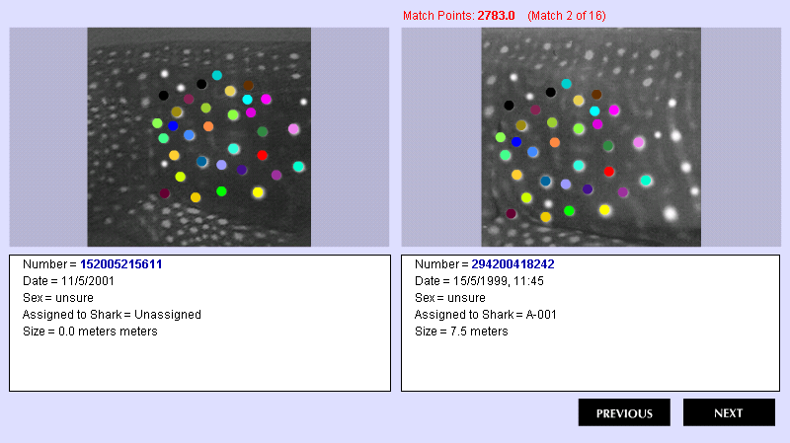
Pattern Matching:
Display of Results

Slide 18
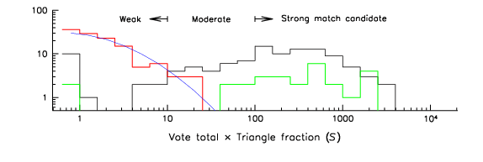

Pattern Matching:
Evaluation of Match Confidence
Low
S < 10
Medium
S >= 10
High
S >= 100
Confidence Intervals

Slide 19
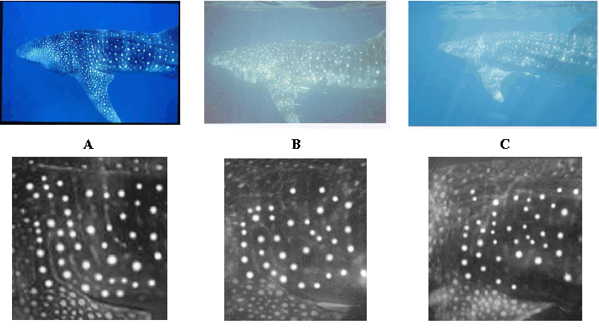
Pattern Matching:
Challenges and Areas for Improvement
The number one cause of match failure is extreme yaw between photographs. Can we get perspective invariance?

Slide 20
Pattern Matching:
Challenges and Areas for Improvement
The number one source of error introduced into the system is human error in image processing (e.g., spot selection). Can we automate spot detection?

Slide 21
Pattern Matching:
Results Summary
Several hundred “blind matches” have been made using the algorithm
Matches have been made with “High” confidence up to eleven years apart (and counting…)
86% (96/111) of matches using real-world data receive a “High” or “Moderate” confidence ranking and are returned by the system as the 1st of all possible matches. 92% of baseline benchmark (25/27).
Tourists in six areas have been successfully trained to take properly-oriented photos, requiring only 5 minutes of lecture time and a good photo example to mimic.

Slide 22
Summary
Spot pattern-matching for whale sharks is a highly accurate, efficient, safe, and cost-effective method of multi-year tagging
The pattern-matching algorithm built into the ECOCEAN Library is based on proven technology used by NASA
Spot pattern-matching is the best tagging technology available for long-term mark-recapture studies of whale sharks.

Slide 23
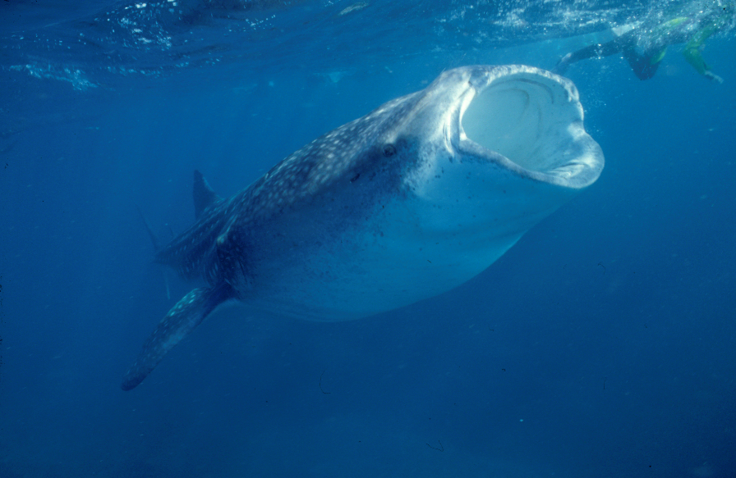
Thank you.
Eat your vegetables.
Notes:
Filter-feeders…
..despite this photo, not dangerous to humans
In fact…..people (ECOTOURISTS) go to extreme lengths to swim in the water with them
……and pay a lot of money!

