Slide 1
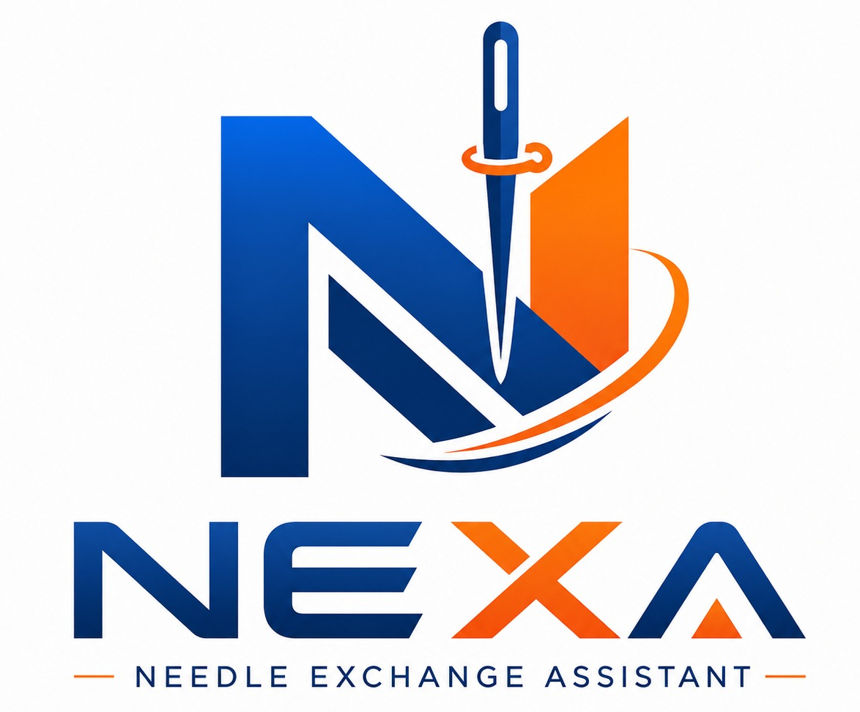




INTRODUCTION
NEXA
Needle Exchange Assistant
Digital needle control, verification and traceability for our sewing production
SCAN
EXCHANGE
VERIFY
TRACK
Accurate input
Fast process
Controlled release
Full traceability
Scan · Exchange · Verify · Track
PT Parkland World Indonesia · Jepara, Indonesia
Prepared for buyer and compliance review · September 2026

Slide 2




Why Needle Control Matters
A single unaccounted needle fragment is a product safety issue. The control around it has to be provable, not merely claimed.
A broken needle is a contamination risk
If a fragment is not recovered, it may remain in the product or the workstation. Recovery must be verified at the moment of the exchange, not reconstructed later.
What a buyer audit needs to see
Every broken needle accounted for, with the fragment outcome recorded at the time of the check.
Evidence that can be retrieved on request — not prepared specially for the visit.
A control that cannot be bypassed by the person standing at the trolley.
The same process applied consistently across every line and every shift.
Stock figures that reconcile with what was actually issued.
Buyer needle policy demands documented control
Every broken needle has to be accounted for, with evidence and a clear decision trail for any case where a fragment is not found.
Paper records are difficult to verify
Handwritten logs and needles taped to forms are slow to complete, easy to fill in after the fact, and hard to search during an audit.
Without data, causes stay hidden
Recurring breakage on a machine or a line cannot be identified if consumption and breakage are never measured.
NEXA — Needle Exchange Assistant · PT Parkland World Indonesia
2

Slide 3
What is NEXA?
NEXA (Needle Exchange Assistant) is our own digital system for controlling sewing machine needles — from warehouse stock, to the trolley serving each line, to the moment a needle is handed to an operator and the used needle is returned. It replaces handwritten needle logs with a guided process that records its own evidence.
SCAN
EXCHANGE
VERIFY
TRACK
Accurate input
Fast process
Controlled release
Full traceability
The operator taps their company ID card. Identity, line and section come from master data instead of handwriting, so the record starts correct.
A guided sequence on the trolley tablet keeps the exchange short, while stock at that trolley is checked and adjusted automatically.
For broken needles the system requires a fragment answer and a photograph. If a fragment is missing, no replacement is released without approval.
Every exchange, decision and stock movement is stored permanently and can be searched by line, date, operator or needle type.
Developed in-house. NEXA is built and operated by PT Parkland World Indonesia, running on trolley stations we assemble ourselves — so the process follows our line layout, our ID cards and our needle range, and can be replicated factory by factory.
NEXA — Needle Exchange Assistant · PT Parkland World Indonesia
3

Slide 4
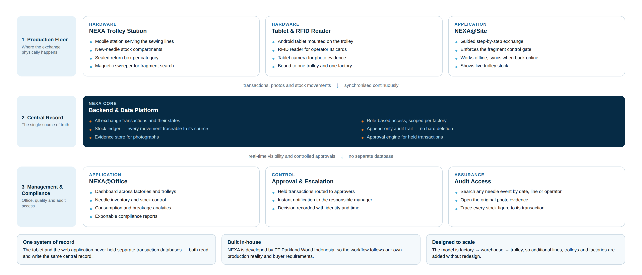
The NEXA System at a Glance
Three layers — the production floor, one central record, and management access — with nothing stored twice.
NEXA — Needle Exchange Assistant · PT Parkland World Indonesia
4

Slide 5
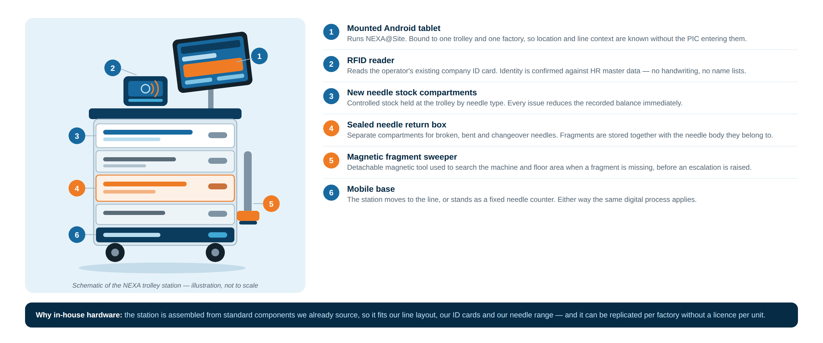
The NEXA Trolley Station
The physical point of control on the production floor, assembled in-house from standard components.
NEXA — Needle Exchange Assistant · PT Parkland World Indonesia
5

Slide 6

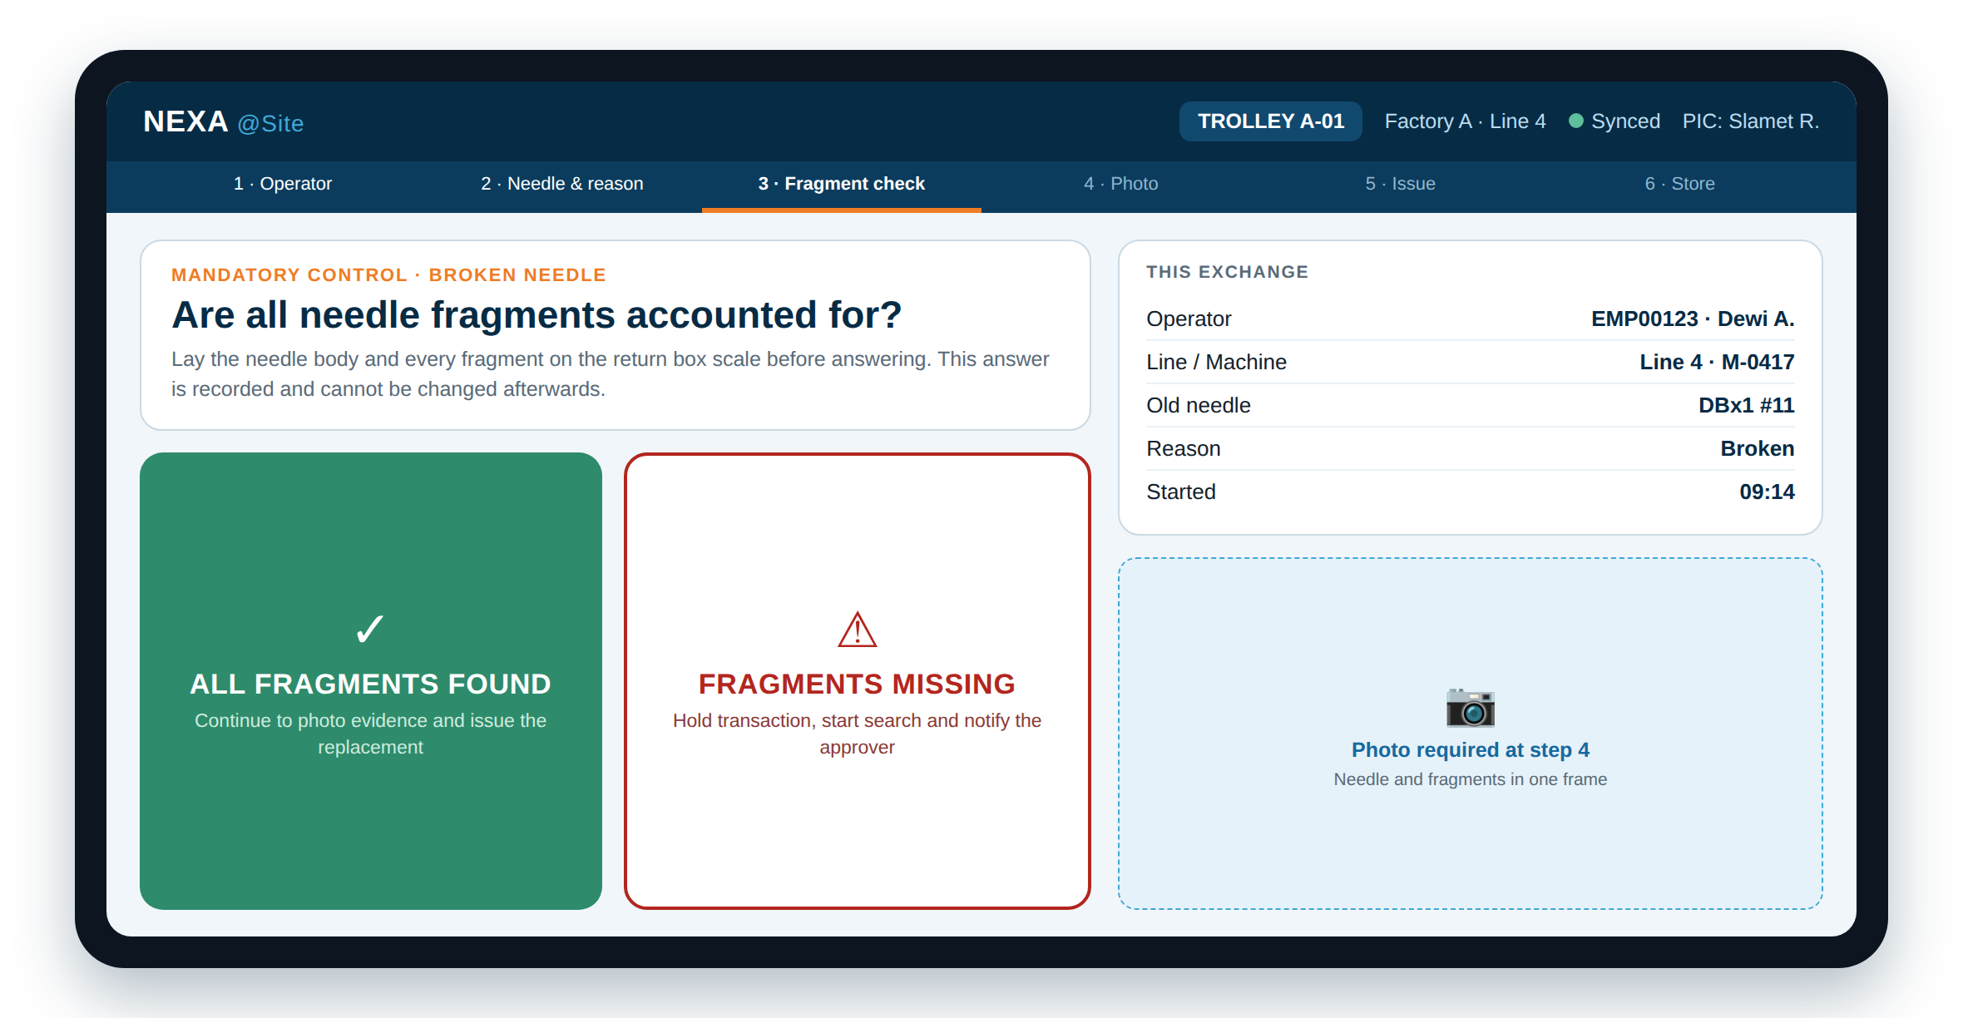





NEXA@Site — The Trolley Application
Used by the needle PIC at the trolley. Designed so the fastest way to work is also the compliant way.
Operator identified by ID card
RFID tap resolves the operator against HR master data — no name lists, no handwriting.
Guided, ordered steps
Each step must be completed before the next appears, so a record cannot be left partly filled.
Fragment control enforced
For broken needles the fragment question is mandatory and its answer is stored permanently.
Photo evidence at the trolley
The tablet camera binds the image to that exchange at the moment it is taken.
Works without a network
If connectivity drops the exchange still runs and syncs afterwards without creating duplicates.
NEXA@Site — fragment verification step. Design screen; data shown is illustrative.
Live trolley stock
Stock by needle type is visible, and a replacement cannot be issued beyond what is held.
NEXA — Needle Exchange Assistant · PT Parkland World Indonesia
6

Slide 7

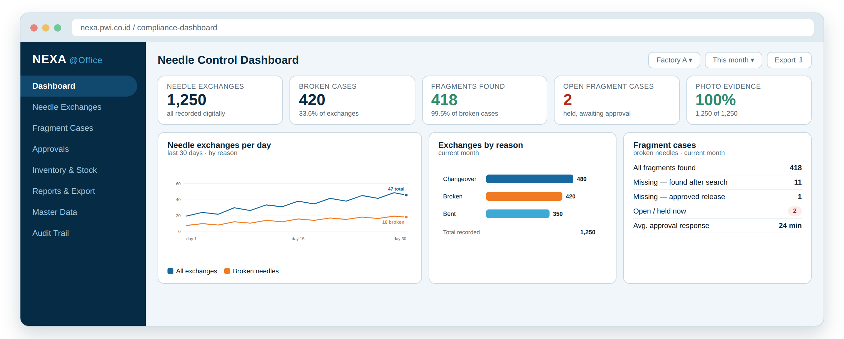




NEXA@Office — Management & Compliance
Browser access for quality, inventory and management — and the surface an auditor can be shown directly.
Needle control dashboard
Exchanges, broken cases, fragment outcomes and open cases across factories and trolleys.
Search any needle event
Filter by date, line, operator, needle type or reason, and open the original record.
Approval of held cases
Missing-fragment cases are decided here, and the decision is stored with identity and time.
Inventory and stock ledger
Receiving, transfers to trolleys, counts and adjustments — every movement traceable.
Reports and export
Filtered results and their evidence can be exported for buyer review.
NEXA@Office dashboard. Design screen; figures shown are illustrative sample data.
Audit trail
Critical actions are recorded with the user, the values before and after, and the timestamp.
NEXA — Needle Exchange Assistant · PT Parkland World Indonesia
7

Slide 8
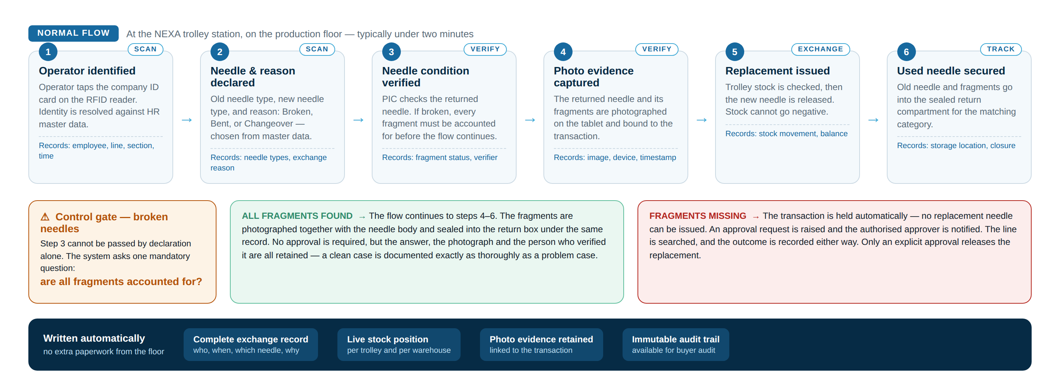
How the System Works — End to End
The complete needle exchange, as it runs at the trolley.
No step can be skipped and nothing is written by hand. The record is a by-product of doing the work correctly.
NEXA — Needle Exchange Assistant · PT Parkland World Indonesia
8

Slide 9
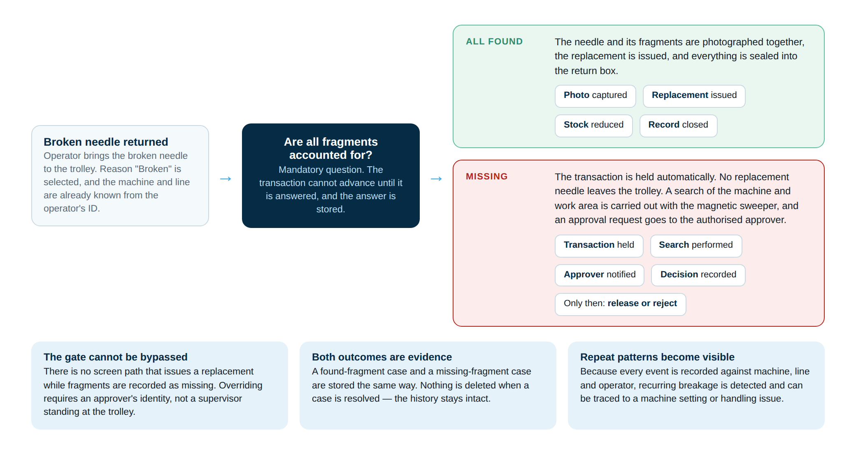
Broken Needle Control — The Critical Path
The control a buyer cares about most: what happens when a fragment cannot be found.
NEXA — Needle Exchange Assistant · PT Parkland World Indonesia
9

Slide 10

Escalation and Approval of a Held Case
A missing fragment is not a decision for the production floor. It is escalated, decided by an authorised person, and recorded.
1
Transaction is held by the system
Instant notification to the approver
The exchange stops at the fragment step. No replacement needle can be issued while the case is open.
2
Search is carried out
NEXA — Approval required
Broken needle, fragment not found
Factory A · Trolley A-01 · Line 4
Operator EMP00123
Needle DBx1 #11
Raised 09:21 · PIC001
Status HELD — no replacement issued
The machine, the work area and the garment are searched, using the magnetic sweeper from the trolley.
3
Authorised approver is notified
A notification is sent immediately with the case details, so the response does not depend on someone walking to the line.
OPEN SECURE APPROVAL PAGE
4
Decision is made in NEXA
The approver opens a secure page in NEXA@Office and records the decision — release with justification, or reject.
The notification only alerts. It carries no approval power — the decision is made and stored inside NEXA.
5
Outcome is stored permanently
Approver identity, decision, reason and timestamp stay attached to the exchange record and appear in reporting.
Until a decision is recorded, the case stays open and visible on the dashboard — it cannot be quietly dropped.
NEXA — Needle Exchange Assistant · PT Parkland World Indonesia
10

Slide 11
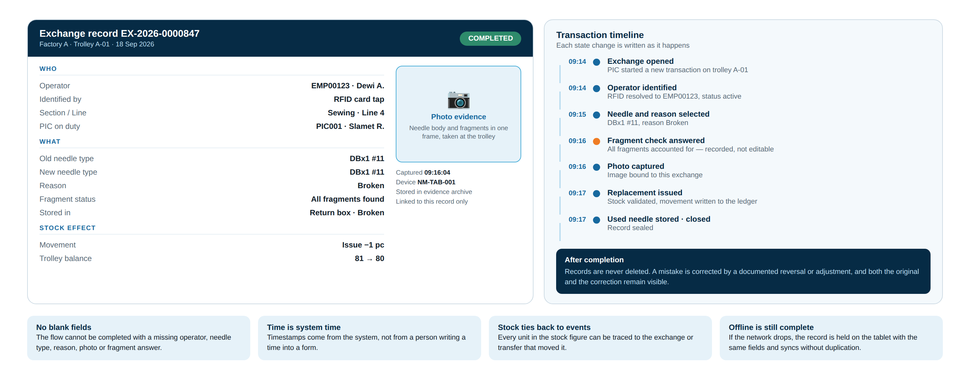
What Is Recorded for Every Exchange
One exchange produces one permanent record — this is what is opened during an audit.
NEXA — Needle Exchange Assistant · PT Parkland World Indonesia
11

Slide 12
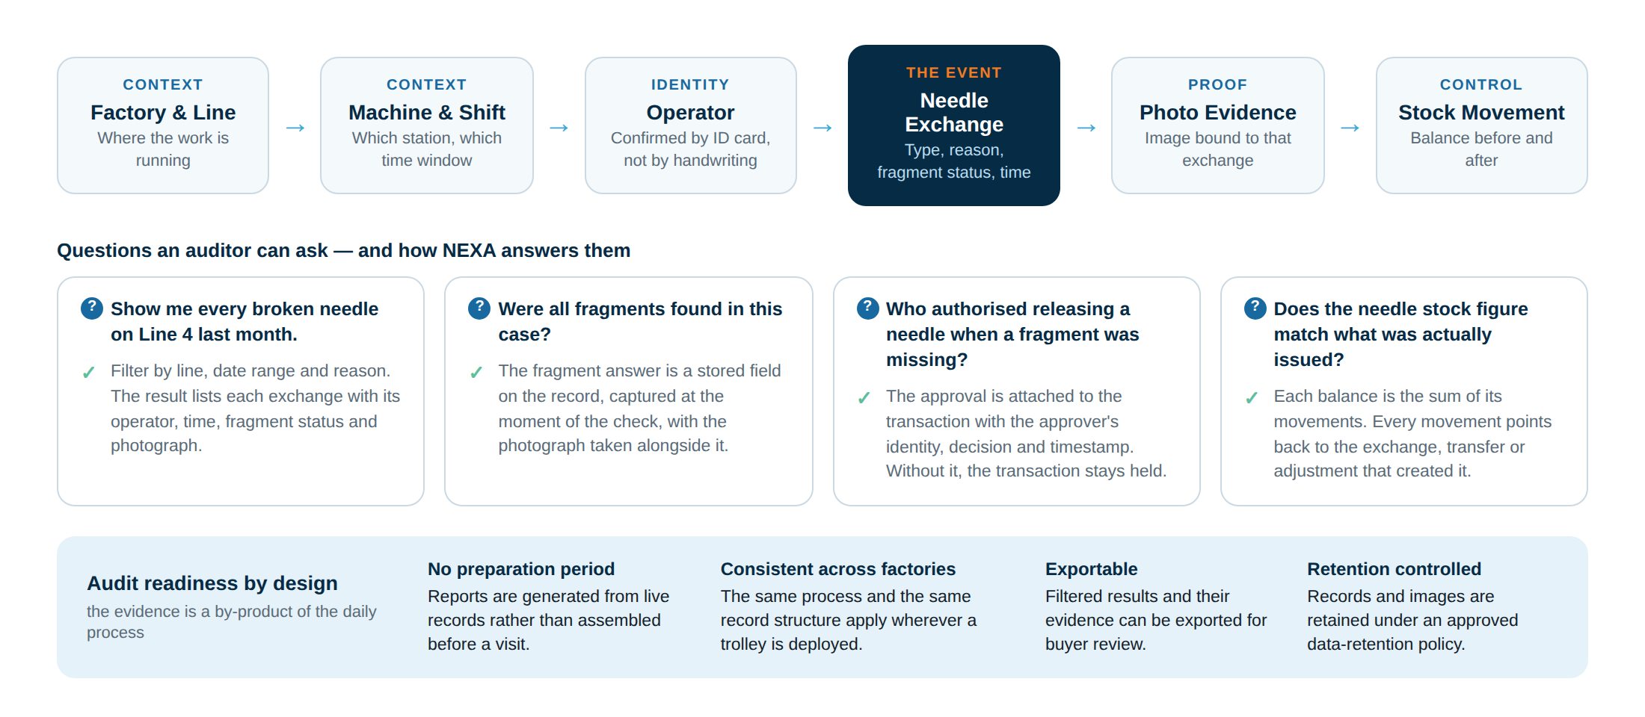
Traceability and Audit Readiness
Following the chain in either direction — from a line and a date to a single needle event, and back again.
NEXA — Needle Exchange Assistant · PT Parkland World Indonesia
12

Slide 13






Governance and Data Integrity
Controls that protect the record itself, so the evidence remains credible over time.
Role-based access
Scoped per factory
No hard deletion
Needle PIC, inventory, management and administrator each see and do only what their role allows. The PIC at the trolley cannot change master data.
Access is limited to the factory and locations a user is responsible for, so data from one site is not editable from another.
A completed exchange is never removed. Corrections are made through a documented reversal or adjustment, and both entries remain visible.
Append-only audit trail
Offline integrity
Registered devices only
Critical actions record the user, the action, the values before and after, the device and the time.
Exchanges captured without a network keep the same mandatory fields, and retried synchronisation cannot create a duplicate record.
Each tablet is registered and bound to one trolley and factory. An unregistered device cannot create transactions.
NEXA — Needle Exchange Assistant · PT Parkland World Indonesia
13

Slide 14
The Standard We Hold Ourselves To
Operating targets for NEXA once live, reported to management and available for buyer review.
100%
100%
100%
broken needles with a recorded fragment outcome
exchanges with photo evidence
missing-fragment cases with a recorded decision
every case answered and stored at the time of the check
the flow cannot complete without an image
no case closed without an approver
0
≥ 95%
100%
replacements issued while a case is open
needle exchanges captured digitally
stock movements traceable to a source transaction
enforced by the system, not by supervision
measured against production records
balances reconcile to events
These are the targets the system is designed to enforce; performance against them will be reported from live NEXA data once the pilot is running.
NEXA — Needle Exchange Assistant · PT Parkland World Indonesia
14

Slide 15
Implementation Status and Roadmap
NEXA is under development. The plan is deliberately staged, with a single pilot factory proving the process before any wider rollout.
IN PROGRESS
IN PROGRESS
PLANNED
1
Foundation
2
Trolley application
3
Inventory control
Central platform, access control and master data: factories, trolleys, employees, ID cards, needle types.
NEXA@Site on the tablet: identification, guided exchange, camera and offline operation.
Warehouse and trolley stock, transfers, counts and the stock ledger.
PLANNED
PLANNED
PILOT TARGET
4
Verification & approval
5
Dashboard & reporting
6
Pilot & rollout
Fragment control gate, escalation, notification and the secure approval decision.
NEXA@Office dashboard, analytics and exportable compliance reports.
One factory, three trolley stations. Evaluate, then extend factory by factory.
Current status: design and development. Screens shown in this presentation are design references, and the figures in them are illustrative rather than production data.
NEXA — Needle Exchange Assistant · PT Parkland World Indonesia
15

Slide 16


In Summary
NEXA turns needle handling from a paper record into a controlled process that produces its own evidence. The same system that keeps the line moving is the system an auditor can be shown.
Control that cannot be bypassed
Evidence as a by-product
A broken needle with a missing fragment stops the exchange until an authorised person decides.
Identity, needle, reason, fragment outcome and photograph are captured while the work happens.
Answers in seconds
Repeatable across factories
Any needle event can be retrieved by line, date, operator or needle type, with its original evidence.
One process, one record structure, extended trolley by trolley and site by site.
Scan · Exchange · Verify · Track
PT Parkland World Indonesia · Jepara · September 2026

