Slide 1

Linux
Week 1
Google Slides Version

Slide 2
What is Linux?
Linux is a kernel, the core of an operating system (OS)
Allocates system resources to running programs
Connects hardware to software
GNU software + Linux kernel → GNU/Linux OS
Linux is free, open-source, and has many distributions: Ubuntu, Arch, Red Hat
Linux is used/built into nearly all aspects of daily life!

Slide 3
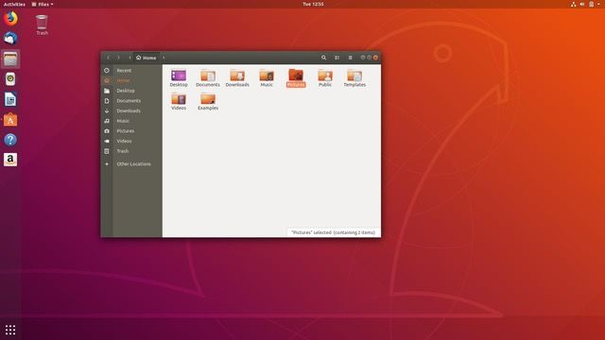
GUI vs CLI
How can we use Linux?
Graphical User Interface: intuitive, easy to use, easy to run commonly available public applications and software, limited developer control

Slide 4
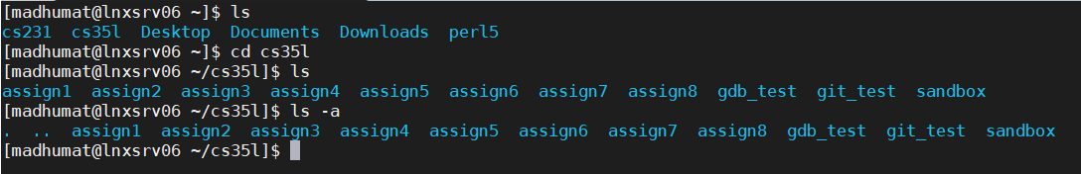
GUI vs CLI
Command Line Interface: less intuitive, more scripting/programming control, more powerful
You can interact with the OS using a shell program. We write text commands into a terminal window, and the shell will take the text commands, execute them, and show results. The most common one you’ll see is Bash (Bourne-again shell).

Slide 5
Accessing Linux CLI
In this class, most of the work will be done on the SEASnet Linux servers, a set of machines that anyone with an account can log onto. Multiple users can be logged into one server.
If you don’t already have a SEASnet account, sign up for one: https://www.seasnet.ucla.edu/seasnet-accounts/
We’d like to be able to directly access the CLI of these Linux machines, and work and run programs from there. So we’re going to need to ssh (secure shell) in.
You must use the UCLA VPN to be allowed to ssh into the SEASnet servers: https://www.seasnet.ucla.edu/setting-up-remoteapps-and-remote-desktop/

Slide 6
Accessing Linux CLI
So you have your SEASnet account, and you have the VPN operating. How do you actually ssh in?
The ssh command:
ssh SEASNET_USERNAME@lnxsrv06.seas.ucla.edu
Use your SEASnet username in the above command, and enter your SEASnet password when prompted. You can use lnxsrv 06, 07, 09, and 10 in this class.
If you’re a Mac user, this is all you need to type into your own terminal window to get access to the SEASnet terminal window.

Slide 7
Accessing Linux CLI
If you’re using Windows, you’ll need to download an SSH client.
PuTTY: most popular client; use host name lnxsrv06.seas.ucla.edu, use port 22, use connection type SSH, use your SEASnet username and password when prompted. Download it here: https://www.chiark.greenend.org.uk/~sgtatham/putty/latest.html

Slide 8
Accessing Linux CLI
When working on the Linux servers, you may need to transfer files back and forth between the server and your local machine, to submit them on Gradescope. The most common method is using the command scp, in your terminal.
To transfer files from the server and your local machine:
scp <SEASnet_username@lnxsrv06.seas.ucla.edu>:<filepath> <destination_path>
Similarly, transferring files from your local machine to the server:
scp <local_file> <SEASnet_username@lnxsrv06.seas.ucla.edu>:<filepath>

Slide 9
SCP Example
I create a file called move_me in on the Linux servers. I want to bring it to my local machine.
I navigate to the directory my file move_me is in, and use the pwd command on my remote machine to get the source file path:
/u/cs/grad/madhumat/cs35l/sandbox
I navigate to the directory I want to put move_me in, and use the pwd command on my local machine to get the destination file path:
/home/mobaxterm/MyDocuments
Now, on my local machine I execute this scp command:
scp madhumat@lnxsrv06.seas.ucla.edu:/u/cs/grad/madhumat/cs35l/sandox/move_me /home/mobaxterm/MyDocuments

Slide 10
SCP Example
Note that:
I can’t forget to add the name of the file (move_me) to the source_path. When I do pwd, I just get the path up to that file; when I transfer that path to the scp command I have to add the file name at the end
There is a space between the end of my source file path and the beginning of my destination file path
Your machine may ask you to add the key fingerprint, and give your SEASnet password. Say yes to add the fingerprint, and enter your SEASnet password when prompted.

Slide 11
Accessing Linux CLI
My own preferred method of connecting is using MobaXterm - it automates scp file transfer, and gives a nice visual representation of your files on the side. It also just looks nicer, IMO. You can download it here: https://mobaxterm.mobatek.net/
Any way you have of connecting via ssh is okay, as long as you can get it to work!

Slide 12
Alright, you’re in. Now what?
In Linux, everything is a file, or a process. A file is just a collection of data, so files in Linux include:
documents
programs you write
executable files (your programs, compiled and turned into things that can be run)
directories
devices
Regular files include text files, images, and most of the files we’re used to seeing. Hidden files start with a dot, and usually need an extra step (either through terminal or through GUI) to be seen.
A process is an instance of a program that’s running and taking up some resources.

Slide 13
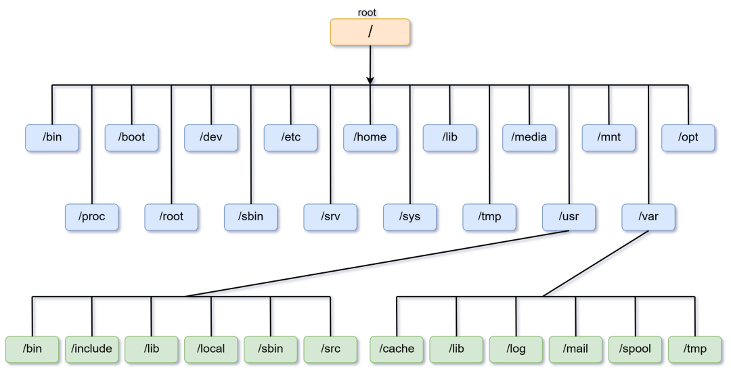
Linux File Layout - Tree Structure

Slide 14
File Paths: Absolute vs. Relative
When we’re moving around this system where everything is a file, we need to be able to know exactly where a file is - it’s file path. Absolute path starts from the root directory, so it starts with a backslash “/”
/usr/local/bin.
Everything else is a relative path, because it is relative to the current directory you’re working in.
../some/path
The tilda, ~, represents the user’s home directory - different from the root directory mentioned above!

Slide 15
File Paths: Current & Parent Directories
Linux has a special way to refer to the directory you’re currently in, and the parent of that directory.

Slide 16
Basic Linux Commands
Commands follow this format:
[your_username@your_server.edu ~/your/current/directory]$ <command> <options> <arguments>
So, a command might look something like this on my account on the SEASnet servers:
[madhumat@lnxsrv06@cs.ucla.edu ~/cs35l]$ rm -r tmp/

Slide 17
Basic Linux Commands
Moving around the terminal:
pwd: present working directory
cd <some_file_path>: change directory
ls <optional_directory>: list all files in current directory, or in optional specified directory
-d lists only directories, -a shows hidden files, -l shows permission info, -s shows file size
mkdir <some_directory>: make a directory
rm <file>: permanently remove some file
rm -r <directory> to recursively delete a directory
mv <file_1> <file_2>: rename file 1 to file 2
cp <file_1> <file_2>: copy the file found at file 1 into the directory found at file 2
man <command>: view documentation for any command
Search the man page by typing a forward slash, and then a word to search for (/word).

Slide 18
Basic Linux Commands
&: run a process in the background (useful in certain cases of using text editors in the background)
emacs sample.txt &
More useful commands (look them up using man): diff, cat, head, tail, touch, echo, wc, df, stat

Slide 19
Environment Variables - PATH
An environment variable exists outside a program, in your system’s environment.
Contains list of directories that your shell program (terminal) should search through when receiving a command
You can add directories to your PATH variable to tell the shell to look for executables in additional places
$export PATH=$PATH:/some/directory/to/append
$export PATH=/some/new/directory/to/prepend:$PATH

Slide 20
Environment Variables - PATH
Say we type ls at terminal. What actually happens?
Shell reads the line you typed and knows that it has to find something called ls and execute it.
It needs to know where to search for ls, so it will go to list of directories contained in PATH.
It will go through first directory structure; then second; then third….so on until it finds the first instance of ls. Then it can execute ls
If we want to force shell to execute a different version of ls stored in a different directory, we need to prepend that directory to our PATH so that it checks our added directory first BEFORE checking anything else

Slide 21
Emacs
In this class, we’ll use the Emacs text editor heavily in the first assignment. You won’t be required to use it past Assignment 1 - you’re welcome to use your text editor of choice after that, or continue using emacs if you like it. The emacs reference card is here: https://www.gnu.org/software/emacs/refcards/pdf/refcard.pdf.
Open emacs at the command line: emacs [filename]
Most emacs commands will use C, the control key, or M, the meta key, which is usually the alt key or option key.
Save a file in emacs using C-x s (press Control and x at the same time, and then s), and exit with C-x C-c (press Control and x at the same time, and then Control and s)

Slide 22
Basic Linux: Redirection
In general, we care about input/output on two different levels:
stdout, stdin, stderr: input/output streams that connect your current environment (terminal) with whatever you’re doing
file streams: input/output given from another file or another data stream
When we type a command in the terminal, the default input is standard input, and the default output is standard output. But we can pipe and redirect to get the input and output we want from the command line.

Slide 23
Basic Linux: Redirection
> file
write stdout to a file
ex: echo one > one.txt will write the line “one” to one.txt instead of printing it out in your terminal
>> file
append stdout to file
ex: echo two >> one.txt will add the line “one” to one.txt instead of printing it out to terminal - so if the file already had the line “one”, it won’t get overwritten

Slide 24
Basic Linux: Redirection
< file
get input from file, instead of standard input
ex: cat < one.txt will pull out whatever text is in one.txt, and then feed that to the cat command so that it prints out what’s in one.txt to the terminal
some_command | some_command
pipe (the “|” character) will take the output of the command on the left and feed it as input to the command on the right
ex: echo one.txt | cat will take the output of the echo command (“one.txt”) and give it as input to the cat command, which will then try to execute “cat one.txt”

Slide 25
Basic Linux: Making Typing Easier
→ the up arrow key will allow you to cycle through all the commands you previously wrote out, so you don’t have to rewrite a command over and over
→ if you begin writing out a file name, you can hit the tab key to try and auto-complete the file name (the results depend on how many similarly named files are in that directory - if shell can find that file exactly based on what you’ve already typed, it will complete it, but if it finds multiple matches it will list all the matches)

Slide 26
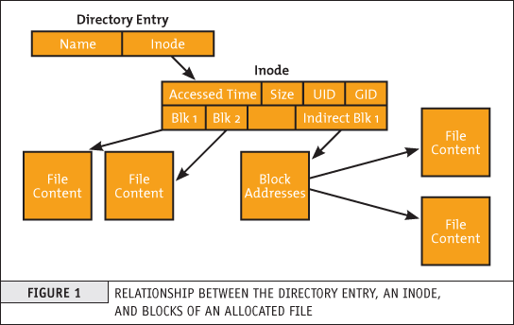
Back to Linux Structure: Inodes
Everything in Linux is a file. But where does the file’s data get stored, and what’s an efficient way to find that data?
Inodes are data structures that store the metadata about a file. (Not the actual data, which is stored elsewhere in memory.)

Slide 27
Inodes
Inodes store:
file size (in bytes)
physical location
permissions for file
file owner
file group
timestamps (last accessed, last modified, etc.)
link count (how many file names were created that point to this specific inode?)

Slide 28
Inodes
An important distinction is that inodes do not contain the file name. Linux accesses the data of a file by looking up the file name in a directory and finding the corresponding inode. The inode then points to where in memory the file’s data is stored.
Why do we want to use inode essentially as a ‘middleman’ between file name and file metadata/data? Mostly because of overhead and robustness; you can move files around directories without the cost of moving all of the data around as well.

Slide 29
Inodes
Accessing inode information from the command line:
stat <file> gives a specific file’s inode information
ls -i lists all files in the directory with their inode numbers
df -hi lists system stats on how many inodes have been used in human-readable format

Slide 30
Hard Links vs. Symbolic Links
hard link: A link that points to the same inode number as the original file does
→ Remember that part of inode metadata is storing a counter of links for every file! So when
this hard link is added into directory, inode metadata updates as well.
symbolic link: A link that points to a different inode number than the original file does
→ A symbolic link simply contains a path to a different file, so it doesn’t get the same inode that the
original file does; it gets a new inode entry.

Slide 31
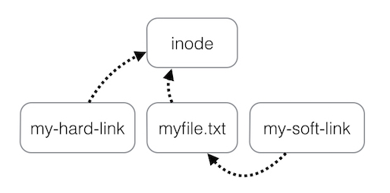
Hard Links vs Symbolic Links
Because a symbolic link doesn’t directly reference the same inode as the original file, if the file that it points to is removed, this symbolic link is now broken!
But a hard link points directly to the same inode. Any number of other files pointing to the same inode can get deleted; that hard link will still have access to the inode and the file data.

Slide 32
Permissions
Who can access a file? Who can modify it? Permission modes/types let us control how our file appears to others, which is important for protecting sensitive data.
Permissions for a file are represented by 10 bits:
1 bit to represent type of file + 3 bits for owner’s permissions + 3 bits for group’s permissions + 3 bits for permissions for everyone else

Slide 33
Permissions
Permission groups:
Permission types:
Letter | Permission
r | read
w | write
x | execute
Letter | User
u | owner
g | group
o | others
a | all

Slide 34
Permissions
Special permissions:
s → specifies how to set userid when running the program. Used in place of execute permission for
owner or group.
t → sticky bit permission (only owner/root user can delete or rename file). Used in place
of execute permission for all users.

Slide 35
Permissions
Binary | Octal
000 | 0 | ---
001 | 1 | --x
010 | 2 | -w-
011 | 3 | -wx
100 | 4 | r--
101 | 5 | r-x
110 | 6 | rw-
111 | 7 | rwx
Binary/Octal Representation:

Slide 36
Permissions
Permissions can be modified by a file’s owner using chmod:
chmod [who] [+,-,=] [permissions] filename
chmod [binary/octal permission notation] filename

Slide 37
Basic Wildcard Matching
Sometimes, we need to find a specific phrase, or letter, or pattern of letters and phrases. Regular expressions allow us to specify these patterns.
Two common regex symbols we’ll look at are ? and *
? matches a single character
* matches zero or more characters in a filename

Slide 38
Basic Wildcard Matching
So, if we’re trying to find all instances of the name Sam in a roster, we might try to match against the pattern ‘Sam*’
If we’re trying to find all instances of the phrases am and pm in a document, we might try to match against the pattern ‘?m’
How can we use this for the homework?

