Slide 1
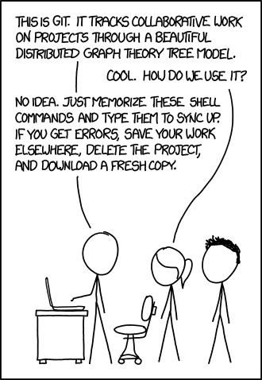
git
Week 8
Google Slides Version
Source

Slide 2
what is git?
version control: a way for different copies of a project to exist and be merged back together safely
mostly: work on your own copy of the project, then push your changes back to the global copy
different from Github, or Bitbucket, or any of the other server-side hosting services for projects; git by itself is version control software.

Slide 3
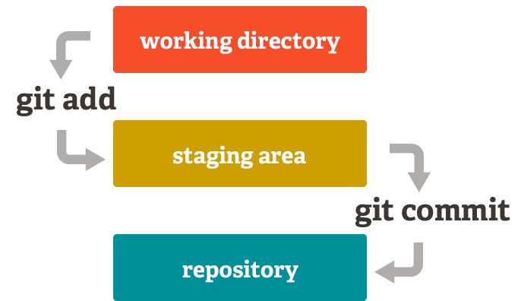

Slide 4
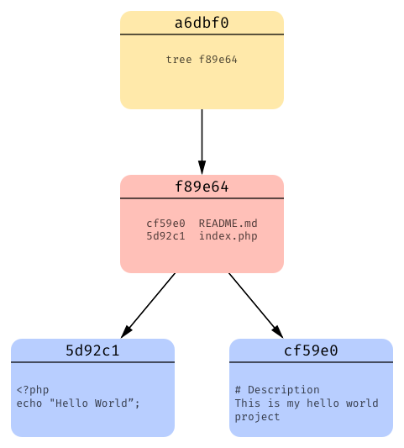
git data model
commit object that points to that particular instance’s tree; each commit is a snapshot
tree that records each file and a pointer to it’s blob
blobs that represent files

Slide 5
git data model
what happens when we modify files, or delete them, or make some changes and commit again?

Slide 6
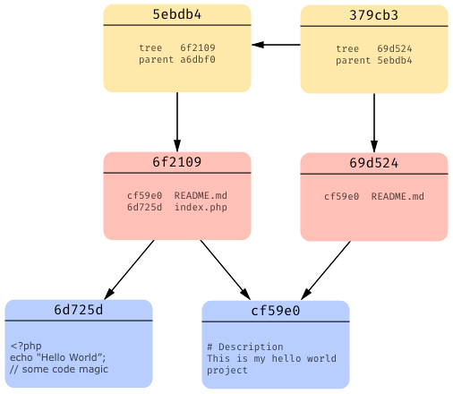
git data model
Create a new commit object that (1) points to any new files created; (2) points to the same copy of an old unchanged file; (3) has a separate tree object; (4) a pointer to the parent commit object that came before it

Slide 7
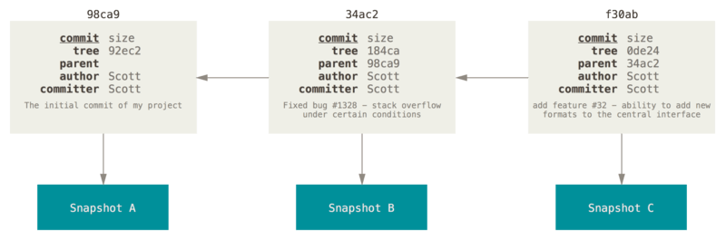
git data model
We can keep adding commits, which will continue to build the tree structure of the data model.

Slide 8
working directory
git init
Initializes the directory you’re in as a new git directory
git clone <server or local path>
Copy an existing git directory into your own current directory

Slide 9
working directory: update from remote repo
git pull
Update local copy with any changes made to remote repository. A combination of:
→ git fetch: get the changes
→ git merge: try to merge the changes with our own working copy

Slide 10
working directory → staging area
git add [files]
Add files in working directory to staging area for git to track in it’s index file
-A flag will add all modified files at once

Slide 11
staging area → repository
git commit -m “commit these changes”
Takes files in the staging area and commits them - records them to your repository.
git push origin master
Sends committed changes to remote repositories. Note origin - where you are pushing to - and master - where you are pushing from

Slide 12
branches
You don’t want code you write for one feature to potentially break/overlap with someone else’s code for some other feature
Use branches to keep features separate until they are well tested, and then they can be merged together by someone in charge of master branch
git checkout existing_branch
git checkout -b new_branch

Slide 13
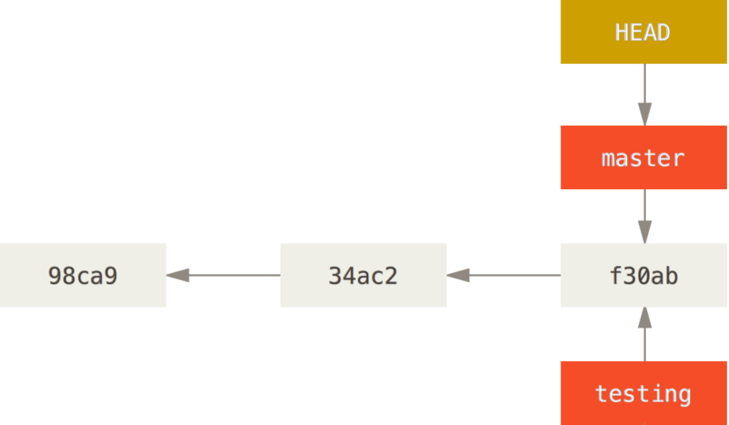
branches: git branch
We keep track of where we are using the HEAD pointer; in this diagram, all we’ve run is git branch testing. We have not switched to the new branch yet!

Slide 14
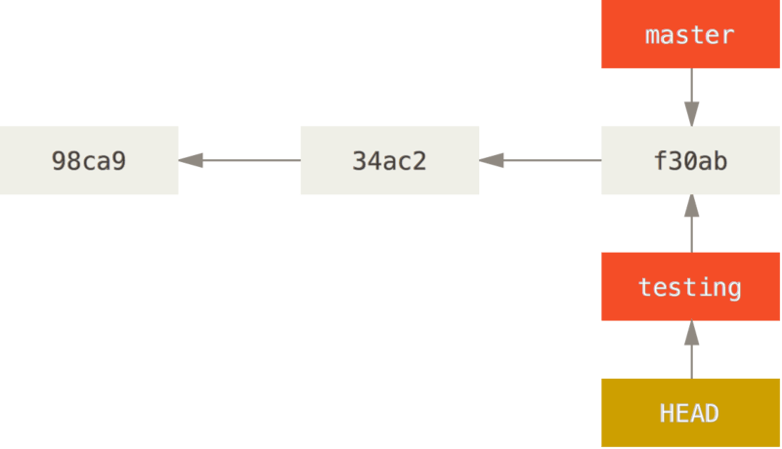
branches: git checkout
Using git checkout will allow us to switch our HEAD pointer...

Slide 15
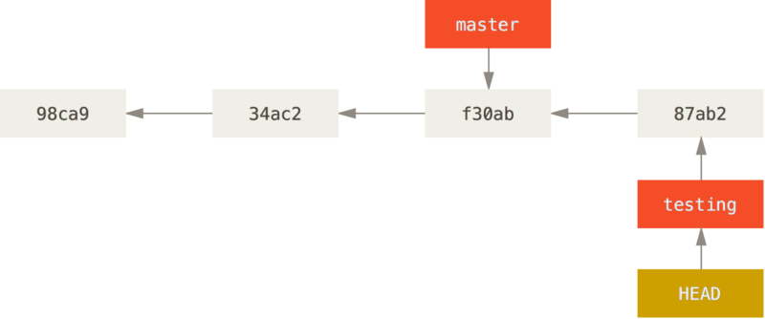
branches: after commit
...and then once we make a commit in the new branch we’re working on, our tree updates to show we have another commit object that master no longer has.

Slide 16
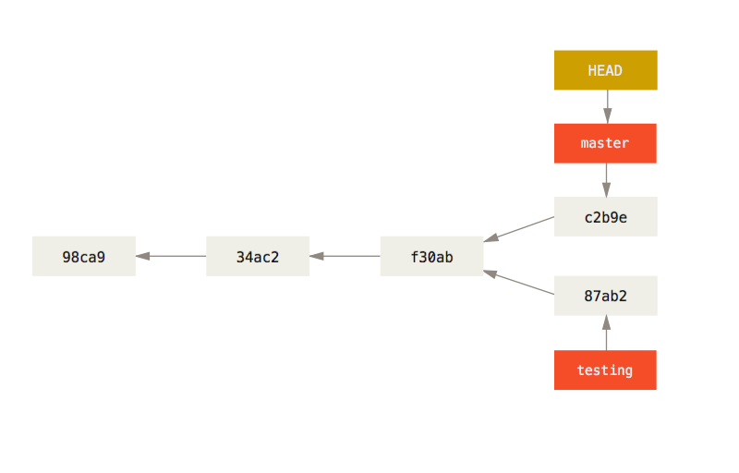
branches: after commit
Now, if make another commit in master, the two branches are completely different. To get a version of our project that has the changes from both of the recent master and testing commits, we have to do some extra work.

Slide 17
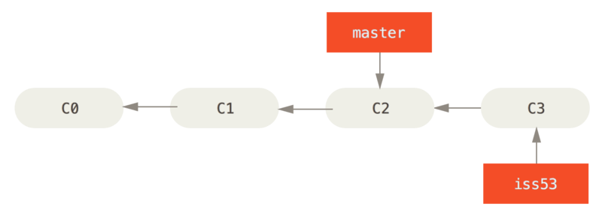
branches: merging
We start with a master branch that’s one commit behind an issue53 (iss53) branch. So far, commands run would have been git branch iss53, git checkout iss53, and a git add and git commit to get the most recent commit C3 for iss53.

Slide 18
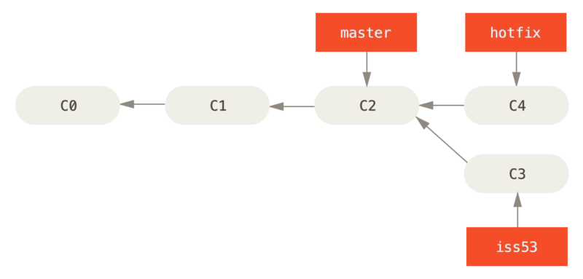
branches: merging
Oops, looks like there’s a problem in our master version that we want to fix. We checkout a hotfix branch and create a new commit with the changes for master. Iss53 remains untouched during this time.

Slide 19
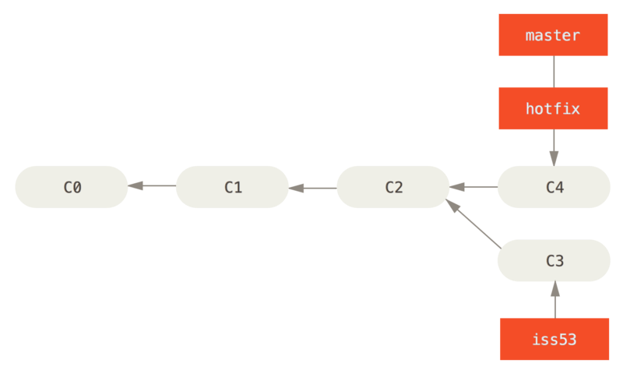
branches: merging
We can apply the fix to master, so we merge master and hotfix using git checkout master (to get to master) and git merge hotfix (to merge current branch master with specified branch hotfix)
Note that this is a fast-forward merge: C4 was directly ahead of C2, so git just moved the pointer.

Slide 20
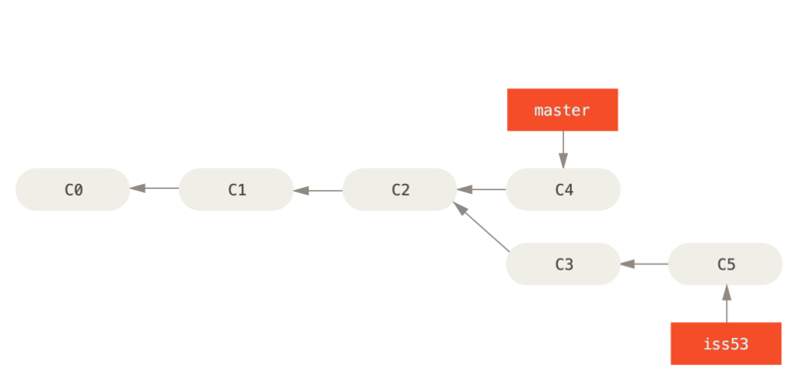
branches: merging
Alright, master and hotfix were merged, our new master points to a commit with the hotfix - but work continues on iss53, taking it further away from original parent commit C2.

Slide 21
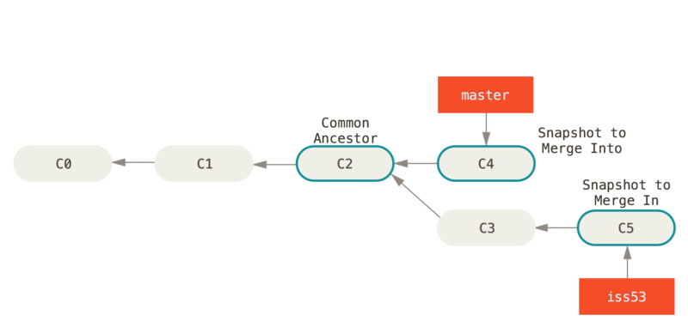
branches: merging
We do the same thing we did to merge hotfix and master; we switch to master using git checkout master, then merge using git merge iss53. But this time, git does a little more work behind the scenes to merge.

Slide 22
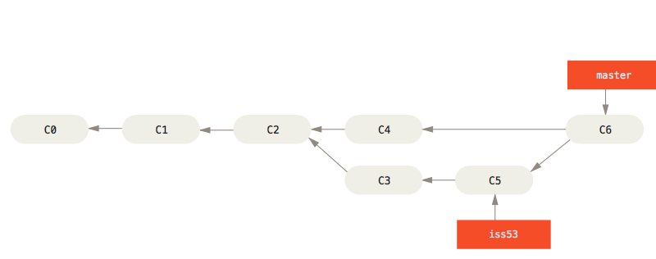
branches: merging
At the end, we get a new commit object that contains the merge version of master with the iss53 changes in it.
This was not a fast-forward merge; we got a new commit object!

Slide 23
branches: rebase
git rebase [rebase-from] [rebase-to]
If your branch b1 was created from an origin o1, but the origin is now on o5, pushing b1 to o5 may cause problems.
Merge b1 to o5 using rebase, which will layer commit after commit and stop the process and force you to review a merge if conflict is found.

Slide 24
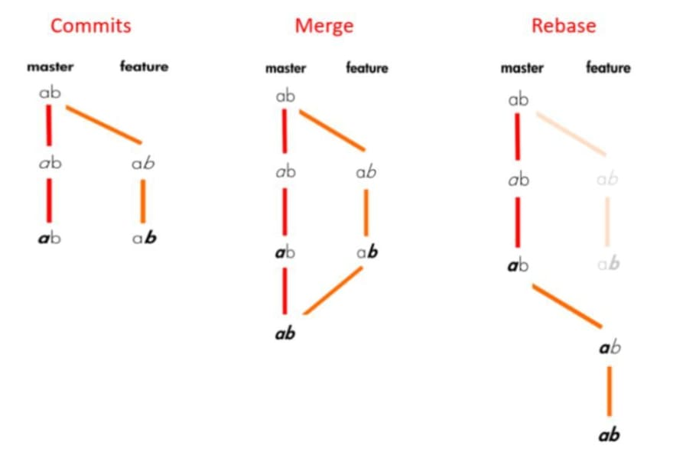
branches: merge vs rebase
Which you use depends on which kind of commit history you want to look at; generally, you don’t want to rebase on public branches.

Slide 25
utility git commands
git status
Check what files have been changed since your last commit
git log
lists commits made in that repository from most recent to oldest; will only show commit history below the branch you’re on (won’t show other branches that are maybe ahead) unless you specify branch name or use --all

Slide 26
utility git commands
git branch
List all branches
git tag
List tags (branches that cannot be changed)

Slide 27
utility git commands
git clean
Remove untracked files; -n will show what would be removed, -f will force a removal

Slide 28
utility git commands
git reset [absolute value of commit]
git reset HEAD~[some number of commits to remove]
The --soft flag will remove the last changes committed, but your local working copy will still have those uncommitted changes.
The --hard flag will actually remove all those changes - dangerous! Make sure you really want to delete all your work before you use this!

Slide 29
.gitignore
Files for git to ignore when adding or committing (for example, generated log files)

Slide 30
patching with git
git format-patch -[# of commits] [commit id] --stdout > some_patch_file
Generate a patch file from a specified git commit; usually number of commits will be 1 and commit id can be found from git log
git am < some_patch_file
Apply patch generated by git-format-patch

Slide 31
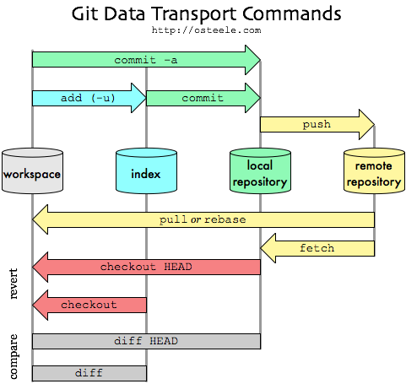

Slide 32
resources to learn git
https://git-scm.com/
https://www.atlassian.com/git

Slide 33
vc & emacs
Emacs has its own generic version control interface we can automatically use with our git directories. For example:
vc-diff: compare your current files with the versions you started from
vc-revert: will show you the results of a vc-diff and ask if you want to delete all the changes you made; if you confirm, your files will revert back to what they looked like at the last commit
You can also move through a diff file hunk by hunk using Emacs diff mode. You can apply specific hunks, undo them, go to the files they refer to, and more.

Slide 34
changelog entries
In the assignment, you’re asked to create a Changelog entry with Emacs’ built-in add Changelog function. Changelog format is just a standardized, formal way of reading changes made to a project.

