Slide 1
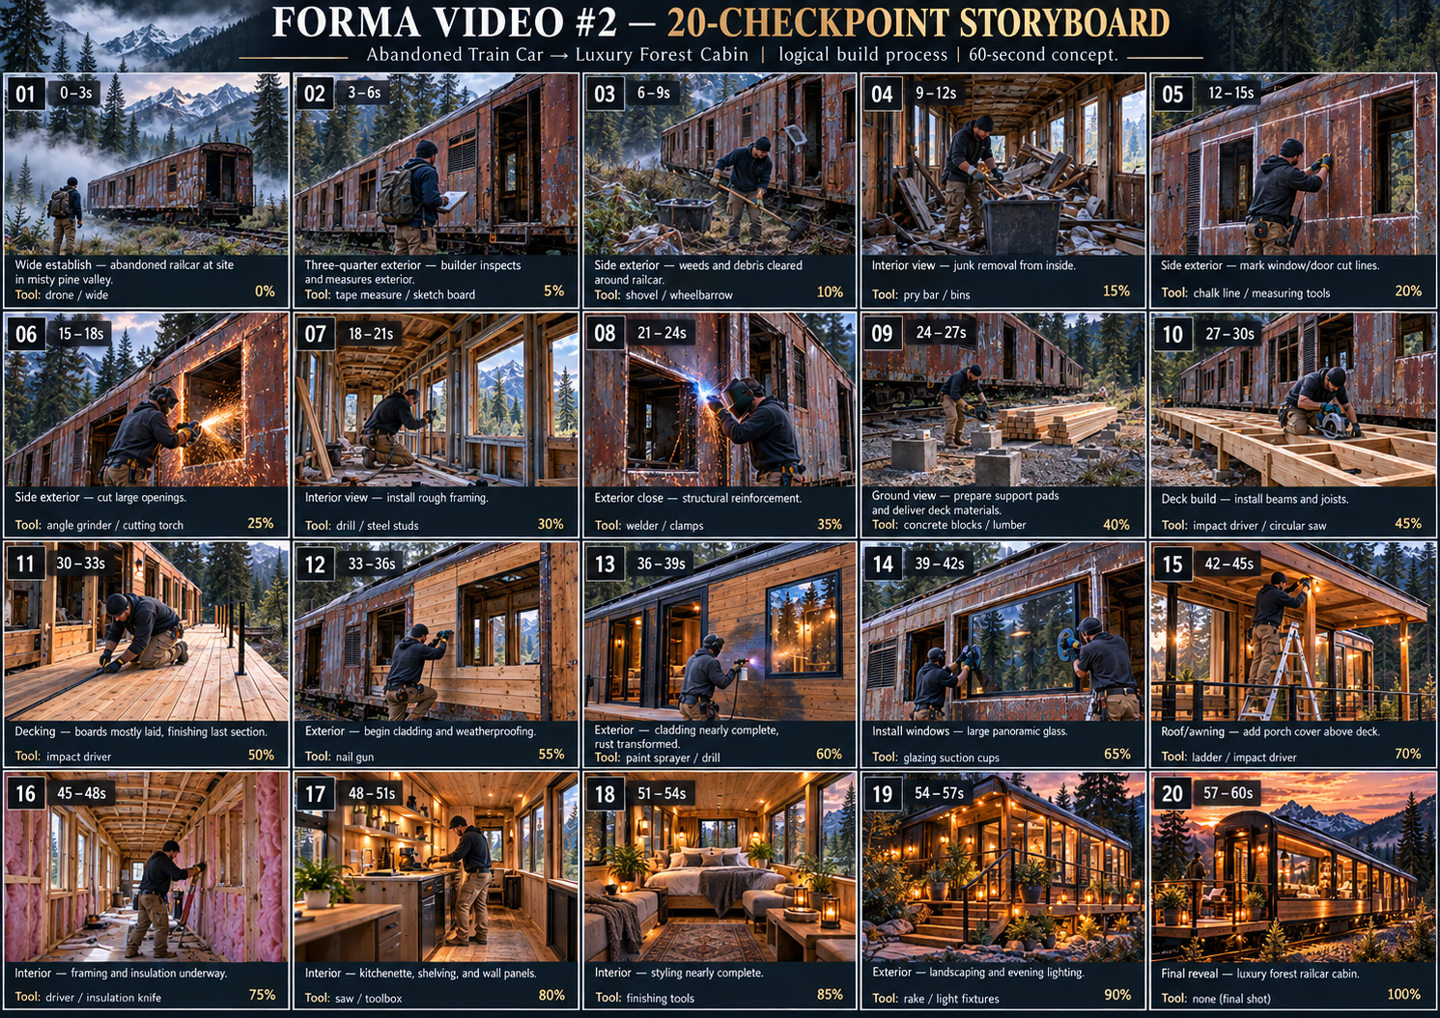
FORMA
20-Checkpoint Storyboard System
Updated creative process for Video #2: Abandoned Train Car → Luxury Forest Cabin
NO MAGICAL BUILDING
70–90% PROCESS RULE
SMALLER TRANSITIONS
VIRTUAL STUDIO READY
Train-car storyboard + FORMA Virtual Studio doctrine
1

Slide 2
Why We Updated the Slideshow
The Alpine baseline proved the system can run, but broad stages create magical construction.
Experiment #1: Alpine
What failed
New answer
• Looked beautiful frame-by-frame
• Pipeline ran end-to-end
• Virtual Studio became usable
• Audio preservation was fixed
• Open frame → finished shell too fast
• Interior jumped from empty to furnished
• Builder often did not cause the change
• Too few checkpoints forced the model to invent
• Move from 8 broad stages to 20 checkpoints
• Animate between nearby states only
• Use the railcar as a permanent visual anchor
• Test current Wan/Nano system fairly before switching
2

Slide 3
Permanent FORMA Rule Set
These rules should govern every future build video and every agent review.
1
Checkpoint wherever someone asks “how did that get there?”
2
One major construction idea per transition
3
Show 70–90% of repetitive work before cutting
4
The builder must visibly cause the progress
5
Previous real frame outranks text prompt
6
Interior design must be earned on-screen
Goal: make the viewer feel they truly watched an abandoned railcar become a luxury cabin.
3

Slide 4
20-Checkpoint Storyboard Overview
This replaces the previous 10-frame / 8-stage thinking with smaller, safer transitions.
Use this as the canonical visual plan: approve stills first, then animate between adjacent states.
4

Slide 5
Old Model vs. New Model
The problem was not only model quality — the transition size was too large.
Old broad-stage logic
New checkpoint logic
• “Build the roof”
• “Finish the glass”
• “Design the interior”
• Model must invent too much
• Results: magical construction
• Opening marked → opening cut
• Supports → beams → joists
• Glass pane 1 → glazing 80%
• Interior frame → insulation → furniture
• Results: visible causality
New rule: never ask the video model to solve a transition with more than one major construction idea.
5

Slide 6
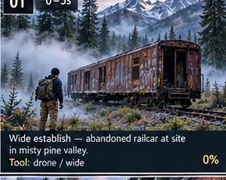
Video #2 Strategy: Final Current-System Test
Train car is the best fair test because the object stays constant.
Why this concept is ideal
• The railcar is a fixed visual anchor across every shot.
• The transformation path is understandable: clean → cut → deck → frame → glass → finish.
• The final result is aspirational but still clearly the same train car.
• If the current system fails even with 20 checkpoints, then provider/model quality is likely the bottleneck.
Test current Wan/Nano fairly before deciding on Higgsfield.
6

Slide 7
01
Checkpoint 01 — Abandoned railcar discovery
0:00–0:03 • target progress 0%
Visual target
Wide establish in misty pine valley; same rusty railcar, track, mountains, and forest are locked.
Tools/materials
Backpack, flashlight, gloves, pry bar
What must happen on-screen
Builder approaches and identifies the project; open-ended curiosity hook.
Not yet / continuity guardrail
No cleanup, no cuts, no deck, no windows, no interior finish.
Use as a hard visual state. Generate video only to the next nearby checkpoint — never skip multiple construction ideas.
7

Slide 8
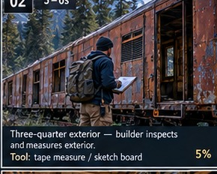
02
Checkpoint 02 — Inspection + plan
0:03–0:06 • target progress 5%
Visual target
Three-quarter exterior at cargo side; builder opens/inspects railcar and measures/sketches facade.
Tools/materials
Tape measure, sketch board, marker
What must happen on-screen
Viewer understands which side becomes deck/window facade.
Not yet / continuity guardrail
No construction changes yet beyond opening/inspection.
Use as a hard visual state. Generate video only to the next nearby checkpoint — never skip multiple construction ideas.
8

Slide 9
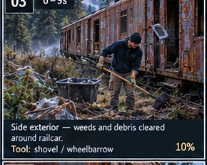
03
Checkpoint 03 — Exterior clearing begins
0:06–0:09 • target progress 10%
Visual target
Side exterior; weeds, brush, and debris are removed along the working side.
Tools/materials
Shovel, wheelbarrow, gloves
What must happen on-screen
Ground next to railcar becomes workable; debris pile/source is visible.
Not yet / continuity guardrail
No new deck components yet.
Use as a hard visual state. Generate video only to the next nearby checkpoint — never skip multiple construction ideas.
9

Slide 10
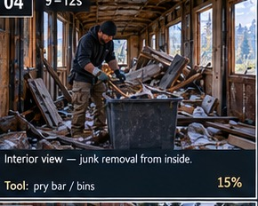
04
Checkpoint 04 — Interior cleanout
0:09–0:12 • target progress 15%
Visual target
Interior doorway view; old junk, seats, insulation scraps, and trash come out.
Tools/materials
Pry bar, bins, broom, respirator
What must happen on-screen
Interior visibly clears from foreground backward; waste pile grows.
Not yet / continuity guardrail
No framing, insulation, glass, or furniture yet.
Use as a hard visual state. Generate video only to the next nearby checkpoint — never skip multiple construction ideas.
10

Slide 11
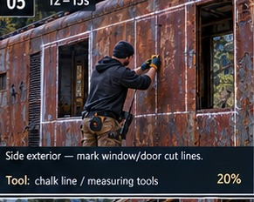
05
Checkpoint 05 — Mark openings
0:12–0:15 • target progress 20%
Visual target
Long-side exterior; window/door cut lines are measured and marked.
Tools/materials
Chalk line, tape measure, square
What must happen on-screen
Future glass locations are established before any cutting happens.
Not yet / continuity guardrail
No finished holes yet, no glass yet.
Use as a hard visual state. Generate video only to the next nearby checkpoint — never skip multiple construction ideas.
11

Slide 12
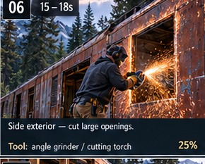
06
Checkpoint 06 — Cut large openings
0:15–0:18 • target progress 25%
Visual target
Side exterior close/medium; sparks and panel removal make openings real.
Tools/materials
Angle grinder / cutting torch, clamps, PPE
What must happen on-screen
At least one opening is physically cut; second opening underway.
Not yet / continuity guardrail
No windows installed yet; raw metal edges remain.
Use as a hard visual state. Generate video only to the next nearby checkpoint — never skip multiple construction ideas.
12

Slide 13
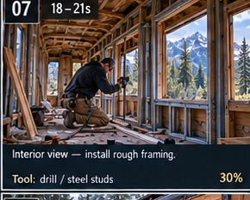
07
Checkpoint 07 — Interior rough framing
0:18–0:21 • target progress 30%
Visual target
Interior lengthwise; studs/furring begin around openings and walls.
Tools/materials
Drill, nailer, steel/wood studs, level
What must happen on-screen
Frame lines explain how future finishes will attach.
Not yet / continuity guardrail
No insulation finish, no paneling, no decor.
Use as a hard visual state. Generate video only to the next nearby checkpoint — never skip multiple construction ideas.
13

Slide 14
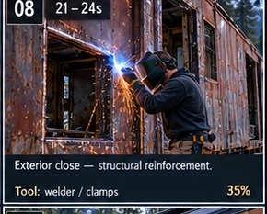
08
Checkpoint 08 — Structural reinforcement
0:21–0:24 • target progress 35%
Visual target
Exterior close; welded/braced edges around cut openings.
Tools/materials
Welder, clamps, grinder
What must happen on-screen
Openings are strengthened logically before glass/deck finish.
Not yet / continuity guardrail
Still no glazing or complete exterior cladding.
Use as a hard visual state. Generate video only to the next nearby checkpoint — never skip multiple construction ideas.
14

Slide 15
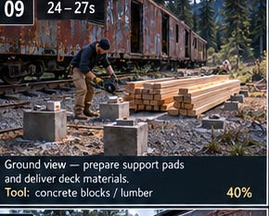
09
Checkpoint 09 — Deck supports + materials
0:24–0:27 • target progress 40%
Visual target
Ground-level deck side; pads/footings, material delivery, outer beam staging.
Tools/materials
Concrete blocks/pads, lumber, level
What must happen on-screen
Deck support system exists before joists/boards.
Not yet / continuity guardrail
No floating deck boards; no finished deck.
Use as a hard visual state. Generate video only to the next nearby checkpoint — never skip multiple construction ideas.
15

Slide 16
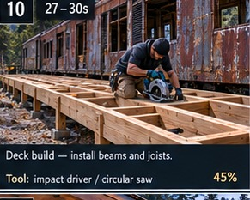
10
Checkpoint 10 — Deck beams + joists
0:27–0:30 • target progress 45%
Visual target
Deck-side three-quarter; joists are placed across most of span.
Tools/materials
Impact driver, circular saw, joist hangers
What must happen on-screen
Visible construction frontier: supports → beams → joists.
Not yet / continuity guardrail
Deck boards not mostly complete yet.
Use as a hard visual state. Generate video only to the next nearby checkpoint — never skip multiple construction ideas.
16

Slide 17
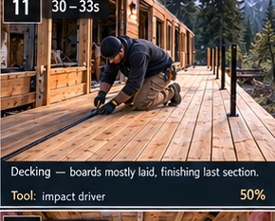
11
Checkpoint 11 — Deck boards mostly laid
0:30–0:33 • target progress 50%
Visual target
Deck-side angle; boards sweep across deck, last section still in progress.
Tools/materials
Impact driver, screws, circular saw
What must happen on-screen
At least 70–90% of deck boarding is visibly earned.
Not yet / continuity guardrail
Do not jump after one board; railings not final yet.
Use as a hard visual state. Generate video only to the next nearby checkpoint — never skip multiple construction ideas.
17

Slide 18
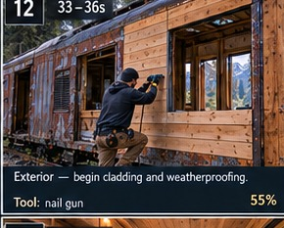
12
Checkpoint 12 — Cladding/weatherproofing begins
0:33–0:36 • target progress 55%
Visual target
Exterior side; wood accents and weatherproofing start around facade.
Tools/materials
Nail gun, weather wrap, trim boards
What must happen on-screen
Exterior finish begins only after openings/deck/framing exist.
Not yet / continuity guardrail
Not fully luxury exterior yet; glass not complete if not shown.
Use as a hard visual state. Generate video only to the next nearby checkpoint — never skip multiple construction ideas.
18

Slide 19
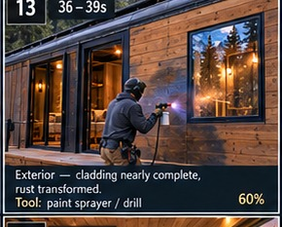
13
Checkpoint 13 — Exterior transformation near complete
0:36–0:39 • target progress 60%
Visual target
Exterior facade; cladding nearly complete but still visibly being installed.
Tools/materials
Paint sprayer, drill, trim, fasteners
What must happen on-screen
Railcar identity preserved under refined finish.
Not yet / continuity guardrail
No final reveal yet; no fully styled interior.
Use as a hard visual state. Generate video only to the next nearby checkpoint — never skip multiple construction ideas.
19

Slide 20
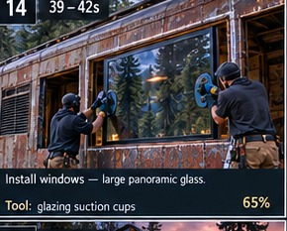
14
Checkpoint 14 — Install panoramic glass
0:39–0:42 • target progress 65%
Visual target
Exterior close/medium; large glass panes carried, suctioned, set, and secured.
Tools/materials
Glass suction cups, caulk gun, shims, drill
What must happen on-screen
Openings from checkpoints 5–8 get filled logically.
Not yet / continuity guardrail
Never one pane → instantly all glass without progress.
Use as a hard visual state. Generate video only to the next nearby checkpoint — never skip multiple construction ideas.
20

Slide 21
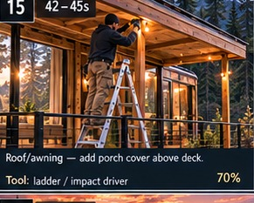
15
Checkpoint 15 — Porch cover / entry finish
0:42–0:45 • target progress 70%
Visual target
Deck angle; small awning/entry cover, stairs, railing, lights.
Tools/materials
Ladder, nailer, impact driver, level
What must happen on-screen
Exterior access and weather protection finish around the already-built deck.
Not yet / continuity guardrail
Interior still not finished.
Use as a hard visual state. Generate video only to the next nearby checkpoint — never skip multiple construction ideas.
21

Slide 22
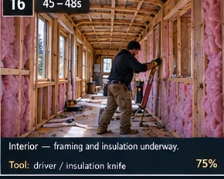
16
Checkpoint 16 — Interior insulation
0:45–0:48 • target progress 75%
Visual target
Interior lengthwise; insulation and service cavities progress down railcar.
Tools/materials
Driver, insulation knife, gloves
What must happen on-screen
Viewer sees hidden layers before wood walls/ceiling cover them.
Not yet / continuity guardrail
No bed, rug, or finished decor yet.
Use as a hard visual state. Generate video only to the next nearby checkpoint — never skip multiple construction ideas.
22

Slide 23
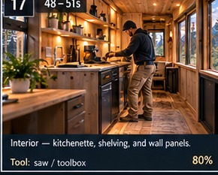
17
Checkpoint 17 — Kitchenette + wall panels
0:48–0:51 • target progress 80%
Visual target
Interior; paneling, counters, shelving/cabinet modules installed.
Tools/materials
Saw, toolbox, brad nailer, driver
What must happen on-screen
Interior function appears step-by-step after insulation/framing.
Not yet / continuity guardrail
Not fully styled; no instant hotel room.
Use as a hard visual state. Generate video only to the next nearby checkpoint — never skip multiple construction ideas.
23

Slide 24
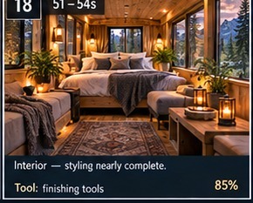
18
Checkpoint 18 — Interior styling nearly complete
0:51–0:54 • target progress 85%
Visual target
Interior warm view; bed/bench textiles, rug, lighting, decor placed.
Tools/materials
Finishing tools, lighting, textiles, decor
What must happen on-screen
Multiple furnishing actions happen before final interior reveal.
Not yet / continuity guardrail
Do not teleport fully complete interior from empty shell.
Use as a hard visual state. Generate video only to the next nearby checkpoint — never skip multiple construction ideas.
24

Slide 25
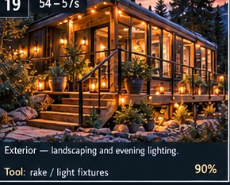
19
Checkpoint 19 — Exterior landscaping + evening light
0:54–0:57 • target progress 90%
Visual target
Exterior dusk setup; lights turn on, landscaping/cleanup completes.
Tools/materials
Rake, light fixtures, planters
What must happen on-screen
Final exterior state is earned; cabin glows but same railcar remains.
Not yet / continuity guardrail
Not the final hero pullback yet.
Use as a hard visual state. Generate video only to the next nearby checkpoint — never skip multiple construction ideas.
25

Slide 26
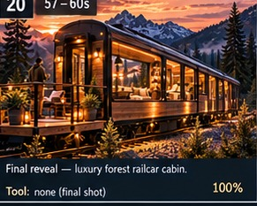
20
Checkpoint 20 — Final reveal
0:57–1:00 • target progress 100%
Visual target
Wide cinematic dusk reveal of finished luxury railcar cabin.
Tools/materials
None
What must happen on-screen
Pure payoff: no more major building, just the result.
Not yet / continuity guardrail
Do not introduce new design elements in the final reveal.
Use as a hard visual state. Generate video only to the next nearby checkpoint — never skip multiple construction ideas.
26

Slide 27
Checkpoint-to-Clip Production Map
Use 20 checkpoints as visual targets; clips can combine adjacent micro-states only when logic remains clear.
Discovery
01 → 02
Hook + inspection
Cleanout
03 → 04
Exterior + interior cleanup
Openings
05 → 08
Mark, cut, reinforce
Deck
09 → 12
Supports, joists, boards
Exterior shell
13 → 15
Cladding, glass, entry
Interior
16 → 18
Insulation, cabinets, styling
Reveal
19 → 20
Evening light + hero reveal
If a clip still creates magic, split it into even smaller checkpoint transitions before changing providers.
27

Slide 28
How This Fits the FORMA Virtual Studio
The 2D world becomes the control room for storyboard-first production.
Story Lab
Build Logic Workshop
stores the 20 checkpoints, reference images, and shot prompts
checks whether each transition makes physical/construction sense
Continuity Office
Render Bay
compares previous frame, target checkpoint, and new output
runs approved adjacent-checkpoint generations
Screening Room / QA
Sound Booth
waits for your approval before continuing
preserves source audio first; later adds foley/music
Workflow: checkpoint approved → generate transition → review output → approve & continue.
28

Slide 29
Decision Gate: Current System vs. Higgsfield
The train-car video is the fair final test before switching providers.
Use current system if...
Switch/test Higgsfield if...
• adjacent transitions stay logical
• railcar identity remains stable
• builder actions cause visible progress
• interior/exterior do not teleport
• cost per usable video is acceptable
• one action still creates whole phases
• checkpoint identity drifts
• interior becomes magic again
• too many retries are needed
• quality remains unpostable despite 20 checkpoints
29

Slide 30
Immediate Next Steps
Use this deck as the canonical creative plan for Video #2.
1
Put this deck + the 20-checkpoint storyboard image into docs/forma/creative/.
2
Ask Claude to create FORMA Video #2 project state from these 20 checkpoint definitions.
3
Generate/approve the 20 still checkpoint references before video generation.
4
Map adjacent checkpoints to the smallest logical video transitions.
5
Run the current Wan/Nano pipeline through the Virtual Studio approval loop.
6
If the current system still fails, run the same checkpoint phase through Higgsfield as the comparison test.
North star: no viewer should ever ask, “Wait — how did that get built?”
30

