Slide 1


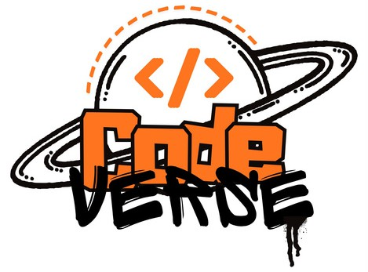




BUILD
भारत 2.0
WITH
N A T I O N A L L E V E L H A C K A T H O N
TEAM NAME: BYTECODE
P R O B L E M S T A T E M E N T : Privacy-Preserving Agentic HR & Code Review Auditor
TEAM MEMBER: Jitendra Behara, Jitendra Shah, Kumari Soni Gupta, Kirti Kashyap, Manthan
COLLEGE : Lloyd institute of engineering and technology
भा र त 2 . 0

Slide 2

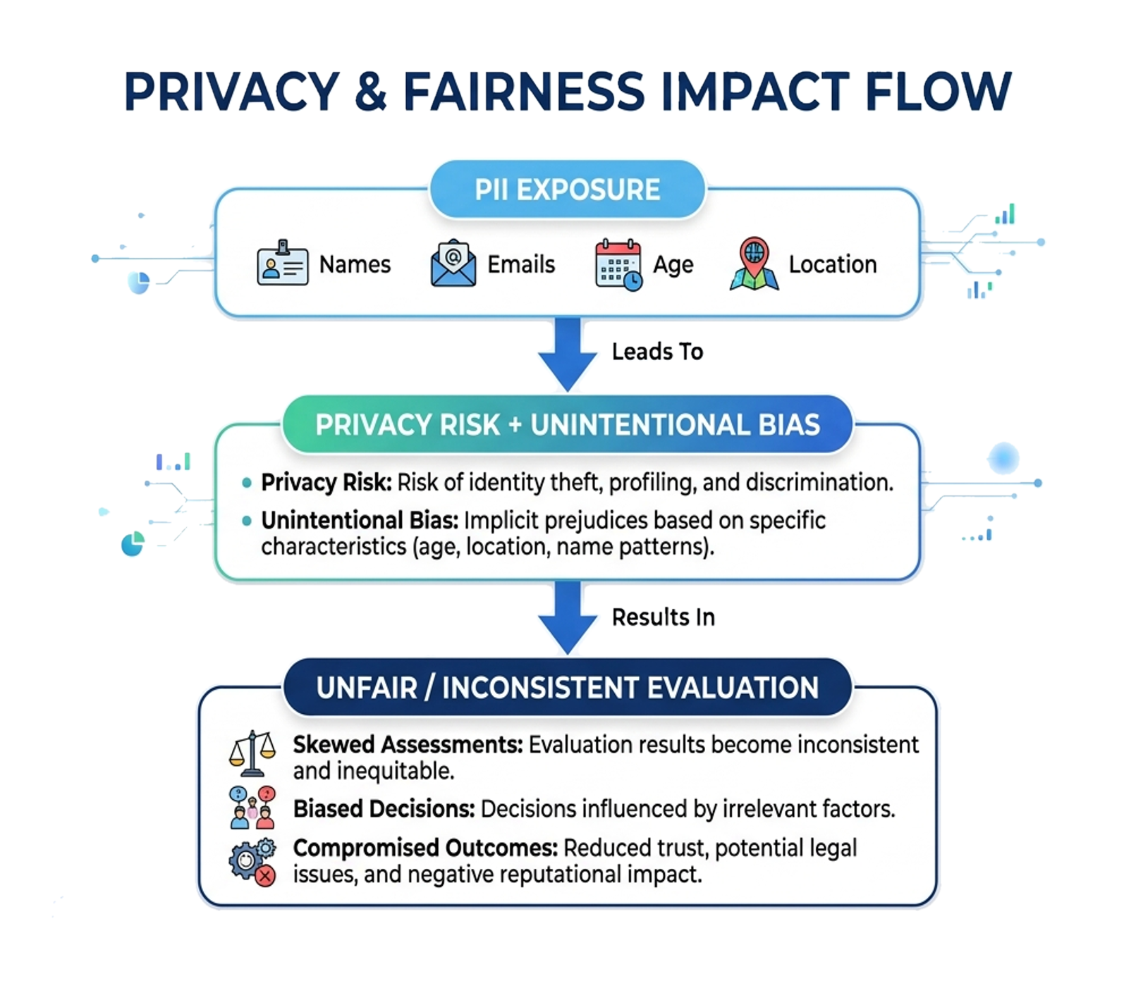
PROBLEM STATEMENT
THE PROBLEM
Modern AI-assisted hiring systems process resumes and code together with personal identity data, creating
Core Challenge
How can we evaluate a developer's skills without letting their identity influence the evaluation?
भा र त 2 . 0

Slide 3
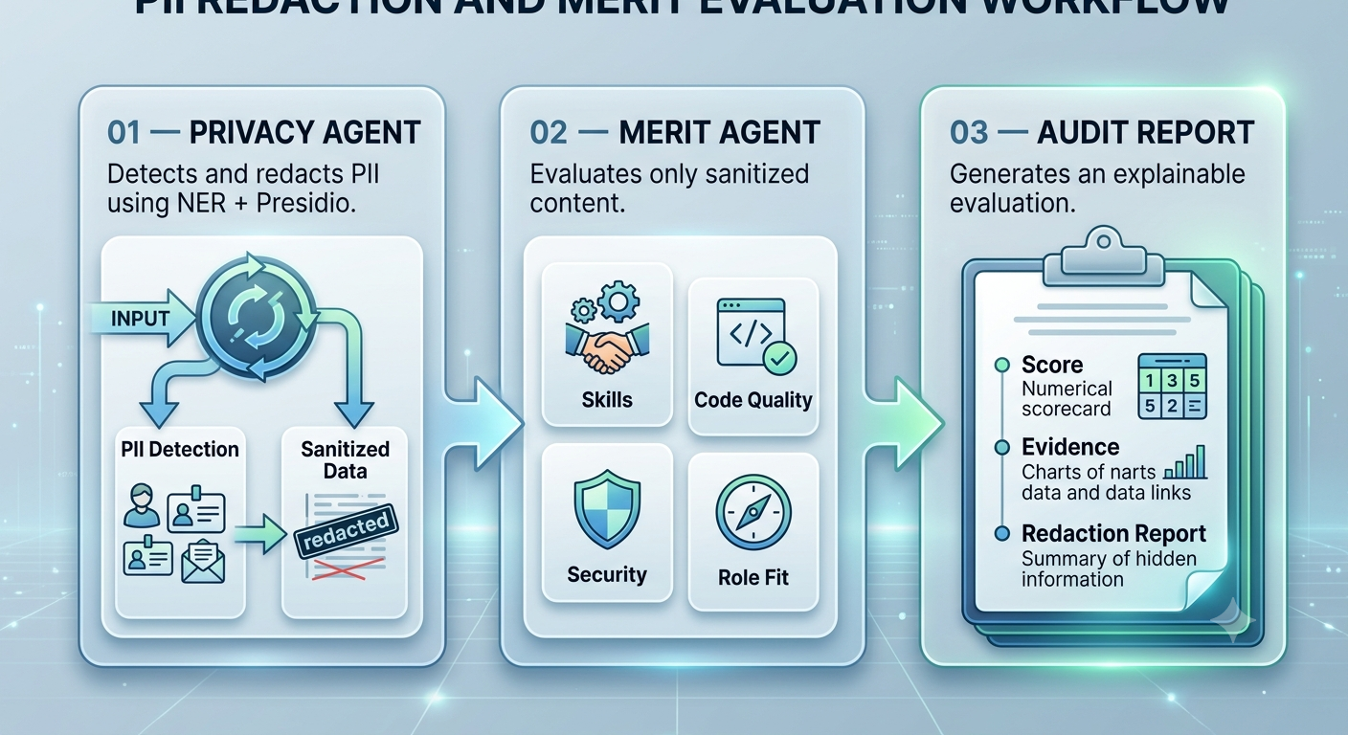
SOLUTION
OUR SOLUTION — VEILAUDIT:
An AI-enabled multi-agent privacy layer that separates identity from merit before evaluation.
Core Principle:
IDENTITY BLIND → MERIT DRIVEN → AUDITABLE
भा र त 2 . 0

Slide 4
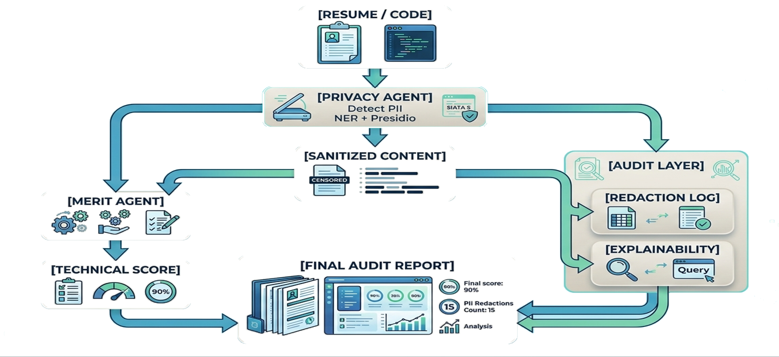
FLOW OF SOLUTION
HOW VEILAUDIT WORKS
Privacy Boundary:
The Merit Agent never receives the original identity-bearing input.
भा र त 2 . 0

Slide 5
TECH STACK
frontend
Html
Css
Javascript
3D interactive interface
AI/NLP
Python
spaCy NER
Local LLM
Secure API
Agent Layer
Privacy Agent
Audit
Explainability layer
AI Model
Groq Cloud
qwen/qwen3.6-27b
Backend
Fast API
PostgreSQL
JWT Auth
pypdf
IMPLEMENTATION APPROACH
Detect → Sanitize → Evaluate → Explain → Audit
भा र त 2 . 0

Slide 6
UNIQUE SELLING PROPOSITION (USP)
WHY
VEILUADIT
🔐 Privacy-First Evaluation PII is removed before merit assessment.
🤖 Multi-Agent Architecture Independent agents handle privacy and evaluation.
⚖Merit-Based Assessment Technical capability becomes the primary evaluation signal.
🧠 Explainable AI Every score is supported by evaluation criteria and evidence.
💻 Code + Resume Analysis One platform for both developer profiles and technical submissions.
⚡ Local-First AI Sensitive data can be processed locally using an Fast Cloud Inference
KEY INNOVATION
We don't just anonymize the candidate — we architect the evaluation pipeline so the scoring agent doesn't need to know the candidate's identity.
भा र त 2 . 0

Slide 7
FEASIBILITY & COMPETITORS
KEY CHALLENGES
FEASIBILITY
Challenge | Our Approach
PII detection | NER + Presidio
Indirect identity clues | Context-aware sanitization
AI bias | Identity-isolated evaluation
Sensitive data exposure | Local/private inference
Explainability | Evidence-based audit report
Technically Feasible
Deployment
1.Open-source NER & PII detection
2.Local LLM inference
3.Lightweight web architecture
4.Modular agent design
1. Local workstation
2.Private server
2. Secure organizational
environment
भा र त 2 . 0

Slide 8

FEASIBILITY & COMPETITORS
COMPETITIVE DIFFERENTIATOR
Traditional ATS
Resume
Screening
AI Code Review
Code
Quality Analysis
Identity
Redaction
Merit Evaluation
Audit
VEILAUDIT

Slide 9
RESEARCH & REFERENCE
PROJECT LINKS
REFERENCES & TOOLS
GitHub Repository
Groq API — LLM inference (qwen/qwen3.6-27b) for redaction, auditing & scoring
FastAPI + PostgreSQL — async backend & data layer
JWT Auth — secure session handling
pypdf — resume/code document parsing
HTML / CSS / JavaScript — interactive frontend
github.com/Wildfrost-stack/CVhelper
Live Demo
cvhelper.jitendra-behera02072000.workers.dev
Team ByteCode — Build with भारत 2.0 National Level Hackathon
भा र त 2 . 0

