Slide 1
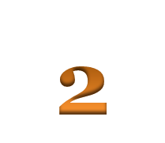
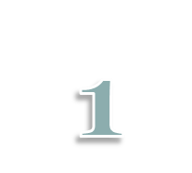
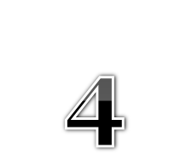
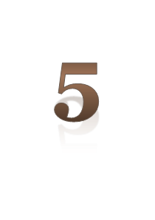
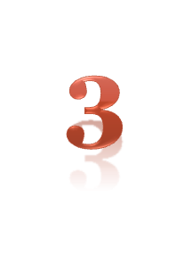
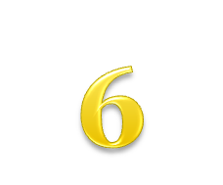
Odd or Even?

Slide 2
Purpose
We were tasked with testing normal distribution and probability using a grid, a penny, and a die.
 |  |  |  | START

Slide 3
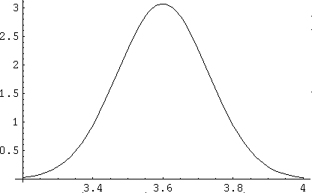
What is normal distribution?
Normal distribution is the statistical theory that a completely random experiment’s data will produce a “bell curve.” A bell curve is shaped like a parabola or a.k.a. a bell with the majority of the data falling in the middle of the curve at the 50% mark, then less and less data falling in the outside edges of the graph, making a bulge in the middle and tails on the end.
Simple Bell Curve
less----------------more--------------less

Slide 4
Probability
Probability is simply the chance that a selected outcome will come true. In the case of a coin flip, the probability that it will be heads is 50% or .5, the closer the probability is to 100% or 1, the better the chance that it is going to happen is. In our case, every time we rolled the die we had a 1 in 6 chance of rolling each number or a 16.7% chance (.166667).

Slide 5
Our Outcome Predictions
Based on what we know from Statistics, we predict that there will be the majority of the outcomes in the middle with few to none on the outsides.
0-2 0 3-4 0 5-6 0 3-4 0 0-2
Column: 1 2 3 4 5 6 7 8 9
The reason we predicted there would be none in columns 2, 4, 6, and 8 is because there is no possible way for the penny to end up on them no matter what path it takes.

Slide 6
Binomial Distribution
The model used in this game is called a binomial distribution. A binomial distribution must be normal, meaning it follows a rough bell curve. The distribution must also be a random sample. Finally, the distribution must also be based on an experiment with only two outcomes (i.e. yes/no, heads/tails, etc.).

Slide 7
Compare and Contrast
We found that the data calculated as well as the data derived, were very similar. Both data sets fell into a normal bell-shaped curve. To find this information out, we compared the data we calculated with the binomialpdf test, then we observed the data from the program to simulate the game like it was meant to be played.

Slide 8
A Change in Rules
The second part of the of the project required us to change the way the penny went. The penny now, when we rolled a 1 or 2 went left and 3 to 6 went right. This made the graph a normal graph that was skewed left. This is because there is more data falling into the upper 3 positions instead of the bottom 2.

Slide 9
Compare and Contrast
Game 1 and 2 were similar in that they both were normal graphs with a random sample. The way we played the games were similar too.
Game 1 and 2 were different in the way the graphs ended up. Game 2’s graph ended up being skewed left with more data because of the unequal division of the game (1 and 2 left 3 to 6 right).

Slide 10
Compare and Contrast
Game 1 and 2 were similar in that they both were normal graphs with a random sample. The way we played the games were similar too.
Game 1 and 2 were different in the way the graphs ended up. Game 2’s graph ended up being skewed left with more data because of the unequal division of the game (1 and 2 left 3 to 6 right).

