Slide 1
oosh: An object oriented shell
Wilfred Hughes

Slide 2
Contents
Features
Evaluation
Problems faced
What's next

Slide 3
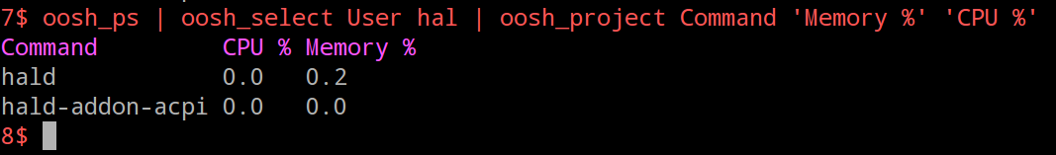
Structured data

Slide 4
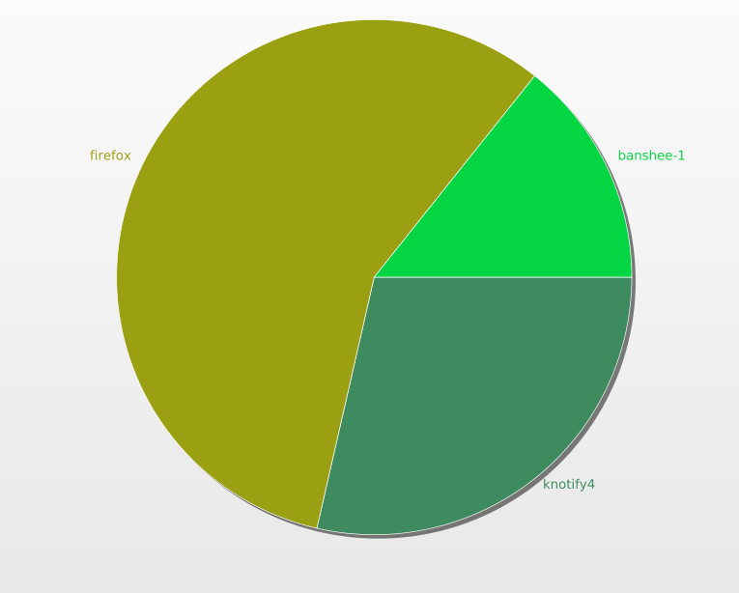
Graphing
$ oosh_ps | oosh_select User wilfred |
oosh_graph pie Command 'CPU %' snazzy_graph.svg

Slide 5
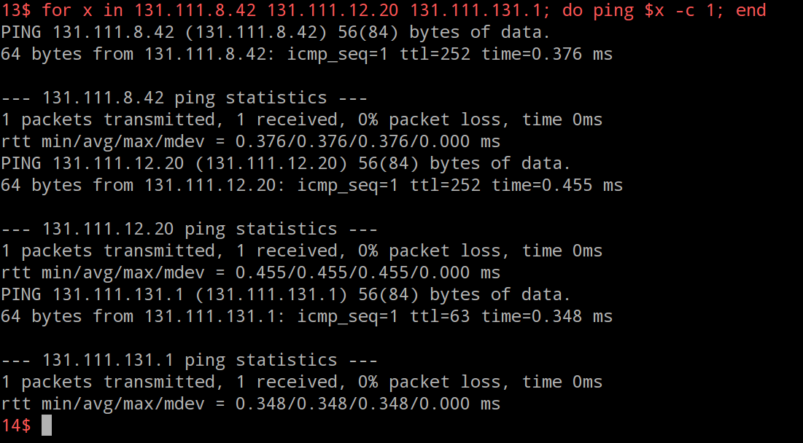
Standard shell features

Slide 6
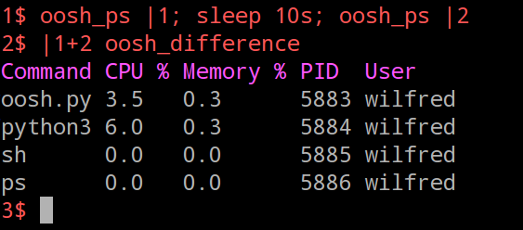
New pipeline concepts

Slide 7
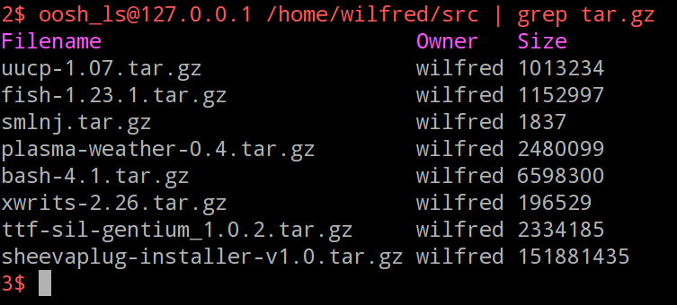
Network integration

Slide 8
Problems encountered
Scope
  What constitutes a complete set of features?

Slide 9
What's next?
Dissertation
Small extensions as prose justifies

Slide 10
Questions?

