Slide 1

1 Cor 12:12-31a

Slide 2


Notices: Keep in touch!
Our newsletter: find it
on the HTC website
emailed out on request
printed at the back
Some details at QR-code
Contact jimkendall@holytrinitycoventry.org.uk
B

Slide 3
Notices:
1030 am 2nd February: Candlemas service
Please bring a covered plate of finger food, to keep with you during the service, ready to share round afterwards, as we enjoy refreshments together.
Note, no nut products please!
B

Slide 4

Notices:
B

Slide 5
Notices:
The Table is a place for students and young adults to gather as people of all languages and nations, around Jesus the only one to reconcile us to God and to one another.
We enjoy a meal, explore scriptures, and grow as apprentices of Jesus.
Every Sunday, 1pm – 3pm, Trinity House (over footbridge to green doors).
B

Slide 6

Notices:
B

Slide 7
Notices:
Coventry Foodbank – latest URGENT needs!
UHT Long Life Milk Tea Bags
Instant Coffee Cooking Sauce
Jam Instant Mash Potato
Dry Noodles
Please place in the Foodbank Collection Basket by the church’s Welcome Desk.
Donated items must be long-dated and in good condition or will be thrown away.
B

Slide 8

Notices:
Request: volunteers to prepare and serve tea + cake for this? Contact office if you can help!
B

Slide 9
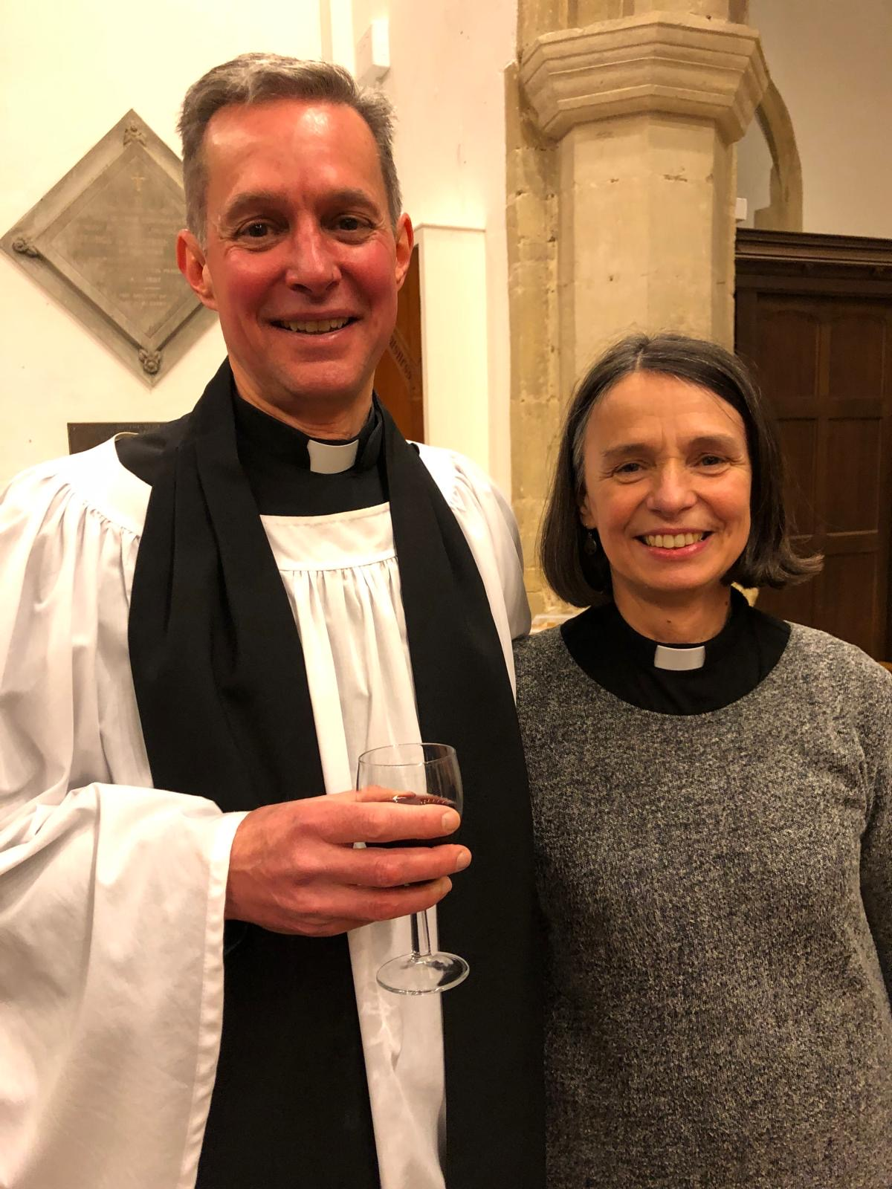
Notices
(a blast from the past):
Long time ago, Sam and Sarah Mortimer worshipped with their children at HTC. They are now both ordained: Sam now licenced as assistant vicar in Bicester, diocese of Oxford.
B

Slide 10

B

Slide 11
Notices:
Security Reminder!
Your valuables - please take your valuables (e.g. handbag) with you when you go forward to take Communion.
Your children - please accompany your children if they need the toilet.
B

Slide 12
Notices:
Hold the date!
Next meeting in the 0930 forum series:
Monday 17th February.
B

