Slide 1
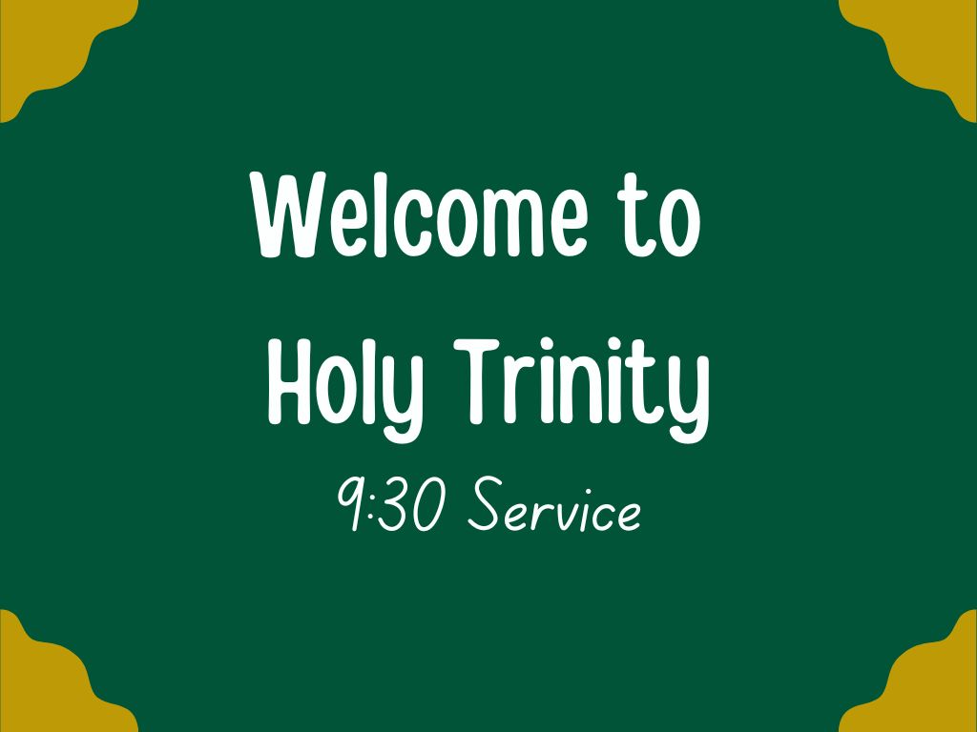
1 Cor 12:12-31a

Slide 2

Leader: Wilfrid K. (Reader)
Talk: Rev Richard Hibbert (Vicar)
Prayers: Anand S.
Reading: Michael G.
Music: Alex Norman, Kathryn, Alison, Anand + Rob
Laptop: Salomon PA: Mike D.
Overseer: Nick J. Livestr: Anita D.
Welcome: Kaye + Chris
Breakfast: Sam + Jean

Slide 3


Slide 4
Opening verse from Bible
“Each of you should give what you have decided in your heart to give, not reluctantly or under compulsion, for God loves a cheerful giver.”
2 Corinthians 9:7

Slide 5
Song 1: Bless the Lord, O my soul (10,000 reasons)
Bless the Lord O my soul O my soul
Worship His holy name
Sing like never before O my soul
I'll worship Your holy name
1/8

Slide 6
The sun comes up it's a new day dawning
It's time to sing Your song again
Whatever may pass and whatever lies before me
Let me be singing when the evening comes
2/8

Slide 7
Bless the Lord O my soul O my soul
Worship His holy name
Sing like never before O my soul
I'll worship Your holy name
3/8

Slide 8
You're rich in love and You're slow to anger
Your name is great and Your heart is kind
For all Your goodness I will keep on singing
Ten thousand reasons for my heart to find
4/8

Slide 9
Bless the Lord O my soul O my soul
Worship His holy name
Sing like never before O my soul
I'll worship Your holy name
5/8

Slide 10
And on that day when my strength is failing
The end draws near and my time has come
Still my soul will sing Your praise unending
Ten thousand years and then forevermore
6/8

Slide 11
Bless the Lord O my soul O my soul
Worship His holy name
Sing like never before O my soul
I'll worship Your holy name
7/8

Slide 12
Bless the Lord O my soul O my soul
Worship His holy name
Sing like never before O my soul
I'll worship Your holy name
Worship Your holy name
I'll worship Your holy name
Jonas Myrin, Matt Redman
CCLI Song #6016351
© 2011 Thankyou Music; Atlas Mountain Songs
For use solely with the SongSelect® Terms of Use. All rights reserved. www.ccli.com
CCLI Licence No.2299
8/8

Slide 13
Confession
Jesus says, ‘Repent, for the kingdom of heaven is close at hand.’
So let us turn away from sin and turn to Christ, confessing our sins in penitence and faith.
cf Matthew 4.17

Slide 14
The kingdom is yours,
but we turn away from your just rule:
Lord, have mercy.
Lord, have mercy.

Slide 15
The power is yours,
but we trust in our own power and strength:
Christ, have mercy.
Christ, have mercy.

Slide 16
The glory is yours,
but we fall short of the glory of God:
Lord, have mercy.
Lord, have mercy.

Slide 17
May almighty God have mercy on us,
forgive us our sins,
and bring us to everlasting life,
through Jesus Christ our Lord.
Amen.

Slide 18
Song 2: Come, now is the time to worship
Come now is the time to worship
Come now is the time to give your heart
Come just as you are to worship
Come just as you are before your God
Come
1/5

Slide 19
One day every tongue
Will confess You are God
One day every knee will bow
Still the greatest treasure remains
For those who gladly choose You now
2/5

Slide 20
Come now is the time to worship
Come now is the time to give your heart
Come just as you are to worship
Come just as you are before your God
Come
3/5

Slide 21
Willingly we choose to surrender our lives
Willingly our knees will bow
With all our heart soul mind and strength
We gladly choose You now
4/5

Slide 22
Come now is the time to worship
Come now is the time to give your heart
Come just as you are to worship
Come just as you are before your God
Come
Brian Doerksen
CCLI Song #2430948
© 1998 Vineyard Songs (UK/Eire)
For use solely with the SongSelect® Terms of Use. All rights reserved. www.ccli.com
CCLI Licence No.2299
5/5

Slide 24
Activity
We need young people to volunteer to help get Jim to the church on time!

Slide 25
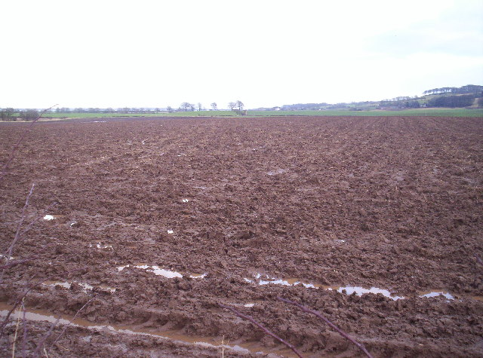
Sticky question
What is one of your favourite walks?
© Copyright Dominic Dawn Harry and Jacob Paterson
and licensed for reuse under this Creative Commons Licence.
https://www.geograph.org.uk/photo/122085

Slide 26

Notices: Keep in touch!
Our newsletter: find it
on the HTC website
emailed out on request
printed at the back
Some details at QR-code
Contact jimkendall@holytrinitycoventry.org.uk

Slide 27

Notices:
Request: volunteers to prepare and serve tea + cake for this? Contact office if you can help!
B

Slide 29
Creed
Do you believe and trust in God the Father,
source of all being and life,
the one for whom we exist?
We believe and trust in him

Slide 30
Do you believe and trust in God the Son,
who took our human nature,
died for us and rose again?
We believe and trust in him

Slide 31
Do you believe and trust in God the Holy Spirit,
who gives life to the people of God
and makes Christ known in the world?
We believe and trust in him
This is the faith of the Church.
This is our faith.
We believe and trust in one God,
Father, Son and Holy Spirit. Amen

Slide 33
Song 3: I Will Offer Up My Life
I will offer up my life
In spirit and truth
Pouring out the oil of love
As my worship to You
In surrender I must give my every part
Lord receive the sacrifice
Of a broken heart
1/4

Slide 34
Jesus what can I give what can I bring
To so faithful a friend to so loving a King
Saviour what can be said what can be sung
As a praise of Your name
For the things You have done
Oh my words could not tell not even in part
Of the debt of love that is owed
By this thankful heart
2/4

Slide 35
You deserve my every breath
For You've paid the great cost
Giving up Your life to death
Even death on a cross
You took all my shame away
There defeated my sin
Opened up the gates of heaven
And have beckoned me in
3/4

Slide 36
Jesus what can I give what can I bring
To so faithful a friend to so loving a King
Saviour what can be said what can be sung
As a praise of Your name
For the things You have done
Oh my words could not tell not even in part
Of the debt of love that is owed
By this thankful heart
Matt Redman
CCLI Song #1083764
© 1994 Thankyou Music
For use solely with the SongSelect® Terms of Use. All rights reserved. www.ccli.com
CCLI Licence No.2299
4/4

Slide 37
Bible reading: 1 Cor 12:12-31a
...

Slide 38
Talk by Rev Richard Hibbert
Wealth and Walk
...

Slide 39
Prayers (Anand Scott)
1. Dear God, thank you for loving each one of us just as we are. You’ve given us so much, and we are grateful. Help us to share what we have, to be kind and generous, and to follow Jesus every day.
Lord, in your mercy,
(Response: 'Hear our prayer')

Slide 40
2. Thank you, Lord, for our church family. You’ve made each of us special, and together we can do so much more. Help us to love and care for one another and to show your love to everyone in Coventry.
Lord, in your mercy,
(Response: 'Hear our prayer')

Slide 41
3. Lord, we pray for the world. There are so many people who feel sad, lonely, or scared. Please comfort them and remind them they are never alone. Help us to see how we can bring your hope and love to others.
Lord, in your mercy,
(Response: 'Hear our prayer')

Slide 42
Merciful Father, thank you for hearing us, for loving us, and for walking with us every step of the way. Accept these prayers, through Jesus Christ, who gave everything so we could belong to you. Amen

Slide 43
The Peace:
The peace of the Lord be always with you
And also with you.
...

Slide 45
The Communion Prayer
The Lord is here
His Spirit is with us
Lift up your hearts.
We lift them to the Lord.
Let us give thanks to the Lord our God.
It is right to give thanks and praise.

Slide 46
We praise God for his mighty acts

Slide 47
… we proclaim your glory
and join their unending hymn of praise:
Holy, holy, holy Lord,
God of power and might.
Heaven and earth are full of your glory.
Hosanna in the highest!

Slide 48
We remember what Jesus did

Slide 49
… Great is the mystery of faith
Christ has died
Christ is risen
Christ will come again

Slide 50
We ask for the help of the Holy Spirit

Slide 51
Our Father in heaven,
hallowed be your name,
your kingdom come,
your will be done,
on earth as in heaven.
Give us today our daily bread.
Forgive us our sins
as we forgive those who sin against us.

Slide 52
Lead us not into temptation
but deliver us from evil.
For the kingdom, the power,
and the glory are yours
now and for ever.
Amen.

Slide 53
Breaking of the Bread
We break this bread
to share in the body of Christ.
Though we are many, we are one body,
because we all share in one bread.

Slide 54
Giving of Communion
We invite all present to receive communion if it is your tradition or custom to do so, or you may receive a blessing instead (keep your hands by your side).
If you would like a gluten free wafer, please ask.

Slide 55
Song 4: Yet not I but through Christ
What gift of grace is Jesus my redeemer
There is no more for heaven now to give
He is my joy my righteousness and freedom
My steadfast love my deep and boundless peace
1/8

Slide 56
To this I hold my hope is only Jesus
For my life is wholly bound to his
Oh how strange and divine I can sing all is mine
Yet not I but through Christ in me
2/8

Slide 57
The night is dark but I am not forsaken
For by my side the Saviour he will stay
I labour on in weakness and rejoicing
For in my need his power is displayed
3/8

Slide 58
To this I hold my Shepherd will defend me
Through the deepest valley he will lead
Oh the night has been won and I shall overcome
Yet not I but through Christ in me
4/8

Slide 59
No fate I dread I know I am forgiven
The future sure the price it has been paid
For Jesus bled and suffered for my pardon
And he was raised to overthrow the grave
5/8

Slide 60
To this I hold my sin has been defeated
Jesus now and ever is my plea
Oh the chains are released I can sing I am free
Yet not I but through Christ in me
6/8

Slide 61
With every breath I long to follow Jesus
For he has said that he will bring me home
And day by day I know he will renew me
Until I stand with joy before the throne
7/8

Slide 62
To this I hold my hope is only Jesus
All the glory evermore to him
When the race is complete still my lips shall repeat
Yet not I but through Christ in me
Yet not I but through Christ in me
Yet not I but through Christ in me
Jonny Robinson, Michael Farren, Rich Thompson
CCLI Song #7121852
© 2018 CityAlight Music; Farren Love And War Publishing; Integrity's Alleluia! Music
For use solely with the SongSelect® Terms of Use. All rights reserved. www.ccli.com
CCLI Licence No.2299
8/8

Slide 63
Post Communion prayer

Slide 64
Song 5: We seek your kingdom
We seek your kingdom throughout every sphere
We long for heaven’s demonstration here
Jesus your light shine bright for all to see
Transform, revive, and heal society
1/5

Slide 65
Before all things, in him were all things made
Inspiring culture, media, and trade
May all our work serve your economy
Transform, revive, and heal society
2/5

Slide 66
Peace, truth, and justice reigning everywhere
With us be present in our public square
Fill all who lead with your integrity
Transform, revive, and heal society
3/5

Slide 67
Forgive us Lord, when we have not engaged
Failing to scribe your heart on history’s page
Make us again what we were made to be
Transform, revive, and heal society
4/5

Slide 68
Faithful to govern ever may we be
Selfless in service, loving constantly
In everything may your authority
Transform, revive, and heal society
NOEL ROBINSON, ANDY FLANNAGAN, & GRAHAM HUNTER
© 2016 Downwardly Mobile Music, Nu Image Music, Graham Hunter
Used by permission. All rights reserved
CCLI License: 7078309
5/5

Slide 69
Closing Prayer

Slide 70
Dismissal
Go in peace to love and serve the Lord.
In the name of Christ. Amen.

Slide 71

Please join us for drinks and “breakfast” in Trinity House (leave church, turn right, walk over footbridge) © The Archbishop’s Council 2000 CCLI No. 6531173
Notices at:

