Slide 1
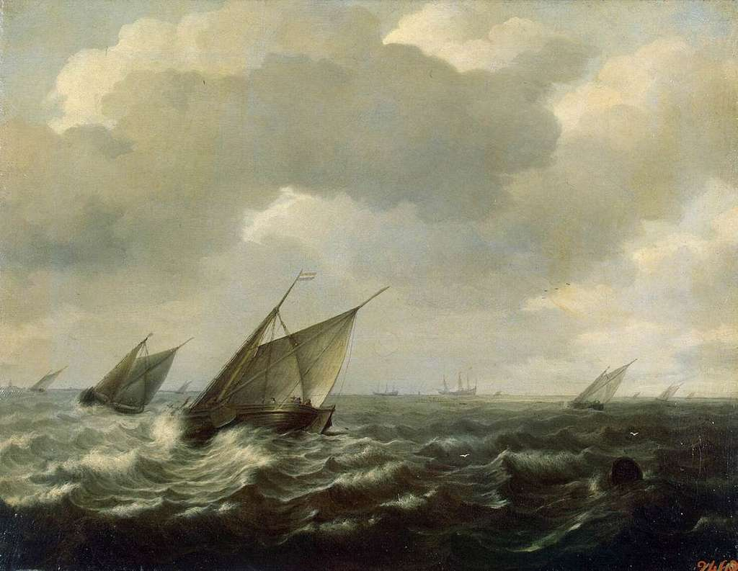
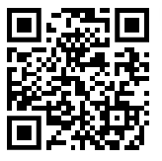
Pentecost 2023
Acts 2:1-21 “When the day of Pentecost came …”
https://wilfridskendall.github.io/Pentecost23/

