Slide 1



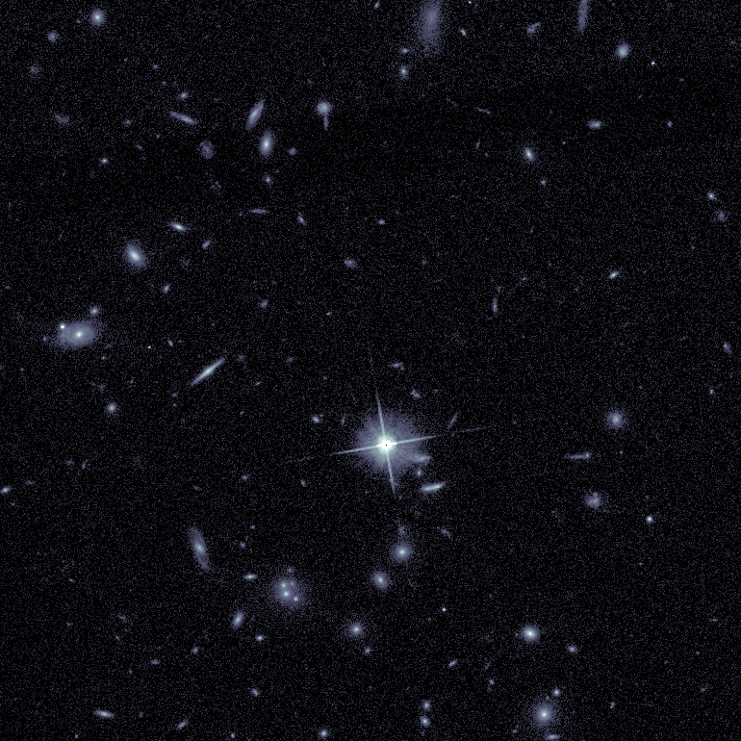
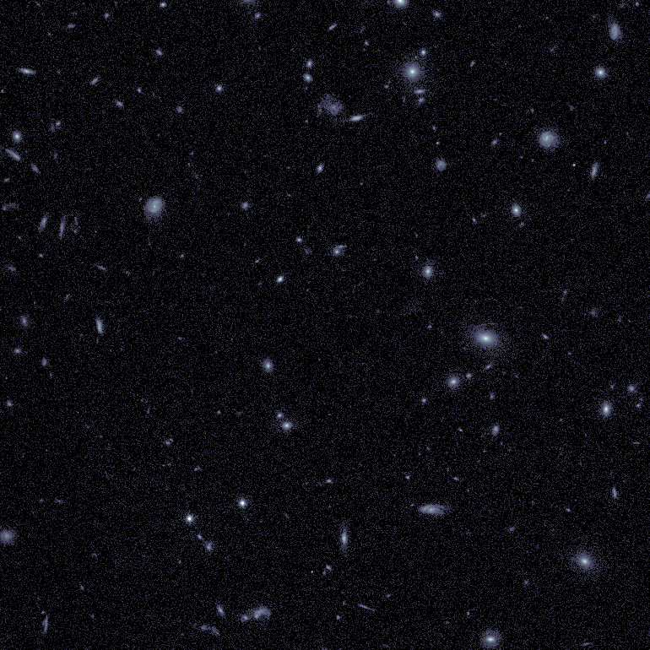
First Instructions for PSF computation and kinematics modeling
Valentina Abril-Melgarejo
Directeurs de thèse: Benoît Epinat & Phillipe Amram. LAM Collaborateurs: Thierry Contini. IRAP & consortium MUSE-GTO

Slide 2
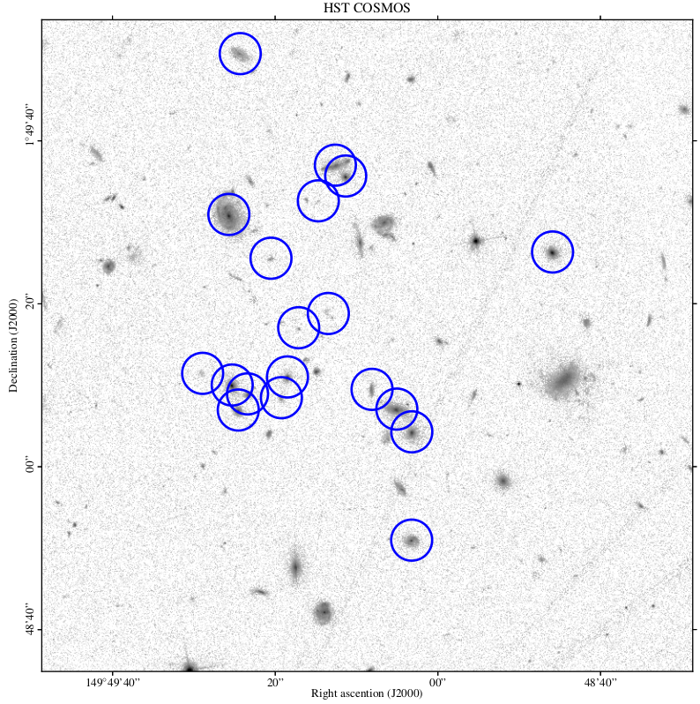
Field CGr 79

Slide 3





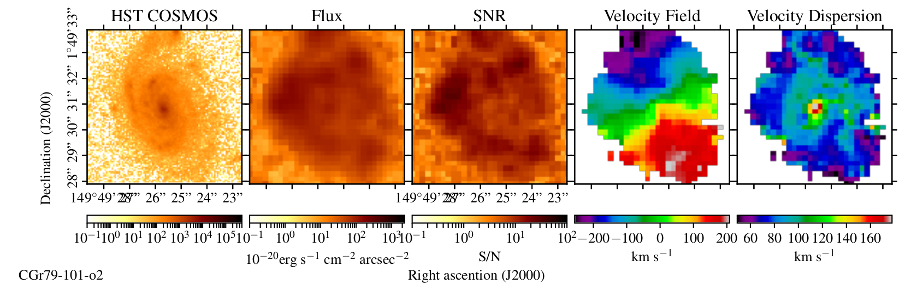

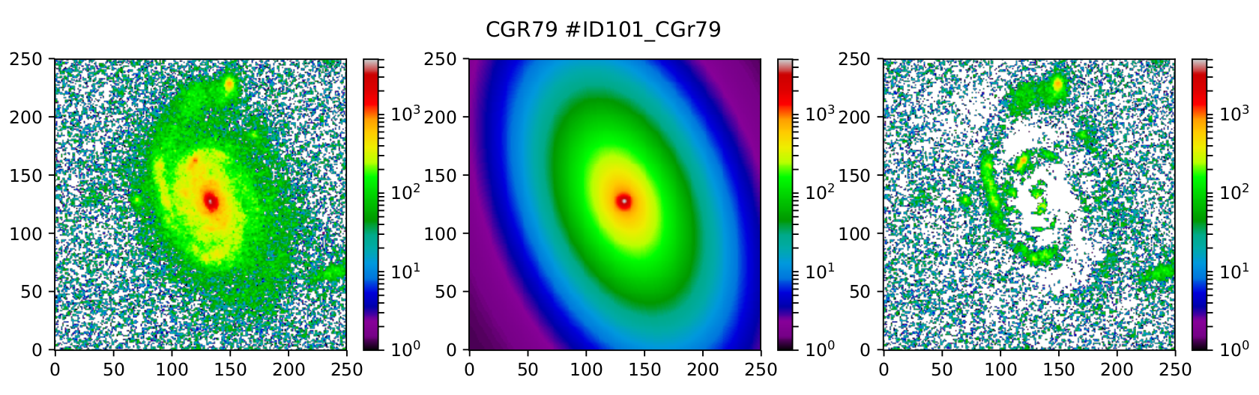
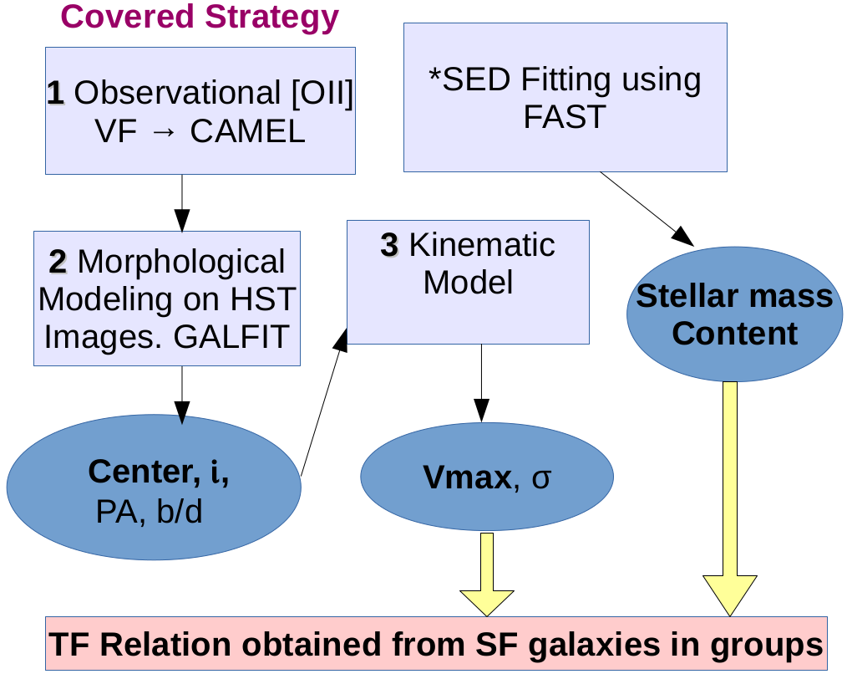
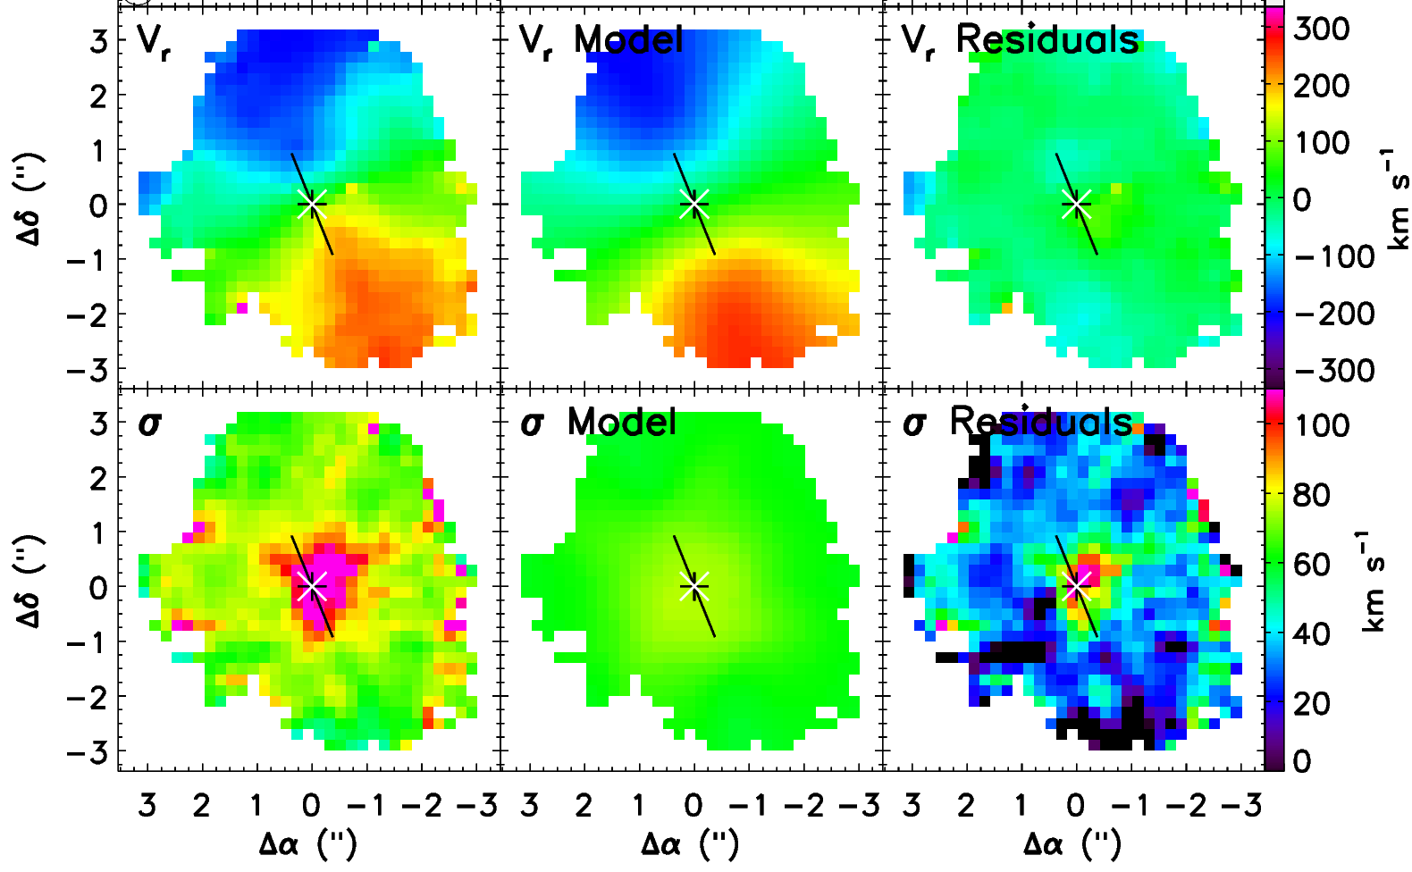

La stratégie pour l’extraction des proprietés cinématiques ...
1
2
3

Slide 4
PSF Computation
1. Identify the stars in the field → Star catalog
2. Project the stars at the z of the galaxy (Galaxy group)
        Produce a data cube with CAMEL
        Model the whitelight image with GALFIT (Gaussian / Moffat Models)
3. Calculate the medium FWHM value among the stars in each field
        From GALFIT in pixels → MUSE 0.2”/pixel (psfx)

Slide 5
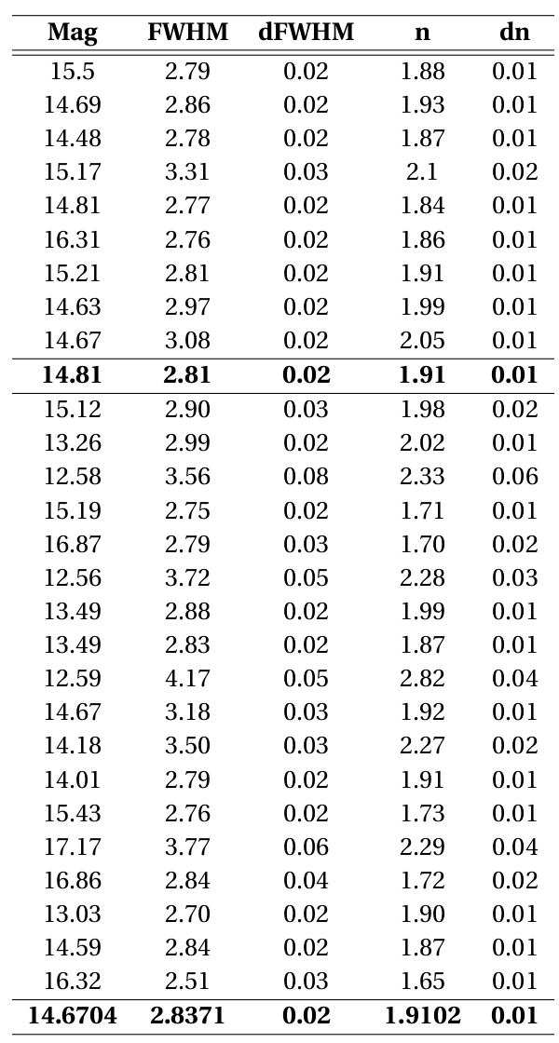
PSF parameters determined with Moffat models for 27 stars from Deep (first ten rows) and Snapshot fields

Slide 6
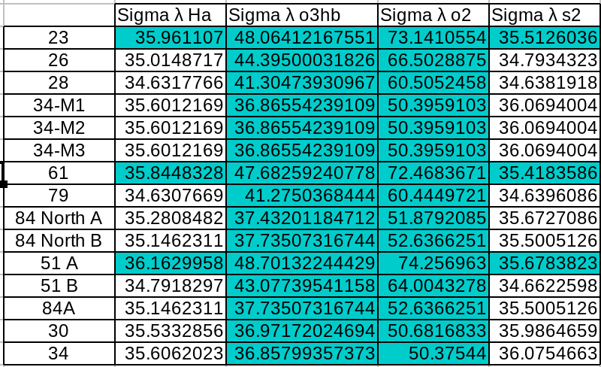
Line Spread Function (LSF) for MUSE
Take the LSF from Bacon et al. 2017 (psfz)

Slide 7
FIT_MASSIV IDL CODE
Prepare the input_line.txt file
Morphology values as input for the center, PA, inclination
PSF Calculation psfx
LSF Calculation psfz
1. Run FIT_MASSIV
2. To Generate the table with the kinematics model results we need the python rutine: kinemorpho_catalogs.py
To Obtain the maps with the kinematics models
1. Generate the file maps_input_line.txt
2. Run the IDL code create_article_maps_musehdfs_galfit.pro

