Slide 1
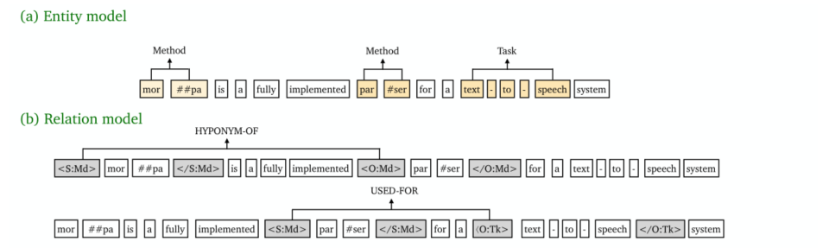


实体抽取：span分类任务
关系抽取：start token对分类任务
Zhong et al., NAACL21

Slide 2
Span Embeddings /
Relation Pair Embeddings
Classifier
0, 1, …, n_classes
CE loss
Cosine Similarity
Input features =
torch.cat([Span Embeddings, visual_feature_of_image, text_feature_of_image])
Label features=
torch.cat([text_feature_of_label, visual_feature_of_label])

Slide 3

Frozen
Discrete Prompt：a photo of { label }
Learnable
Input features = torch.cat([Span Embeddings, visual_feature_of_image, text_feature_of_image])
+
Span Embeddings /
Relation Pair Embeddings
$$×$$
Distribution
∙
Token Embeddings
CLIP
Text Encoder
Img Encoder
BERT
DiscretePrompt
Twitter
Images
Twitter
Tokens
PER
LOC
ORG
MISC
+
Pretrained Visual Prompt On CIFAR100

Slide 4

Frozen
Soft Prompt:
Learnable
Discrete Prompt：a photo of { }
Label features=
torch.cat([text_feature_of_label, visual_feature_of_label])
+
dot
backward
CLIP
Img Encoder
Text Encoder
BERT
DiscretePrompt
Random Tensor
Span
Labels
Soft
Prompt
Pretrain visual feature of span labels

Slide 5
Frozen
Soft Prompt:
Learnable
Discrete Prompt：a photo of { }
Label features=
torch.cat([text_feature_of_label, visual_feature_of_label])
+
Pretrained Vqgan-CLIP text2image generator
BERT
DiscretePrompt
Span
Labels
Soft
Prompt
Pretrain visual feature of span labels

Slide 6
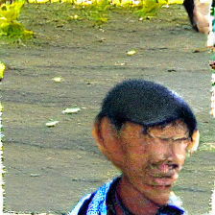
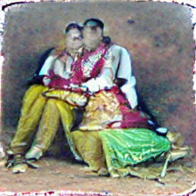
NER
RE
Person.png
couple.png

Slide 7
Span Embeddings /
Relation Pair Embeddings
Classifier
0, 1, …, n_classes
CE loss
Cosine Similarity
Input features =
torch.cat([Span Embeddings, visual_feature_of_image, text_feature_of_image])
Label features=
torch.cat([text_feature_of_label, visual_feature_of_label])

Slide 8
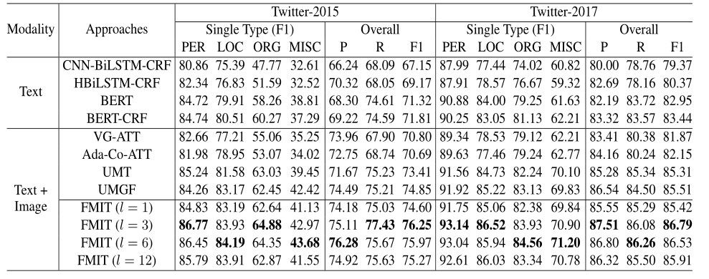
实验
Twitter15：74.6
Twitter17：86.7
Lu et al., COLING 22

Slide 9
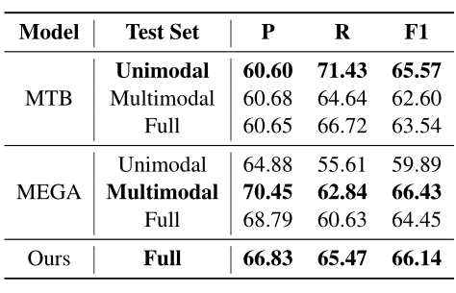
实验
MNRE:65.94
Xu et al., COLING 22

