Slide 1
ACCEL AI INNOVATE PARIS · DATA-CENTRIC AGENTS · OCT 2026
WINDFALL
Use power when the grid is full of sun and wind.
DAY-AHEAD PRICE · FRANCE · REAL DATA (ENERGY-CHARTS)
■ cheapest hours: Windfall loads here ■ evening peak: Windfall avoids
Five AI agents that move a small business’s flexible load into the cheapest, cleanest hours — and never break the cold chain.

Slide 2
WINDFALL │ ENERGY AUTOPILOT FOR SMEs
02 / THE PROBLEM
SMES PAY PEAK PRICES
FOR POWER THEY COULD SHIFT.
[ 01 ] THE GRID
[ 02 ] THE SITE
[ 03 ] THE GAP
Every sunny noon France has so much solar that prices fall, sometimes below zero (23 negative-price hours in our 41-day sample). Every evening at 7 pm the grid burns gas and prices peak.
A cold store keeps freezers on a thermostat and plugs its electric vans in at 6 pm. Everything draws power at the same expensive, dirty hour: 156 kW against a 110 kW subscription.
Big industrials have energy traders and demand-response contracts. SMEs have flexible load — inertia in their cold rooms, idle hours on their chargers — and nobody to use it.
The insight A freezer doesn’t care when it runs, as long as the food stays below −18 °C. A van doesn’t care when it charges, as long as it’s full at 6 am. That flexibility is worth ~20% of the bill — and a sixth of the carbon.
Accel AI Innovate Paris · Data-Centric Agents · built on Aiven
01a162cc-…-8080.eur-1.aiven.app ↗

Slide 3
WINDFALL │ ENERGY AUTOPILOT FOR SMEs
03 / THE PRODUCT
FIVE AGENTS,
ONE SITE.
[ 01 / FCST ]
[ 02 / PLN ]
[ 03 / WCH ]
[ 04 / LRN ]
[ 05 / AUD ]
Forecaster
Planner
Watcher
Learner
Auditor
Finds the most similar past days in a pgvector memory and forecasts price and grid carbon 2 days ahead.
Dynamic programming over cold-room temperatures and van charging under hard limits. Claude writes the plan.
Consumes the Kafka telemetry stream. Door left open, van back late: replans the day in seconds.
Re-fits each cold room’s thermal model every night from ClickHouse history. Gets measurably better.
Logs every decision to OpenSearch and drafts the CSRD carbon note.
Claude explains, the maths decides. Optimisation is deterministic and auditable; Claude turns it into plans and explanations a site manager reads. Keenable brings grid news to the Planner.
Accel AI Innovate Paris · Data-Centric Agents · built on Aiven
01a162cc-…-8080.eur-1.aiven.app ↗

Slide 4
WINDFALL │ ENERGY AUTOPILOT FOR SMEs
04 / THE DATA LAYER
GROUNDED IN DATA,
ON AIVEN.
[ 01 ] SOURCES
[ 02 ] STREAM
[ 03 ] MEMORY & HISTORY
[ 04 ] RUNS ON
AIVEN
AIVEN
AIVEN
Energy-Charts
Kafka
ClickHouse
Aiven Runtime
FR day-ahead prices + generation by fuel → hourly grid carbon
site.telemetry · agent.decisions → Watcher
Market history, telemetry, backtests → Learner
App built from GitHub; service credentials injected automatically
AIVEN
AIVEN
Open-Meteo
Valkey
PostgreSQL + pgvector
Graceful degradation
Temperature at the site
Live site state · windfall:events bus
Assets, learned physics, vector memory of every past day → Forecaster
Any store missing → app keeps running, /api/health says what is live
AIVEN
Keenable
OpenSearch
Grid news & alerts
Full-text audit of every decision → Auditor
Site telemetry
Rooms, chargers, meter
Accel AI Innovate Paris · Data-Centric Agents · built on Aiven
01a162cc-…-8080.eur-1.aiven.app ↗

Slide 5
WINDFALL │ ENERGY AUTOPILOT FOR SMEs
05 / EVIDENCE
41 REAL DAYS,
REPLAYED.
Real French market data (Energy-Charts + Open-Meteo), same site, same weather. Naive = thermostat + vans charge when plugged in. RECORDED SCENARIO
−21.8%
−17.4%
0 h
0
ENERGY COST
CO₂, LOCATION-BASED
ABOVE 110 KW
COLD-CHAIN BREACHES
€7,180 → €5,615 · ≈ €13.9k / yr / site
1,704 → 1,408 kg · 2.6 t / yr / site
naive: 62 h · peak 156 → 101 kW
100% of vans ready at 06:00
[ LRN ] THE LEARNER GETS BETTER EVERY NIGHT
[ FCST ] FORECASTER vs "SAME AS 2 DAYS AGO"
88% → 0%
Price · persistence
50.3 €/MWh
Price · pgvector analog days
40.9 €/MWh
Cold-room model error, first vs last week. Safety overrides fall from 10.8 to 0.2 per day as the Learner re-fits each room’s physics from ClickHouse history.
Carbon · persistence
13.4 g/kWh
Carbon · pgvector analog days
11.1 g/kWh
Accel AI Innovate Paris · Data-Centric Agents · built on Aiven
01a162cc-…-8080.eur-1.aiven.app ↗

Slide 6
WINDFALL │ ENERGY AUTOPILOT FOR SMEs
06 / WHY US, WHY NOW
SAME POWER.
CHEAPER, CLEANER HOURS.
[ 01 ] WHO IT'S FOR
[ 02 ] WHY NOW
[ 03 ] FIRST USERS
Cold-chain SMEs: food logistics, bakeries, butchers, pharma depots. Tens of thousands of euros a year on power, flexible load, and no energy team.
France and the EU run on 15-min dynamic prices; negative-price hours are routine. CSRD makes SMEs’ clients ask for carbon numbers. Delivery fleets are going electric.
Rungis market (~1,200 food companies on one site) as the beachhead. Free audit = our backtest on their meter data. Paid as a share of savings; sold through electricity suppliers and charge-point installers.
POINT OF DIFFERENCE
Not a dashboard: agents that act on live data, remember every past day, and learn each site’s physics — with a searchable audit trail that doubles as CSRD evidence.
Accel AI Innovate Paris · Data-Centric Agents · built on Aiven
01a162cc-…-8080.eur-1.aiven.app ↗

Slide 7
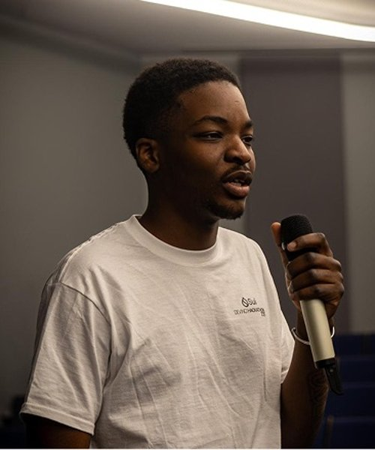

WINDFALL │ ENERGY AUTOPILOT FOR SMEs
07 / WHO BUILT IT
BUILT IN ONE DAY
BY WILIAMS LOPES.
WILIAMS LOPES
Founder · builder of Windfall
EDUCATION
M1 Financial Engineering & Mathematics, ESILV.
COMMUNITY
Events Lead at DeVinci Blockchain (DVB), the Web3 association of De Vinci Higher Education. Organises the association’s events and represents DVB at hackathons.
WHY ENERGY
Quant background meets the energy transition: prices, optimisation and data are the same toolkit — pointed at a cleaner grid.
CONTACT
linkedin.com/in/wiliams-lopes-3382921ba
Accel AI Innovate Paris · Data-Centric Agents · built on Aiven
01a162cc-…-8080.eur-1.aiven.app ↗

