Slide 1
VLSI DSP Final Project MIMO Detection Algorithms Comparison and Analysis
Team members: 310513008 楊士緯, M093799 鄭宇倫
June 6th, 2022

Slide 2
Outline
Introduction
System Model
MIMO detection algorithm
ML detector
ZF detector
MMSE detector
K-best detector
Simulation results
Conclusion
References

Slide 3
Outline
Introduction
System Model
MIMO detection algorithm
ML detector
ZF detector
MMSE detector
K-best detector
Simulation results
Conclusion
References

Slide 4
Introduction (1/2)
A communication system is composed of transmitter, receiver, and channel
In multiple-input multiple-output (MIMO) communication system
Both the transmitters and the receivers are equipped with several antennas
Which will help in achieving high gains in spectral, power, and energy efficiency
The hardware implementation of MIMO detector is an important issue [1]
As the scale of the system getting larger to deal with the 5G technologies
Optimal MIMO detector such as maximum likelihood detector is
Infeasible due to its high computational complexity
Low computational complexity algorithm achieving near-optimal performance is required
Linear detectors [2], tree-based-search detectors [3][4] are used to deal with MIMO detection

Slide 5
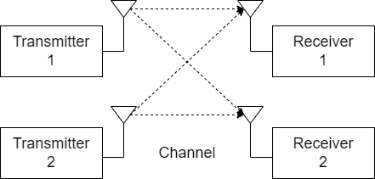
Introduction (2/2)
In this project, we comparison the performance and complexity of some algorithms mentioned above
Maximum likelihood, zero forcing, minimum mean square error, and K-best
A simulation platform was built to implement the MIMO detection algorithm
A 2X2 MIMO system with QPSK modulation
MIMO
detector
2X2 MIMO system

Slide 6
Outline
Introduction
System Model
MIMO detection algorithm
ML detector
ZF detector
MMSE detector
K-best detector
Simulation results
Conclusion
References

Slide 7
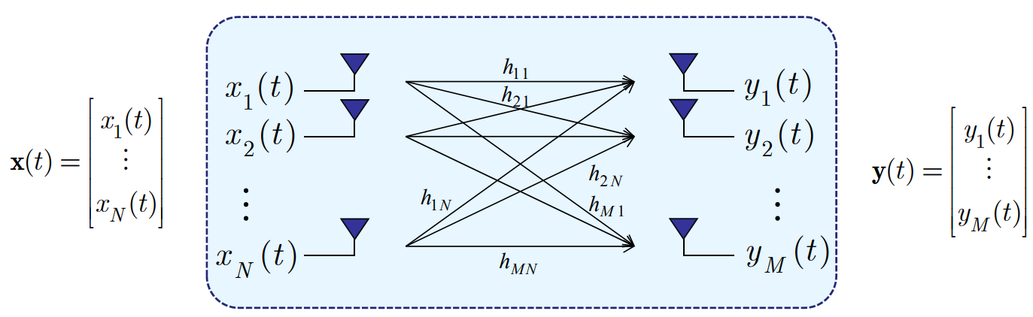


System Model (1/2)
$y\left(t\right)=Hx\left(t\right)+n(t)$
x is the input vector
y is the output vector
H is the channel matrix
n is noise
$$H=\left[\begin{matrix}\begin{matrix}h_{11} & h_{12} \\ h_{21} & h_{22}\end{matrix} & \begin{matrix}… & h_{1N} \\ … & h_{2N}\end{matrix} \\ \begin{matrix}⋮ & ⋮ \\ h_{M1} & h_{M2}\end{matrix} & \begin{matrix}⋱ & ⋮ \\ … & h_{NM}\end{matrix}\end{matrix}\right]$$
Noise

Slide 8
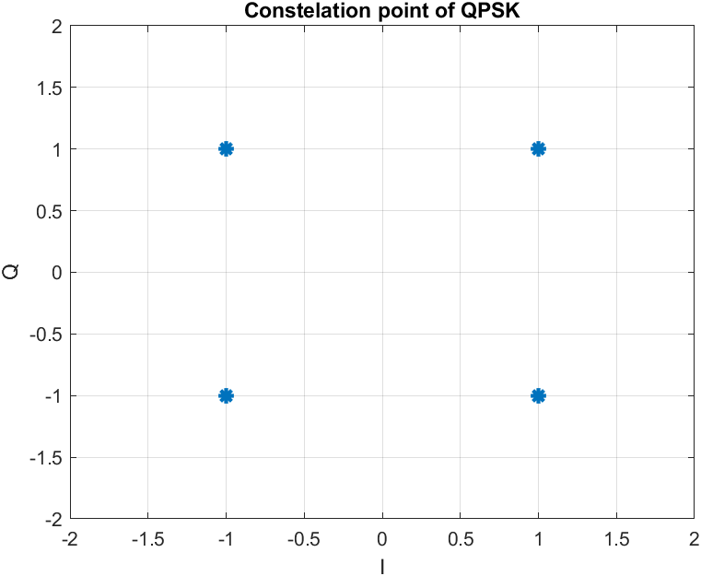
System Model (2/2)
In our system
The input antenna number (N) is 2
The output antenna number (M) is 2
The modulation is QPSK (4-QAM)
With an additive Gaussian white noise
Channel matrix size : 2X2
The signal length is 1024
Channel matrix H can obtain by
Channel Model
Ex: in slow and flat fading case, the channel matrix element typically assumed i.i.d. Rayleigh distributed
Sampling : Channel State Information (CSI)
Performance comparison criterion
Signal-to-noise ratio (SNR), bit error rate (BER)
-1+j
1+j
-1-j
1-j

Slide 9
Outline
Introduction
System Model
MIMO detection algorithm
ML detector
ZF detector
MMSE detector
K-best detector
Simulation results
Conclusion
References

Slide 10

ML Detector
The optimum detector
$\min_{\hat{x}(k)∈S}{\sum_{k=1}^{K}{{\left\|y\left(k\right)−H\hat{x}(k)\right\|}^{2}}}$
S: symbol set
K: sample size
The complexity grows exponentially with the number of the antenna
4 symbols, 1 antenna – S=4
4 symbols, 2 antenna – S=16
Symbol set
1+j | 1-j | -1+j | -1-j

Slide 11
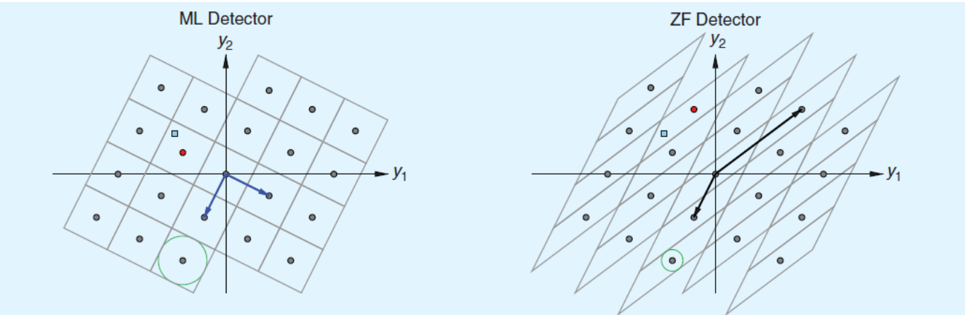

ZF Detector
Linear detector
$y=Hx+w⇒H^{−1}y=x+H^{−1}w⇒\tilde{y}=x+\tilde{w}$
Noise enhancement would be serious if H is ill-conditioned
Effected of ill-conditioned channel
Decision regions of detector have been twisted by H
With ZF detector adopted, transformed noise would be seriously enhanced
Making decision easily wrong

Slide 12

MMSE Detector
Linear detector
$y=Hx+w⇒\min_{W}{E\{{\left(x−Wy\right)}^{H}(x−Wy)\}}$
The solution:
$W={\left(H^{H}H+ρ^{−1}I\right)}^{−1}H^{H}$
$ρ=\frac{σ_{x}^{2}}{σ_{w}^{2}}$
Jointly consider channel and noise effects
Better performance than ZF detector

Slide 13
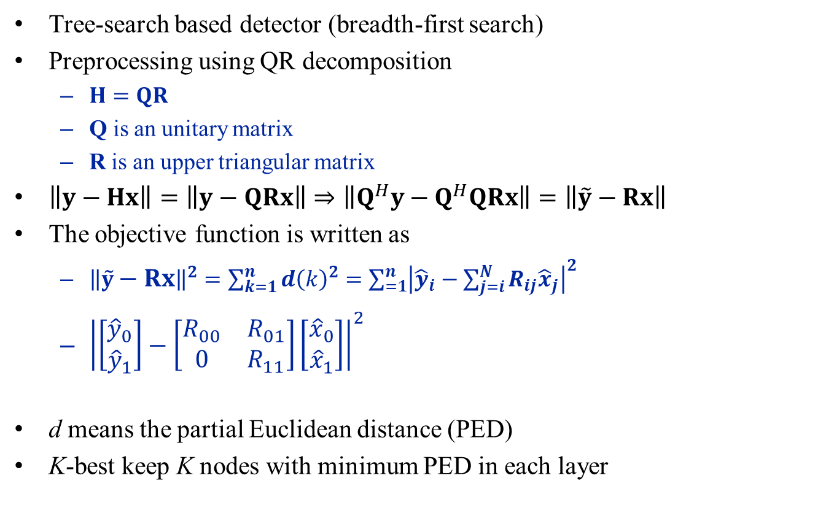
K-Best Detector (1/3)
Tree-search based detector (breadth-first search)
Preprocessing using QR decomposition
$H=QR$
Q is an unitary matrix
R is an upper triangular matrix
$\left\|y−Hx\right\|=\left\|y−QRx\right\|⇒\left\|Q^{H}y−Q^{H}QRx\right\|=\left\|\tilde{y}−Rx\right\|$
The objective function is written as
${\left\|\tilde{y}−Rx\right\|}^{2}=\sum_{k=1}^{n}{d{\left(k\right)}^{2}}=\sum_{=1}^{n}{{\left|{\hat{y}}_{i}−\sum_{j=i}^{N}{R_{ij}{\hat{x}}_{j}}\right|}^{2}}$
${\left|\left[\begin{matrix}{\hat{y}}_{0} \\ {\hat{y}}_{1}\end{matrix}\right]−\left[\begin{matrix}R_{00} & R_{01} \\ 0 & R_{11}\end{matrix}\right]\left[\begin{matrix}{\hat{x}}_{0} \\ {\hat{x}}_{1}\end{matrix}\right]\right|}^{2}$
d means the partial Euclidean distance (PED)
K-best keep K nodes with minimum PED in each layer

Slide 14
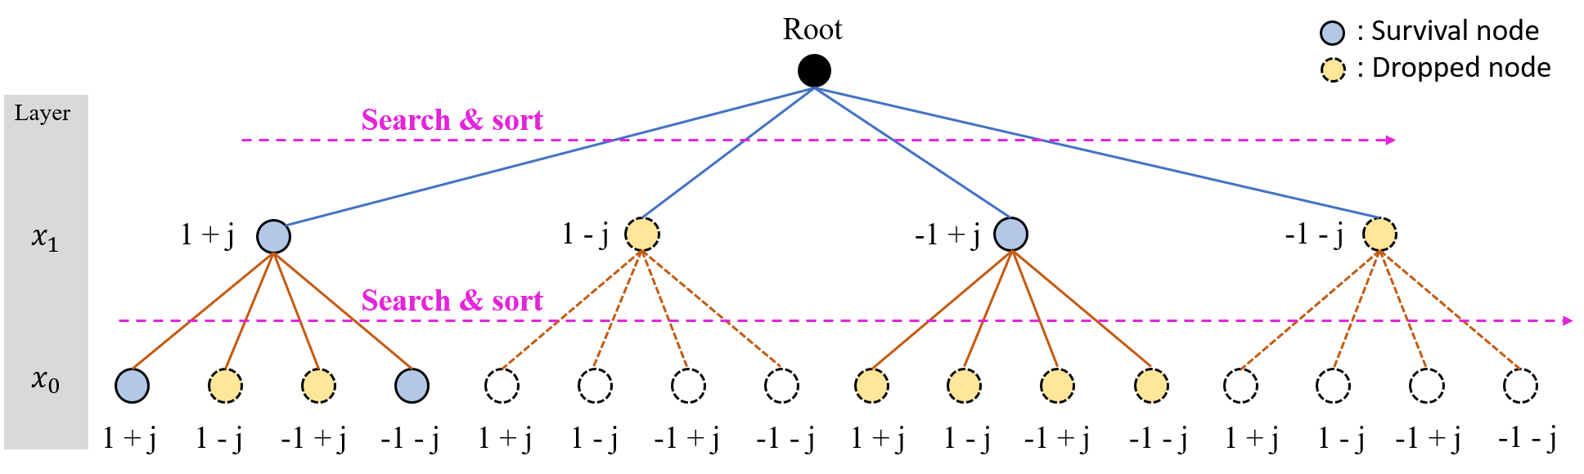
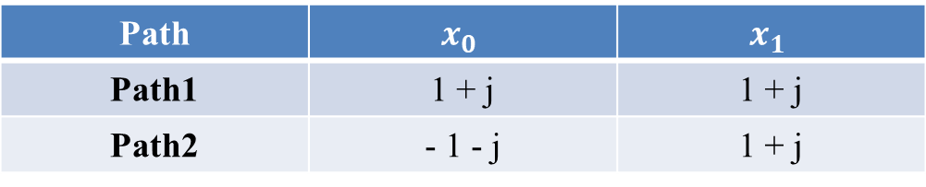

K-Best Detector (2/3)
For K=2
Path1
Path2
Path | $$x_{0}$$ | $$x_{1}$$
Path1 | 1 + j | 1 + j
Path2 | - 1 - j | 1 + j
$$⇒\min{\{path1, path2\}}$$

Slide 15
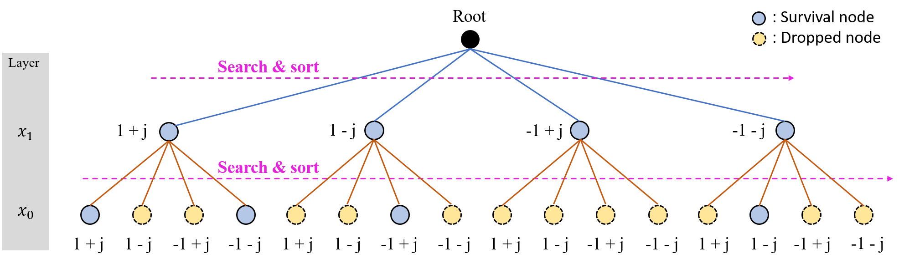
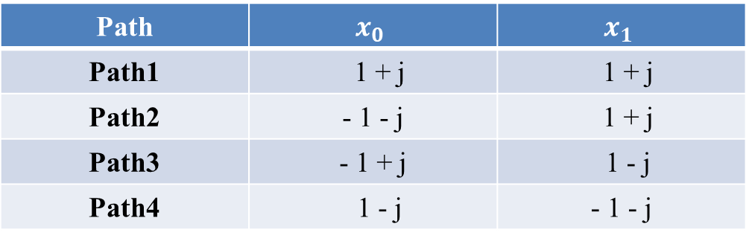
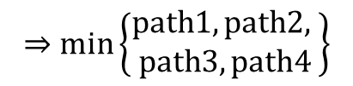
K-Best Detector (3/3)
For K=4
Path1
Path2
Path3
Path4
Path | $$x_{0}$$ | $$x_{1}$$
Path1 | 1 + j | 1 + j
Path2 | - 1 - j | 1 + j
Path3 | - 1 + j | 1 - j
Path4 | 1 - j | - 1 - j
$$⇒\min\left\{\begin{aligned}path1, path2, \\ path3, path4\end{aligned}\right\}$$

Slide 16
Outline
Introduction
System Model
MIMO detection algorithm
ML detector
ZF detector
MMSE detector
K-best detector
Simulation results
Conclusion
References

Slide 17
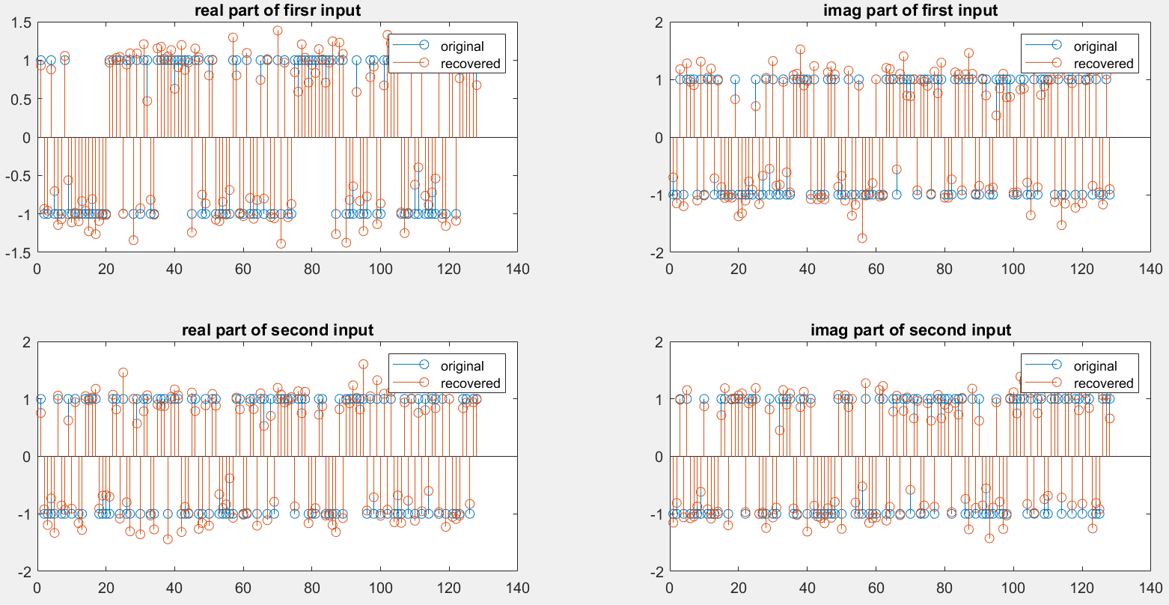
Simulation Results (1/4)
Detection results

Slide 18
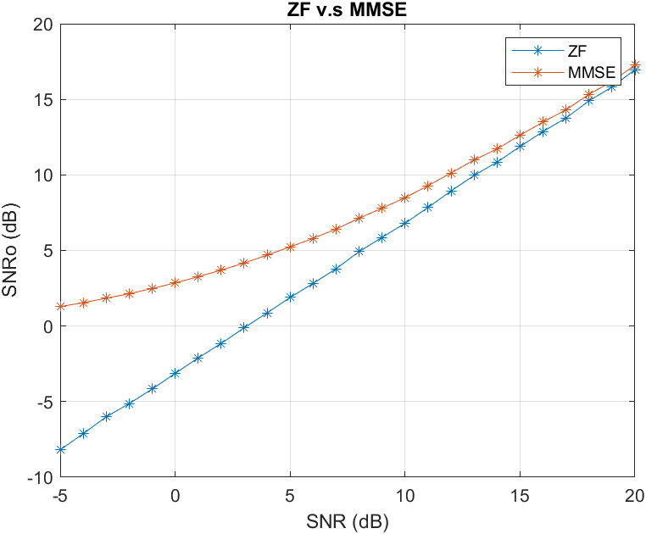
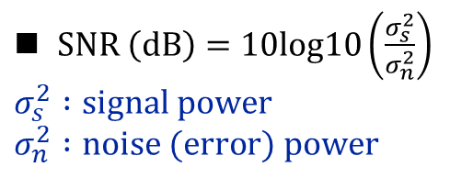
Simulation Results (2/4)
Noise enhancement problem in ZF detector
$SNR \left(dB\right)=10log10\left(\frac{σ_{s}^{2}}{σ_{n}^{2}}\right)$
$$σ_{s}^{2} :signal power$$
$$σ_{n}^{2} :noise (error) power$$

Slide 19
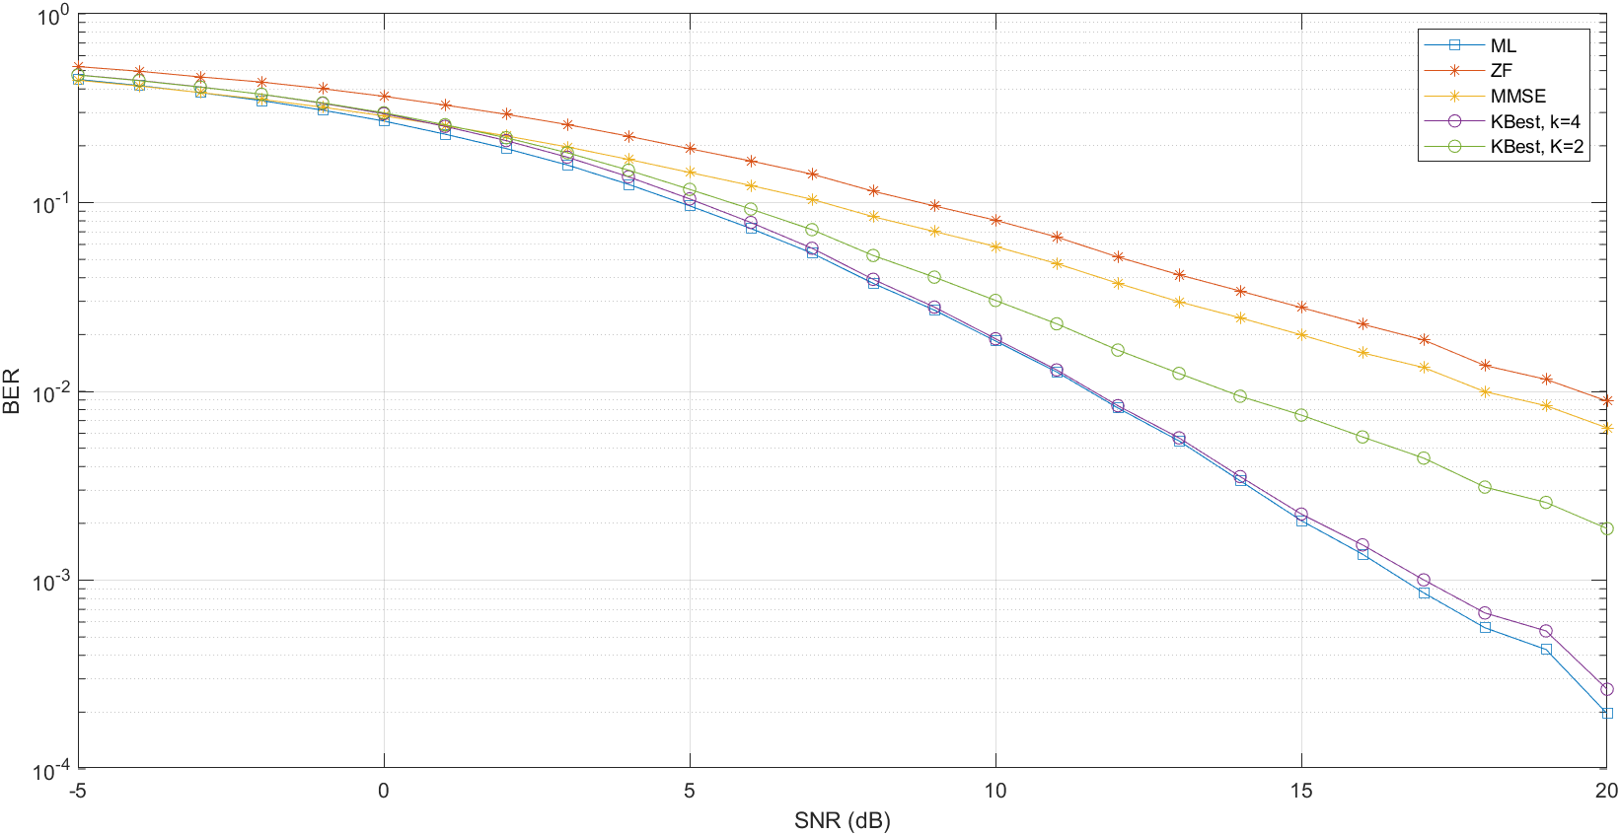

Simulation Results (3/4)
BER performance comparison
$BER \left(dB\right)=10log10\left(\frac{number of error bits}{number of total bits}\right)$

Slide 20
Simulation Results (4/4)
Complexity analysis
Summary of all detectors
Detector | BER | Complexity | Type
ML | Optimal | Dramatically complex
ZF | Very poor | Very simple | Linear detector
MMSE | Poor | Simple | Linear detector
K-best | Good | Rather complex | Tree-based-search detector (breadth first search)

Slide 21
Outline
Introduction
System Model
MIMO detection algorithm
ML detector
ZF detector
MMSE detector
K-best detector
Simulation results
Conclusion
References

Slide 22
Conclusion
From the simulation results, we can found the disadvantage of ZF detector
Noise enhancement problem may influence the detection results seriously
For the linear detector
ZF is the best linear detector regarding SNR criterion
MMSE is the best linear detector regarding SINR criterion
For the K-best detector
Has a higher performance than linear detector but also a higher complexity
The value of K in K-best detector is an important issue
Since the value of K is a tradeoff between BER and complexity
K-best detector is a more flexible choice than ZF and MMSE for MIMO system and VLSI implementation

Slide 23
References
[1] Trotobas, B.; Nafkha, A.; Louët, Y. A.; Louët, Y. A review to massive MIMO detection algorithms: Theory and implementation. In Advanced Radio Frequency Antennas for Modern Communication and Medical Systems; IntechOpen: London, UK, 2020.
[2] Wübben, D. Seethaler, J. Jaldén, and G. Matz, “Lattice reduction,” IEEE Signal Processing Mag., vol. 1, no. 3, pp. 70‐91 May 2011.
[3] Burg, “VLSI circuit for MIMO communication systems,” Ph.D. dissertation, Swiss Federal Institution of Technology Zurich, 2006.
[4] I. A. Bello, B. Halak, M. El-Hajjar and M. Zwolinski, "VLSI implementation of a scalable K-best MIMO detector," 2015 15th International Symposium on Communications and Information Technologies (ISCIT), 2015.

Slide 24
Thank you！

