Slide 1
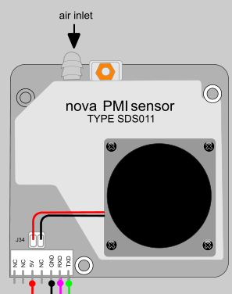

Air quality
Mutation date 06-11-2021

