Slide 1

P1 Presentation
Dane Sperling
Will-BigData/Dane-Sperling-P1

Slide 2
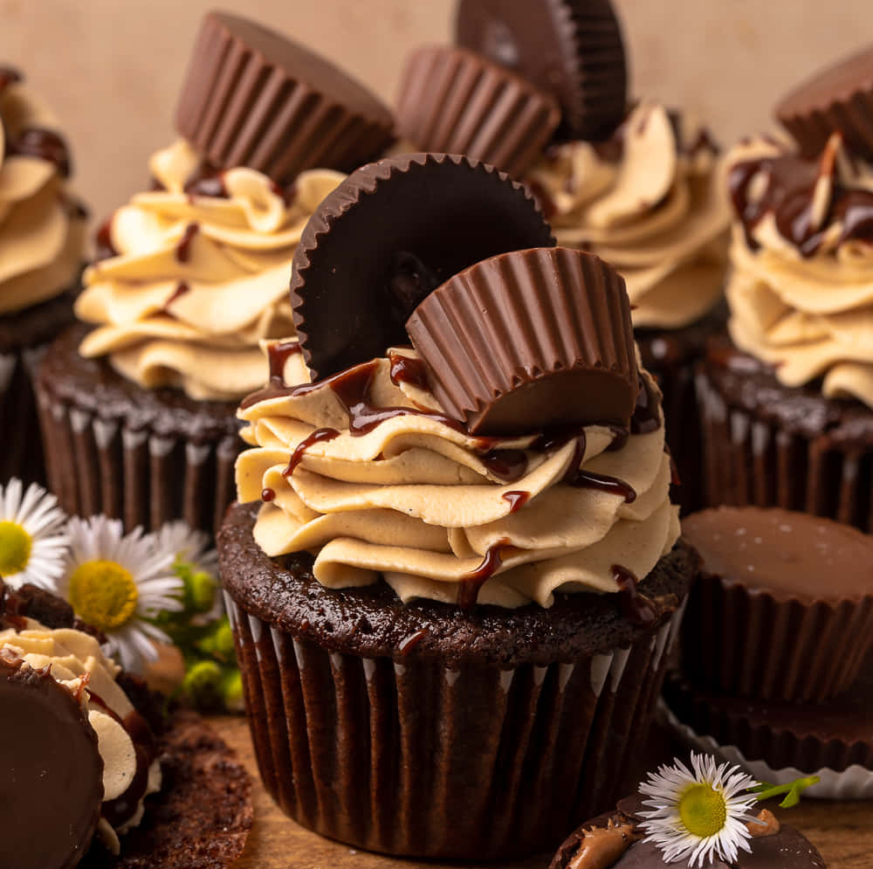
P1 – Dane's Cupcakes
A simple cupcake shop with a variety of flavors
Keeps track of customer's orders, who has ordered something, user information, and also the menu which can be modified
Users can add a cupcake to their order, change their passwords or usernames, view their current cart and also check their totals
Admins can update the menu, add/delete items from the menu, make users admins, take away admin privileges, delete users, and view the total profit of the store

Slide 3
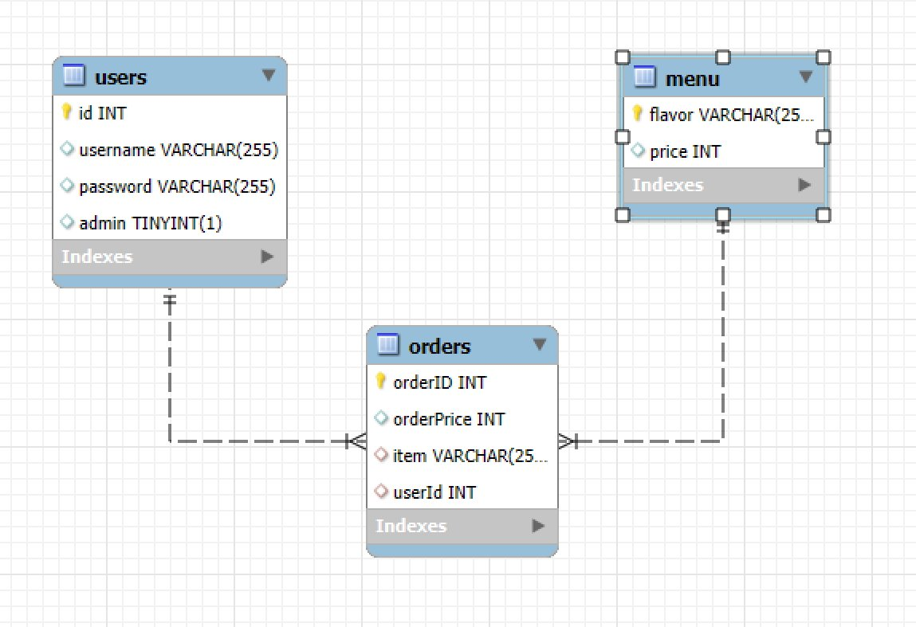
ERD
Users.id -> orders.userId
Menu.price -> orders.item

Slide 4
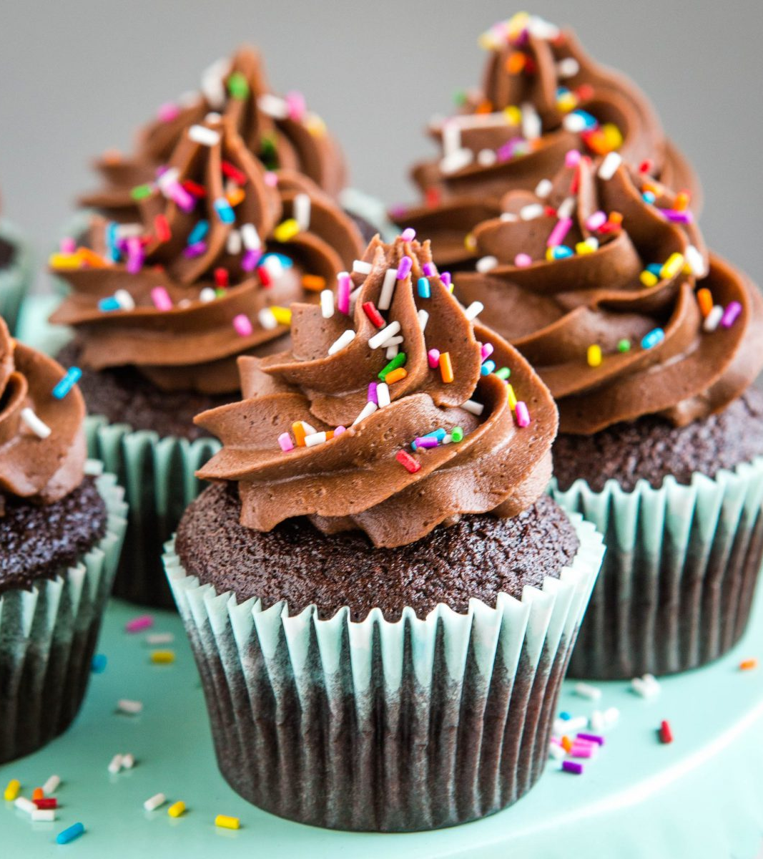
Tables
Users
Id
Username
Password
admin
Menu
Flavor
Price
Orders
OrderId
OrderPrice
Item
UserId

Slide 5
Tech stack
Python 3.12
MySQL Workbench
AWS RDS

