Slide 1

The Furniture Hub
Project one presentation
Name: Dejen Tesfagergs
Date: 10/25/2024

Slide 2
INTRODUCTION
This is an online shopping app called The Furniture Hub.
This app is designed to help users to buy furniture online

Slide 3
FEATURES
This app has two types of users
1. Admin users
2. None admin users

Slide 4
As an Admin, I can:
Register and login to the app
Add products
Update or delete products
Update or delete users
Update or delete orders
View all the products
View all the users
Change user role

Slide 5
As a User, I can:
Register and login to the app
View all the products
Add products to the cart
Check order history
Update or delete order
Checkout by adding shipping details

Slide 6
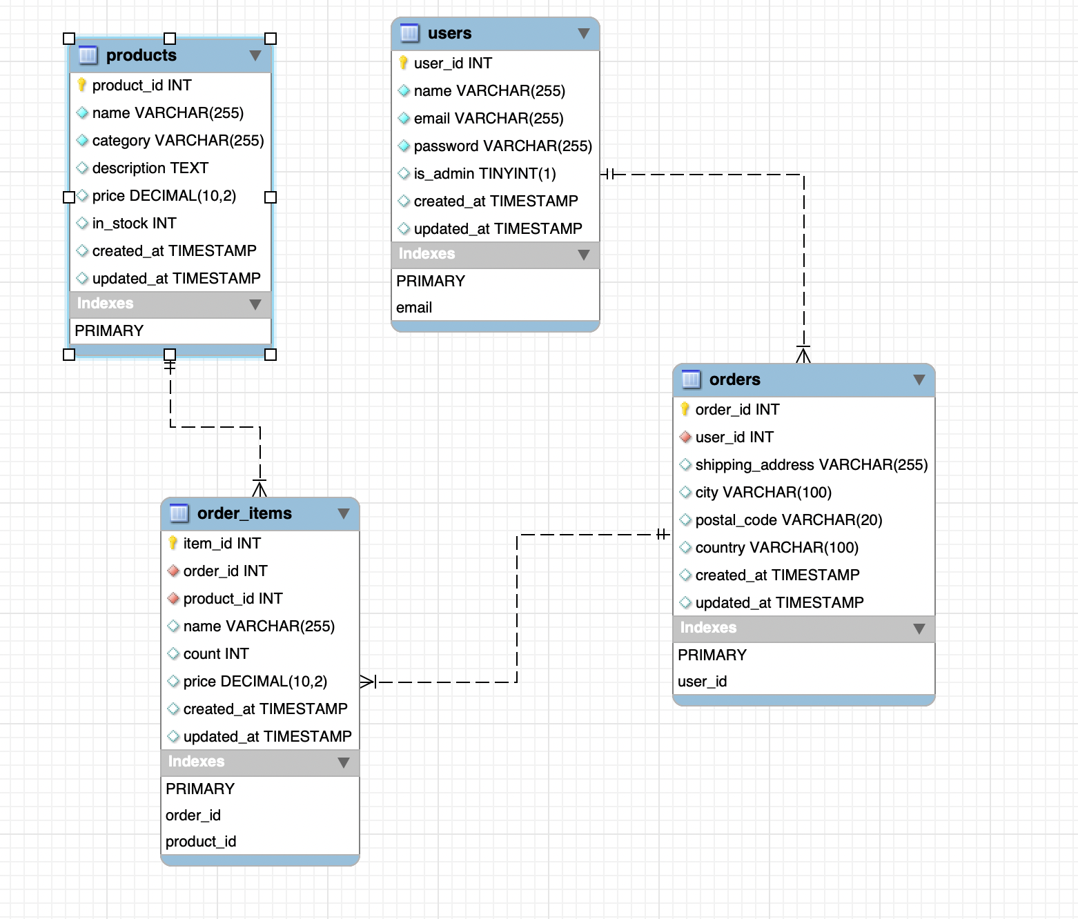
ERD

Slide 7
TECHNOLOGIES USED
Python
MySQL
Git
Github

Slide 8
Thank you
Q and A

