Slide 1


Gordy’s Novelties Store Application
Project 1:
By Kenny Muriel

Slide 2
Overview and Features
This application is an inventory management system for Gordy's Novelties. It allows users to log in, create accounts, view products, place orders, and for admins to manage users and inventory.
Features Include:
User authentication (login and account creation)
View products with details (name, price, quantity)
Create orders for products
Admin functionalities including:
View all users and orders
Change user roles
Add, update, and delete inventory items
Mark orders as complete

Slide 3
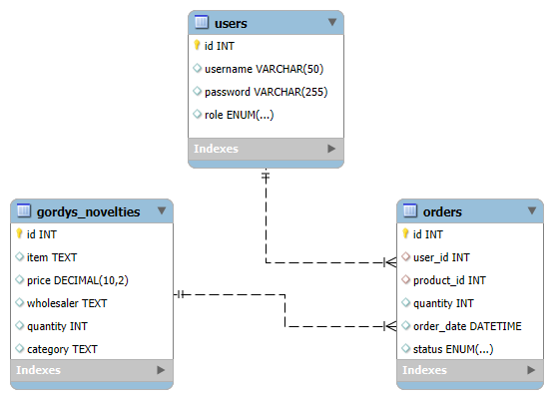
Entity Relationship Diagram (ERD)
Users to Orders is a one-to-many relationship, as a single user can place multiple orders. Each order is associated with one user, identified by the user_id foreign key in the Orders table. For example: If you have a user who places three orders, there will be three records in the Orders table with the same user_id, indicating that all these orders belong to that single user.
Gordys_Novelties to Orders is also a one-to-many relationship, since a single product can be included in multiple orders. Each order references one product, identified by the product_id foreign key in the Orders table. An example is if a particular product, such as “Settlers of Catan” is ordered multiple times by different users or the same user, there will be multiple records in the orders table with the same product_id pointing to “Settlers of Catan”.

Slide 4
Tech Stack
Python 3.x
MySQL
VS Code
Git

