Slide 1
. . .

Slide 2
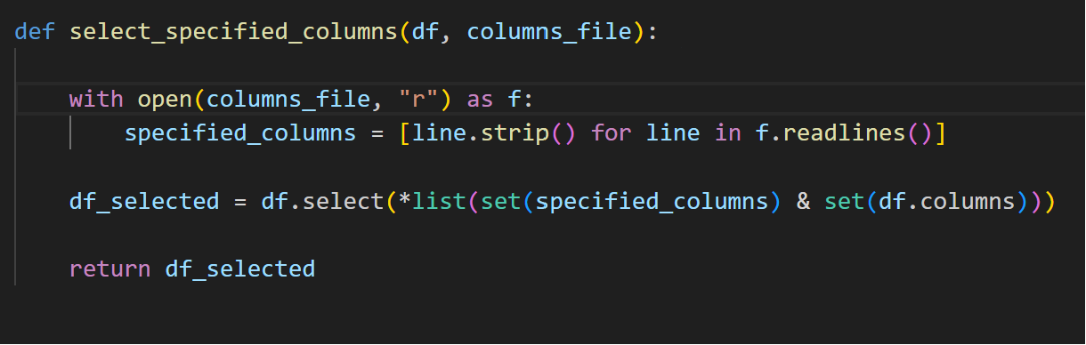
Filtering the Data by Columns

Slide 3
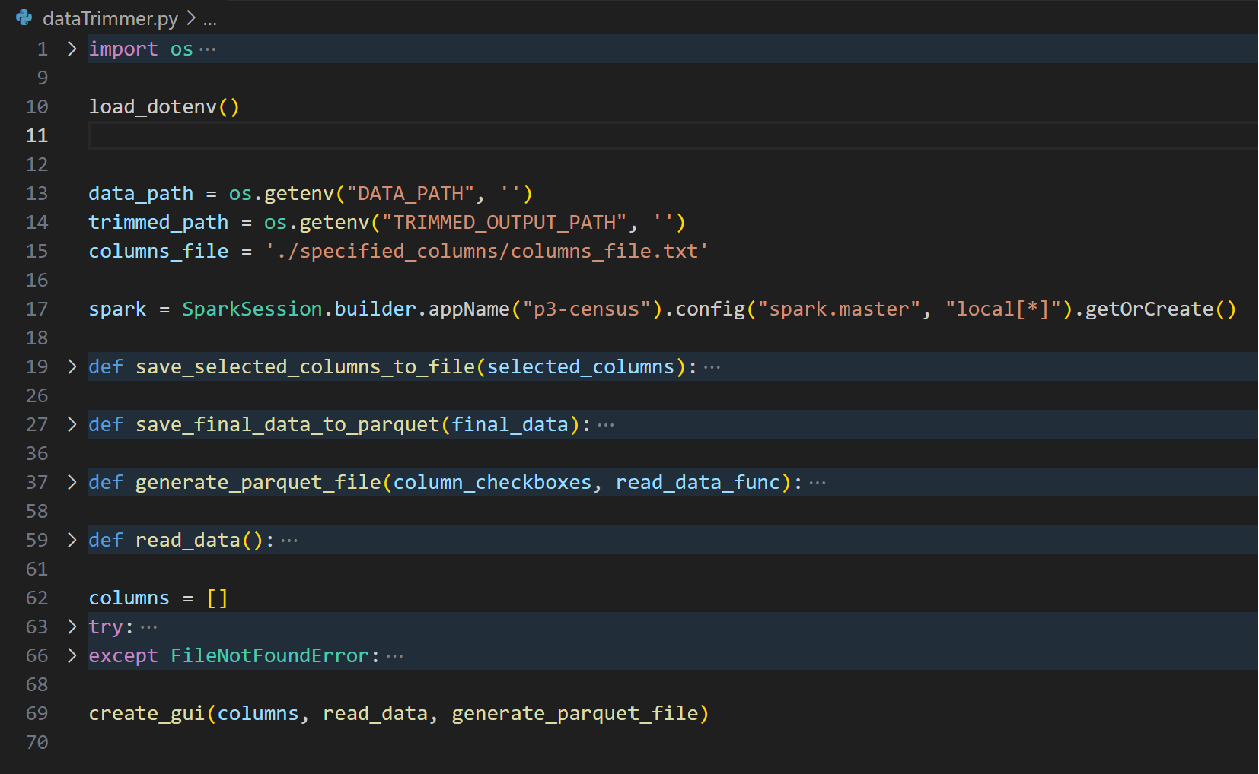
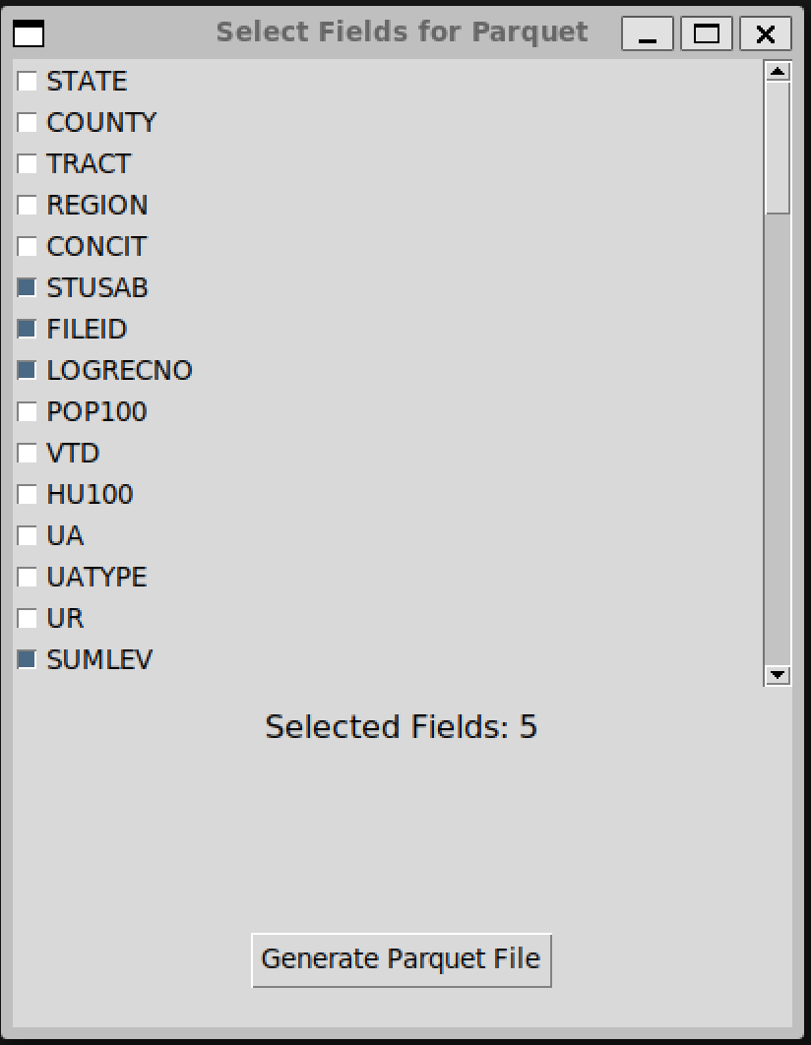
Generating parquet file - Tkinter GUI

Slide 4
Data Analyses
How has the percentage growth in total population varied across regions between 2000, 2010, and 2020?
What percentage of people have moved between states as inferred from inter-census changes?

Slide 5
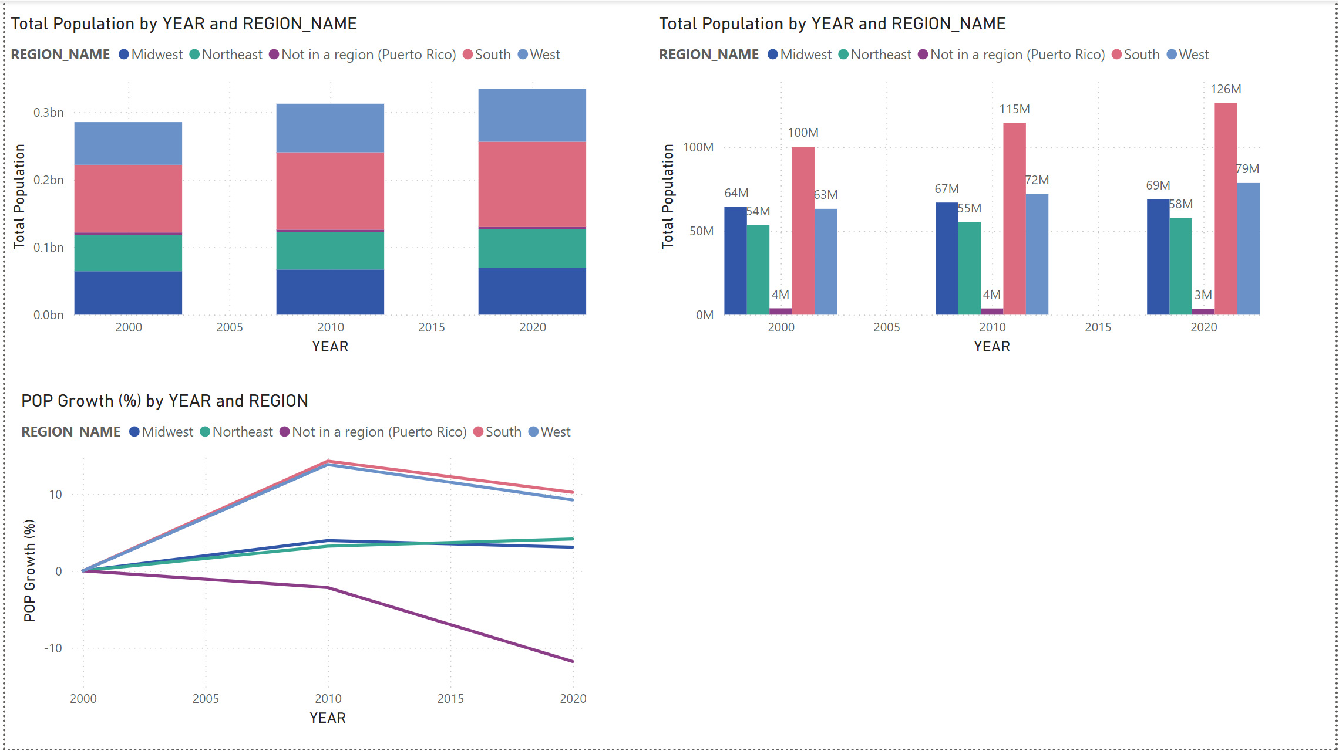
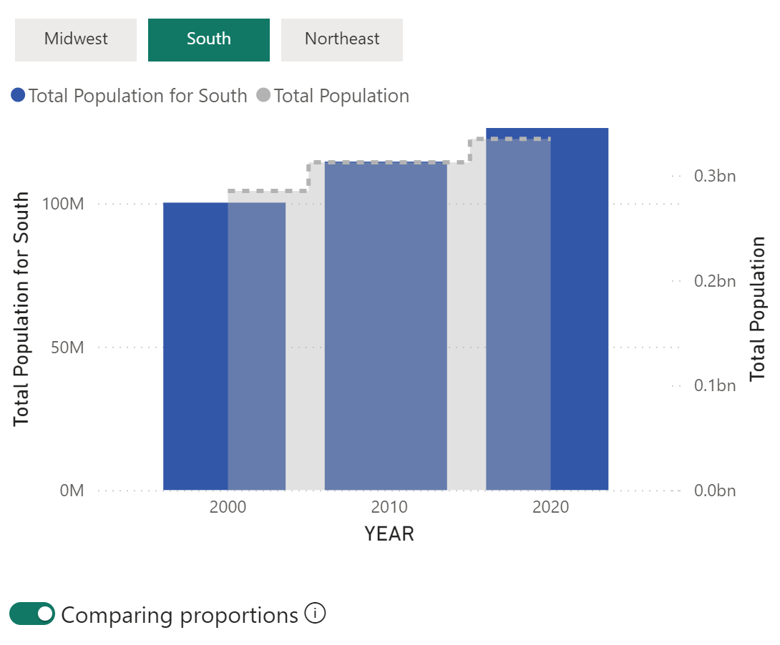
How has the percentage growth in total population varied across regions between 2000, 2010, and 2020?

Slide 6
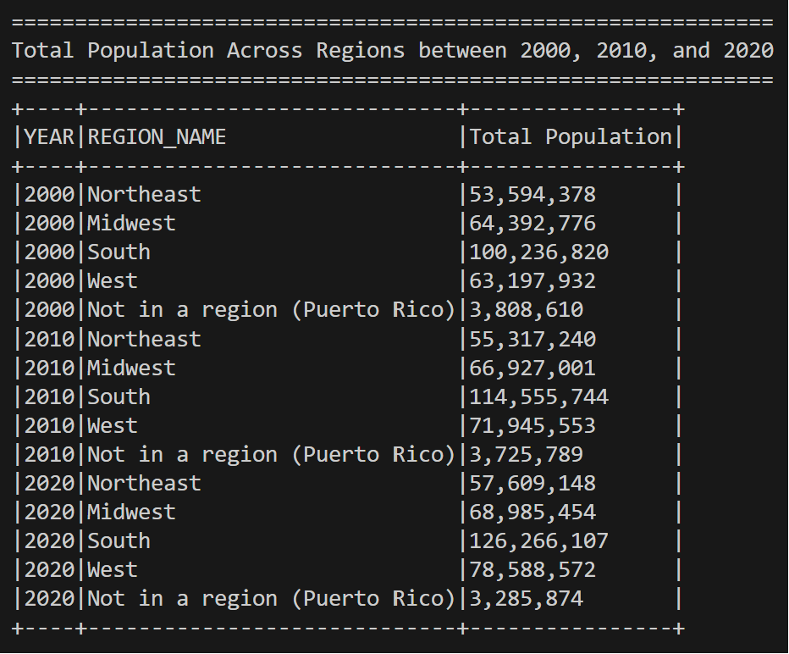
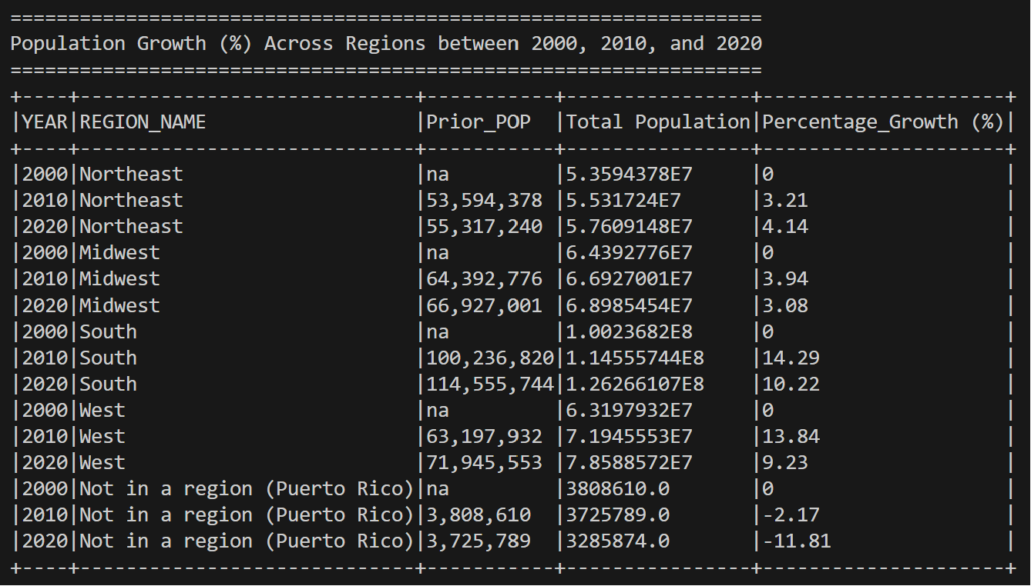
How has the percentage growth in total population varied across regions between 2000, 2010, and 2020?

Slide 7
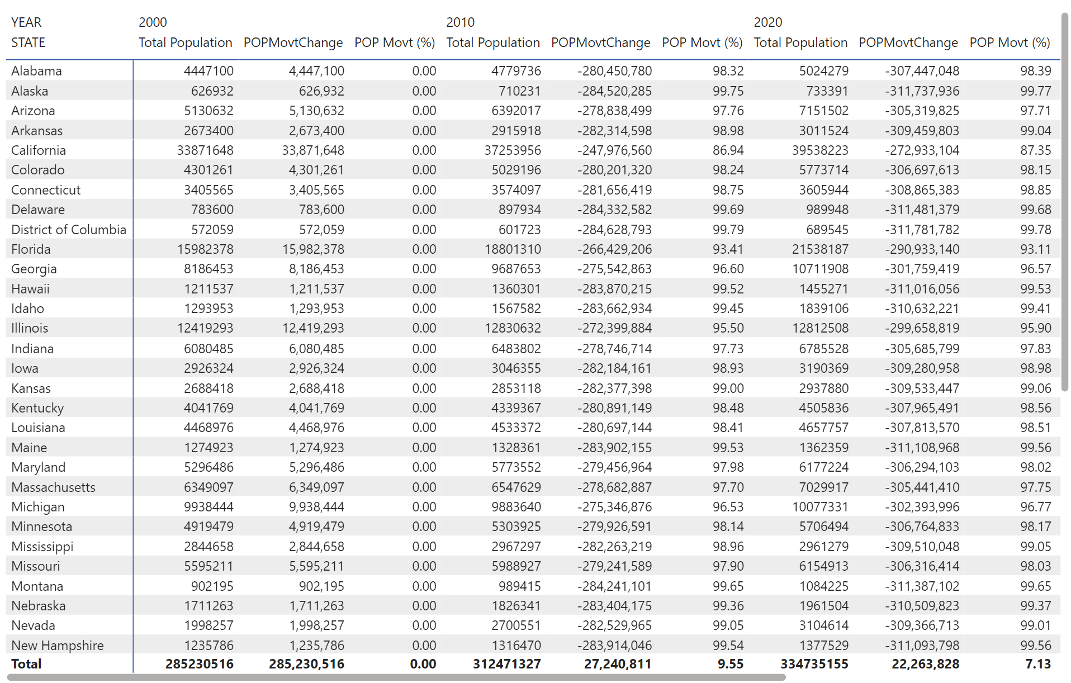
What percentage of people have moved between states as inferred from inter-census changes?

Slide 8
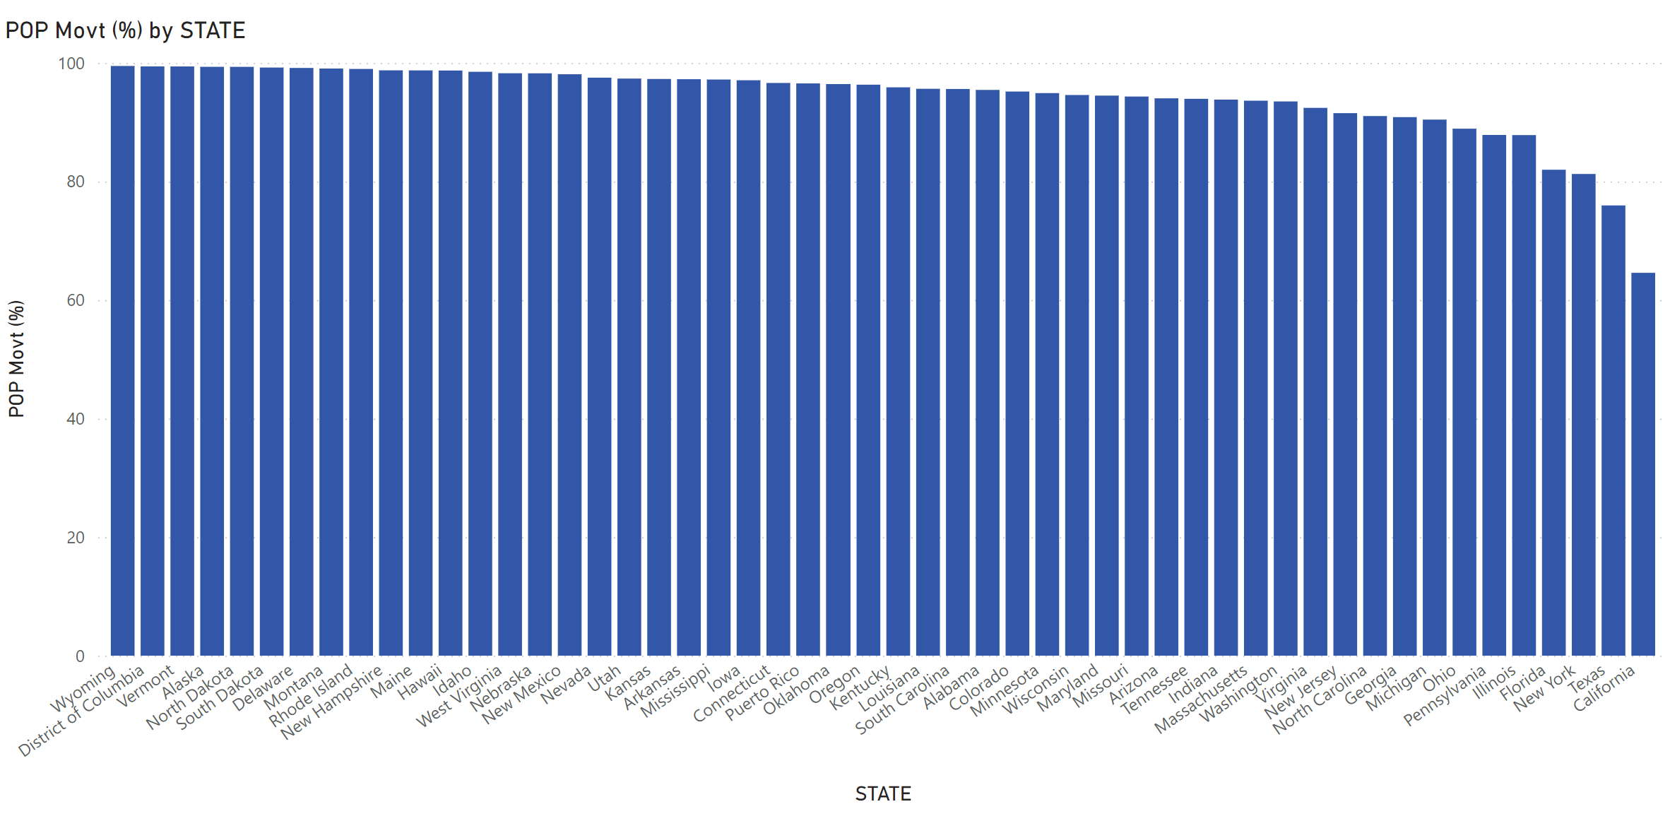
What percentage of people have moved between states as inferred from inter-census changes?

Slide 9
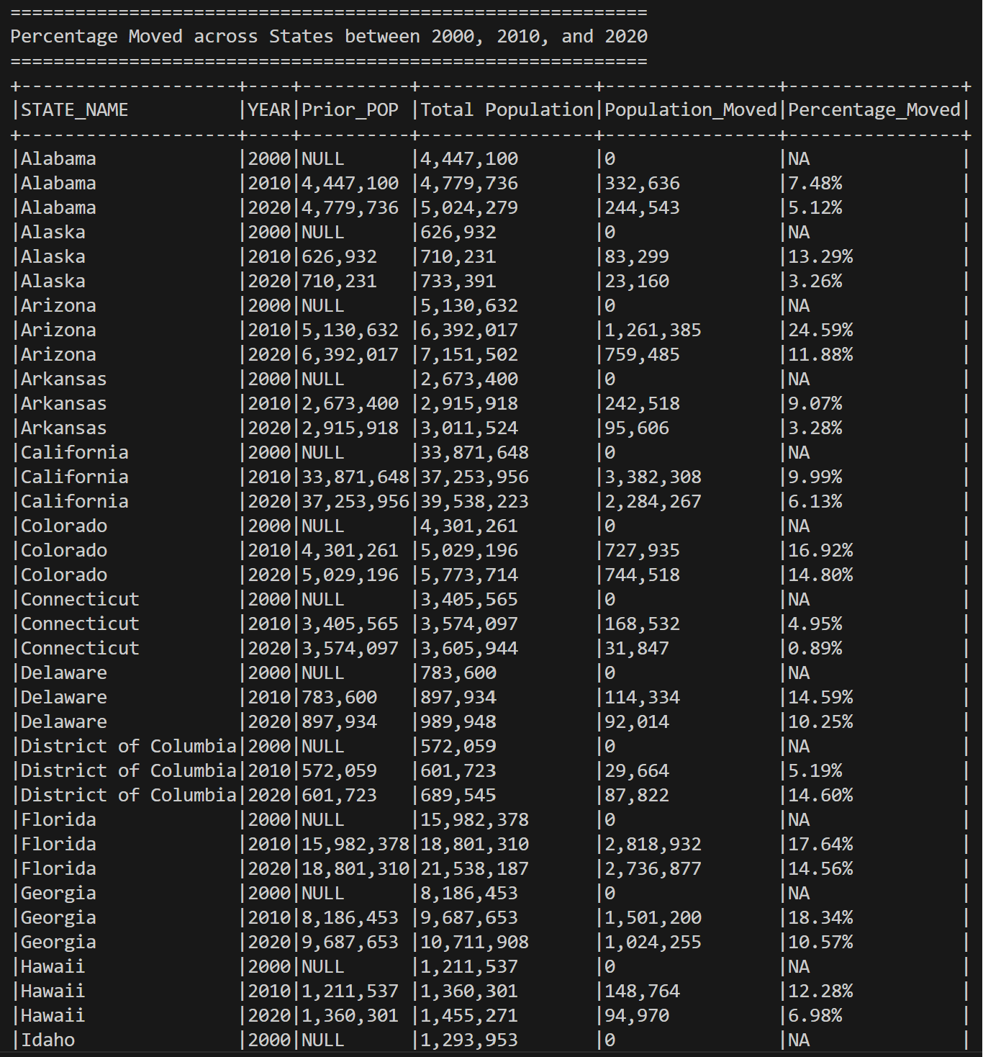
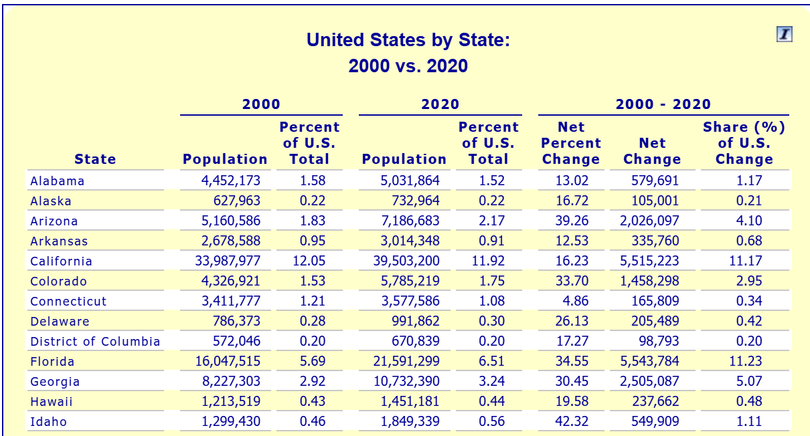
What percentage of people have moved between states as inferred from inter-census changes?
Source: Calculations by the United States Regional Economic Analysis Project (US-REAP) with data provided by the U.S. Department of Commerce, Bureau of Economic Analysis

Slide 10
. . .

