Slide 1
P1 Store
Zakaria Alhomsy - https://github.com/Will-BigData/Zakaria-Alhomsy-p1

Slide 2
Project Requirements
A CLI Python application that models a store, with data stored in a backend database
Must be able to have CRUD functionality
Database must have a minimum of 3 tables/collections
Must have a login feature and admin/user roles

Slide 3
Grocery Store
-A Grocery store that sells all types of groceries
-users can add to their balance to enable them to purchase items
-keeps track of customers orders and balances
-admins can modify inventory and look at purchase history
- All database related events are logged and admins can check logs

Slide 4
Tech Stack
-python 3
- mongodb
-git

Slide 5
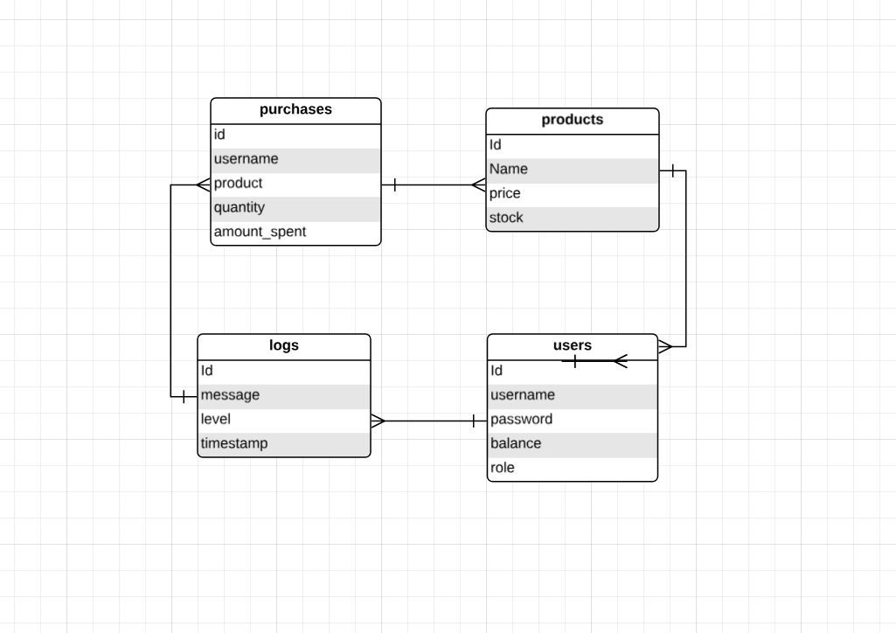
Demo and ERD

