Slide 1
Fourier Analysis & Signal Processing
By: Will Dinicola

Slide 2
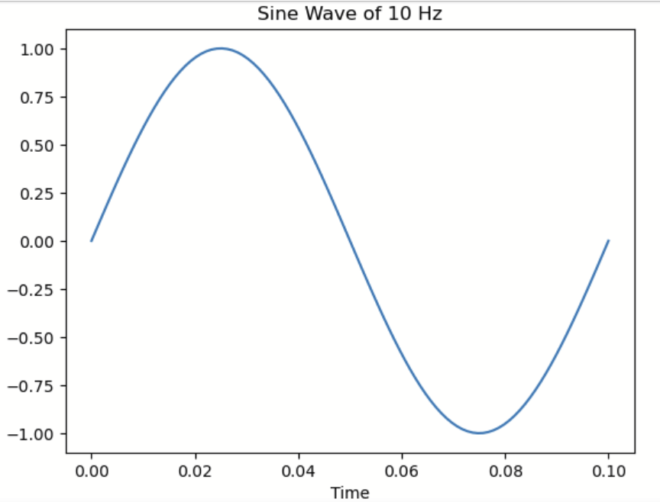
Basic Sine Wave in ‘Time Domain’
Note
x-axis plots Time
y-axis plots Height

Slide 3

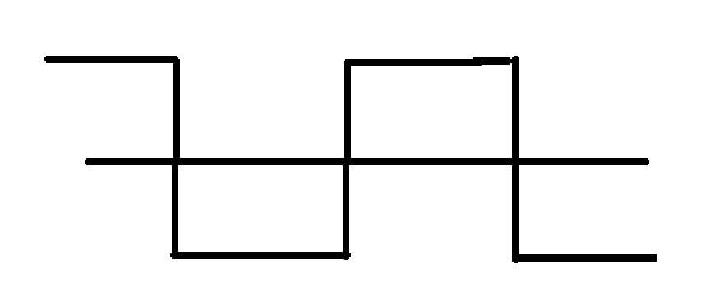
Fourier Series
What this functions says:
Any periodic function that is ‘tame’ (continuous, has non infinite max/min) can be represented an infinite sum of sine and cosine functions
Let’s see it in action to approximate a square wave
https://bgrawi.com/Fourier-Visualizations/

Slide 4
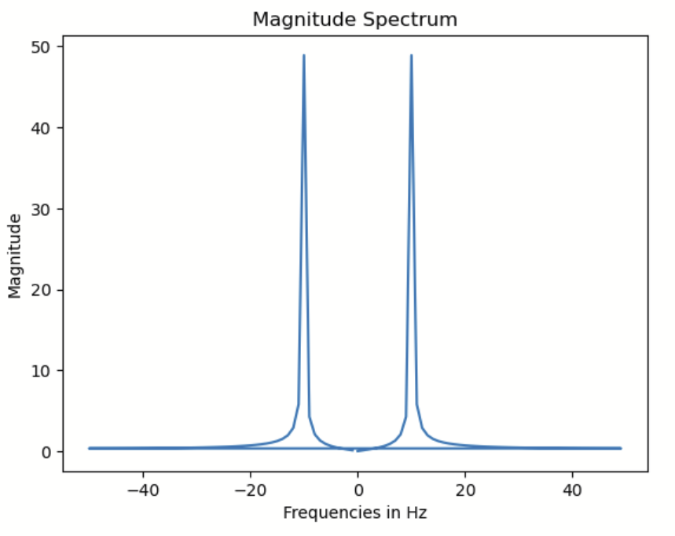
Frequency Domain
a_, b_n represent ‘how much’ of different frequencies present
Taking the ‘Fourier Series’ of a function in the ‘Time Domain’ converts to the ‘Frequency Domain’
Notes:
The reason that it has a bell-shape instead of a single height at 10Hz is due to approximation problems w/ DFT and spectral leakage

Slide 5
Negative Frequencies?
https://commons.wikimedia.org/wiki/File:Unfasor.gif
The x-axis is Real
The y-axis is ‘Imaginary’
Stores phase shift/magnitude even when ‘phasor’ isn’t drawing maximum value

Slide 6
Why the Frequency Domain?
‘Convolution’ is a complicated operation required to apply a ‘filter’ to audio in the ‘Time Domain’
Image processing, machine learning, statistics, and many more
(6:54 - 8:15) https://www.youtube.com/watch?v=IaSGqQa5O-M
(7:35 - 12:52) https://www.youtube.com/watch?v=KuXjwB4LzSA

Slide 7
Convolution
Convolution can be an expensive operation compared to multiplication
Important: Convolution in the ‘Time Domain’ is equivalent to multiplication in the ‘Frequency Domain’
If our signal is converted to the ‘Frequency Domain’ manipulating it is faster, easier, more intuitive
INVERSE Fourier Series can take us back to the ‘Time Domain’

