Slide 1
POSC 3710: European Politics
10/28/2026: The Other Challengers: Greens, Regionalists, and the Radical Left
Dr. Will Horne
Clemson University

Slide 2
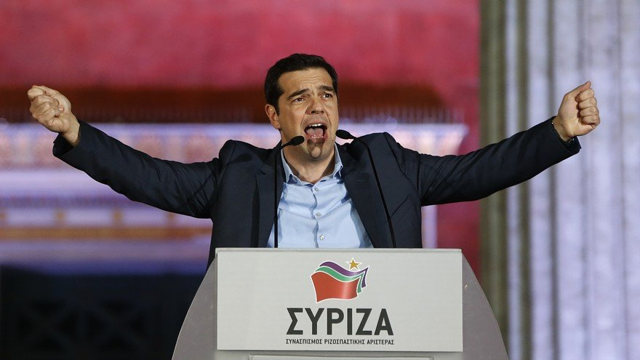
Who Is This?
Who is this?
Alexis Tsipras, prime minister of Greece, 2015–19. His radical left party, Syriza, won 36% of the vote in January 2015.
By 2023 it was down to 18%. Tsipras resigned as leader, left parliament in 2025, and launched a new party in May 2026.

Slide 3
Where We Left Off
A new unit: challengers and cleavages
Just wrapped: the mainstream families, and party systems built on class and religion
Since the 1970s the big parties have been losing voters
Today: the first wave of challenges, mostly on the left
Next: the radical right

Slide 4
Challenger Parties
Mainstream parties: the long-standing, office-seeking parties in most European party systems
Challengers have come in waves over the last 30 to 40 years
  Some became established; others disappeared
Greens, new-left parties, anti-tax parties, radical centrists, regional parties, pirate parties…
Is it what the parties supply, or what voters demand?

Slide 5
Downs: Spatial Models of Politics
Anthony Downs, an American economist, 1957: a model of where shops locate on a street, applied to parties
The simplest version:
  Two parties, one dimension from left to right
  Most voters near the middle: think of a bell curve
  Each voter picks the closest party
How should the two parties position themselves? Why?

Slide 6
Two Parties, One Dimension
Two parties. Where should each one stand?
Voters
A
B
Party A
Party B
Left
Right
Each party gains votes by moving toward the other, until they meet at the median voter. Neither can do better by moving away.

Slide 7
Spatial Models with More Parties
With more parties, where should each one stand?
Extra parties can differentiate themselves and pick up voters far from the middle
Parties in the middle should still do well: that is where most voters are
No clear equilibrium, so less stability than in a two-party system
Far left
Center-left
Center
Center-right
Far right
What might complicate this?

Slide 8
Multiple Dimensions
Cultural: liberal (top) to conservative
What if voters care about more than one dimension, and the two are not closely related?
  To Americans these preferences can look “incoherent”
A party can be anti-immigrant, but also pro-union and pro-environment
Or for small government and low taxes, but also socially liberal
Then no position is safe: party systems should change more from election to election
Green
Liberal
Social Democrat
Radical Left
Conservative
Radical Right
Economic: left to right

Slide 9
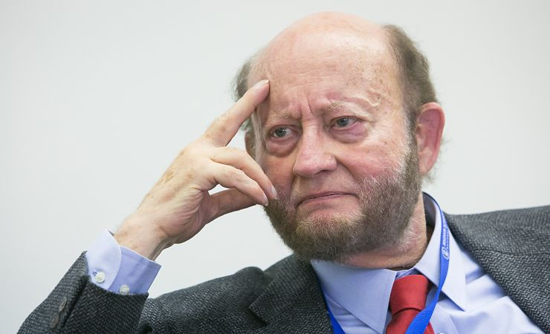
Post-Materialist Values
Ronald Inglehart, an American political scientist: as societies grow richer, priorities change
From material concerns (economic security, law and order) to post-materialist values (the environment, human rights, personal autonomy)
The shift first fed the Greens and other progressive challengers, among younger, educated voters
Later it also fed the populist right
Ronald Inglehart

Slide 10
Electoral Supply and Demand
Elections as a marketplace of ideas: supply and demand
SUPPLY
DEMAND
Parties offer
Parties supply packages of issue positions, and persuade voters that those issues matter
Niche parties can be “issue entrepreneurs”
Voters ask
Voters want certain policies, and parties adjust their positions to match
The Greens: voters’ concern, or the party’s campaign?
If the existing parties can’t or won’t reposition, new parties emerge

Slide 11
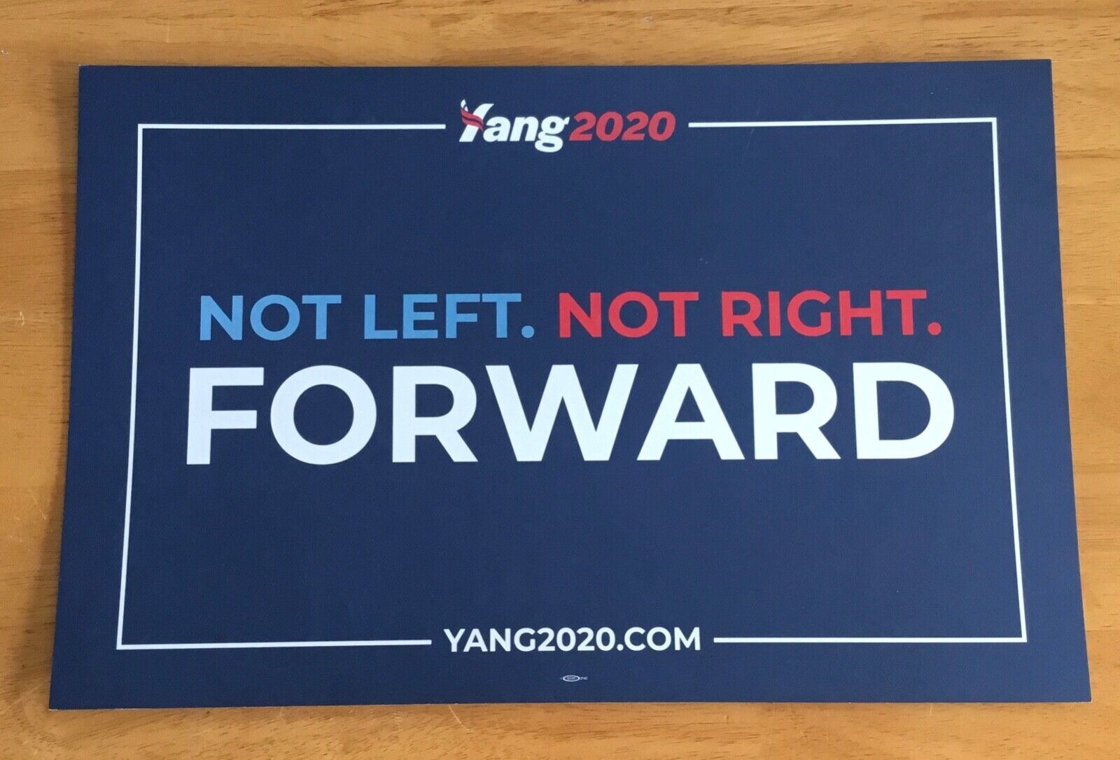
Meguid: What Makes Niche Parties Different?
From today’s reading: Meguid
Bonnie Meguid, an American political scientist, 2005
They reject the class-based orientation of politics
Their issues cut across the old lines of division
They stick to a narrow set of issues
  What is the Green Party’s foreign policy? The populist right’s economic philosophy?
A sign from Andrew Yang’s 2020 campaign for the Democratic presidential nomination. Note, I met the head of Forward party at an electoral reform event – interesting guy!

Slide 12
You Run the Big Party
You run the big party of the center-left. What do you do?
A new Green party has just won 6% of the vote by campaigning on one issue, the environment. Most of its voters used to be yours.
A
Ignore it
Say nothing about the environment. Treat the new party as a fad.
B
Copy it
Adopt its position on the environment as your own.
C
Attack it
Take the opposite position, and say so loudly.
DISMISSIVE
ACCOMMODATIVE
ADVERSARIAL
Now you run the big party of the center-right. The Greens are taking votes from your rival, and almost none from you. What do you do?

Slide 13
Three Strategies
From today’s reading: Meguid
What each strategy does to the niche party
DISMISSIVE: IGNORE
ACCOMMODATIVE: COPY
ADVERSARIAL: ATTACK
How much the issue matters to voters
Falls
Rises
Rises
Who owns the issue
No effect
Moves to the mainstream party
Stays with the niche party
The niche party’s vote
Falls
Falls
Rises
Note – this is Meguid’s theory. The accommodative strategy assumes that voters find the mainstream party credible on the issue. This might not always be true!

Slide 14
What the Evidence Shows
From today’s reading: Meguid
Meguid’s Results
Niche party loses
Niche party gains
Both ignore it
−1.37
Both copy it
−1.52
One ignores, one copies
−0.92 (not significant)
One ignores, one attacks
+3.72
Both attack it
+6.54
Percentage points of the vote. Green and radical right parties in 17 Western European countries, 1970–2000. If one party copies and the other attacks, the more forceful of the two wins out.
This data is old. Someone should write a follow up paper!

Slide 15
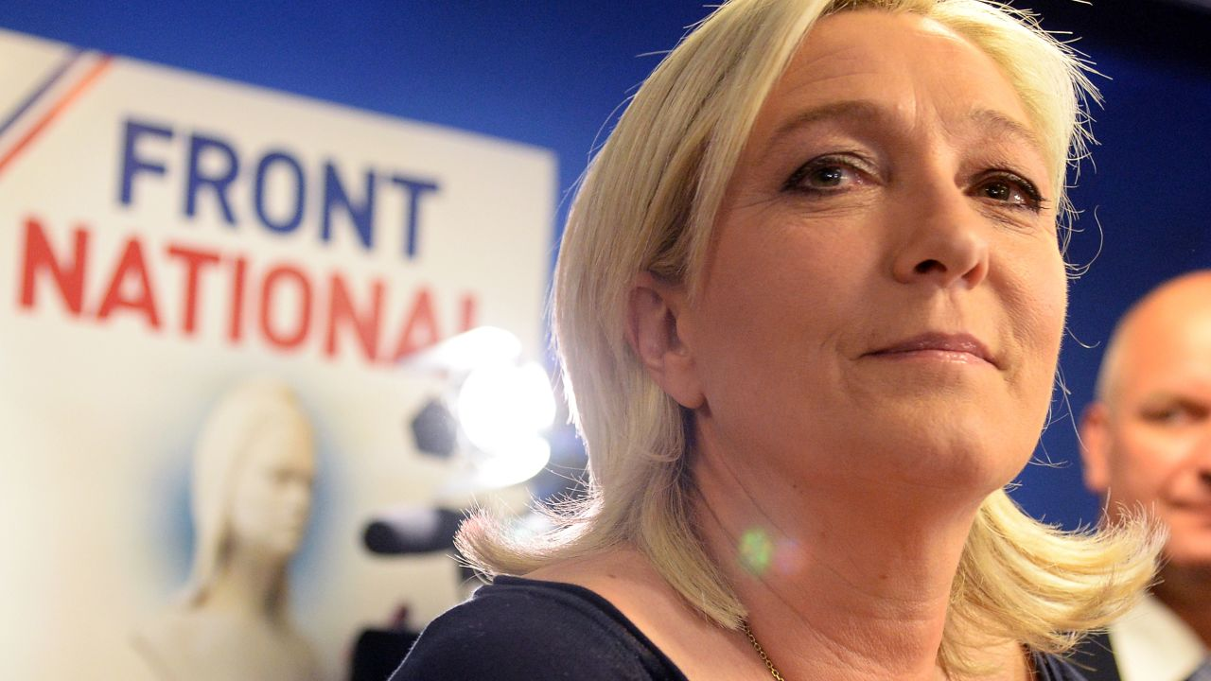
France: The Socialists and the National Front
From today’s reading: Meguid
Socialist party attacked the National Front (FN) early. That strengthened the Front at the expense of the Gaullist right
1986: the Socialists switched to proportional representation, and the Front won 35 seats
  Then they switched back because the right wanted to block the FN
The right only moved towards FN on immigration after they had already become a strong party
Marine Le Pen, who led the National Front from 2011; it is now the National Rally. In the 1980s the leader was her father, Jean-Marie Le Pen

Slide 16
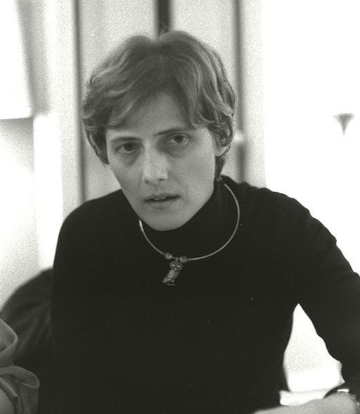
Origins of Green Parties
Green parties grew out of the ecological and anti-nuclear movements of the 1960s and 70s
  First national green party: New Zealand, 1972. Germany’s Greens: 1980
At first often anti-capitalist, anarchist and pacifist
By the 1990s: more mainstream positions, middle-class and educated voters, a narrower focus
As concern over climate change grew, Greens entered coalition governments across Europe
Petra Kelly, a founder of the German Greens (“Neither left nor right, but in front”)

Slide 17
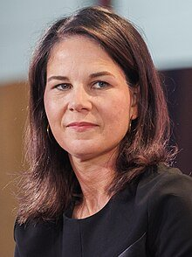

Green Parties
Climate is still the key issue: a “Green New Deal,” 100% renewable energy, often opposed to nuclear power
Social policy: progressive, often explicitly feminist and pro-multicultural
Economic policy: “green capitalism.” Pro-market, with environmental regulation
Foreign policy: ????
Annalena Baerbock of the Greens, Germany’s foreign minister, 2021–25

Slide 18
Guess the Number: The Greens
GUESS THE NUMBER
The Greens’ group won 74 seats in the European Parliament in 2019. How many in 2024?
A
91
B
74
C
67
D
53
D
53
20.5%
In between, the Greens got what they asked for:
the European Green Deal
A law binding the EU to net-zero emissions by 2050
13.5%
11.9%
5.5%
2019
2024
2019
2024
Germany’s Greens
France’s Greens
Share of the vote in each country’s European Parliament election. The Parliament had 751 seats in 2019 and 720 in 2024; after Britain left, the Greens’ group held 67.

Slide 19
From Pitch Perfect to Epic Fail
From today’s reading: Gherghina
What the Greens said about climate: 2019 and 2024
2019: “PITCH PERFECT”
2024: “EPIC FAIL”
Two messages
Strategies for the climate and energy transition
The opportunities the transition would bring
Four messages
Repeated the promises of 2019
Technical issues that are hard to grasp
Criticized the Green Deal
Shifted attention to other initiatives
Sergiu Gherghina, a political scientist at the University of Glasgow: the manifestos of 16 Green parties in 13 countries. They said more about climate in 2024 (113 statements, up from 73). How much a party said had no relation to the seats it won or lost.

Slide 20
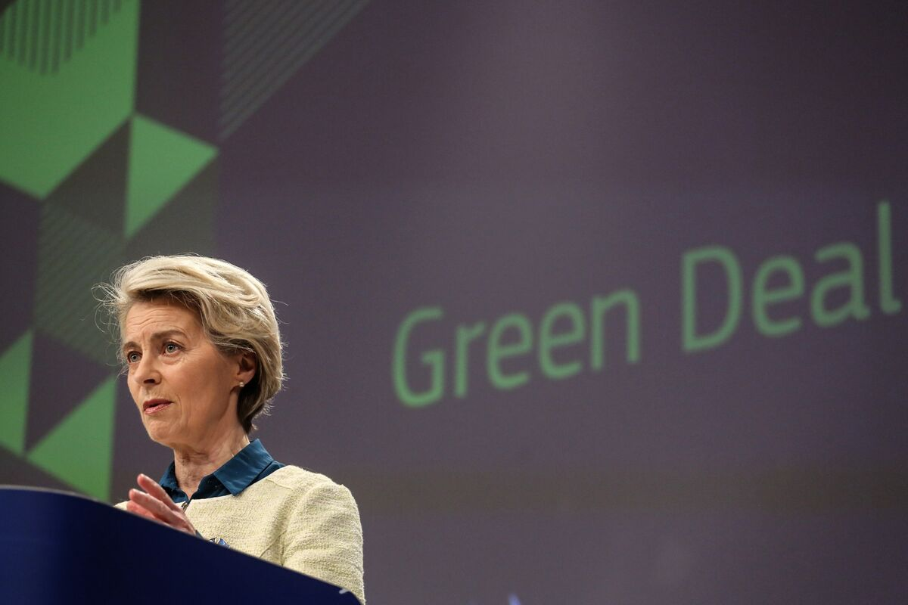
Won the Debate, Lost the Election
From today’s readings: Meguid and Gherghina
The Green Deal was the program of Ursula von der Leyen, president of the European Commission and a German Christian democrat
Meguid: when a big party copies the issue, ownership moves to it
The Greens’ problem in 2024: claim the Deal and sound like the establishment, or criticize it and disown their own success
In 2025 the Greens left government in Ireland, Belgium, Austria and Germany
Ursula von der Leyen at the EUs presentation of the Green Deal

Slide 21
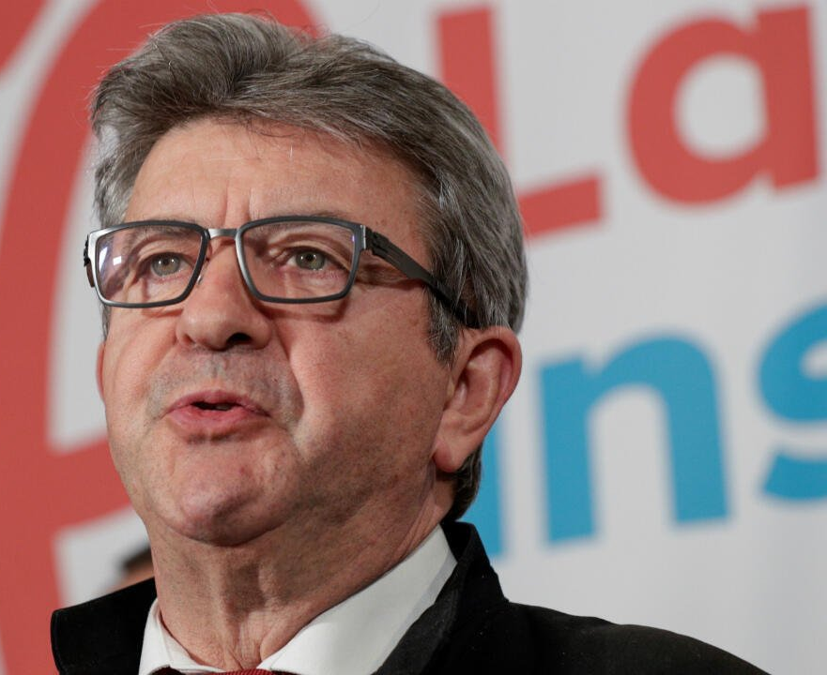

Populist and Radical Left Parties
Often grew out of Marxist or communist movements
Discredited during the Cold War, except in France and Italy
Reborn after the USSR fell, and became more popular after the 2008 financial crisis
  A backlash against austerity and “third way” social democrats
Success varies: Syriza governed Greece; France Unbowed is the largest party of the French left; Spain’s Podemos faded
Jean-Luc Mélenchon, founder of France Unbowed: 22% for president in 2022

Slide 22
Radical Left or Radical Right?
From today’s reading: Rooduijn et al.
Radical left voter, radical right voter, or both?
“The economy is in bad shape.”
Has a university degree
“Immigration is a threat.”
BOTH
RADICAL LEFT
RADICAL RIGHT
“European unification has gone too far.”
“The government should reduce differences in income.”
Working class, with a low income
BOTH
RADICAL LEFT
BOTH
European Social Survey, 2002–2014: voters for 23 radical left and 26 radical right parties in 23 countries, compared with mainstream voters.

Slide 23
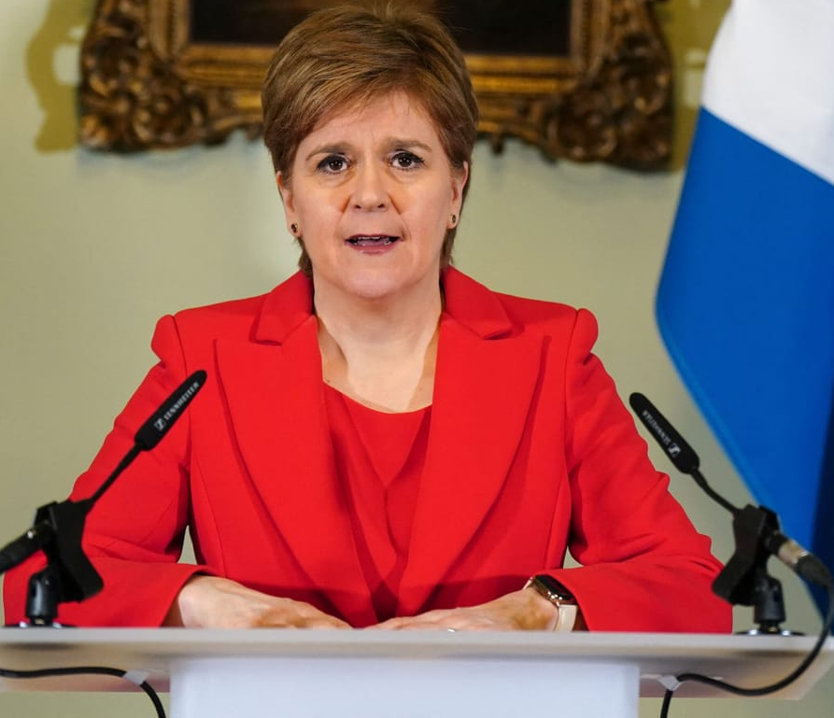
Regional Parties
Tied to regions that are distinct economically, culturally or linguistically
Belgium has regional party systems instead of regional parties!
Historically not very successful in Western Europe as electoral vehicles
  In Northern Ireland and the Basque Country, some nationalists took up arms instead
In recent years, some have done very well
Nicola Sturgeon of the Scottish National Party, first minister of Scotland, 2014–23

Slide 24


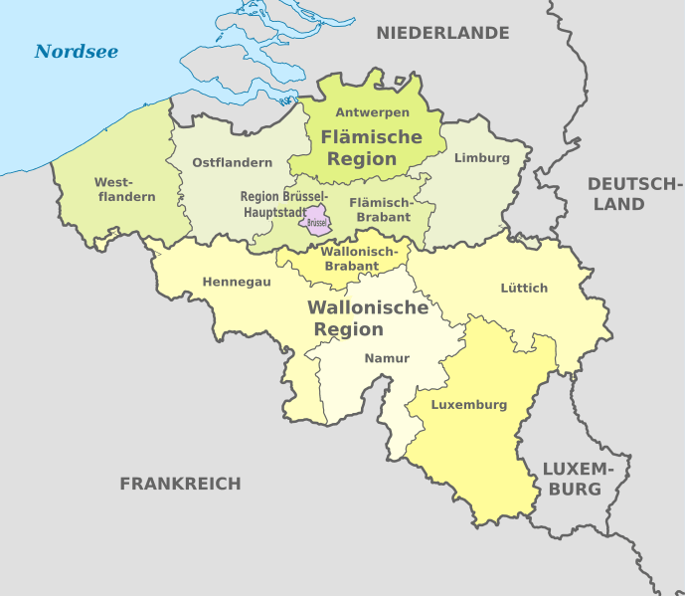
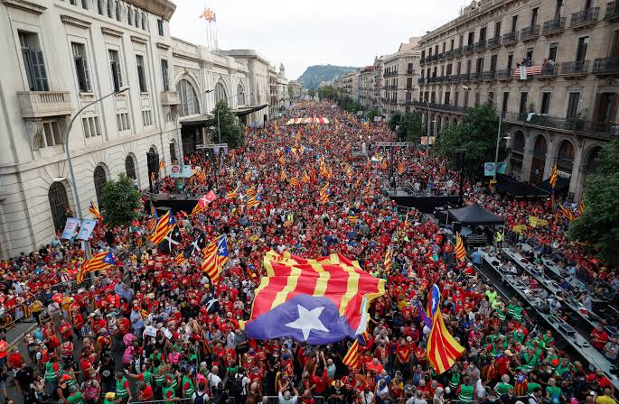
Who Governs the Regions?
Which of these is not led by a regionalist or nationalist party today?
A
Scotland
B
Wales
C
Belgium
D
Catalonia
D
Catalonia
SCOTLAND
WALES
BELGIUM
CATALONIA
The Scottish National Party won its fifth election in a row in May 2026: 58 of 129 seats. John Swinney is first minister.
Plaid Cymru came first in May 2026, with 43 of 96 seats. Its leader, Rhun ap Iorwerth, is first minister. Labour fell to 9.
Bart De Wever, a Flemish nationalist, has been prime minister of the whole country since February 2025.
The pro-independence parties lost their majority in 2024. Salvador Illa, a Socialist, leads the regional government.
At Westminster the Scottish National Party went from 56 of Scotland’s 59 seats in 2015 to 9 of 57 in 2024.

Slide 25
Seats or No Seats?
Some other parties
Pirate Party
Czech Republic
Began with file sharing and internet freedom
Party for the Animals
Netherlands
Animal rights first
50PLUS
Netherlands
A party for pensioners
Farmer–Citizen Movement
Netherlands
Founded in 2019 against limits on farming
SEATS
SEATS
SEATS
SEATS
18 seats in 2025; in government 2021–24
3 of 150 seats in 2025
2 seats in 2025
First in the 2023 provincial elections; then in government
Beer Party
Austria
Founded by a punk rock singer
Two-Tailed Dog Party
Hungary
A joke party
Die PARTEI
Germany
Founded by the editors of a satirical magazine
Automobile Party
Switzerland
Founded in 1985 to defend drivers
NO SEATS
NO SEATS
SEATS
SEATS
2.0% in 2024; the threshold is 4%
None in April 2026
2 in the European Parliament since 2019
8 seats in 1991

Slide 26
Key Points
European party systems leave room for many more parties, and so for more issues and combinations of issues
New parties respond to what voters demand, and also act as “issue entrepreneurs”
How a new party fares depends in large part on how the big parties respond to it
New issues do not automatically map onto the old divisions

