Slide 1
POSC 3710: European Politics
10/26/2026: How Governments Form
Dr. Will Horne
Clemson University

Slide 2

Happening Now: Sweden
Happening now: Sweden is waiting for a government
The Riksdag elected on September 13, 2026: 349 seats
IMAGE PLACEHOLDER
Magdalena Andersson, leader of Sweden’s Social Democrats
Her Wikipedia page has an official portrait; or a news photo from September 28, 2026
The left bloc
176
The right bloc
173
Social Democrats, Left Party, Greens, Centre Party
Moderates, Sweden Democrats, Christian Democrats, Liberals
WHY 176 IS NOT ENOUGH
Rules
The Centre Party will not back a government that depends on the far left
The Left Party wants seats in the cabinet
The speaker proposes a prime minister, who takes office unless 175 members vote no
Four failed proposals: a new election
Magdalena Andersson, leader of the Social Democrats and prime minister in 2021–22. On September 28 she gave up her first attempt to form a government. Lost a vote 10/15.
Who is Sweden’s prime minister at Christmas?
The latest:

Slide 3

Coalition Bargaining
A party without a majority of the seats cannot elect a prime minister alone
Usually the largest party gets the first chance to form a coalition
  If it fails, the next party tries
Smaller parties bargain for specific concessions and specific ministries
If no government can be formed, there is a new election
Pedro Sánchez, prime minister of Spain. In 2019 no government could be formed, and Spain voted twice

Slide 4
Three Accounts of Coalition Formation
Accounts of how coalitions form
OFFICE
POLICY
SOMETHING MESSIER
Parties want power
They build the smallest coalition that wins
They split the cabinet in proportion to seats
Implication: Take any party out, and the majority is gone
Parties want policy
They build coalitions of ideological neighbors
The party in the middle sets the terms
The test: the partners sit side by side, from left to right
Neither explains it all
Personalities, mistakes and deadlines
Parties that refuse to sit with each other

Slide 5
Germany 2025: Build a Majority
From today’s reading: Stoeckel
Germany 2025: build a majority
630 seats, so 316 make a majority. Which coalitions of neighbors get there?
LEFT
316 seats
RIGHT
The Left
64
Greens
85
SPD
120
CDU/CSU
208
AfD
152
The Left + Greens + SPD = 269: short
CDU/CSU + AfD = 360: ruled out before the election
SPD + CDU/CSU = 328: the government
The smallest coalition that wins: yes. Neighbors: yes. The only two-party majority without the AfD: yes.
All three accounts fit this case, so it cannot choose between them.
“Friedrich Merz has repeatedly ruled out forming a coalition with the far-right party.” Merz, the leader of the CDU, has been chancellor since May 2025.

Slide 6
Minimum Winning, Oversized, Minority
Types of Government
MINIMUM WINNING
OVERSIZED
MINORITY
Just enough parties for a majority
What we expect if parties care only about power: fewer partners, more ministries each
Germany today: CDU/CSU and SPD
More parties than a majority needs
More stable: no single partner can bring the government down
Finland: a show of unity next to the Soviet Union
Italy: a buffer, when members voted by secret ballot
Fewer than half the seats
Survives on other parties’ votes, one deal at a time
The Netherlands today: 66 of 150 seats
Which did the FRC form?

Slide 7
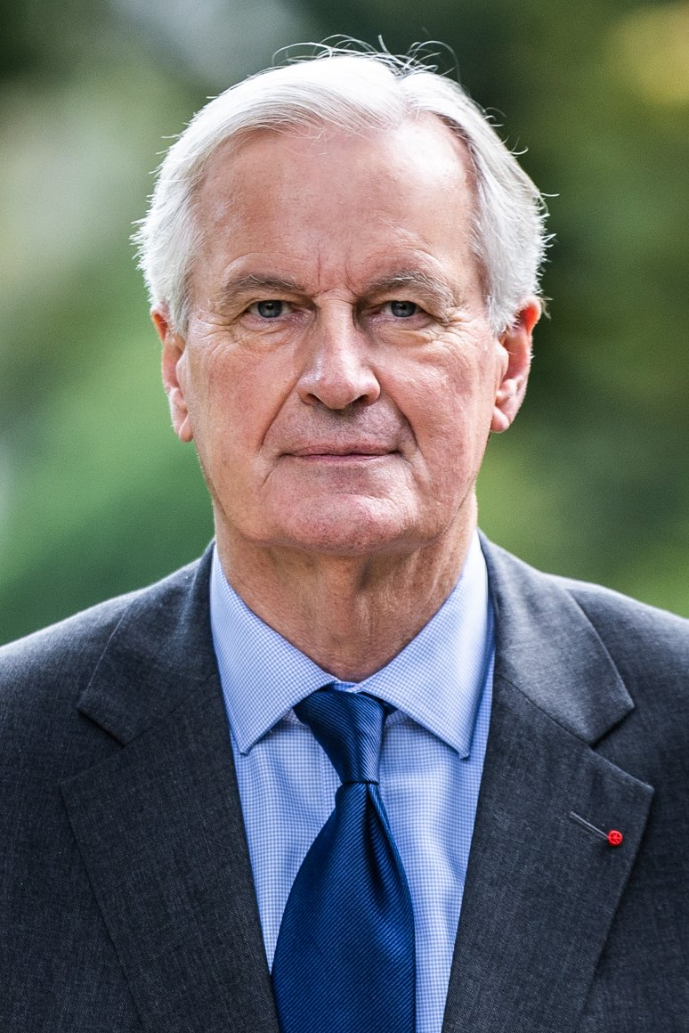
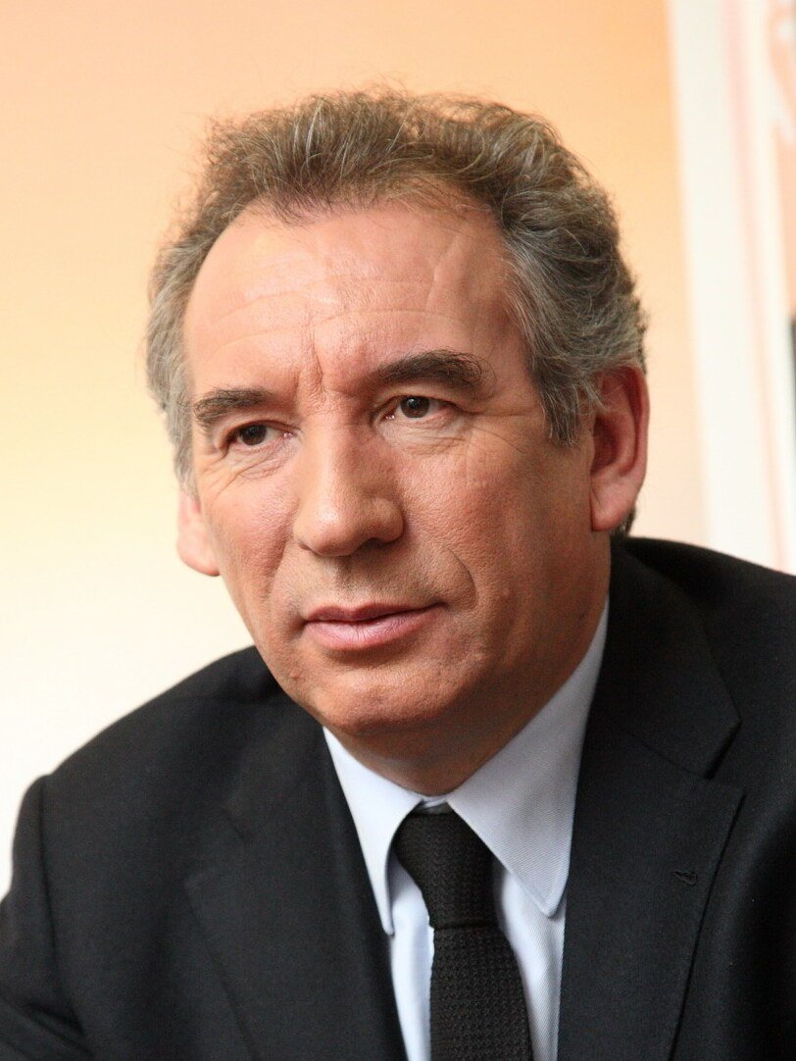
Minority Governments
Governing with fewer than half the seats
Not possible everywhere: some parliaments must vote a new government in (an investiture vote)
Attractive to the governing party: rule alone, avoid hard compromises
  But why would the other parties allow it?
Often fragile
Michel Barnier and François Bayrou, prime ministers of France. Both led minority governments, and the National Assembly removed both within nine months

Slide 8
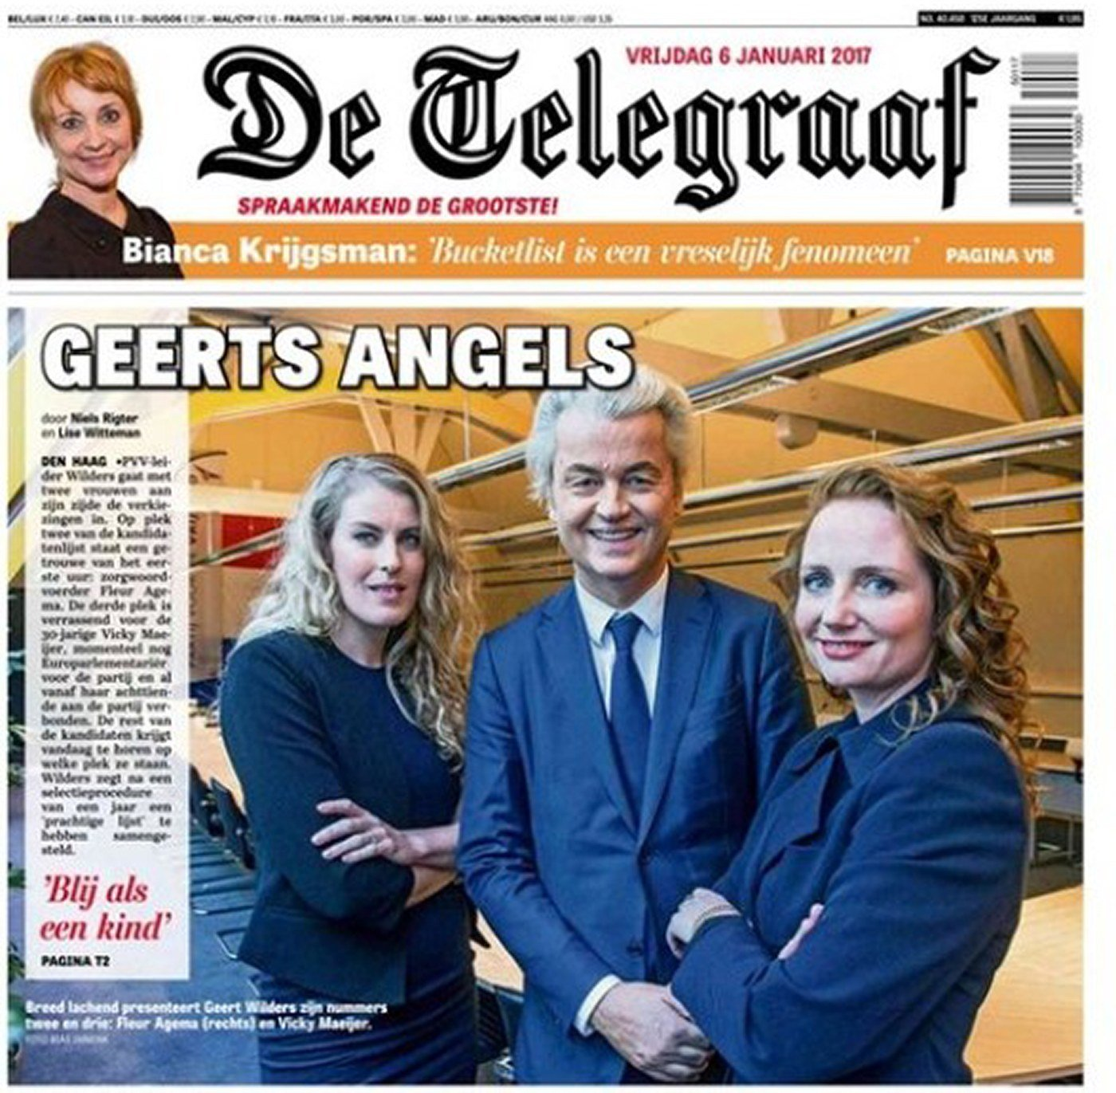
The Dutch Election: Not Quite a Return to the Center
From today’s reading: van Kessel and Zaslove
October 29, 2025: D66, a liberal party of the center, finishes first
The PVV of Geert Wilders, on the radical right, falls from 37 seats to 26
But the far-right bloc holds 42 seats, against 41 before
The left: “no more than 30 seats”
“The core message of the far right has entered the mainstream of Dutch politics.”
Geert Wilders, leader of the PVV, on the front page of De Telegraaf in January 2017

Slide 9

The Netherlands: How Do You Get to 76?
From today’s reading: van Kessel and Zaslove
The Netherlands: how do you get to 76 seats?
Imagine you lead D66, the largest party, with 26 of 150 seats. The broad coalition or the narrow one?
76 seats: a majority
Through the center
D66
26
VVD
22
CDA
18
GL–PvdA
20
86 seats. The VVD refused to govern with GL–PvdA, the alliance of the left.
To the right
D66
26
VVD
22
CDA
18
JA21
9
75 seats: “one seat short.”
With the PVV
PVV
26
Ruled out by “most other parties.”
What formed
D66
26
VVD
22
CDA
18
66 seats: a minority government, sworn in after 117 days.
Rob Jetten of D66 has been prime minister since February 2026. His cabinet is ten seats short, and in September it was still looking for votes to pass its first budget.

Slide 10
Who Gets What?
Parties join coalitions for control of the policies they care about
  Greens want the environment; the populist right, immigration; agrarians, agriculture
Often several parties want the same ministry
  It goes to the party with the most leverage: its “walk-away value”
A rule of thumb: ministries in proportion to seats

Slide 11
Guess the Cabinet
Guess the cabinet: seats in, ministries out
THE NETHERLANDS, 2026
GERMANY, 2025
BRITAIN, 2010
SHARE OF THE COALITION’S SEATS
SHARE OF THE COALITION’S SEATS
SHARE OF THE COALITION’S SEATS
39%
33%
27%
63%
37%
84%
16%
D66 26 · VVD 22 · CDA 18
CDU/CSU 208 · SPD 120
Conservatives 306 · Liberal Democrats 57
18 ministers. How many for each party?
18 in the cabinet. How many for the SPD?
23 in the cabinet. How many for the Liberal Democrats?
SEATS IN THE CABINET
SEATS IN THE CABINET
SEATS IN THE CABINET
7
6
5
11
7
18
5
7, 6 and 5: almost exactly their shares
7 of 18: 39% of the cabinet with 37% of the seats
5 of 23: 22% of the cabinet with 16% of the seats
Ministries follow seats closely, and the smaller partner tends to get a little more than its share. The cabinet counts include the head of government.

Slide 12
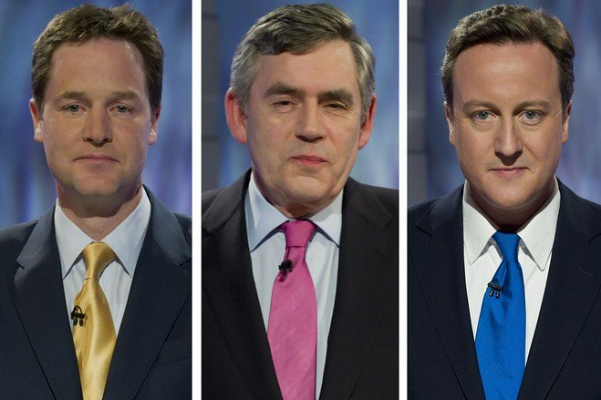
Britain, May 2010: No Majority
From today’s reading: Fox
Britain, May 2010: no party has a majority
306
326 of 650 seats: a majority
258
57
29
Conservatives
Labour
Liberal Democrats
Others
Nick Clegg (Liberal Democrats), Gordon Brown (Labour, the prime minister) and David Cameron (Conservatives), the three party leaders
Conservatives + Liberal Democrats = 363
Labour + Liberal Democrats = 315
Labour + Liberal Democrats + four small parties = 328
Paddy Ashdown, a former Liberal Democrat leader: “our instincts go one way but the mathematics go the other.”

Slide 13
The Liberal Democrats’ Three Options
HANDS UP
From today’s reading: Fox
The Liberal Democrats’ options
You lead the Liberal Democrats, with 57 seats. One, two or three?
SEATS
WHAT IT OFFERED
THE PROBLEM
1. A coalition with the Conservatives
363
Five seats in the cabinet, 20 ministers in all, and a referendum on the voting system
Their own voters preferred Labour, by 40% to 22%
2. A deal with Labour
315, or 328 with four small parties
Lib Dems closer to Labour on policy
“The arithmetic did not add up,” and it kept a defeated government in office, required other parties
3. Support from outside
363 on votes of confidence and the budget
No ministers and no joint program
“The worst of all possible worlds”: no influence, and still get blame
They chose the first, and Nick Clegg became Deputy PM to David Cameron.

Slide 14
What It Cost
GUESS THE NUMBER
From today’s reading: Fox
The Liberal Democrats won 57 seats in 2010. How many did they win in 2015?
A
41
B
23
C
8
C
8
D
2
THE REFERENDUM
THE VOTERS
A WARNING FROM 2010
May 2011
Their prize was a vote on a new electoral system
67.9% voted No
2010 to 2015
Their share of the vote fell from 23.0% to 7.9%
The Conservatives won a majority alone
Ruth Fox, of Britain’s Hansard Society
“It will not take much for the party’s future electoral prospects to be ravaged.”

Slide 15
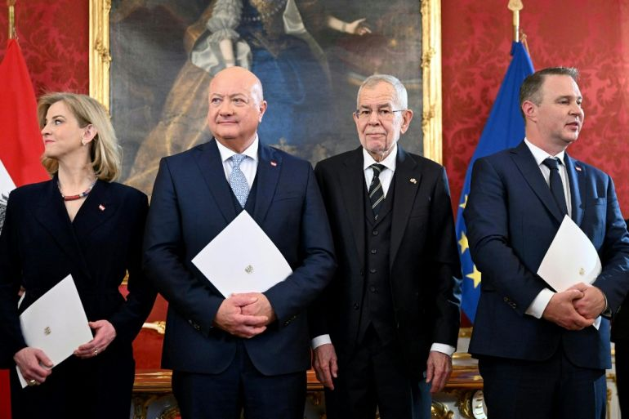
When a Large Party Is Ruled Out
When a large party is ruled out
THE PARTY LEFT OUT
WHAT REMAINED
THE RESULT
Germany, 2025
The AfD: second, with 152 of 630 seats
One two-party majority was left: CDU/CSU and SPD
The SPD, with 16% of the vote, took 7 of the 18 cabinet seats
The Netherlands, 2025
The PVV: joint first, with 26 of 150 seats
A broad coalition that the VVD refused, or 75 seats
A minority government, after 117 days
Vienna, March 3, 2025: Christian Stocker (second from left), Austria’s new chancellor, and the leaders of his two coalition partners with President Alexander Van der Bellen
Austria, 2024
The Freedom Party: first, with 57 of 183 seats
No party would make its leader chancellor, and its own talks failed
Three other parties govern, after 155 days
Who gains? The parties that remain. Each one is needed, so each can ask for more.
What results: grand coalitions, minority governments and three-party deals.

Slide 16
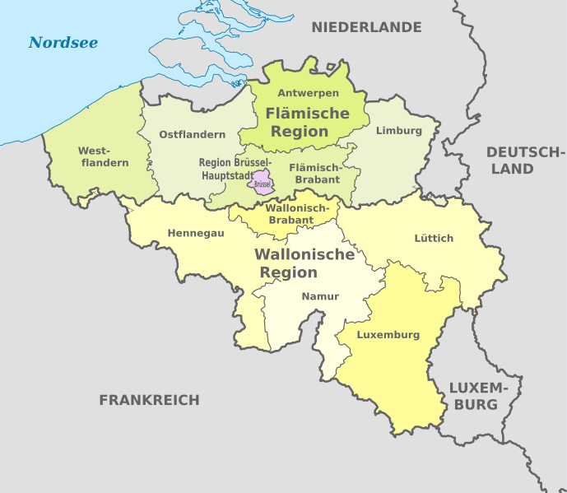
How Long Does It Take?
GUESS THE NUMBER
Britain took five days in 2010. How long did Belgium take in 2010–11?
A
54 days
B
154 days
C
341 days
D
541 days
D
541 days
Britain 2010
5
Germany 2025
72
Netherlands 2025–26
117
Austria 2024–25
155
Germany 2017–18
171
Belgium 2024–25
239
Netherlands 2021–22
299
Belgium: Flanders and Wallonia have separate parties, so every government is a coalition across the language line
Belgium 2010–11
541
Days from the election to a new government taking office. Until then the old government stays on as a caretaker.

Slide 17
Coalition Histories and Polarization
Coalition histories and polarization
THE ARGUMENT
How much less do partisans dislike another party when the two parties have governed together?
Most multi-party systems have dense histories of coalition partnerships
Parties are never certain whom they might need to work with next
That rewards “playing nice” and not burning bridges
It could lower animosity between party elites, and between their voters
Governing together now
1.02
Governed together in the last 10 years
0.75
10 to 15 years ago
0.65
15 to 20 years ago
0.13
Both in opposition now
0.41
This is what my co-authors and I find.
Reduction in dislike of the other party, holding the left–right distance between the two parties constant. The grey bar cannot be told apart from zero.

Slide 18
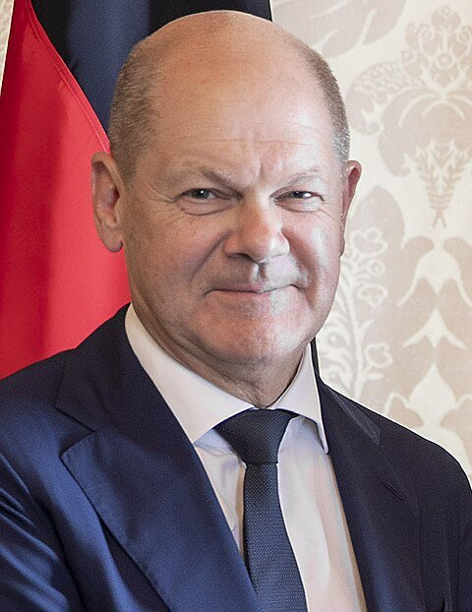
Governing Together
A common program, agreed when the coalition forms
  Britain, 2010: over 400 commitments and 29 policy reviews
Laws follow the coalition’s compromise more than any one minister’s wishes
Ministers share collective responsibility; when it fails, they feud in public
A problem the program did not foresee can break a coalition
Olaf Scholz, chancellor of Germany, 2021–25. His three-party coalition collapsed in November 2024 over the budget

Slide 19
The FRC’s Government
Wednesday, October 21: what happened, and which account explains it?

Slide 20
What Happened on Wednesday
What happened in our government?
SEATS
IN THE GOVERNMENT?
MINISTRIES
Radical Left (RLP)
?
?
?
Social Democrats (SD)
?
?
?
Greens (GP)
?
?
?
Liberals (LP)
?
?
?
Christian Democrats (CD)
?
?
?
Populist Right (PR)
?
?
?
Prime Minister: ?
Vote of confidence, in seats: ?

Slide 21
Test 1: Office
THE FRC
Test 1: did the parties want office?
WHAT THE ACCOUNT PREDICTS
CHECK IT AGAINST THE RECORD
The smallest coalition that reaches 51 seats
Ministries split in proportion to seats
The largest party in the coalition takes the Prime Minister
Take any one party out of the government. Does it still have 51 seats?
Each party’s share of the coalition’s seats, and its share of the ministries: do they match?
Was there a smaller coalition that would have won? Why did it not form?
Does the office account explain the FRC’s government?
Yes
Partly
No
Whatever your answer: what in your negotiation record is the evidence?

Slide 22
Test 2: Policy
THE FRC
Test 2: did the parties want policy?
LEFT
RIGHT
RLP
SD
GP
LP
CD
PR
Radical Left
? seats
Social Democrats
? seats
Greens
? seats
Liberals
? seats
Christian Democrats
? seats
Populist Right
? seats
WHAT THE ACCOUNT PREDICTS
CHECK IT AGAINST THE RECORD
A coalition of neighbors on this line
The party that holds the middle seats is in the government, and it sets the terms
Are the governing parties next to each other?
Count from the left: which party holds seats 50 and 51? Is it in the government?
On each of the five issues, whose position is in the coalition agreement?
Does the policy account explain the FRC’s government?
Yes
Partly
No

Slide 23
Test 3: Something Messier
THE FRC
Test 3: or was it something messier?
Three minutes in your caucus, with your negotiation records. Then one sentence from each party.
AN OFFER REFUSED
A RED LINE
A SURPRISE
Who offered what, to whom, and at what time?
What happened next?
One that held
One that did not hold
What did nobody see coming?
Radical Left
Social Democrats
Greens
Liberals
Christian Democrats
Populist Right
Then the question for your memo: was it one of these that decided the government, or seats and policy after all?

Slide 24
The Debrief Memo
No more than 1000 words
Three parts: what happened; which account explains it; what the theory missed
Compare what we did to what has happened in the real world
Use this unit’s readings to make the case

