Slide 1
POSC 3710: European Politics
9/16/2026: The European Union: (How) Does it work?
Dr. Will Horne
Clemson University

Slide 2
Election Watch: Mecklenburg-Vorpommern and Berlin
Two more German states vote on Sunday
MECKLENBURG-VORPOMMERN
BERLIN
The SPD’s last eastern stronghold
Minister-President Manuela Schwesig (SPD) has governed since 2017, since 2021 in coalition with the Left. In 2021 the SPD took nearly 40%
Last poll: AfD 35, SPD 32, Left 11, CDU 8
Watch: can the SPD and the Left keep their majority,
What happens if the AfD finishes first?
Five parties within nine points
Governing Mayor Kai Wegner (CDU) has led a CDU–SPD coalition since 2023. He withdrew as candidate in July, after criticism of his handling of January’s multi-day blackout; Finance Senator Stefan Evers leads the CDU
Last poll (Infratest dimap, 7–9 September): Left 21, CDU 20, AfD 18, Greens 16, SPD 12
The Left’s candidate is Elif Eralp; the AfD’s is Kristin Brinker
Watch: Who gets the first chance to form a government? Will the SPD work with the Left?

Slide 3
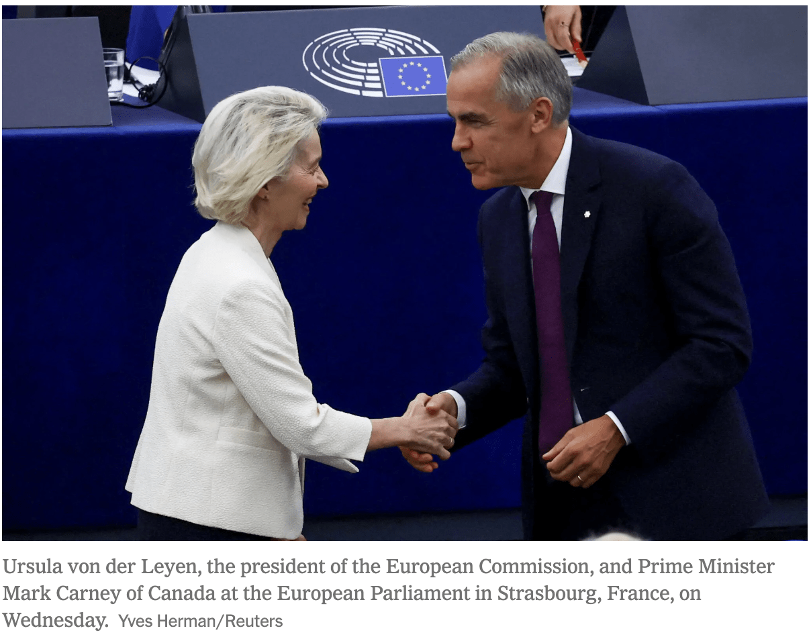
Canada to “Join” the EU?

Slide 4
This Morning in Strasbourg
The State of the (European) Union, Strasbourg, this morning
What she announced
THE SPEECH
1.
The 2028–34 budget “needs new own resources”: EU-level revenue, on top of what the 27 governments pay in
The Commission sets its program
Commission President Ursula von der Leyen (Germany) addresses the European Parliament every September, then debates its members. The first was in 2010
It sets the Commission’s legislative program for the year, as an American president’s address does. The Parliament approved her; voters did not elect her
This year’s questions: the 2028–2034 budget, defense, enlargement, trade with China, the cost of living
What does she ask for from EU member states? What does she offer?
2.
“Europe’s own Article 4”: one state triggers it, all 27 convene. A Security Council with the UK, Norway, Canada and Ukraine
3.
After Ceuta (70,000 migrants crossed from Morocco in July): a European Emergency Response Framework. “Ceuta is Spain. Ceuta is Europe”
4.
EU Kids Act, proposed tomorrow: no social media under 13, no personal account under 15. Platforms must prove they are safe
Quite literally 0 mentions of the USA, which is a bit odd

Slide 5
Who Runs the EU?
Who runs the EU these days?
URSULA VON DER LEYEN
ANTÓNIO COSTA
ROBERTA METSOLA
President of the European Commission, since 2019
Germany. Former German defense minister. Proposes EU laws and runs the civil service. Won a second term in 2024
President of the European Council, since 2024
Portugal. Prime minister of Portugal, 2015–24. Chairs the summits of the 27 heads of government
President of the European Parliament, since 2022
Malta. Leads the 720-member chamber, the only EU body that voters choose directly
KAJA KALLAS
MICHEÁL MARTIN
CHRISTINE LAGARDE
High Representative for Foreign Affairs, since 2024
Estonia. Prime minister of Estonia, 2021–24. Speaks for the EU abroad.
Taoiseach of Ireland; Council presidency, July–December 2026
Ireland chairs the ministers’ meetings for six months and is brokering the 2028–2034 budget
President of the European Central Bank, since 2019
France. Former French finance minister and head of the IMF. Sets interest rates for the 21 euro countries

Slide 6
Where We Left Off
9/2: France and Germany pooled coal and steel to allow economic recovery and to make another war nearly impossible
9/9: nations are often modern and perhaps “Imagined”.
Last Time: the Christian democrats designed European integration; the social democrats came round to it
Today: What kind of supranational organization did the European nation-states build?. What it is, how it decides, whether it is democratic

Slide 7
Opening Discussion
South Carolina cannot leave the United States (although, it tried once). Britain left the EU with a democratic vote. Which arrangement would you rather live under?
Suppose the fifty governors met in Washington to write federal law, and Congress could only amend it. How would we evaluate that in terms of democracy?
What would you hand to a body above your own government in return for one market, one currency and free movement? Is this appealing at all? Why is it appealing to (some) Europeans?

Slide 8
What the EU Is
From today’s reading: CRS
It’s enormous: 27 states, about 450 million people, bound by treaties that can only be changed through consensus
A customs union + a single market: goods, services, money and people move freely
21 members share a currency; 25 have abolished passport checks between them
Its own parliament, court, budget and civil service. No standing army, no police, almost no taxes
“A unique political and economic partnership”

Slide 9
From Six to Twenty-Seven
From today’s reading: CRS
From six members to twenty-seven, 1951–2026
The Coal and Steel Community: France, West Germany, Italy, Belgium, the Netherlands, Luxembourg
Britain, Ireland and Denmark; then Greece; then Spain and Portugal
Thirteen more members, eleven of them former communist states. The Union reaches 28
Nine candidates. Ukraine, Moldova, Montenegro and Albania all held accession conferences on one day in July
1951
1973–86
2004–13
2026
1957
1993
2020
Treaty of Rome: a common market, the EEC
Maastricht: the European Union, EU citizenship, the road to the euro
Britain leaves, after a 52–48 referendum in 2016
Joining takes the unanimous consent of the existing members and usually a decade + of negotiation; Turkey has been a candidate since 1999.

Slide 10
Not Everyone Is In Everything
From today’s reading: CRS
The Union, the euro and Schengen all have different members
THE UNION: 27
THE EURO: 21
SCHENGEN: 29
Single market, court,
parliament
All members are in the single market and the customs union, and under the Court of Justice
Enlargement and treaty change need all 27
Left: Britain, in 2020. Waiting: nine candidates
Six members keep
their own currency
Denmark negotiated an opt-out in 1992; Sweden voted no in 2003
Poland, Czechia, Hungary and Romania have not joined the Euro. Bulgaria did, on 1 January 2026
The European Central Bank in Frankfurt sets one interest rate for all 21
  This has created problems…
No passport checks,
four non-members included
25 EU states plus Norway, Iceland, Switzerland and Liechtenstein
Ireland stays out to keep its open border with Britain. Cyprus is waiting for the other 25 to vote it in
Any member can restore checks for a while. Germany did so in 2024

Slide 11
Is it really above the State?
From today’s reading: CRS
Supranational: above the states. A member is bound to decisions even if it votes no. The Commission, Parliament, Court and Central Bank
Intergovernmental: between governments. Every state keeps a veto. The European Council, and the Council on tax, foreign policy and new members
Most laws now pass by qualified majority: 55% of the states, holding 65% of the population
  Leads to the question we take up later today – is the EU democratic?

Slide 12
The Five Institutions
From today’s reading: CRS
Five institutions: Who are they and what do they do?
WHO
HOW THEY GET THERE
WHAT IT DOES
European Commission
27 commissioners, one per state, under President von der Leyen
Nominated by the governments, approved by the Parliament, five-year term
Proposes EU law, enforces the treaties, negotiates trade deals
Council of the EU
The 27 governments’ ministers
Elected at home. The chair rotates every six months; currently Ireland
Amends and adopts laws with the Parliament. Requires unanimity on tax, foreign policy, new members
European Parliament
720 members in eight cross-national groups, under President Metsola
Elected directly every five years by proportional representation; most recently in June 2024
Amends and adopts most laws with the Council; approves the Commission and the budget
European Council
The 27 heads of government, chaired by President Costa
Elected at home; meets at least four times a year
Sets direction and settles the big issues: budget, treaties, enlargement. Passes no laws
Court of Justice
27 judges, one per state, in Luxembourg
Appointed by the governments for six-year terms
Binding rulings. EU law > National law when they conflict
A sixth is the European Central Bank in Frankfurt, which sets interest rates for the euro and is nominally independent of politics (like the US fed).

Slide 13
How a Law Gets Made
From today’s reading: CRS
How a bill becomes a law, EU Edition
2a THE PARLIAMENT
720 elected members amend it and vote
1 COMMISSION PROPOSES
3 BOTH MUST AGREE
4 IT BECOMES LAW
Only the Commission can put a bill on the table. It consults, drafts, and sends bill text to both chambers
The same text must pass both. If not, a reconciliation committee; if that fails, no law
Governments apply it at home. The Court of Justice enforces it
2b THE COUNCIL
The 27 governments amend it and vote: requires 55% of states with 65% of the population

Slide 14
What the EU Does Not Do
From today’s reading: Moravcsik
It does not tax.
  Its budget is 1% of the Union’s income; raising the ceiling needs all 27 states to approve
It does not run the welfare state, schools, hospitals, police or armies.
National officials apply EU rules.
  EU employs fewer people than a mid-sized city
Its focus is cross-border economics: trade, competition, the single market, the euro
Moravcsik: the EU does the tasks that democracies everywhere hand to experts

Slide 15
The Budget in Proportion
From today’s reading: Moravcsik
How much does the EU Spend?
Public spending, share of national income
Where the EU’s €193 billion goes, 2026
49.5%
Regional and social funds (cohesion)
37%
Farming and the environment
29%
Single market, research, digital
12%
Neighbourhood and the world
8%
Administration
7%
Reserves and special instruments
3%
Migration and borders
3%
1.0%
Security and defence
2%
All 27 governments, 2025 (share of GDP)
The EU budget, 2026 (share of national income)
Council of the EU (2026 budget, €192.8bn in commitments); Eurostat (government expenditure, 2025). About one euro in fifty of public money in Europe is spent through Brussels. The 2028–34 budget is being negotiated now: the Commission asked for about €1.8 trillion over seven years; Germany wants €400 billion less.

Slide 16
The Parliament Today
The European Parliament, 720 seats, September 2026
The Left
45
Socialists and Democrats (S&D)
135
Greens
53
Renew (liberals)
78
European People’s Party (EPP): Christian democrats and conservatives
184
Conservatives and Reformists (ECR): Italy’s Brothers of Italy, Poland’s PiS
84
Patriots for Europe (PfE): France’s National Rally, Hungary’s Fidesz
85
Sovereign Nations (ESN): the AfD’s group
27
No group
28
European Parliament, July 2026; one seat vacant. The two families of Monday, EPP and S&D, are still the two largest groups and hold 44% of the seats between them; the three groups to their right hold 27%. Members vote by group, not by country: a French socialist usually votes with a German one.

Slide 17
Second-Order Elections
From today’s reading: Follesdal & Hix
Turnout in European Parliament elections, 1979–2024
62%
59%
58%
57%
50%
51%
51%
46%
43%
43%
1979
1984
1989
1994
1999
2004
2009
2014
2019
2024
European Parliament, EU-wide turnout. Follesdal and Hix call these ‘second-order national contests’: contested by national parties on national issues, with governing parties losing. Turnout fell for thirty-five years and recovered in 2019 and 2024, as Europe itself became a source of conflict

Slide 18
(Is there a)The Democratic Deficit?
From today’s reading: Follesdal & Hix
Power moves to executive: ministers in Brussels escape their own parliaments
The European Parliament is weak: it cannot propose a law or choose a government
European elections are “second order”: they depend on national issues
The EU is too distant and too strange to understand, voters cannot judge it
Policy drifts from what majorities want: deregulation, tight monetary policy, farm subsidies

Slide 19
A Defense of the EU
From today’s reading: Moravcsik
Critics measure the EU against an ideal democracy.
  Against real ones, it looks normal. We have farm subsidies, tight fiscal policy and deregulation here too!
Not a superstate: narrow mandate, no tax power, unanimity for treaties, supermajorities for laws
Democraticly accountable : elected Parliament and the elected governments in the Council
Its insulated parts, central bank, court, regulators, are insulated at home too,
Voters ignore EU elections because health, schools, pensions and taxes are national. National elections matter more to voters lives

Slide 20
In the Readings’ Words
From today’s readings: Moravcsik; Follesdal & Hix
Moravcsik vs Follesdal and Hix
“Constitutional checks and balances, indirect democratic control via national governments, and the increasing powers of the European Parliament are sufficient to ensure that EU policy-making is, in nearly all cases, clean, transparent, effective and politically responsive to the demands of European citizens.”
Moravcsik, p. 605
“The EU may be more ‘representative’ precisely because it is, in a narrow sense, less ‘democratic’.”
(Is there such a thing as ‘too democratic’?)
Moravcsik, p. 614
Contestation for political leadership “is ultimately the difference between a democracy and an enlightened form of benevolent authoritarianism, is an essential element of even the ‘thinnest’ theories of democracy, yet is conspicuously absent in the EU.”
Follesdal & Hix, p. 534

Slide 21
The Debate, Side by Side
From today’s readings: Moravcsik; Follesdal & Hix
The Debate
MORAVCSIK (2002)
FOLLESDAL AND HIX (2006)
The standard
Real democracies, in a multi-level system
Democracy requires contestation for power
What the EU does
Regulates cross-border markets: low-salience, expert work
Makes choices with winners and losers: budgets, trade, labour rules
Accountability
Through the elected governments in the Council, plus the Parliament
Nowhere: no one can be voted out for an EU policy
Why voters don’t care
The issues are not salient to them
Nothing is contested, so nothing is salient
Insulation
Normal and justified: courts, central banks, regulators
Fine for technical choices; wrong for distributive ones
The remedy
None. More participation would backfire
A contest for the Commission presidency; an open Council

Slide 22
Twenty Years Later
2014: parties named lead candidates; Luxembourg’s former premier Jean-Claude Juncker won and got the job
Europe is now fought over in national elections: Brexit, France’s National Rally, the AfD
  UK shows that it is possible to hold the EU accountable through threat of exit
Follesdal and Hix got part of their wish. Did it make the EU more democratic?

Slide 23
What Europeans Think
From today’s reading: CRS
What Europeans say about the Union, spring 2026
Feel they are citizens of the EU
75%
Support the euro
74%
Say their country has benefited from membership
73%
Optimistic about the EU’s future
60%
Satisfied with how democracy works in the EU
57%
Trust the EU
51%
Standard Eurobarometer 105, fieldwork 12 March to 5 April 2026, all 27 states. Trust in the EU is at a high, and since the 2010s it has run above trust in national governments. Moravcsik predicted the pattern in 2002: insulated institutions are often more popular than legislatures.

Slide 24
A European Nation?
Gellner: one culture, one state. The EU runs in 24 official languages, contains even more distinct cultures
Anderson: imagined through shared symbols. The EU has: flag, anthem, holiday, passport, euro
Three in four feel like EU citizens, butmost still put their nationality first
Nations were made by schools, conscription and railways. The EU doesn’t control these, and member states have no incentive to foster an EU identity

Slide 25
Above and Below
Nation-states are squeezed from above (the EU) and below (nations without states)
Scotland and Catalonia want independence inside the EU; the single market makes a small state viable
Regions deal with Brussels directly: offices, funds, a committee of their own
Brussels is cautious: a new state must apply to join, and Spain’s veto is waiting
Which is it: a release valve inside old states, or an exit door?

Slide 26
Discussion
Is the EU democratic? How can we decide?
The Commission proposes; two elected bodies decide. More or less democratic than an executive order?
Nine countries are waiting to join. What makes the EU so attractive?
The FRC is an EU member. Think about which of today’s arguments will you use when an accession vote reaches your parliament?

Slide 27
Where We Go Next
Next: the welfare state. Why Europe’s states spend half of everything, while the EU spends one per cent
Case Study: health care systems.
Then: can the welfare state survive?
~11/18: the EU under strain. Brexit ten years later, enlargement, rearmament

Slide 28
The Federal Republic of Clemson
The FRC is a member state. On 11/18 your parliament votes on a new member’s accession and on the FRC’s contribution to European defense
Your manifesto has a Europe section: enlargement, defence, the United States and Russia. Two of the six parties are EU-critical, from opposite ends of the spectrum
Manifesto due Wednesday 9/30, ~2,000 words
Next: the welfare state

