Slide 1
POSC 3710: European Politics
11/4/2026: The Populist Radical Right
Dr. Will Horne
Clemson University

Slide 2
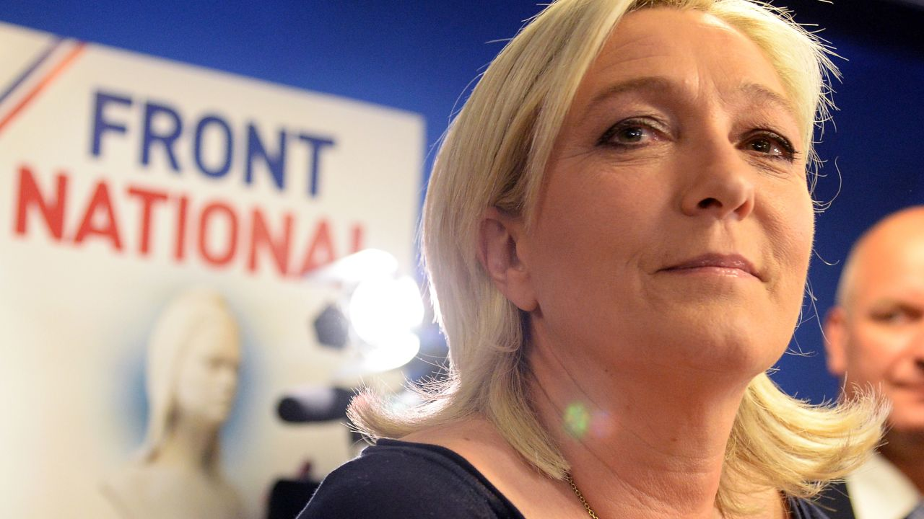
Notes:
The populist right in Europe has grown from a series of fringe parties in the 1970s and 1980s to a major force in European Politics. No party characterizes this ascent more than the RN, formerly the Front National, in France. The party was founded in the early 1970s by Jean Marie Le Pen, who has a sort of longstanding political gadfly and fringe right figure. Le Pen had begun his political journey as a monarchist, then fought against Algerian independence, where he was accused of using torture. Upon his return to France, he ran the presidental campaign of Jean-Louis Tixier, a controversial figure who had prominently collaborated with the Nazi’s during the Vichy France period and was also a prominent holocaust denier. Le Pen himself remained a holocaust denier his entire life, claiming that the death counts were over stated, and that the holocaust was simply a minor detail of the second world war. After founding the FN, Le Pen repeatedly ran for President starting in 1974, initially receiving less than 1% of the vote. He even failed to receive the 500 signatures necessary to get on the ballot in 1981. Yet, over time he became known as a very charismatic speaker, even as he continued to take very extreme right wing positions, including arguing for the removal of anyone who has HIV positive from society (he advocated forced confinement) and arguing that fundamental differences between the races made it impossible to for multicultural societies to co-exist, claiming biological superiority of the European Races. Desipte all of this nastiness, the complete fragmentation of the French Left in 2002 led to him finishing second in the first round of the 2002 presidential elections, albeit with only 18% of the vote. In the second round, he did not improve his vote total with Chirac receiving over 80% of the vote. s. More than one million people in France took part in street rallies; slogans such as "A crook is better than a fascist" (Un escroc mieux qu'un facho) and "Graft rather than hate, Chirac rather than Le Pen" (L'arnaque plutôt que la haine, Chirac plutôt que Le Pen) were heard in opposition to Le Pen.
He ran again in 2007, and then stepped down from party leadership. He was later also convicted of embezzling Eu funds. I really try to not take strong positions on politicians/parties in class, but Le Pen (the elder) is an exception, he just seems to have been all around terrible. His daughter, Marine Le Pen now runs the party and has been the presidential candidate in each consequent election. This is something notable about many populist right parties, although the FN/RN is the only one that still has only had a single family control it. She renamed the party, disavowed her fathers holocaust denial and kicked him out of the party. She has tried, and largely succeeded, in softening the image of the party, has moved away from the explicit racism of the party under her father. It’s a bit of an open question how “reformed” the party is or is not under her, but the racism and clear ties to fascism are gone. Remains to be seen how she would govern, but on current polling we may well get a chance to see what a Presidente Le Pen would look like.

Slide 3
What Is Populism?
From today’s reading: Mudde
What is populism?
Cas Mudde, a Dutch political scientist, defines it as
“an ideology that considers society to be ultimately separated into two homogeneous and antagonistic groups, ‘the pure people’ versus ‘the corrupt elite’, and which argues that politics should be an expression of the volonté générale (general will) of the people.”
Populism is contrasted with two other traditions.
Technocracy/Elitism
PLURALISM
“Populism’s mirror-image” – rule by experts (or elites). Follow science/economics rather than what the people want
Society is “a heterogeneous collection of groups and individuals with often fundamentally different views and wishes”

Slide 4
A Thin Ideology
From today’s reading: Mudde
A thin ideology
Populism “can be easily combined with very different (thin and full) other ideologies, including communism, ecologism, nationalism or socialism.”
ON THE LEFT: POPULISM WITH SOCIALISM
ON THE RIGHT: POPULISM WITH NATIVISM
The people: the working class, “the 99%”
The elite: business and the wealthy
Podemos in Spain, Syriza in Greece, France Unbowed, Bernie Sanders (or the DSA) in the USA
The people: the native-born; sometimes narrower, the “real” citizens
The elite: “traitors to the nation,” the media, “globalists,” intellectuals; historically, Jews
The National Rally in France, the AfD in Germany, the PVV in the Netherlands, (parts of) MAGA in the USA
First waves of populism associated with the left – William Jennings Bryan in the USA and Latin American populism.

Slide 5
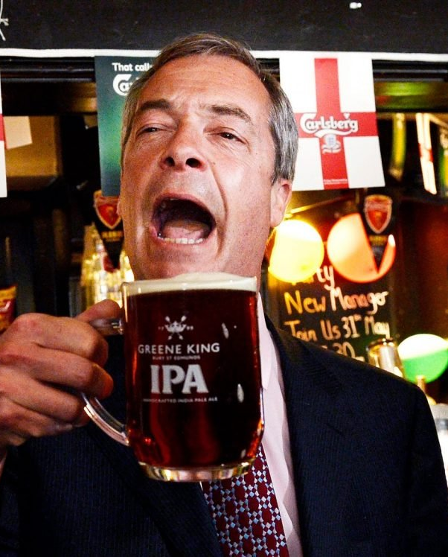
Populist or Not? 1: Real People
POPULIST OR NOT? ROUND 1 OF 3
“This will be a victory for real people, a victory for ordinary people, a victory for decent people.”
Nigel Farage
Leader of the UK Independence Party, at 4 a.m. on June 24, 2016, as Britain voted to leave the EU
POPULIST
Leave won 52% to 48%. If the winners are the real people, what are the other 48%?

Slide 6
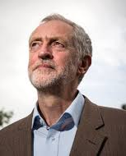
Populist or Not? 2: The Establishment
POPULIST OR NOT? ROUND 2 OF 3
“It is the establishment versus the people and it is our historic duty to make sure that the people prevail.”
Jeremy Corbyn
Leader of Britain’s Labour Party, opening his election campaign on April 20, 2017
POPULIST, ON THE LEFT
The same two camps. The elite here is economic: “a rigged system set up by the wealth extractors.”

Slide 7
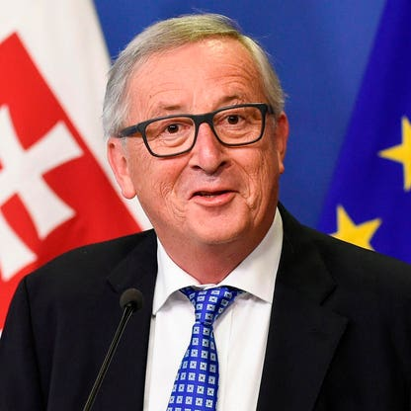
Populist or Not? 3: We All Know What to Do
POPULIST OR NOT? ROUND 3 OF 3
“We all know what to do, but we don’t know how to get re-elected once we have done it.”
IMAGE PLACEHOLDER
Jean-Claude Juncker
Official portrait: European Commission audiovisual service
Jean-Claude Juncker
Prime minister of Luxembourg and chair of the euro zone’s finance ministers, on economic reform, 2007
NOT POPULIST: ELITIST
The leaders know what is right, and the voters are the obstacle. Mudde calls elitism populism’s mirror image.

Slide 8
Why “Radical”?
A radical version of views the mainstream also holds
  Most parties now want less immigration and stronger borders
  Radical: remove immigrants whatever their legal status; ignore asylum law
Hostile to parts of liberal democracy: a free press, pluralism
  Orban referred to “Illiberal Democracy”
They accept elections, and want fewer limits on whoever wins
  More recently, challenge legitimacy of results and claim corruption

Slide 9
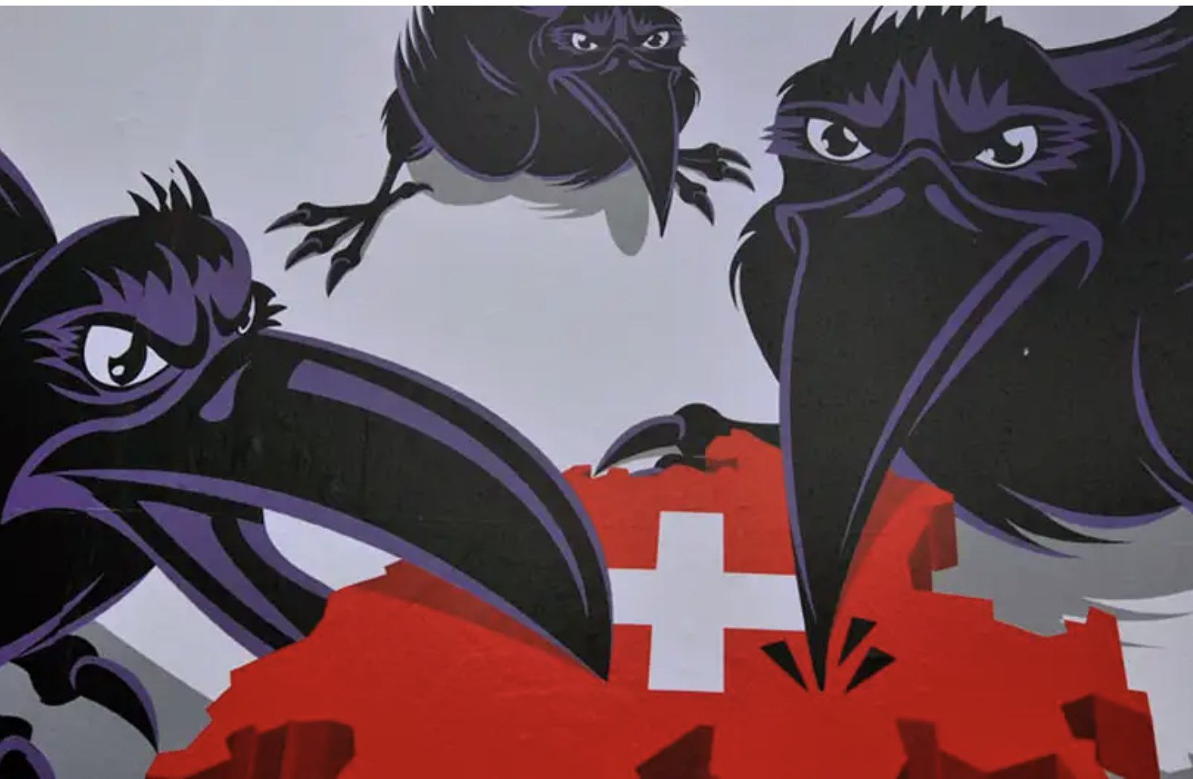
Core Feature: Nativism
Core feature: nativism
NATIVISM
Before the click: what does this poster say, and about whom?
Mudde, in a later book: “an ideology which holds that states should be inhabited exclusively by members of the native group (‘the nation’) and that nonnative elements (persons and ideas) are fundamentally threatening to the homogeneous nation-state”
Often the aim is a state with one culture
The charge against the elite: it sold the country out to foreigners
The Swiss People’s Party, 2009, against letting Bulgarians and Romanians work in Switzerland. Its campaign chief: “The ravens are aggressive, cunning and devious.”
The Swiss People’s Party is the largest party in Switzerland: 27.9% in 2023, and two of the seven seats in the government.

Slide 10
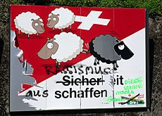
Nativism: Two More Campaigns
Core feature: nativism, two more campaigns
Before the click: what does this one say?
2007: THE BLACK SHEEP
White sheep kick a black sheep off the Swiss flag
The slogan: “Create security”
2011: KOSOVARS
Its advertisement: “Kosovars slash the Swiss”
Two party officials were convicted of racial discrimination
Both are campaigns of the Swiss People’s Party, the largest party in Switzerland.

Slide 11
Economics or Culture?
ACTIVITY
From today’s reading: Gidron and Hall
Economics or culture?
1
ECONOMICS
2
CULTURE
3
BOTH
“On site, 90% of them are Polish. They will put in a quote for a pittance and put in ten times more hours than you.”
“People are getting sick and tired that England isn’t English. It is immigration, but it’s lots of things.”
“I went to the housing office with my husband to see about a council house and they said ‘you’ve got no chance, we’ve got to move the immigrants in first’.”
A Labour voter considering UKIP, Newcastle-under-Lyme
A Labour voter considering UKIP, Newcastle-under-Lyme
A UKIP voter, Thurrock
4
ECONOMICS
5
CULTURE
6
BOTH
France: 95% of workers had permanent contracts in 1982, and 86% in 2012. Under 25, fewer than half.
Britain, 2016: 14% of Leave voters called immigration a force for good. Among Remain voters, 57%.
“A policeman told me you can’t get promoted now unless you’re a certain colour.”
Gidron and Hall
Gidron and Hall
A Labour voter considering UKIP, Newcastle-under-Lyme
Gidron and Hall’s answer: each of the six is about where the speaker’s group stands in society.
The voters’ words: focus groups run for Lord Ashcroft, a British pollster, in 2012. UKIP is the UK Independence Party.

Slide 12
Subjective Social Status
From today’s reading: Gidron and Hall
Subjective social status: the ladder
10
the top
THE SURVEY QUESTION
“In our society, some groups are more on top and others are more at the bottom. Thinking about yourself, where would you place yourself in this scale?”
9
8
7
6
5
WHAT IT MEASURES
“The level of social respect or esteem people believe is accorded them within the social order.”
4
3
2
Asked in the same words in many countries since 1987, so the answers can be compared across countries and over time.
1
the bottom

Slide 13
What Gidron and Hall Find
From today’s reading: Gidron and Hall
What Gidron and Hall find
6% → 11%
10 of 12
9 of 12
The predicted chance of a vote for the populist right, moving from medium-high to medium-low status
Countries where men without a college degree rank lower, relative to everyone else, than 25 to 30 years earlier
Countries where women’s status rose relative to men’s over the same years
Their claim is a modest one: status is “one pathway” by which economic and cultural change reach the ballot box.

Slide 14
Two Roads to Lower Status
From today’s reading: Gidron and Hall
Two roads to lower status
THE ECONOMIC ROAD
THE CULTURAL ROAD
“The gradual disappearance of low-skilled decent jobs”
Part-time and temporary work in their place
Esteem goes to skills and degrees: “It is no longer enough to be a hard worker.”
Women in paid work, ages 25 to 54: 54% in 1980, 71% in 2010
LOWER STANDING
for people (particularly men) without a college degree
SUPPORT FOR THE POPULIST RIGHT
“Threats to a person’s social status evoke feelings of hostility to outgroups.”

Slide 15
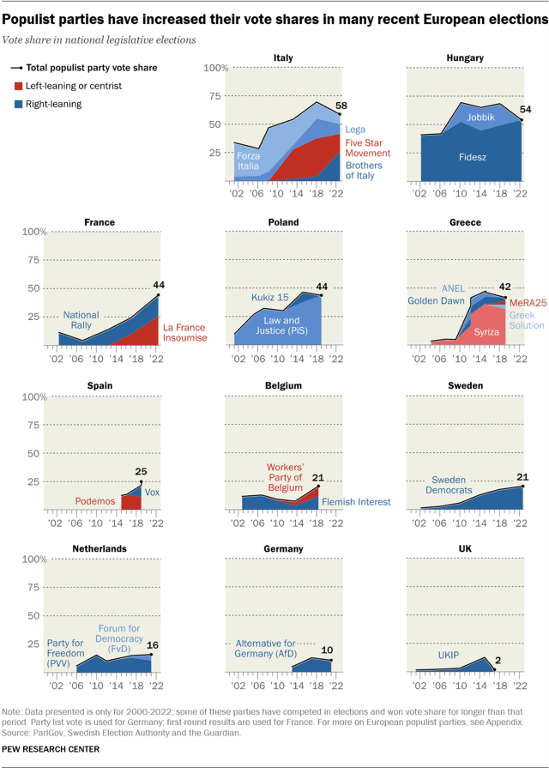
Source: Pew

Slide 16
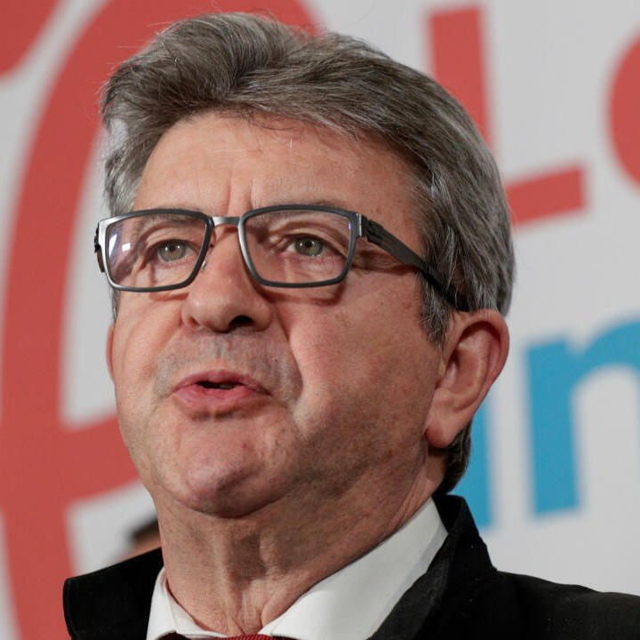
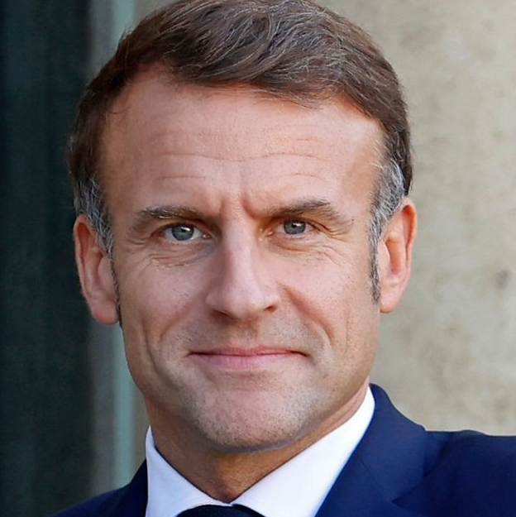
Who Votes Against the System?
France, April 2022: who votes against the system?
HANDS UP
In France, who backs Le Pen more?
Voters over 60
Voters under 60
Voters under 60
Vote for Macron and the other mainstream candidates, first round of the presidential election
Voters under 35: the three leading candidates
Over 70
around 57%
Mélenchon
over 30%
Le Pen
around a quarter
Aged 18 to 24
27%
Macron
little over 20%
Emmanuel Macron, president of France since 2017. Marine Le Pen, of the National Rally, on the radical right. Jean-Luc Mélenchon, of France Unbowed, on the radical left.
The finding: youth predicts a vote against the system, on the left and on the right. Support for the mainstream grows with age.

Slide 17
Education Sets the Direction
Education sets the direction
Two 24-year-olds without steady work. One has a degree. Who is the likelier far-right voter?
The graduate
The school leaver
The school leaver
WHY THE YOUNG
WHICH WAY THEY TURN
Reforms opened up labor markets and cut social protection, mostly for the young. Rights already earned stayed in place
“dualization.” Insiders, pensioners above all, keep their protection; outsiders go without
Most of all in southern Europe; also in Belgium, France, Germany and Austria
In most countries the young prefer the radical left to the far right: Syriza in Greece, Podemos in Spain
In France, graduates who vote against the establishment lean to Mélenchon. School leavers lean to Le Pen
“Higher education seems to have a powerful inoculating effect against sympathy for the far right”
Graduates and less educated voters “share a feeling that things need to change, but disagree on the direction of this change.”

Slide 18
Are These Männerparteien?
Are these Männerparteien [men’s parties]?
THE PATTERN
Germany’s election of February 2025: the share of men and of women who voted for each party (%)
The first leaders were all men, and so were nearly all their members of parliament
These parties have always done better among men than among women
Often anti-feminist, and for traditional roles
Women vote further left than men
men
women
37.1
25.1
16.7
17.6
9.4
6.5
AfD, all voters
The Left, all voters
The Left, voters aged 18 to 24

Slide 19
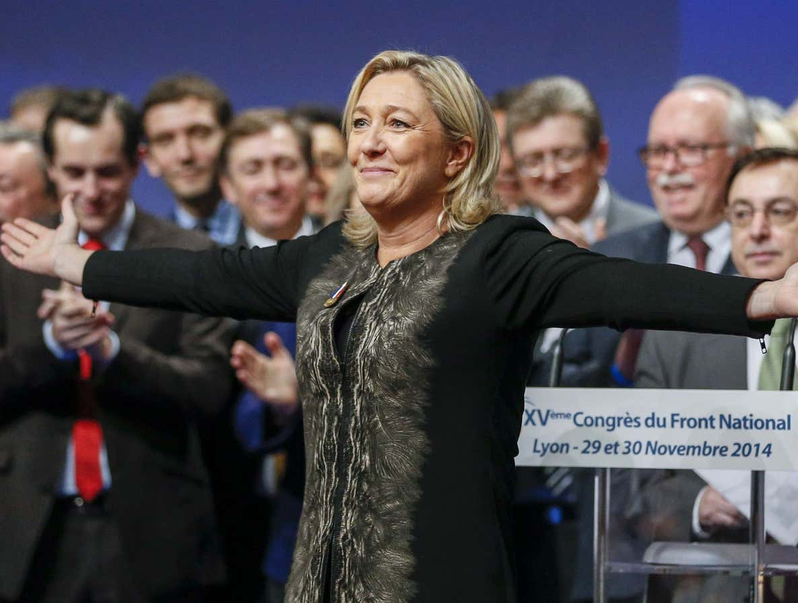

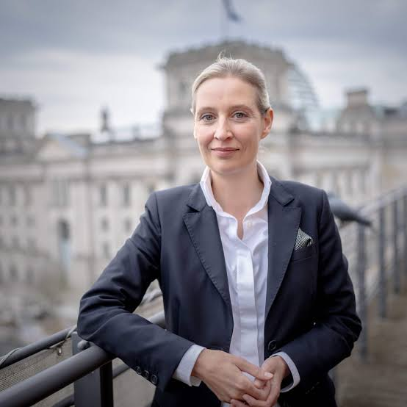
On the Other Hand…
On the other hand…
Marine Le Pen, France
Giorgia Meloni, Italy
Alice Weidel, Germany
Leader of the National Rally in parliament; a candidate for president in 2027
Leader of the Brothers of Italy; prime minister since 2022
Co-leader of the AfD, re-elected in July 2026
ASK THE ROOM
Why would a radical right party want a woman at the top?

Slide 20
Did the Party Leave Its Voters?
Britain’s working-class voters: did they leave Labour, or did the party leave them?
How working-class voters voted at general elections (%)
WHY THE LEFT MOVED
80%
Working-class voters were once a majority. In most countries they are now far from one
Many live in safe city seats or in declining towns
They lean left on the economy and right on social issues. Middle-class voters: the reverse
The change is starkest under first-past-the-post
60%
Conservatives
40%
Labour
20%
0%
1964
1979
1997
2010
2019
Could the left win them back with more working-class candidates?
Yes
No
In 2019 the Conservatives led Labour among working-class voters, about 47% to 33%.

Slide 21
More recent waves: Moderation and Breakthrough
In recent years, right populist parties have started to be structured more like normal parties, rather than vehicles for charismatic populist politicians
Parties have made a serious attempt to clean up their image, kicked out most extreme and racist politicians, moved away from anti-semitism
To some extent, this has been successful. Populist right parties have joined several governments, and their vote share has dramatically increased.

Slide 22
Key Points
Populism: the pure people against the corrupt elite
It is thin: with nativism it is right-wing, with socialism left-wing
Its voters: people whose standing in society has slipped
The anti-system vote is young; education sets its direction
Since the 1990s: more polished parties, and a way into government

