Slide 1
POSC 3710: European Politics
10/19/2026: Electoral Systems
Dr. Will Horne
Clemson University

Slide 2

Britain May Change the Rules
September 29, 2026: Andy Burnham, Britain’s Labour prime minister, announces a commission on electoral reform
Labour will run on “a manifesto commitment to change the electoral system”
His warning: today’s rules could put a party in power “with 30% of the vote or less”
We’ve seen this story before…
What do you all think: would Labour gain seats under new rules, or lose them?
The 2024 election: Keir Starmer (left), who led Labour to victory, debates Rishi Sunak, the Conservative prime minister

Slide 3
Guess the Number: Britain, 2024
In 2024 Labour won 33.7% of the vote in Britain. What share of the seats did it win?
A
34%
B
45%
C
55%
D
63%
D
63%
Share of the vote
Share of the seats in the House of Commons
63.2%
33.7%
23.7%
18.6%
14.3%
12.2%
11.1%
6.7%
2.5%
0.8%
0.6%
1.4%
Labour
Conservatives
Reform UK
Liberal Democrats
Greens
Scottish National Party
650 seats; Labour won 411. Reform UK won more votes than the Liberal Democrats, and 5 seats to their 72. It was the least proportional election in British history.
NOTE – it’s not Gerrymandering (per se). A natural consequence of first past the post.

Slide 4
A Minimum Definition of Democracy
From today’s reading: Gallagher and Mitchell
Every adult citizen has the right to vote periodically
  To choose who governs, and to hold politicians accountable
The type of election is not specified
  Plurality, runoffs, ranked choice, proportional, mixed
Nor is the timing
  Fixed terms (USA, Norway), a maximum term (most of Europe), a hybrid (Sweden)
An electoral system: the rules for “how votes are cast” and how they are “converted into seats”

Slide 5
European Electoral Systems
From today’s reading: Gallagher and Mitchell
European electoral systems: three ideal types
SINGLE-MEMBER DISTRICTS
PROPORTIONAL REPRESENTATION
MIXED SYSTEMS
One winner per district
Plurality: the most votes wins. Britain, the United States
Majority: a runoff if no one wins outright. France
Ranked ballots: Australia
Seats in proportion to votes
Party lists in districts with many seats: Spain, the Netherlands, Sweden
Ireland: voters rank the candidates, in districts of three to five seats
  My op-ed (and other research) proposes a similar plan for the US
Two votes: a candidate and a party
Germany: list seats make the whole parliament proportional
Hungary: most seats go to district winners. April 2026: 53% of the vote, 71% of the seats
Most European countries use (some form of) proportional representation. Britain and France are exceptions.

Slide 6
How Far Are Seats from Votes?
From today’s reading: Gallagher and Mitchell
How far are seats from votes?
Single-member districts
Mixed
Proportional
Britain 2024
1 seat per district
23.6
DISTRICT MAGNITUDE
France 2024
1 seat per district, two rounds
7.8
The number of seats a district elects
“The smaller the average district magnitude, the greater the disproportionality.”
The reading calls it one of the most robust findings in the field.
Germany 2025
mixed, with a 5% threshold
6.5
Ireland 2024
3 to 5 seats per district
5.8
Spain 2023
6.7 seats per district on average
5.7
Netherlands 2023
150 seats in one national district
1.5
Measurement: The least squares index for the latest election: 0 means every party’s share of seats equals its share of votes. Germany’s threshold left 13.9% of voters without a party in the Bundestag in 2025.

Slide 7
Duverger’s Law
From today’s reading: Benoit
Duverger’s law
“The simple-majority single-ballot system favours the two-party system.”
Maurice Duverger, French political scientist, 1951
THE MECHANICAL EFFECT
THE PSYCHOLOGICAL EFFECT
At the count
The rules turn votes into seats
A party that finishes second or third in every district wins nothing (Reform UK in 2024)
Before the vote
Voters avoid “wasting their votes on sure losers”
Candidates and donors stay away from parties that cannot win

Slide 8
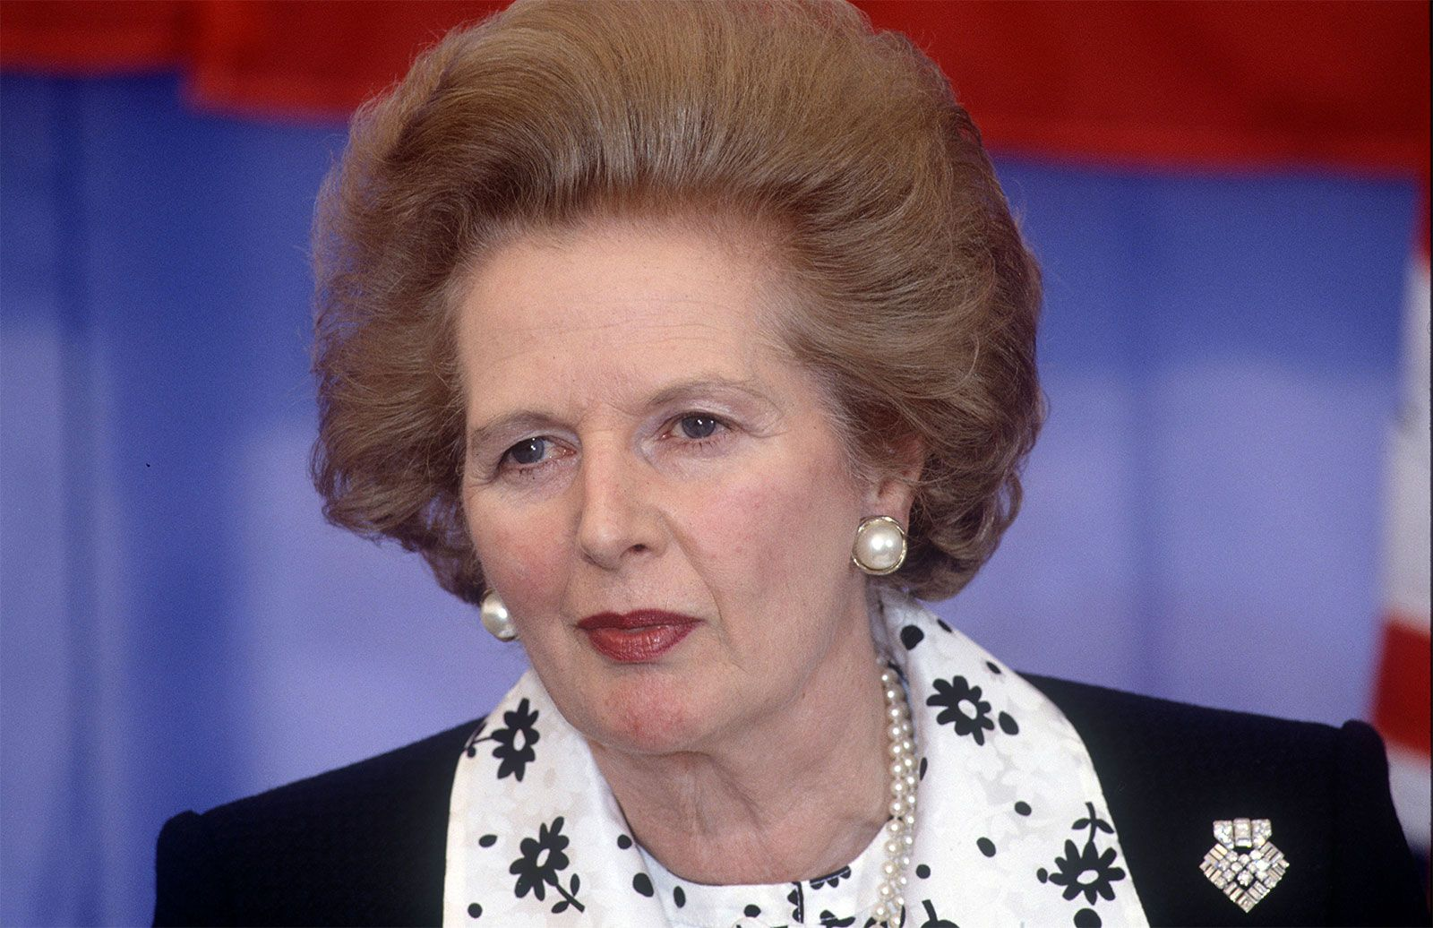
Guess the Number: Britain, 1983
Britain, 1983: Labour won 27.6% of the vote and 209 seats. The SDP–Liberal Alliance won 25.4%. How many seats?
A
23
A
23
B
62
C
120
D
190
Share of the vote
Seats (bar: share of the 650 seats)
397 seats
42.4%
209 seats
27.6%
25.4%
23 seats
Margaret Thatcher, prime minister of Britain, 1979–90
Conservatives
Labour
SDP–Liberal Alliance
The Alliance was two parties running together: the Liberals and the new Social Democratic Party. Thatcher’s Conservatives won 61% of the seats with 42.4% of the vote.

Slide 9
Guess the Number: Britain, Today
A September 2026 projection for Britain: the Greens win 8% of the vote and 3 seats. The Scottish National Party wins 2%. How many seats?
A
1
B
9
C
27
C
27
D
61
Projected share of the vote
Projected seats (bar: share of the 650 seats)
250
26%
24%
147
22%
125
11%
63
8%
2%
27
3
Labour
Reform UK
Conservatives
Liberal Democrats
Greens
Scottish National Party
Key point: The SNP runs only in Scotland’s 57 districts.

Slide 10
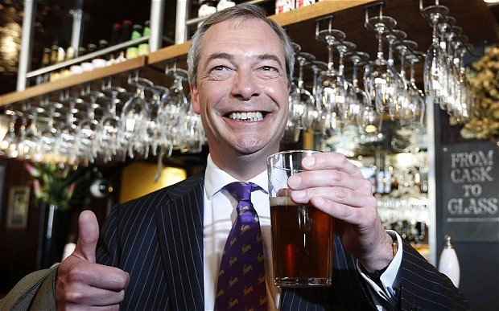
Disproportionality in Winner-Take-All Elections
Disproportionality in winner-take-all elections
VOTES
SEATS
WHY?
France 2002: the center-right UMP
33%
62%
The largest party wins most of the runoffs
Britain 2005: Labour v Conservatives
35.2%, 32.4%
355, 198
Efficient votes: narrow wins in many districts
Nigel Farage, leader of Reform UK and a member of Britain’s Parliament since 2024
Britain 2010: Liberal Democrats
23%
9%
Small parties are punished
Britain 2024: Reform UK
14.3%
5 of 650
So are votes spread evenly across the country
Britain 2024: Plaid Cymru, in Wales
0.7%
4 of 650
Regionally concentrated parties are rewarded
France’s Socialists in 2012: 29% of the vote, nearly half the seats.

Slide 11
The Trade-Off
HANDS UP
From today’s reading: Gallagher and Mitchell
Which matters more to you?
A LOCAL MEMBER AND A CLEAR WINNER
SEATS THAT MATCH VOTES
Single-member districts
One representative for your district
One party usually governs alone, so voters know whom to hold accountable
The price: Parties can win Majorities with even 1/3 of the votes
Proportional representation
Each party’s share of seats is close to its share of votes
More parties in parliament, and a wider range of views
The price: “a coalition government is nearly inevitable,” and it forms after the vote
“With only one level of seat allocation, we are forced to sacrifice a bit of one desirable property in order to get more of the other.”

Slide 12

France: Majority Elections with Runoffs
Single-member districts, as in Britain and the United States
First round: a candidate with a majority wins the seat
No majority: the top two, and anyone over 12.5% of registered voters, advance
Second round: the most votes wins
Third-placed candidates often stand aside
“Vote with your heart in the first round, vote with your head in the second”
Marine Le Pen of the National Rally, a candidate for president of France in 2027

Slide 13
France 2024: First in Votes, Third in Seats
France 2024: votes in the first round, seats after the second
Share of the first-round vote
Seats (bar: share of the 577 seats)
BETWEEN THE ROUNDS
33.2%
Three or more candidates qualified in 311 districts
216 candidates of the left and center withdrew, to unite against the National Rally
Only 91 districts still had more than two candidates
180
28.2%
159
142
21.3%
6.6%
39
National Rally and allies
radical right
New Popular Front
the alliance of the left
Ensemble
President Emmanuel Macron’s alliance
Republicans
center-right
577 seats, 289 for a majority: no bloc has one. The party that came first in votes came third in seats.

Slide 14
Proportional Representation
Most European countries use proportional representation (PR)
The share of seats roughly equals the share of votes
  How closely depends on the size of the districts and on thresholds
Several parties in parliament, and a wider range of views
Easier for new parties to form and win seats
Frequent coalition governments

Slide 15
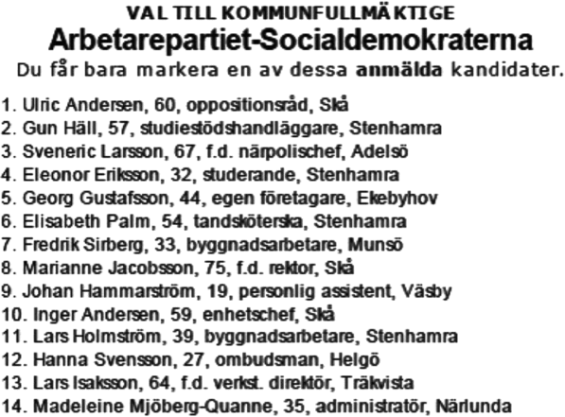
Open List or Closed List
From today’s reading: Gallagher and Mitchell
Closed lists (Spain, Portugal): the party sets the order
  Wins 15 seats: the first 15 names are elected
Open lists (Finland, Poland): voters’ preference votes decide who is elected
Flexible lists (Sweden, the Netherlands): the party ranks, but a candidate with enough personal votes moves up
Hands up: who should rank a party’s candidates, the party or its voters?
A Social Democratic ballot for a Swedish municipal council: “You may mark only one of these candidates”

Slide 16
Threshold or Not?
ACTIVITY
From today’s reading: Gallagher and Mitchell
Threshold or not?
The case for a threshold: “preventing excessive fragmentation and thereby making it easier to form stable governments.”
THE NETHERLANDS: NO THRESHOLD
GERMANY: 5%
TURKEY, 2002: 10%
0.67% of the vote wins a seat
15 parties won seats in 2025
The largest has 26 of 150 seats
Forming a government took 117 days
Or win three districts
2025: the BSW won 4.98% and no seats. It was 9,529 votes short
13.9% of voters chose a party that won no seats
With the BSW in, today’s two-party government would have no majority
Two parties cleared
46% of votes went to parties that won no seats
The winner, the AKP, took 66% of the seats with 34% of the vote
The threshold has been 7% since 2022
What threshold should tonight’s election have?
.

Slide 17
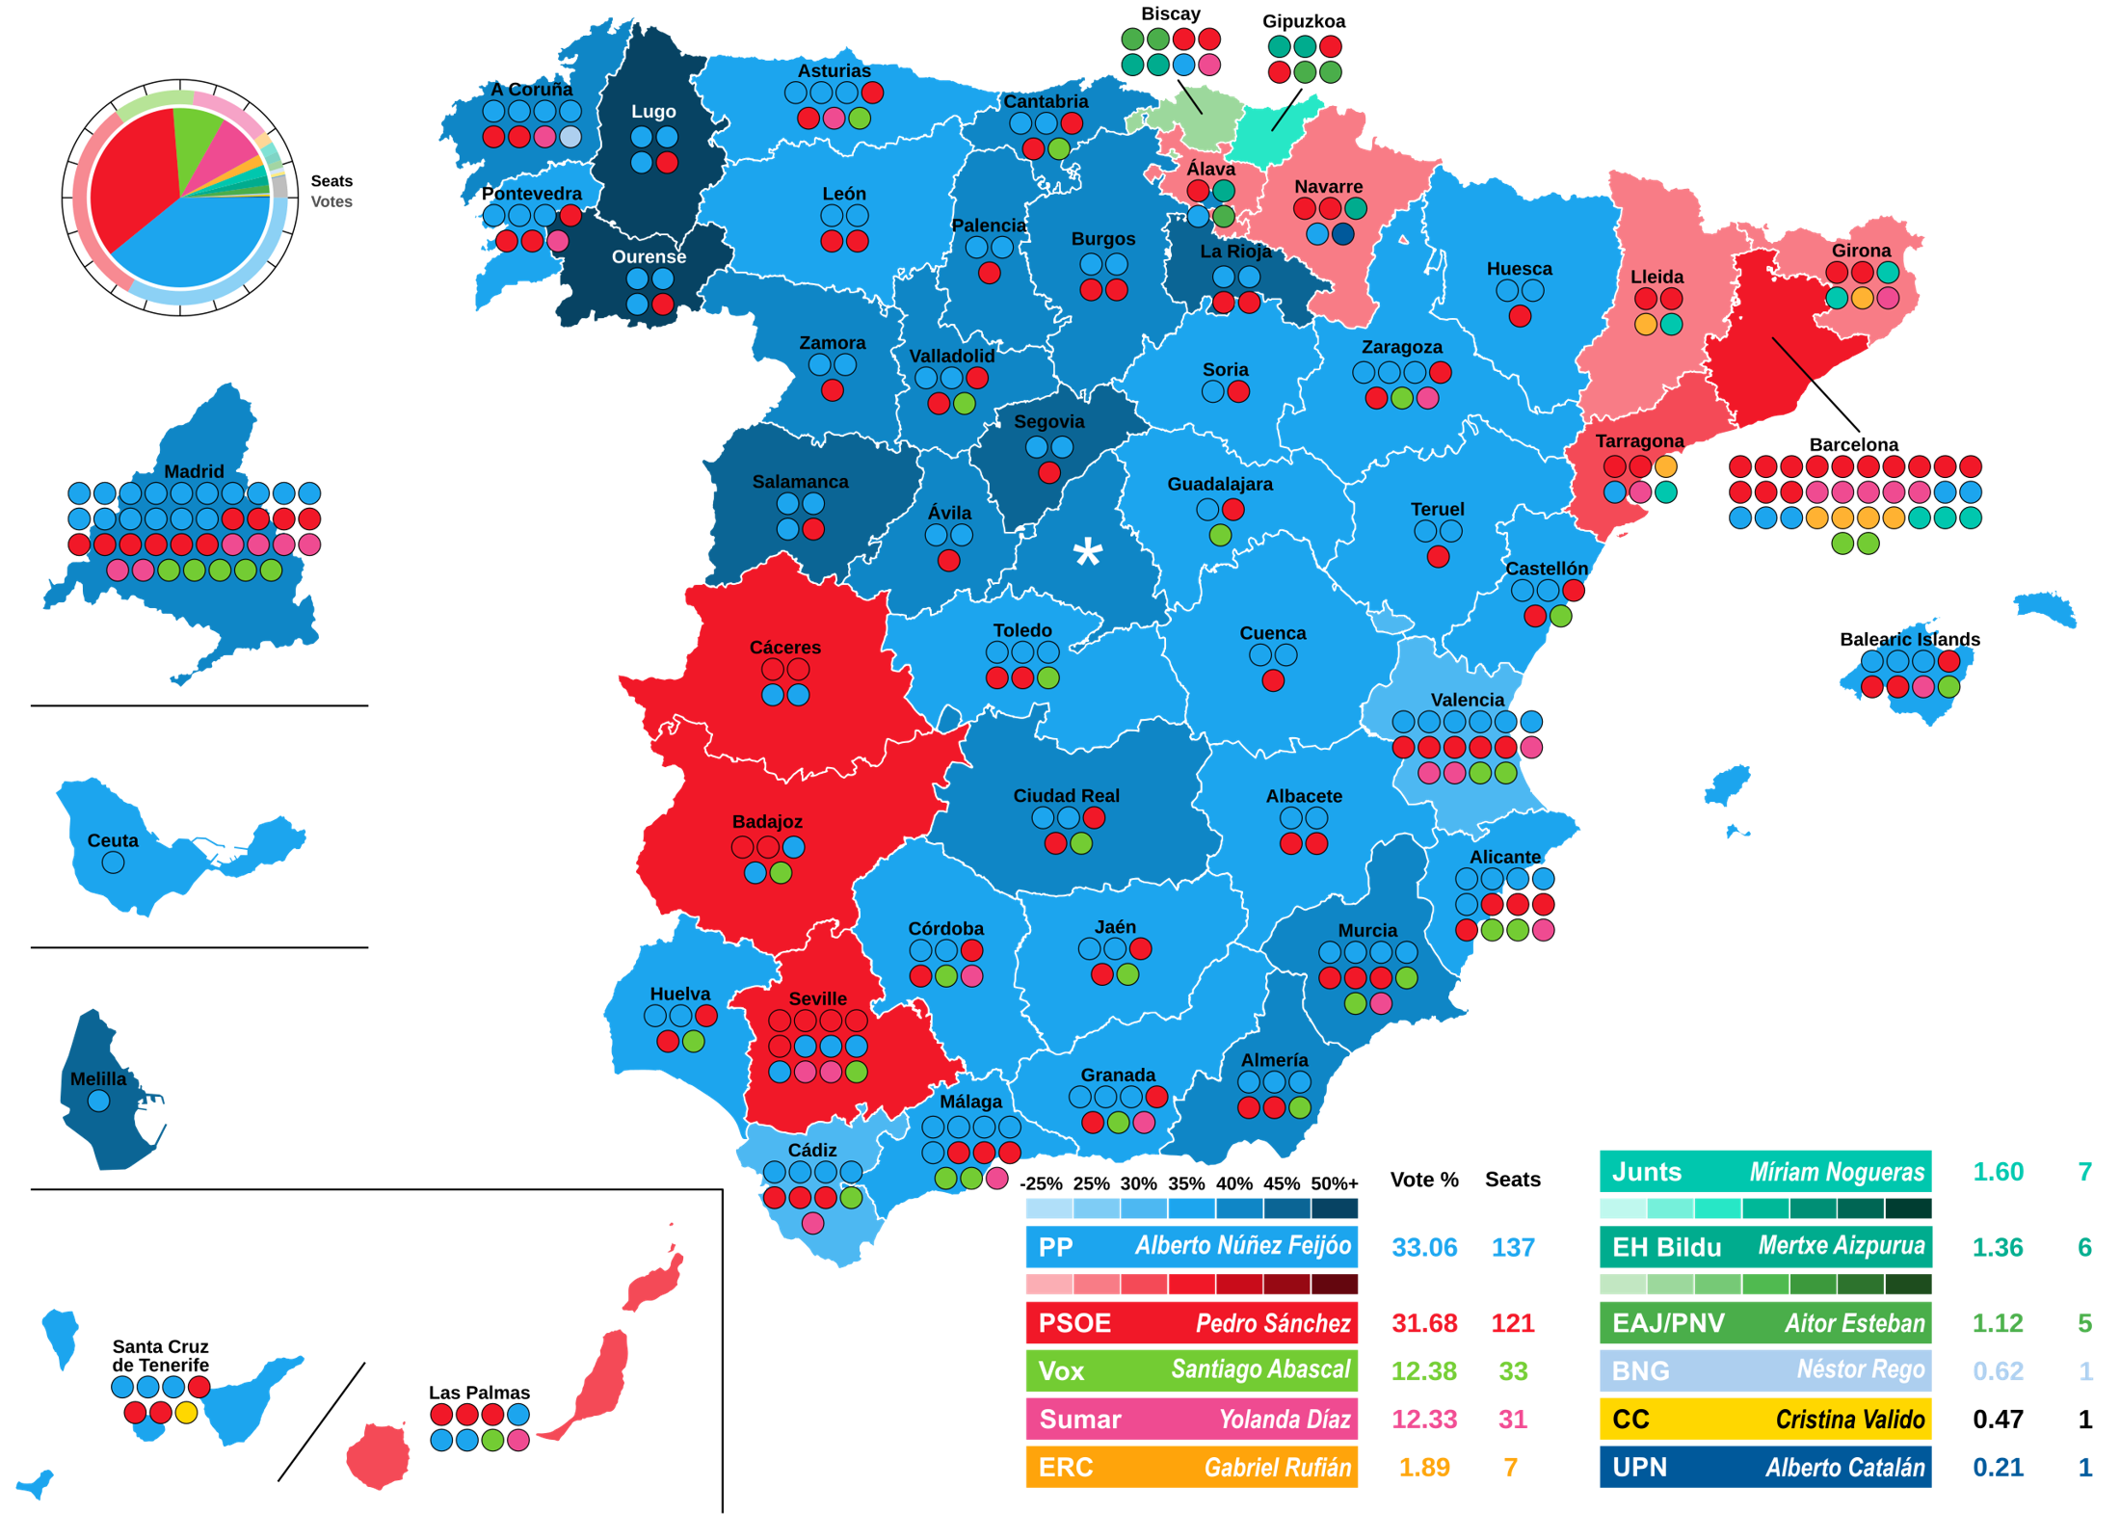
Spain’s Hidden Threshold
From today’s reading: Gallagher and Mitchell
Spain’s hidden threshold
350 seats in 52 districts
6.7 seats per district on average
THE EFFECTIVE THRESHOLD
About 75 ÷ (seats + 1)
2 seats: 25% of the vote
5 seats: 12.5%
10 seats: 6.8%
37 seats (Madrid): 2%
2023
The People’s Party: 33.1% of the vote, 39.1% of the seats. Vox: 12.4% of the vote, 9.4% of the seats.
Spain implicitly has a threshold by splitting into 52 electoral constituencies

Slide 18
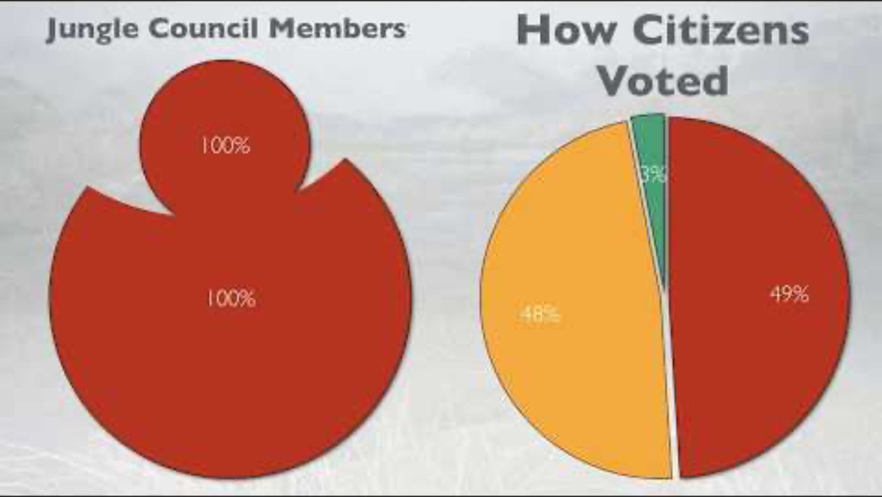
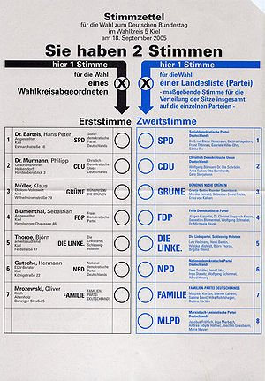
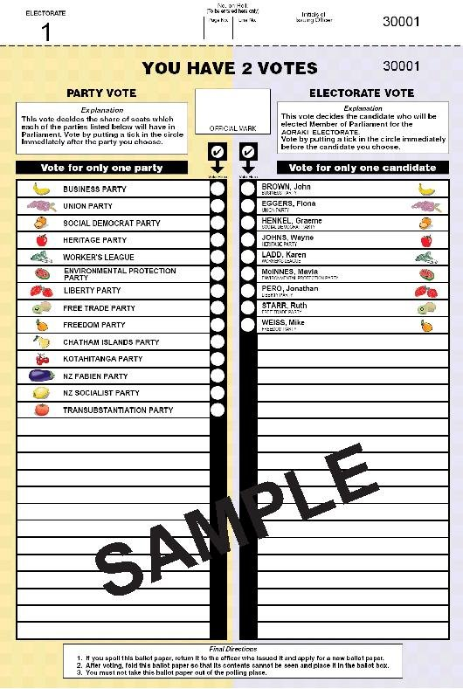
MMP Explainer
Mixed-member proportional representation: two votes
Germany, 2005: the first vote is for a district candidate, the second for a party
New Zealand: a party vote and an electorate vote
Mixed-Member Proportional Representation Explained
CGP Grey · ▶ Plays in full
Both ballots begin with the same words: “You have 2 votes.”
Click the card to play · fallback: youtube.com/watch?v=QT0I-sdoSXU

Slide 19
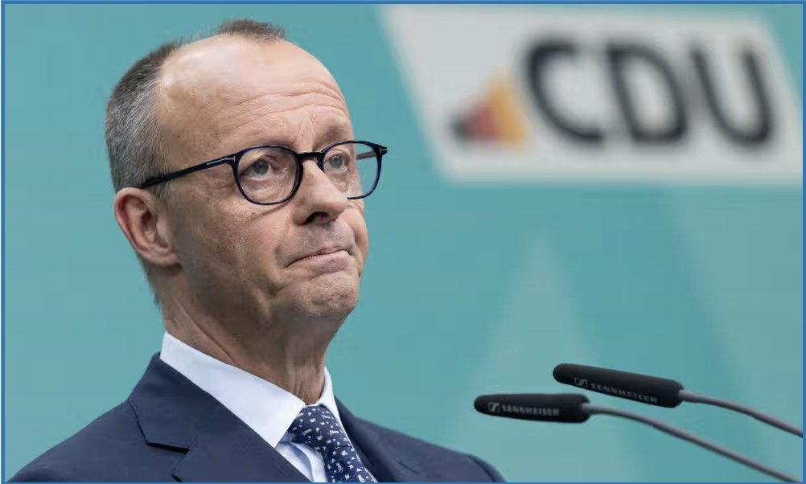
Mixed-Member Systems: The Best of Both Worlds?
From today’s reading: Gallagher and Mitchell
You get a local member from your first vote
List seats bring each party up to its share of the party vote
Gallagher and Mitchell: a way to “have our cake and eat it”
Germany since 2023: 630 seats, shared out by the party vote alone
  In 2025, 23 district winners got no seat
How important is local representation?
Friedrich Merz (CDU), chancellor of Germany. Fifteen CDU district winners got no seat in 2025

Slide 20
Same Votes, Three Parliaments
ACTIVITY
Same votes, three parliaments: Britain, 2024
In pairs, before the click: 650 seats. Labour won 33.7% of the vote and Reform UK 14.3%. How many seats each, if seats matched votes?
First past the post: the real result
Seats in proportion to the votes cast
A mixed system like Germany’s (a model)
411
326 seats: a majority
219
228
154
139
121
93
100
72
79
73
71
44
5
4
9
16
16
Labour
33.7% of the vote
Conservatives
23.7%
Reform UK
14.3%
Liberal Democrats
12.2%
Greens
6.7%
Scottish National Party
2.5%
The mixed-system column is the Electoral Reform Society’s model, built from a survey of how people would vote under those rules. 28% said they had voted tactically in 2024.

Slide 21

America’s Two-Party Problem
“In any other country, Joe Biden and I would not be in the same party.”
  Alexandria Ocasio-Cortez, Democratic representative from New York, in 2020, when Biden was running for president
In 2024, fewer than 10% of U.S. House races were competitive
A proposal: bigger districts that elect several members each, in proportion to the vote
The New York Times, January 14, 2025

Slide 22
Georgia: 14 Seats, Two Ways to Fill Them
From today’s reading: Horne and Oldham
Georgia: 14 seats, two ways to fill them
TODAY: 14 SINGLE-MEMBER DISTRICTS
THE PROPOSAL: PROPORTIONAL DISTRICTS
R
R
R
R
R
R
R
+
R
R
D
D
D
D
D
2 statewide top-up seats
4 seats
4 seats
4 seats
9 Republicans, 5 Democrats
in a state that votes about 50–50. Competitive seats: zero.
7 Republicans, 7 Democrats
on every simulated map: the same as the state’s vote.
HARDER TO GERRYMANDER
MINORITY VOTERS
THE OBSTACLE
Moving voters from one district to another no longer moves seats
A group with 20% of a district’s voters, voting together, can elect a candidate
A 1967 federal law requires single-member districts for the U.S. House

Slide 23
Draw the Districts
ACTIVITY
From today’s reading: Horne and Oldham
Draw the districts: 25 voters, 5 districts of 5
Purple has 10 voters and Orange has 15. In pairs: draw five districts of five neighboring voters each, so that Purple wins the most districts.
ONE DISTRICT, FIVE SEATS
Proportional rules
Orange 3 · Purple 2
There are no lines to draw.
By row
Orange 3 · Purple 2
By column
Orange 5 · Purple 0
Can we draw one for purple?
Orange 2 · Purple 3
“Proportional districts cannot be manipulated like single-winner districts, where parties can win more seats simply by shifting voters between districts.”

Slide 24
Key Points
Electoral systems turn votes into seats, and politicians choose them
The fewer seats per district, the further seats stray from votes
Duverger’s law: a mechanical effect and a psychological effect
Every system trades proportionality against local representation and fewer, larger, parties
Under debate this year: Britain, Italy

