Slide 1
POSC 3710: European Politics
9/9/2026: A Europe of Nations? Nations and Nationalism
Dr. Will Horne
Clemson University

Slide 2
Election Watch: Saxony-Anhalt
Saxony-Anhalt (Germany) voted on Sunday
2021
6 Sept 2026
Share of party-list votes
Details
AfD
20.8
43.8
CDU
37.1
Turnout 77.8%, up from 60.3% in 2021. The highest since reunification
The AfD won 38 of the 41 districts. In 2021 it won one district
The CDU won 40 districts in 2021. This time it won none
The three districts the AfD lost are in Magdeburg and Halle. The Left won them
17.2
SPD
8.4
9.3
Greens
5.9
8.9
Left
11.0
8.6
BSW
did not exist
5.3
FDP
6.4
2.6
Seats in the new Landtag: 83
AfD 39
CDU 15
SPD 8
Greens 8
Left 8
BSW 5
Majority: 42 seats. The AfD has 39 as does the non BSW opposition
Preliminary official result, Landeswahlleiterin Sachsen-Anhalt (7 Sept 2026);. Landtag: 41 districts plus list seats, 5% threshold.

Slide 3
What Happened, What Next
The AfD doubled its vote and won 38 of 41 districts. The CDU colappsed
The state lists the AfD as right-wing extremist.
Most parties will not consider working with AfD (BSW less clear on this)
The CDU rules out working with AfD and Die Linke.
Possible outcomes
  BSW supports AfD
  BSW + the rest of the parties form an anti-AfD government
  New Elections

Slide 4
The AfD Across Germany
The AfD in every state election since 2024
Eastern states (former GDR)
Western states
43.8%
32.8%
30.6%
29.2%
Bundestag election, Feb 2025
20.8% nationally
18.8%
19.5%
7.5%
Thuringia
Sept 2024
Saxony
Sept 2024
Brandenburg
Sept 2024
Hamburg
Mar 2025
Baden-
Württemberg
Mar 2026
Rhineland-
Palatinate
Mar 2026
Saxony-Anhalt
Sept 2026
Share of party-list votes, state election authorities; Saxony-Anhalt preliminary. Germany has been one state since 1990. Why does the east vote so differently?

Slide 5
Three Nations Without States
Nations don’t always have states
SCOTLAND
CATALONIA
CORSICA
Contested Support
Independence Referendum in 2014: No gets 55%
Support for Independence seems to have increased after Brexit
May 2026: SNP and Greens take 73 of 129 seats
  The largest pro-independence majority ever elected
Scottish Parliament voted 72–55 for anew referendum. Westminster said no
The fragmentation problem
Catalan parliament declares itself sovereign in 2013
  Independnce Referenum in 2014, 80% yes on 40% turnout. Not sanctioned by Spanish state
In recent years, support for independence appears to have fallen
  Polling shows it close, Catalan politics more fragmented
Not the only movement for independence in Spai
Autonomy over Independence
June 2026: the Assemblée votes 271–202 for autonomy
Autonomy added to the constitution, inside the French Republic
  Corsican recognised as a historic community
Still needs the Senate and a Congress at Versailles
Why do these independence movements exist? What do they want?

Slide 6
Who counts?
Italy, March 2026: automatic citizenship by descent ends
Swiss Referendum tries to cap population
France: naturalization now requires advanced French
All trying to figure out who counts as a member of the national identity
  And who is legally a member of the nation-state?

Slide 7
Where We Left Off
Last week: how European states rebuilt themselves after 1945
  Nation-States gave up sovereignty to facilitate it
But we skipped a question…
  What is a nation, and where did it come from?
Today: What is national identity? Where does it come from?
And: Why are there so many European nations without their own state

Slide 8
Opening Discussion
What makes you a member of a nation?
  Can you choose? What are the limits on this choice?
Is there anything you would call an American tradition that is actually old?
What would Scotland gain by becoming a state that it does not have now?
Nations can exist without states: Can a state exist without a nation?

Slide 9
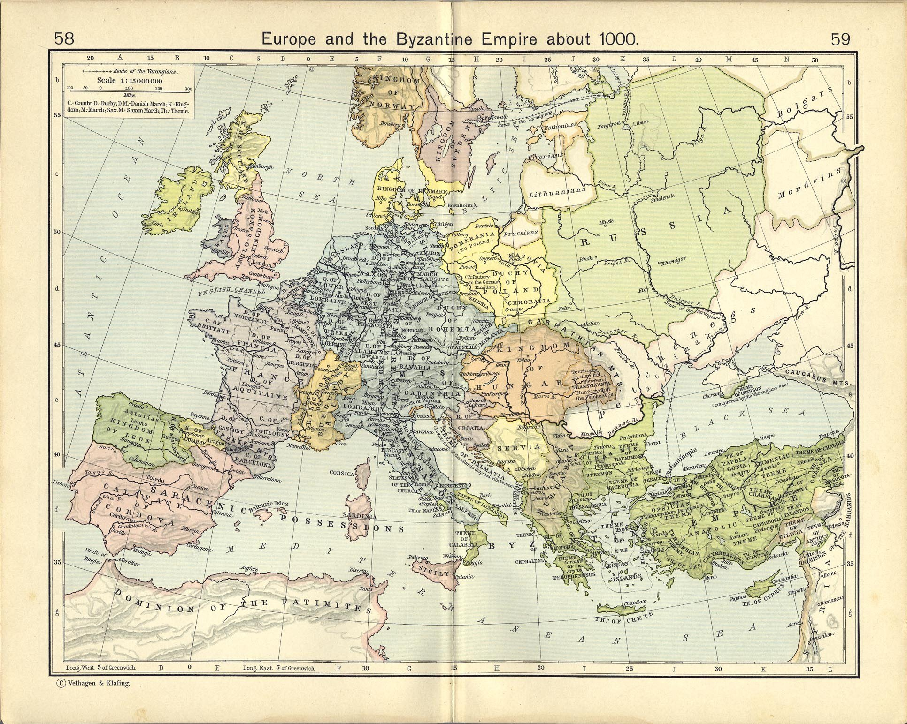
Europe Before Nations

Slide 10
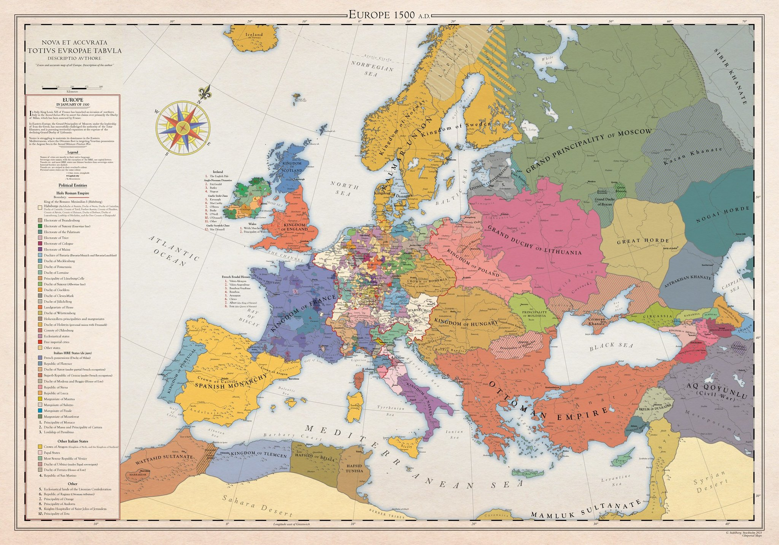
Europe in 1500

Slide 11
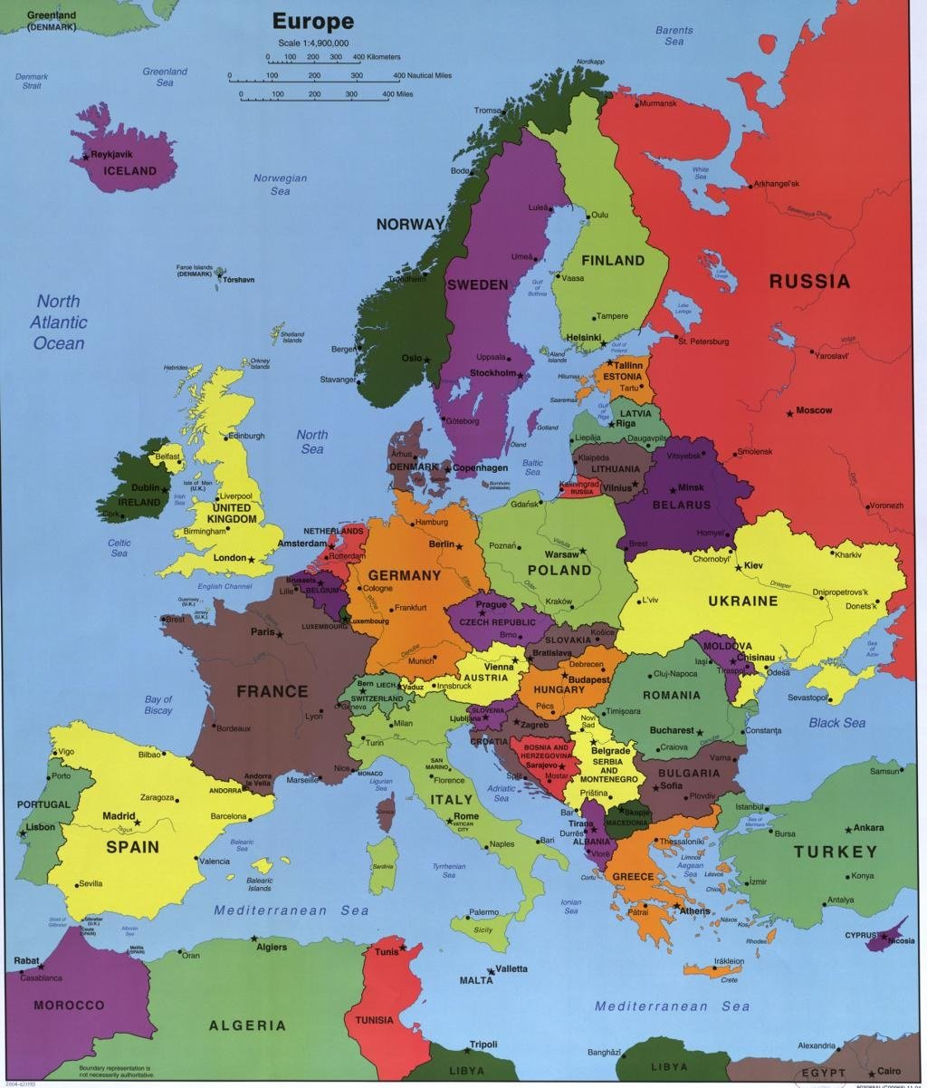
Europe Today

Slide 12
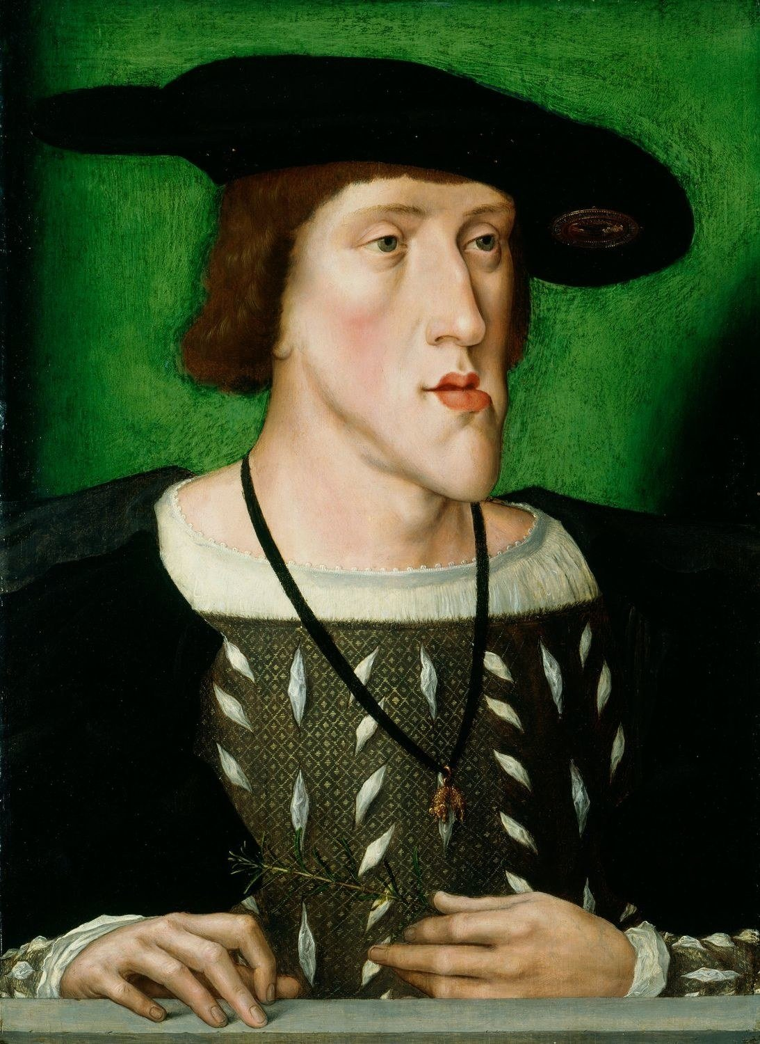
Charles V: Ruling Before Nations
Charles V: Ruling Before Nations
Ruled a collection of separate kingdoms at once
  Crowned separately in each, on different terms
Holy Roman Emperor, but also count, duke, king
  His authority differed in every territory he held
Language and culture were not the determinants

Slide 13
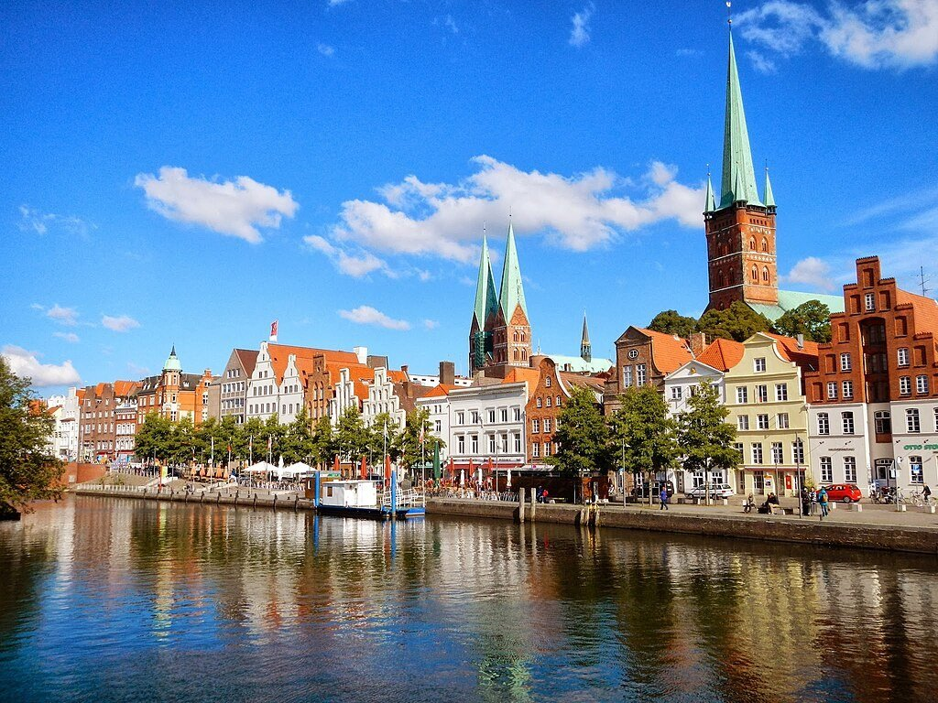
Free Cities and the Hanseatic League
Free Cities and the Hanseatic League
A trading network, not a territory
From Belgium in the west to Russia in the east
Cities taxed, raised armies, made war and treaties
Members of empires and of the League at once
Overlapping authority was normal, not a crisis

Slide 14
Popular Sovereignty, 1789
Under the old regime, legitimacy came from God and dynastic inheritance
Louis XIV: “L’état, c’est moi”
In 1789 the French Third Estate declared itself a National Assembly
  Claimed to represent the French nation, not the kingdom
Today we assume legitimacy comes from the people. But who are they?

Slide 15
France: State to Nation
Revolutionaries claimed to speak for “the French nation”
  Most people inside France would not have thought themselves part of it
So, the state set out to make (imagine) a nation
  Schools, conscription, railways, a standardised language
A state built with the purpose of constructing a nation

Slide 16
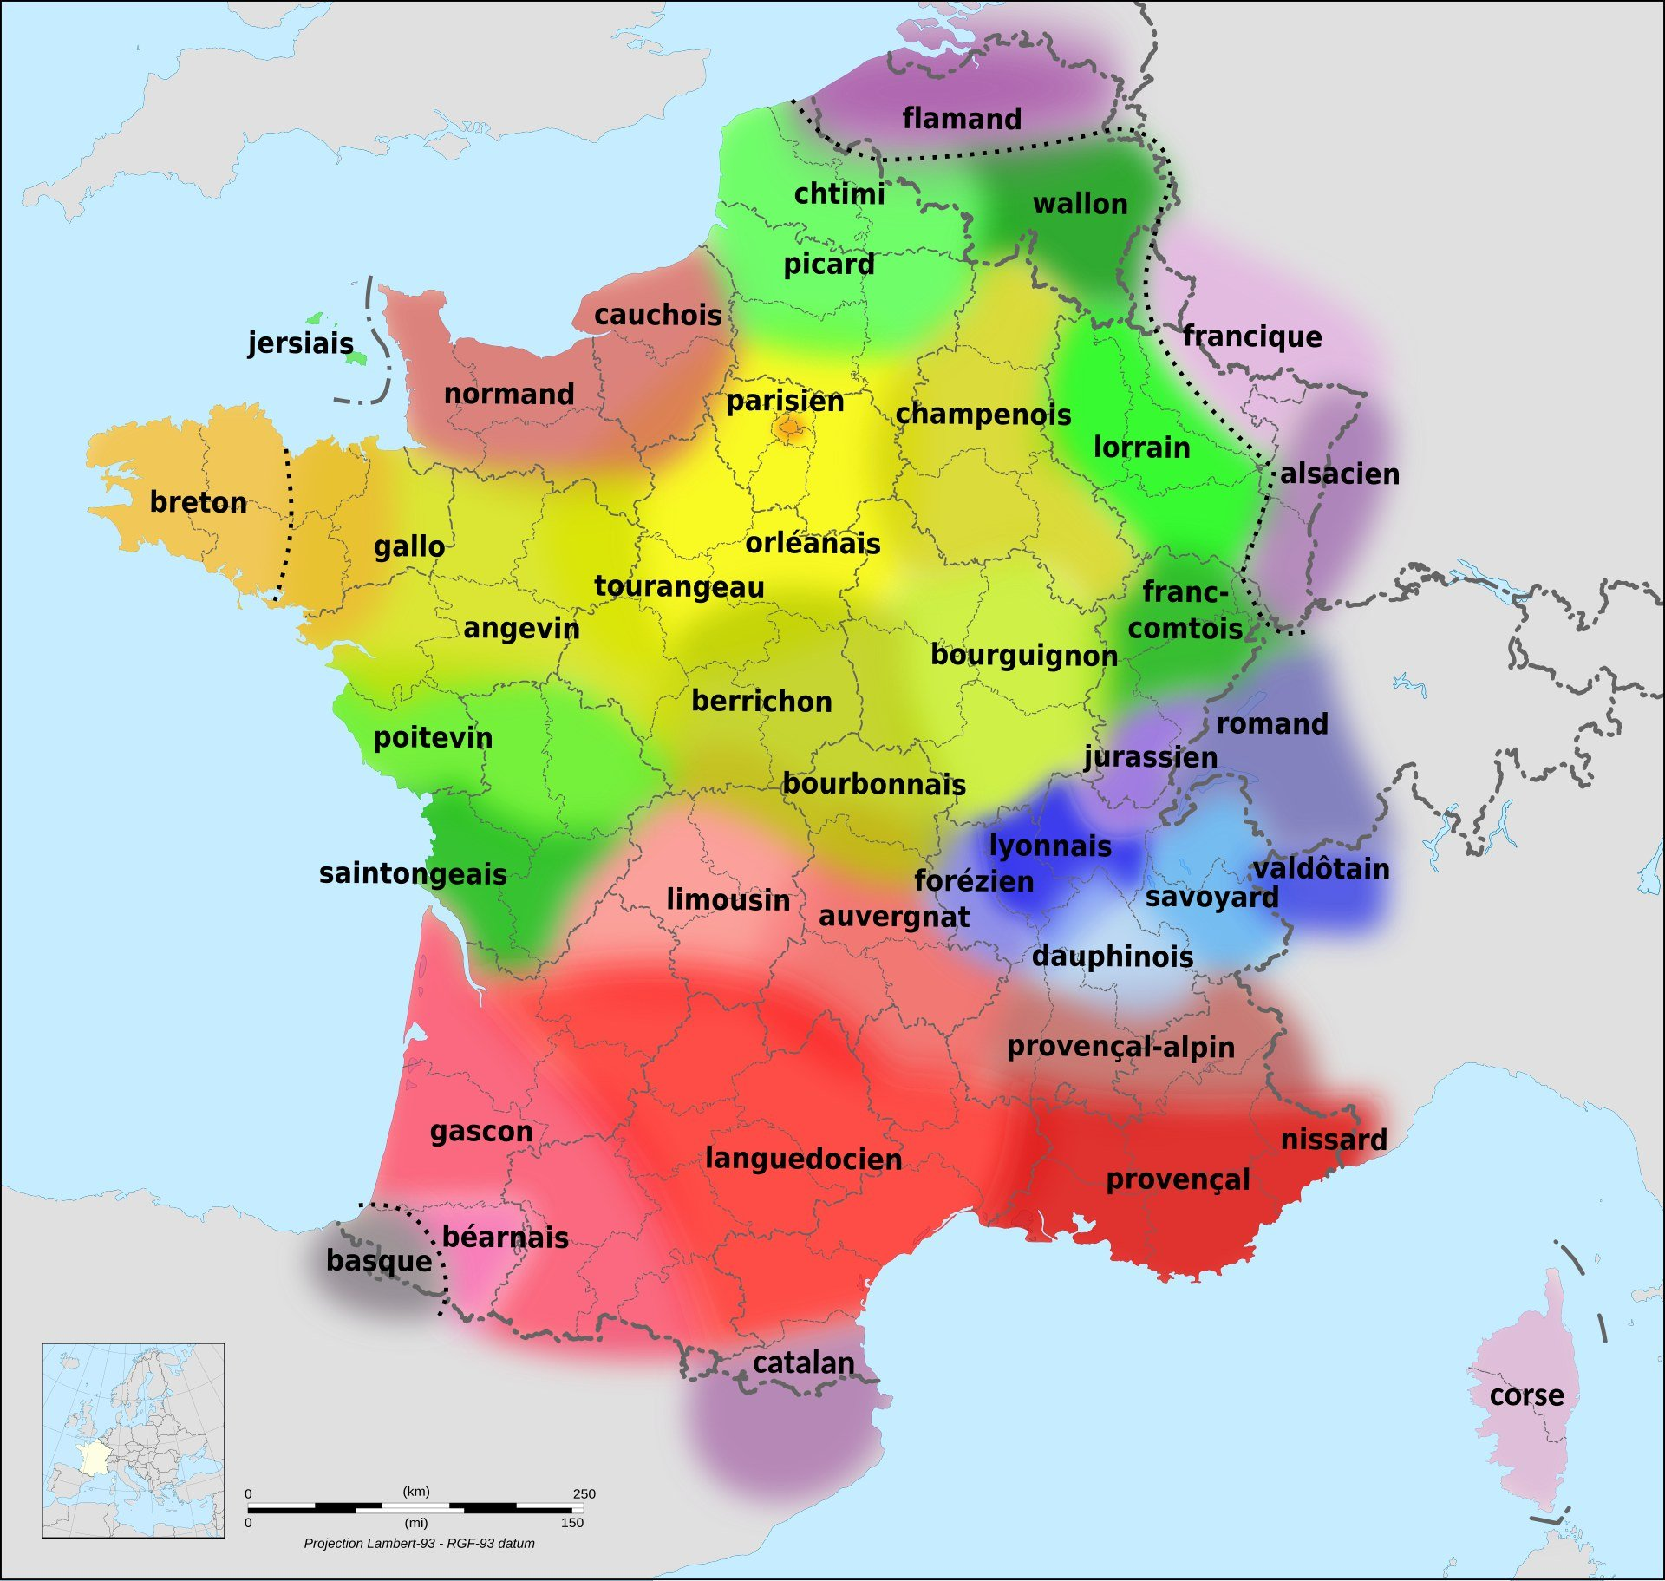
Who Actually Spoke French

Slide 17
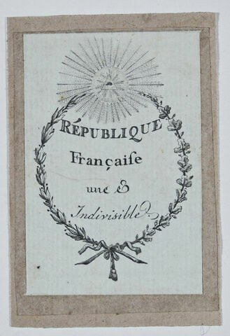
One and Indivisible

Slide 18
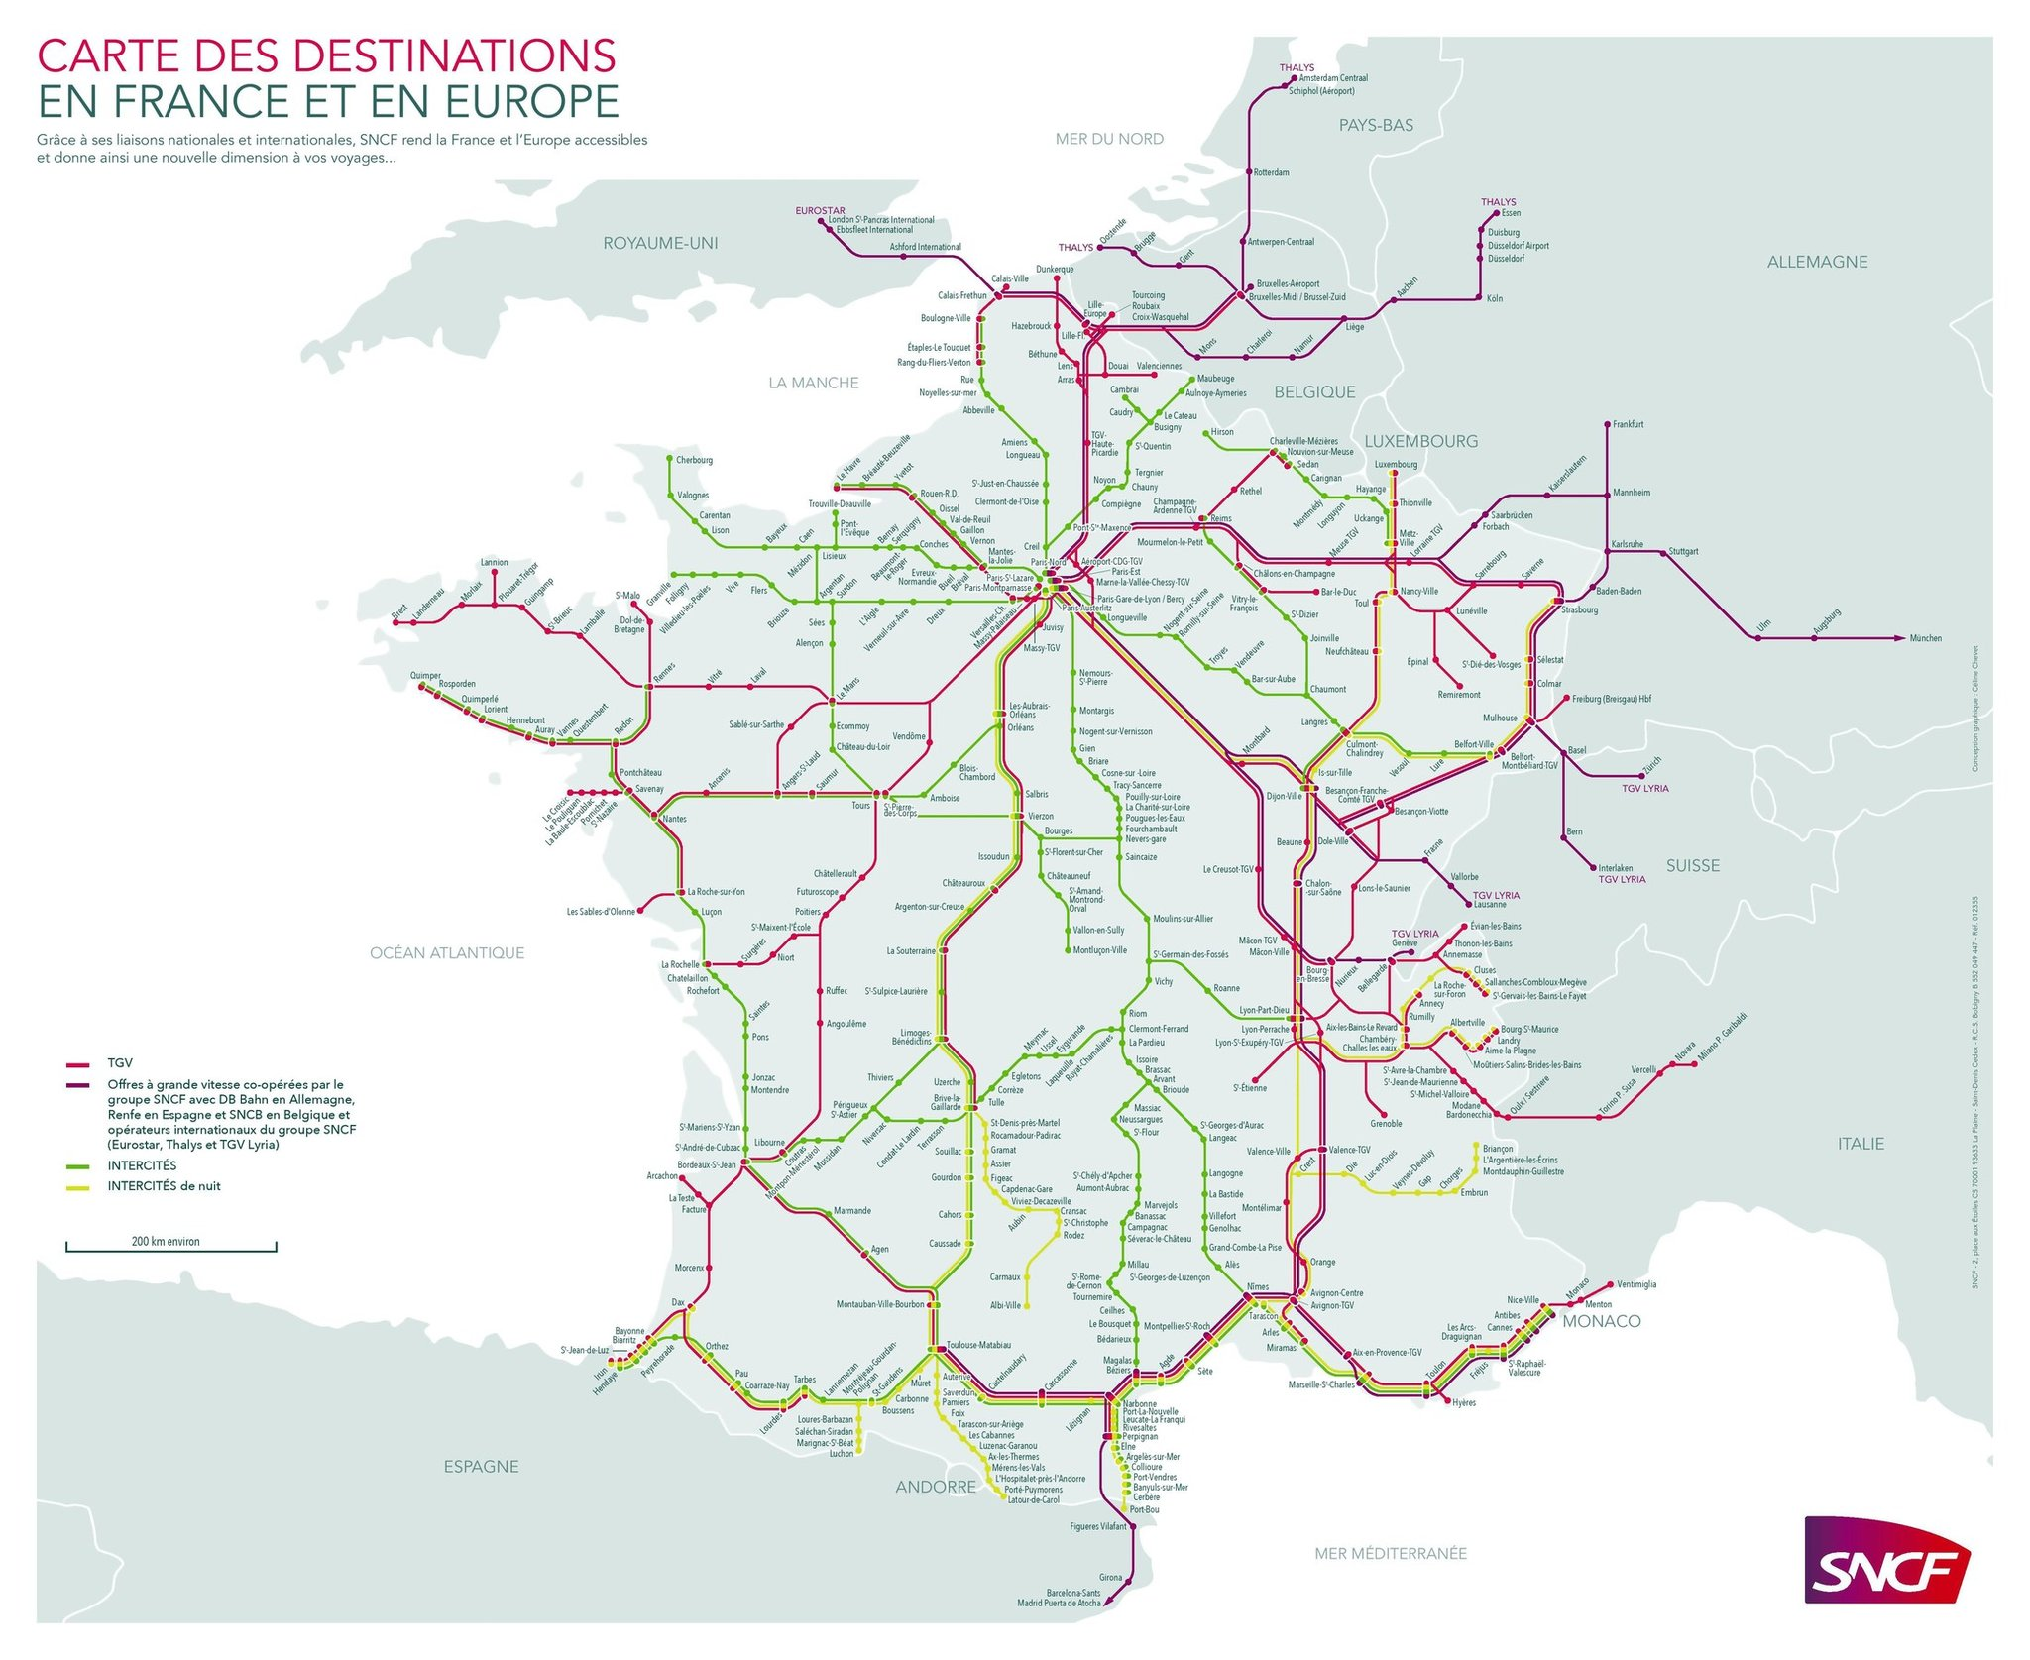
Connecting the Country

Slide 19
Germany: Nation to State?
The Holy Roman Empire was hundreds of states, loosely joined
  Dissolved by Napoleon, leaving a power vacuum
German intellectuals answered with cultural nationalism
No single state existed to make Germans the way France made Frenchmen
  But France provided a template for German intellectuals
So the nation was imagined first, and the state built to house it

Slide 20
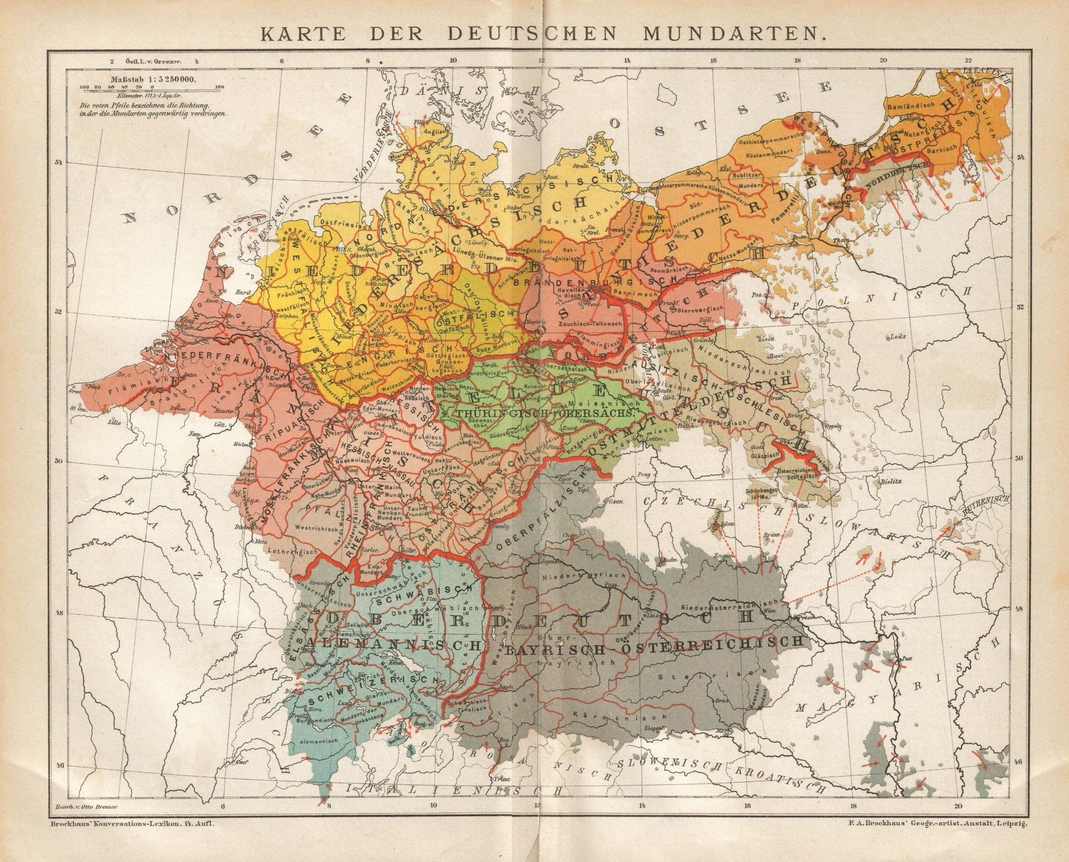
German Dialects, 1894

Slide 21
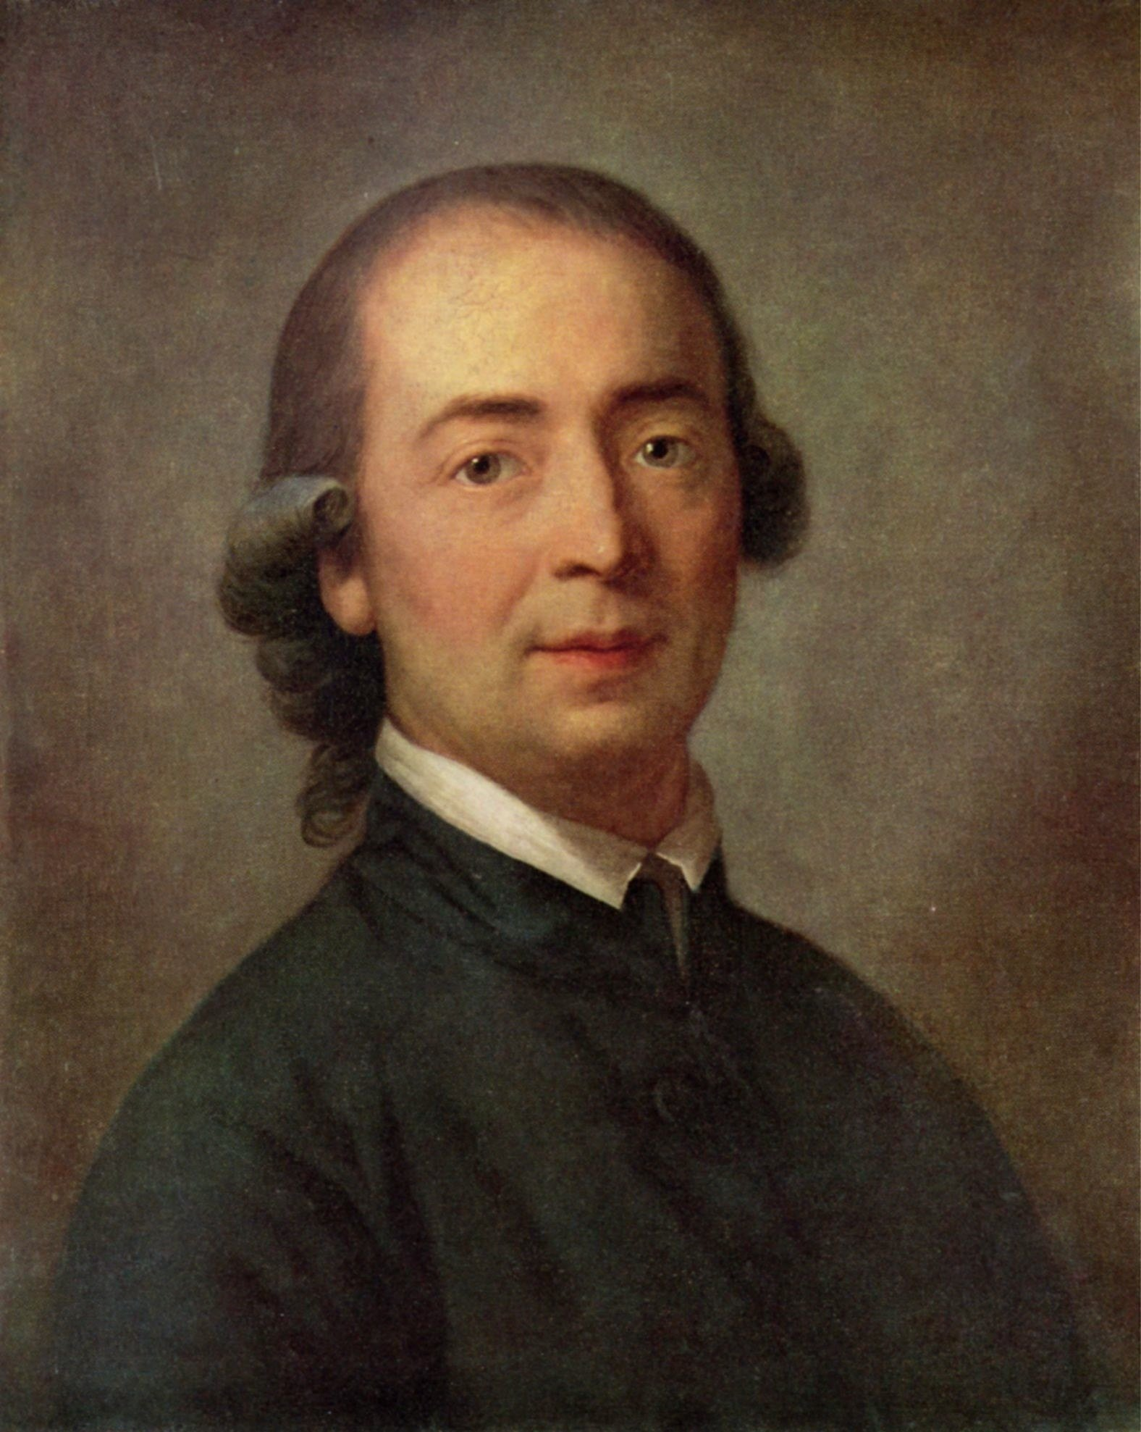
Herder and the Volk
Herder and the Volk
Johann Gottfried Herder, 1744–1803
The Volksgeist: a people’s distinctive spirit
Nations as natural, organic, and pre-political
Made by language, folk tradition, shared heritage
The opposite of the French approach

Slide 22
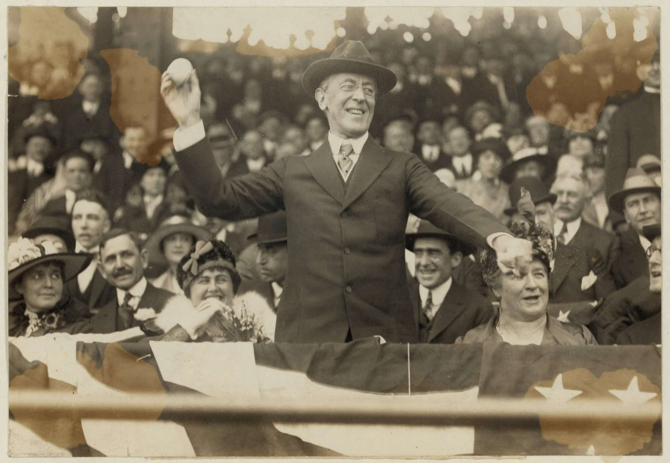
The Nation-State Becomes Natural

Slide 23
Competing Theories: Primordialists and Modernists
Primordialists: nations are ancient, organic, "discovered"
This is how nationalist movements describe themselves
Serbia dates itself to Kosovo in 1389; Greece to Athens
Modernists: nations are recent, and made
Anderson and Gelner (and most historians/political scienctists) are modernists
  Most people are unknowingly primordialist

Slide 24
Gellner on Nationalism
“Nationalism … holds that the political and the national unit should be congruent”
Where does it come from: Capitalism and Modernity
Industry needs a mobile, literate, interchangeable workforce
  Needs one standard culture, taught in schools
  Only a state can run an education system that big
So nationalism is an effect of modernity + industry

Slide 25
Anderson: Imagining Nations
Sacred languages decline
  Latin gives way to the vernacular (the languages that people
Printing Press + Mass mediaturns vernaculars into markets
A print language creates a field of people who read together
  Newspapers make strangers share a single day’s events
Identity forms around who you read with and about

Slide 26
Anderson’s Key Insights
The nation is “an imagined political community”
  What does he mean by that?
Limited: every nation has a boundary and an outside
Sovereign: born in the age of revolution, against divine right of kings
A community: “a deep, horizontal comradeship”

Slide 27
The Invention of Tradition
Hobsbawm and Ranger (Optional): national traditions are often recent
Trevor-Roper (optional) on Scotland: the kilt and the tartan
  He dates the small kilt to 1727, and an Englishman
  Clan tartans: a nineteenth-century commercial invention
  My extended family would be very upset to hear about this!
Invented tradition works by looking ancient

Slide 28
Two Kinds of Nationalism
Theorists point to two different nationalisms
CIVIC
ETHNIC
Membership by
consent
Built on citizenship and shared political values
In principle open to anyone who accepts them
The French revolutionary claim
  American tradition as well
Scotland’s movement describes itself this way
Membership by
descent
Built on ancestry, language, cultural inheritance
You are born into it, or you are not
  You can’t become German
Herder’s claim of an organic nation
This is how populist right movements often discuss the nation
Burt…France suppressed its regional languages for a century; Germany has had birthright citizenship since 2000.

Slide 29
Back to the Cases
Scotland: a civic claim, and some autonomy already
Catalonia: still a minority, and splitting on immigration
  Basque independence movement has largely lost momentum
Corsica: autonomy inside the Republic, not exit
How do the theories we’ve read and discussed related to these national movements?

Slide 30
Discussion
If nations are made, does that make national feeling less real?
Gellner says industry needs one culture.
  Do we have a shared global culture now? What are the implications?
Should a state be allowed to decide who counts as a member of its national community?
What would it take to make a new European nation today?

Slide 31
Where We Go Next
9/14: Christian Democracy and Social Democracy
  The middle paths between Hayek’s laissez-faire Liberal Capitalism and Marx’s central planning/communism
9/16: the EU: a political order that is above the nation-state
November: Immigration and the radical right
  Policing national boundaries

Slide 32
The Federal Republic of Clemson
Get into your party groups
Introduce yourselves and start discussing party strategy
Your manifesto is due Wednesday 9/30 (3 weeks)
Does your party have a story about who the FRC is for?

