Slide 1
POSC 3710: European Politics
10/7/2026: European Party Systems
Dr. Will Horne
Clemson University

Slide 2
Final Times of Clemson Poll
Christian Democrats (26%)
Social Democrats (24%)
Populist Right (18%)
Greens (15%)
Liberals (12%)
Radical Left (5%)
Remember, this is a poll, it may be wrong!

Slide 3
Where We Left Off
Before the Midterm: presidents, prime ministers, and how governments can be replaced
In a parliamentary system, the government is made of parties
  Even more so than in the US; and the parties have more power
Today: What are parties, exactly? What is a “party system?”

Slide 4
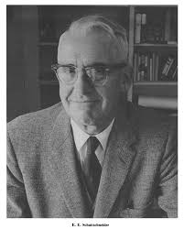
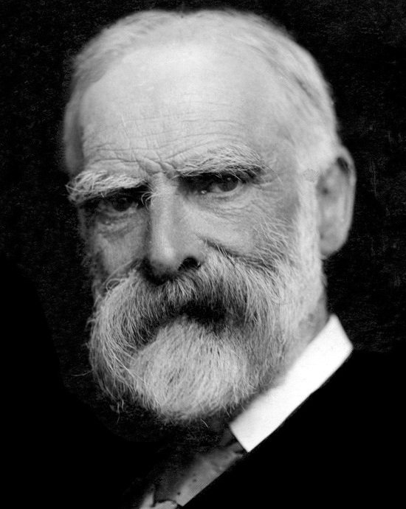
Parties and Democracy
“The political parties created democracy and … modern democracy is unthinkable save in terms of the parties.”
“Parties are inevitable. No free large country has been without them. No one has shown how representative government could be worked without them.”
E. E. Schattschneider, American political scientist, 1942
James Bryce, British scholar and ambassador to the United States, 1921
Today’s reading from Katz and Mair asks:
if “the parties are being fundamentally transformed, what happens to modern democracy?”

Slide 5
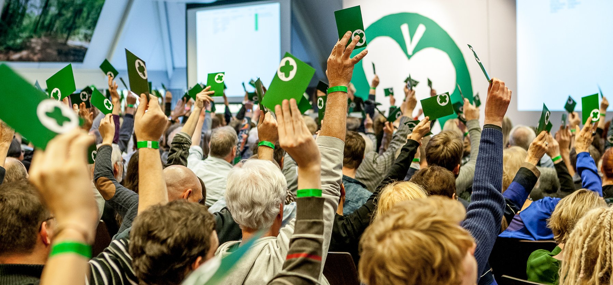
What Is a Political Party?
Anyone want to try to define it?
A reasonable minimalist definition:
  “Political parties are organizations that recruit candidates to contest elections in the hope that they can participate in government, or at least push it in the direction of their own ideas.”
Basically, they are social organizations that seek election
Many different types, in structure and in ideology
  Some try to win, some try to get a few seats
  Some have narrow electoral bases. Others try to appeal to the whole electorate.
The Dutch Partij voor de Dieren (Party for Animals) annual congress

Slide 6
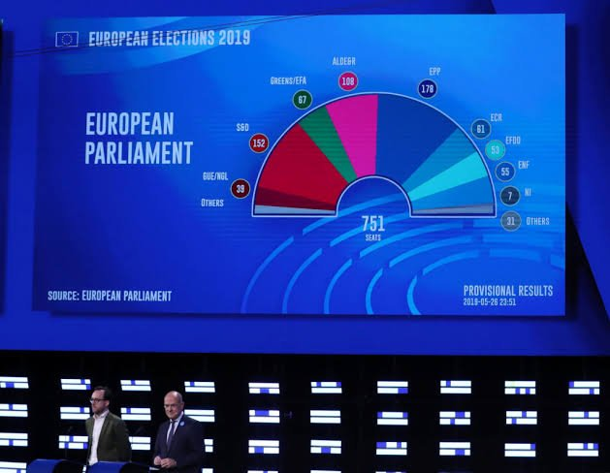
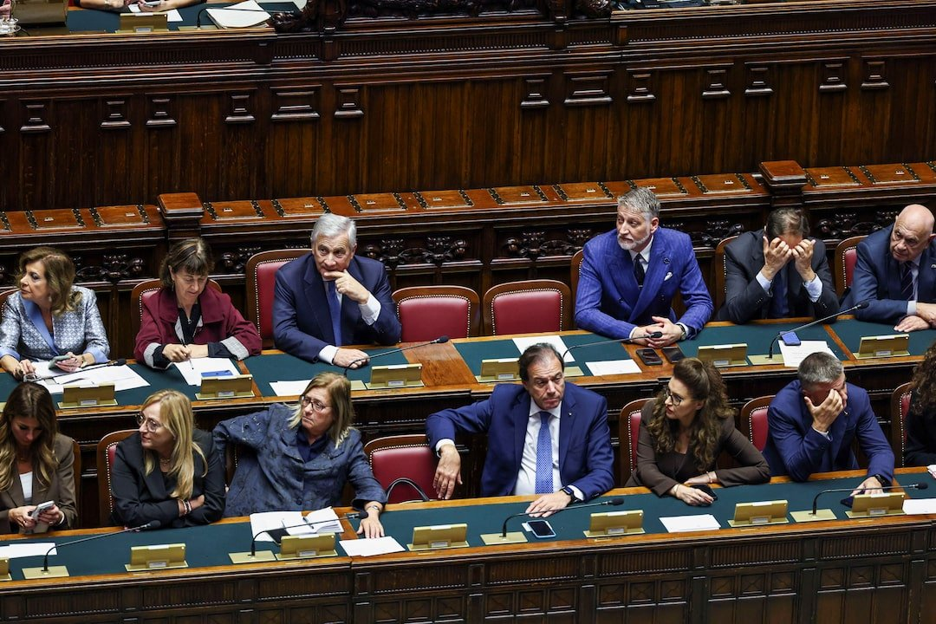
(Why) Do We Need Parties?
Parties mediate between citizens and the state
  The state might otherwise act only for those who control it
Parties structure the political agenda
  They give voters a menu of choices
Parties recruit, select and socialize political candidates
Parties represent socially and culturally significant interests
  And aggregate them into a coherent bundle
Parties form governments

Slide 7
Guess the Number: Parties
How many parties won seats in the Dutch parliament in October 2025?
A
4
B
7
C
11
D
15
D
15
In government: D66, VVD and CDA, 66 of 150 seats
26
26
22
20
18
9
7
4
3
3
3
3
3
2
1
D66
PVV
VVD
GL–PvdA
CDA
JA21
FvD
BBB
Denk
SGP
PvdD
CU
SP
50PLUS
Volt
150 seats, so a majority is 76. The largest party won 26. Prime Minister Rob Jetten of D66 leads a minority government. The United States House has two parties.

Slide 8
Party Families
Party families, roughly from left to right
EXAMPLES
IN THE EUROPEAN PARLIAMENT
IN THE FRC
Radical Left
Die Linke (Germany), France Unbowed
The Left
Radical Left (RLP)
Social Democratic
SPD (Germany), Labour (Britain), PSOE (Spain)
Socialists and Democrats
Social Democrats (SD)
Green
Greens (Germany), GroenLinks (Netherlands)
Greens/EFA
Greens (GP)
Agrarian
Centre Party (Sweden), Centre Party (Finland)
Mostly Renew Europe
Liberal
VVD and D66 (Netherlands), FDP (Germany)
Renew Europe
Liberals (LP)
Christian Democratic
CDU/CSU (Germany), ÖVP (Austria)
European People’s Party
Christian Democrats (CD)
Conservative
Conservatives (Britain), Republicans (France)
European People’s Party; ECR
Radical Right
National Rally (France), AfD (Germany)
Patriots for Europe; ECR; ESN
Populist Right (PR)
Political scientists group parties into families to compare across countries. Some parties, like regional or single-issue parties, are hard to classify.

Slide 9
Where the Families Come From
From today’s reading: Ford and Jennings
Four cleavages, frozen into party systems
WHO AGAINST WHOM
THE PARTIES IT PRODUCED
Center vs. periphery
The national culture against ethnic, linguistic and religious minorities, often in outlying regions
Regional parties; Belgium’s parties, split by language
Church vs. state
The church defending its historic powers against a growing state
Christian democrats, such as Austria’s People’s Party
Urban vs. rural
The traditional landed elite against the new industrial class
Agrarian parties, such as Sweden’s Centre Party
Labor vs. capital
Workers against owners
Social democrats and the other parties of the labor movement
Seymour Martin Lipset, an American sociologist, and Stein Rokkan, a Norwegian political scientist, 1967: the party systems of the 1960s still reflected conflicts from the years when the mass franchise arrived.

Slide 10
Stable Party Systems (1945–1975)
After World War II, most European countries had stable party systems
Usually one large social democratic party on the left, a Christian democratic or conservative party on the right, and sometimes liberals in the middle
Politics turned mainly on the worker–owner divide, with some religious and regional conflict
The stagflation of the 1970s and new social movements of the 1980s strained the system

Slide 11
Four Kinds of Party
How parties changed: four kinds of party
CADRE PARTIES
MASS PARTIES
CATCH-ALL PARTIES
CARTEL PARTIES
19th century
Founded by elites to represent elites
Early conservative and liberal parties
From the late 1800s
Represent people who had not held power before
Often social democratic parties
After 1945
Reach beyond one class or one church
Christian democrats; later, social democrats
Since the 1970s
Collude with their rivals to stay in office
Contested: critics find little evidence
THE MONEY COMES FROM
the leaders’ own wealth and contacts
THE MONEY COMES FROM
members’ dues
THE MONEY COMES FROM
donors of many kinds
THE MONEY COMES FROM
the state
Anti-system parties campaign against all of them: the populist left and right, and at first the Greens.

Slide 12
Guess the Number: Members
GUESS THE NUMBER · 2 OF 3
In 1953 Britain’s Conservative Party reported 2.8 million members. How many does it have now?
A
1.4 million
B
620,000
C
123,000
C
123,000
D
31,000
2.8 million
over 1 million
1,022,000
735,000
265,000
348,000
357,000
123,000
1953
2025
1953
2025
1976
2025
1983
2025
Conservatives (Britain)
Labour (Britain)
SPD (Germany)
CDU (Germany)
Reform UK reported about 268,000 members in December 2025, and the Greens passed 200,000 in March 2026: both more than the Conservatives. The 1950s figures are the parties’ own claims and are probably inflated.

Slide 13
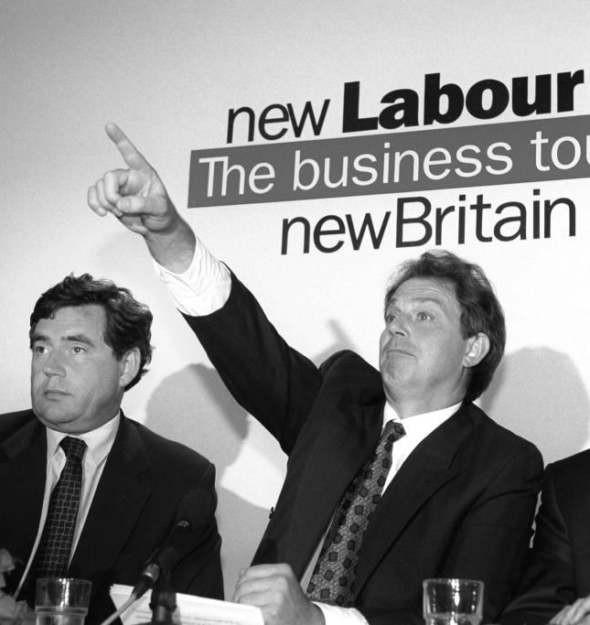
The Cartel Party
From today’s reading: Katz and Mair
Richard Katz (American) and Peter Mair (Irish), political scientists, 1995 and 2009
Parties “increasingly function like cartels, employing the resources of the state to limit political competition”
They moved toward the state: public money, party laws, public office
And away from society: fewer members, weaker loyalties, lower turnout
Gordon Brown and Tony Blair on New Labour’s “business tour” in the 1990s

Slide 14
What the Cartel Does
From today’s reading: Katz and Mair
What the cartel does
LIMITS THE CONTEST
SHARES THE MONEY
KEEPS OUTSIDERS OUT
Fewer questions are put to the voters
Hard choices are delegated to “independent central banks, courts, or the EU Commission”
Campaigns turn on who manages better, and on “spectacle, image, and theater”
The state pays
State subsidies replace members’ dues
The gap between being in office and out of office shrinks: losing costs less
Rules that favor insiders
Funding rules, ballot access and media access that “disadvantage challengers from outside”
Party activists, who want sharper differences, lose influence
No conspiracy is required. Katz and Mair: it is “possible to produce the effects of collusion without any illicit communication.”

Slide 15
Cartel or Not?
Cartel or not?
PARTY FUNDING, GERMANY
THE GRAND COALITION
The state pays the parties about €230 million a year, roughly a third of their income. In 2018 the two governing parties raised the cap by €25 million, in a bill passed in ten days.
Germany’s two big parties, the CDU/CSU and the SPD, campaign against each other. They have governed together for 13 of the last 21 years, and they do today.
Cartel. But the Constitutional Court struck the raise down in 2023, and it makes the state fund any party that wins 0.5%.
It looks like one. But they won 69% together in 2005 and 45% in 2025: often no other majority exists.
THE EUROPEAN CENTRAL BANK
THE FIREWALL
Interest rates for 21 countries are set in Frankfurt by a central bank that no government may instruct and no election can change.
Every other party in the Bundestag refuses to govern with the AfD, which won 20.8% in 2025 and leads the polls today.
The reading’s own example of an issue taken out of party competition. Defenders say independence is the purpose.
The AfD’s 2016 program calls the political class “a political cartel.” The other parties call the firewall a defense of democracy.
Katz and Mair’s test: do the parties in office use the state to protect themselves from competition?

Slide 16
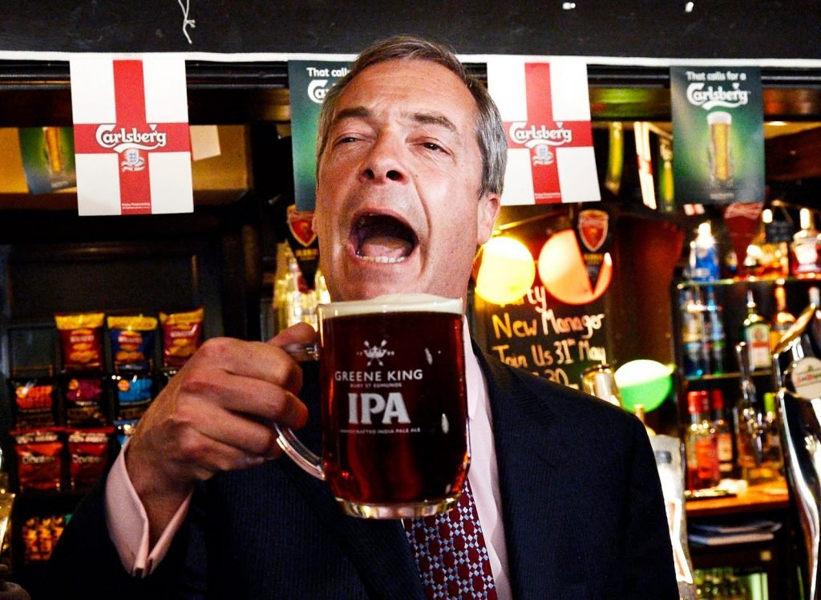
The Backlash
From today’s reading: Katz and Mair
If the big parties look alike, where do voters who want change go?
Cartelization “has clearly contributed to the rise of populist anti-party-system parties”
The big parties are “closer to one another … than any one of them is to the voters”
“The mass party is dead.”
Critics: collusion, or parties chasing the same voters?
Nigel Farage, leader of Britain’s Reform UK

Slide 17
Guess the Number: France
GUESS THE NUMBER · 3 OF 3
France, 2012: the Socialist and the mainstream-right candidates for president won 55.8% between them. And in 2022?
A
41%
B
26%
C
16%
D
6.5%
D
6.5%
55.8%
26.4%
6.5%
2012
Socialist 28.6 + right 27.2
2017
Right 20.0 + Socialist 6.4
2022
Right 4.8 + Socialist 1.8
First round. The top three in 2022: Emmanuel Macron, the president (28%); Marine Le Pen of the National Rally (23%); Jean-Luc Mélenchon of France Unbowed (22%). None came from the two old parties.

Slide 18
The Big Parties, Then and Now
The big parties’ combined share of the vote, then and now
96.8
93.4
91.2
85.3
57.4
47.4
44.9
38.8
1951
2024
1975
2024
1976
2025
1986
2025
Britain
Conservatives + Labour
Austria
People’s Party + Social Democrats
Germany
CDU/CSU + SPD
Netherlands
CDA + Labour + VVD
Percent of the vote in national parliamentary elections. 1976 is West Germany. In 2025 the Dutch Labour Party ran on a joint list with the Greens.

Slide 19
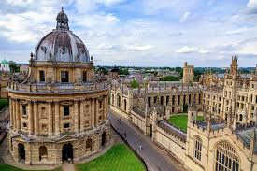
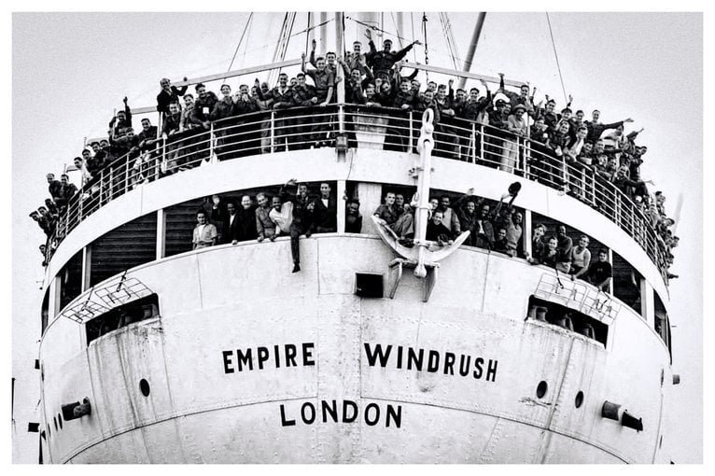

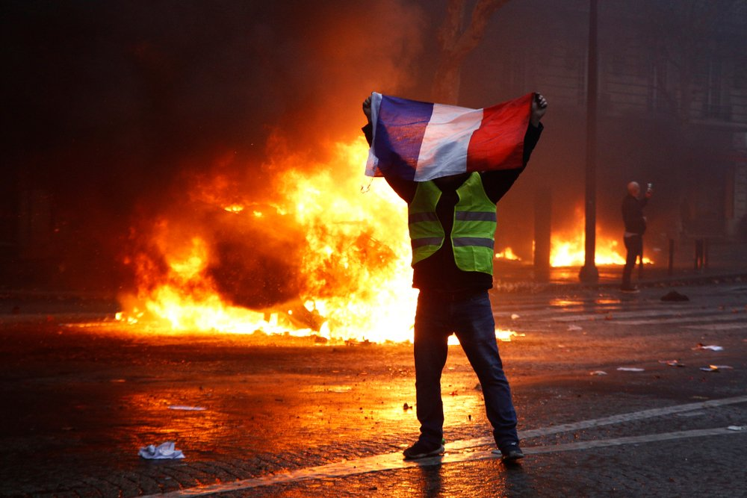
What Changed? The Voters
From today’s reading: Ford and Jennings
Four changes in who the voters are
EDUCATION
MIGRATION
AGING
PLACE
Graduates are 32% of adults in Western Europe; their share more than doubled from 1992 to 2018
Graduates lean green and liberal. White school leavers are the radical right’s core voters
Migrant-origin communities have grown across Western Europe
Minority voters have gravitated to center-left parties: in Britain, to Labour
One in ten Western Europeans was 65 or older in 1967; nearly one in five is now
Older voters turn out more, but age is “not yet being mobilized” as a divide
Big cities draw graduates, the young and the jobs; towns and the countryside lose them
France’s yellow vests: anger at “metropolitan Paris elites”
Robert Ford and Will Jennings, British political scientists, 2020. Education and migration already separate the parties’ voters; they expect place to matter more.

Slide 20
A Second Dimension
From today’s reading: Ford and Jennings
Two dimensions: economics and culture
GAL
green, alternative, libertarian
ECONOMIC: LEFT TO RIGHT
Greens
Taxes, spending, the welfare state, the role of the market
Liberals
Social Democrats
Radical Left
CULTURAL: GAL TO TAN
Christian Democrats
Conservatives
Immigration, Europe, national identity, social values
TAN
traditional, authoritarian, nationalist
Radical Right
Economic left Economic right
GAL–TAN is the label of Liesbet Hooghe and Gary Marks, political scientists at the University of North Carolina. Positions are my rough estimates.

Slide 21
Takeaways
Party families are useful, but imperfect labels
  Labour under Blair was far from the Scandinavian social democrats
  Social liberals and right liberals differ even more
Historically: a unified mainstream left and a fragmented mainstream right
Mainstream parties dominated until about 2008; they have lost ground to challengers of every type since
Two explanations today: the parties changed (Katz and Mair), and the voters changed (Ford and Jennings)

