Slide 1
POSC 3710: European Politics
11/9/2026: The Radical Right in Power
Dr. Will Horne
Clemson University

Slide 2
Where We Left Off
Wednesday: what these parties are, and who votes for them
Since the 1990s they have found a way into government
  Today: what the other parties do about them, and what they do in office
Two cases from the readings: Germany’s firewall and Meloni’s Italy
Then parliament sits: the Budget Bill

Slide 3
Three Answers to a Party You Reject
How do the mainstream parties interact with them?
SHUT IT OUT
LET IT GOVERN
TAKE UP ITS POSITIONS
No coalition, no deals
Germany: the “firewall” around the AfD
Belgium: a cordon around the Flemish radical right for more than thirty years
France: rivals stand down in the runoff
In the cabinet, or supporting it from outside
Austria in 2000 and 2017
Italy since 2022, Finland since 2023
From outside: Denmark from 2015 to 2019, Sweden from 2022 to 2026
Compete for its voters
Meguid’s “accommodative” strategy, from November 2
Denmark’s Social Democrats, on immigration
Mudde’s warning: it can make the challenger stronger
Which did the FRC choose?

Slide 4
Everyone Else Dislikes Them
Why shut them out? Everyone else dislikes them
How much the supporters of each party family dislike the other families (0 = like, 10 = dislike)
THE PENALTY
the other families, on average
the radical right
1.47 points
How much more a radical right party is disliked than its policy positions and its coalition record would predict
Its own supporters dislike the other families at 6.4, on average
SUPPORTERS OF THE
Radical left
6.1
8.6
Greens
5.5
8.6
Social democrats
5.8
8.0
Liberals
5.8
7.3
Christian democrats
5.8
7.0
Conservatives
6.4
6.6
This is what my co-authors and I find: election surveys in 20 Western democracies, 1996 to 2017.

Slide 5
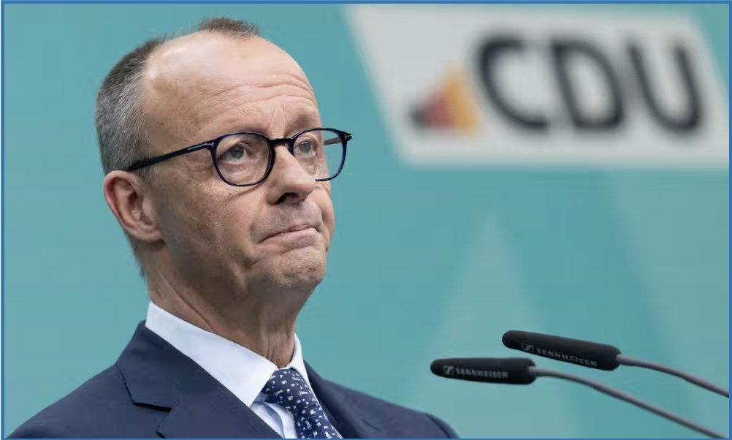
Germany’s Firewall
From today’s reading: Bröning
Germany’s firewall
THE RULE
THE STRAIN
THE DILEMMA
The Brandmauer: “all parties have refused to cooperate with the AfD”
The CDU’s own rule since 2018: no coalition with the AfD, and none with the Left
January 2025: a CDU motion on migration passed with AfD votes, 348 to 345
The AfD in the west, March 2026: 18.8% in Baden-Württemberg, “around 20 percent” in Rhineland-Palatinate
Among blue-collar workers: “nearly 40 percent”
Polls: “nearly half of voters in southwestern Germany now open to cooperation”
“How can center-right majorities in public opinion be translated into policy when doing so requires cooperation with the political left?”
Some conservatives call the firewall a “straitjacket”
Friedrich Merz, leader of the CDU and chancellor of Germany since May 2025. He has ruled out a coalition with the AfD
Michael Bröning is a political scientist and sits on a commission of Germany’s Social Democrats.

Slide 6
You Lead the CDU
ACTIVITY
Saxony-Anhalt, September 6, 2026: you lead the CDU
You are Sven Schulze, the CDU minister-president of this German state. 83 seats; 42 make a majority.
The Left
8
Greens
8
SPD
8
BSW
5
CDU
15
AfD
39
The AfD won 43.8% of the vote. The BSW is a new party, left on the economy and against immigration.
A. EVERYONE BUT THE AFD
B. A MINORITY GOVERNMENT
C. LET THE AFD GOVERN
CDU, SPD, Greens, the Left and BSW: 44 seats
Your party’s rule forbids governing with the Left
CDU, SPD and Greens: 31 seats
It needs the Left and the BSW for every vote
The AfD alone: 39 seats. With the BSW: 44
Your party’s rule forbids working with the AfD
WHERE IT STANDS, EARLY NOVEMBER
The CDU, SPD, Greens and the Left refused the AfD’s invitation to talk. The BSW accepted
Without the BSW it is 39 seats against 39, and the BSW says it will abstain
The SPD, Greens, the Left and the BSW discussed a minister-president from outside the parties. The CDU stayed away
Ulrich Siegmund, the AfD’s lead candidate, will stand in December. On a third ballot a majority of the votes cast is enough
The latest:

Slide 7
Are populist right parties anti-democratic?
In general, no. Most populist right parties favor free and fair elections (but, see Hungary as an exception).
However, these parties are less supportive of liberal democracy
  Liberal Democracy: Free speech, free press, right to protest, protections for minority opinions or identities, etc.
Argue that the government should reflect the voice of the “true people”, and things like the bureaucracy and elite must be pushed aside
  Might need to break some things to get the needed change

Slide 8
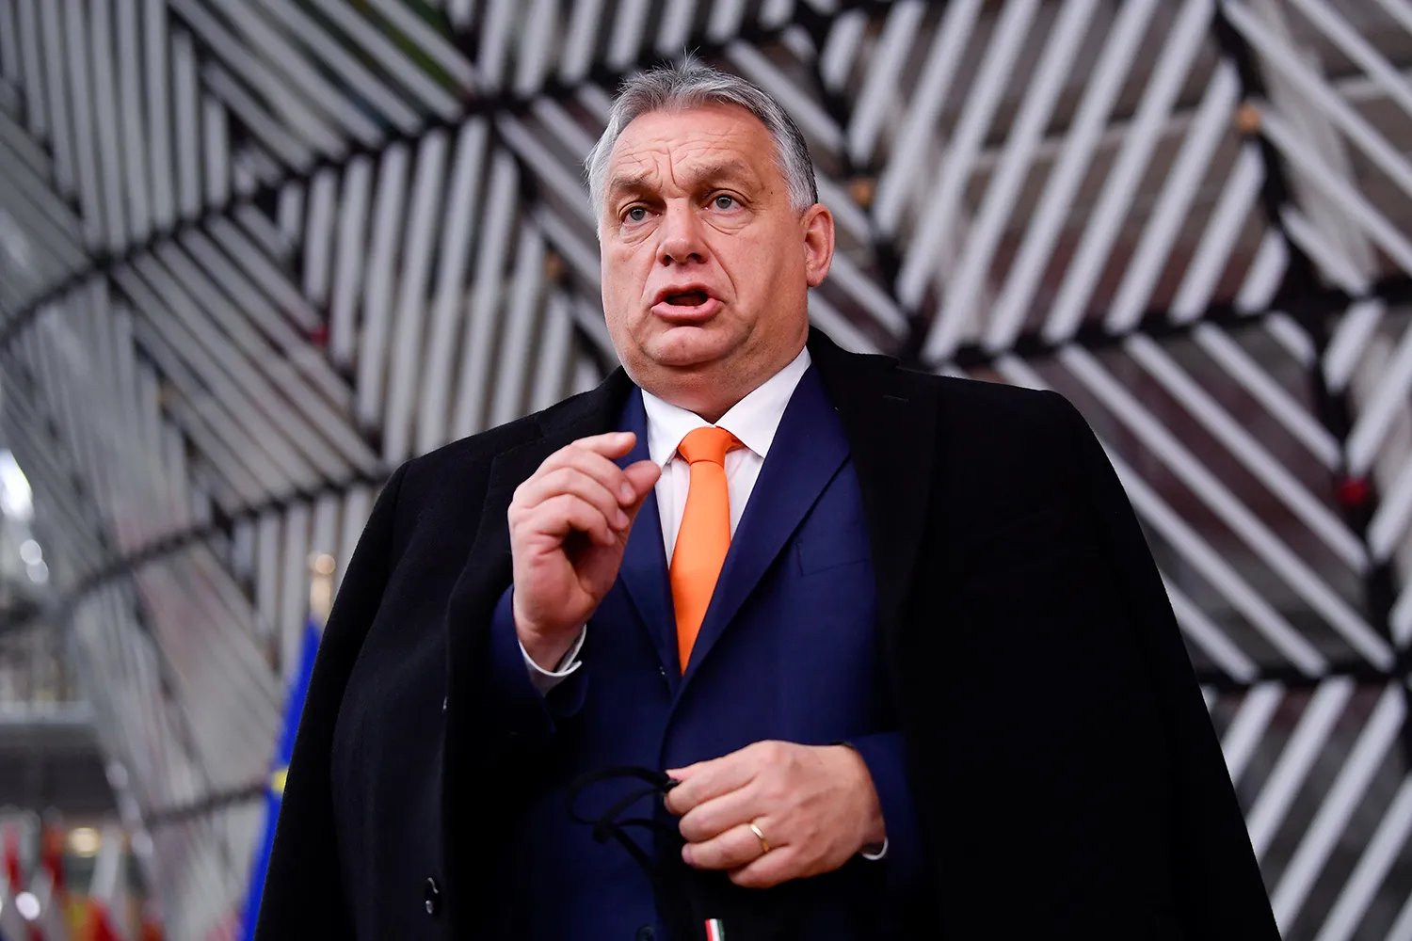
Notes:
Orbán himself has championed the idea of an "illiberal democracy," arguing that liberal democratic values—such as pluralism, minority rights, and separation of powers—are obstacles to national sovereignty and cultural homogeneity.
Key examples of Fidesz's opposition to liberal democracy include:
Erosion of Judicial Independence – The government has packed courts with loyalists, weakening checks on executive power.
Media Control – Independent media has been marginalized, with most outlets now favoring the government.
Weakening Civil Society – NGOs and opposition groups face significant restrictions, especially those that advocate for human rights and democracy. He kicked the Central European University out of Budapest for claims that it was tied to globalist elites.
Anti-Pluralist Rhetoric – Orbán frames political opposition as illegitimate, often using nationalist and anti-elitist rhetoric to attack Brussels, migrants, and liberal elites.
These actions align with Mudde's view that radical right populists are not just anti-elite but also anti-pluralist, seeing their own rule as the only legitimate representation of the "true people." While still winning elections, Fidesz undermines key liberal democratic norms
Orban wasted no time in employing this mandate to hollow out the judiciary, rewrite Hungary’s legal code, and promulgate a new constitution. New laws made it harder for upstart parties to win seats and even easier for a large party, like Fidesz, to capture a legislative supermajority with less of the vote. And the refashioned legal code saw to it that Fidesz’s cronyism and subsequent amassing of power fell close enough within the law that it would not be sanctioned domestically.
Hungary still meets a minimal definition of democracy, in that there are elections and there is no evidence of tampering with ballots, but with a single party controlling nearly all cultural institutions, the judiciary, the media and having changed electoral laws to favor a single party, Hungary is at best a flawed, illiberal, democracy.

Slide 9
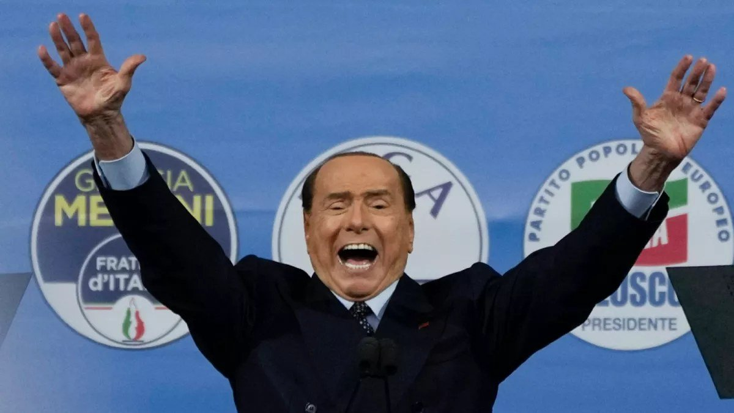
Italy: Why Meloni Won
From today’s reading: Jones
Her party’s roots: the Italian Social Movement, founded by former fascists
Shut out until 1994, when Silvio Berlusconi took it into government
After 2011: technocrats and grand coalitions, built to avoid early elections
2021: every large party governs but hers
2022: her party wins 26%, up from 4% in 2018
Silvio Berlusconi, a former prime minister of Italy, at a rally of the right-wing alliance. Behind him: the logos of his own party and of the Brothers of Italy, the party of Giorgia Meloni, prime minister since 2022

Slide 10
Did Office Tame Meloni?
ACTIVITY
From today’s reading: Jones
Did office tame Meloni? Six fears, four years on
Erik Jones, a political scientist, two months into her government: “popular, scary, and competent, all at the same time.”
THE FEAR, AND WHAT JONES SAW AFTER TWO MONTHS
HAPPENED?
FOUR YEARS ON
A fight with the EU over the budget
First budget: “softer than her campaign rhetoric”
No
Tight budgets. Her former minister Raffaele Fitto is a vice-president of the European Commission
An end to arms for Ukraine
More arms, backed by “most of Parliament”
No
The Associated Press: “steadfast support for Ukraine”
A hard line on migration
Her response: “more bluster than action”
Yes
Asylum centers in Albania. And nearly 500,000 work visas for foreign workers over three years
A stronger executive, fewer checks
She wants “a directly elected president”
Tried
Her bill for a directly elected prime minister stalled. March 2026: voters rejected her reform of the courts, 53% to 47%
Limits on protest and on rights
A decree “seemed to threaten the right of assembly”
Yes
2025: heavier penalties at protests. 2024: a ban on surrogacy abroad
One more short-lived government
“Likely to last longer” than her predecessors
No
September 2026: the longest-lasting government since World War II
HANDS UP
Tamed?
Yes
Partly
No
Jones’s conclusion: “Democratically successful parties appear to be illiberal; elections serve primarily to delay confrontations between politicians and voters; and principled politicians are judged more by what they say than what they accomplish.”

Slide 11
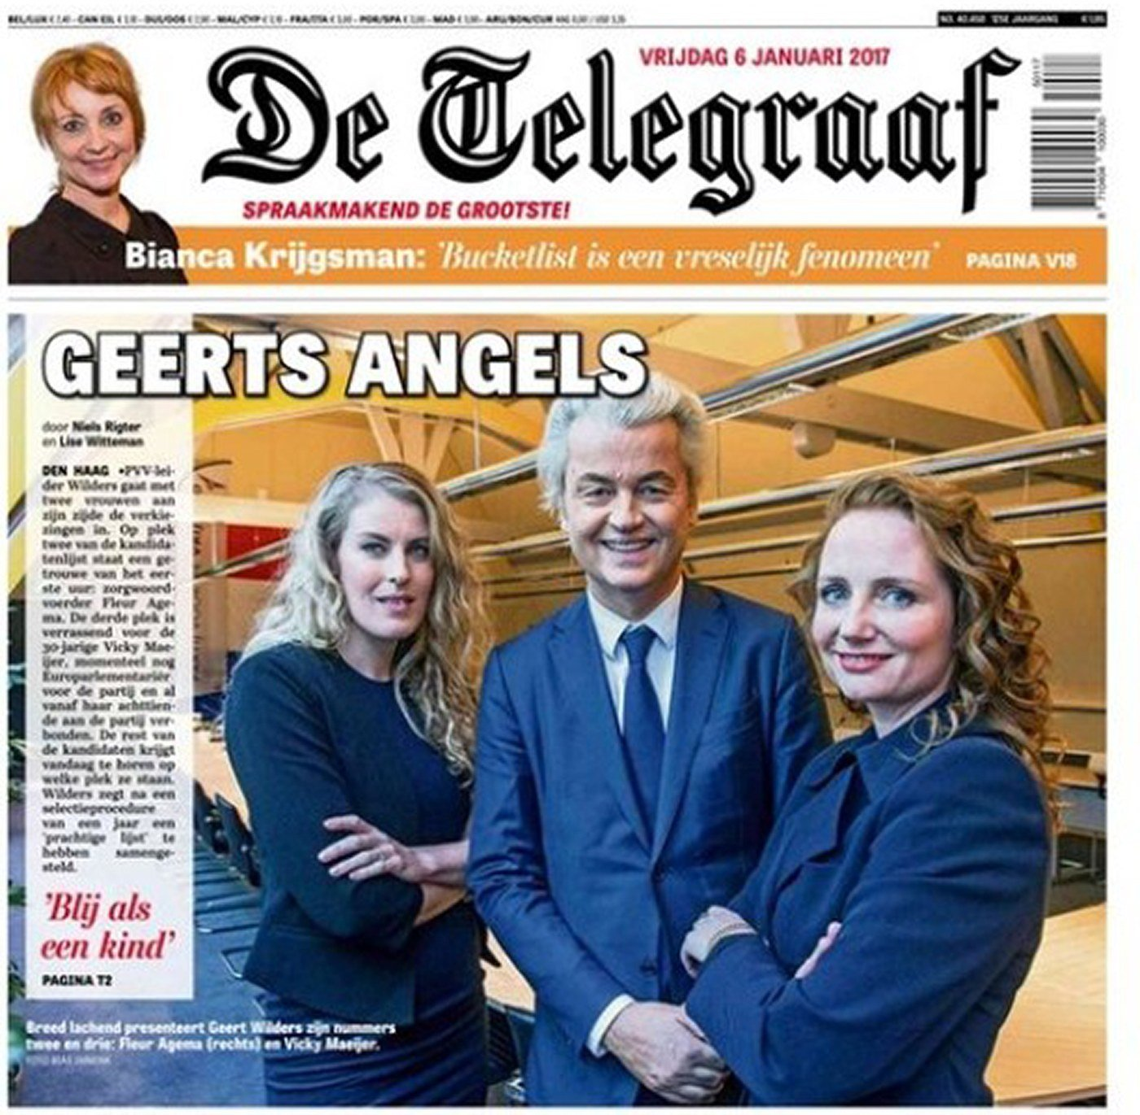
What Office Does to Them
HANDS UP
What office does to radical parties
Before the click: does a spell in government cost these parties votes?
the election before
the election after
Austria, Freedom Party, 2000–02
26.9%
10.0%
Austria, Freedom Party, 2017–19
26.0%
16.2%
Netherlands, PVV, 2024–25
23.5%
16.7%
Denmark, People’s Party, 2015–19*
21.1%
8.7%
Geert Wilders, leader of the Dutch PVV, on a newspaper front page in 2017. His party joined the government in July 2024 and walked out eleven months later
Sweden Democrats, 2022–26*
20.5%
17.5%
Italy, Brothers of Italy, since 2022
26.0%
29.3% in a poll
* Supported the government from outside. The exception leads her government; the others were junior partners or outside supporters.

Slide 12
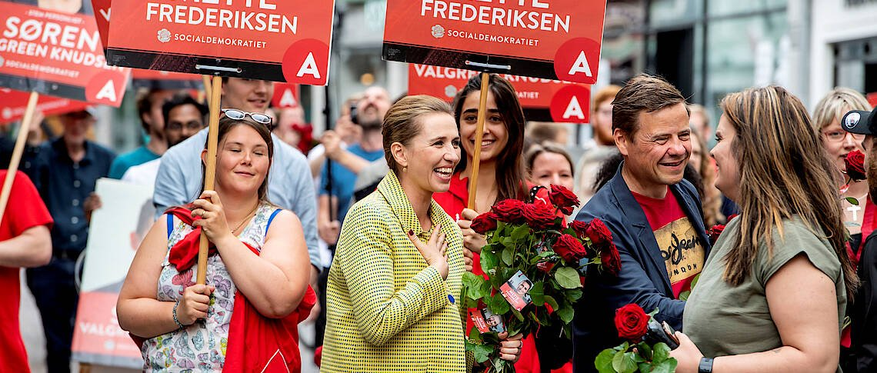
Denmark: Did It Work?
Denmark: did copying work?
From 2015 they took the radical right’s line on immigration. Before the click: did it work?
Social Democrats
Danish People’s Party
26.3
25.9
27.5
21.1
21.8
Mette Frederiksen, leader of Denmark’s Social Democrats since 2015 and prime minister since 2019
8.7
9.1
THE SOCIAL DEMOCRATS’ HARD LINE
In opposition they voted to ban face veils and to take valuables from refugees at the border
In office, the goal: “zero spontaneous asylum seekers”
2.6
2015
2019
2022
2026
2019 and 2022: the People’s Party collapsed. 2026: it more than tripled its vote, and the Social Democrats had their worst result since 1903. They still lead the government.

Slide 13
Italy or Germany?
Let it govern, or shut it out?
LET IT GOVERN: ITALY
SHUT IT OUT: GERMANY
For: office brings limits (EU money, the markets, allies), and voters get a record to judge
The risk: it uses office to loosen the checks on government
For: no ministries for a party hostile to parts of liberal democracy
The risk: it grows as the one real opposition, while its rivals’ coalitions agree on little
HANDS UP
Which is riskier for democracy in the long run?
Letting it govern
Shutting it out

Slide 14
Key Points
Three answers: shut it out, let it govern, take up its positions
Junior partners and outside supporters lost votes. Meloni, who leads, has not
Germany’s firewall kept the AfD out of office while its vote doubled
Denmark’s hard line worked twice, then stopped working
None of the three has made these parties go away

Slide 15
The Budget Bill
The Federal Republic of Clemson: the first governing session

Slide 16
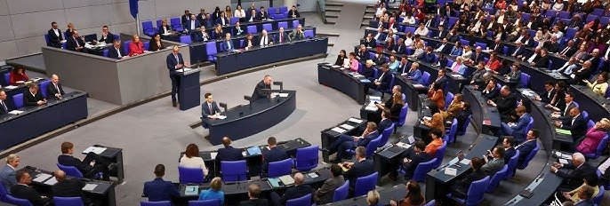
How the Session Runs
THE FRC
The Budget Bill: how the session runs
MINUTES
WHAT HAPPENS
WHO SPEAKS
0 to 5
The government presents the bill
The Finance minister, the PM or the Welfare minister, or shared
Germany’s parliament, March 2025: 513 votes to 207 to loosen the constitution’s limit on borrowing, for defense and infrastructure
5 to 10
The opposition responds
The Populist Right’s Finance spokesperson: 3 minutes. The Radical Left: 2
10 to 30
Amendments
Slips close at 5:00. The Speaker alternates the benches
ON YOUR DESK
The Budget Bill
The coalition agreement
Your position paper
Amendment slips
30 to 35
The final vote, in seats
A majority of the votes cast passes the bill. A tie fails it
Legislation that fails stays failed. A government that loses its budget faces a confidence vote at the next session.

Slide 17
Amendments
THE FRC
Amendments
THE RULES
MOVED BY
SECONDED BY
FOR
AGAINST
RESULT
A change to a numbered measure, with its cost
On a slip, handed to the Speaker by 5:00
Seconded by an MP from a different party
The Speaker alternates opposition and coalition
One minute from the mover, one from the Finance minister, then a vote in seats
1
?
?
?
?
?
2
?
?
?
?
?
3
?
?
?
?
?
4
?
?
?
?
?
5
?
?
?
?
?
For and against are counted in seats.

Slide 18
The Final Vote
THE FRC
The final vote on the Budget Bill
SEATS
FOR
AGAINST
ABSTAIN
THE BUDGET
Radical Left
7
?
?
?
Social Democrats
31
?
?
?
?
Passed or failed
Greens
10
?
?
?
Liberals
15
?
?
?
Christian Democrats
18
?
?
?
Populist Right
19
?
?
?
Independents and splinters
0
?
?
?
Parliament
100
?
?
?
A majority of the votes cast passes the bill; a tie fails it. If the budget fails, the government faces a confidence vote at the next session.

