Slide 1
POSC 3710: European Politics
8/19/2026: Introduction
Dr. Will Horne
Clemson University

Slide 2
Who Am I?
I am a comparative political scientist
I study political parties, polarization and elections, mostly in Western Europe
I also work on how to apply computational and statistical methods to political science.
Office: 230a Brackett Hall. Office hours Wednesdays 10–12, or by appointment
Notes:
Where I did PhD, how I got to Clemson, how I ended up studying Europe.

Slide 3
What Will We Cover?
Domestic and inter-state politics of European countries
Mostly western Europe, but some coverage of central and eastern Europe.
Not a course on the EU as an institution — that is POSC 3750
Four broad areas: history and ideas; domestic politics; European (dis)integration; contemporary issues
Alongside political science research: how scholars have tried to explain all of it
Notes:
Set expectations: this is a seminar, not a lecture course. The readings are important.. Flag that we cover Europe broadly, not just the EU.

Slide 4
How This Class Works
Two in-class exams — midterm 25%, final 30%
Simulation portfolio — 25%
Party manifesto, coalition memo, two position papers, two in-class debrief memos
Participation and attendance — 10%
Reading checks — 10%, unannounced - lowest dropped
No textbook. Every reading is free on Canvas or open access

Slide 5
The Federal Republic of Clemson
A semester-long simulation. You are a member of parliament in a fictional European democracy
You will found a party, write a manifesto, campaign, contest an election, and bargain over a coalition
Then you govern — or oppose — through a budget, an immigration bill, and a European summit
And in late November, you’ll deal with a political crisis
Notes:
Emphasize: your grade rewards preparation and good-faith engagement, not whether your party wins. Some of the best grades will be earned in opposition. Role preference survey goes out next Wednesday.

Slide 6
Let's Go Through the Syllabus
Questions?
Notes:
Walk the syllabus on screen. Budget ~20 minutes.

Slide 7
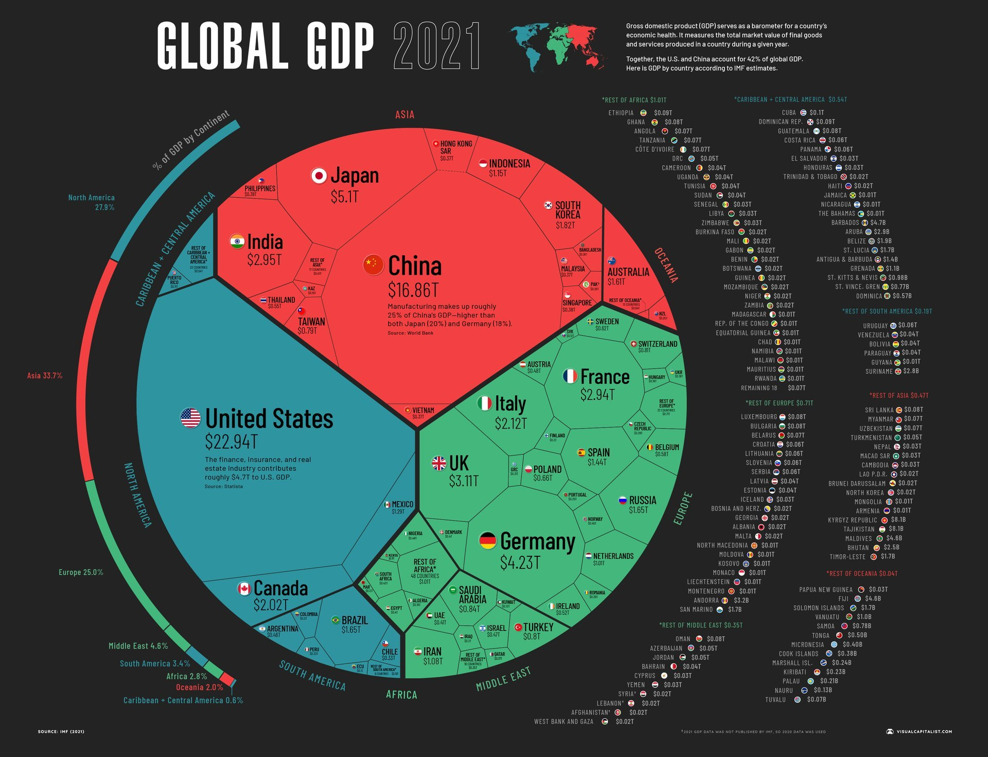
Europe is an Economic Power
Notes:
Image from New Capital, data from the IMF. The point: the EU as a bloc is one of the three great economic centers of the world, and individual European economies punch well above their population weight. Set up the tension for later.

Slide 8
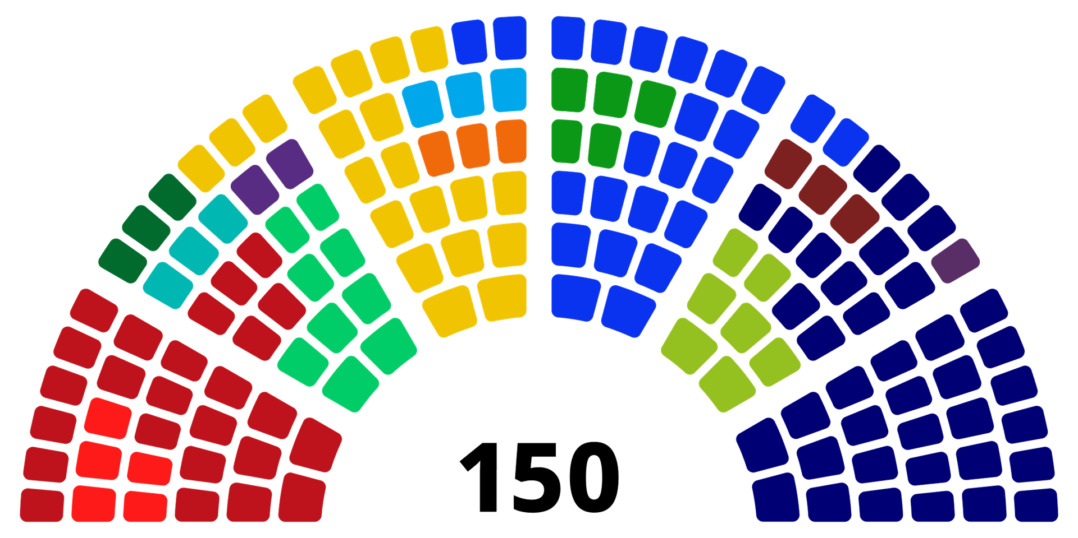
How Does Politics Work With Fifteen Parties?
Notes:
Party breakdown of the Dutch lower house, sorted left to right.

Slide 9
Europe is Weird (to Americans)
Governments that fall between elections, and elections nobody scheduled
Coalitions of parties that campaigned against each other
Monarchies that are also democracies
Countries that share a currency but not a budget
Parties that win the most votes and still end up in opposition

Slide 10
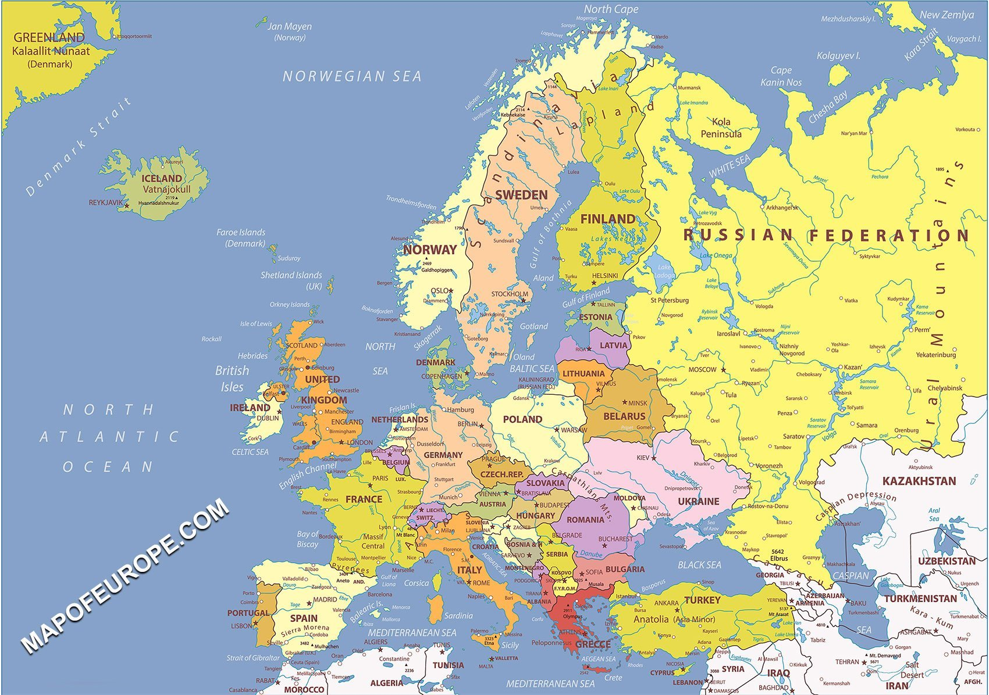
What is Europe?
Notes:
The Map itself is making some interesting choices. Turkey is in, Russia is in. Georgia is out? Greenland is in (perhaps just because it is part of Denmark).

Slide 11
Who Counts as European?
By ethnicity or 'European heritage'
Beyond the normative problems, some indigenous Europeans would not count
By religion or Christian tradition
Ignores longstanding native Jewish and Muslim populations
By geography
Where does Europe end? Turkey, Russia, the Caucasus, Cyprus?
By institutions — membership of the EU, Council of Europe, Schengen
“Europe as an Idea”
Notes:
Ronald Reagan, “I received a letter just before I left office from a man. I don’t know why he chose to write it, but I’m glad he did. He wrote that you can go to live in France, but you can’t become a Frenchman. You can go to live in Germany or Italy, but you can’t become a German, an Italian. [and often, neither can your children] He went through Turkey, Greece, Japan and other countries. but he said anyone, from any corner of the world, can come to live in the United States and become an American.”

Slide 12
A little history
European States are relatively new
Europe was a continent of shifting empires, rather than nation-states
National European Identities are newer still
At the turn of the 20th century, many “French” and “Italians” would not have considered themselves such
European States do not always map on to European Nations
“We have created Italy, now we must create Italians” – Massimo D’Azeglio (1861)
Notes:
Really, a continent of Empires up until 1918. And of course, in 1918 we get the formation of what could be called the final European imperial state or empire (USSR).
Peasants into Frenchmen. We will have a whole session on the formation of European national identities next week.

Slide 13
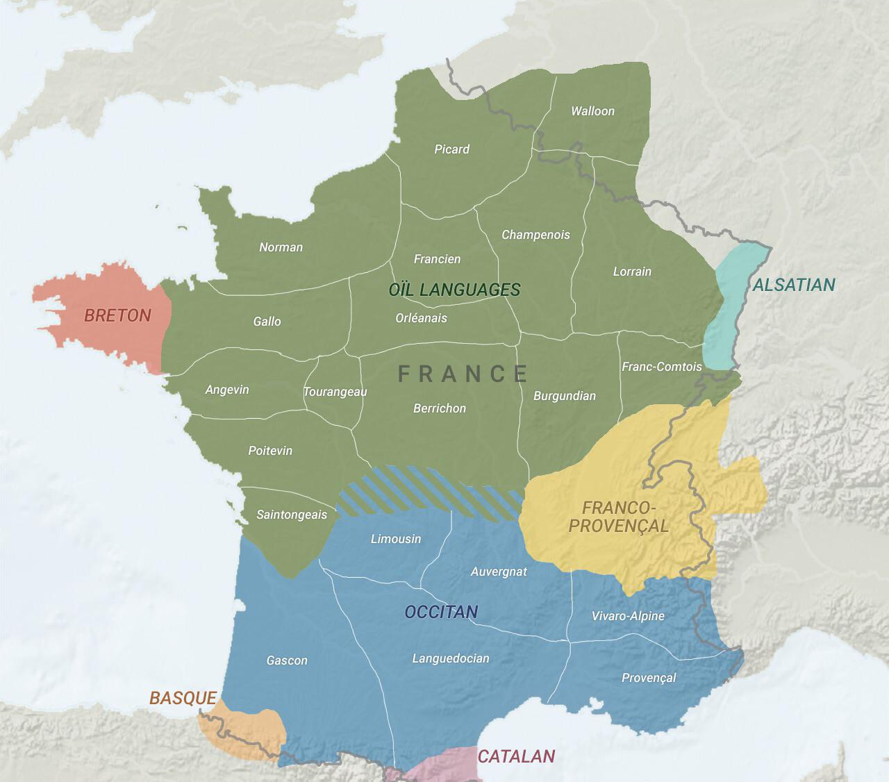
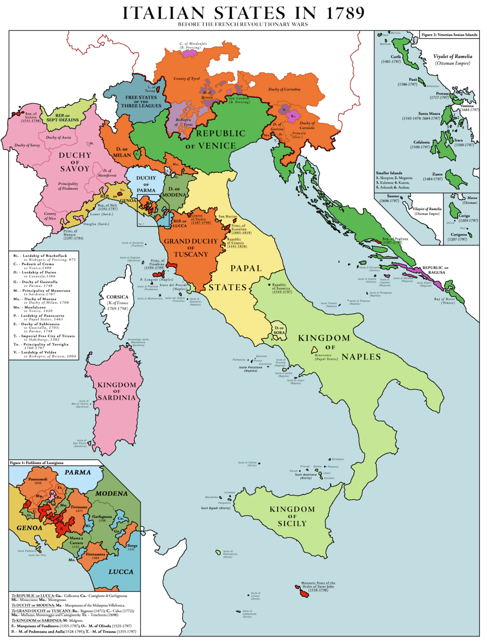
France and Italy
Notes:
French linguistic communities around 1900. Oil and Occ are the words for yes in the respective languages. Note that only a geographical minority of the country spoke “French” as we think of it in the 19th century. Only the “Francien” region spoke modern French – the rest of Oil the dialects were somewhat but not entirely mutually intelligible – arguably remained distinct languages until well after the French Revolution, as the state began to try to standardize language. Occitan remains distinct and in wide use until WW1 – which brought Occ speakers into contact with Oil speakers.
“This way to France” – Eugen Weber/PIFM
Alsatian is a dialect of German which captures that regions history.
Breton is a celtic language closer to Welsh than anything spoken on the European continent. There is a fairly fringe nationalist movement pushing for independence. Culturally quite distinct from France.
Catalan is a romance language, reads like a bridge between French and Spanish almost. Whereas Basque is a language of unknown origin that does not appear to be related to any other European language. Interestingly, the Basque and Catalan communities in France have much interest in Independence, while there are quite active successionist movements in both the Basque country of Spain and particularly in Catalonia (where a majority seem to want independence based both on polling and a 2017 referendum) . Any students of European history have a guess as to why that might be?

Slide 14
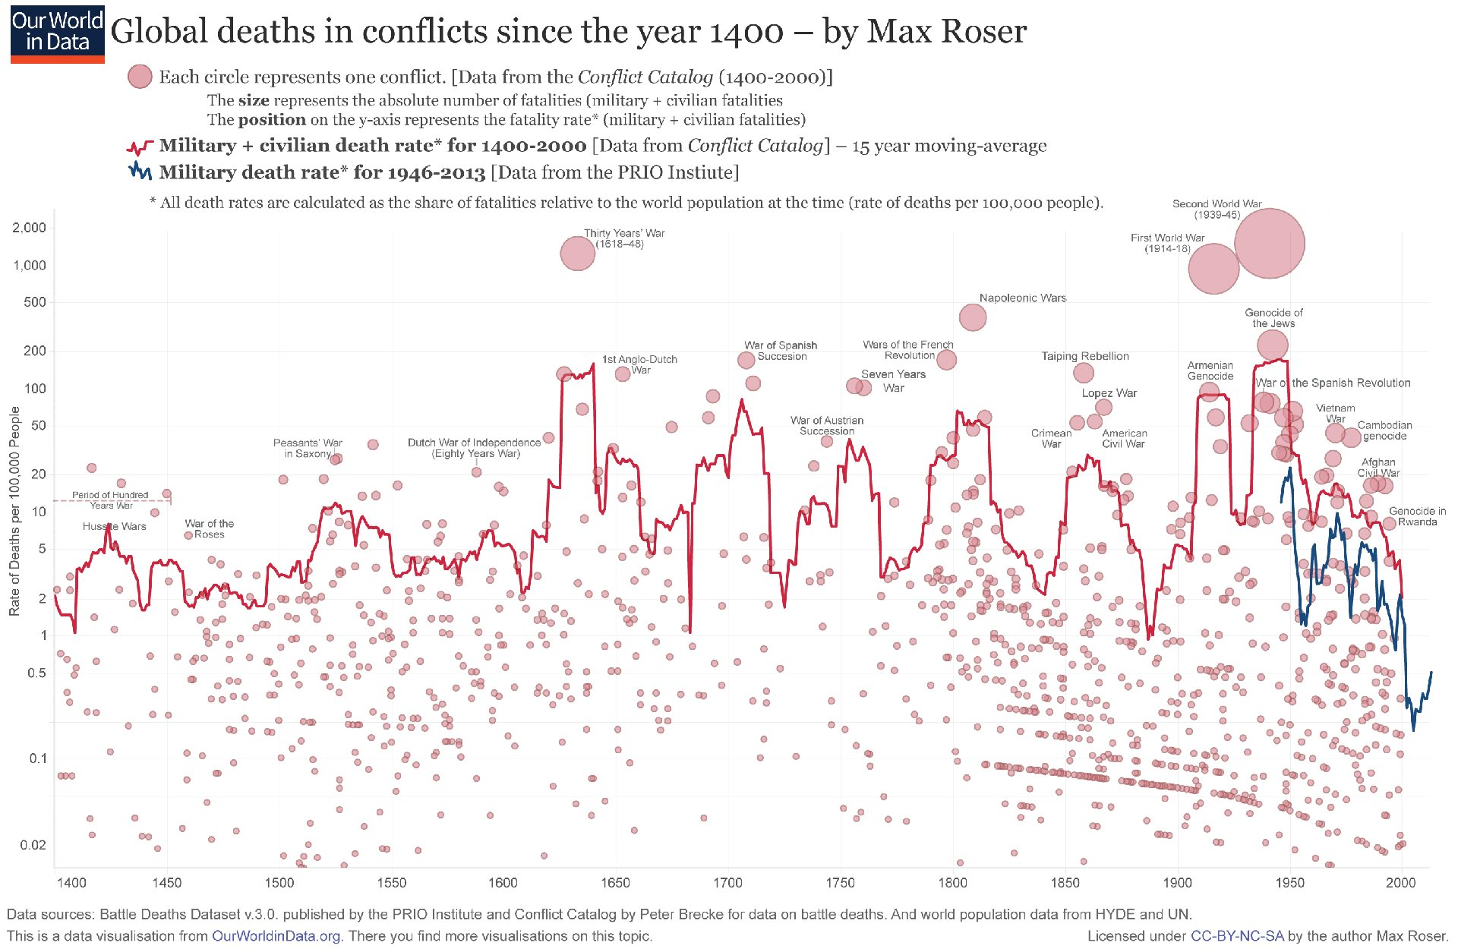
A Continent at War
Notes:
Most of these at the top are European. Craters after 1945: start of cold war.

Slide 15
Europe Today is Kind of a Miracle
Highly prosperous — extraordinary growth after 1945
Though with real regional variation; post-communist countries remain poorer
Peaceful — no war between EU member states since 1945
Though war returned to the continent in 2022, and has not left
Democratic — dictatorships in Spain, Portugal and Greece within living memory
Though democratic quality is now contested in several member states
Notes:
From a fractured history and a desperate situation at the end of WWII, including starvation and displacement on a scale that is hard to imagine now, to what Europe looks like today. Each 'though' previews a unit later in the course: Ukraine, backsliding, regional inequality.

Slide 16
“Joining Europe”: Place, Idea, or Argument?
Slovenia, Poland, Ukraine can “join Europe”
But nobody joins a continent
Judt: “Europe today is not so much a place as an idea” — peace, prosperity, human rights, open borders
A “hyper-real Europe, more European than the continent itself” — the old civilization’s virtues “shorn of its darker qualities”
So who built this idea, when, and what for?
Notes:
Bridge from the Miracle slide: we have seen the place: its history, its wars, its recovery. Judt’s opening (p. 3): the “Europe” that countries apply to join is not the place at all. Nobody joins a continent; what you join is the idea — peace, prosperity, rights, openness.
Read the hyper-real line aloud (p. 4): an idealized Europe, “more European than the continent itself,” the old civilization’s virtues “shorn of its darker qualities.”
Call back to the map (Turkey in, Georgia out?) and to Who Counts as European: every criterion fails because the boundary is drawn by the idea, not by geography, religion, or culture. That is why Europe is best treated as an argument rather than a fact.

Slide 17
What Actually Made “Europe”?
Judt: not idealists, not destiny — an “accident”
Every founder was solving a national problem
France: contain Germany, keep the coal.
Germany: “This is our breakthrough.”
Benelux: markets.
Britain: stayed out until after decolonization + declining global position
And reacting to
Increasing strong Soviet Union just to the east
Concerns about overreliance on American power
Unrepeatable luck: shared defeat, the Cold War, catch-up growth, Marshall dollars, a divided continent
The idea came later — Europe’s “foundation myth”
Notes:
Not idealists: the European Unity Movement had “no discernible real-world impact” (p. 4), and by 1945 “united Europe” talk was actually polluted — it had been the language of Speer’s New Order and of collaborators. Not destiny: the ECSC was “neither predicted nor predictable” (p. 17); the French Assembly approved a West German state by four votes.
The founders: France reached the Schuman Plan as a third-best answer to its German problem, after occupation-style extraction and a Soviet alliance both failed — “Europeanizing” the German question kept the coal flowing and Germany contained. Delors admitted as much decades later: creating Europe regained “that margin of liberty necessary for a ‘certain idea of France.’” Adenauer, on first hearing of the plan: “This is our breakthrough” — Europe as Germany’s road back to sovereignty. The Dutch needed German markets. Britain needed none of it, so it joined nothing.
Of course – maybe now they have a common outside threat – but who? Russia? China? The USA?

Slide 18
Four Stylized Models of Europe
Europe as a shining example of social democracy
Europe as a cautionary tale for the left
The European Union as a model of supranational cooperation
The European Union as a declining power
Notes:
Pause here — talk among your table. Which of these have you heard before, and where? Then present the case for each in turn. The point is not that one is right; it is that each is built from real evidence, and the semester is about learning to weigh them.

Slide 19
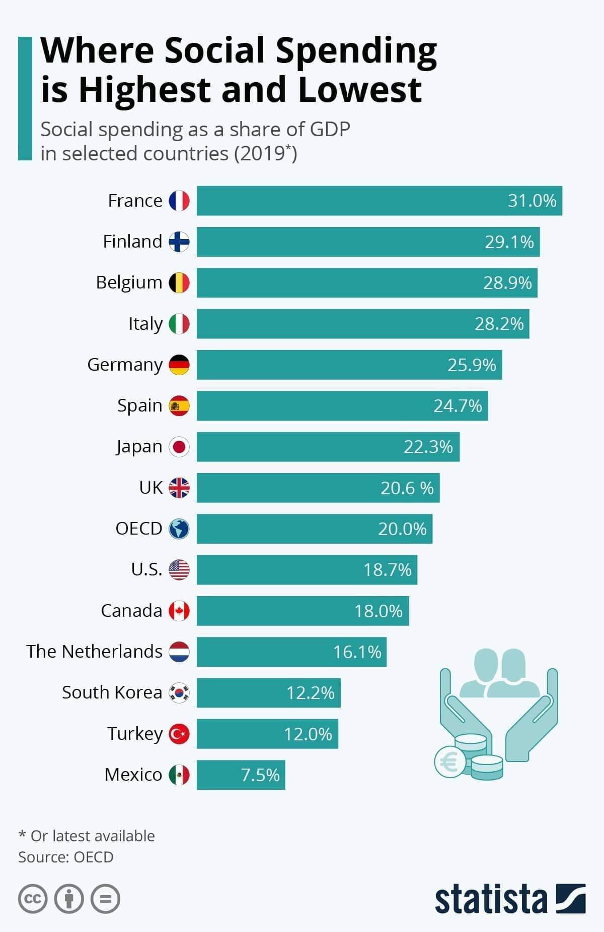
Social Democracy
Generous welfare states, built after 1945
Lower inequality and poverty
Low-cost healthcare and education
Stronger unions, wider bargaining
Notes:
Worth noting: the US spends MORE public money per capita on healthcare than many of these countries and still does not cover everyone. That comparison lands hard and sets up the health care case study in September.

Slide 20
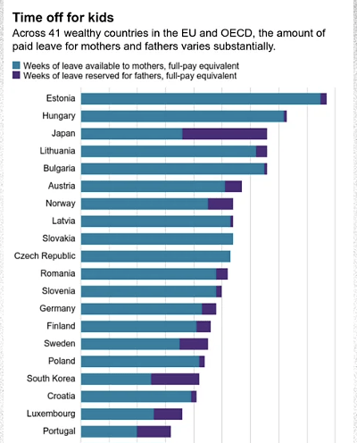
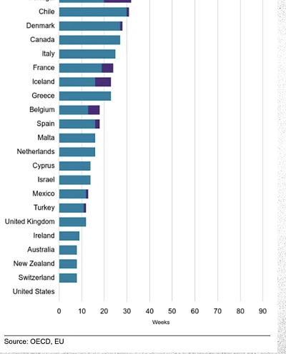
Notes:
Many of these countries now also provide paternity leave. I have good friends from the states who currently live in Germany and will have their first child this summer. They had considered moving back to US but decided it would be easier and more career compatible to have kids in Europe.

Slide 21
But…
Aging populations make social spending hard to sustain
Unless birth rates or immigration rise, something has to give
Economic and technological change have strained the postwar bargain
Reform is politically punishing — France has now suspended a pension reform twice
We will spend a full session on why these systems have proved so hard to cut
Notes:
Key point: you can fund a very generous safety net, particularly for retirees, when the age pyramid is wide at the bottom. That pyramid has inverted. Flag the 9/23 session on Pierson — the puzzle is not that welfare states are strained, it is that they have survived anyway.

Slide 22
A Cautionary Tale for the Left
Center-left parties have lost their historic working-class base
Voters without degrees dissatisfied on economics and culture alike
Backlash against globalization and immigration
In 2026: the AfD polls first in Germany, the RN is France's largest party
Labour replaced Starmer with Andy Burnham in July after heavy local losses
Notes:
As of summer 2026: Merz governs in Germany with the AfD leading national polls; Burnham took over Labour in July 2026; France is on its fifth prime minister since 2022.

Slide 23
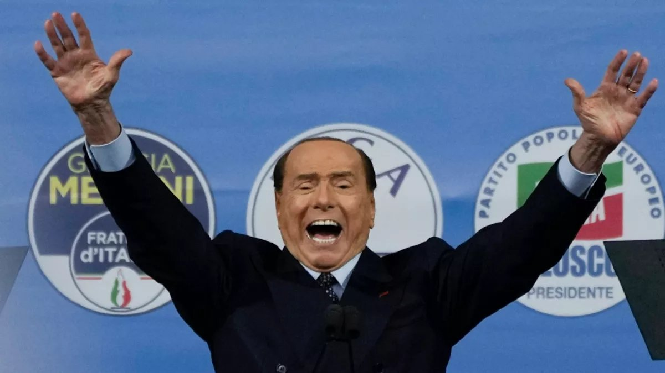
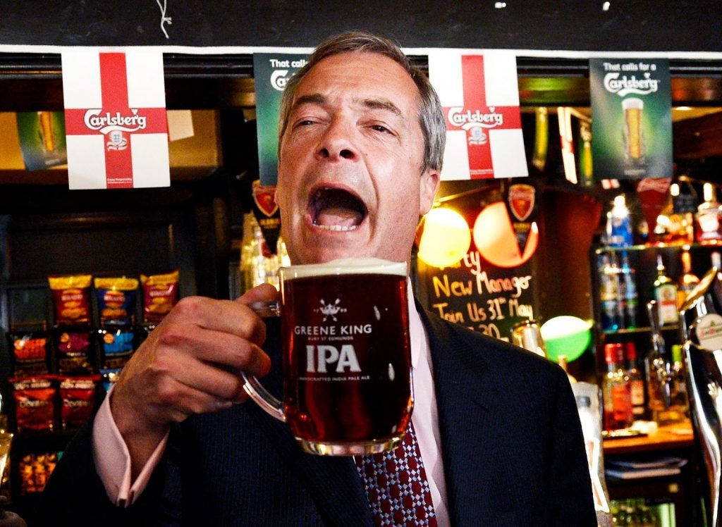
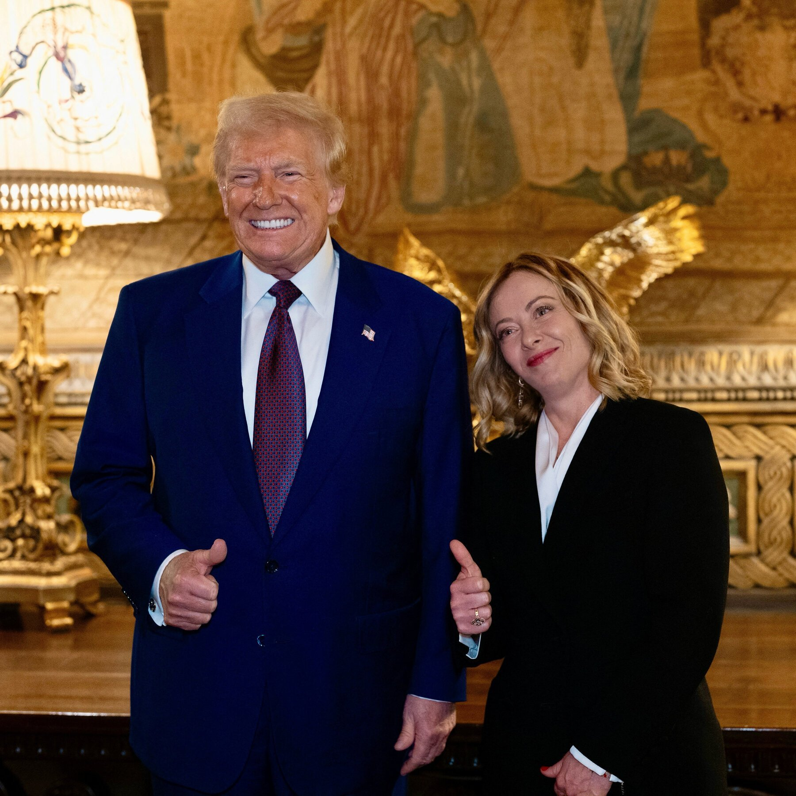
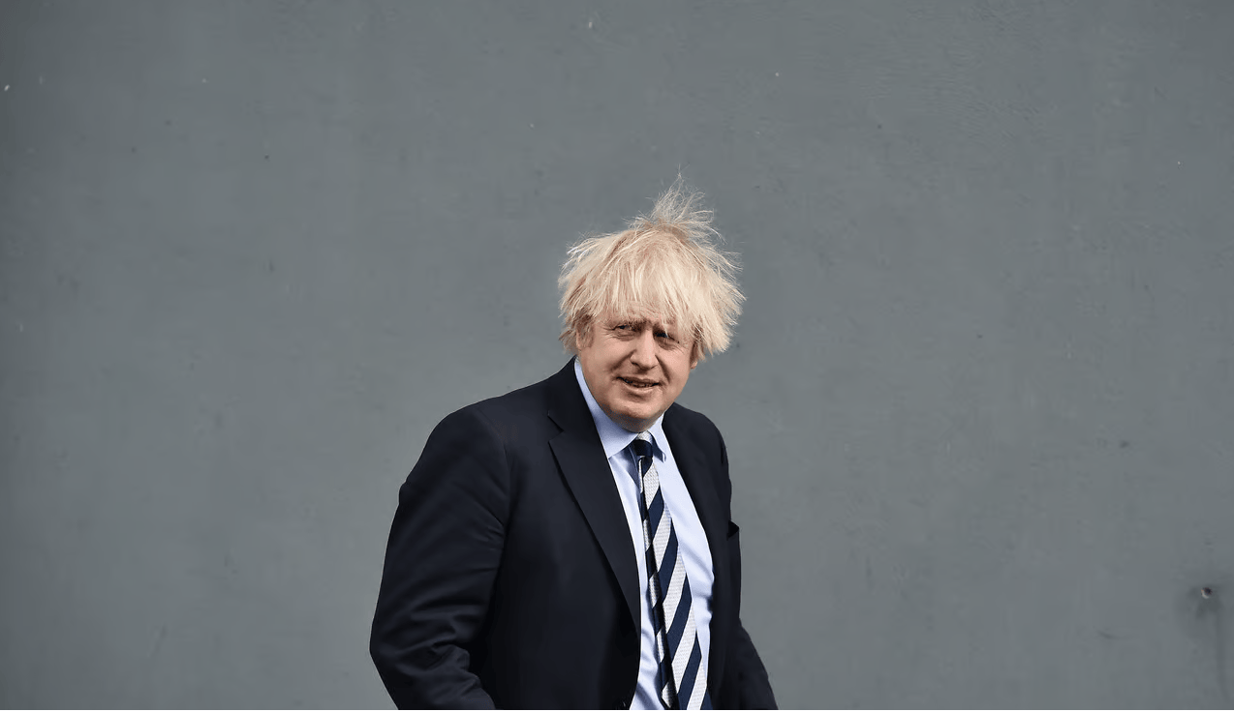
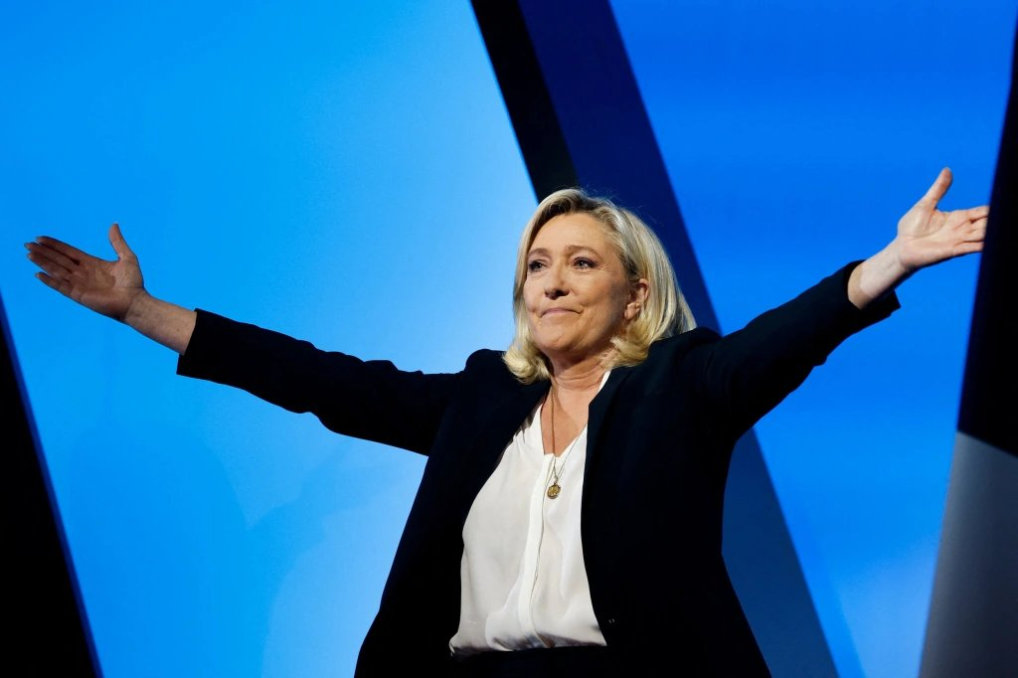
Notes:
Berlusconi, Farage, Trump with Meloni, Boris Johnson, Marine Le Pen. Worth updating the photo set at some point — several of these figures are no longer the most useful examples. Meloni is now the durable case; Le Pen's 2025 conviction was overturned on appeal, so she remains a candidate.

Slide 24
The EU as a Global Power
Started with six members, now 27 — and enlargement is live again
Accession talks with Ukraine and Moldova advanced in 2026; Montenegro is furthest along
The world's largest single market, and a regulatory superpower
The 'Brussels effect' — EU rules become global rules
Rearming: the ReArm Europe package committed up to €800bn in 2025
Notes:
Enlargement is the live story again after two decades of stagnation, and it is driven by security rather than economics. Connect forward to the FRC's European Summit session in November, where students will vote on admitting a new member state.

Slide 25
The EU as a Declining Power
Brexit removed the second-largest European economy — ten years on, the costs are measurable
A widening economic gap with the United States, and now with China on key technologies
The 2024 Draghi report called it an 'existential challenge'
Euroskeptic and radical-right parties in government or near it in several member states
Dependent on an American security guarantee that no longer feels guaranteed
Notes:
The Draghi competitiveness report is the document the entire European economic debate now orbits — we’ll return to it on the last day. Transatlantic relationship changed materially in 2025–26 and Europe is still working out what to do about it.

Slide 26
None of These Models is Right or Wrong
Europe is more generous in welfare spending, but the systems are under real strain
The populist right has reshaped politics — without winning everywhere
Hungary's Fidesz lost power in April 2026 after sixteen years.
The EU is both a regulatory superpower and an economy growing more slowly than its rivals
Your job this semester is to adjudicate between these models/ideas and figure out what you think
Notes:
The models are useful as heuristics and dangerous as conclusions. The Hungary example is the one to lean on: an entrenched hybrid regime lost an election it had engineered to win, which is a reminder that trend lines are not destiny. Preview Monday: 20th-century ideologies, Marx and Hayek.

