Slide 1
POSC 3710: European Politics
8/24/2026: 20th-Century European Ideologies
Dr. Will Horne
Clemson University

Slide 2
Opening Discussion
What should the government's role be in managing a national economy?
What differences have you heard about between how the US and European countries do this?
Where do you think those differences came from?
Notes:
The point is to surface the priors students walk in with. Write two or three answers on the board (class room design allowing) and leave them up.

Slide 3
Three Answers to One Question
Industrial capitalism produced enormous wealth — and enormous misery.
What should be done about it?
MARX
HAYEK
THE THIRD ANSWER
Abolish it
Private ownership of the means of production is the problem
Capitalism generates the class that will overthrow it
Revolution, then a classless society
Protect it
Planning cannot aggregate dispersed knowledge
Central direction of the economy requires direction of people
Markets as a discovery procedure and safeguard against government
Tame it
Keep markets, but constrain and compensate for them
Social democracy takes this route by ballot, fascism by force
We take these up on 8/26 and 9/9
Notes:
Everyone in this unit is answering the same question: industrial capitalism made societies rich and made a lot of people miserable, so what do you do about it? Marx says abolish, Hayek says protect, and the third tradition says tame. Today is the first two, then the middle paths (SD and CD) later.

Slide 4
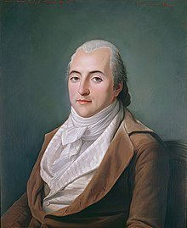
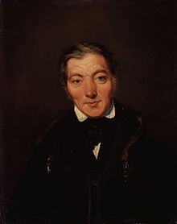
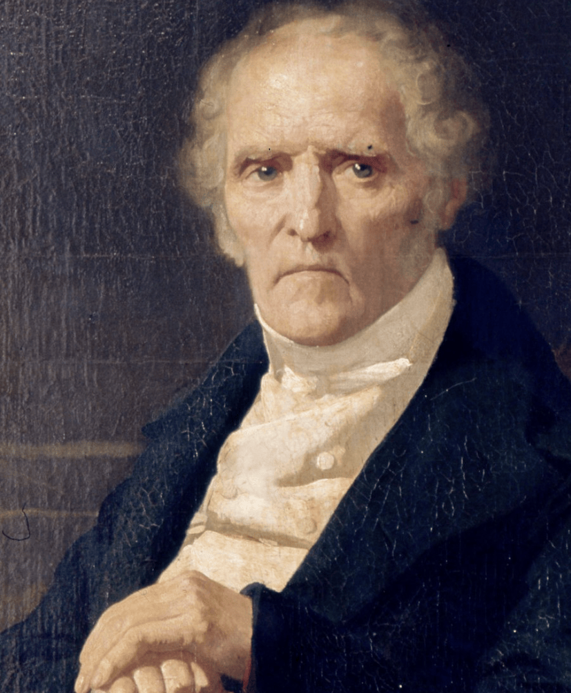
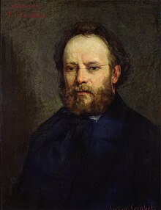
Before Marx: Early Socialists
Henri de Saint-Simon
1760-1825
Robert Owen
1771-1858
Charles Fourier
1772-1837
Pierre-Joseph Proudhon
1809-1865
Notes:
Saint-Simon, Owen, Fourier, Proudhon. The point is that Marx did not invent the critique of industrial capitalism, he inherited a crowded field and claimed to put it on a scientific footing. Owen is the most concrete: New Lanark was a real mill with real reforms, so students can see utopian socialism as a practical project rather than a daydream.

Slide 5
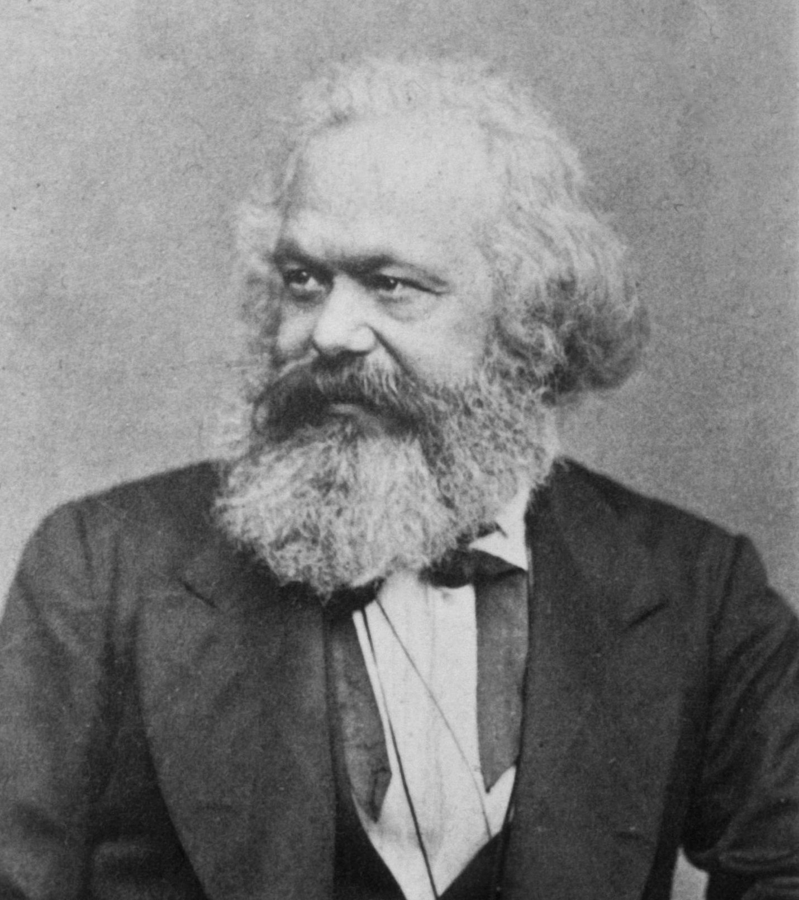
Karl Marx
1818 — born in Trier
1841 — PhD in philosophy
1845 — Manchester, with Engels
1848 — The Communist Manifesto
1867 — Capital, vol. 1
Notes:
Marx's intellectual journey from philosophy to political economy reflects the dramatic changes happening in European society. Born into a middle-class Jewish family in Trier, he began his career in academia, completing his doctorate in philosophy in 1841 with a dissertation on ancient Greek philosophy. His early work focused on abstract philosophical questions about human nature and freedom.
Everything changed when he moved to Paris in 1843. There, he encountered working-class political movements and began studying political economy. It was in Paris that he met Friedrich Engels, who would become his lifelong collaborator and friend. Engels, the son of a factory owner, helped Marx understand the practical workings of industrial capitalism.
The move to Manchester in 1845 proved transformative. Manchester was the world's first industrial city, and Engels, who managed his family's textile factory there, showed Marx firsthand the conditions of industrial capitalism. This wasn't just abstract theory anymore – Marx could see the fourteen-hour workdays, child labor, and dangerous working conditions with his own eyes.
After publishing the Communist Manifesto, Marx settled in London in 1849, where he would spend the rest of his life. In London, he had access to the British Library, where he spent years researching factory reports, economic statistics, and historical documents for his masterwork, Capital. While the Manifesto was a political call to action, Capital was a scholarly work that tried to understand the deep structures of capitalist economy.

Slide 6
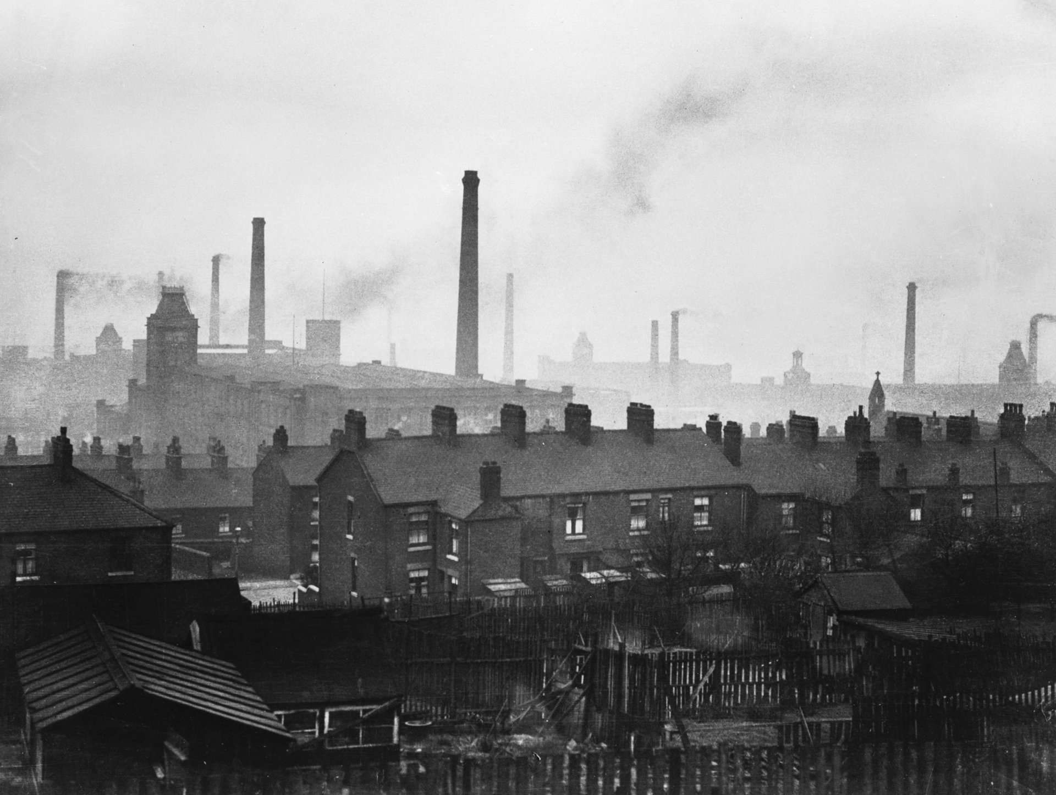
Marx and Manchester: Capitalism at Its Most Extreme
Average age at death, working-class districts: 17
Average age at death, affluent districts: 38
Half of all children did not live past five
Twelve-hour days [6 days a week]; no sick pay, time off, pension, or insurance
Notes:
These statistics, documented in John Rule's "The Labouring Classes in Early Industrial England," reveal the human cost of unregulated capitalism. The 21-year gap in life spans between working-class and middle-class districts shows how industrial capitalism was literally shortening workers' lives. The working hours and child labor practices come from Parliamentary investigations and Factory Inspector reports, particularly the 1833 Factory Commission Report. While the Factory Acts attempted to regulate these conditions, enforcement was limited and many workshops remained unregulated.

Slide 7
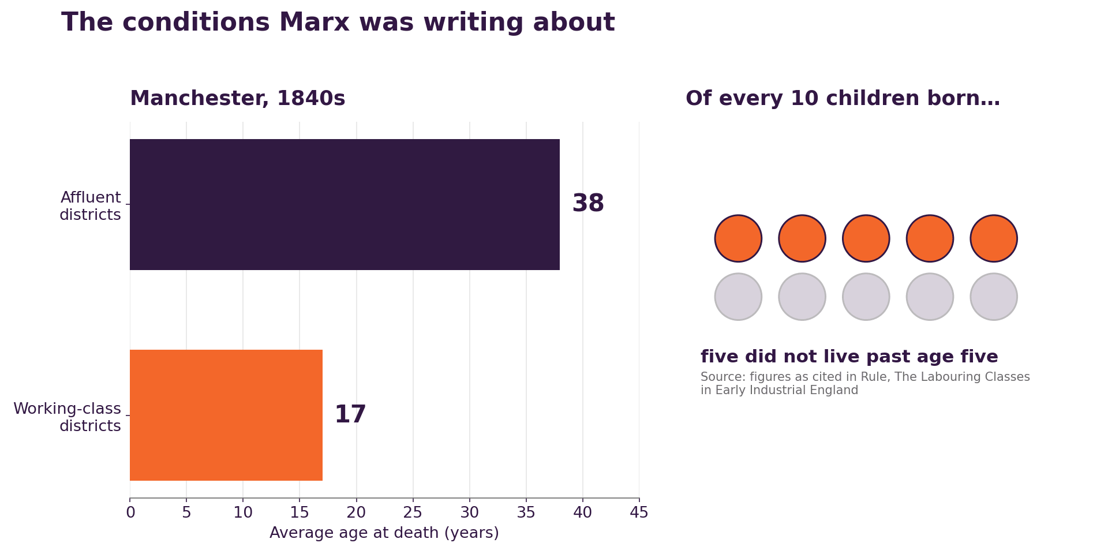
The Conditions Marx Was Writing About
Notes:
Two questions worth asking:
Would you draw the same conclusions Marx drew from this?
And, given that life expectancy in these cities rose sharply over the following century without a revolution, what does that tell us about his prediction

Slide 8
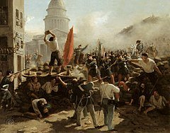
Understanding Marx's Context
Key Factors
Very Rapid Industrialization
Rise of Worker Movements/Socialist Ideas
Failed 1848 Revolutions
New ‘Scientific’ Theories
Truly appalling conditions for labor
Notes:
Marx was writing at a unique historical moment. The speed of industrialization was unprecedented, creating social upheaval on a massive scale. Workers were beginning to organize but facing fierce resistance. The revolutions of 1848 showed both the possibility and limitations of political change. And new scientific ideas about evolution and natural laws were transforming how people thought about society. Marx attempted to weave all of these threads into a comprehensive theory of historical change.

Slide 9
Reading Discussion: Bourgeois and Proletarians
What is the force that defines human history, according to Marx?
Is he right? If not, what are some alternatives?
Who are the two opposing camps in society?
Does this apply to 21st century society?
What impact did capitalism have on social order?
How does Marx think revolution happens?
Notes:
Constant revolutionising of production, uninterrupted disturbance of all social conditions, everlasting uncertainty and agitation distinguish the bourgeois epoch from all earlier ones. All fixed, fast-frozen relations, with their train of ancient and venerable prejudices and opinions, are swept away, all new-formed ones become antiquated before they can ossify.
The need of a constantly expanding market for its products chases the bourgeoisie over the entire surface of the globe. It must nestle everywhere, settle everywhere, establish connexions everywhere.
Globalization etc
The bourgeoisie has subjected the country to the rule of the towns. It has created enormous cities, has greatly increased the urban population as compared with the rural, and has thus rescued a considerable part of the population from the idiocy of rural life.
A similar movement is going on before our own eyes. Modern bourgeois society, with its relations of production, of exchange and of property, a society that has conjured up such gigantic means of production and of exchange, is like the sorcerer who is no longer able to control the powers of the nether world whom he has called up by his spells.

Slide 10
What Marx Actually Argued
Capitalism generates its own contradictions
Workers are alienated from their labour
History moves through class struggle
The state reflects the owning class
What's Missing in Marx?
Detailed plans for what Communism might look like
Blueprint for successful revolution
How a socialist economy will be run
What if capitalism makes (some) workers rich too?
Notes:
Stress what Marx was and was not doing. He was primarily analysing capitalism, not designing communism — he wrote very little about how a post-capitalist society would actually be run, which is part of why twentieth-century regimes claiming his authority looked so different from each other. Students routinely conflate Marx with the USSR; separate them explicitly here.

Slide 11
Evaluating Marx
Right: capitalism is dynamic, crisis-prone, and relentlessly reshapes society
Right: class shapes life chances, and economic power translates into political power
Wrong: the revolution came in agrarian Russia, not industrial Britain
Wrong: workers did not steadily immiserate — real wages rose, and they organized instead
Open: whether the concentration of capital he described is happening again
Notes:
Perhaps also worth mentioning LVT

Slide 12
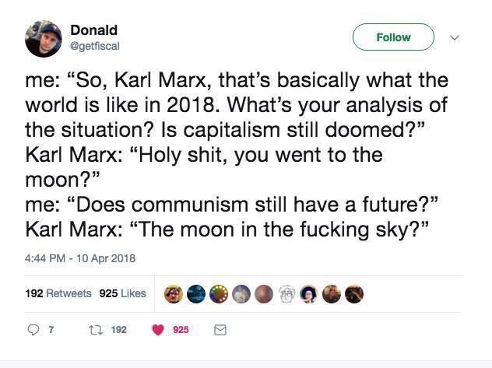
Marx and the Moon
Notes:
Note– this probably applies well to most 18th and 19th (and even early 20th century figures). The Marx worship is weird, but so is the expectation that the wisdom of the American Founders would apply well today (or French Revolutionaries or…)

Slide 13
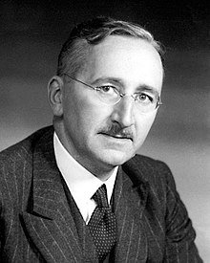
Hayek and The Road to Serfdom
Born in Austria-Hungary in 1899
Moves to the LSE in 1931
Hugely influential on right-wing parties in Europe
Particularly on Margaret Thatcher (and Ronald Reagan), but also Liberal parties throughout Europe.
Opposed “Conservative” label, saw himself as a classical liberal (Markets and Freedom)
Road to Serfdom is his best known popular work (1944)
Nobel Prize in Economics in 1974
Notes:
We're shifting now from Marx's critique of unrestrained capitalism to Hayek's defense of market economies. But Hayek wasn't simply advocating for a return to 19th-century Manchester-style capitalism. Instead, he was responding to specific developments in the 1930s and 40s that he saw as threatening both economic and political freedom. Understanding his historical context helps us see why his arguments took the form they did.

Slide 14
Liberal and Conservative
Two traditions, not two ends of one line
LIBERAL
CONSERVATIVE
Starts from the individual and their rights
Wary of concentrated power: state, church, or monopoly
Rule of law, constitutional limits, free exchange
Change through reform and argument
Grew up against absolutism and aristocratic privilege
Starts from inherited institutions and social order
Wary of abstract reason and rapid change
Nation, church, family, established hierarchy
Change should be gradual and organic
Grew up in reaction to the French Revolution
In American Politics, we would probably call Hayek a conservative (at least on economic issues). Buy, Hayek called himself a liberal. He titled an essay “Why I Am Not a Conservative.” This is because Liberal means something totally different everywhere but the US!
Notes:
In Europe these are two distinct traditions with different origins, not two positions on a single left-right line.
Liberalism grows out of the fight against absolute monarchy and inherited privilege - it is about limiting power and protecting the individual. Conservatism grows out of the reaction to 1789 - it is about the value of institutions that already exist and scepticism that reason can redesign a society.
The Hayek connection: he is a liberal in the European sense, and the postscript to The Constitution of Liberty (1960) is called 'Why I Am Not a Conservative.'

Slide 15
Same Word, Different Politics
The same words mean different things
In the United States
In Europe
“Liberal”
Centre-left. Welfare state, social progressivism, the Democratic Party.
Pro-market and pro-individual-rights. Often a centre-right party: the FDP, the VVD. Sometimes you see left liberals too (UK: Liberal Dems)
“Conservative”
Free markets plus social traditionalism, fused into one movement. The Republican Party.
Supportive of traditional social order, the church, aristocracy, perhaps monarchist/anti-democratic.
“Social democrat”
Rarely used, and often heard as a synonym for socialist. Sometimes confused with Democratic Socialist or DSA.
A major governing tradition that combines support for markets with a strong welfare state.
When a European calls someone a liberal, they are not calling them left wing!
Notes:
The vocabulary trips students up all semester, and it will trip them up in the simulation when they are handed a Liberal party brief.
Ask first: what does 'liberal' mean to you? Then show the European usage. The FDP and the VVD are the cleanest examples — pro-business, socially permissive, and coalition partners to the centre-right.
Flag for later: the FRC's Liberal party is European-liberal, not American-liberal. Students assigned to it should read this slide again before writing their manifesto.

Slide 16
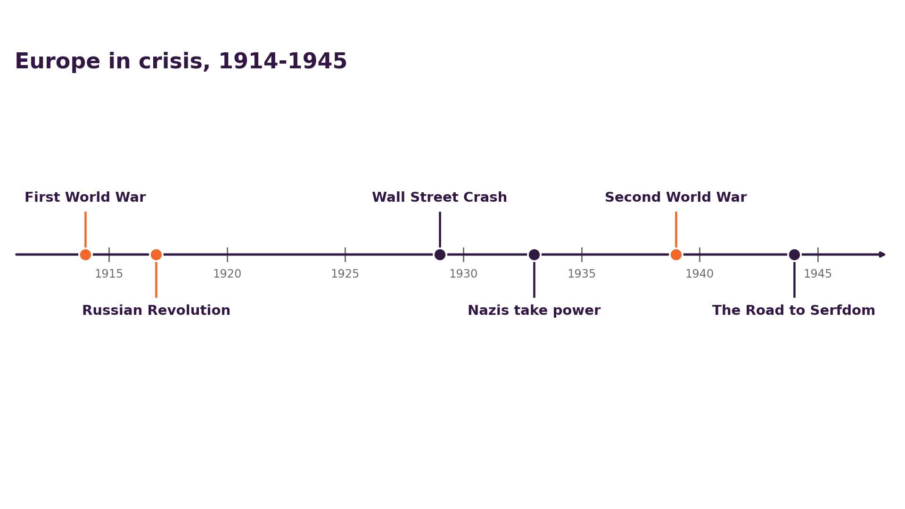
Europe in Crisis, 1914-1945
Notes:
Hayek published The Road to Serfdom in 1944, at the end of this sequence. His readers had seen economic planning used by both the Soviet Union and Nazi Germany. Ask what difference that context makes to how the argument reads now, and whether it should.

Slide 17
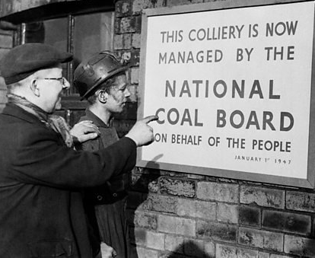

Why Planning Looked Like the Future
Wartime planning had worked
Soviet industry grew fast
Never another Depression
Faith in scientific management
Notes:
During World War II, Britain had successfully managed its economy to maximize war production. This seemed to prove that planning could work. The Soviet Union had industrialized rapidly through its Five-Year Plans. The memory of the Great Depression made many people skeptical of free markets. Many intellectuals believed modern scientific methods could make economic planning rational and efficient, and that governments could manage what industry produced and how to distribute resources. Hayek was pushing back against all of these ideas.

Slide 18
Hayek's Core Claim: The Knowledge Problem
The knowledge an economy runs on is dispersed, local, and often tacit
No planner can gather it, because much of it cannot be written down
Prices are how that scattered knowledge gets communicated and acted on
So planning fails for an informational reason, before any argument about incentives
And the political claim: directing an economy means directing the people in it
Notes:
The economic claim is about information, planners cannot know enough, in principle. The political claim is about liberty, comprehensive planning requires coercion. You can accept the first and reject the second. Note also that Hayek allows a substantial role for the state; the caricature of him as an anti-government absolutist does not survive reading the book.

Slide 19

What Could a Banana Cost?
What should a banana cost?
Notes:
Setup for price theory, following the knowledge problem.
Lucille Bluth has no idea what a banana costs because she has never had to find out. The joke works because a price is information, and she is insulated from it.
Points to draw out: a price summarises what a thing costs to make and how much people want it, without anyone needing to know either figure; nobody in the chain from grower to shelf knows the whole story, and none of them needs to; that is the argument Hayek makes in 'The Use of Knowledge in Society' (1945).
Then the question for the room: what does a planner have to know to set the price of a banana, and where would they get it?

Slide 20
Discussion
Why does Hayek think planning cannot match a market?
Does that argument hold up in an age of enormous datasets and machine learning?
Is the road from planning to tyranny as short as he claims?
Whose objections would Marx have to answer here — and vice versa?
Notes:
The machine-learning question is the one that gets students going, and it is a real debate: does computational capacity solve the knowledge problem, or is Hayek's point about tacit and dispersed knowledge immune to it? Push them on whether the relevant knowledge is the kind that exists as data at all.

Slide 21
Where we go next
Neither answer won outright. Post-1945 Europe took the third road
Wednesday: how Europe democratized
Then: Alternatives to Communism and Liberals – Fascism, Social Democracy and Christian Democracy
Keep the question from today's first slide in mind all semester. What role should the government play in the economy? We will see lots of alternatives!
Notes:
Set up next class: the ideological argument we just had was settled less by argument than by who got to vote, which is the democratization story.

Slide 22
Welcome to the Federal Republic of Clemson
A parliamentary democracy of 100 seats, six parties
You will be an MP: join a party, campaign, contest an election, bargain, govern
You will also be assigned a specific “portfolio”
Role preference survey goes out this week, due Friday
Party assignments are unveiled next Week
Notes:
Keep this brisk: two minutes at most. The detail is in the Handbook on Canvas. Survey genuinely matters: preferences are honoured where possible, and being in a party you find uncongenial is a legitimate experience of parliamentary politics but not one I am trying to inflict deliberately.

