Slide 1
POSC 3710: European Politics
9/2/2026: Europe After the Second World War
Dr. Will Horne
Clemson University

Slide 2
Today: Germany Is Rearming
Germany’s 2026 defence budget is €108bn — 2.5% of GDP
More than double the €48bn it spent in 2021
The plan from here: €162bn and 3.5% of GDP by 2029
Target of 260,000 active troops; registration of 18-year-old men resumed in January
Merz: Germany will build “the strongest conventional army in Europe”
Germany certainly not alone in re-arming

Slide 3
And the Americans Are Leaving
5,000 US troops ordered out of Germany, leaving about 30,000
Trump: “we’re cutting a lot further than 5,000”
EU defence spending projected at €454bn in 2026
Europe is being asked to defend itself for the first time since 1949
Is the alliance with America breaking, or is this just Europe finally doing it’s part?

Slide 4
The 1945 Settlement, Renegotiated
Are we renegotiating the post-war settlement?
GERMAN POWER
AMERICAN PRESENCE
EUROPEAN UNITY
1951
Coal and steel pooled under a High Authority, so Germany cannot rearm alone
2026
€108bn defence budget, and its neighbours are asking it to lead
1949
NATO commits the United States to European defence
2026
Terms of security guarantee are more unclear than ever, and troops are leaving
1957
Six members, common market, governed by a fairly popular centrist coalition
2026
Enlargement reopened, and the center-left and center-right are in disarray

Slide 5
Where We Left Off
Monday: how the Weimar Republic was dismantled from the inside
Why other countries were more resilient
Spoiler Alert: War followed, by 1945 most of Europe had been occupied by fascists, and tens of millions were dead
Today: how Western Europe was rebuilt after 1945

Slide 6
Opening Discussion
You are governing a European country in 1945.
What do you do about Germany?
Who pays for reconstruction, and what will they want in return?
What would make you give up part of your own sovereignty?

Slide 7
Europe at the End of the War
From today’s reading: Judt
Judt: Exhausted, hopeless, and with reason
For occupied Europe the war was a civilian experience
Repression and occupation, not battle
Hunger, destruction, and refugees moving west
In the British zone of Germany, official rations fell to about 1,000 calories a day in 1946

Slide 8
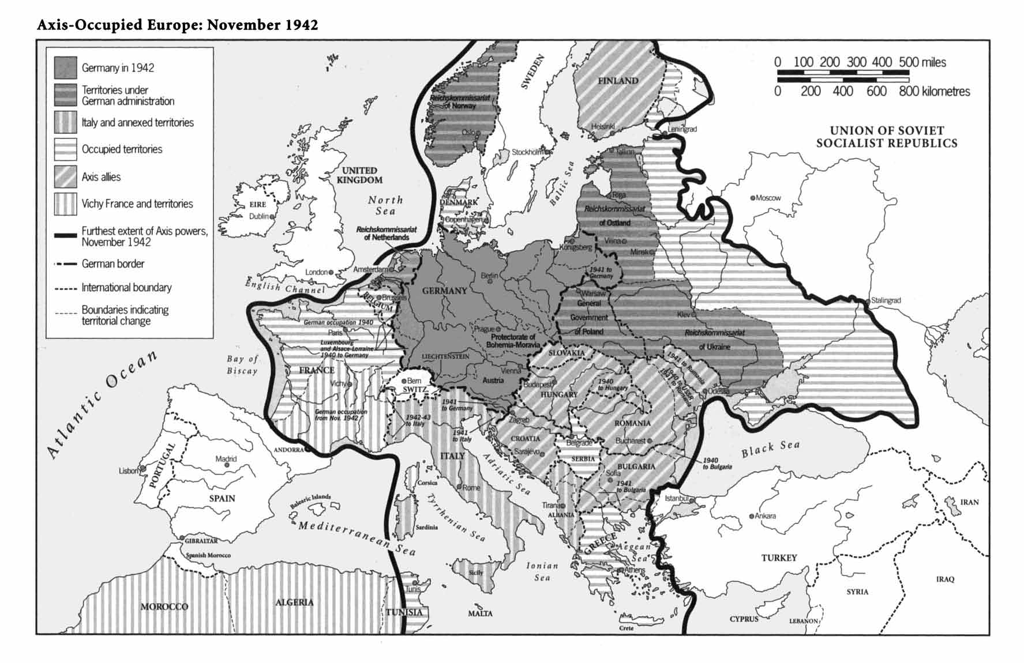
Axis-Occupied Europe, November 1942

Slide 9
The Human Cost
The human cost
Worldwide: roughly 15 million battle deaths and 45 million civilian deaths
Total deaths
As a share of prewar population
Soviet Union
24m
13–14%
Germany
6.6–8.8m
9–13%
Poland
5.6m
≈16%
Yugoslavia
1.0m
≈6%
Romania
0.8m
≈4%
Hungary
0.6m
≈6%
France
0.6m
≈1.4%
Italy
0.5m
≈1%
United Kingdom
0.45m
≈1%
Netherlands
0.3m
≈3%
Deaths: National WWII Museum estimates.

Slide 10
The Holocaust
The Holocaust
ESTIMATED VICTIMS — US HOLOCAUST MEMORIAL MUSEUM
Jews
Soviet civilians*
Soviet prisoners of war
Non-Jewish Polish civilians
Serb civilians
People with disabilities, in institutions
Roma
Repeat offenders and so-called asocials
LGBTQ+
Jehovah’s Witnesses
6,000,000
around 7,000,000
around 3,000,000
around 1,800,000
312,000
up to 250,000
up to 250,000
at least 70,000
hundreds, possibly thousands
around 1,900
*Includes 1.3 million Soviet Jewish civilians who are also counted among the six million Jews.

Slide 11
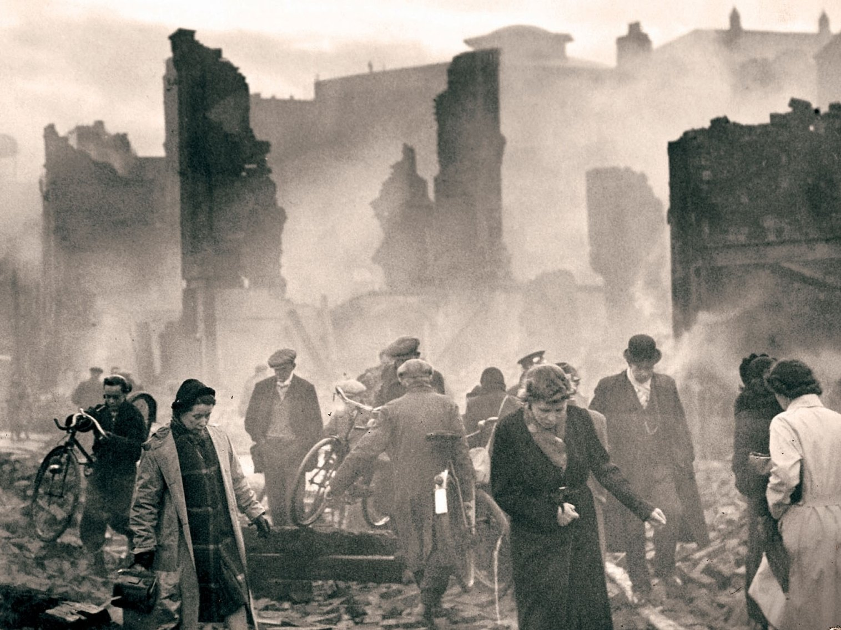
What Was Left
Image credit: NPR

Slide 12
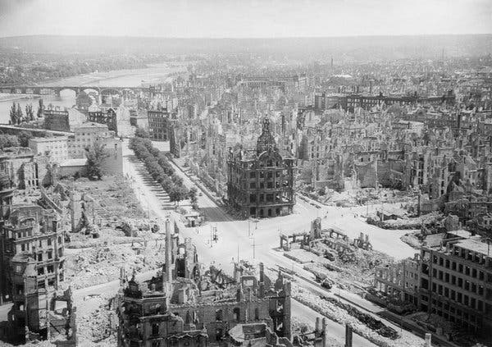
Dresden
Image credit: New York Times

Slide 13
Uprooted
From today’s reading: Judt
Uprooted
“Between them Stalin and Hitler uprooted, transplanted, expelled, deported and dispersed some 30 million people in the years 1939–43.”
— Tony Judt, Postwar, ch. 1
At the end of the war about 8 million displaced people were in Germany alone. Most went home within months: repatriations ran at 33,000 a day.
About 1.2 million could not or would not go back. Their camps operated into the 1950s.
Roughly 12 million Germans were expelled from Eastern Europe by 1950. Potsdam had called for transfers “in an orderly and humane manner.”

Slide 14
Questions Facing Europe
What to do about Germany
Partition, or reintegration?
What to do about refugees and camp survivors?
How to handle the legacy of fascism and the threat of communism?
Prewar liberalism was discredited. What replaces it?
And the colonies: can an anti-fascist, democratic, Europe stay imperial?

Slide 15
The Postwar Bargain
One settlement, in three parts
SECURITY
ECONOMICS
POLITICS
Tie Germany in,
keep America in
Occupation gives way to integration
NATO brings an American guarantee, 1949
Coal and steel pooled, 1951
Open markets,
but with safety nets
Trade liberalized between European states
Full employment becomes a government promise
Welfare states built on market economy rather than in opposition to it
Limit
class conflict
Workers moderate their wage demands
Employers accept unions and taxes
Government guarantees demand and jobs

Slide 16
The Crisis of 1947
The winter of 1946–47 froze coal in the railway wagons
British industry lost power; benefit claims spiked
Europe could not earn the dollars to buy American goods
Marshall made the offer at Harvard in June 1947
Sterling turned convertible in July and collapsed in 37 days

Slide 17
The Marshall Plan, in Two Views
The Marshall Plan, in two views
Enormous in dollars
Small in the economy
United Kingdom
3,190
1.8%
France
2,714
2.2%
Italy
1,509
2.3%
West Germany
1,391
1.5%
Netherlands
1,084
4.0%
Austria
678
5.7%
Belgium-Lux.
559
2.2%
Denmark
273
2.2%
Norway
255
2.5%
Sweden
107
0.4%
US aid received, 1948–52 ($ millions)
US aid as a share of GDP, 1948–51 (%)
Countries ordered by dollars received. Britain took the largest share of the money and among the smallest relative to its economy.
Left: CRS R45079, 1948–52. Right: Crafts (2011), 1948–51 — different spans, different sources.

Slide 18
What the Aid Bought
Optional reading: De Long & Eichengreen
Aid was under 3% of recipients’ combined national income
And less than a fifth of their gross investment
De Long and Eichengreen: too small to explain the recovery by itself
What it bought was policy — open markets, stable prices, balanced budgets
And room to settle the fight over who got what

Slide 19
The Marshall Plan Divided Europe
From today’s reading: Metz
The offer was open to all of Europe — the Soviet Union included
Bohlen, State Department: “we gambled that the Soviets would not” join
Molotov walked out; Stalin forced Czechoslovakia and Poland to withdraw
The Cominform followed in September 1947, the Prague coup in February 1948
Metz: the Plan hardened a division that lasted nearly fifty years

Slide 20
What Happened to Germany
What happened to Germany, 1945–1955
Potsdam: Germany split into four occupation zones
Treaty of Paris: West German coal and steel pooled
NATO founded, providing the American guarantee
Jul–Aug 1945
Apr 1949
Apr 1951
Jun 1948
May / Oct 1949
May 1955
Soviet blockade of Berlin
Two German states: Federal Republic, then GDR
West Germany joins NATO and rearms — inside the alliance

Slide 21
The Schuman Declaration
From today’s reading: Schuman
Robert Schuman, 9 May 1950
“World peace cannot be safeguarded without the making of creative efforts proportionate to the dangers which threaten it.”
“Europe will not be made all at once, or according to a single plan. It will be built through concrete achievements which first create a de facto solidarity.”
“The solidarity in production thus established will make it plain that any war between France and Germany becomes not merely unthinkable, but materially impossible.”

Slide 22
Why Coal and Steel?
From today’s reading: Schuman
They were the both materials of war, and the drivers of the peacetime economy
They sat in the contested borderland: the Ruhr and the Saar
Pooling replaced Allied occupation with joint management
Narrow enough to negotiate, big enough to matter
Schuman: “one limited but decisive point”

Slide 23
The Coal and Steel Community
Treaty of Paris signed 18 April 1951, in force 23 July 1952
Six members: France, West Germany, Italy, Belgium, Netherlands, Luxembourg
Britain was invited to the negotiations and declined
A High Authority with power over the member governments: the first European institution above the nation-state
Written to last fifty years. It expired in 2002

Slide 24
Growth Before and After 1950
Growth before and after 1950
1913–50
1950–73
ALONGSIDE THE GROWTH
4.7%
Unemployment in the 1960s ran a little over 2%
At 3.9% a year, incomes double roughly every 18 years
A growing middle class took the heat out of the class conflict
3.9%
1.4%
0.9%
GDP, % a year
GDP per person, % a year
Twelve Western European economies, average annual growth. Maddison (1995), via Eichengreen & Vázquez, Table 1.
Unemployment: European Commission (1998) figures, via Bermeo (ed.), Unemployment in the New Europe.

Slide 25
Why?
Catch-up growth: Europe was rebuilding from a low base
Abundant labor: the baby boom, and migration
Government investment, driven partly by fear of communism
Trade liberalization and stable exchange rates
And the Marshall Plan, mostly through the policies it bought

Slide 26
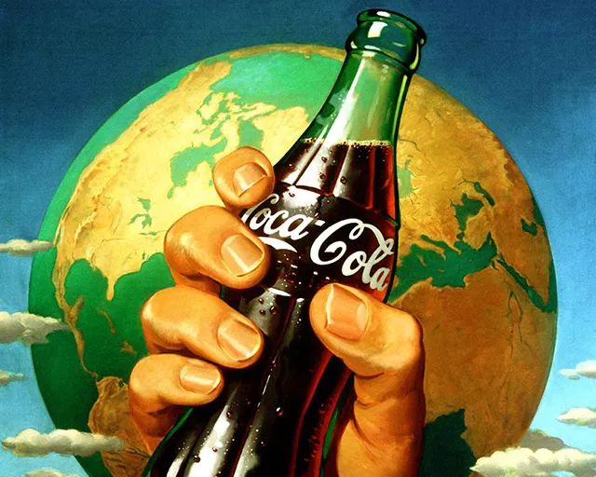
Americanisation

Slide 27
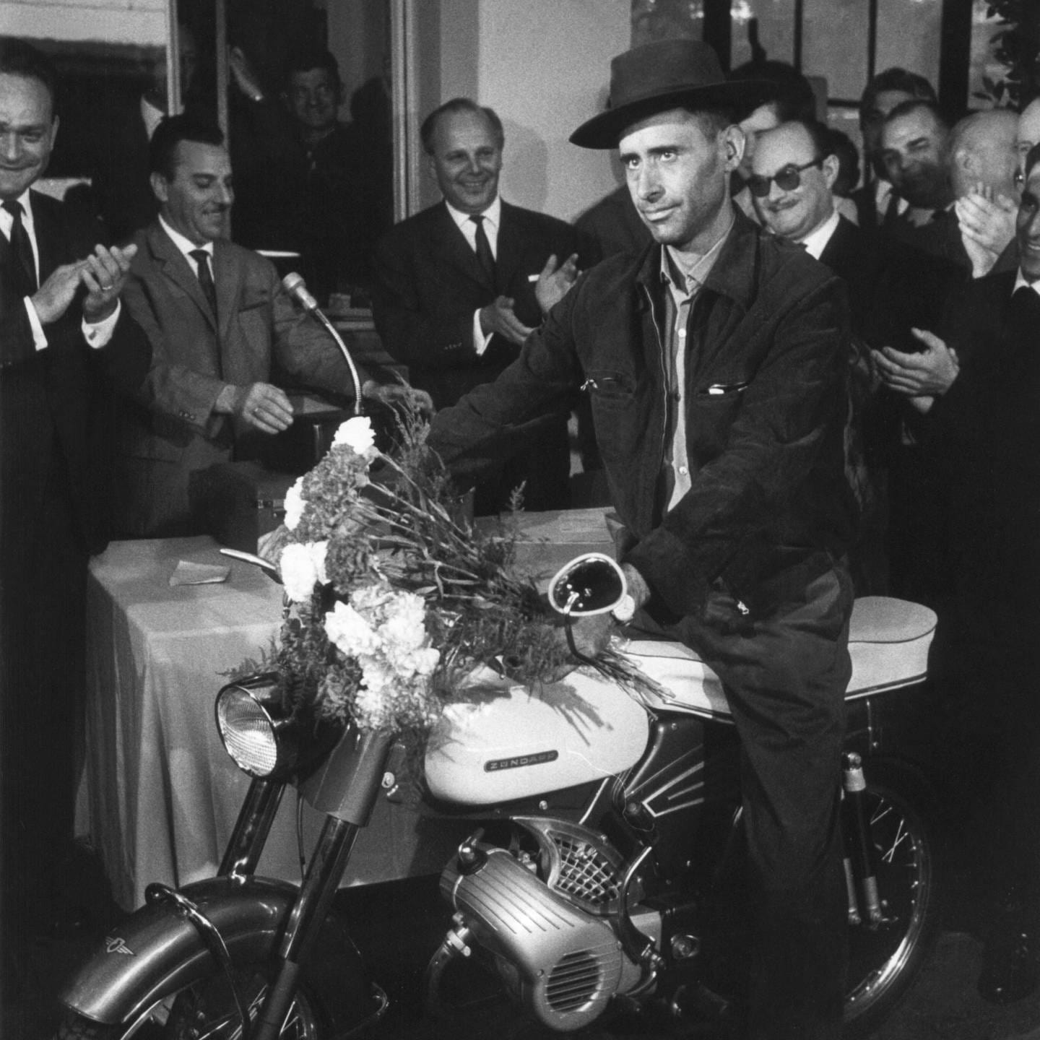
The Millionth Guest Worker
Image credit: Der Spiegel

Slide 28
Two Stories About Integration
Optional reading: Milward
Who actually built Europe?
THE FOUNDING FATHERS
Self Interested Nation States (Milward’s argument)
Visionaries transcended
the nation-state
Monnet, Schuman, Adenauer, De Gasperi
Supranational institutions with their own logic
Spillover carries integration onward
Governments rescued
themselves
Every step a national calculation, ultimate power retained by nation-state
Federalists had almost no influence at Paris
Integration was the price of keeping national promises
“To supersede the nation-state would be to destroy the Community.” — Milward

Slide 29
Discussion
Were the origins of this order idealistic:peace, reconciliation, “never again” or self-interested
(why) Does it matter?
Which parts of the 1945 bargain are still standing in 2026, and which are being renegotiated?

