Slide 1
Basics of React + MUX
Why you should consider React for your next FE project!
Presenters Brooke Bailey, Catherine Ellingham, and Will Nippard with special thanks to Sean Donnellan and Muthu Chellappa

Slide 2
React
A JavaScript library for building user interfaces
Easy to create dynamic web apps
Mobile applications also easy via React Native
Declarative development
Devs define how the UI should look according to user interactions
React takes care of updating the view (Virtual DOM)
Relies on reusable components to build web pages
Libraries such as Material UI or Manulife’s MUX library provide predefined components and more, freeing up devs to focus on functionality not form
Flexibility
Vue, NextJS, NestJS, remix, and (many!) more
https://react.dev/ https://opensource.fb.com/projects/react/

Slide 3
Why React?
Why use React, not Angular/Vue/Svelte/Ember/Solid/Stimulus/Apline/Lit
Popularity in the industry
Despite an excess of FE tools, React stands out among the pack!
https://2023.stateofjs.com/en-US/libraries/front-end-frameworks/
Easy to learn & great for prototyping
Supports both typescript and javascript
Easier to build a small application
Well supported & strong community
Large community of developers
Numerous reliable 3rd party libraries
Built by Facebook, maintained by Meta
While quite new to JH, not new to Manulife!
https://react.dev/ https://opensource.fb.com/projects/react/

Slide 4
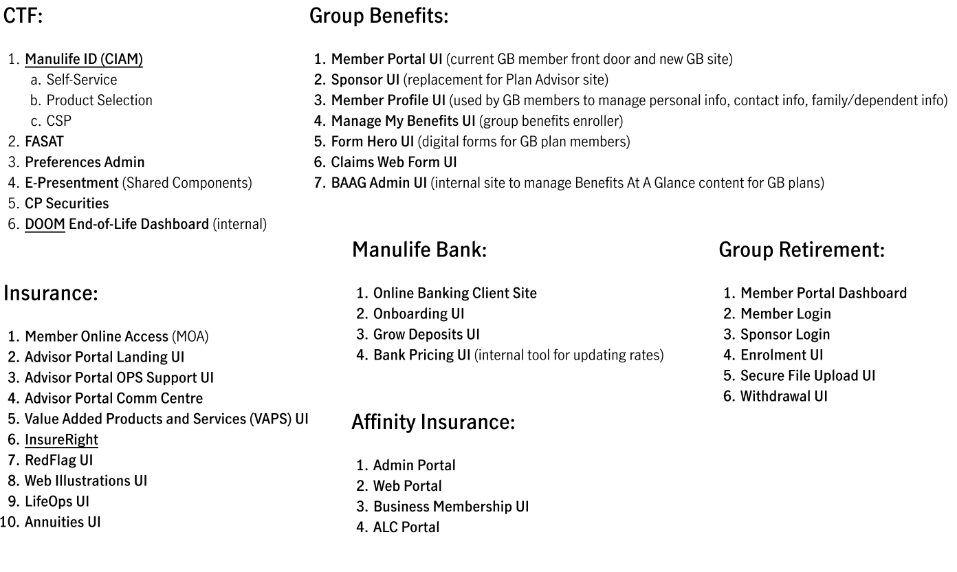
React @ Manulife

Slide 5
MUX
MUX is a React component library
Prebuilt React components, hooks, and utilities
Plug-n-play React extension for UI
Modern design best practices that follows our brand guidelines
Removes a lot of the “busy work” a dev would need to do in a raw React app
Styling, Accessibility, Responsive Design, Icons, Event Handling, browser specifics, following industry UI standards, etc…
Accessibility (ADA) considerations made for all components
Innersource project
Excellent support
Internal library allows us to directly ask questions of the developers and maintainers of this library via Teams
MUX: https://mux.manulife.com/ CDS: https://design.manulife.com/ Teams Channel: Engineering | topic-mux | Microsoft Teams

Slide 6
Demo React + MUX

Slide 7
Questions

