Slide 1
In this module we will talk about
Proposing Explanations
Framing Hypotheses
common mistakes in hypothesis writing
intervening variables
Making Comparisons
cross-tabulations
mean comparisons
Graphing Relationships and Describing Patterns

Slide 2
Goals of Social Science Analysis
The first goal is to define and measure concepts.
clearly define the concept to be measured
determine how to measure the concept accurately
select variables that measure the concept precisely

Slide 3
Goals of Social Science Analysis
The second goal is to propose and test explanations for political phenomena.
to answer “Why?” questions
Why do some people attend religious services weekly, whereas others never attend?
Why do some students prefer to sit in the back of the class, whereas others prefer the front?
Why do some people favor abortion rights, while others are opposed?
Why do some people vote, whereas others do not?

Slide 4
“Why?” Questions: 2 Elements
“Why?” questions cite a variable
attend / not attend religious services
sit in back / sit in front of class
favor / oppose abortion rights
voted / did not vote
“Why?” questions seek a causal explanation
Each can be recast into the form, “What causes differences between individuals on this variable?”

Slide 5
Dependent and Independent Variables
In the context of a causal explanation, the dependent variable represents the effect and the independent variable represents the cause.
Example: If I think that educational attainment causes people to vote, then education is the independent variable and voting turnout is the dependent variable.

Slide 6
An Acceptable Explanation
describes a connection between the dependent variable and an independent (causal) variable
asserts the direction or tendency of this connection
is testable
A good explanation does not have to be correct. It needs to be testable to find out if it is correct.

Slide 7
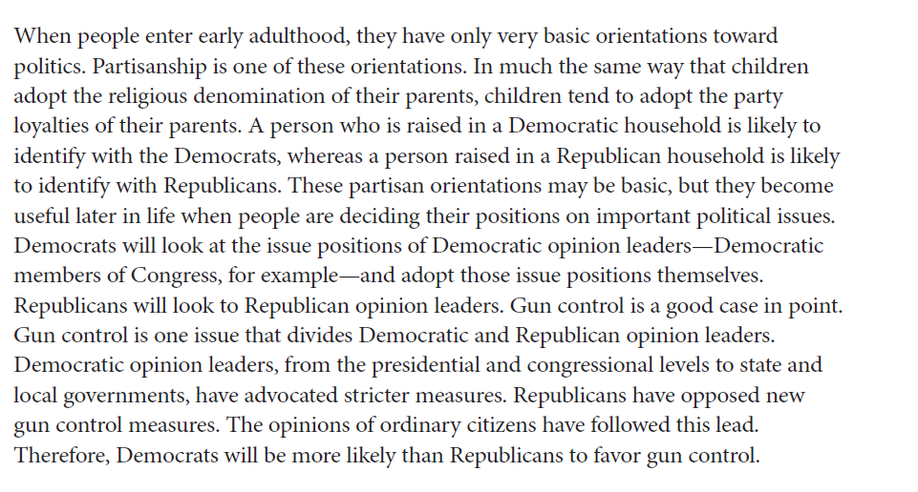
Partisanship and Gun Control Opinions

Slide 8
What makes this a good explanation?
1. It describes a connection between the dependent variable, gun control opinions, and an independent variable, partisanship.
Differences in gun control opinions depend on differences in partisanship.
2. It asserts the direction or tendency of this difference.
Democrats will be more likely than Republicans to favor the regulation of gun ownership.
3. It is testable.
If we find that Democrats and Republicans do not differ in their gun opinions, then we can seriously question or discard the explanation.

Slide 9
Framing Hypotheses
A hypothesis is a testable comparison.
divide units of analysis on the basis of the independent variable, and then compare values of the dependent variable
Example: In a comparison of individuals, those who are Democrats will be more likely to favor gun control than will those who are Republicans.

Slide 10
Template for Framing Hypothesis
In a comparison of units of analysis, those having one value on the independent variable will be more likely to have one value on the dependent variable than will those having a different value on the independent variable.

Slide 11
Examples
In a comparison of countries, those having PR electoral systems will be more likely to have higher voter turnout than will those having plurality electoral systems.
In a comparison of individuals, those who are women will be more likely to be Democrats than those who are men.

Slide 12
Syntax-Friendliness is OK
Formally correct: In a comparison of individuals, those who are women will be more likely to be Democrats than those who are men.
Syntax-friendly: In a comparison of individuals, women are more likely than men to be Democrats.

Slide 13
Mistake: Describing one variable
In a comparison of individuals, some people are more likely to donate money to political candidates than other people.
If donating money is the dependent variable, what is the independent variable?
If donating money is the independent variable, what is the dependent variable?

Slide 14
Mistake: Not making an explicit comparison
Highly religious people vote at high rates.
The key comparison, that less religious people vote at lower rates, is implicit.
Correct: In a comparison of individuals, those who have high levels of religiosity will be more likely to vote than will those who have low levels of religiosity.

Slide 15
Mistake: Not stating direction or tendency
In a comparison of individuals, gender and abortion attitudes are related.
How, exactly, are the two variables related?
Are women more likely to be pro-choice than are men?
Or are men more likely to be pro-choice than are women?

Slide 16
Mistake: Being vague
Because of sociocultural changes associated with the growth in social media, contemporary political conflicts revolve around postmaterialist values.
What is meant by “sociocultural changes,” “social media,” and “postmaterialist values”?

Slide 17
Example
In a comparison of voters, those who think the economy has gotten better will be more likely to have favorable opinions about the incumbent’s handling of the economy than will voters who think the economy has gotten worse.
opinion about the incumbent is the dependent variable
In a comparison of voters, those who have favorable opinions about the incumbent’s handling of the economy will be more likely to vote for the incumbent-party candidate than will those who have unfavorable opinions.
opinion about the incumbent is the independent variable

Slide 18
Making Comparisons
A hypothesis suggests that if we separate units of analysis according to their values on the independent variable and compare their values on the dependent variable, we should find a difference.
When the dependent and independent variables are measured at the nominal or ordinal level, we test the hypothesis using cross-tabulation analysis.
When the independent variable is nominal or ordinal and the dependent variable is interval level, we test the hypothesis using mean comparison analysis.

Slide 19
Cross-Tabulation Analysis
A cross-tabulation shows the distribution of cases across values of the dependent variable at each value of the independent variable.
Recall the hypothesis: In a comparison of individuals, Democrats will be more likely than Republicans to favor gun control.

Slide 20
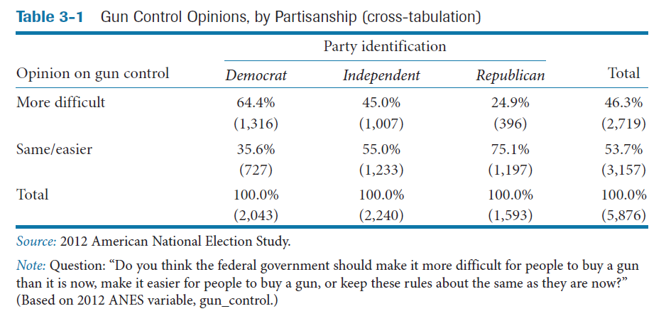
Testing the Hypothesis

Slide 21
Three Rules
Rule One: Set up a cross-tabulation so that the categories of the independent variable define the columns of the table, and the values of the dependent variable define the rows.
The independent variable, partisanship, goes on the columns.
The dependent variable, gun control opinions, goes on the rows.

Slide 22
Three Rules
Rule Two: Always calculate percentages of categories of the independent variable. Never calculate percentages of categories of the dependent variable.
Visual cue: Percentages must sum to 100 percent at the bottom of each column.

Slide 23
Three Rules
Rule Three: Interpret a cross-tabulation by comparing percentages across columns at the same value of the dependent variable.
We could compare the percentage of Democrats in the “more difficult” value of the dependent variable with the percentages of Independents and Republicans in this value.
Alternatively, we could compare the partisan groups across the other category of the dependent variable, “same/easier.”
we could not mix and match

Slide 24
Does the partisanship hypothesis appear to be correct?
Focus on the percentage of each partisan group favoring stronger restrictions and read across the columns, starting with the Democrats.
Democrats are most in favor (64.4%)
Independents show weaker support (45.0%)
Republicans are least likely to favor (24.9%).
The pattern is systematic and consistent with the hypothesis.
Each time we change the independent variable, from Democrat to Independent to Republican, the distribution of the dependent variable changes in the hypothesized way.

Slide 25
Age and support for same-sex marriage
In a comparison of individuals, young people will be more likely to support same-sex marriage than older people.

Slide 26
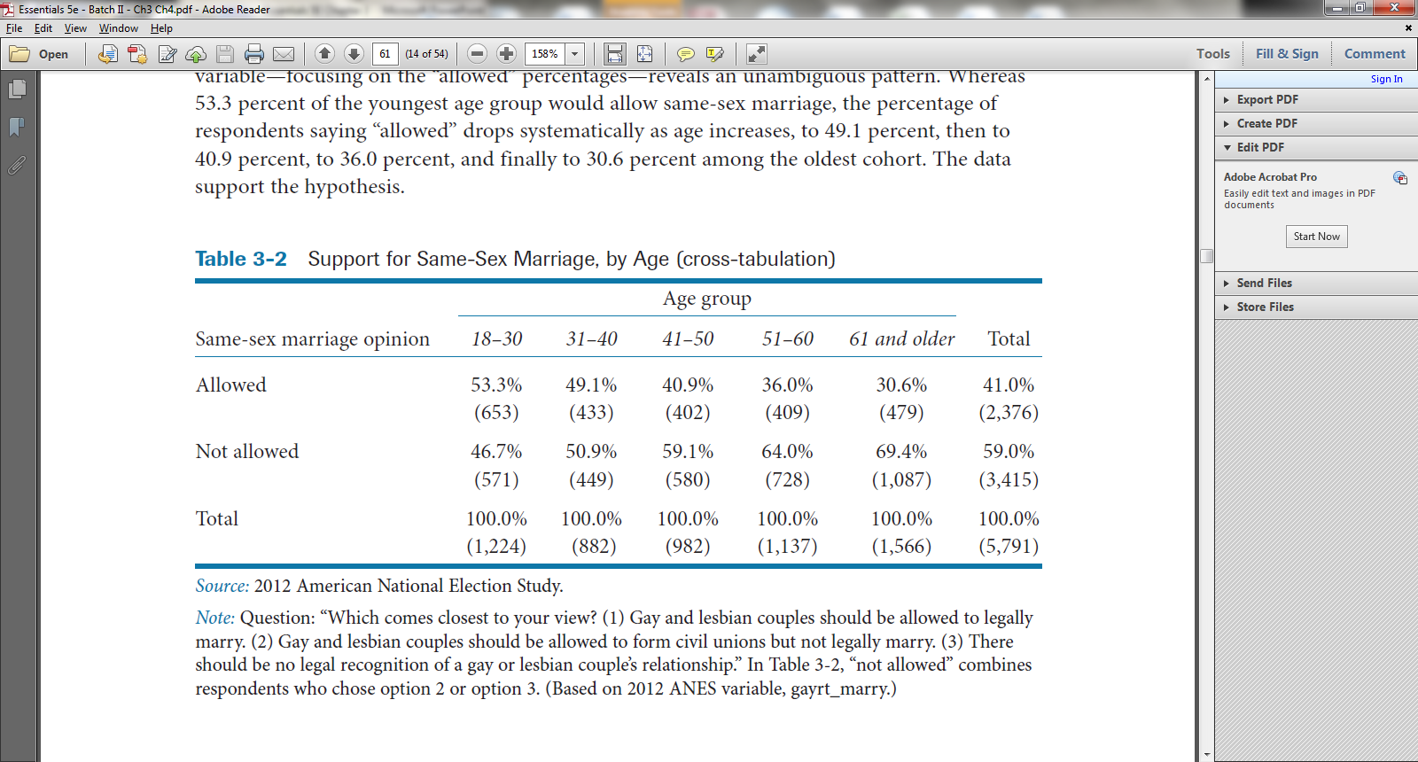
Test the Hypothesis

Slide 27
Is the age hypothesis supported?
Focus on the percentages in the “Allowed” row.
What do you conclude…
Hypothesis supported?
Hypothesis not supported?

Slide 28
Mean Comparison Analysis
The same logic of comparison applies when the independent variable is nominal or ordinal and the dependent variable is interval.
Instead of comparing percentages across values of the independent variable, we compare means.

Slide 29
Economic Development and Political Rights and Freedoms
In a comparison of countries, those having lower per capita GDP will have fewer political rights and freedoms than will countries having higher per capita GDP.

Slide 30
Independent and Dependent Variables
Independent variable is a 4-category ordinal.
Low GDP per capita, medium-low GDP per capita, medium-high GDP per capita, and high GDP per capita.
Dependent variable is an interval scale.
Countries can range from 0 (few rights and freedoms) to 12 (many rights and freedoms).

Slide 31
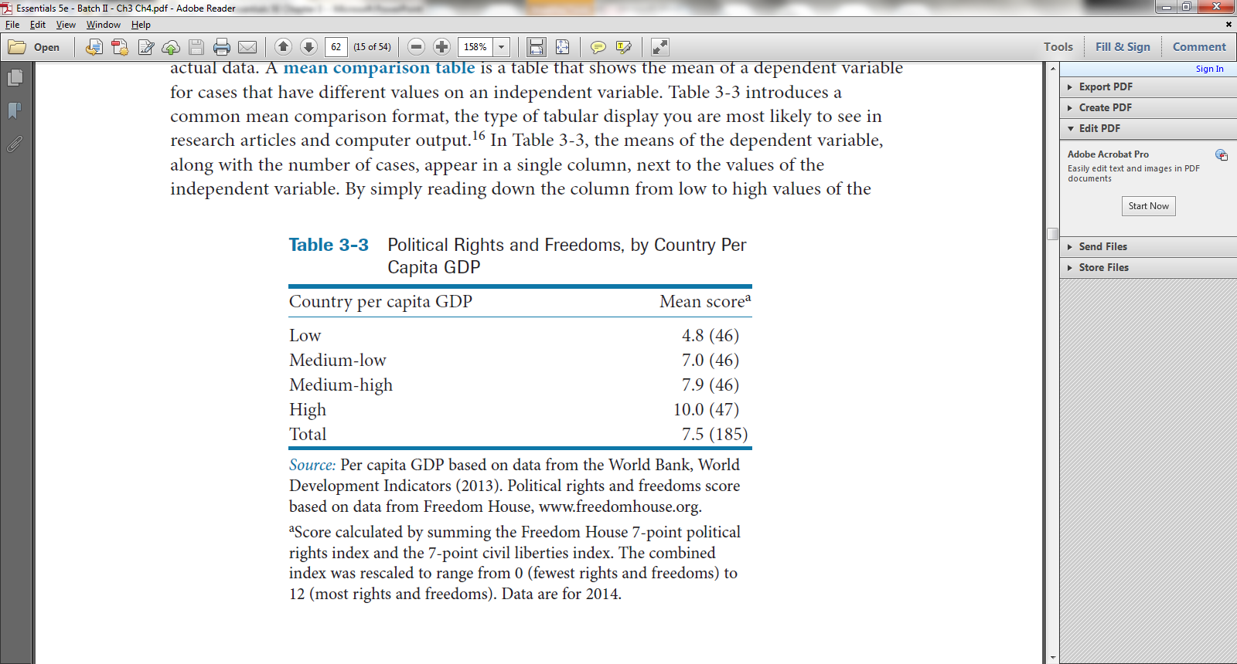
Test the Hypothesis

Slide 32
Mean Comparison Table
The means of the dependent variable, along with the number of cases, appear in a single column, next to the values of the independent variable.
Read down the column from low to high values of the independent variable.

Slide 33
Is the hypothesis supported?
As we proceed from low values of the to high values of the independent variable, what happens to mean values of the dependent variable?
Mean values of the dependent variable increase, from 4.8 to 10.0.
Yes, the hypothesis is supported.

Slide 34
Graphing Relationships and Describing Patterns
The GDP–political rights and freedoms relationship is a direct relationship, a relationship that runs in a positive direction.
An increase in the independent variable, per capita GDP, is associated with an increase in the dependent variable, political rights and freedoms.

Slide 35
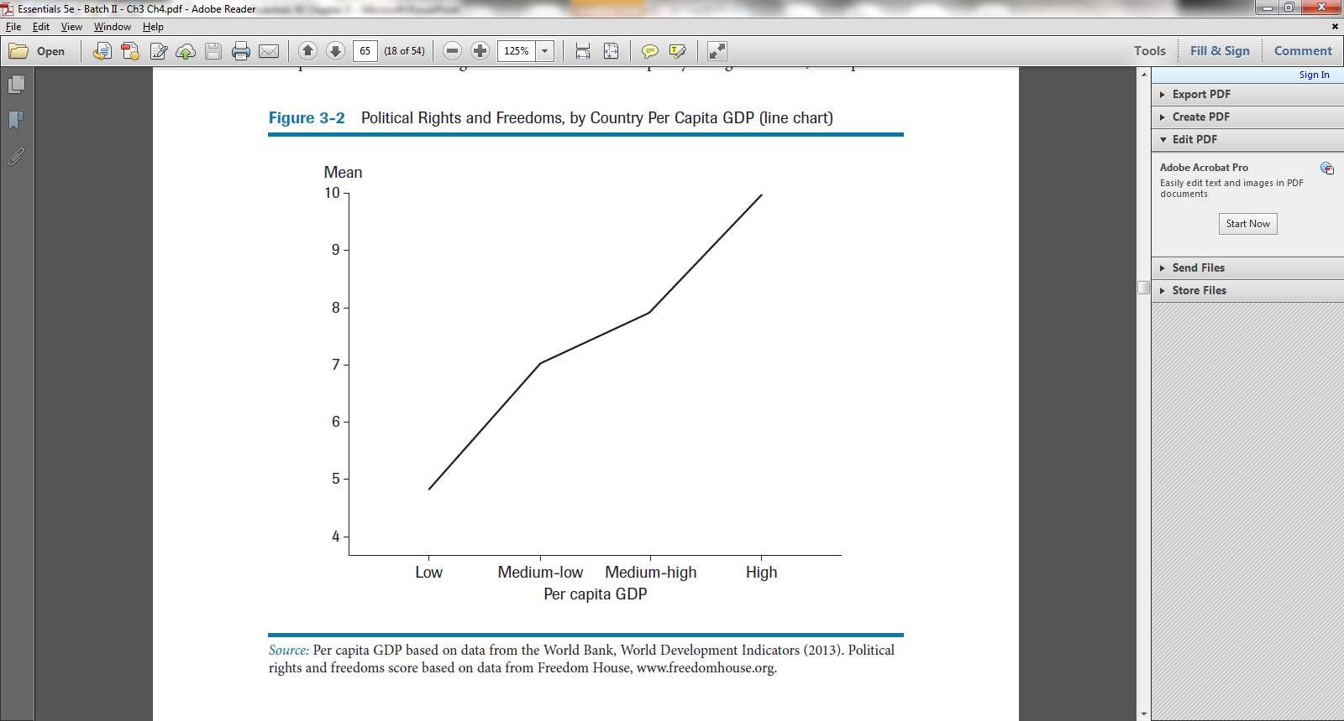

Slide 36
Graphing Relationships and Describing Patterns
The relationship between age and support for same-sex marriage is an inverse relationship, a relationship that runs in a negative direction.
An increase in the independent variable, age, is associated with a decrease in the dependent variable, the likelihood of supporting same-sex marriage.

Slide 37
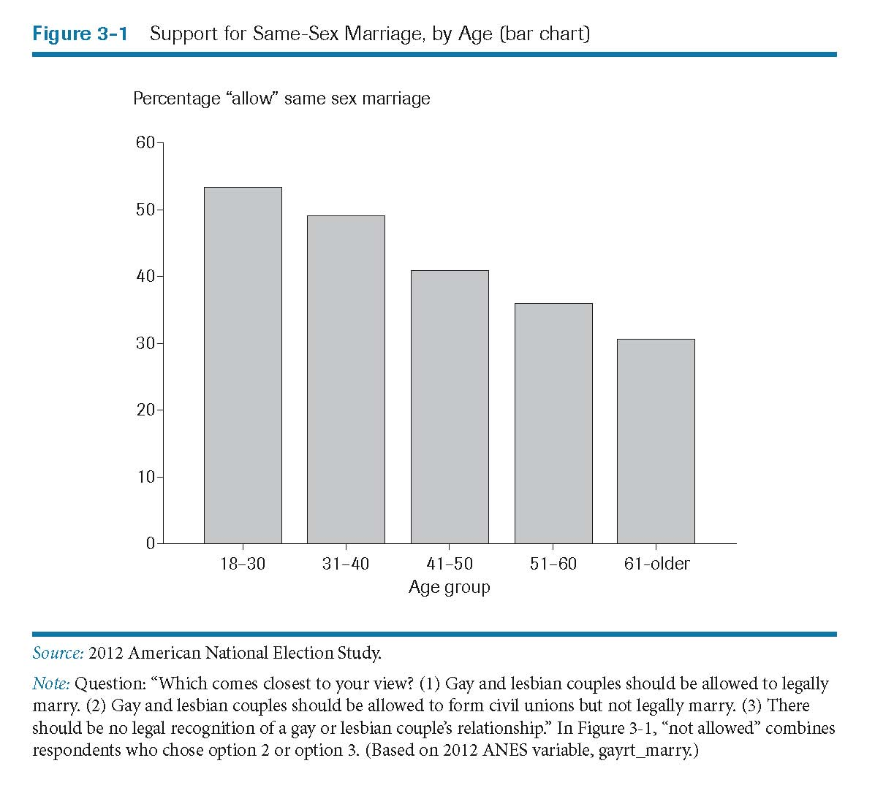

Slide 38
Graphing Relationships and Describing Patterns
Both the age–same-sex marriage relationship and the GDP–political rights relationship are linear.
An increase in the independent variable is associated with a consistent increase or decrease in the dependent variable.

Slide 39
Graphing Relationships and Describing Patterns
Many relationships are nonlinear or curvilinear.
The relationship between the independent variable and the dependent variable depends on which interval or range of the independent variable is being examined.

Slide 40
Graphing Relationships and Describing Patterns
As one moves across the values of the independent variable, the relationship might remain positive (or negative) but change in strength or consistency, from strong to weak or from weak to strong.

Slide 41
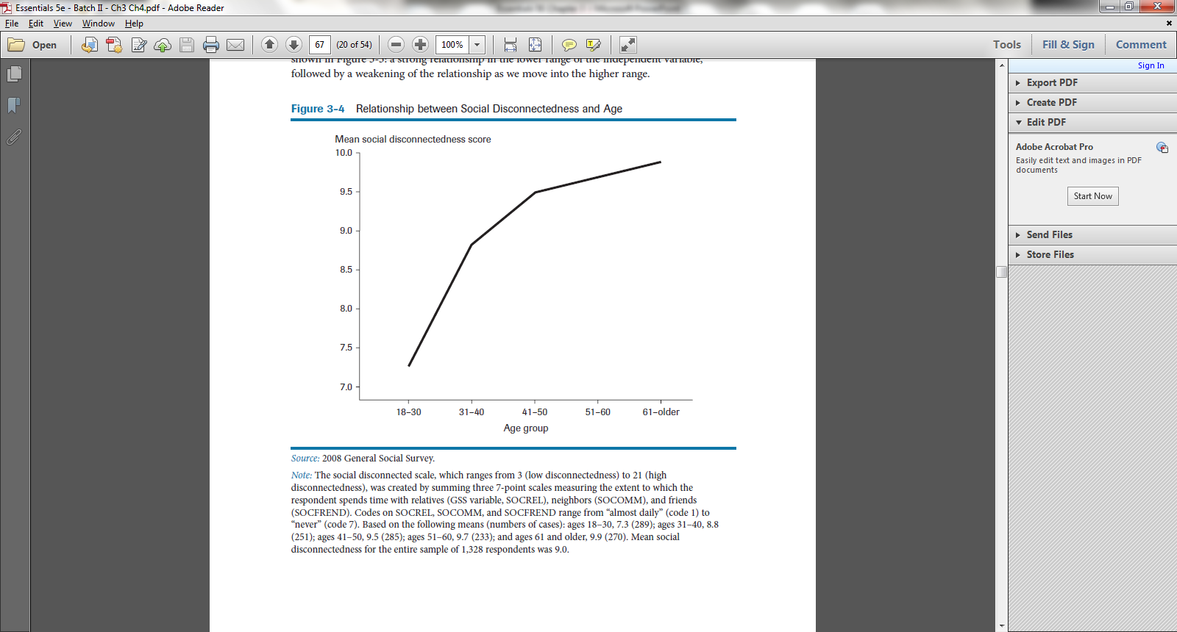

Slide 42
Graphing Relationships and Describing Patterns
As one moves across the values of the independent variable, the relationship may change direction, from positive to negative or from negative to positive.

Slide 43
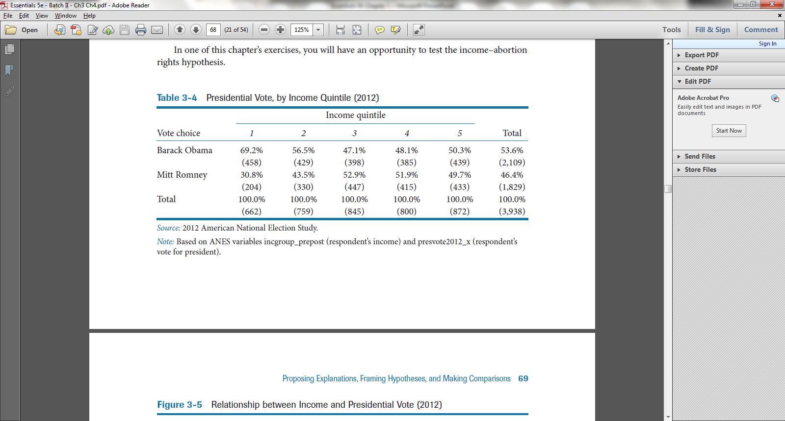

Slide 44
